Slide 1
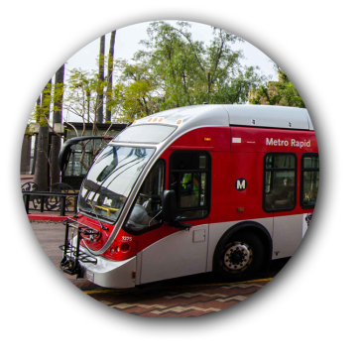
Metro Board Legislative Management
Los Angeles County Metropolitan Transportation Authority
42
02/12/2015

Slide 2
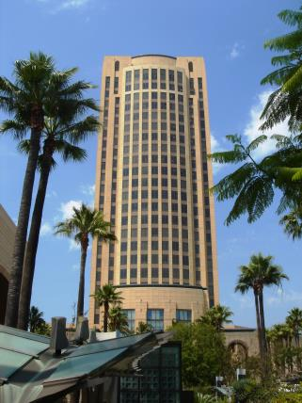
Overview
Technological Improvements 2013 Boardroom Audio-Video & Webcasting/Voting
Motion [58] EMC – 2-20-2014 Directors Bonin & Krekorian Amended by Director DuBois Improvements to Board Archives: Paperless Searchability Subscription based updates Link content to meetings Public comment Contracts
Receive & File EMC – 7-17-2014
2 of 6

Slide 3
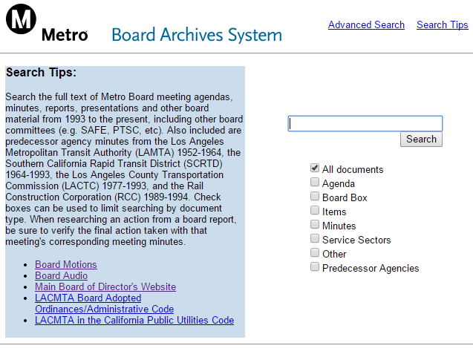
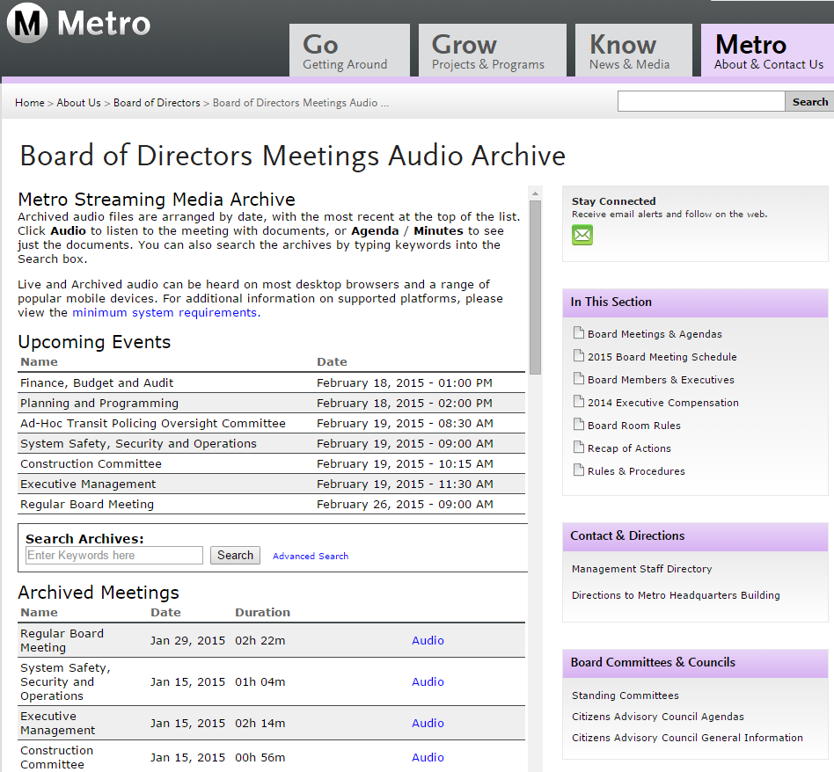
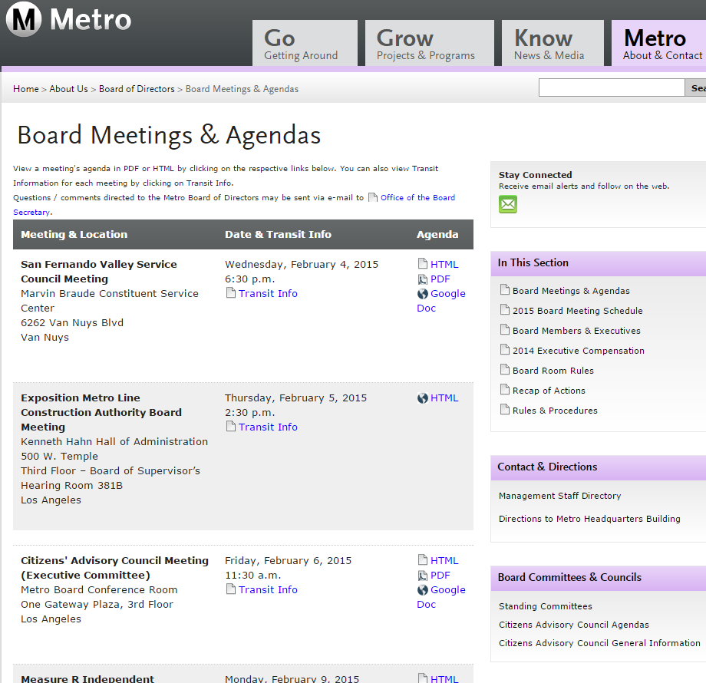
Current Systems
3 of 6

Slide 4
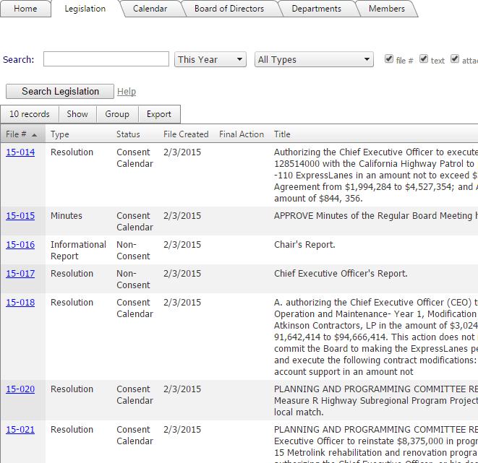
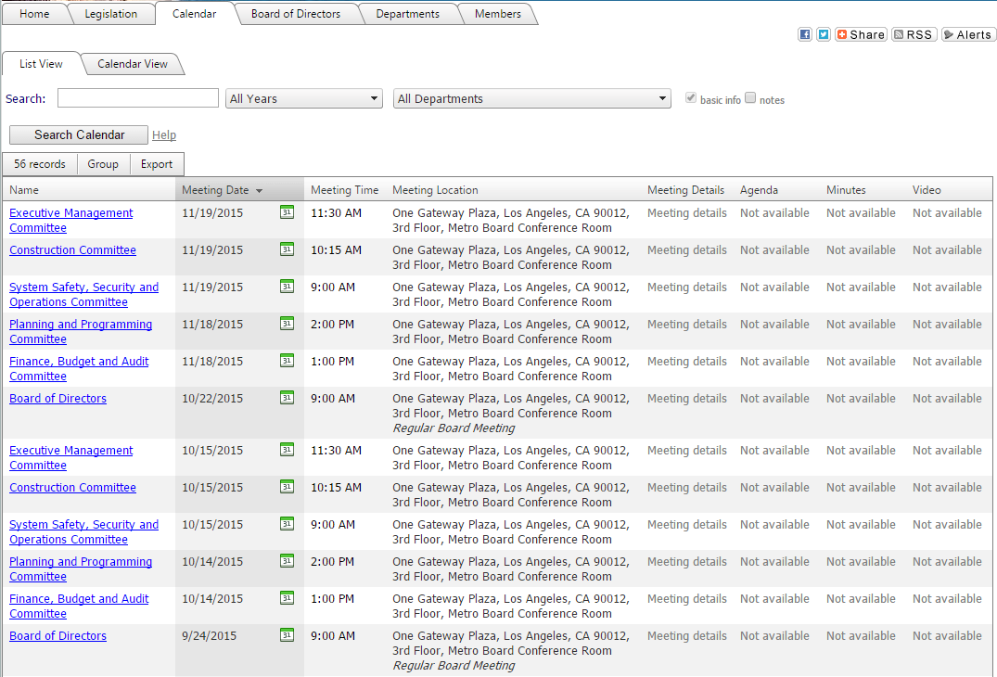
Improved Capabilities (Test Site)
4 of 6

Slide 5
Timeline
Kickoff
Implementation
Testing / Training
February – March 2015
Pilot Meetings
May 2015
April 2015
1/27/2015
Office of the CEO
Research & Records
Office of the Board Secretary
Information Gathering
Schedule NACs
Schedule Training (Online & Onsite)
NAC 1, 2, 3, 4, 5
Configuration
Online Training Admins
Onsite Training for Pilot Group
QA Testing
Training for Additional Departments
Transition Phase
5 of 6

Slide 6
Looking Ahead
Public Comment
Contracts
6 of 6

