Slide 1
Supporting Capstone Research for Metro Leadership Academy 2025 Cohort
METRO TRANSPORTATION RESEARCH LIBRARY & ARCHIVE
Presented by
Ariel Hahn
Senior Librarian, Systems & Data
hahna@metro.net

Slide 2
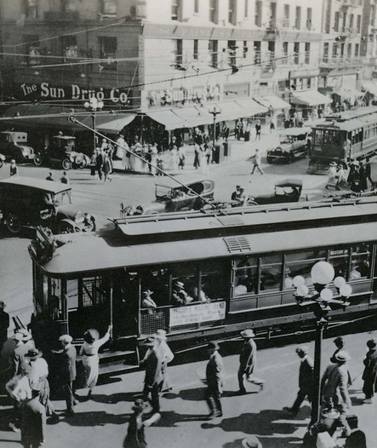
The Metro Transportation Research Library & Archive exists to gather and preserve documents created by Metro and our numerous predecessor agencies.
We also curate related material on professional development, history, transportation engineering, Los Angeles, and other vital topics – all available to employees for check-out.
7th and Broadway Intersection of Downtown LA from LA Railway Collection (1919)

Slide 3
About the Library & Archive
Provide information and research support to employees, contractors, government officials, and the public – for our circulating, library materials as well as our archival, historic transportation records.
Collection contains over 60,000 books, technical studies, environmental impact reports, maps, historic images, film, and other media formats from our existing agency as well as several of our predecessor agencies including Los Angeles Railway, Pacific Electric Railway, Los Angeles Metropolitan Transit Authority, Southern California Rapid Transit District, and the Los Angeles County Transportation Commission.
40% of our library collection is unique, we’re the only transportation research library in SoCal, and we’ve been a repository for federally funded transportation reports since 1971.
Our physical space on the 15th Floor of Gateway is named the Dorothy Peyton Gray Transportation Library & Archive – after Metro’s Library Manager from 1988-2001, Dorothy Peyton Gray (1943-2001). She is credited with assembling our separate archival collection, among other achievements. We are one of only two Metro facilities named after former employees.

Slide 4
About the Library & Archive, continued
Overseen by the Board Clerk, under the Board Administration
Work alongside Records Management Center (RMC), Electronic Records, and Legal Services
Comprised of six full-time-employees, one as-needed librarian, four interns, one fieldwork volunteer:
Matt Barrett, Director
Kenn Bicknell, Senior Manager
Ariel Hahn, Senior Librarian, Systems & Data
Chris Salvano, Digital Resources Librarian
Claire Kennedy, Archivist
Alanna Marcelletti, Cataloging Librarian (FT)
Nick Aurrichio, Cataloging Librarian (PT)

Slide 5

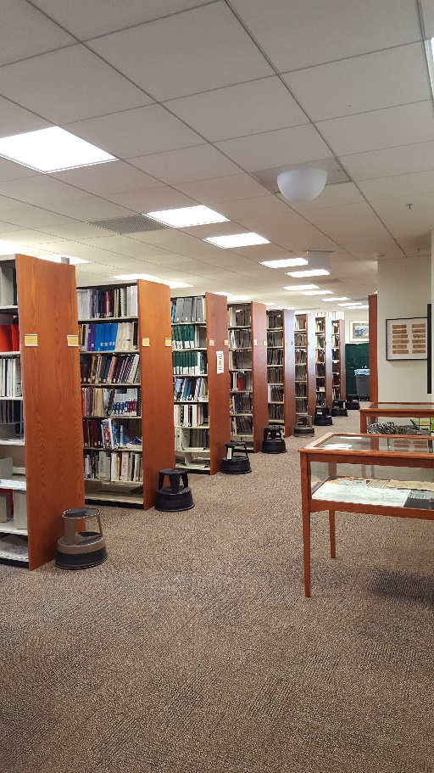
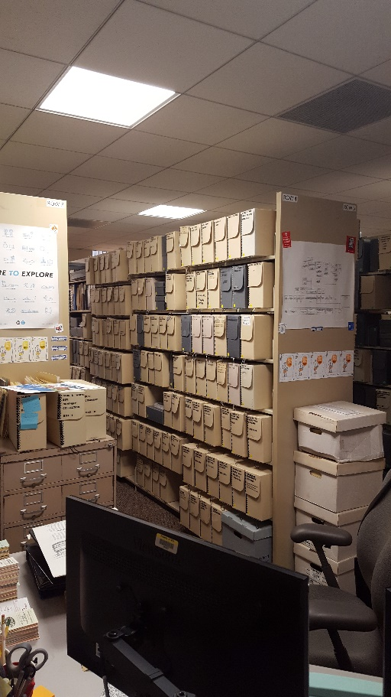
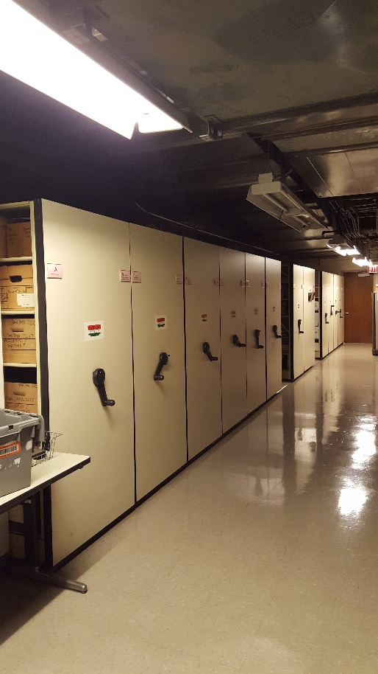
Locations
15th Floor Library
15th Floor Archive
P-1 Additional Storage

Slide 6
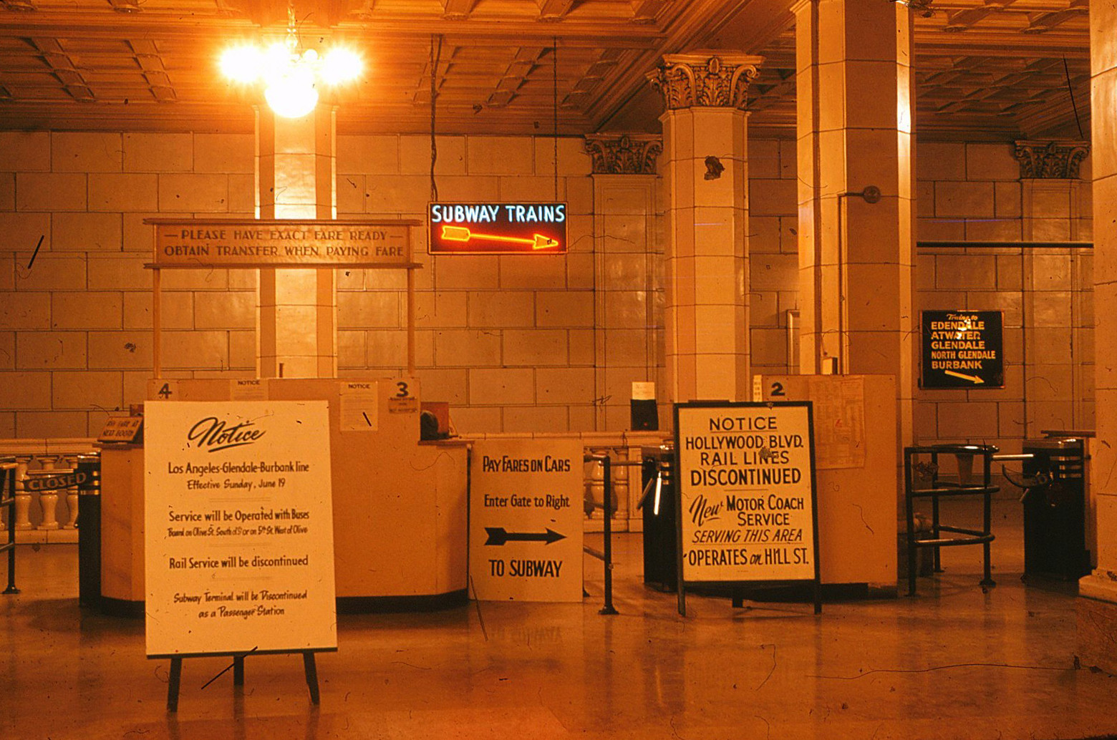
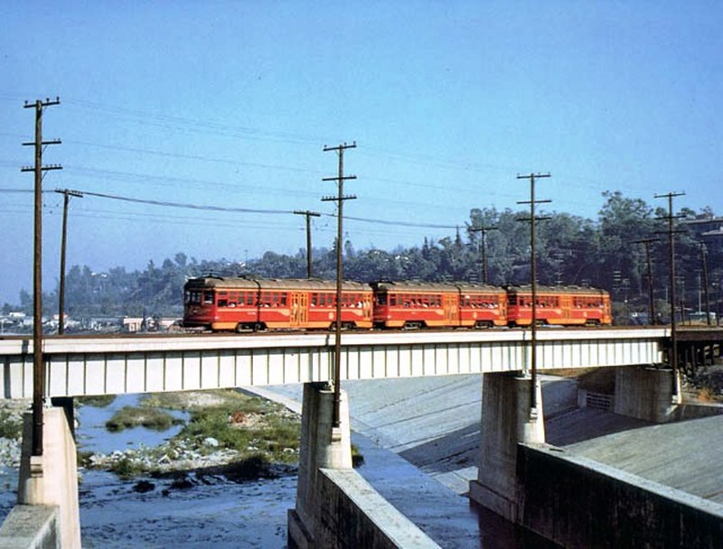
Library Research 101
Information Timeline – a current event will be written about on social media and news outlets the day or week it takes place, an article in a magazine will come out after that and it will take even longer for that event to examined in a book.
Time Range – are you looking for contemporary information or historic, archival information?
Primary Resource vs. Secondary Resource – knowing what you are looking for.
Identifying Key Words
Crafting your Search – using your key words with Boolean Operators (AND, OR, NOT)
Pacific Electric Rail & Facilities (1950s)

Slide 7
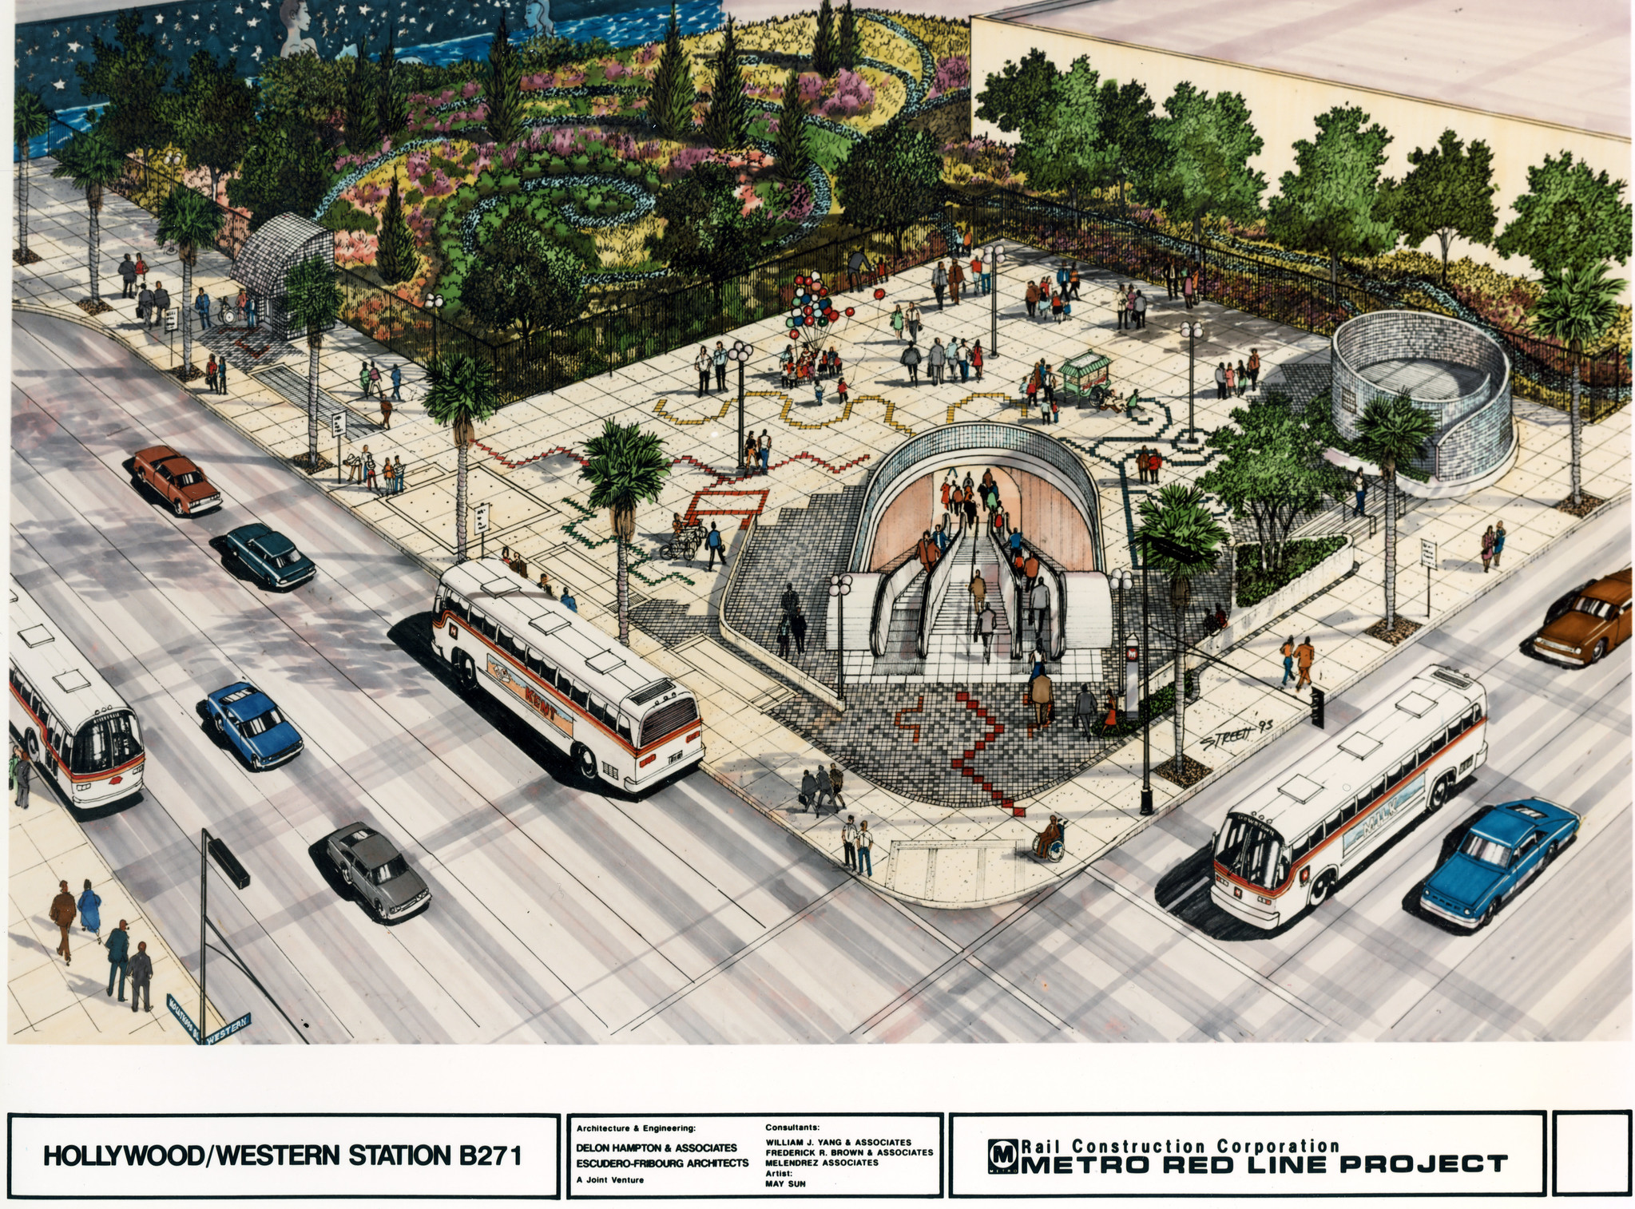
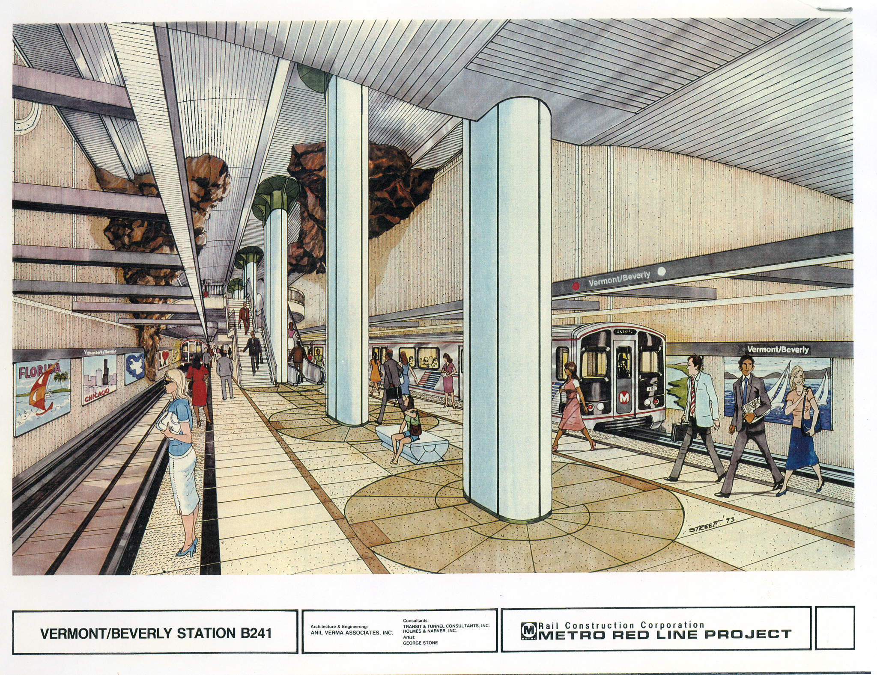
Resources
Website – online hub for all resources and information from the Metro Library & Archive – metroprimaryresources.info
Library Catalog – the go-to location for any circulating materials – librarycat.metro.net
Databases – access new and legacy research on transportation through our paid subscriptions with EBSCO and Knovel Engineering Village (accessible through our website and SharePoint)
External Libraries and Databases – dive deeper into your research by looking for resources in the catalogs of other transportation libraries (Start Here: An Approach to Transportation Research Guide)
Red Line Project Renderings (1985)

Slide 8
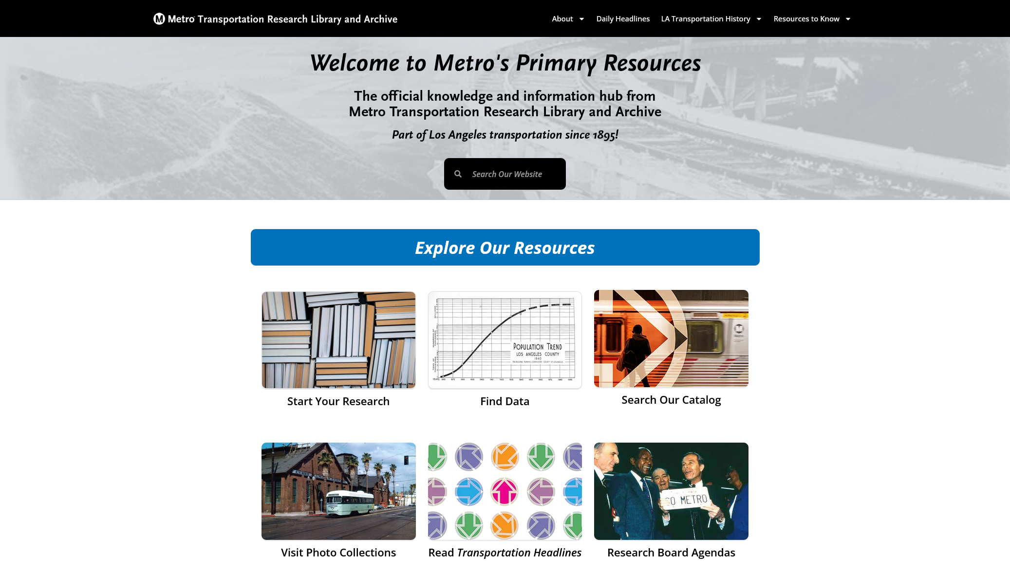
Library Website

Slide 9
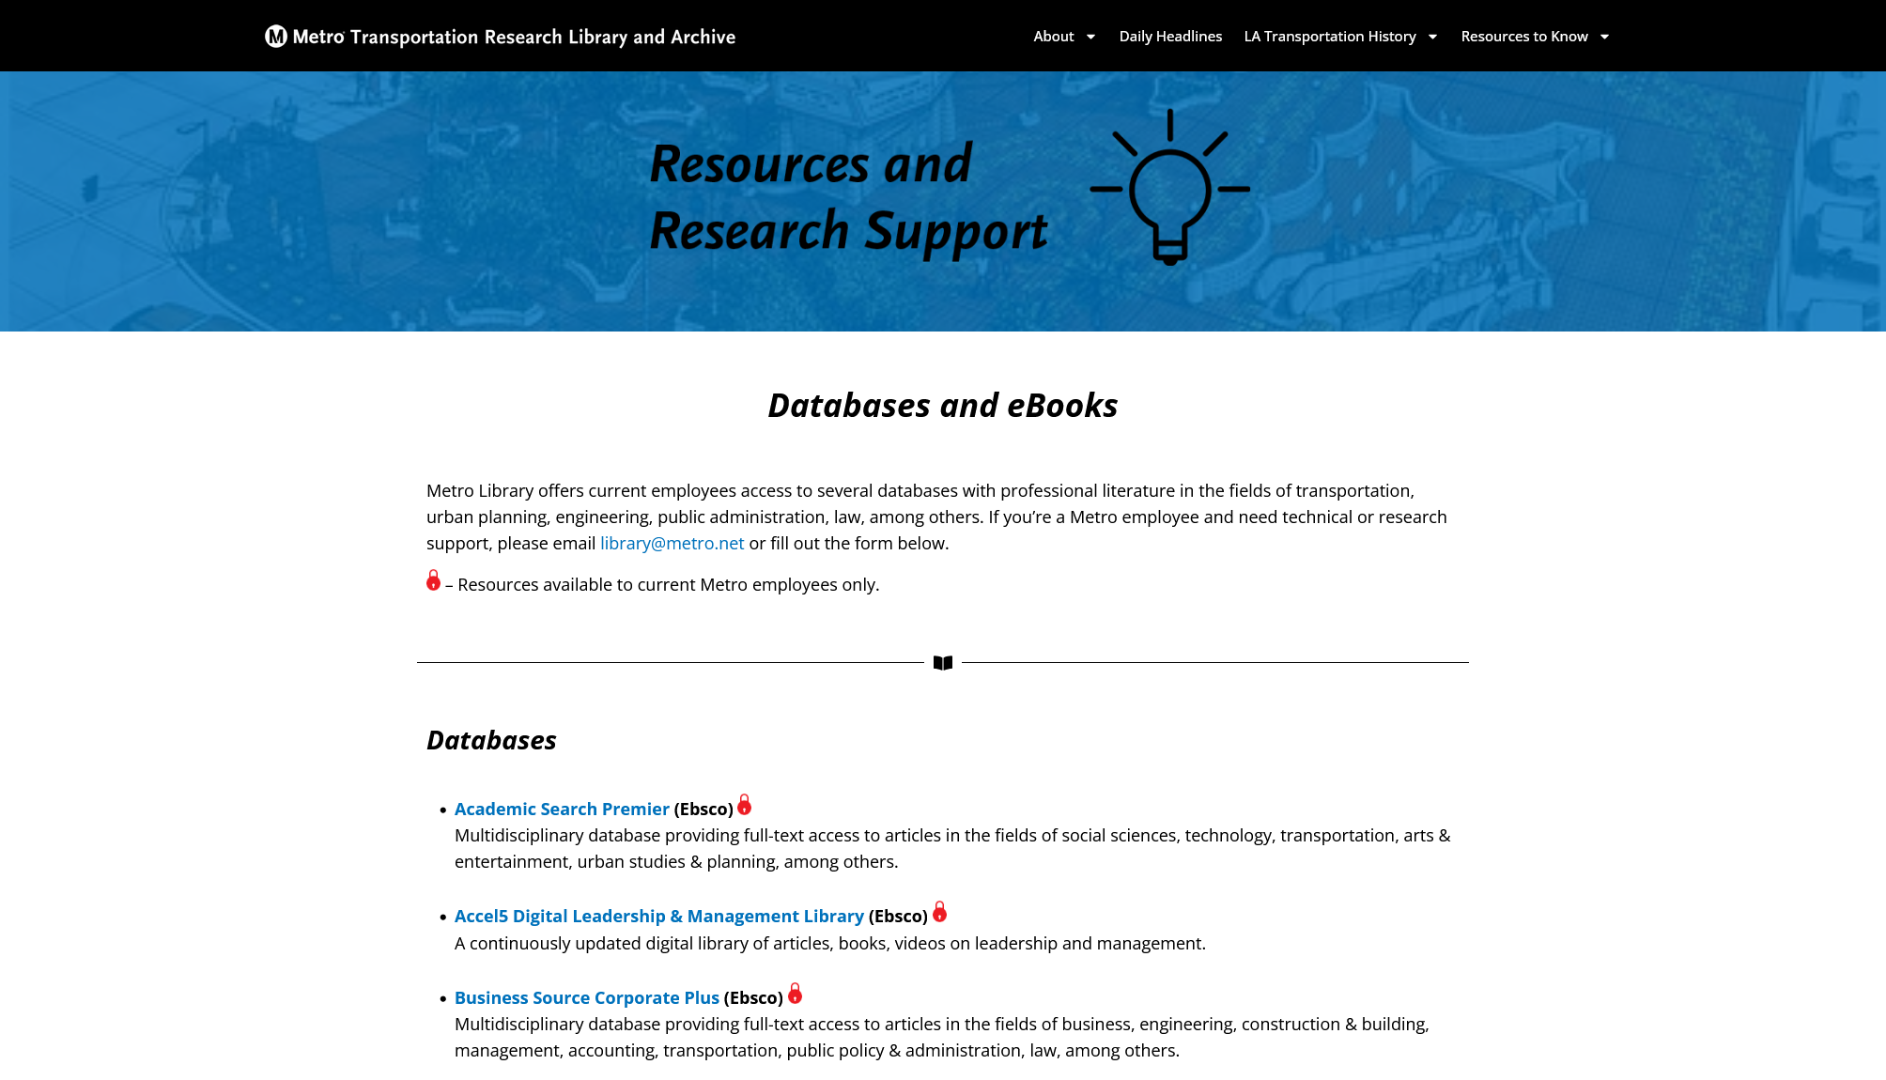
Databases

Slide 10
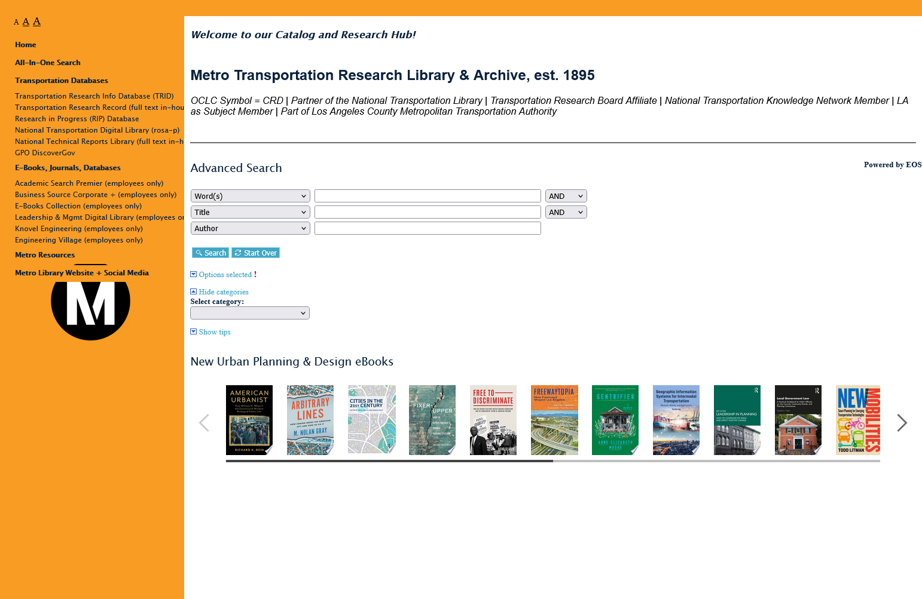
Catalog

Slide 11
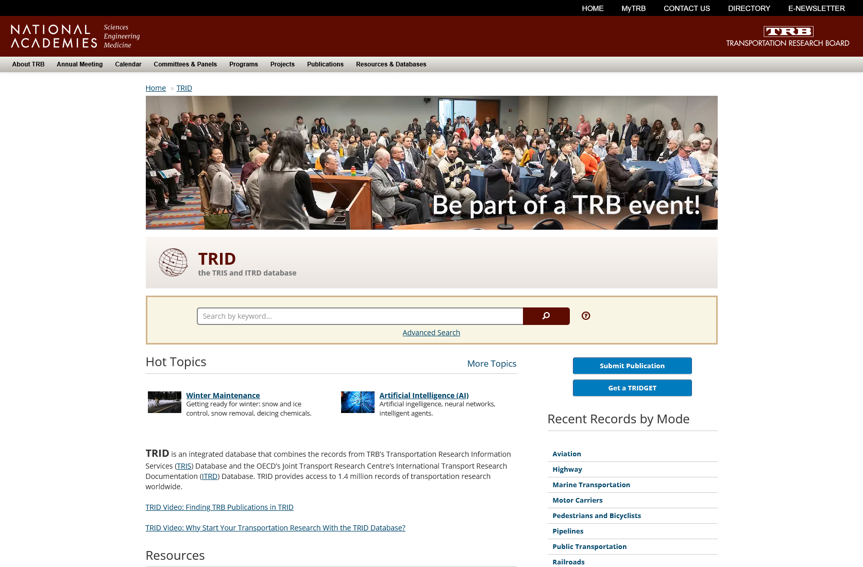
TRID from TRB

Slide 12
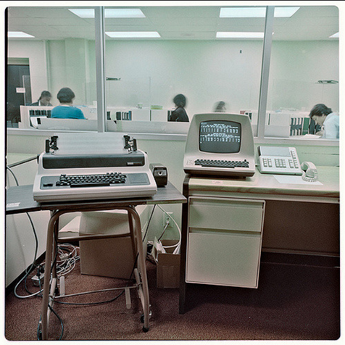
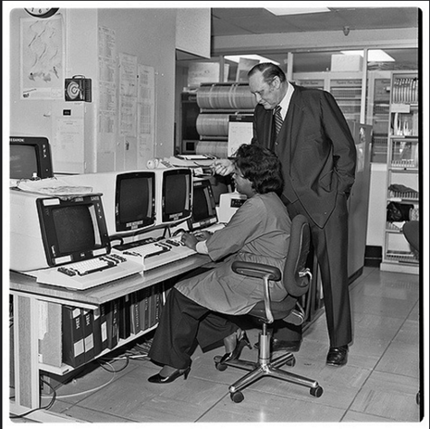
Additional Resources
Board Archive 1951-2015 – managed by the Records Department (RMC)
Contemporary Board Records – board reports, new filings, recordings – boardagendas.metro.net
Employee News Magazines 1916-2010 – collection holds employee news publications from Metro and predecessors like Pacific Electric, LACTC, and more.
California Highways 1924-1967 – the official publication from the California Highway Commission, predecessor to CalTrans
Metro Press Releases 1994 – Present
News Clippings 1940-2012 (access forthcoming)
Transit Management Information System (TRANSMIS) from IBM for RTD (1984)

Slide 13
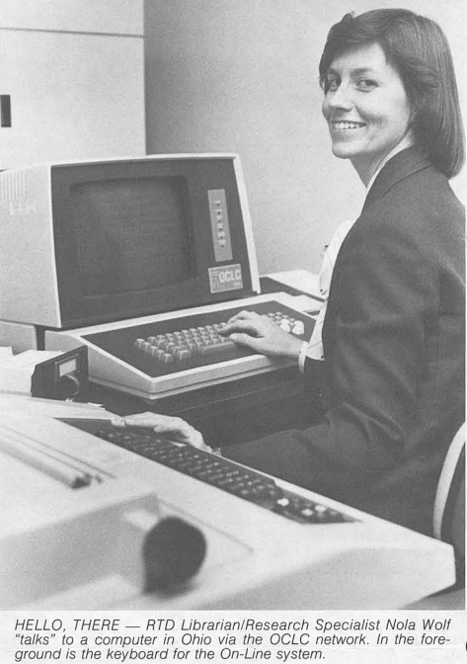
Questions?
Metro Transportation Research Library & Archive
1 Gateway Plaza, 15th Floor Los Angeles, CA 90012
Email – library@metro.net
Employee Hours – 10AM to 4PM, Monday through Thursday; Open Friday by Appointment

