Slide 1
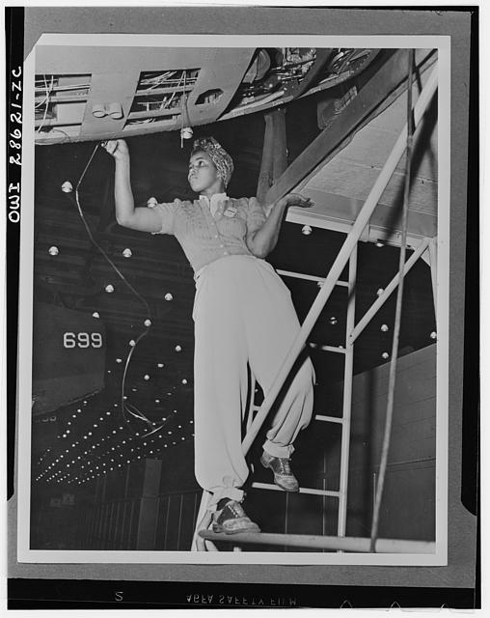
Black History &
Los Angeles
Transit: Local Firsts
By Matthew Barrett
Dorothy Peyton Gray Transportation Research Library & Archive

Slide 2
Accessing Research Library & Records Online
Online: metro.net/library
  Library Catalog librarycat.metro.net
  Daily aggregated transportation news headlines: metroprimaryresources.info/headlines
  Highlights of current and historical documents in our collection: metroprimaryresources.info
  Photos: flickr.com/metrolibraryarchive
  Film/Video: youtube/metrolibrarian
  Social Media: facebook, tumblr, historypin, Tiki-Toki (timeline), Peopleplotr (family tree), Threads
  Digitized Employee News Magazines 1918-2009 search
  Digitized California Highways Magazine 1924-1967 search
  Digitized Electric Street Railway Journal 1884-1931 search
  Records and Records Requests at https://lametro.nextrequest.com
Email: library@metro.net or rmc@metro.net
In Person:
  15th floor of the Metro Headquarters building at the terminus of the Red/Purple Line, Gold Line & Metrolink, on the east side of Union Station, downtown Los Angeles.

Slide 3
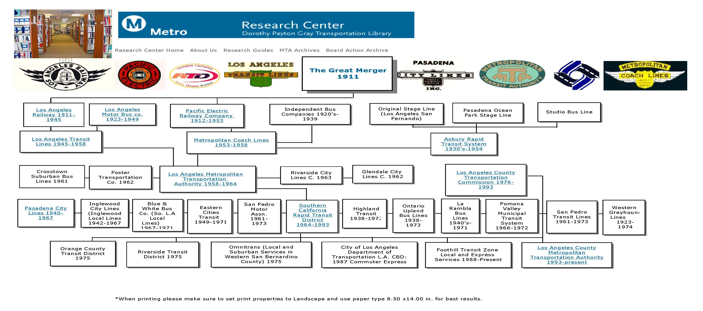
Transit’s Family Tree
Complete family tree: http://www.peopleplotr.com/plot/entry/10814/Los-Angeles-Transit-Agencies/
Notes:
Many private operators prior to 1911 Merger that created two large systems, Pacific Electric for longer distance travel and Los Angeles Railway for shorter distance travel connecting with downtown.
First bus company created in 1923 by PE and LARy to serve Wilshire Blvd.
First large diesel bus order in 1940 (and first smog alert issued in 1943)
Fares regulated by Sacramento and held low for many years.
Public governance and local control begins in 1958 with first MTA.
SCRTD created to give the underpowered MTA the tools it needed.
Watts Riots – report on causes cited lack of access to a well coordinated transit system, SCRTD takes over 11 failing transit operators
Transportation Commissions created in 1976.
Merger of transit district and transportation commission in 1993.

Slide 4
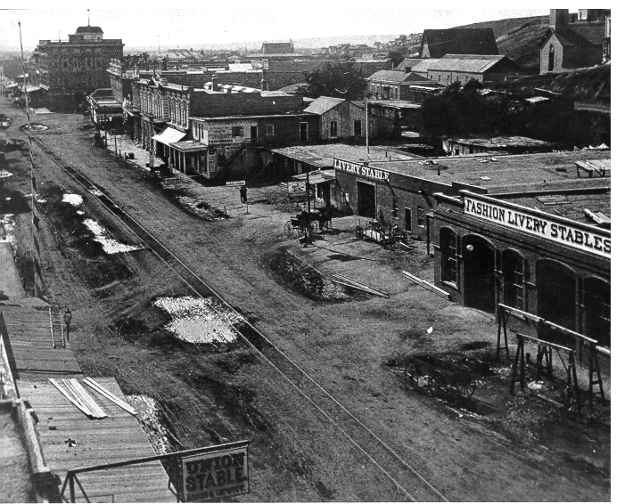
Early Years – Horse Drawn – 1870’s
Complete Timeline: available here
Biddy Mason and her children, wealthy real estate speculators, owned first livery stables.
Notes:
First franchise granted in 1873, first line opens in 1874. Horse drawn rail is the biohazard of its day, frequently complained about in newspaper letters to the editor.

Slide 5
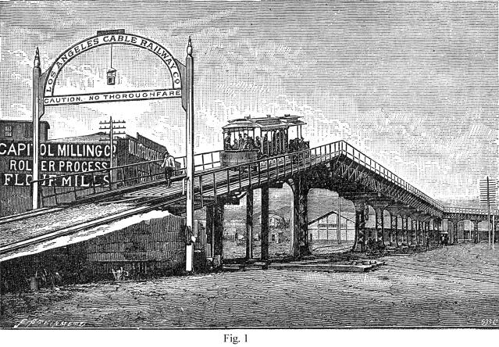
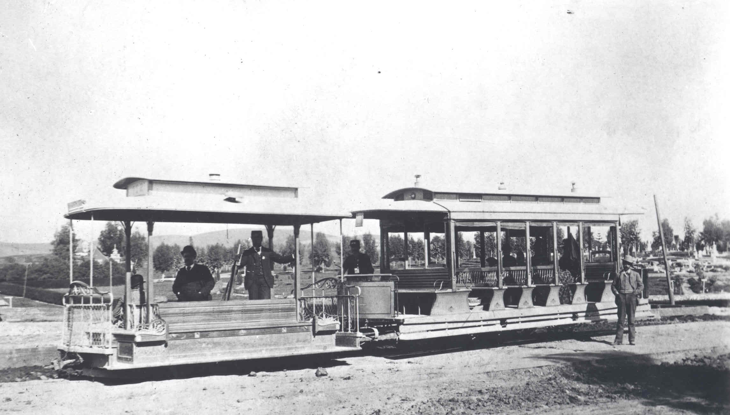
Early Years – Cable Cars – 1880’s
As population and transit use grew in Los Angeles, horse drawn rail cars were quickly replaced with newer technology cable cars.
Cable Cars proved highly unreliable operating under the unpaved dirt roads of early Los Angeles, they frequently froze, choked with dirt and gravel.
Notes:
Innovation with Cable drawn railways, all of these companies went bankrupt quickly. Accident prone, unpaved streets, and expanding city made service with this technology a challenge.

Slide 6
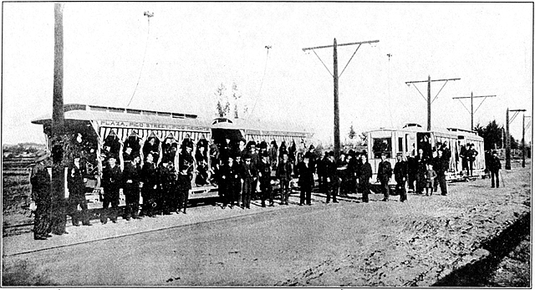
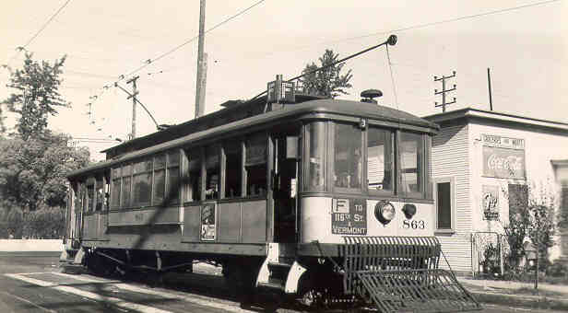
Early Years – Electrification – 1890’s
Better technology, overhead electrically-powered rail cars, allowed the transit system to rapidly consolidate, expand, and create the sprawling Southern California we know today.
Mexican and Mexican American workers, the Traqueros, laid out LA's rails for the various rail companies. Pacific Electric even built housing, assisted with citizenship applications and sponsored company picnics for the Traqueros. Today's Metrolink trains run in the rail corridors their labor originally created.
Notes:
Quickly supplants horse drawn and cable railways. Leads to the first transit library open to the public in 1895. Had to convince the Victorian era minded public that electricity and speed were safe.
Massive expansion outward, first to Pasadena, then Long Beach, based on those successes, every suburban community lobbied for rail connections to downtown.

Slide 7
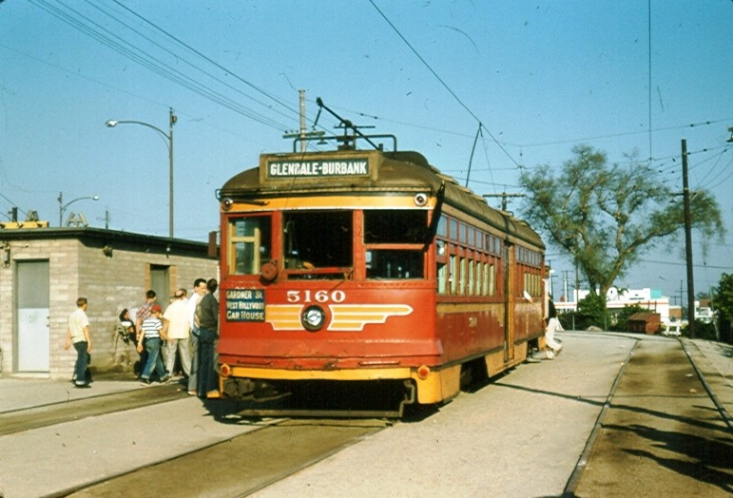
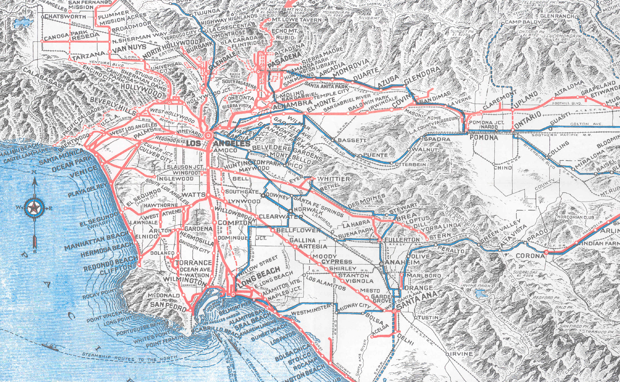
Pacific Electric (1898-1953)
Made concept of suburbia possible. Connected the suburbs and the city center, served Los Angeles, San Bernardino, Riverside and Orange Counties, also ran some connecting buses and open top double deck buses on Wilshire Boulevard.
Peak number of rail lines in 1925, peak ridership in 1923, and again during WWII due to rationing.
It was the electric “Metrolink” commuter rail of its day, only much more extensive with 1,100 track miles, up to 2,700 trains a day, and multiple hubs. Important connection from South LA to Downtown.
Notes:
The Red Cars – source of urban mythology promoted in Disney’s Who Framed Roger Rabbit. Story is repeated as fact – Standard Oil, Firestone Tire and General Motors conspired to dismantle the Red Cars.
Timelines don’t match up. The court case was about anti-competitive contracting with suppliers and took place in 1948. National City Lines was involved, which was the parent company of theYellow Cars, not the Red Cars, and most of LA’s rail was converted to bus in the 1950’s, after the court case, not before.
System connected four counties. 450 miles of its remaining right of way was purchased from Southern Pacific in 1992 for $980 million. Allowed Metrolink to begin service quickly and preserved corridors for future Light Rail and BRT.

Slide 8
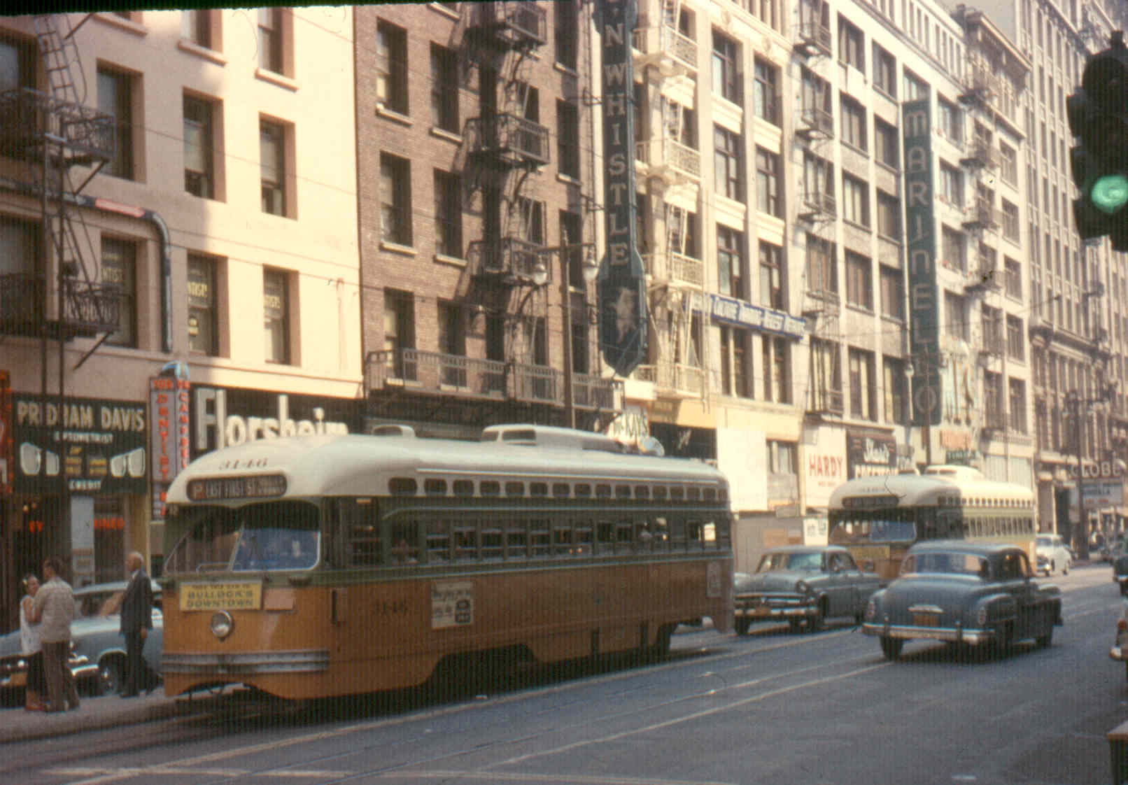
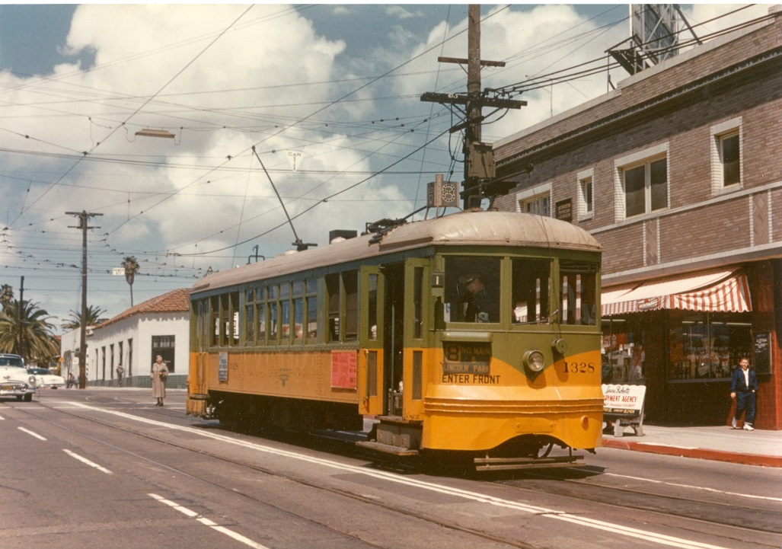
Los Angeles Railway (1895-1945)
Operated in the center of city streets, connecting points north, south, east and west with downtown Los Angeles, Pacific Electric and other transit service providers.
Peak number of lines around 1925, peak ridership during WWII, 742 streetcars and about 650 track miles, also operated motorbuses and electric trolley buses.
Known as the “Yellow Cars”. Grandfather of today’s urban bus system. Largely forgotten and frequently confused with Pacific Electric. Important connections from all over South LA to Downtown.
Notes:
Henry Huntington, ran this system until his death in 1927. His estate continued to run it until 1945 when it sold it to Los Angeles Transit Lines.
Work horse system, morphed into today’s bus system.

Slide 9
Black Population in Los Angeles
LA is founded in 1781 – among its first 44 settlers are 26 people of African and mixed Mexican African descent.
1880 102
1890 1,258
1900 2,231
1910 7,599
1920 15,579
1930 38,894
1940 63,744
1950 170,000+
Los Angeles rivals the East Coast in manufacturing jobs
Many of those jobs union with middle class pay & benefits

Slide 10
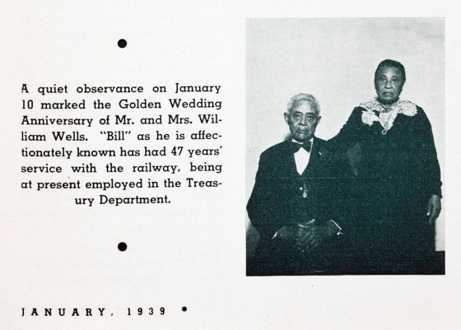
First Black Employee
Reaching back through our all of our direct predecessors (SCRTD 1964-1993, LAMTA 1958-1964, L.A. Transit Lines 1945-1958, Metropolitan Coach Lines 1953-1958, Pacific Electric 1899-1953, Los Angeles Railway 1898-1945) to Los Angeles Consolidated Electric Railway, 1890-1898, we found the story of William E. “Bill” Wells
Read about his life and history here on the Metro Primary Resources Blog:
https://metroprimaryresources.info/los-angeles-transits-first-black-employee-william-e-bill-wells-1862-1943/15263/

Slide 11
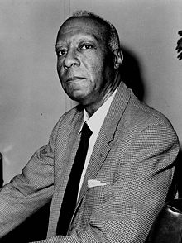
A. Phillip Randolf
He organized and led the Brotherhood of Sleeping Car Porters, the first predominantly Black labor union. In the early civil-rights movement, Randolph led the March on Washington Movement, which convinced President Franklin D. Roosevelt to issue Executive Order 8802 in 1941, banning discrimination in the defense industries during World War II. After the war Randolph pressured President Harry S. Truman to issue Executive Order 9981 in 1948, ending segregation in the armed services.
In 1963, Randolph was the head of the March on Washington, which was organized by Bayard Rustin, at which Reverend Martin Luther King, Jr. delivered his "I Have A Dream" speech. Randolph inspired the Freedom budget, sometimes called the "Randolph Freedom budget", which aimed to deal with the economic problems facing the Black community, particularly workers and the unemployed.

Slide 12
WW II – President Roosevelt’s Order
Executive Order 8802
  On June 25, 1941, President Roosevelt created the Fair Employment Practices Committee (FEPC) by signing Executive Order 8802, which stated, "there shall be no discrimination in the employment of workers in defense industries or government because of race, creed, color, or national origin." This was due in large part to the urging of A. Philip Randolph, who was the founding president of the Brotherhood of Sleeping Car Porters.
  The Fair Employment Practices Commission (FEPC) implemented US Executive Order 8802, requiring that companies with government contracts not to discriminate on the basis of race or religion. It was intended to help African Americans and other minorities obtain jobs in homefront industries.

Slide 13
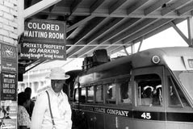
Los Angeles Railway & the Initial Reaction
Henry E. Huntington’s Estate ran Los Angeles Railway (LARy) after his death in 1927, up until 1945.
LARy wrote letters* to the wartime Fair Employment Practices Commission in 1942 arguing they couldn’t comply with Order 8802 due to the costs associated with building new facilities required to keep races/genders separate. The attorneys reject LARy’s argument.
In 1944, LARy places its first black operator in service, Arcola Philpott.
In 1945, LARy sells out to Los Angeles Transit Lines.
*LARy correspondence on this subject is kept in the National Archives & Records Administration offices in San Bruno, California.

Slide 14
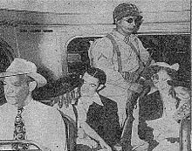
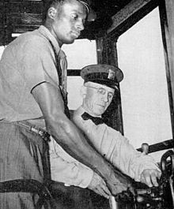
Meanwhile on East Coast….
White streetcar operators went on strike.
President Franklin D. Roosevelt authorized the Secretary of War Henry L. Stimson to take control of the Philadelphia Transportation Company (now SEPTA), and Major-General Philip Hayes was put in charge of its operations.
After several days of unsuccessful negotiations with the strike leaders, Hayes issued an order that the striking workers return to work on August 7, 1944, and that those refusing to comply be fired, stripped of their military draft deferment, and denied job availability certificates by the War Manpower Commission for the duration of the war.
This ultimatum proved effective and on August 7 the strike ended and the strikers returned to work. The black workers, whose pending promotions to non-menial jobs triggered the strike, were allowed to assume those jobs.

Slide 15
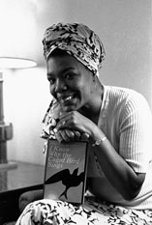
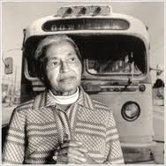
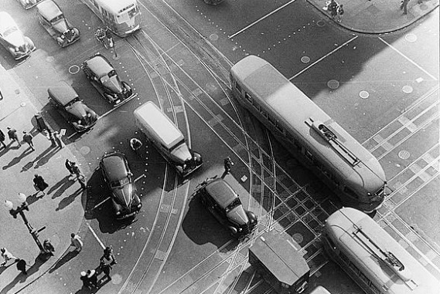
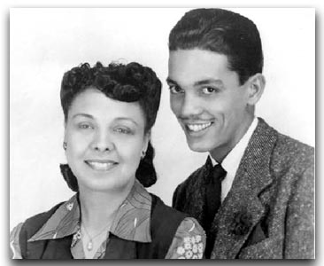
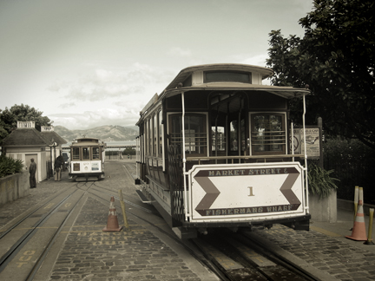
Firsts Around the Country
See Video: Rosa Parks Legacy
Philadelphia: William Barber had to be protected by troops in order to Operate
  See Philly.com “In Midst Of A World War, They Had To Mobilize Against Hate Wildcatters Of '44 Froze City Transit - Until Troops Came”.
New York: Rupert Bath, a newspaper columnist and an immigrant from Trinidad became New York City’s first black Subway motorman.
Washington DC: B.A Simmons and Sarah Owens
  See Washington City Paper “Today in D.C. History: Streetcar Operator Hires 1st African American Motorman” about B.A. Simmons
  See Video: Sarah Owens - First post WWII black woman bus operator in Washington DC
San Francisco Muni: Audley Cole
  See “Transit in San Francisco, a selected chronology 1850-1995” not mentioned, his wife becomes San Francisco’s first black public school teacher.
  Also San Franciso Cable Cars: Maya Angelou The famous author, poet, and social activist Maya Angelou dropped out of Mission High School at 15 to work the cable cars. “The thought of sailing up and down the hills of San Francisco in a dark-blue uniform, with a money changer at my belt, caught my fancy,” she later recalled in 1969's I Know Why the Caged Bird Sings. Angelou won the job as San Francisco’s first African American (and female) cable car conductor by heckling reluctant company managers until they caved and she was hired to ring the cars’ bells and swing “on the back of the rackety trolley, smiling sweetly and persuading [her] charges to ‘step forward in the car, please.’”

Slide 16
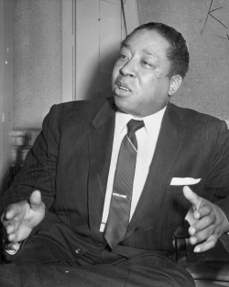
L.A.’s advocate for equality
Reverend Clayton D. Russell
During World War II Russell become one of the most prominent leaders in Los Angeles’s African American community.
In 1941 he organized the Negro Victory Committee, which sponsored mass meetings and demonstrations to protest discrimination against African American workers.
Russell and his church, whose membership peaked at 4,000, were also the driving force behind the Victory Markets, a chain of cooperative grocery stores that served the rapidly expanding African American community during the war.
In addition to leading the struggle against employment discrimination, Russell worked to elect African Americans to political offices.

Slide 17
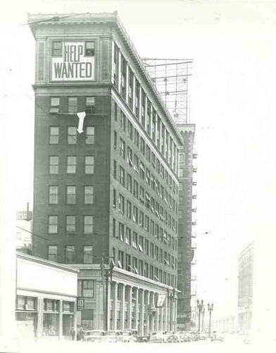
Rev. Clayton Russell’s Action Plan
Weekly radio addresses against LARy’s hiring practices to put pressure on the company.
Held war bond buying fund raisers with Hollywood celebrity concerts in Pershing Square Park to publicly shame LARy further. Generated public empathy with his cause.
He led marches to LARy headquarters at 1060 S. Broadway and sent in prospective black employees to fill out job applications.
LARy’s company physician passed only 5% of black job applicants.

Slide 18
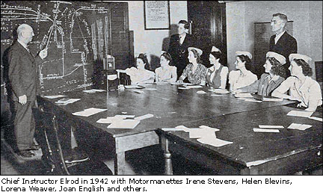
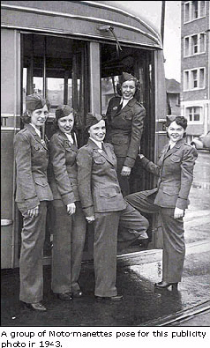
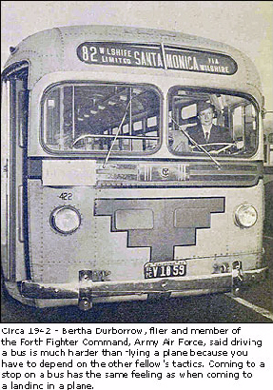
LARy Hires Women
Much to male instructors' surprise, women drove as well as men, and LARy hires over 200 women to replace drafted men.
Women had to sign an agreement to give up their job to any returning veterans they displaced.

Slide 19
LARy hires its first black streetcar operators
An initial group of 10 men passed physicals and were supposed to start training, but felt too intimidated to show up.
Second group of 2 men passed physicals, completed training classes, and were sent to Division 5, but not given assignments.
LARy then hires Arcola Philpott, a black women from Chicago, who makes it past the physical exam, training classes, and receives an assignment to operate Streetcar Line F – 116th/S. Vermont to Union Station loop, operating out of Division 5 (now Arthur Winston/Mid Cities/Division 5).

Slide 20
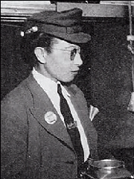
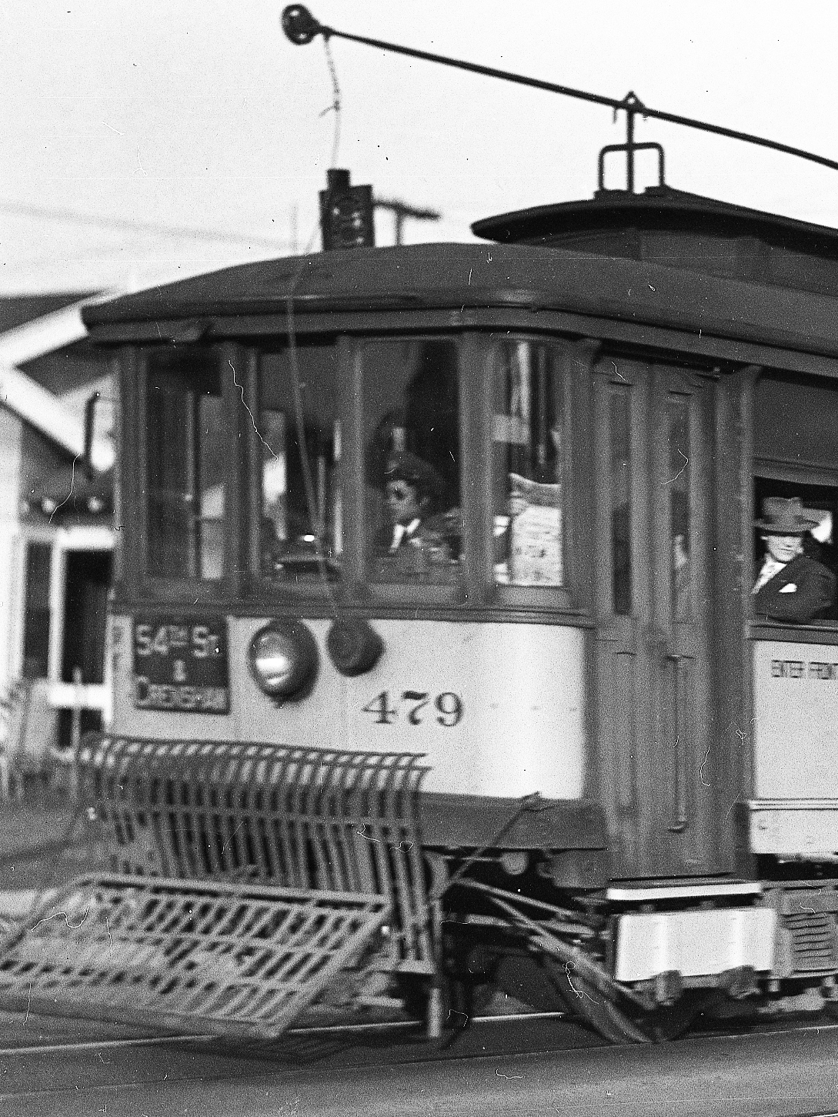
Arcola Philpott
Arcola Philpott was born Arcola Ruffins on July 21, 1913.
She married Robert Philpott and had two children, Robert Jr. and Ethel.
Arcola was an accomplished pianist and spoke several foreign languages.
Prior to coming out to Los Angeles from Chicago, she performed welfare work for seven years and also worked in research for the University of Chicago's History Department.
She attended Loyola University studying social science and attended City College while in Los Angeles.
We located her 1945 payroll record in our archives and discovered that she lived near the corner of Adams and Central, at 1119 E. Adams. She also worked at the Brown Derby Restaurant.
After she returned to Chicago, she worked as a licensed practical nurse as well as a journalist for the Chicago Defender and Pittsburgh Courier.
In her later years she worked as a docent for the Museum of Science and Industry and the Chicago Public Library. Arcola Philpott passed away on May 14, 1991. She is survived by her daughter Ethel, three grandchildren and one great-grandchild.

Slide 21
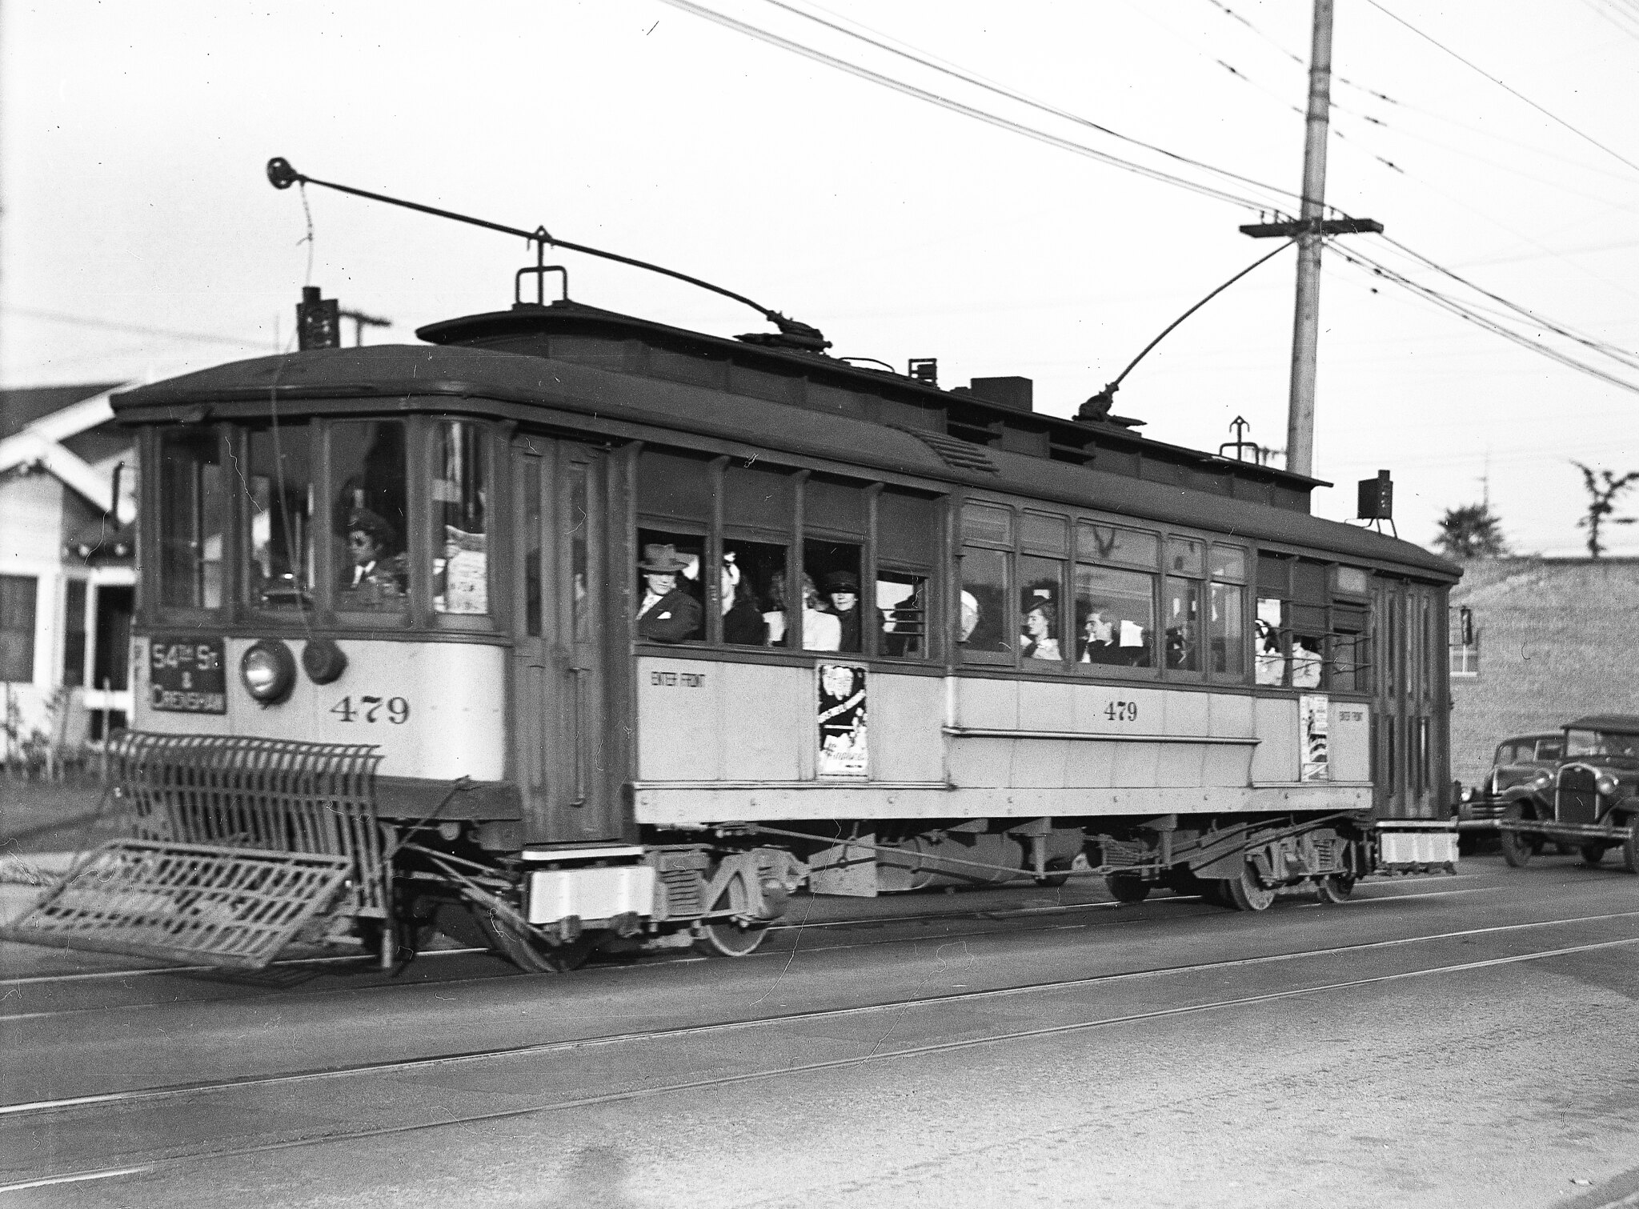
Arcola Philpott – at the controls

Slide 22
Glass Ceilings Broken Through for Motormen/Operators
Arcola Philpott’s employment at LARy earned her an important place in L.A. Transportation History. She opened two doors that had previously been closed.
Arcola’s daughter Ethel, who still lives in Chicago, believes it was the sight of other women going to work doing traditionally men’s jobs that inspired her Mother.
  “My Mother was just like that, born in the wrong era for all the things she wanted to do, she was a real go-getter. She was extremely intelligent, courageous, fearless, and a life-long learner”.
Within a few weeks of Arcola being on the job, and without any negative reaction, LARy went on to hire 20 black women and 50 black men as Operators.

Slide 23
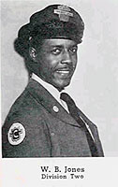
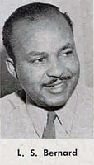
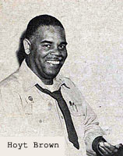
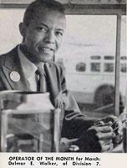
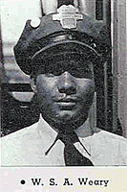
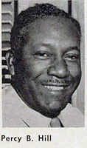
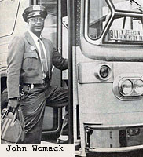
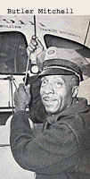
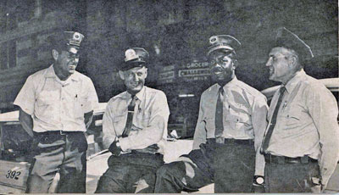
L.A.s First Black Operators and Supervisors
Supervisor Nathaniel Lewis
Source: Employee Newsmagazines

Slide 24
Some Issues Remained in Maintenance
Some white ATU members went on sit down strike at South Park Shops (today’s CMF) after WWII when they returned from the war and discovered their former black employees were now their Supervisors.
LARy overreacts and demotes them back down to Clerks.
LARy later reinstates them to Supervisors after pressure from Rev. Clayton Russell, the Mayor of Los Angeles and the City Attorney. (source: LA Times)
The 4 years of bad PR for the Los Angeles Railway seems to have prompted its sale to Los Angeles Transit Lines in 1945.

Slide 25
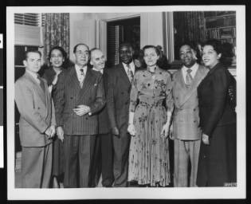
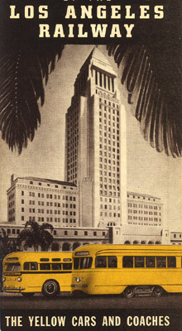
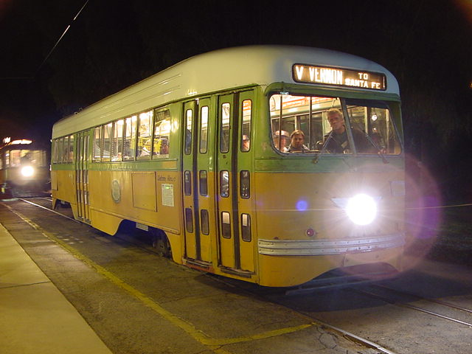
Black community leaders travel to Washington DC to report on progress in L.A.
U.S. Rep. Helen Gahagan Douglas, third from right, meeting some of her Los Angeles constituents who have traveled to Washington, D.C.
The visitors are, from left, Claude McKinnon, Juanita Terry, Dr. H. Claude Hudson, Amerigo Bozzani, H.A. Howard, Douglas, Clayton Russell, and Gwendolyn Diggs Russell. Douglas represented the 14th District of California in the House of Representatives from 1945 until 1950.
Clayton Russell was the head of the People's Independent Church of Christ; Gwendolyn Diggs Russell was his wife. H. Claude Hudson was president of the Los Angeles branch of the NAACP 1924 until 1934, and in 1947 founded Broadway Federal Savings, a financial institution serving Los Angeles' African-American community.

Slide 26
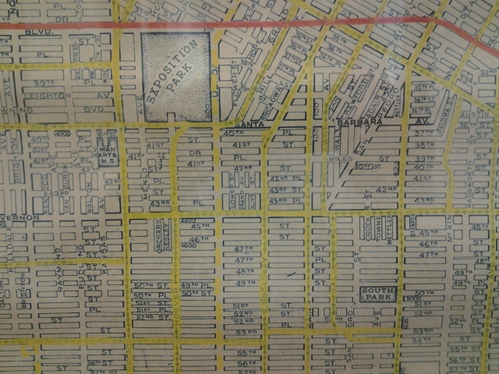
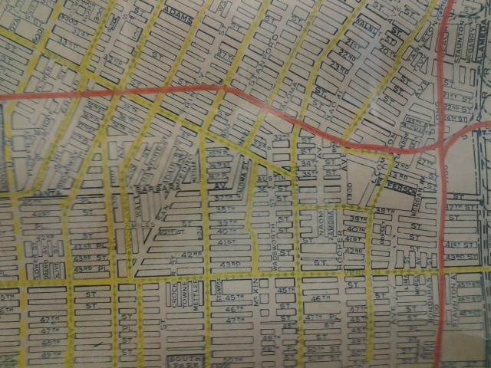
LA’s prior transit system was a cleaner air, electric transit and electric freight rail system
South LA had the most dense coverage of Yellow Car and Red Car rail lines to reach jobs in Downtown, the Ports, and the Westside.
Massive freeway construction and conversion to diesel freight trains and diesel buses divide and pollute South and East LA neighborhoods.

Slide 27
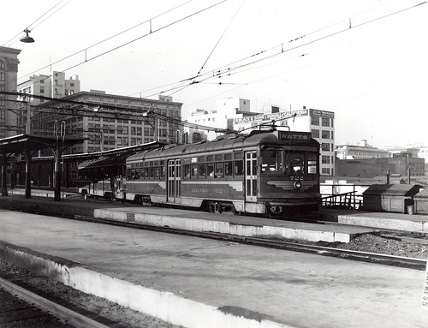
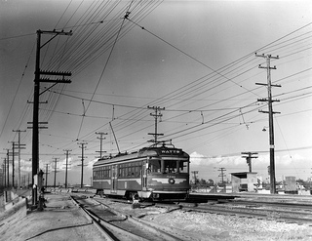
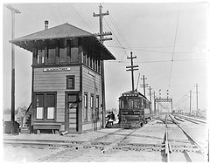
Only Protests Against Ending Rail Transit
The only areas of Los Angeles to organize against dismantling the last remaining Red Car trains were residents of South Los Angeles and Watts. Watts began as community of Pacific Electric track worker housing. Without the trains, their public transit journeys to job centers were twice as long and much more expensive with LA’s mix of private and public operators.
Sacramento listened and extended the Red Car’s life, refusing to approve Pacific Electric’s first application to convert the Long Beach and Watts Lines to buses.
The new local MTA disastrously tried to convince South LA residents that buses and new Monorails would be better.
After 1965, the post-Watts riots McCone Commission report cited the lack of access to a well coordinated transit system as one of the root causes of the civil rebellion. SCRTD went to work to address it.
Slauson Tower

Slide 28
Why did rail service die off?
Private ownership under state regulation claimed it couldn’t afford the capital costs to replace aging power substations, catenary wire and rail cars; buses become the economical alternative, rail-to-bus conversions begin in 1925 and rapidly accelerate in 1950’s with little public resistance.
Public Utilities Commission held back fare increases – 5 cents from 1877 to 1927, 7 cents from 1928 to 1945, 10 cents from 1946 to 1951, 15 cents from 1952 to 1956.
No public subsidies for capital or operating costs available from local, state or federal governments.
Cultural changes - automobile reliability improves, status symbol marketing, women & minorities enter the industrial workforce.
Modal improvements - brand new un-crowded highways and freeways.
Transit service operators believed that the freeway system would accommodate and improve bus transit as a high speed backbone, thereby increasing their attractiveness to passengers.
GM perfects and markets the 45 seat transit bus; air conditioning, air suspension and automatic transmission become options.
Diesel is not yet considered to be a component of a new phenomenon called “smog”.

Slide 29
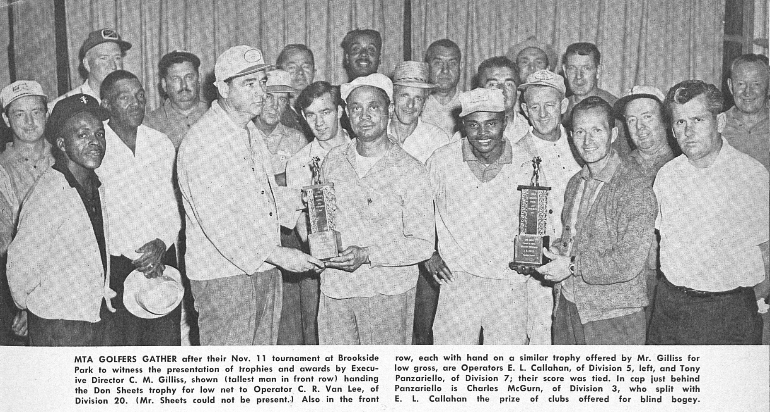
A chance for employees to get to know each other – socializing through sports clubs
Division 7 Golf Club – December 1962

Slide 30
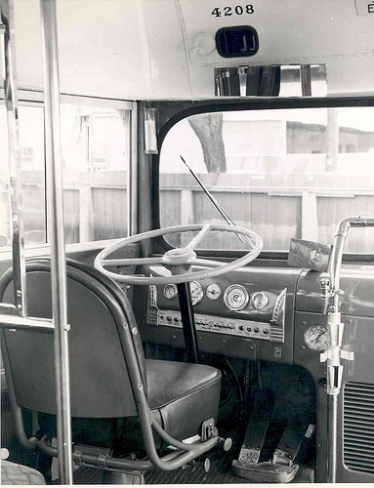
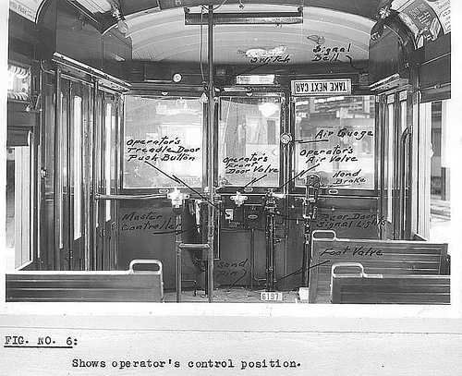
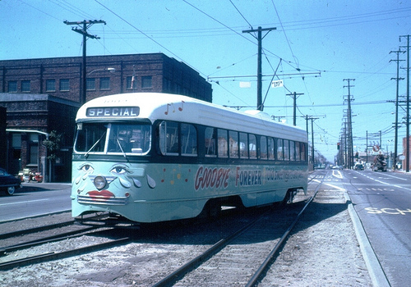
Leilia Bailey – Breaks The Glass Ceiling for Women a Second Time at SCRTD
The remaining few women operators from the WWII era retired from the LAMTA when the last streetcars ran in 1963. They did not make the transition to buses.
LAMTA, then SCRTD goes seven years without a woman operator.
Leilia Bailey applies to be an SCRTD Bus Operator in 1970 and is initially denied an Operator’s job and instead offered an office job.
She files a complaint with U.S. Equal Employment Opportunity Commission and becomes a bus Operator.

Slide 31

Leilia Bailey – Breaks The Glass Ceiling for Women a Second Time, a career of firsts
A career of firsts – See handout Headway Newsmagazine, March 1980, and handout, Leilia Bailey’s Biography.

Slide 32
Southern California Rapid Transit District (1964-1993), a Metro predecessor
Known for Innovations & Special Services:
EEO established in 1971, successful Management Trainee Program
El Monte Busway HOV Project
Mini-Bus circulator routes and Freeway Flyer services (today’s DASH and Commuter Express services)
Bus Technology
  In-house Air Quality Testing lab
  1974 FTA/California Steam Bus project
  Particulate traps, alternative fuels - ethanol, methanol, hydrogen fuel cell & CNG
  Double Deck and Articulated buses
  First large-scale wheelchair lift equipped bus order in history
Bus Scheduling and System Grid design, system route renumbering
Technology – Robotic Parts Delivery, Pre-GPS Radio tracking system
FFGA for Metro Rail Subway Project
Rail Start up for the first new Light Rail Line & Subway Line
Earthquake service, Civil Unrest service, Papal Visit, 1984 International Olympic Games, and coordinating other large scale special events year-round countywide. Also bought the land and planned Metro’s headquarters.

Slide 33


Metro Facilities Named for Employees
On January 22, 1997 the Metro Board of Directors voted to rename Bus Division 5 as the Arthur Winston Division to recognized the career of Metro’s longest serving employee, Arthur Winston, who continued working until his 100th birthday, with 77 years of service to Metro and its predecessors. He was featured on Oprah, and named by President Clinton as Employee of the Century. More on his life and career can be found here:
Youtube | StoryCorps Interview | Metro Family Magazine
On October 25, 2001 the Metro Board of Directors voted unanimously to rename the transportation research library and archive as the Dorothy Peyton Grey Transportation Research Library and Archive in recognition of her career leading the nation’s largest transit operator library, the 4th largest in the US, and formally creating its archive collections, bringing it national and international respect and renown. More on Dorothy Peyton Gray can be found here on this Sharepoint page.

Slide 34
Some Other Black History Firsts to Remember & Document their contributions
First employee - William E. “Bill” Wells, 1891
First BF Operator - Arcola Philpott, 1944
First SCRTD Board Member – Thomas G. Neusom, appointed 1969
First SCRTD BF Operator – Leilia Bailey, 1970
First LACTC Board Member – Mayor Tom Bradley, 1977
First LACMTA Board Member – Mayor Tom Bradley & Supervisor Yvonne Burke, 1993
First SCRTD Assistant General Manager, EEO Programs – Walter Norwood
First SCRTD Assistant General Manager, Customer Relations – Bob Williams
First LACTC Deputy Executive Director (Deputy CEO) – Jerry Givens
First LACTC Assistant Executive Director Finance – Les Porter
First LACMTA CEO – Franklin E. White
First LACMTA Deputy CEO – John Catoe
First LACMTA COO – Carolyn Flowers
First LACMTA CROO – Gerald Francis
First LACMTA CCO – Rae James
First LACMTA CAO – Judith Pierce
First LACMTA Treasurer – Leslie V. “Les” Porter
First LACMTA EEO Programs Director – Gail Charles
First LACMTA Director of Human Resources – Ray Inge
First LACTMA Manager of Career Development – Naomi Nightingale
Expo Start up Operators & Rail Roadeo Winners – Sheila Celestain and Carolyn Kelly, See Zev’s blog
First LACMTA BF CEO – Stephanie Wiggins
First LACMTA Equity Officer – KeAndra Cylear Dodds
    More departmental or executive firsts to add to this list?

Slide 35
Learning Online
Video: Measure R & America Fast Forward
21st Century Transportation System for Los Angeles
Video: Sarah Owens on Desegregating the DC Metro
Sarah Owens - First post WWII black woman bus operator in Washington DC
Video: Rosa Parks Legacy
Slide Show – Notable California African Americans
Video: We Are Metro
Additional Presentation: LACMTA Celebrates Black History Month 2013 – African Americans in Transportation

Slide 36
Further Reading on Transit History
The Development of Leadership and Organization Building in the Black Community of Los Angeles from 1900 through World War II. By E. Frederick Anderson. Saratoga, Calif.: Century Twenty One Publishing. 1980. (Rare book, only one I’ve seen that covers transportation and the black community.)
Electric Railway Historical Association – http://www.erha.org
Pacific Electric Historical Society http://www.pacificelectric.org
This Was Pacific Electric - DVD - A documentary film by Tom Eberhardt
Henry E. Huntington and the Creation of Southern California by William B. Friedricks
From Railway to Freeway - Pacific Electric and the Motor Coach by Eli Bail.
Los Angeles & the Automobile by Scott Bottles.
Street Railways and the Growth of Los Angeles by Robert C. Post.
Ride the Big Red Cars: How Trolleys Helped Build Southern California by Spencer Crump

Slide 37

Field Trip?
L.A. African Firefighters Museum
Address: S. 1401 Central Ave.
Phone: (213) 744-1730
http://www.aaffmuseum.org/

Slide 38

End
Photo by Fred Camino

