Slide 1
COMMUNITY CURATION, NEWS AGGREGATION & “DATA ALCHEMY”: The Bleeding Edge of Library Opportunity
California Library Association
November 9, 2014
Kenn Bicknell: @StrategicLbries
Digital Resources Librarian
Los Angeles County Metropolitan Transportation Authority
Notes:
Thank you! It’s a pleasure to be a part of this exciting day.
I’ve worked in public libraries, an academic library, a corporate special library and a museum library, and I have taught five years of cataloging and research methodology, and now I wear several other hats: blogger, historical researcher, and as mentioned in my introduction, I lead an alliance of libraries, archives, museums, historical societies and personal collectors across Southern California. I’m also a reformed cataloger!
So, in preparing for this talk, I wanted to combine a sort of 30,000 foot overview of what I see as some exciting directions with some real world, practical stuff.
While some thought leaders in libraries focus on EMERGING TRENDS or LIBRARY FUTURES, I’m focused much more on what you can begin to do RIGHT NOW to engage your users – and your POTENTIAL users as well.
So today, I am going to identify three opportunities for you, and look at strategies to consider SEIZING them as well. More on those in just a minute! OK, let’s get started…

Slide 2
About The Metro Library
Notes:
The Metro Transportation Library is rather unique.
We are the most comprehensive transit-operator owned libraries in the United States, and the only multimodal transportation library in Southern California.
We serve over 8,000 employees, plus contractors, consultants, educators, students, the media, transit buffs, history nerds, and our colleagues in transit and transportation throughout the world.
(I will be using various historic images from our collection to spruce up some of these slides. This image is of a 1920s open-air double-decker bus on Wilshire Boulevard. Not only are the buses great to share, but so is the story of why streetcars were never built on Wilshire – it was full of mansions way back when and wealthy citizens had it written into the city code, and it remains to this day. You can read that story on our blog later)

Slide 3
Breaking The Mold
Notes:
So that’s 9,000 employees, in a County of about 10 million people, and we’re on the 15th floor of a building in downtown Los Angeles – not the most accessible place for the public.
But as a publicly-funded government agency, we serve not only our staff, including planners, engineers and operators, but contractors, consultants, academics, instructors, students, journalists and other media types, historians, bloggers, transit advocates, the film industry, L.A. history nerds, and pretty much everyone else!
And oh yes, we do it all with just 1.5 Librarians. I’m ONE, and my Library Administrator is the .5 (He also oversees Records Management, which is rather ulcer-inducing.
Obviously, traditional service model does not work.

Slide 4
The Perfect Storm Drives Innovation
Notes:
I could do an entire presentation about the collection and its history, but I will just give you the basic facts to provide the context for how we have met the challenge of outreach through innovation despite being resource-deprived.

Slide 5
OPPORTUNITIES & STRATEGIES
NEWS AGGREGATION & DISSEMINATION
COMMUNITY CURATION
DIGITAL DATA ALCHEMY
Notes:
But we don’t take these values into consideration in a vacuum – we have to think about how our users and potential users and future users all look for and find information.
As I mentioned, for the purposes of this talk, I have identified THREE of those STRATEGIC DIRECTIONS as roles that you may want to investigate further:
They are:
News aggregation and dissemination
Community curation
And Data alchemist
I want to examine each of these in concept and with some examples…

Slide 6
STRATEGIC DIRECTION #1: NEWS AGGREGATION & DISSEMINATION
Notes:
Let’s start with news aggregation and dissemination. Why would a library want to get involved in THIS?
As libraries strive to position themselves in an increasingly technological world as not just RELEVANT, but VITAL, one strategic direction is to leverage our expertise as information professionals in GATHERING and PUSHING organizational or community news from a variety of sources into a must-read digest.
So what are we looking at here. On the left is a traditional newsstand, circa 1950s. On the RIGHT, a contemporary or “MODERN” newsstand. What’s so MODERN about it? The HOUSING of the structure holding the media, not the TYPE of media, or the WAY in which the consumer accesses the information contained IN IT.
The consumer still has to make their choice based on past experience with a particular publication, or what they see on the cover (given that you aren’t supposed to stand there and read the entire publication).
The consumer has to TAKE THEIR CHANCES on what they find inside will be important or interesting to them. And with broadcast news, it’s whatever fits into a pre-determined time period.
But new tools allow libraries to BREAK DOWN those restrictions. This isn’t about replacing news sources – or even newsstands – it’s ABOUT CONTRIBUTING TO THE QUALITY OF LIFE OF THE USERS. Aggregating news and information helps them do their jobs or live their lives better without the DISTRACTION FROM, or LABOR OF finding information they want…need…or even don’t realize they need.

Slide 7
Our Changing News Consumption
Growth in online news easy to disseminate
Growth in ways information can be repurposed & shared
Growth in hyper-local citizen journalism
24/7 access to news and round-the-clock news cycle
Users welcoming valuable knowledge amidst info-glut

Slide 8
Blogger Headlines Product

Slide 9
Aggregation
Notes:
We began aggregating transportation news way back in 2005. Our initial blogger platform is like the Stonehenge of transportation social media
This eventually evolved into a curated keyword list in Google Alerts. When Los Angeles County passed what is known as “Measure R” in 2008, a PERFECT STORM of converging factors slammed us in the face. More citizen advocacy, more attention being paid to multiple transit projects and proposals in a range of planning and construction, and more opportunity to inform people – OR GET IT WRONG
We had to evolve, and we had to go mobile as well. But alas, Google Alerts died off recently, so we had to go with another aggregator tool and began using Feedly
However, there are other models for getting what you need and what will work best for you and what you are trying to accomplish

Slide 10
Where they are looking for information

Slide 11
2: Online Newspaper
Notes:
Metro Library identity
Collecting and disseminating disparate information on an interdisciplinary topic in a timely way.
Transportation is complicated
Los Angeles County is a complicated landscape
Local, state, federal realms all have their own complexities

Slide 12
Creating Your Own Newspaper
Notes:
Over time, we realized that a growing list of 40-50 headines and links was neither sustainable in terms of labor involved 5 days a week, nor visually appealing for the reader.
We migrated our platform from a hands-on Blogger site to a the Paper.li online newspaper format. Paper.li takes Twitter feeds and publishes them daily or weekly as a “tweet digest.” It’s like the old informercial: “Just set it and forget it.” It publishes automatically with the frequency you choose.
But by gaming the system with curated twitter feeds and some crafty front-end customization, we got rid of clutter and began publishing our own customeized newspaper. On the left you see a screen shot of the “raw” rendering of the daily “Twitter” news, but on the right is the enhanced product, with a branded banner, more information about us in the box on the right, a nice background image, etc.

Slide 13
Featured Content Every Day
Notes:
Now, our Daily Transportation Headlines is a core Library service. On the left is a screenshot of our Library homepage. In the lower left you see how RSS feed brings the curated transportation news content into that prime real estate.
On the right is a screenshot for THE SOURCE, the primary online communication tool for the entire agency. Our transportation headlines are featured there also, with added commentary from other Departments, so we have internal and external customers, along with repurposing within our organization to supplement their messaging out to the community.
We have received national recognition for this effort, and when we have had to suspend publication of it for technical issues, BOY, do we hear about it from our subscribers. They PANIC and ask, “DID YOU STOP PUBLISHING THE HEADLINES?” It’s a great service to not only keep our users informed and save them time so they can focus on other things, but it also serves as a platform to promote some of our other products as well!
We are currently re-evaluting our platforms and the time and labor involved, but the product’s value CANNOT be denied.

Slide 14
Case study: Community News Rooms Fourth Estate (Detroit)
NEED: Watchdog journalism in “news deserts”
PROPOSAL: Pooling community talent and resources into a network of independent, sustainable and cooperatively networked organizations
OUTCOMES: Self-sustaining Town Square, Real local public interest news

Slide 15
Case study: University of Oregon & KEZI
NEED: Identifies gaps in historical accounts, expands existing initiatives with underrepresented communities (Latino, Native American)
PROPOSAL: Facilitate personal and collective sensemaking and action via
news reporting, digital
OUTCOMES: Collaboration
with UO SOJC, Latino Roots
Project, Tribal Archives Portal;
Interactive digital storytelling
Portal; replicable statewide/beyond

Slide 16
STRATEGIC DIRECTION #2: COMMUNITY CURATION

Slide 17
Differentiation

Slide 18
Theme: Local History Advocacy

Slide 19
L.A. as Subject

Slide 20
L.A. as Subject

Slide 21
Media Partnerships

Slide 22
Archives Bazaar

Slide 23
Archives Bazaar

Slide 24
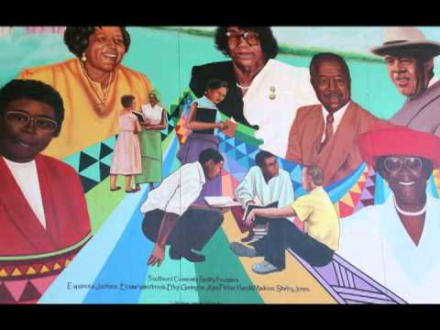
Case Study: Citizenscapes: Stories of Our San Francisco
NEED: Preserve diverse neighborhood histories in a time of rapid gentrification and change
PROPOSAL: Program to train people how to be digital “citizen storytellers using smart phones, tablets, cameras
OUTCOME: Neighborhood history for SFPL audiovisual archives, public engagement, model for other cities, skill-building for participants

Slide 25
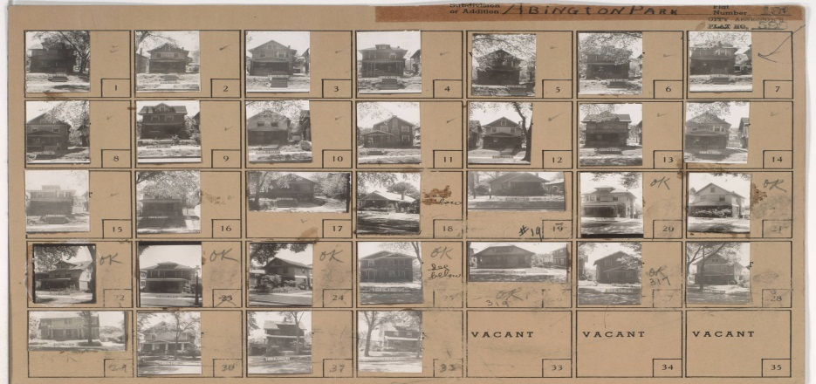
Case Study: Kansas City (MO) Then & Now
NEED: Engendering interest in city’s history via one comprehensive resource: 1940 Tax Assessment photos
PROPOSAL: Crowdsource item-level metadata, add contemporary images as platform for storytelling, neighborhood development
OUTCOMES: Citizen sense of place, increase knowledge about historic assets, link past to present and future, model for other cities

Slide 26
Theme: New Technology Tools

Slide 27
Interactive Timelines
Notes:
We have used other tools to explain local history as well.
One of them I discovered is Tiki Toki, a free interactive timeline tool that our superstar intern built and launched to tell the very complex story of Los Angeles transportation history going back to the 1870s.
Did you know that Los Angeles had cable cars, just like San Francisco? Check out the timeline later to learn why they lasted less than a decade.
I don’t know how well you can see this screenshot, but it features a traditional horizontal timeline where you can drag through the decades at the bottom, or click on any of the text bubbles that feature thumbnail photos to link to the corresponding Flickr photo set within our online collection, as well as video, digital documents, etc.
We had all the resources in-house to plug into a creative timeline, with hyperlinks out to our primary resources. Tiki Toki loved it so much, they chose OUR timeline from amongst 100,000 created on their website as their inaugural “Timeline Of The Month” featured on their own blog.

Slide 28
Interactive Family Trees
Notes:
We have used other tools to explain local history as well.
One of them I discovered is Tiki Toki, a free interactive timeline tool that our superstar intern built and launched to tell the very complex story of Los Angeles transportation history going back to the 1870s.
Did you know that Los Angeles had cable cars, just like San Francisco? Check out the timeline later to learn why they lasted less than a decade.
I don’t know how well you can see this screenshot, but it features a traditional horizontal timeline where you can drag through the decades at the bottom, or click on any of the text bubbles that feature thumbnail photos to link to the corresponding Flickr photo set within our online collection, as well as video, digital documents, etc.
We had all the resources in-house to plug into a creative timeline, with hyperlinks out to our primary resources. Tiki Toki loved it so much, they chose OUR timeline from amongst 100,000 created on their website as their inaugural “Timeline Of The Month” featured on their own blog.

Slide 29
ScenePast App

Slide 30
ScenePast App

Slide 31
How did this happen?

Slide 32
Theme: Volumization

Slide 33
Leverage Tools
Notes:
Tumblr to Flickr, Twitter to Facebook, Instagram to everything, Pinterest…

Slide 34
Theme: Beyond “Traditional” Social Media
Notes:
Now things start getting really interesting. Up to this point, I’ve shared some of the tools I’ve used at the Metro Transportation Library for just our resources. But what happens when we start playing in a shared sandbox?
This is Historypin. In a nutshell, it was developed by a guy named Nick Stanhope in London. He was looking at old family photos with his grandmother, and asking her “Who is in this picture?” “Where was this taken?” “What are they doing?” and so forth.
She shared with him all the stories behind the images – the METADATA if you will, and he realized that he would never have known all that good stuff if he hadn’t asked. Obviously, once our seniors are gone, the metadata goes out the window with them. Some of us have varying degrees of experience with oral histories, but check this out.
Historypin acts like a photo sharing site, with geolocation features like you would find in Flickr mapping, but it ALSO features a chronological data layer – so you can search for images across place AND time. Once I heard about THAT, I was all about it.
We were a global launch partner for Historypin, uploading 200 images to get going. We wanted to be sure that they clustered together and weren’t just scattered all over the map, so you could move about easily without searching for other photos from our collection. So we focused on Broadway downtown, Hollywood, and a few other key areas for the initial upload.
On the left is an image of our Historypin site – you see a 1950s photo of Hollywood Boulevard at Highland Avenue – a multi-modal image with streetcars, automobiles, pedestrians and there’s a bus back there, too…
You can create an account and upload your photos here and view them through your own channel or “mashed up” with contributions from other individuals and libraries, archives, museums and other collections.
On the right, you see a zoomed-in map of central Los Angeles where our photos are clustered. The tabs above the map show that you can search our images as a feed, a list, or grouped by collection, or even as a tour – which is wonderful for telling a story through maps and photos in order, like we did with our images of the role that transportation played in the 1984 Summer Olympics in Los Angeles. We promoted that narrative while the 2012 London games were going on, leveraging a contemporary event as an opportunity to highlight our own historic resources.

Slide 35
Historypin: Augmented Reality

Slide 36
Augmented Reality
Google Street View
Fade Button Slider
Notes:
Here’s one of our Historypin images – a late 1940s photo of that same intersection of Hollywood Boulevard and Highland Avenue in the heart of Hollywood, looking northwest. We’ve clicked the “little yellow guy” to superimpose the geo-located image over contemporary street view, and position it accordingly so it matches up.

Slide 37
Case Study: Santa Ana PL
Notes:
And at Santa Ana Public Library, they are fortunate to have a superstar archivist named Manny Escamilla. Manny has organized “TEEN COMMUNITY HISTORIANS” who do a number of wonderful things out in the community like working in conjunction with Cal State Fullerton to train them in how to do oral histories and investigate information about photos uploaded to Historypin. The city’s demographics have changed quite a bit over the past few decades, and the Local History Room had found that its collection reflected about 5% of the current population.
Manny set out to change that – and he motivated and enlisted a small army of teenagers to help him. They have received grants to record the stories of Hispanic veterans, among other projects. They are a force to be reckoned with!
Part of that story – storytelling with cultural heritage data – along with MANY more Historypin applications, can be found in a great presentation by Jon Voss of Historypin from which this screenshot is taken, so contact me offline if you’d like the link!
It’s phenomenal. Very powerful stuff.

Slide 38
Collaboration Around New Tools
Notes:
While you can leverage an incredible tool like this for your own purposes, it truly begs for collaborative opportunities. And we are already beginning to see this type of activity as libraries, archives and museums begin working together to upload images together.
Here’s a screenshot for “Year Of The Bay,” a Historypin site marking the 150th anniversary of the Port of San Francisco. The images come from several institutions around the Bay Area. At the bottom you can see the “chronology slider” to choose which point in time you want to see photos from – the map reorients the thumbnails that match the decade you choose.
Not only is it content-rich, and not only does it foster collaboration amongst various institutions, and not only does it serve as a powerful educational tool, but to quote ANOTHER infomercial: “BUT WAIT, THERE’S MORE!”…and that wonderful MORE is that it solicits community participation to help identify photos, to map them, to position them properly for the Google Street View augmented reality overlay, and to enjoy some treasure hunts and contests associated with this anniversary. (You know, you gotta wonder about those images that are pinned to the map in the middle of the Bay, but besides Alcatraz, I hope those are for images taken from a boat and not just someone playing “Pin the Tail on the Donkey” with our historical resources!).
So to summarize: Getting information directly from the community, to CROWDSOURCE THIS METADATA, is very powerful indeed. And fun. And can only lead to the type of engagement that will carry over to other service areas for your library.

Slide 39
Theme: Calendaring

Slide 40
Online Calendar

Slide 41
Sample Calendar Entries

Slide 42
Local History Goes Viral

Slide 43
Theme: Storytelling Comes Alive

Slide 44
L.A.’s First “Motormanettes”

Slide 45
1980 Summer Olympics Tour

Slide 46
1980 Olympics: Storytelling

Slide 47
1980 Olympics: Storytelling

Slide 48
Theme: Exploiting Embedded Resources

Slide 49
Goodell Monorail Rendering

Slide 50
A+D Museum: Never Built Exhibit

Slide 51
Goodell Monorail, 1962: What stories does this image tell?

Slide 52
Theme: Creative Collaboration
Notes:
As noted in my introduction, I serve as the Executive Chair of LA as Subject, a network of more than 200 archives, libraries, museums, historical societies and cultural institutions who collections pertain to the history and culture of Southern California. We are currently working with Historypin to get more members’ digitized images uploaded to create an incredible experience for both the user and the participants. It can only create closer working relationships and higher visibility for all.
I also hope we can partner with other organizations outside of the library/archive world who value this type of work as well. For example, the LA Conservancy.
While they don’t have collections, they do have extraordinary, trained docents who provide historical walking tours of Los Angeles. Imagine a high-interest guided walking tour supplemented by “augmented reality” on your phone or tablet. Pre-loaded tours could be accessed on loaned iPads – there’s lots of potential for cross-pollination with what people are doing in Museums as well.
The sky’s the limit, and I intend to explore how high we can fly with this one.

Slide 53
The Exo-Library

Slide 54
Interactive Transit Kiosks

Slide 55
Interactive Transit Kiosks

Slide 56
Interactive Transit Kiosks

Slide 57
Case Study: “City Key-osks”: Bringing Community Information To The Masses (Baton Rouge, LA)
NEED: Bridge gap for information-deprived
PROPOSAL: Essential services & information available 24/7, plus boost for visitors
OUTCOMES: Playing an essential role in community building and fostering civic pride

Slide 58
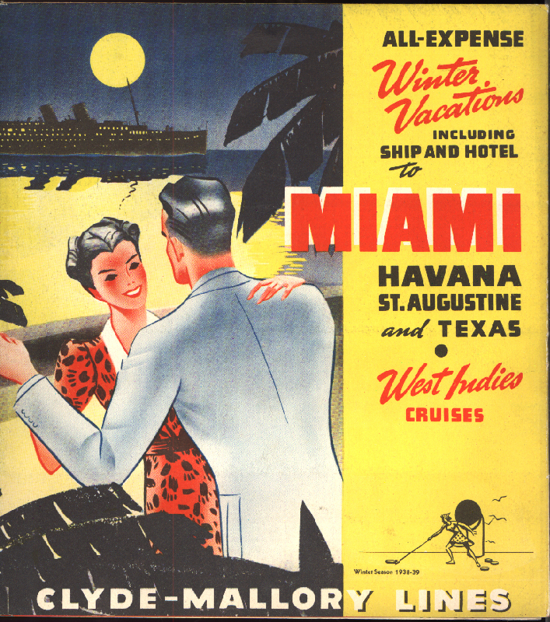
Case Study: Library as Cruise Ship Destination (FIU)
NEED: 9 million passengers rarely exposed to rich, diverse cultural resources such as Wolfsonian, Jewish Museum of Florida
PROPOSAL: Build itineraries & presentations for visitors to explore what Miami Beach holds for them
OUTCOMES: Ongoing partnerships with cruise lines, social networking opportunities, enriched travel experiences leading to broader support

Slide 59
Theme: Knowledge Base

Slide 60
STRATEGIC DIRECTION #3: DATA ALCHEMY

Slide 61
Open Data: “The New Oil”

Slide 62
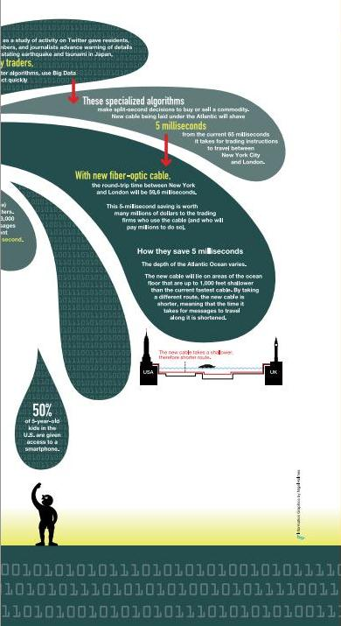
Some statistics, please…
Notes:
From the beginning of time until the year 2003, we humans created 5 exabytes of data (5 billion gigabytes). In the year 2011, we created that much data EVERY TWO DAYS. In other words, 90% of all the data in the world was created 2009-2011.
Again, from 2011, 10% of all the photos ever taken in history, were taken that year.
Every hour, we create enough internet traffic to fill 7 billion DVDs. (Every hour!)
The amount of data generated between 2012 and 2015 was expected to double.
Data is not generated only at the national or even state level. Look at all of the information being generated at the county or city level. By Universities and private enterprise that is sharing it on the web. Think about all the micro-level data being generated by drone photography. So we can imagine what this is like at the local level.

Slide 63
Infographics / Data Visualization

Slide 64
Case Study: California State Library Public Information Portal
NEED: State needs infrastructure for data, State Library has “information & knowledge sharing burned into its DNA”
PROPOSAL: Improve govt information access, boost civic awareness, spur community action via connection to state’s 1,182 public libraries
OUTCOMES: Revamped data.ca.gov site as data set clearinghouse in 2015, CalCloud in 2016

Slide 65
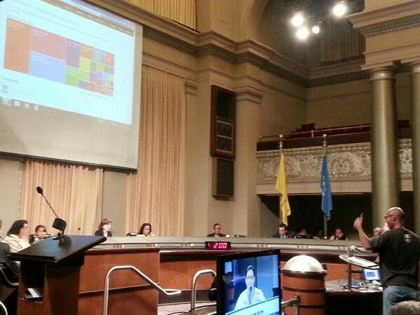
Case Study: Libraries as Labs for Open Government (Oakland, CA)
NEED: Increasing public data + less public penetration = underutilized & disengaged citizenry
PROPOSAL: Bring citizens of disparate neighborhoods together for technology applications for local govt
OUTCOMES: Future civic app design, local civic software incentives, informed/engaged population

Slide 66
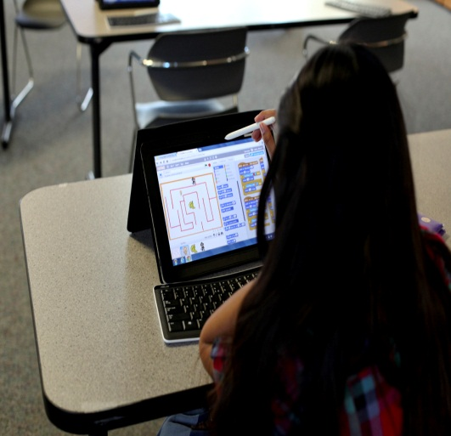
Case Study: National Library Coding League Challenge
NEED: Addresses STEM-related learning opportunities, inequities in gender. 68% of young Americans view PLs as playing important role in everyone succeeding
PROPOSAL: Librarians & Tech mentors facilitate group challenges around the country
OUTCOMES: Coding skills for teens, a national model

Slide 67
The Path Forward

Slide 68
New Paradigm Considerations

Slide 69
“Better Than Free”: 8 Generative Values Of Digitization

Slide 70
“Better Than Free”: 8 Generative Values Of Digitization

Slide 71
IMMEDIACY: The “Expectation Economy”

Slide 72
PERSONALIZATION: Delivery tailored to needs and proficiency of users

Slide 73
INTERPRETATION: Access to everything just as useless as access to nothing

Slide 74
AUTHENTICITY: Reinforcing perceptions of original, unaltered information
Notes:
Authenticity is another important value – reinforcing the perception that in this day and age of mash-ups, Photoshop and other types of edits, digitization allows users to “handle” true copies while we guard the unaltered originals for safekeeping.

Slide 75
ACCESSIBILITY: Elbowing our way into an increasingly agile and mobile world
Notes:
We need to elbow our way into an increasingly agile and mobile, but crowded, world.
We are competing for eyeballs in telling our story and promoting our value.
Multiple platforms are key to being where our users are, and I will be addressing more of this a little later. In the image here, you can see a “modern” streetcar headed for Century City – as proposed back in the early 1960s when Century City was being built.

Slide 76
FINDABILITY: Providing access means NOTHING if users cannot locate it
Notes:
But providing access means nothing if users cannot locate resources.
Findability is a different consideration than access – we need to address the ease with which users can locate material, not just access it.
(This image is the “before” and “after” images of one of the many bridge crossings over the Los Angeles River in March, 1938. Hard to imagine now during the drought, but L.A. got like 15 inches of rain in a few days. The heavy runoff washed out numerous Los Angeles Railway and Pacific Electric streetcar lines, leading to the “concretization” of the River to avoid future floods)

Slide 77
EMBODIMENT: Becoming a trusted source for and protector of resources
Notes:
Embodiment addresses our desire to further strengthen our reputation as a trusted source for information.
We protect not just individual resources, but collections and the overall heritage of the mobility agenda and transportation legacy of Southern California.
(What you’re looking at here is a recently discovered image of visitors atop Mt. Lowe, the railway east of Los Angeles that was one of the biggest tourist attractions in California in the early 1920s).

Slide 78
PATRONAGE: Keep them coming back for more
Notes:
And finally, we want to build on all of these values.
I believe that the only thing better than free is more of it. Nothing beats word of mouth marketing, so engaging our users and making them into our own most valuable boosters and referrers is in our in addressing the other values

Slide 79
New Promotional Opportunities

Slide 80
Los Angeles Historic Traffic Plans

Slide 81
Getty Museum: Overdrive

Slide 82
National Building Museum, Washington D.C.

Slide 83
How Can We Best Support Each Other?

Slide 84
Kenn Bicknell email: bicknellk@metro.net
www.metro.net/library
http://metroprimaryresources.info
Librarycat.metro.net
Kennbicknell.com
@StrategicLbries

