Slide 1
Twitter For Biz & New Social Media Strategies
Internet Librarian: C201
October 28, 2014
Kenn Bicknell
Digital Resources Librarian
Los Angeles County Metropolitan Transportation Authority

Slide 2
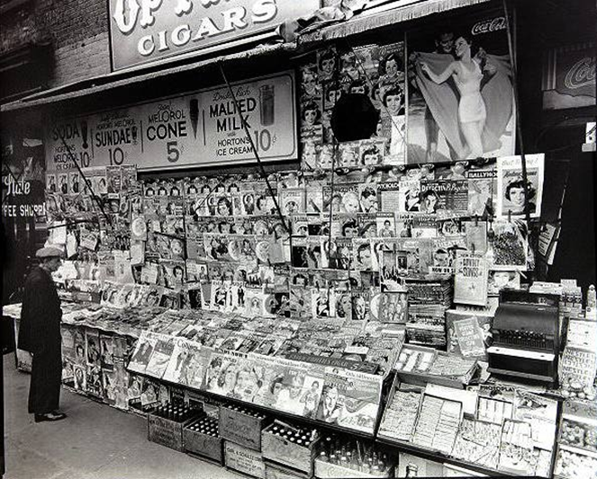
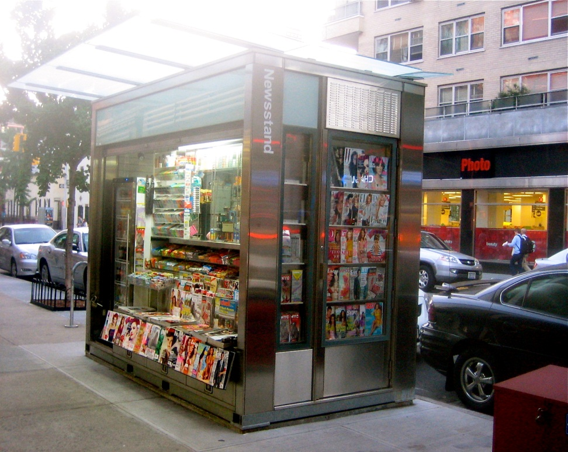
News Aggregation
Notes:
Let’s start with news aggegation and dissemination. Why would a library want to get involved in THIS?
As libraries strive to position themselves as not just RELEVANT, but VITAL, one strategic direction is to leverage the expertise of information professionals in GATHERING and PUSHING organizational or community news from a variety of sources into a must-read digest.
So what are we looking at here. On the left is a traditional newsstand, circa 1950s. On the RIGHT, a contemporary or “MODERN” newsstand. What’s MODERN is the HOUSING of the media, not the way TYPE of media, or the WAY in which the consumer accesses the information contained in it.
The consumer still has to make their choice based on past experience with a particular publication, or what they see on the cover (given that you aren’t supposed to stand there and read the entire publication).
The consumer has to TAKE THEIR CHANCES on what they find inside will be important or interesting to them.

Slide 3
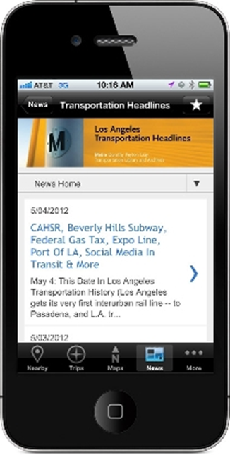
Aggregation
Notes:
We began aggregating transportation news way back in 2005. Our initial blogger platform is like the Stonehenge of transportation social media
This eventually evolved into a curated keyword list in Google Alerts. When Los Angeles County passed what is known as “Measure R” in 2008, a PERFECT STORM of converging factors slammed us in the face. More citizen advocacy, more attention being paid to multiple transit projects and proposals in a range of planning and construction, and more opportunity to inform people – OR GET IT WRONG
We had to evolve, and we had to go mobile as well. But alas, Google Alerts died off recently, so we had to go with another aggregator tool and began using Feedly
However, there are other models for getting what you need and what will work best for you and what you are trying to accomplish

Slide 4

Online Newspaper
Notes:
Metro Library identity
Collecting and disseminating disparate information on an interdisciplinary topic in a timely way.
Transportation is complicated
Los Angeles County is a complicated landscape
Local, state, federal realms all have their own complexities

Slide 5
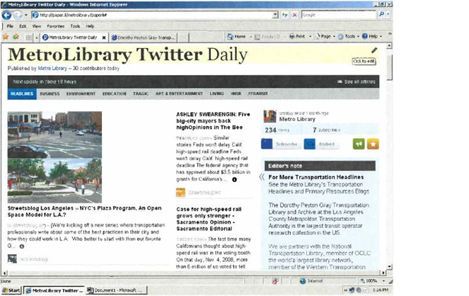
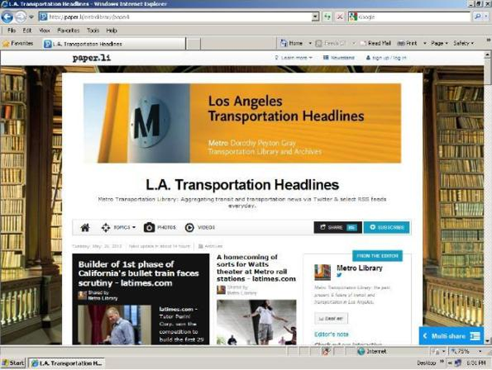
Creating Your Own Newspaper
Notes:
Over time, we realized that a growing list of 40-50 headines and links was neither sustainable in terms of labor involved 5 days a week, nor visually appealing for the reader.
We migrated our platform from a hands-on Blogger site to a the Paper.li online newspaper format. Paper.li takes Twitter feeds and publishes them daily or weekly as a “tweet digest.” It’s like the old informercial: “Just set it and forget it.” It publishes automatically with the frequency you choose.
But by gaming the system with curated twitter feeds and some crafty front-end customization, we got rid of clutter and began publishing our own customeized newspaper. On the left you see a screen shot of the “raw” rendering of the daily “Twitter” news, but on the right is the enhanced product, with a branded banner, more information about us in the box on the right, a nice background image, etc.

Slide 6
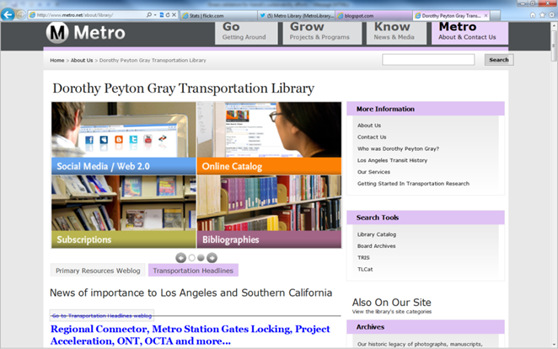
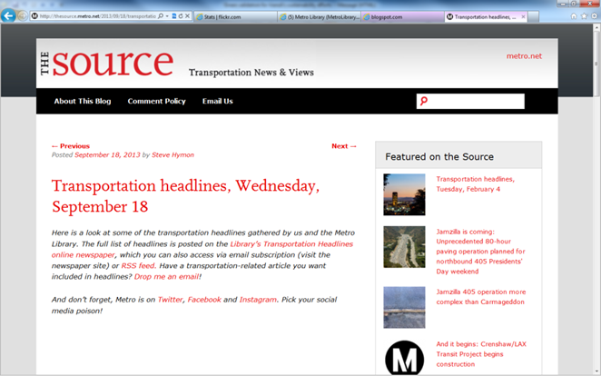
Featured Content Every Day
Notes:
Now, our Daily Transportation Headlines is a core Library service. On the left is a screenshot of our Library homepage. In the lower left you see how RSS feed brings the curated transportation news content into that prime real estate.
On the right is a screenshot for THE SOURCE, the primary online communication tool for the entire agency. Our transportation headlines are featured there also, with added commentary from other Departments, so we have internal and external customers, along with repurposing within our organization to supplement their messaging out to the community.
We have received national recognition for this effort, and when we have had to suspend publication of it for technical issues, BOY, do we hear about it from our subscribers. They PANIC and ask, “DID YOU STOP PUBLISHING THE HEADLINES?” It’s a great service to not only keep our users informed and save them time so they can focus on other things, but it also serves as a platform to promote some of our other products as well!
We are currently re-evaluting our platforms and the time and labor involved, but the product’s value CANNOT be denied.

Slide 7
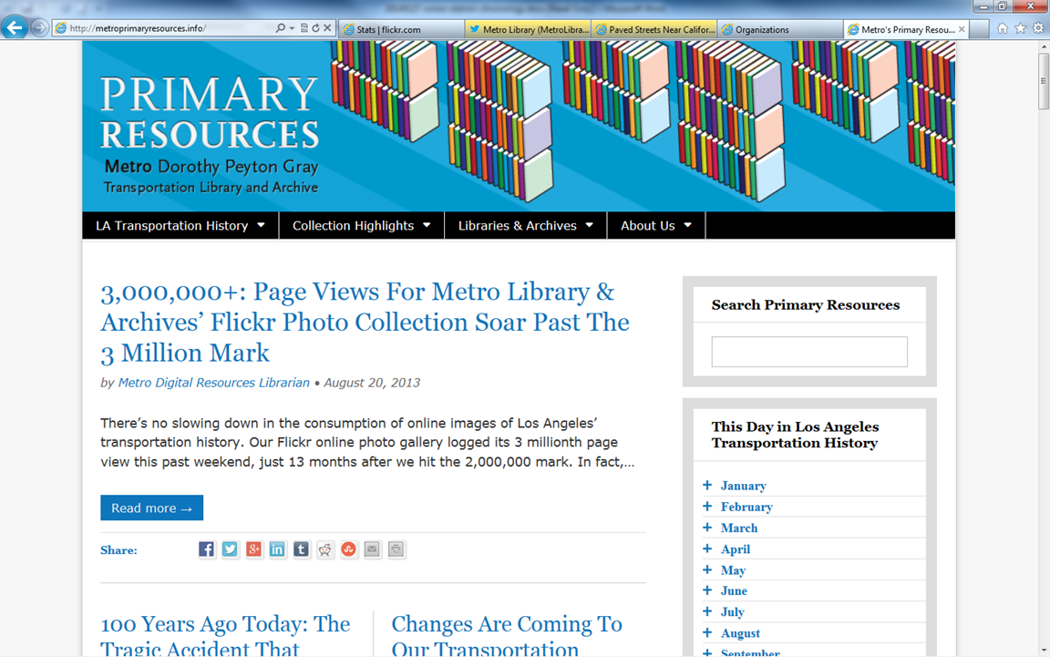
Online Calendar

Slide 8
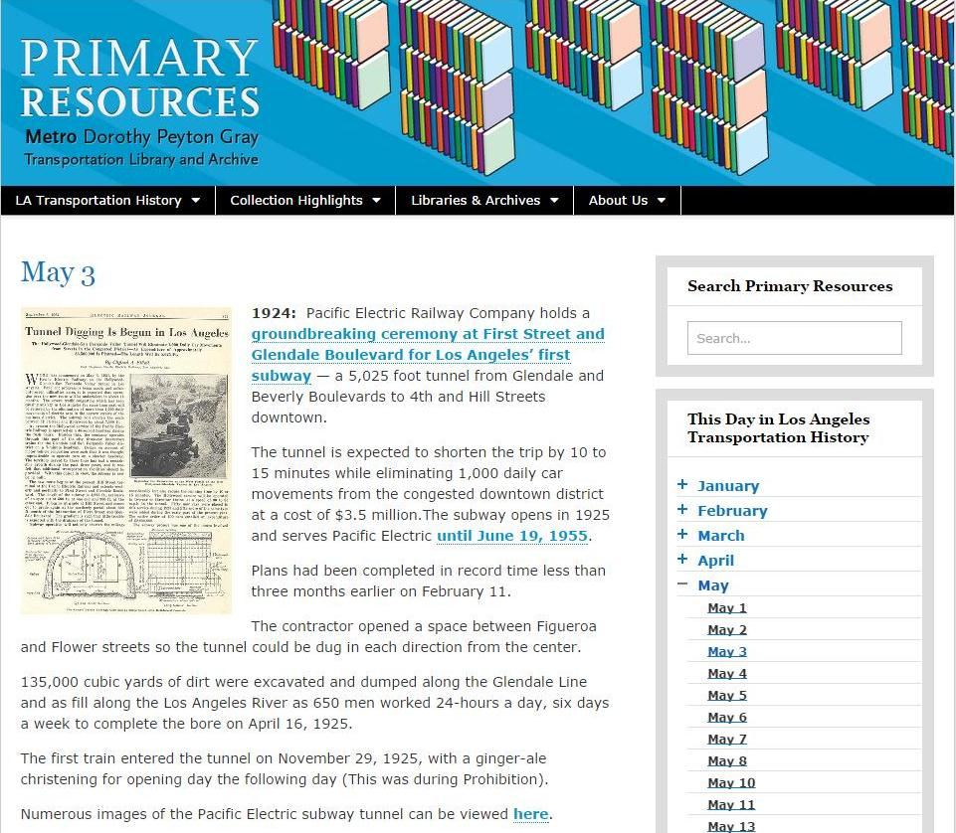
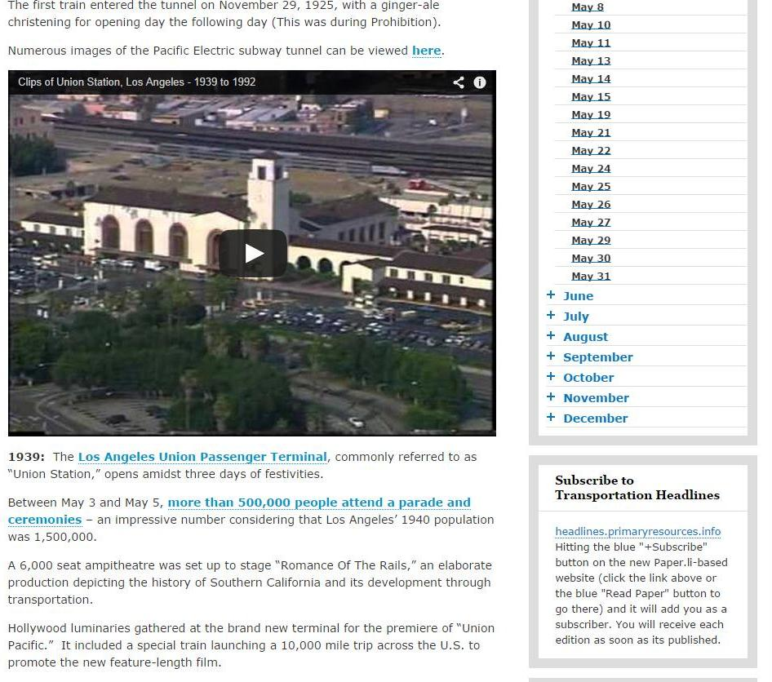
Sample Calendar Entries

Slide 9
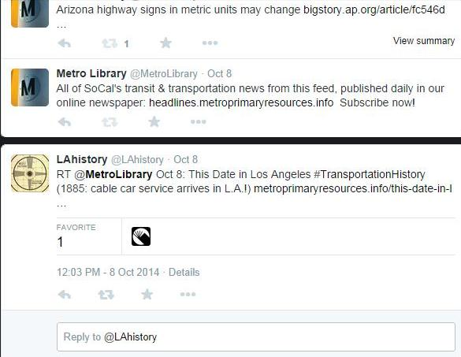
Local History Goes Viral

Slide 10
Kenn Bicknell
Digital Resources Librarian
Los Angeles County Metropolitan Transportation Authority
bicknellk@metro.net
http://www.metro.net/library
http://www.metroprimaryresources.info
Executive Committee Chair
LA as Subject
http://www.laassubject.org
Kennbicknell.com
Twitter: @StrategicLbries

