Slide 1
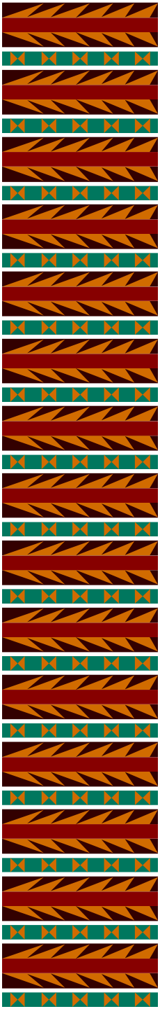
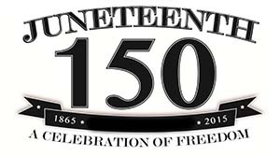

LACMTA
Celebrates Juneteenth!
African Americans in Transportation

Slide 2
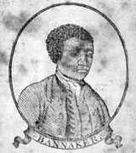
African Americans in Transportation
1791 Benjamin Banneker- Surveyor Washington DC
A portrait of Benjamin Banneker
on the cover of his Farmers Almanac - circa 1795
Benjamin Banneker reached national acclaim for his scientific work in the 1791 survey of the Federal Territory (now Washington, D.C.). In 1753, he built one of the first watches made in America, a wooden pocket watch.
Twenty years later, Thomas Jefferson commissioned Banneker to perform the surveying & mapping lay out of Washington D. C. after receiving a recommendation from George Elliot.

Slide 3
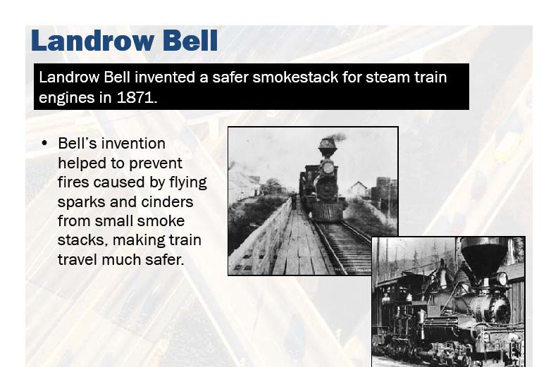
African Americans in Transportation
1871 Inventor- Rail Safety Devices

Slide 4
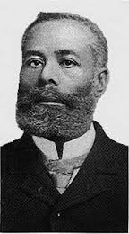
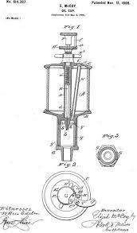
African Americans in Transportation
1844-1929 Elijah McCoy
Engineer & Inventor Rail Engine Lubricator
A mechanical engineer and inventor, McCoy’s high-quality inventions were the basis for the expression, “the real McCoy.”
1972, McCoy invents the steam engine lubricator, which automatically lubricates steam engines without having to shut them down. This saved time and effort in transportation and in industrial production.

Slide 5

African Americans in Transportation
1864-1922 Lewis Latimer
Patent and Electrical Lighting Engineer
Drafting and his creative genius led him to invent a method of making carbon filaments for the Maxim electric incandescent lamp.
1881, supervised the installation of the electric lights in New York, Philadelphia, Montreal, and London.
Lewis Latimer was the original draftsman for Thomas Edison (who he started working for in 1884) and as such was the star witness in Edison's infringement suits.
Latimer was the only African American member of the twenty-four "Edison Principles," Thomas Edison's engineering division of the Edison Company. He also co-authored a book on electricity, "Incandescent Electric Lighting: A Practical Description of the Edison System" (1890)

Slide 6
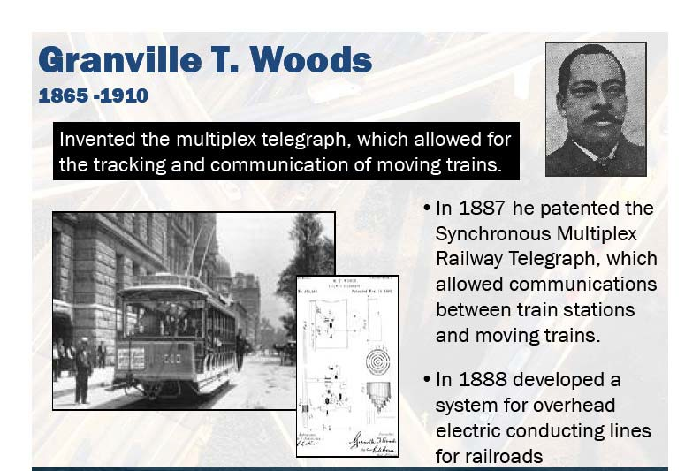
African Americans in Transportation
1865-1910 Inventor –Train Communications Systems

Slide 7
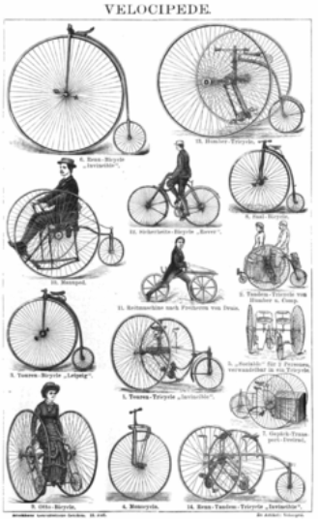
African Americans in Transportation
1886 Matthew A. Cherry
Tri Cycle & Street Car Fender
1st major device was a velocipede, consisting of a metal frame upon which were attached two or three wheels. This would evolve into a bicycle and tricycle.
Cherry also patented the street car fender on January 1, 1895 The fender acted as a shock absorber, thereby diminishing the force of the impact in the event of an accident.

Slide 8

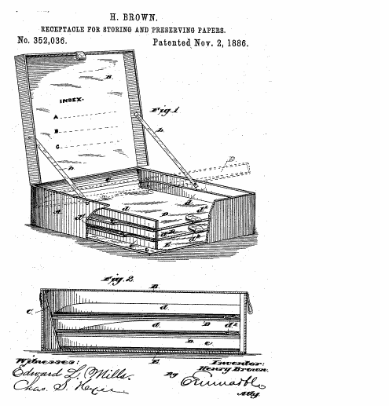
African Americans in Transportation
1886 Henry Brown – Fire Proof Box
Henry Brown patented a "receptacle for storing and preserving papers on November 2, 1886" This was a fire and accident safe container made of forged metal, which could be sealed with a lock and key. It was special in that it kept the papers separated. Perhaps an early forerunner to the filofax?

Slide 9
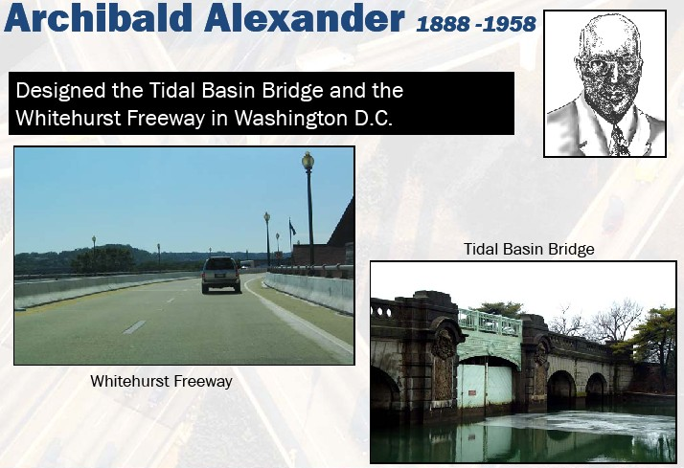
African Americans in Transportation
1888 Washington DC Designer- Planner

Slide 10
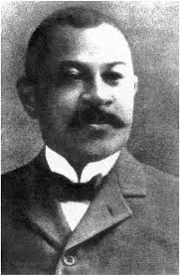
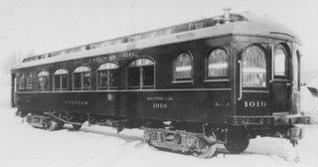
African Americans in Transportation
1893 Elbert R. Robinson
Creator of the Electric Railway Trolley
Sept. 19, 1893, Elbert R. Robinson received a patent for the electric highway trolley.
“Doc” Robinson also devised the flanged railway car wheel, an interlocking switch, and a track crossing, all useful on a system of street railways and steam trunk lines using steam or Diesel locomotives.

Slide 11

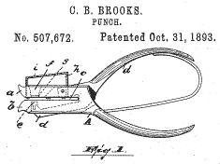
African Americans in Transportation
1896 Charles Brooks - Paper Punch
March 17, 1896, working on a street sweeper truck, Charles Brooks of Newark, New Jersey, he added interchangeable, revolving brushes to the front fender that could be used in the winter for snow removal.
Brooks also patented an early paper punch, also called a ticket punch. It was a ticket punch that had a built-in receptacle on one of the jars to collect the round pieces of waste paper and prevent littering.

Slide 12
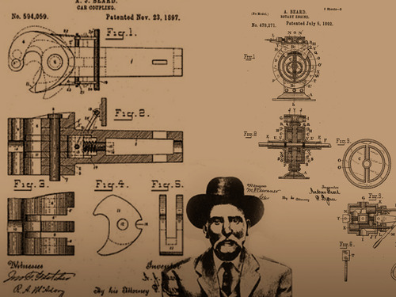
African Americans in Transportation
1849-1921 Andrew Beard - Inventor Rail Coupler
On November 27, 1897, Beard received a patent for the railroad car-coupler called the “Jenny Coupler.”
The “Jenny Coupler” automatically joined train cars by allowing them to bump into each other, eliminating the dangerous job of manually connecting train cars.
1892, Beard developed the rotary engine.

Slide 13
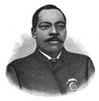
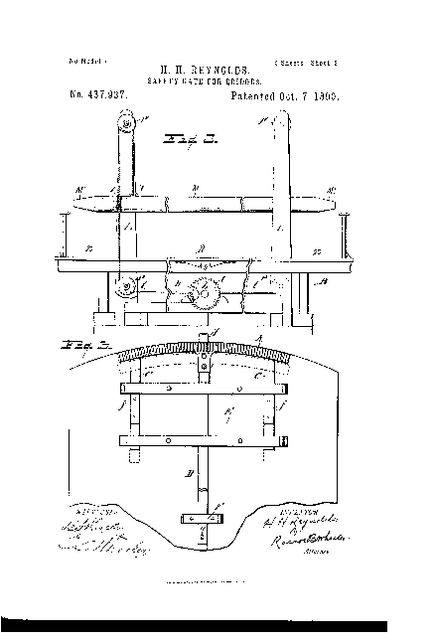
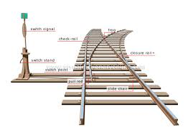
African Americans in Transportation
Late 19th Century – Railway Patents
1888, A.B. Blackburn patented a railway signal designed to be operated by the wheels of a train
1890, Humphrey Reynolds invented the safety gate for bridges to prevent cars and pedestrians from entering the tracks at the same time a train is approaching
1899, W.F. Burr invented a railway switching device

Slide 14
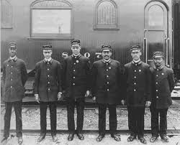
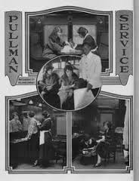
African Americans in Transportation
PULLMAN PORTERS
Pullman Porters were men hired to work on the railroads as porters on sleeping cars. Starting shortly after the American Civil War, George Pullman sought out former slaves to work on his sleeper cars.
Pullman Porters served American railroads for 100 years, from the late 1860s into the 20th Century.
Under the leadership of A. Philip Randolph, Pullman Porters formed the first African American union, the Brotherhood of Sleeping Car Porters, also becoming leaders in the Civil Rights movement.

Slide 15
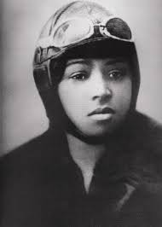
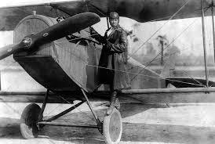
African Americans in Transportation
1892-1926 Bessie Coleman - Aerospace Pilot
First African American female pilot
Coleman earned her license on June 15, 1921 form the Federation Aeronautique Internationale
Taught other Black women to fly, gave lections and performed at flying exhibitions

Slide 16
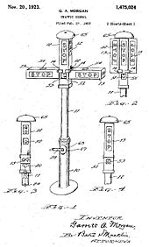
African Americans in Transportation
1875-1963 Garrett A. Morgan
Designer of the Automatic Traffic Signals
1923, After witnessing a serious accident at an intersection, Morgan designed a traffic control device that included a third position.
The signal Morgan patented was a T-shaped pole with three settings. At night, when traffic was light, it could be set at half-mast (like a blinking yellow light today), warning drivers to proceed carefully through the intersection. He sold the rights to his invention to General Electric for $40,000.

Slide 17
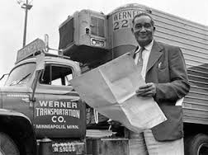
African Americans in Transportation
1893-1961 Frederick McKinley Jones
Transportation & Refrigeration
Jones was an American inventor, entrepreneur, winner of the National Medal of Technology, and inductee of the National Inventors Hall of Fame
1935, Jones designed a portable air-cooling unit for trucks carrying perishable food, and received a patent for it on July 12, 1940.
1940, co-founded Thermo-King Company, manufacturer of transport temperature control systems for trucks, trailers, shipboard containers and railway cars as well as HVAC systems for bus, shuttle and passenger rail applications.

Slide 18
African Americans in Transportation
H I G H W A Y S
1935 (WPA)
Works Progress Administration
B R I D E G E S
In 1935 President Theodore Roosevelt formed the Works Progress Administration which was later renamed the Work Projects Administration (WPA). This program helped provide economic relief to the all citizens of the United States who were suffering through the Great Depression. The depression, while imposing hardships of people of all races and ethnic
backgrounds, struck blacks particularly hard. The WPA came at a time of critical need for African-Americans. Jobs formed by the WPA included a variety of construction of bridges, highways, dams, hospitals, along with providing training and work in the clerical, professional and arts endeavors. By the time the program ended in February 1943, it had allocated
$11 billion dollars and employed more than 8 million people.
D A M S
The WPA not only hired African-Americans, its projects contributed to their well- being. WPA construction crews built and renovated hospitals, housing projects, schools, parks, playgrounds, and swimming pools in Black communities

Slide 19


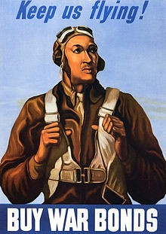
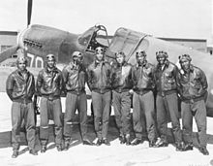
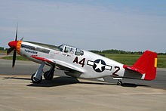
African Americans in Transportation
1940-1953 Tuskegee Airmen
The Tuskegee Airmen is the popular name of a group of African-American pilots who fought in World War II. Formally, they formed the 332nd Fighter Group and the 477th Bombardment Group of the United States Army Air Corps (United States Army Air Forces after 20 June 1941).
The Tuskegee Airmen were the first African-American military aviators in the United States armed forces. During World War II, African Americans in many U.S. states were still subject to the Jim Crow lawsThe American military was racially segregated, as was much of the federal government. The Tuskegee Airmen were subjected to racial discrimination, both within and outside the army. Despite these adversities, they trained and flew with distinction. All black military pilots who trained in the United States trained at Tuskegee, including five Haitians.

Slide 20
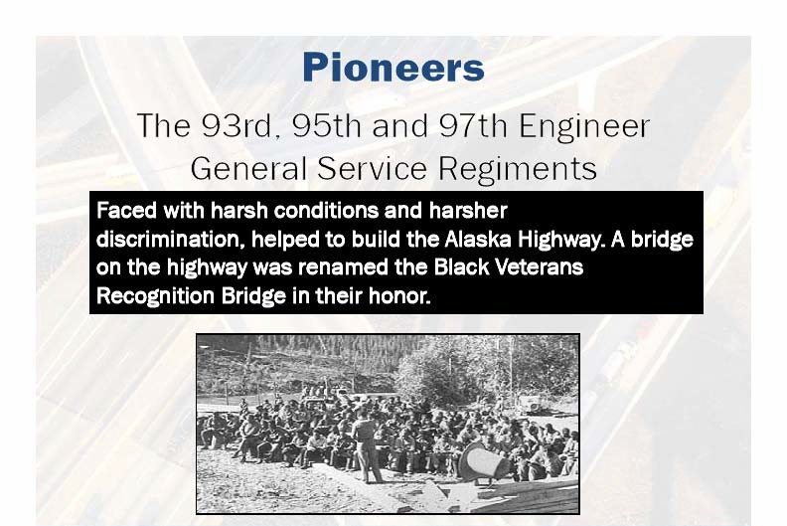
African Americans in Transportation
E N G I N E E E R S
1942 Alaska Highway
B U I L D E R S
President Franklin Roosevelt authorized the building of the Alaska Highway in February 1942 with black engineers and builders.

Slide 21
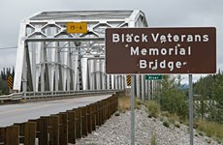
African Americans in Transportation
E N G I N E E E R S
B U I L D E R S
1942 Alaska Highway
Memorials for the veterans are scattered in spots throughout the highway, including the Black Veterans Memorial Bridge, dedicated in 1993.

Slide 22
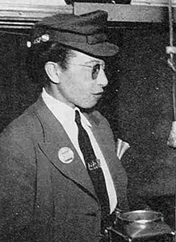
African Americans in Transportation
1944 Arcola Philpott
Los Angeles' First African American Motor Woman
In August of 1944, and without much fanfare, Los Angeles Railway hired its first African-American motorman, a motormanette,
Mrs. Arcola Philpott.

Slide 23
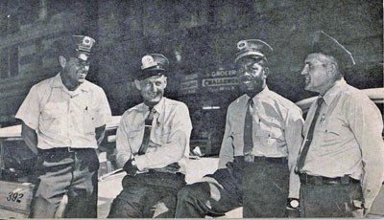
African Americans in Transportation
1945 Los Angeles' First African American Motormen
Los Angeles Railway initially hired 10 Black motormen who did not show up due to weather conditions. LA Railway then hired two more Black motormen who completed training but were never given assignments.
Nathaniel Lewis, third from left, with fellow operators in 1958.

Slide 24


African Americans in Transportation
1920-1982 Otis Boykin - Electrical Resistor
Boykin was born Otis Boykin was born on August 29, 1920, in Dallas, Texas. He graduated from Fisk College in 1941 and took a job with the Majestic Radio and TV Corporation.
Boykin is best known for inventing an improved electrical resistor used in computers, radios, television sets and a variety of electronic devices. His resistor helped reduce the cost of those products.
He also invented a variable resistor used in guided missile parts, a control unit for heart stimulators, a burglar-proof cash register and a chemical air filter.
In total, Otis Boykin patented 28 electronic devices

Slide 25


African Americans in Transportation
1958 Emmett W. Chappelle - Aerospace Engineer Designer
1958, Chappelle joined the Research Institute in Baltimore, a division of the Martin Marietta Corporation which was famous for designing airplanes and spacecraft.
While designing instruments for the Mars Viking spacecraft,. He also showed how satellites can monitor luminescence levels to monitor crops (growth rates, water conditions and harvest timing).

Slide 26
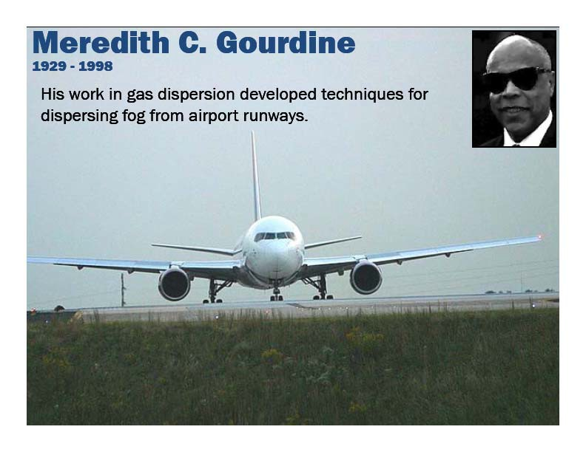
African Americans in Transportation
1929-1998 Meredith C. Gourdine
Engineer - Airport Runway Defogging Methodology

Slide 27
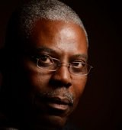
African Americans in Transportation
1950- Dr. Michel Molaire – Scientist & Inventor
Molaire is the holder of 58 American patents and 120 foreign patents.
Originally from Haiti, Molaire started working at Kodak in 1974, and is Senior Research Associate Chemist, a formulation and coating scientist. He is also a Principal for MOLAIRE CONSULTING LLC.
After receiving more than 20 patents, Molaire was inducted into Eastman Kodak’s Distinguished Inventor’s Gallery in 1994.
Invented an electrographic imaging process and materials useful for color filter array fabrication and xenographic master applications.

Slide 28
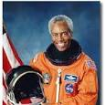
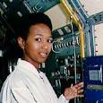
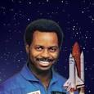
African Americans in Transportation
Black Astronauts
Guion Bluford (1942-), an engineer, NASA astronaut and the first African American to travel in space in 1983
Mae Jemison (1956-), a physician, NASA astronaut, and first African American woman to travel into space in 1992
Ronald McNair (1950-1986), was a physicist, NASA astronaut, died during the launch of the Space Shuttle Challenger in 1986

Slide 29
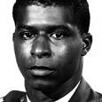
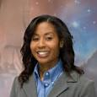
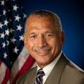
African Americans in Transportation
Black Astronauts
Robert Henry Lawrence, Jr. (1935-1967), was a U.S. Air Force officer and the first African American astronaut
Stephanie Wilson (1966-), an engineer and NASA astronaut. She flew her first mission in space on board the Space Shuttle mission STS-121, in 2006.
Charles Bolden (1946-), current administrator of NASA and a retired U.S. Marine Corps Major General
And many more not listed!

Slide 30
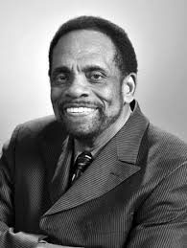
African Americans in Transportation
1940- George Edward Alcorn, Jr. - Aerospace Engineering
Alcorn received a four- year academic scholarship to Occidental College in Los Angeles, where he graduated with a Bachelor of Science in Physics. He received his degree with honors while earning eight letters in basketball and football.
Alcorn earned a Master of Science in Nuclear Physics in 1963 from Howard University, after nine months of study.
During the summers of 1962 and 1963, he worked as a research engineer for the Space Division of North America Rockwell. He was involved with the computer analysis of launch trajectories and orbital mechanics for Rockwell missiles, including the Titan I and II, Saturn IV, and the Nova.

Slide 31
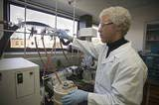
African Americans in Transportation
1994 Robert Bryant – Engineering
Aerospace, NASA's Langley Institute.
Chemical engineer, Doctor Robert G Bryant works for NASA's Langley Research Center and has patented numerous inventions.
LaRC-SILaRC-SI, Robert Bryant headed the team that invented Soluble Imide (LaRC-SI) the self-bonding thermoplastic that received an R&D 100 award for being one of the most significant new technical products of 1994. According to a NasaTech report LaRC-SI proved to be a moldable, soluble, strong, crack-resistant polymer that could withstand high temperatures and pressures, unlikely to burn, and was resistant to hydrocarbons, lubricants, antifreeze, hydraulic fluid, and detergents.
Applications for LaRC-SI have included use with mechanical parts, magnetic components, ceramics, adhesives, composites, flexible circuits, multilayer printed circuits, and coatings on fiber optics, wires, and metals.

Slide 32





African Americans in Transportation
2012 William Lark, Jr. - CityCar
William Lark, Jr., an African American PhD. Candidate at MIT, is the chief designer for the CityCar, a stackable small car that folds .
The cars, which are smaller than Smart Cars, are battery-electric, so they don’t cause tailpipe emissions. They also weigh less than a 1,000 pounds and are intended to “meet the demand for enclosed personal mobility.”
The two-passenger vehicle will be available for use around different cities and allow drivers to pick up and drop off the vehicle at different locations.

Slide 33

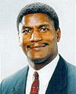
African Americans in Transportation
LEADERS
William Thaddeus Coleman
First African American U.S. Supreme Court Secretary. Became Secretary of Transportation in 1975 and served to 1977.
Rodney Slater
First African American Director of the Federal Highway Administration. Appointed Secretary of Transportation, from 1997 to 2001

Slide 34
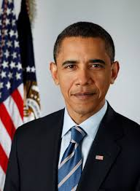
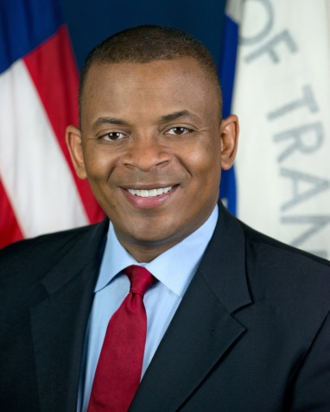
African Americans in Transportation
LEADERS
President Barak Obama
44th and current President of the United States, and the first African American to hold the office.
Anthony Foxx
Became Secretary of transportation on June 27, 2013. Serves as Charlotte, NC’s second African American Mayor and the youngest elected to that office at age 38

Slide 35

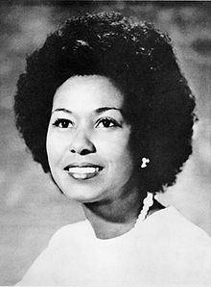
African Americans in Transportation
LA LEADERS – Yvonne Brathwaite Burke
1972-2008 Former MTA Board Chair Yvonne Brathwaite Burke
March 29, 2012, nominated by President Barack Obama to serve as Director of the Amtrak Board of Directors.
•1967-1972 California State Assemblymember, 63rd District
•1972-1978 California's First Black Congresswoman
•1979-1980 Los Angeles County Board of Supervisors 4th District
•1972-2008 Los Angeles County Board of Supervisors 2nd District

Slide 36

African Americans in Transportation
LA LEADERS
Nate Holden
•California State Senator 1974-1978 where he authored and co-authored more than 70 bills that became law.
•Los Angeles City Council (1987 to 2003).
•Chairman of the Air Quality and Waste Management Committee
•Chairman of the Transportation Committee.
•Chairman of the Inter-Government Relations Committee
•Vice-Chairman of the Public Safety Committee.
•Vice-Chairman of the Rapid Transit District (RTD)
•Public Utilities Transit and Energy Committee.
•Member of the LA County Transportation Committee (LACTC)
•Member of the LA Metropolitan Transit Authority (LAMTA).

Slide 37

African Americans in Transportation
LA LEADERS
1973-1993 Thomas “Tom” Bradley Mayor of Los Angeles, California – Five Terms
On January 29, 1993, former Los Angeles Mayor Tom Bradley stood among a swarm of public officials and transit agency staffers on the cramped Pershing Square subway platform. Standing shoulders above everyone else, including then-California Gov. Pete Wilson, Bradley proudly inaugurated the opening of the first modern subway in Los Angeles. “Twenty years is a long time. That’s how long we have been pushing on this dream, this vision of what we should do in Los Angeles County,” Bradley said, referring to the subway’s quixotic path to reality in ‘93. “I made a promise when I ran for mayor in 1973 that in 18 months, we’d deliver by breaking ground for rapid transit. Well, I missed by only a few months…”

Slide 38
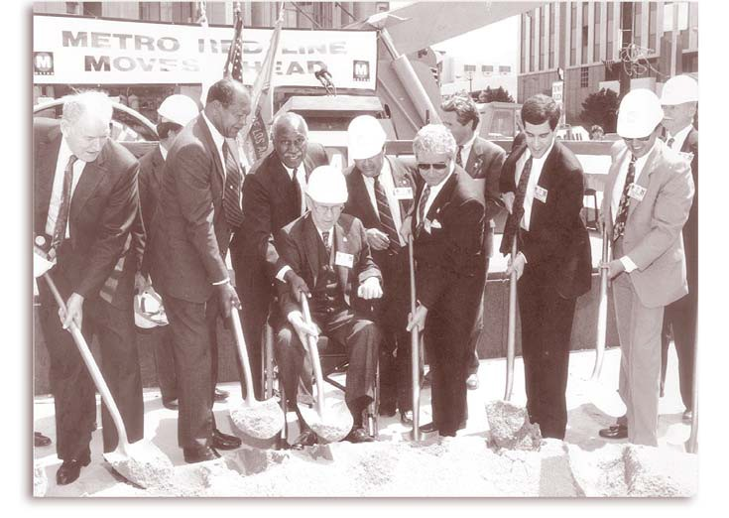
African Americans in Transportation
LA LEADERS
1996 - LA Mayor Tom Bradley & RTD Board Member Nate Holden
At 1st and Hill streets, participants at groundbreaking ceremony for Metro Red Line subway on Sept. 29, 1986 included LA Mayor Tom Bradley, LA City Councilmembers John Ferraro and Richard Alatorre, LA County Supervisor Kenneth Hahn, Southern California Rapid Transit District (RTD) Director Nick Patsaouras, RTD Board Member Nate Holden, RTD director of systems design and analysis Joel Sandberg, Los Angeles County Transportation (LACTC) Executive Director Neil Peterson and LACTC Commissioner Ray Grabinski.

Slide 39
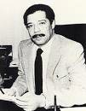
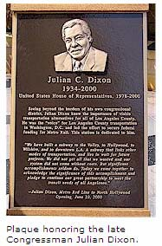
African Americans in Transportation
LA LEADERS - 1979-2000 U. S. Representative & Congressman Julian C. Dixon
“This special bronze plaque signifies the tremendous gratitude MTA and the region owe to Congressman Julian Dixon for the accomplishments he made in improving transportation for Los Angeles County. Not only a champion of rail, Congressman Dixon also helped secure funding to revamp MTA's bus service and provide funding for more than a dozen municipal bus operators in Los Angeles County."
-MTA Board Chairman John Fasana.
The 7th Street Metro Center Station, the junction of the Metro Red Line subway system and the Metro Blue Line light rail system, has been renamed the 7th Street/Metro Center/Julian Dixon Metro Rail Station to honor Congressman Dixon because it brings together two important rail lines. Dixon was 'The Voice' of Los Angeles County transportation in Washington, leading the effort to secure federal funding for Metro Rail and, together with the late Tom Bradley and Kenny Hahn, put together the combination of federal, state and local funding that established this critical component of Los Angeles' mass transit system," said Burke.
He was elected to the California State Assembly as a Democrat in 1972, and served in that body for three terms. Dixon was elected to the House of Representatives in 1978. He chaired the rules committee at the 1984 Democratic National Convention and the ethics probe into Speaker Jim Wright. Dixon won re-election to the 107th United States Congress, but died of a heart attack in December 2000.

Slide 40
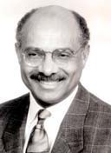
African Americans in Transportation
LA LEADERS – Franklin E. White
March 1, 1993-1995
Franklin E. White Chief Executive Officer Los Angeles County Metropolitan
Transit Authority
•Franklin E. White is named MTA’s first CEO on February 4 after the merger of Southern California Rapid Transit District (RTD) & Los Angeles County Transportation (LACTC). MTA officially takes over policy-making, bus and rail operations and construction on April 1. 1993. MTA adopts $3.4 billion budget, the agency’s first spending plan. A total of 246 positions and 21 vacancies are eliminated during the merger.
•First Black METRO CEO
Mr. White had served in 1985 as commissioner of the New York State Department of Transportation.
Franklin White

Slide 41
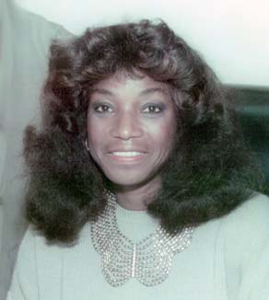
African Americans in Transportation
LA LEADERS – Leilia Bailey-Leahy
1987-1991 First African American Women Director Southern California Rapid Transit District (RTD)
Leilia Bailey-Leahy started her transportation career in July, 1971 as an Operator for the Southern California Rapid Transit District (RTD)
She worked at Division 5 (now known as the Arthur Winston Division) for a number of years.
Bailey-Leahy served as Assistant Director of Transportation (1986 to 1987) before becoming Director of Transportation (1987 to 1991).

Slide 42

African Americans in Transportation
LA LEADERS – Herb J. Wesson Jr.
President of Los Angeles City Council Member, since 2012
  District boundaries include the Crenshaw District & Lemert Park, historically Black neighborhood.
  Integral to Exposition Metro Line Construction
Member of the Los Angeles City Council, 2005
Chair of the Arts, Parks and Neighborhoods Committee
Chairs the Rules and Elections Committee.
  Member of the Housing, Community and Economic Development (HCED)
65th Speaker of the California State Assembly, 2002-2004
Member of the California State Assembly, 47th District, 1998-2004
Chief of Staff to 2nd District Supervisor Yvonne Burke
Chief of Staff to former 10th District Councilmember Nate Holden

Slide 43
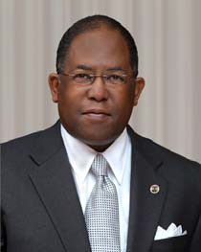
African Americans in Transportation
LA LEADERS – Mark Ridley-Thomas
2013- MARK RIDLEY-THOMAS,
Los Angeles County Board of Supervisors Supervisor District 2nd
MRT vision to connect the Crenshaw public transit rail line to the airport. “This would link airport terminals to Metro’s Crenshaw and Green lines with an “automated people mover” similar to those used in airports such as San Francisco and Newark, New Jersey. “The Crenshaw rail line is scheduled to open in 2019”
•2008 –Present Los Angeles County Board of Supervisors
•2006-2008 California State Assemblymember, 26th District
•2002-2006 California State Assemblymember, 48th District
•1991-2002 Los Angeles City Council
•1972-1978 California State Assembleman

Slide 44










African Americans in Transportation
April 23, 1998 LA METRO Rosa Parks Station
BOARD RENAMES METRO RAIL STATION IN HONOR OF ROSA PARKS, MOTHER OF THE MODERN DAY CIVIL RIGHTS.
Parks' refusal to give up her seat on a Montgomery, Alabama bus in1955 was a milestone in the modern day civil rights movement. "Rosa Parks is clearly a symbol of civil rights in the 20th Century, said Los Angeles Mayor and MTA Board Chairman Richard J. Riordan. "We are honored to recognize her contributions to American history in this public way. I hope MTA's passengers will recall her actions when passing through the Rosa Parks Station. Parks was arrested as the result of her quiet protest. Her defiance touched off a wave of other non- violent civil rights demonstrations throughout the South and the rest of country, and led to a boycott of Montgomery's city bus system which lasted 381 days. The renaming follows a celebration on March 20, 1998 when officials unveiled an artist's rendering of a bronze plaque to be installed at the station in Parks' honor.

Slide 45

Other Black Transportation Inventors

Slide 46

Other Black Transportation Inventors

Slide 47
African Americans in Transportation
 | June 19, 2015 Black History Month Celebration METRO (A.A.E.A )African American Employees Association

