Slide 1
COMMUNITY CURATION, NEWS AGGREGATION & “DATA ALCHEMY”:
The Bleeding Edge of Library Opportunity
Texas Library Association
March 24, 2015
Kenn Bicknell
Digital Resources Librarian
Los Angeles County Metropolitan Transportation Authority
Notes:
Thank you, Ted! It’s a pleasure to be a part of this exciting day. I am so impressed with the Texas Library Association and its ongoing commitment to profession development that it is my pleasure to speak to you about three very exciting strategic directions that everyone can consider for their library. Each of these propositions is scalable, so they offer food for thought for just about everyone. I hope we have time for some Q & A at the end, and beyond that you are welcome to email me for more information regarding the examples coming up.
So, in preparing for this talk, I wanted to combine a sort of 30,000 foot overview of what I see as some exciting directions with some real world, practical stuff.
While some thought leaders in libraries focus on EMERGING TRENDS or LIBRARY FUTURES, I’m focused much more on what you can begin to do RIGHT NOW to engage your users – and your POTENTIAL users as well.
So today, I am going to identify three opportunities for you, and look at strategies to consider SEIZING them as well. More on those in just a minute! I do tend to speak quickly, so please forgive me if I sound rushed – you will have access to this presentation and all the links afterwards, and I just want to be sure I have time to cover everything.
OK, let’s get started…

Slide 2
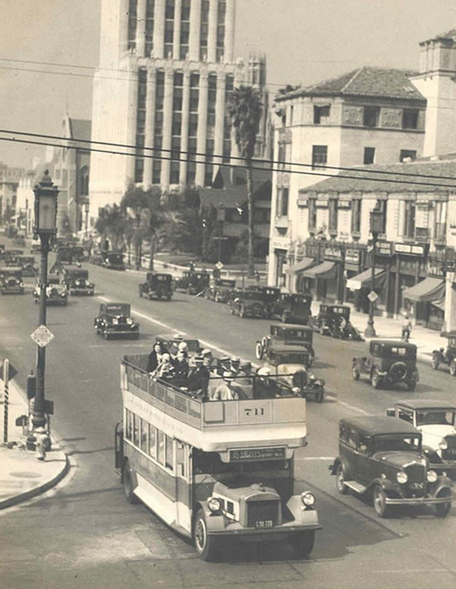
Who Am I?
About The Metro Library
Notes:
The Metro Transportation Library is rather unique.
We are the most comprehensive transit-operator-owned transportation libraries in the United States, and the only multimodal transportation library in Southern California.
We serve over 9,000 employees, plus contractors, consultants, educators, students, the media, documentary film makers, transit enthusiasts, history nerds, and our colleagues in transit and transportation throughout the world.
(I will be using various historic images from our collection to spruce up some of these slides. This image is of a 1920s open-air double-decker bus on Wilshire Boulevard. Not only are the buses great to share, but so is the story of why streetcars were never built on Wilshire – it was full of mansions way back when and wealthy citizens had it written into the city code, and it remains to this day. You can read that story on our blog later)

Slide 3
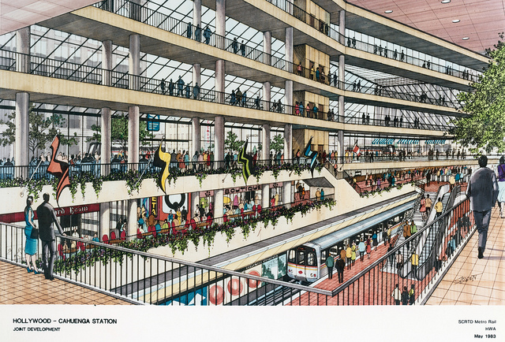
Collections & Services Overview
Notes:
We do this with a collection of more than 250,000 items in our Library & Archive. A recent analysis of our holdings in WorldCat showed that 41% of our collection was unique to us and found nowhere else – a rather high percentage given its size.
Anyone studying Los Angeles cannot ignore a few essential defining elements: the role of water, the film industry, and transportation. The city that people most associate with the automobile (and traffic) had the largest streetcar system in the entire world in the 1920s. So what happened? That story, along with many others, is what we attempt to address with our service. Los Angeles is studied around the world, not just as a subject, but as an archetype for a diverse, international city. Loosely defined, Los Angeles is made up of 10 million people speaking well over 100 languages. It means a lot of different things to a lot of different people, and we now have the most ambitious mobility agenda of any city in the world, so there is a great demand for transportation history, civic information related to this interdisciplinary subject, and someone to provide the context for the role of transit and transportation today.
This is a 1983 rendering of a proposed rail station that was never built, it had to be moved for a very interesting reason – you will have to ask me why later!

Slide 4
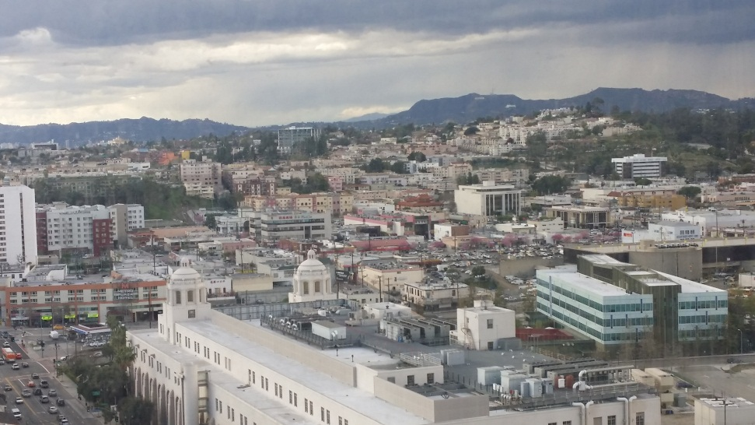
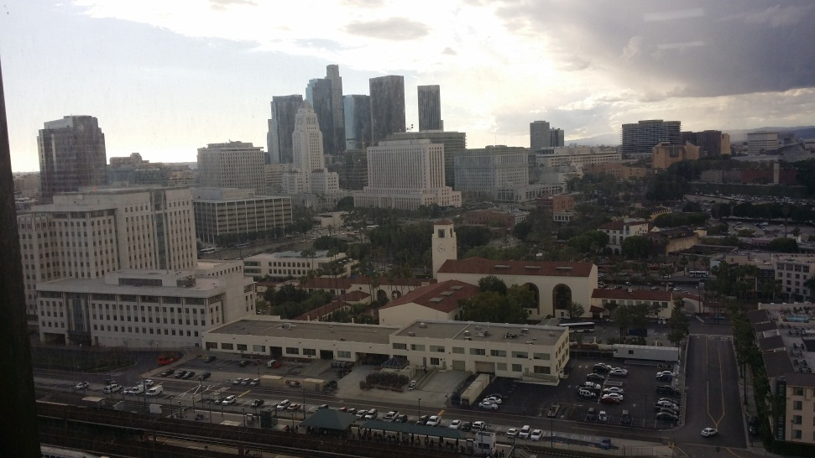
Challenges Breed Opportunities
Notes:
So we attempt to serve that very broad and disparate audience from the 15th floor of a building in downtown Los Angeles – not the most accessible place for the public.
And oh yes, we do it all with just 1.5 Librarians. I’m ONE, and my Library Administrator is the .5 (He also oversees Records Management, which takes him away from the Library half of his time).
Obviously, the traditional service model does not work. By the way, here is what I am looking at outside the window right now, so if it sounds like a heavy workload, at least I have an incredibly inspiring view. In the photo on the left you can see the Hollywood Sign and famous Griffith Observatory, and out the other window is our iconic Union Station in the foreground of the downtown skyline.

Slide 5
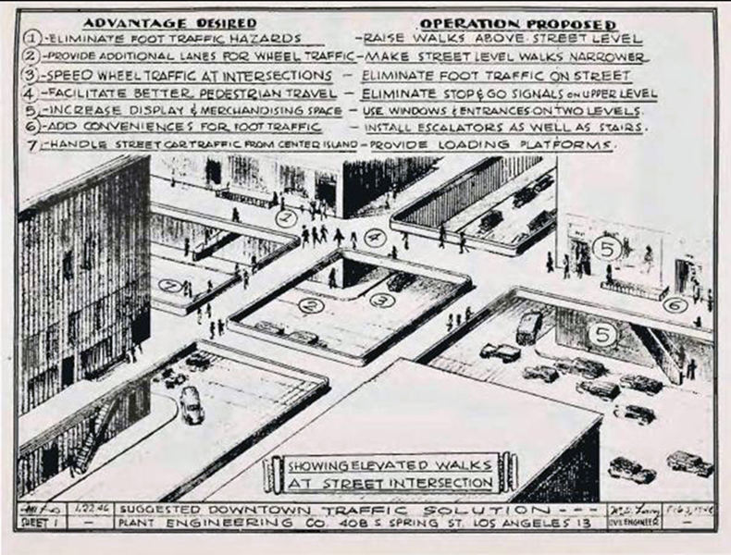
The Perfect Storm
Drives Innovation
Notes:
I could do an entire presentation about the collection and its history, but I want to talk to you about meeting the challenge of outreach through innovation despite being resource-challenged. In the downturn of 2008, our Library took a 57% budget cut – yet we managed to come back swinging more successfully than ever, and here’s how.
(This image is from a 1946 report from a steel manufacturer that proposed removing all the sidewalks from downtown Los Angeles to make more room for cars. Long fascinating story, but clearly this never ended up happening!)

Slide 6
ENGAGEMENT STRATEGIES
NEWS AGGREGATION & DISSEMINATION
COMMUNITY CURATION
DIGITAL DATA ALCHEMY
Notes:
For the purposes of this talk, I have identified THREE of those STRATEGIC DIRECTIONS as roles that you may want to investigate further:
They are:
News aggregation and dissemination
Community curation
And what I refer to as Digital Data Alcheny

Slide 7
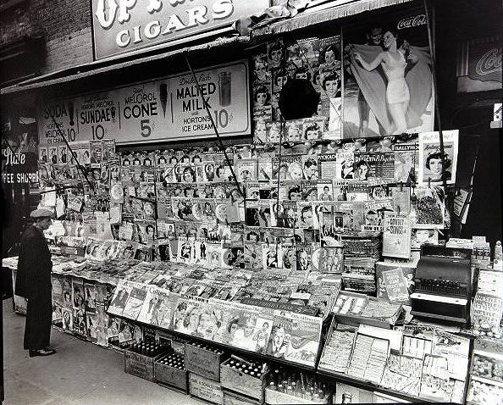
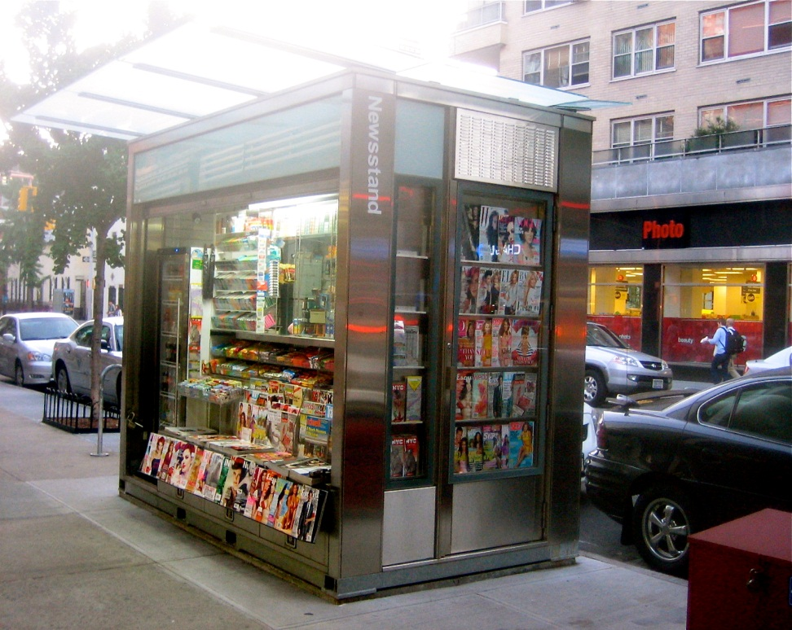
STRATEGIC DIRECTION #1:
NEWS AGGREGATION & DISSEMINATION
Notes:
Let’s start with news aggregation and dissemination. Why would a library want to get involved in THIS?
As libraries strive to position themselves in an increasingly technological world as not just RELEVANT, but VITAL, one strategic direction is to leverage our expertise as information professionals in GATHERING and PUSHING organizational or community news from a variety of sources into a must-read digest.
So what are we looking at here. On the left is a traditional newsstand, circa 1950s. On the RIGHT, a contemporary or “MODERN” newsstand. What’s so MODERN about it? The HOUSING of the structure holding the media, not the TYPE of media, or the WAY in which the consumer accesses the information contained IN IT.
The consumer still has to make their choice based on past experience with a particular publication, or what they see on the cover (given that you aren’t supposed to stand there and read the entire publication).
The consumer has to TAKE THEIR CHANCES on what they find inside will be important or interesting to them. And with broadcast news, it’s whatever fits into a pre-determined time period.
But new tools allow libraries to BREAK DOWN those restrictions. This isn’t about replacing news sources – or even newsstands – it’s ABOUT CONTRIBUTING TO THE QUALITY OF LIFE OF THE USERS. Aggregating news and information helps them do their jobs or live their lives better without the DISTRACTION FROM, or LABOR OF finding information they want…need…or even don’t realize they need.

Slide 8
Our Changing
News Consumption
Growth in online news easy to disseminate
Growth in ways information can be repurposed & shared
Growth in hyper-local citizen journalism
24/7 access to news and round-the-clock news cycle
Users welcoming valuable knowledge amidst info-glut
Notes:
Many factors contribute to how news today is generated, published, disseminated, consumed and shared. In many ways, the radical changes to news and journalism mirror the rapid evolution of libraries in recent years.
Libraries used to be the gatekeepers of information, where you went when you were seeking access to information. NOW, people have all the access they want in certain ways, and it is FINDABILITY they crave. Anyone who has done a Google search, no matter how specific, and gotten 10 million search results knows what I mean.
So our users appreciate the library as an intermediary in providing quality information in a timely manner.

Slide 9
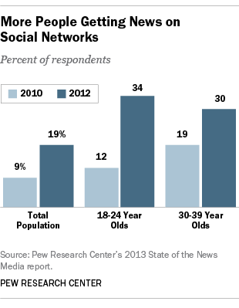
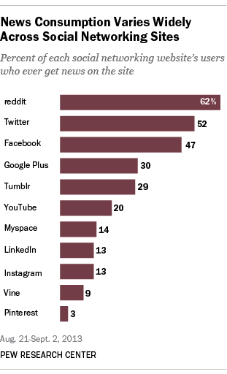
Where they are looking for information
Notes:
We do this in response to what people are asking for, but can we serve them in ways they need when they are NOT asking?
Sure. Let’s take a look at how news consumption has evolved – you can see in the chart on the left that news intake via social media has grown remarkably in just a couple of years (and these charts are already a couple of years out of date, but you get the idea). In the chart on the right, we see that Twitter and Facebook are near the top of the list for social media sites feeding news consumption.

Slide 10
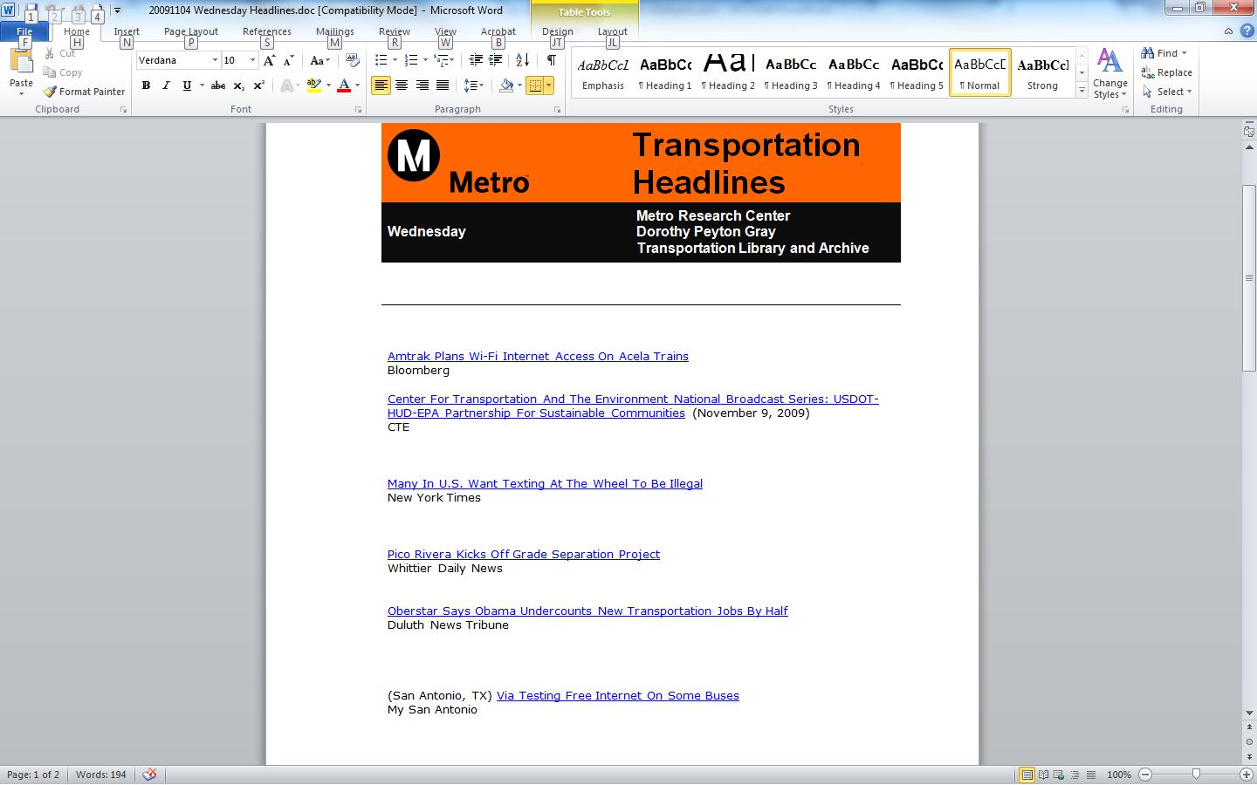
Blogger Headlines Product
Notes:
Because transportation is such a complex, interdisciplinary subject area, the Metro Library dipped its toe in the social media ocean by blogging way back in 2005. That is like the Stonehenge of the social media era – 10 years ago this Fall.
My colleague knew that he could pull together news stories that would be of interest and benefit to our urban planners – stories that would have taken them a very long time to find even if they knew where to look. So each day, he published half a dozen stories from print and televised media regarding what was happening with transportation in Los Angeles.

Slide 11
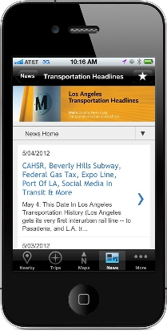
Aggregation & Mobile Access
Notes:
This eventually evolved into a curated keyword list in Google Alerts. When Los Angeles County passed what is known as “Measure R” in 2008, a PERFECT STORM of converging factors literally SLAMMED us in the face. This legislation increased the sales tax one half of one percent to raise $40 BILLION over the next 30 years to build out the proposed transportation system in Los Angeles County. Sales tax measures require a 2/3 vote, so the 68% approval of the measure was really an achievement.
More citizen advocacy, more attention being paid to multiple transit projects and proposals in a range of planning and construction, and more opportunity to inform people – OR GET IT WRONG…
We had to evolve, and we had to go mobile as well. But alas, Google Alerts died off recently, so we had to go with another aggregator tool and began using Feedly
However, there are other models for getting what you need and what will work best for you and what you are trying to accomplish

Slide 12

Online Newspaper:
The Library as News Channel
Notes:
The process evolved into our Library becoming a veritable news source. Not only were we aggregating 50 or more stories each day, we were finding ourselves with thousands of subscribers, including many local and state political figures, as well as our lobbyists in Sacramento and Washington.
We had created a service, and a demand for, information that nobody asked us to do, but which has since become indispensable.
Our users appreciate this, because:
We collect and disseminate disparate information on an interdisciplinary topic in a timely way.
Transportation is complicated
Los Angeles County is a complicated landscape, as I mentioned, and
The local, state, and federal realms all have their own complexities – for example, there are 87 other cities in Los Angeles County alone, besides the City of Los Angeles

Slide 13
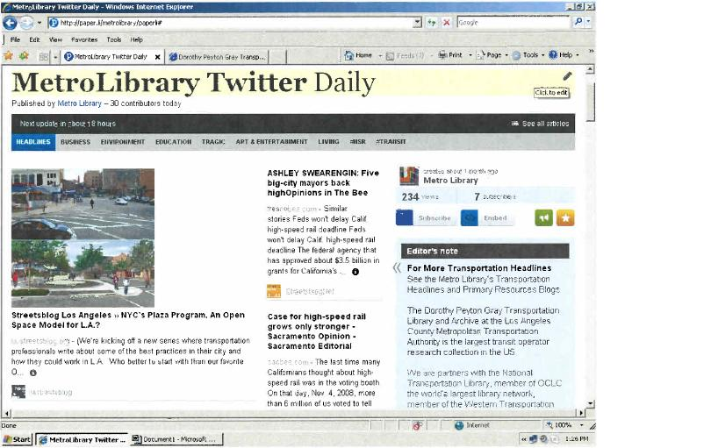
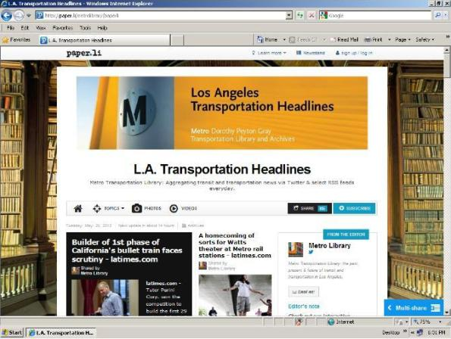
Creating Your Own Newspaper
Notes:
Over time, we realized that a growing list of 50-60 headines and links every single workday was neither sustainable in terms of labor, nor visually appealing for the reader.
We migrated our platform from a hands-on Blogger site to a the Paper.li online newspaper format. Paper.li takes Twitter feeds and publishes them daily or weekly as a “tweet digest.” It’s like the old informercial: “Just set it and forget it.” It publishes automatically with the frequency you choose.
But by gaming the system with curated twitter feeds and some crafty front-end customization, we got rid of clutter and began publishing our own customeized newspaper. On the left you see a screen shot of the “raw” rendering of the daily “Twitter” news, but on the right is the enhanced product, with a branded banner, more information about us in the box on the right, a nice background image, etc.

Slide 14
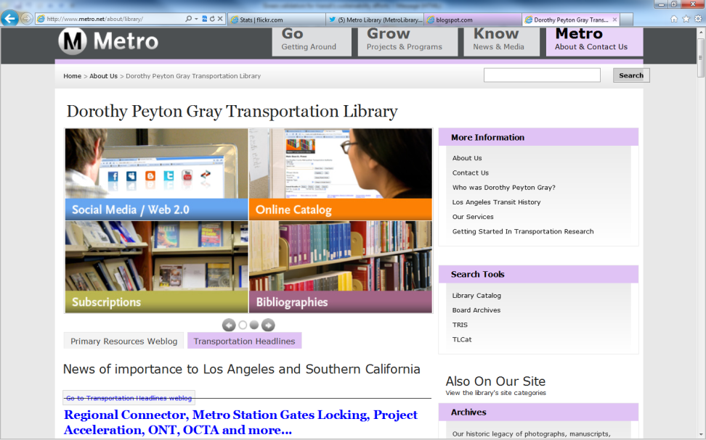
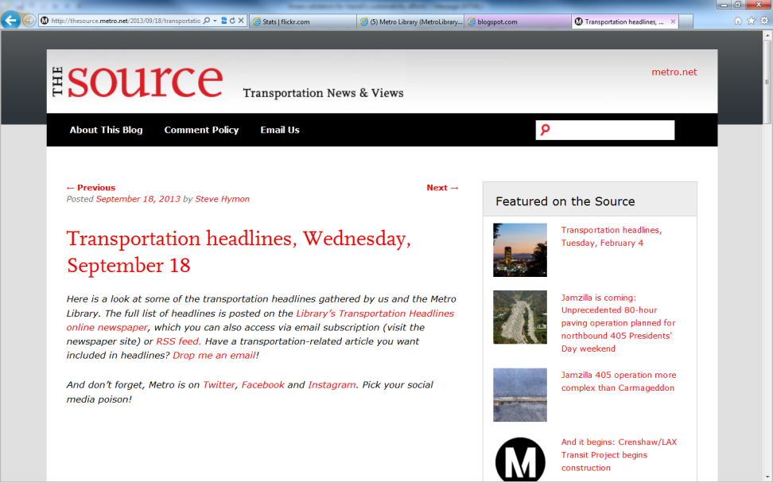
Featured Content Every Day
Notes:
Now, our Daily Transportation Headlines is a core Library service. On the left is a screenshot of our Library homepage. In the lower left you see how RSS feed brings the curated transportation news content into that prime real estate.
On the right is a screenshot for THE SOURCE, the primary online communication tool for the entire agency. Our transportation headlines are featured there also, with added commentary from other Departments, so we have internal and external customers, along with repurposing within our organization to supplement their messaging out to the community.
We have received national recognition for this effort, and when we have had to suspend publication of it for technical issues, BOY, do we hear about it from our subscribers. They PANIC and ask, “DID YOU STOP PUBLISHING THE HEADLINES?” “Are you OK?” “Are you in the hospital or something?”
It’s a great service to not only keep our users informed and save them time so they can focus on other things, but it also serves as a platform to promote some of our other products as well!

Slide 15
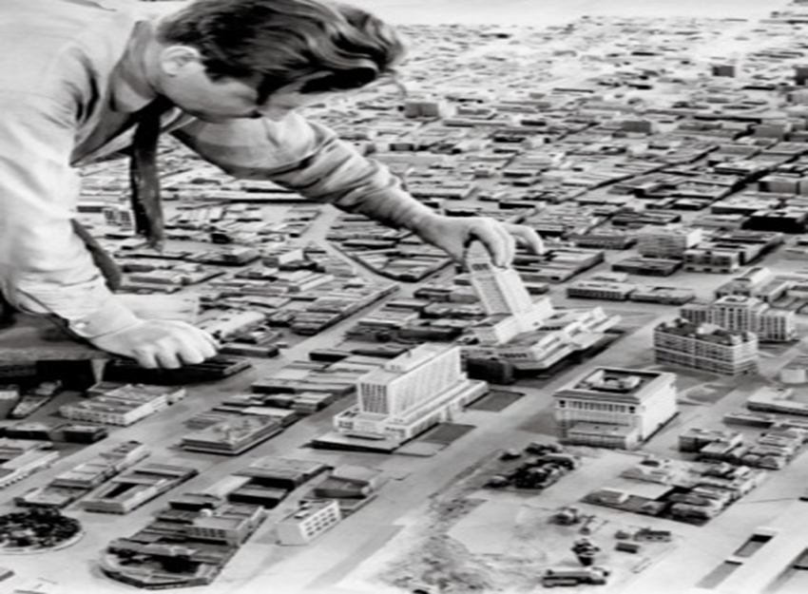
STRATEGIC DIRECTION #2:
COMMUNITY CURATION
Notes:
The second strategic direction I want to share with you is what I call “COMMUNITY CURATION.”
Basically, this involves a number of directions you can pursue to both build community AND get them to share some of your hard work for you. You DON’T have to do it all by yourself! But some strategic legwork up front will position you to get some great results.

Slide 16
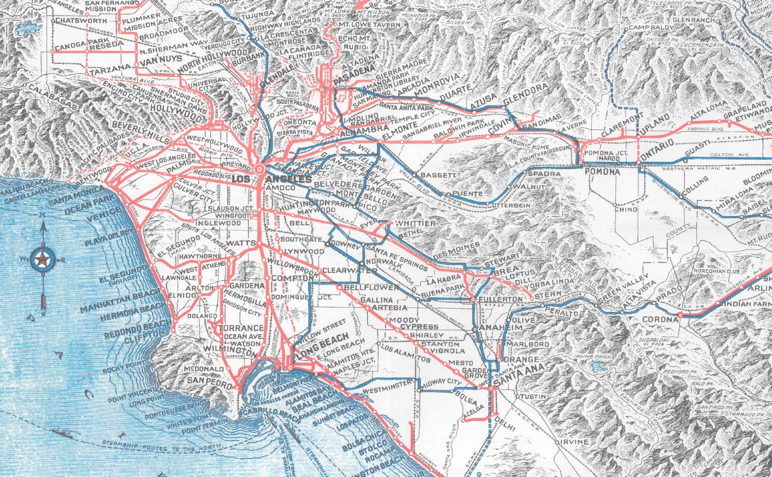
Theme:
Local History Advocacy
Notes:
The first theme in this Strategic Direction is local history advocacy. I love history. I imagine most librarians do. In a time of public libraries being increasingly similar with centralized collection development and universal borrowing – it is worthwhile to take a look at what really sets your library apart from others.
One of those things is your own unique local history.
We now have amazing tools and resources at our disposal to amplify the importance of those histories and celebrate everything associated with them.

Slide 17
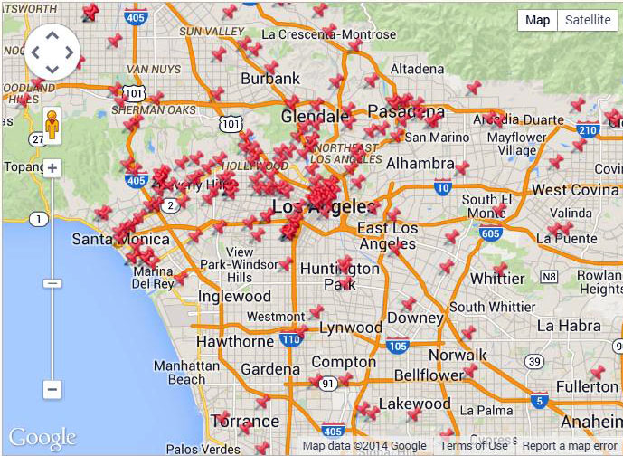
L.A. as Subject
Notes:
One way to do that is through collaboration.
Two decades ago, the Getty Museum here in Los Angeles began a project to identify the “less-visible” collections in Southern California which focused on the history and culture of the region. Over time, this evolved into a network of libraries, archives, museums, historical societies and other organizations sharing best practices on preservation, resource sharing and other issues.
Many of these collections are very very small, but a rising tide lifts all boats, and together we have achieved some wonderful things.

Slide 18
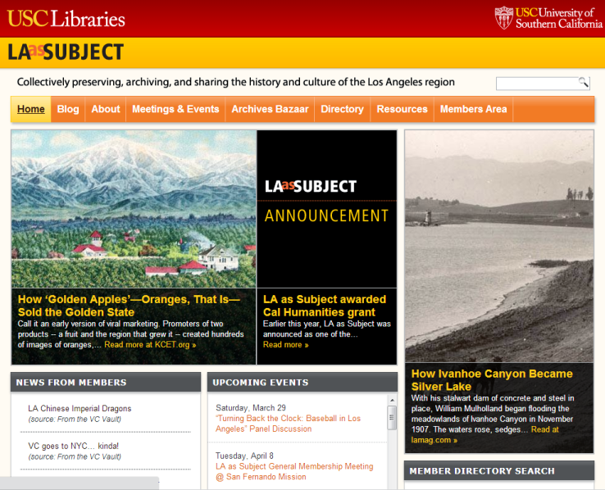
L.A. as Subject
Notes:
By banding together, we promote our shared history, along with research and activities being pursued by the institutions involved. LA as Subject members have benefitted from grant funding and professional help that they would never have otherwise received on their own.
There’s no reason that any other region in a state anywhere could not do the same thing.

Slide 19
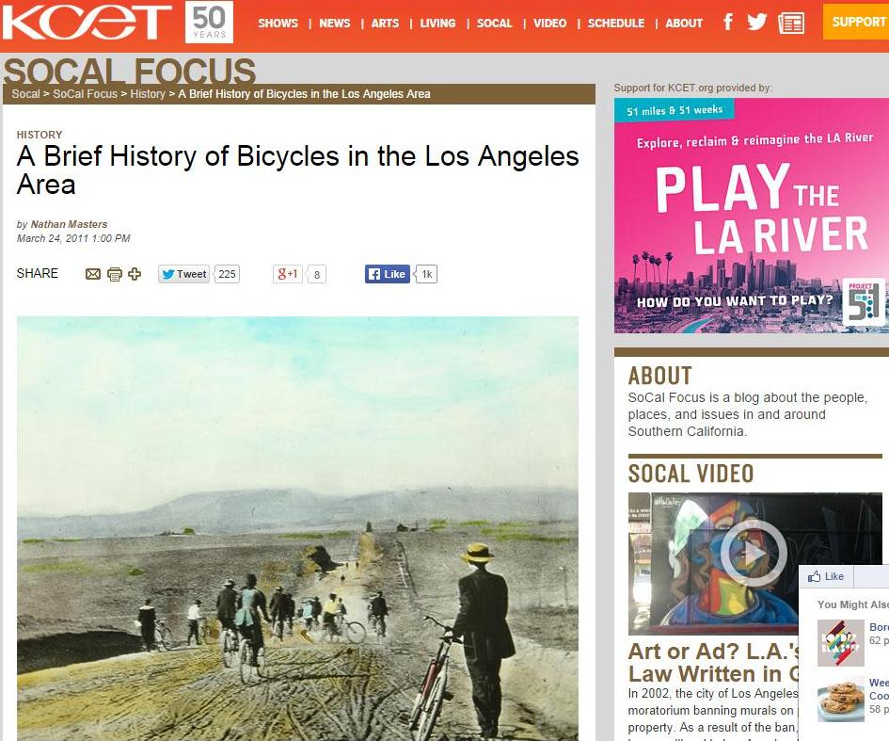
Media Partnerships
Notes:
Our host institution, the University of Southern California Libraries, has entered into media partnerships with the local television affiliate. Some of the most popular items on the KCET website are the LA as Subject-inspired tales of what Los Angeles used to be like, along with photos, maps and other primary resources from our member collections. The public television website gets more traffic, USC fulfills its mission of each department having some component of community engagement, and both LA as Subject and individual member collections have their profile raised with every click.
EVERYONE WINS! (This photo is Western Avenue in 1904 – the site of the very densely populated and super-chic Koreatown in L.A.)

Slide 20
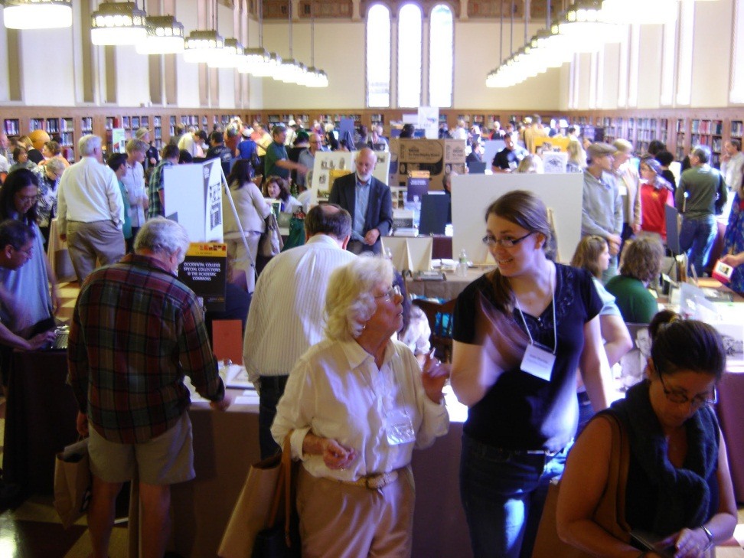
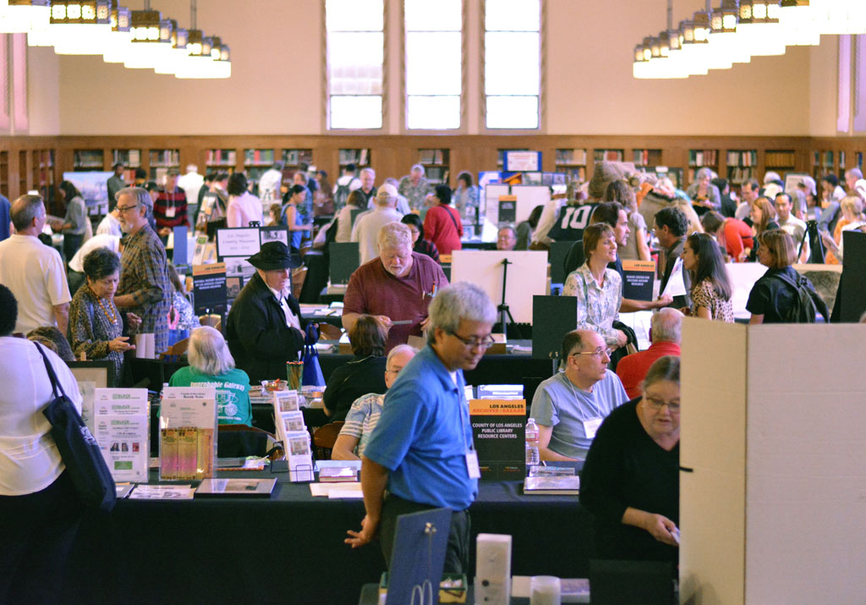
Archives Bazaar
Notes:
Our marquee event is held every October during National Archives Month.
The annual ARCHIVES BAZAAR is a free, all-day cornucopia of wonderful history engagement for thousands of people. Exhibits are complimented by speaker programs, documentary film screenings and genealogy meetings. It’s like visiting 90 museums in one day, and it is really something to behold.

Slide 21
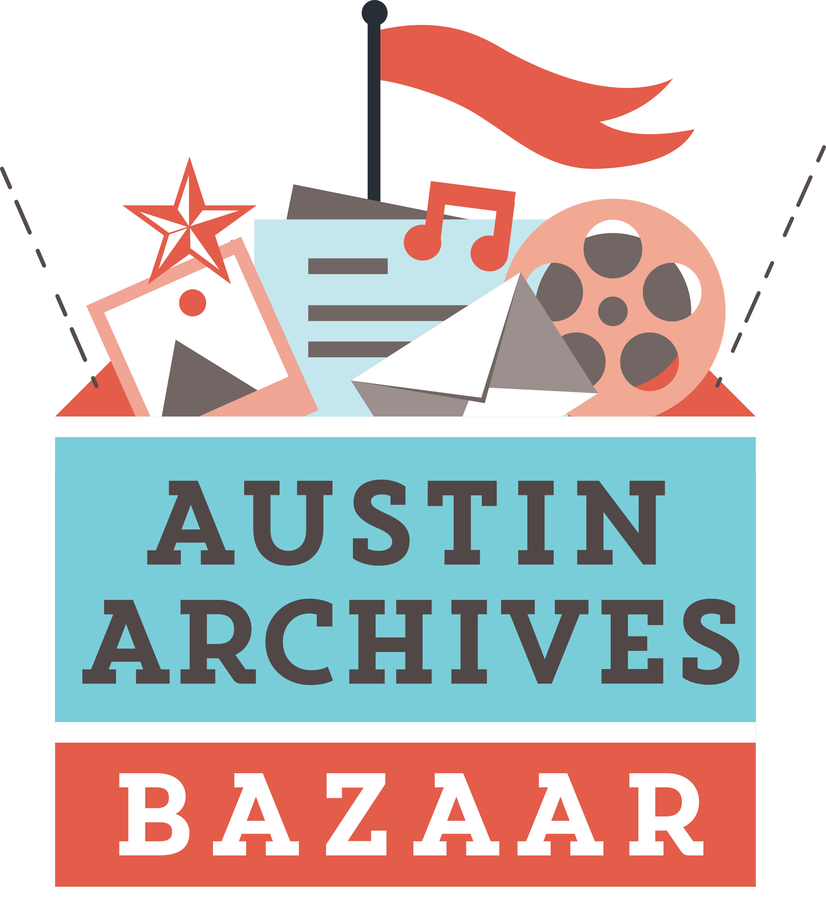
Archives Bazaar
Notes:
And HEY! Imitation is the sincerest form of flattery!
Our first copycat is right there in Texas, where Austin created their own event last October. They event took the same name, and I look forward to meeting up with the organizers when I attend your state library conference in a few weeks.
But back to scalability – why not get some collections together in one county or a group of county to strategize on what you can do together???

Slide 22
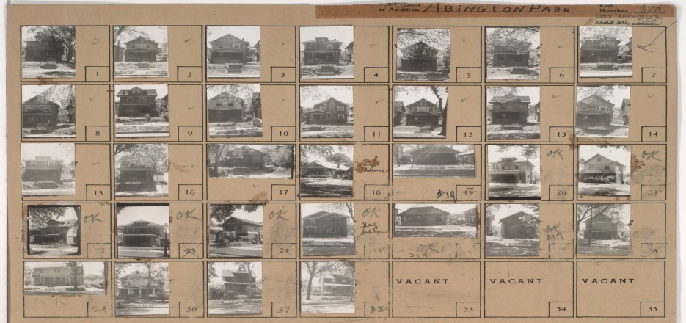
Case Study:
Kansas City (MO)
Then & Now
NEED: Engendering interest in city’s history via one comprehensive resource: 1940 Tax Assessment photos
PROPOSAL: Crowdsource item-level metadata, add contemporary images as platform for storytelling, neighborhood development
OUTCOMES: Citizen sense of place, increase knowledge about historic assets, link past to present and future, model for other cities
Notes:
Here’s a great example of starting small.
The Kansas City Public Library has created an entire historical program out of one resource. OK, the “one resource” is actually a collection of photos, but still, it demonstrates how you can scale some of these community curation opportunities to a library of any size.
In 1940, the WPA photographed every residence and every commercial building in Kansas city – no small undertaking! Eventually those images ended up in a city department and were thrown away! Some local superheroes went dumpster diving and rescued these gems and they are now part of Kansas City’s local history collection.
The Library is engaging the public by asking them to help in a number of ways. Many of the buildings are only identified by what street or block they were on, so librarians are looking for specific addresses. They are asking the public to share stories of what happened in a particular building, or who lived there. They are basically CROWDSOURCING THE METADATA about the city’s history from the vantage point of one snapshot in time: 1940.
This project could lead to any number of other ventures, but surely all of them are thought-provoking and get folks talking to the Library, about the Library, and to each other.

Slide 23
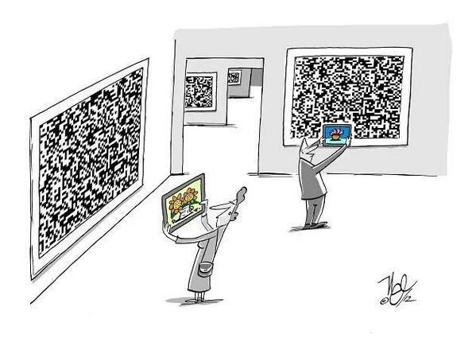
Theme:
New(ish) Technology Tools
Notes:
The next theme in Community Curation is New (ish) Technology Tools. This is where things start to get REALLY interesting…

Slide 24
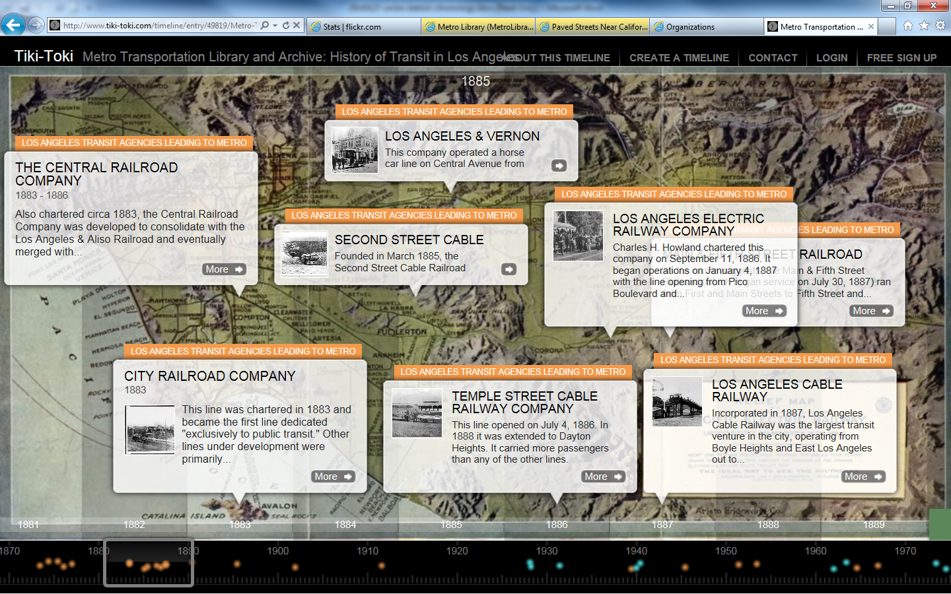
Interactive Timelines
Notes:
I have used a number of tools to explain local history – here are some of the most dynamic and scalable for your consideration.
One of them I discovered is Tiki Toki, a free interactive timeline tool that our superstar intern built and launched to tell the very complex story of Los Angeles transportation history going back to the 1870s.
Did you know that Los Angeles had cable cars, just like San Francisco? Check out the timeline later to learn why they lasted less than a decade.
I don’t know how well you can see this screenshot, but it features a traditional horizontal timeline where you can drag through the decades at the bottom, or click on any of the text bubbles that feature thumbnail photos to link to the corresponding Flickr photo set within our online collection, as well as video, digital documents, etc.
We had all the resources in-house to plug into a creative timeline, with hyperlinks out to our primary resources. Tiki Toki loved it so much, they chose OUR timeline from amongst 100,000 created on their website as their inaugural “Timeline Of The Month” featured on their own blog.

Slide 25
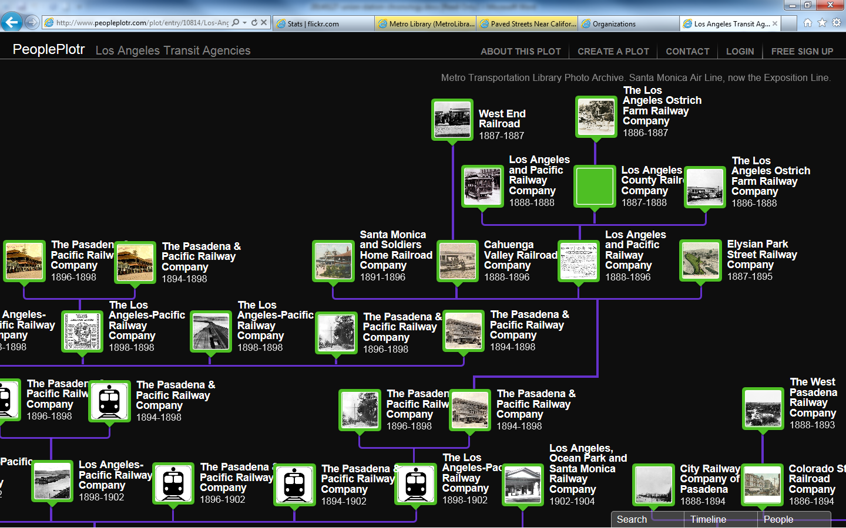
Interactive Family Trees
Notes:
Tiki-Toki’s sister product is called People Plotr.
This is also a dynamic schematic, but in the form of a family tree rather than chronological timeline.
So we can use this tool to help people better understand our crazy history of dozens of predecessor agencies. It’s like the BEGATS of the Bible – lots and lots of relationships going WAY back.
Did you know that Los Angeles used to have an Ostrich Farm Railway Company? Look up here in the upper right. Ostrich Farms were a huge tourist attraction a long time ago – but that story is also for a different presentation!

Slide 26
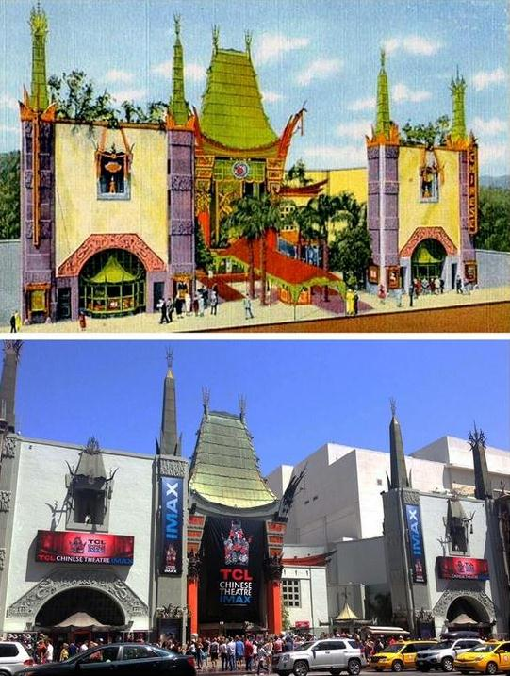
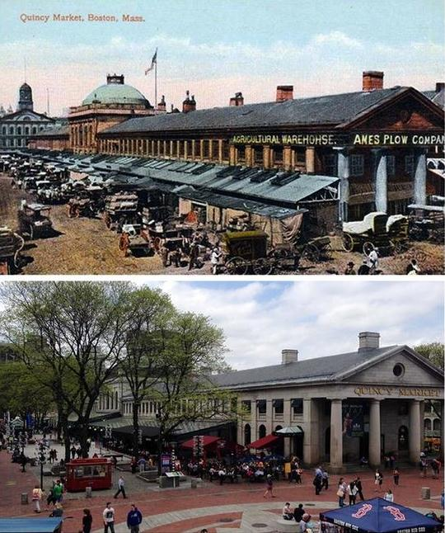
ScenePast App
Notes:
If these tools seem too complicated, I just wanted to let you know that there are far simpler ones.
ScenePast is an app that allows for side-by-side history and contemporary views of places you want to show off.
On the left is a digitized postcard of Hollywood’s Graumann’s Chinese Theatre, and below a contemporary view. On the right, the same thing with Quincy Market in Boston.
Most libraries have funky old photos and maps they could turn into something cool with a relatively simple app.

Slide 27
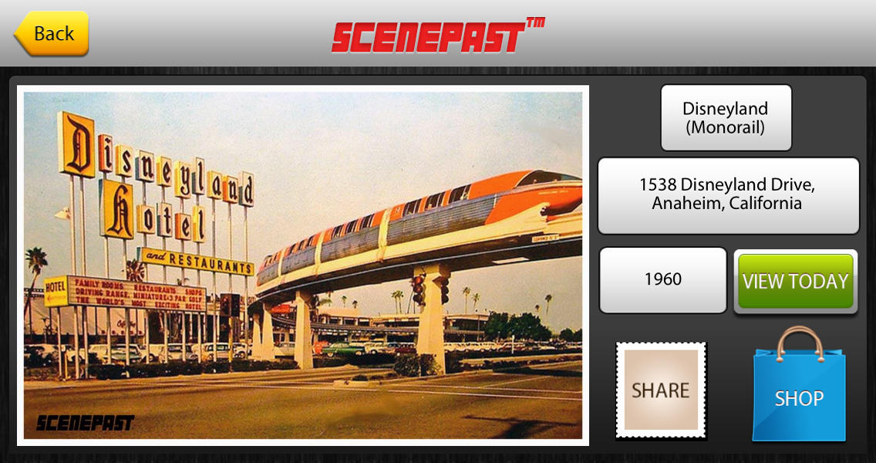
ScenePast App
Notes:
A vintage postcard of Disneyland becomes an interesting venue to explore when you click back and forth between the old view and “Today”

Slide 28
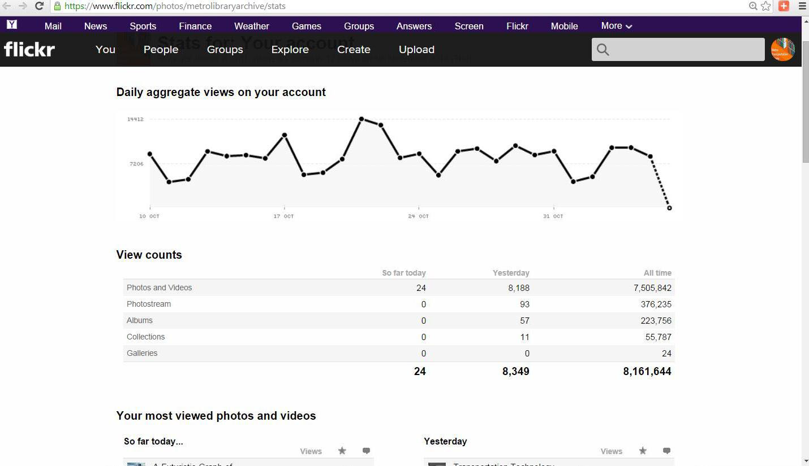
How did this happen?
Notes:
By leveraging historic images, our little 1.5-person Metro Library has become a national leader user engagement of digitzed photos.
We currently have just about 10,000 images on our Flickr site, organized by collections. The chart here is also a little out of date – we just surpassed 9.5 MILLION ALL-TIME VIEWS of our images, and on an average day, we get about 12,000 hits.
How did this happen? It isn’t because people just decided that pictures of old buses were sexy all of a sudden, it is because of what we do with the images besides putting them online. We provide context and we leverage one tool against another.

Slide 29
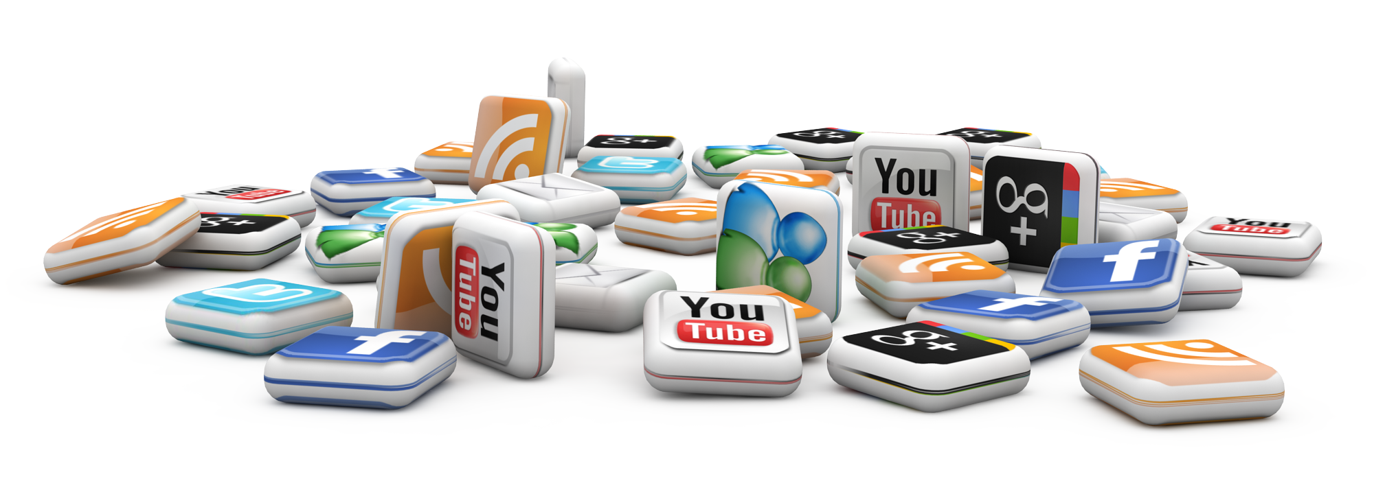
Theme:
Volumization
Notes:
Volumization is a social media strategy for you to consider.
For example, we put all these great images on Flickr, but if the anniversary of something comes up, we post that on Tumblr and link back to Flickr. We embed YouTube clips on our blog. We embed Tweets into our daily transportation news.
We are truly “webifying” all of our hard work making it all interconnected.

Slide 30
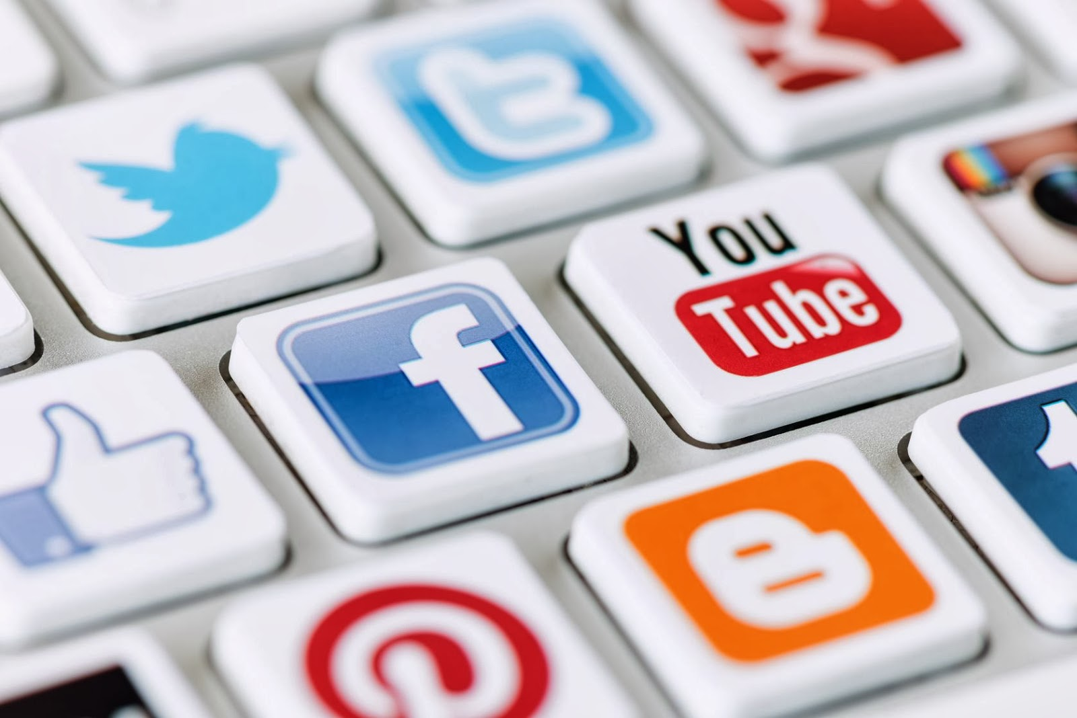
Leverage Tools
Notes:
Tumblr to Flickr, Twitter to Facebook, Instagram to everything, Pinterest…still not fully realized in our library – what will be the next big thing? Whatever it is, think about how it relates to everything else as opposed to just being a stand-alone product.

Slide 31
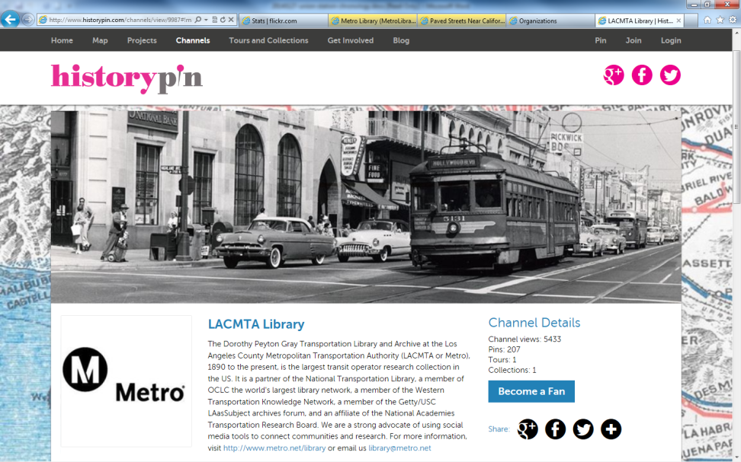
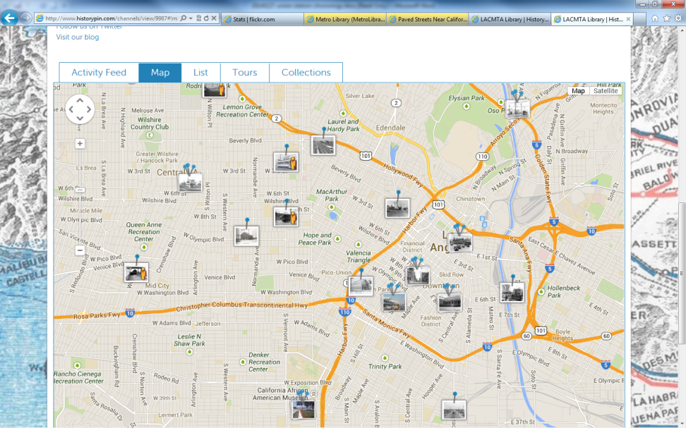
Theme:
Beyond “Traditional” Social Media
Notes:
Now things start getting even more interesting. Up to this point, I’ve shared some of the tools I’ve used at the Metro Transportation Library for just our resources. But what happens when we start playing in a shared sandbox?
This is Historypin. In a nutshell, it was developed by a guy named Nick Stanhope in London. He was looking at old family photos with his grandmother, and asking her “Who is in this picture?” “Where was this taken?” “What are they doing?” and so forth.
She shared with him all the stories behind the images – the METADATA if you will, and he realized that he would never have known all that good stuff if he hadn’t asked. Obviously, once our seniors are gone, the metadata goes out the window with them. Some of us have varying degrees of experience with oral histories, but check this out.
Historypin acts like a photo sharing site, with geolocation features like you would find in Flickr mapping, but it ALSO features a chronological data layer – so you can search for images across place AND time. Once I heard about THAT, I was all about it.
We were a global launch partner for Historypin, uploading 200 images to get going. We wanted to be sure that they clustered together and weren’t just scattered all over the map, so you could move about easily without searching for other photos from our collection. So we focused on Broadway downtown, Hollywood, and a few other key areas for the initial upload.
On the left is an image of our Historypin site – you see a 1950s photo of Hollywood Boulevard at Highland Avenue – a multi-modal image with streetcars, automobiles, pedestrians and there’s a bus back there, too…
You can create an account and upload your photos here and view them through your own channel or “mashed up” with contributions from other individuals and libraries, archives, museums and other collections.
On the right, you see a zoomed-in map of central Los Angeles where our photos are clustered. The tabs above the map show that you can search our images as a feed, a list, or grouped by collection, or even as a tour – which is wonderful for telling a story through maps and photos in order, like we did with our images of the role that transportation played in the 1984 Summer Olympics in Los Angeles. We promoted that narrative while the 2012 London games were going on, leveraging a contemporary event as an opportunity to highlight our own historic resources.

Slide 32
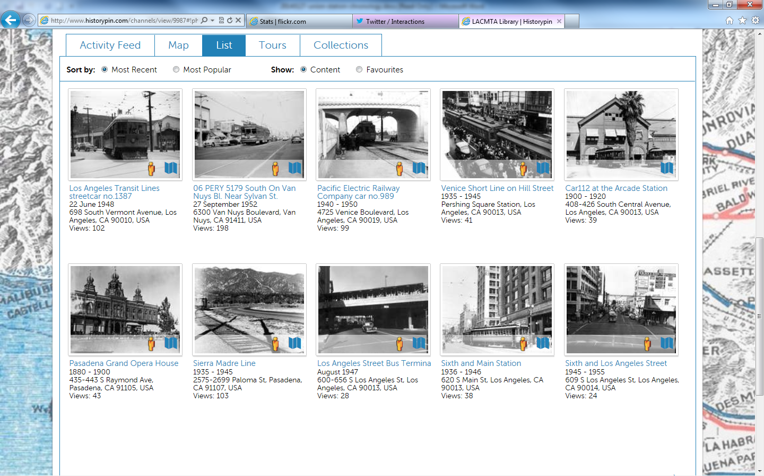
Historypin: Augmented Reality
Notes:
At this point, I am going to try going outside of PowerPoint to get into the Live Web to demonstrate how it works. I hope Ted will be on hand to assist if I have any technical difficulties…

Slide 33
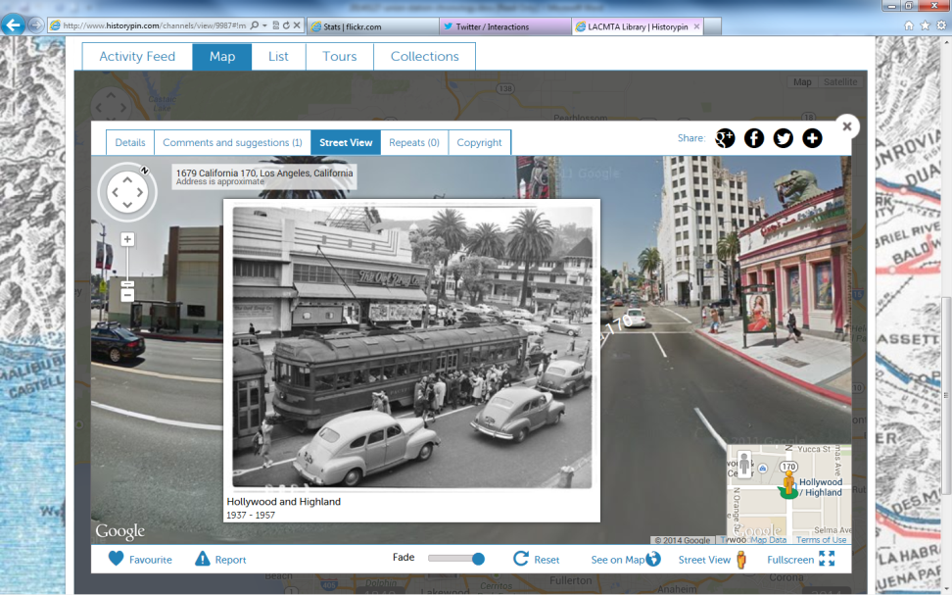
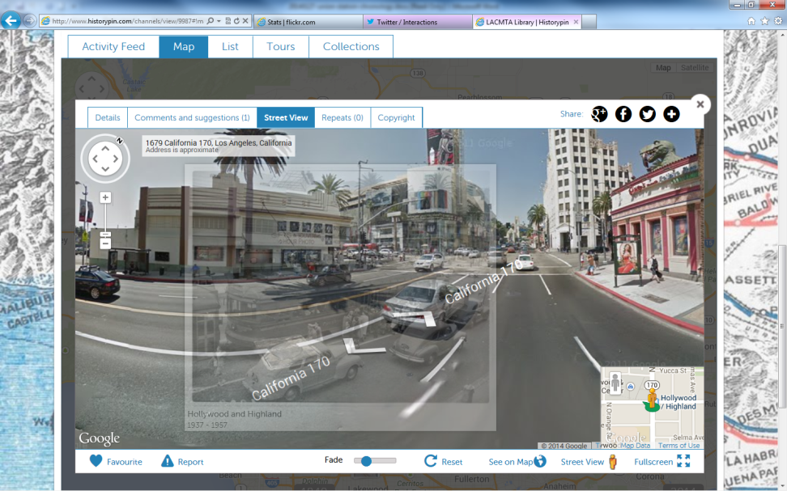
Augmented Reality
Google Street View
Fade Button Slider
Notes:
Here’s one of our Historypin images – a late 1940s photo of that same intersection of Hollywood Boulevard and Highland Avenue in the heart of Hollywood, looking northwest. We’ve clicked the “little yellow guy” to superimpose the geo-located image over contemporary street view, and position it accordingly so it matches up.

Slide 34
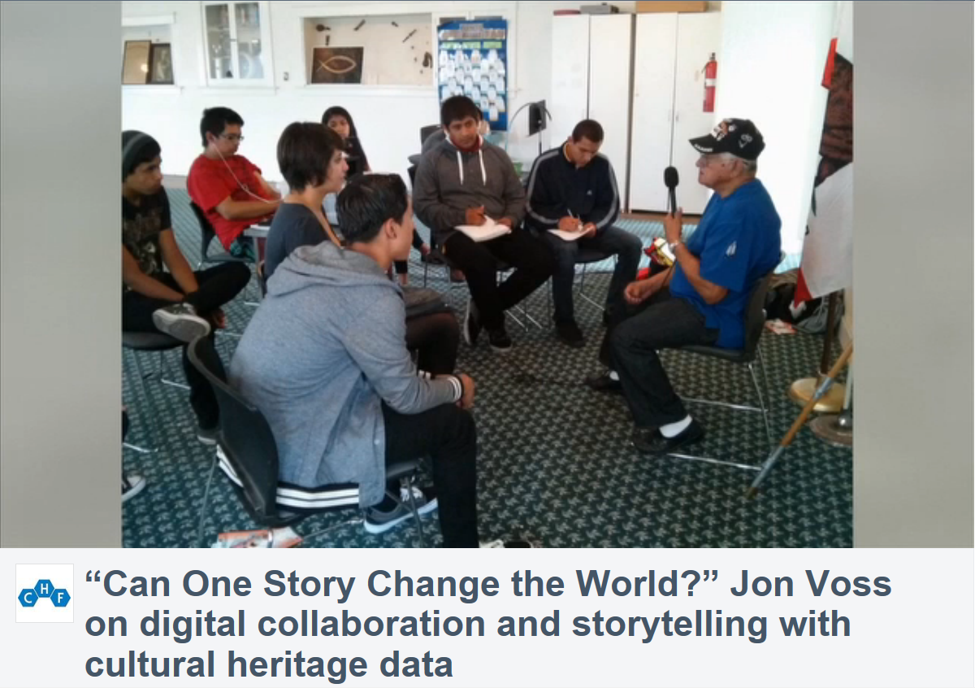
Case Study: Santa Ana PL
Notes:
And at Santa Ana Public Library, they are fortunate to have a superstar archivist named Manny Escamilla. Manny has organized “TEEN COMMUNITY HISTORIANS” who do a number of wonderful things out in the community like working in conjunction with Cal State Fullerton to train them in how to do oral histories and investigate information about photos uploaded to Historypin. The city’s demographics have changed quite a bit over the past few decades, and the Local History Room had found that its collection reflected about 5% of the current population.
Manny set out to change that – and he motivated and enlisted a small army of teenagers to help him. They have received grants to record the stories of Hispanic veterans, among other projects. They are a force to be reckoned with!
Part of that story – storytelling with cultural heritage data – along with MANY more Historypin applications, can be found in a great presentation by Jon Voss of Historypin from which this screenshot is taken, so contact me offline if you’d like the link!
It’s phenomenal. Very powerful stuff.

Slide 35
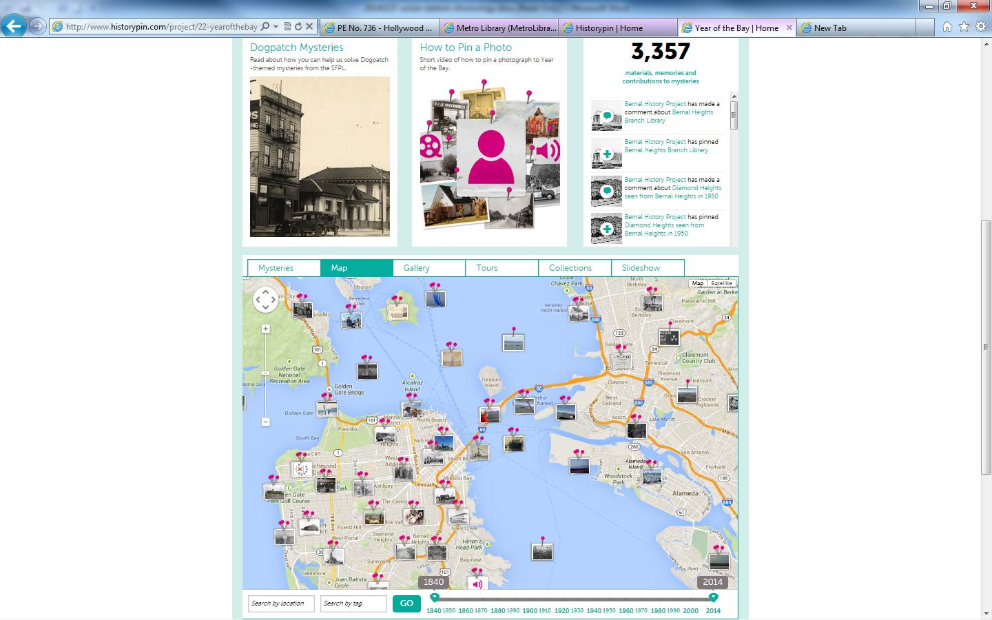
Collaboration Around New Tools
Notes:
While you can leverage an incredible tool like this for your own purposes, it truly begs for collaborative opportunities. And we are already beginning to see this type of activity as libraries, archives and museums begin working together to upload images together.
Here’s a screenshot for “Year Of The Bay,” a Historypin site marking the 150th anniversary of the Port of San Francisco. The images come from several institutions around the Bay Area. At the bottom you can see the “chronology slider” to choose which point in time you want to see photos from – the map reorients the thumbnails that match the decade you choose.
Not only is it content-rich, and not only does it foster collaboration amongst various institutions, and not only does it serve as a powerful educational tool, but to quote ANOTHER infomercial: “BUT WAIT, THERE’S MORE!”…and that wonderful MORE is that it solicits community participation to help identify photos, to map them, to position them properly for the Google Street View augmented reality overlay, and to enjoy some treasure hunts and contests associated with this anniversary. (You know, you gotta wonder about those images that are pinned to the map in the middle of the Bay, but besides Alcatraz, I hope those are for images taken from a boat and not just someone playing “Pin the Tail on the Donkey” with our historical resources!).
So to summarize: Getting information directly from the community, to CROWDSOURCE THIS METADATA, is very powerful indeed. And fun. And can only lead to the type of engagement that will carry over to other service areas for your library.

Slide 36
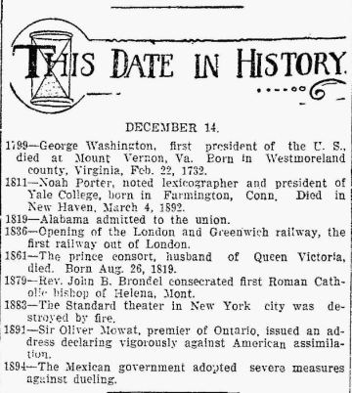
Theme: Calendaring
Notes:
Yet another theme is calendaring. Do you all recognize what this is? Old-timey newspapers used to tell you what happened on that date in history.
It dawned on me one day that our internal spreadsheet of anniversaries and dates could be put to use online in the same way.
Over the years, we had built up a “ready reference” file answering the same old questions:
When did this streetcar line open?
When did they build that freeway?
When did the Board of Directors vote to do something in particular?
If these are our most important questions being asked, why keep all that good stuff to myself? So I built a “This Date in Los Angeles Transportation History” feature on my Primary Resources blog.

Slide 37
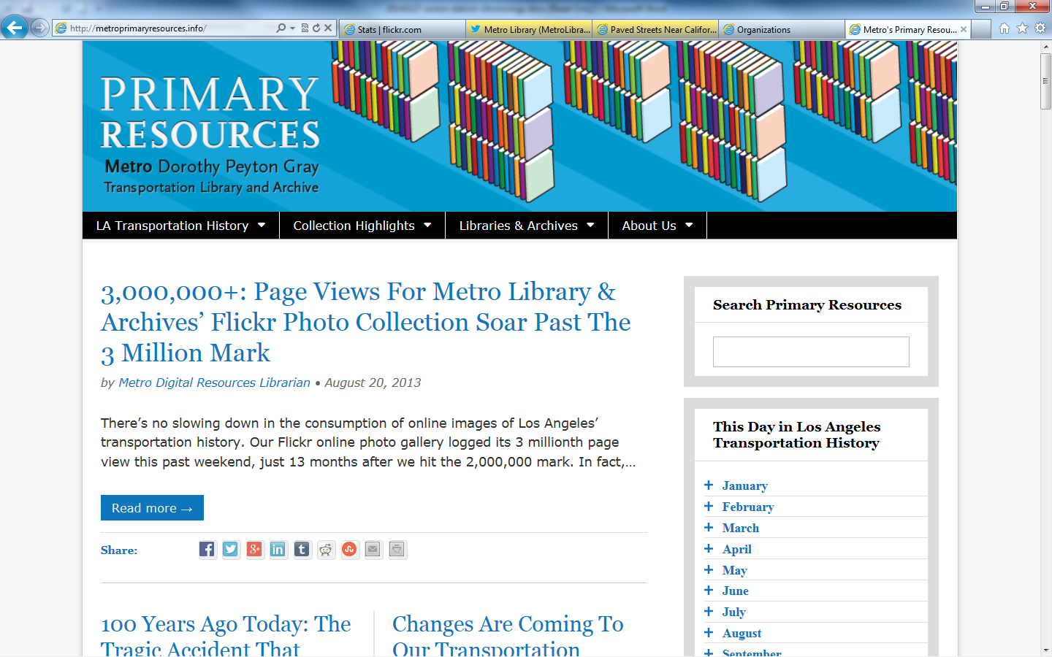
Online Calendar
Notes:
On the right, you can see a calendar with an accordion-style monthly list.
When you click on a particular month, it opens up so you can select a particular date.

Slide 38
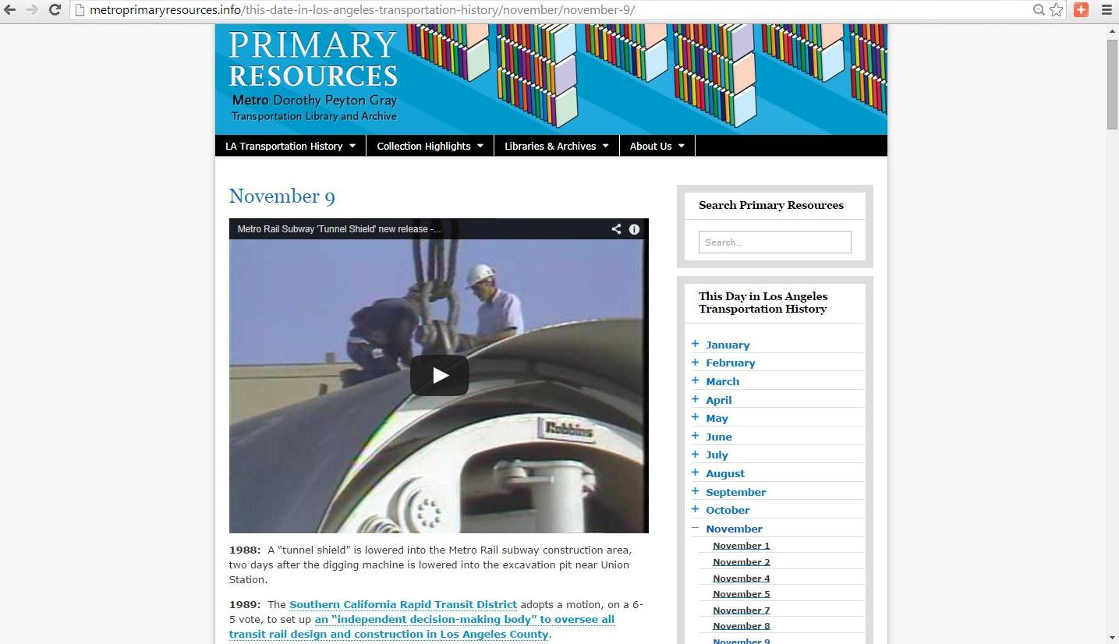
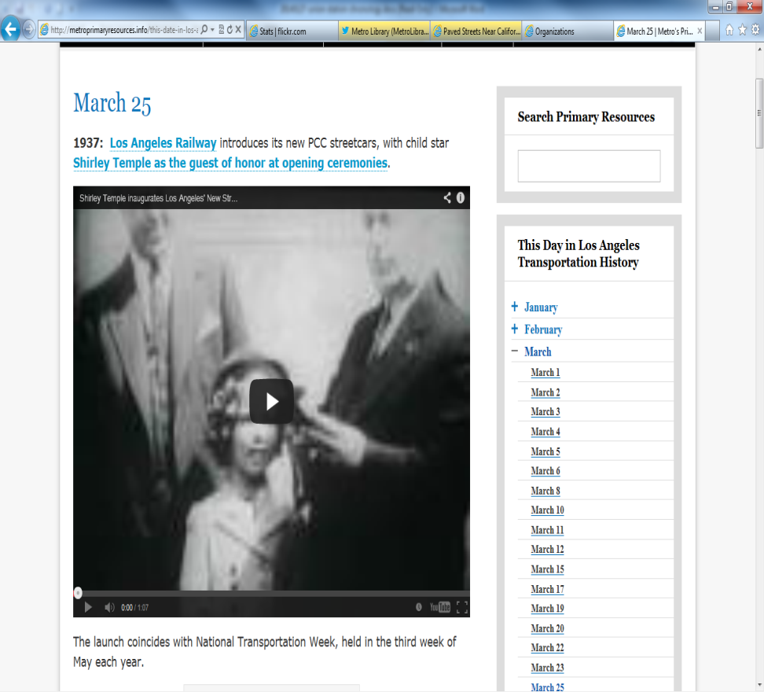
Sample Calendar Entries
Notes:
Here are two examples of date entries.
On the left, you can see I can embed one of our YouTube videos from our YouTube channel right into the date, along with hyperlinks to digitized reports, maps, photos, and other items.
On the right is archival footage of Shirley Temple inaugurating new streetcars in Los Angeles in 1937. Let’s watch that for a moment…

Slide 39
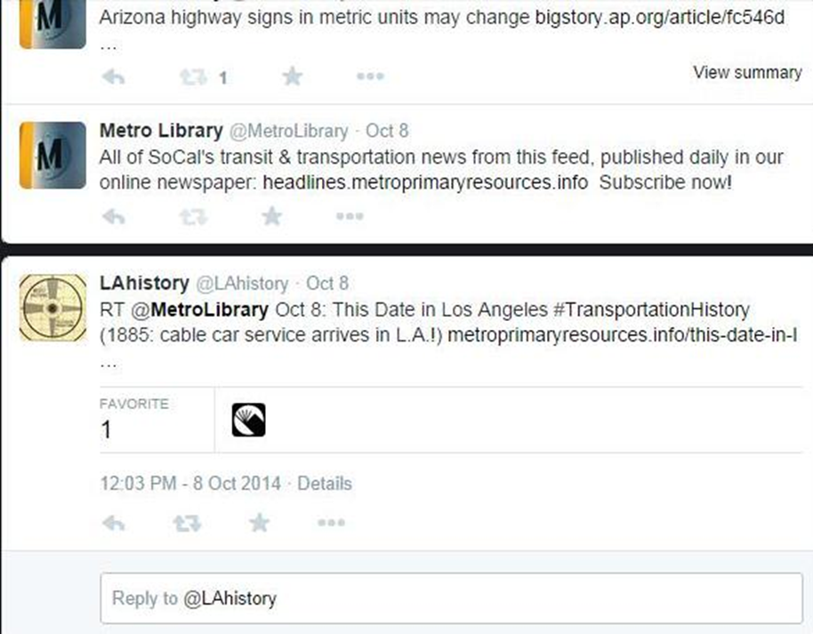
Local History Goes Viral
Notes:
At any rate, local history quickly goes viral. Our “This Date in Los Angeles Transportation History” gets tweeted out every day along with the news – it is the first thing I send out because, hey, I think it is most important!
But when you get picked up by the LAHistory Twitter account and then Los Angeles Public Library, you quickly have thousands and thousands of eyeballs on your social media properties and lots of awareness of what you are doing.

Slide 40

Theme:
Storytelling Comes Alive
Notes:
Finally, I want to highlight the value of storytelling – the personalized touch we can all bring to local history in building community.

Slide 41
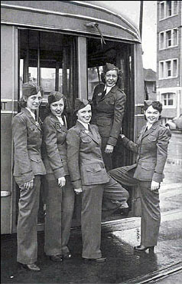
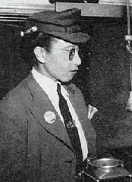
L.A.’s First “Motormanettes”
Notes:
We were asked a very good question awhile back: “When were the first female streetcar operators hired?”
We knew the story of the “motormanettes,” but the public did not. These women were hired to backfill key positions in operations when so many men had been sent off to fight in World War II.
When we researched even further, we discovered the first female operator was from long before World War II – and she was African-American!
On the right, you see Arcola Philpott, who drove a streetcar in the 1920s.
When our “Expo Line” recently opened, the first two operators based on seniority were African American women, so this was a great opportunity for the Library to get out in front of the community and a lot of eyeballs with a story that everyone enjoyed hearing about.

Slide 42
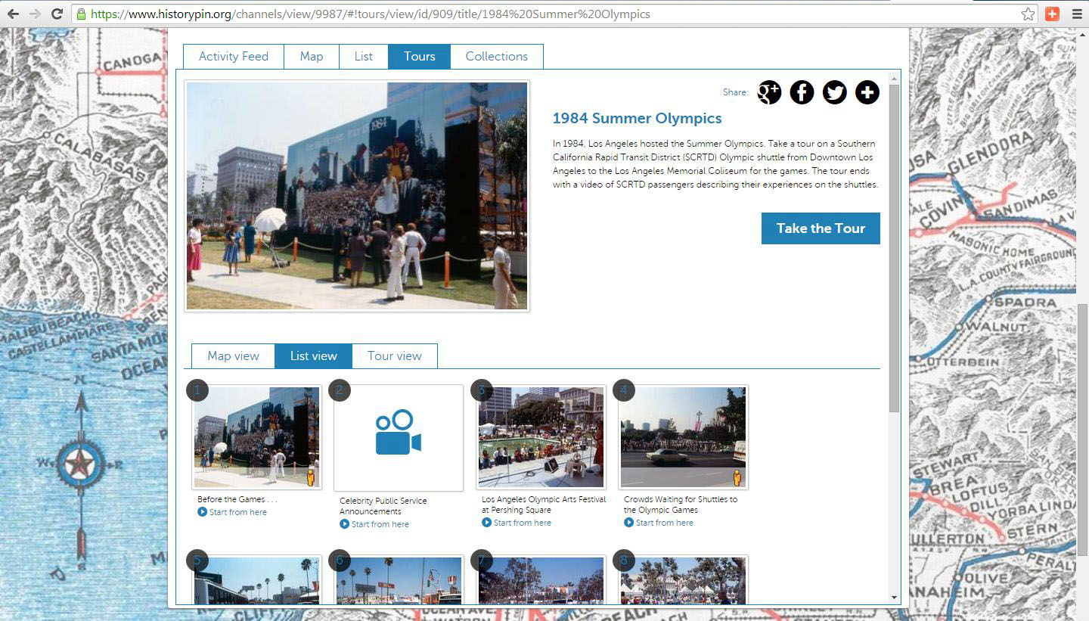
1984 Summer Olympics Tour
Notes:
Going back to Historypin for a minute, it can also be used to tell stories. We looked at the “LIST” view of images, but there is also a “TOURS” view, where you can lead users through images and other resources in a particular order.
We capitalized on an anniversary unrelated to Los Angeles to tell one of our stories. The 2012 Summer Olympics in London was a perfect opportunity to relate the story behind the transportation component of the 1984 Summer Olympics in Los Angeles.
The ‘84 Games were the only Summer Olympics in modern history without rail to shuttle people between the venues. It was all done by buses, and the games were a huge success and turned a profit. So we built that story in Historypin and engaged a lot of users and new users along the way.

Slide 43
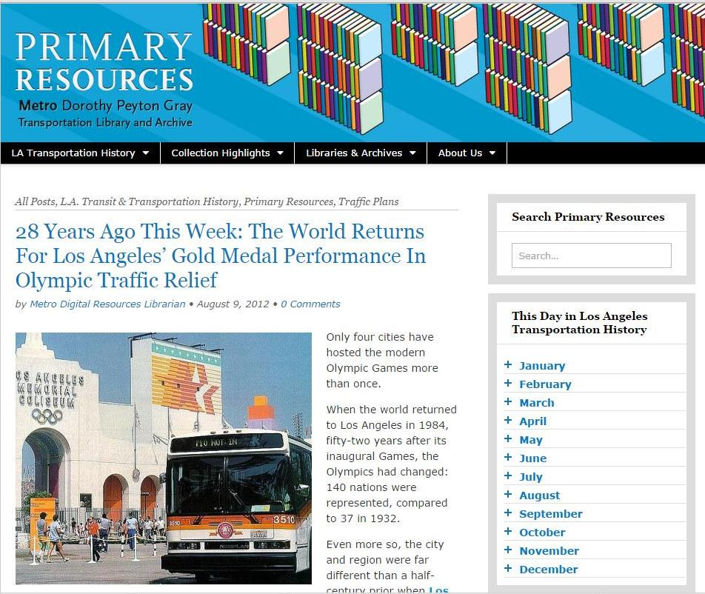
1984 Olympics: Storytelling
Notes:
The story of the 1984 Games became a platform for other kinds of storytelling. Our Primary Resources Blog compliments our website in that it can feature longer stories that again, link to digitized documents, as well as photos, maps, video, and other resources.

Slide 44
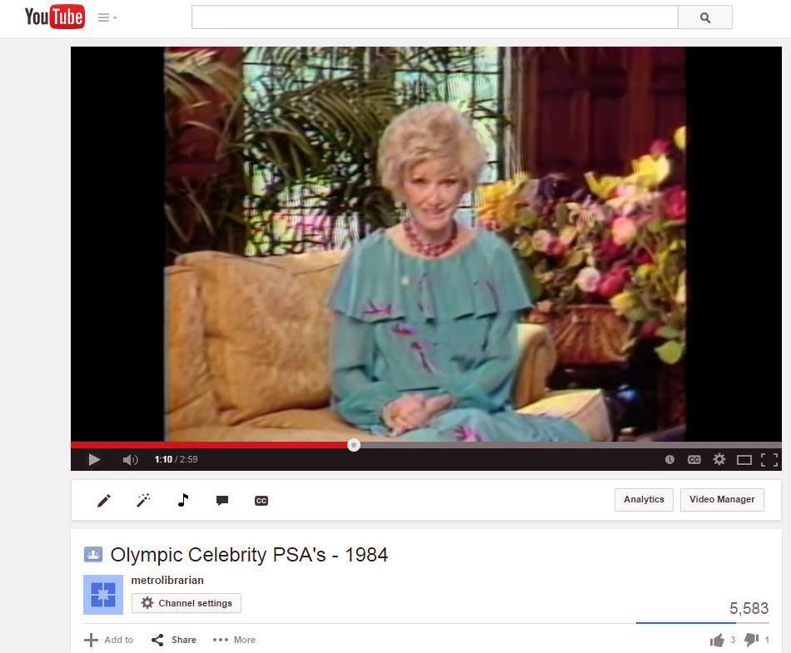
1984 Olympics: Storytelling
Notes:
Normally not very compelling public service announcements were soon of high interest once we painted a full picture of how Los Angeles pulled this off. Yes, that IS a screenshot of Phyllis Diller telling Angelenos during primetime television not to drive if you don’t have to!

Slide 45

Theme:
Exploiting Embedded Resources
Notes:
As we have dug deeper and deeper into our resources, it became apparent that we were actually creating new resources all on their own.
Here is a cover letter that accompanied a 1962 report for a monorail plan in Los Angeles. In the wake of Disneyland opening in 1955, and a push by science fiction writer Ray Bradbury, several plans for monorail service around L.A. made it to the drafting table.
Monorails were futuristic and so was Los Angeles in the post-WWII building boom.
But this dusty old typewritten report looks rather dull, doesn’t it?

Slide 46

Goodell Monorail Rendering
Notes:
That is, until you get to the illustrations!
Here is a rendering for the suspended monorail that would have zipped up the Los Angeles River from Long Beach to downtown. How ridiculous looking is that thing? It looks like something from THE JETSONS, right?
The rocket-like part on top of the rail serves no purpose, and neither do the “tailfins.” I mean, what aerodynamic component is necessary when you are on a fixed-guideway?
So this is an opportunity to engage our users with some questions. Were the tailfins supposed to look futuristic? Were they meant to look like an expensive automobile of the era, making public transportation more palatable? What WAS the design consideration for the whole thing?
It is a thought-provoking image that I harvested from the report, and added to our Flickr collection, and used in a blog post and some tweets. Before you know it, I am getting calls from two architects who have been selected to curate an exhibit at Los Angeles’ Architecture and Design Museum called “Never Built L.A.”
They found my image online and wanted to check out all sorts of things we had. By harvesting embedded resources, we were able to reach new audiences – not just the two architects…

Slide 47

A+D Museum: Never Built Exhibit
Notes:
But everyone who went to the exhibit. And here you see on the right a replica of that image on the front of the museum next to the front door, so every attendee can see it, as well as everyone driving down Wilshire Boulevard, the grandest street in Los Angeles, across from our Los Angeles County Museum of Art.
It pays to leverage those embedded resources – so look closely for them, they are engagement opportunities no matter what size library you are!

Slide 48

Goodell Monorail, 1962: What stories does this image tell?
Notes:
Here you can see another view of it – just think of the stories you can create from one photo – not unlike the stories being created in Kansas City as people interact with those 1940 WPA photographs of every building…

Slide 49

Theme:
Creative Collaboration
Notes:
Looking forward, I am currently working with L.A. as Subject members in the Historypin environment to get more members’ digitized images uploaded to create an incredible experience for both the user and the participants. It can only create closer working relationships and higher visibility for all, while users enjoy a robust mash-up of historic and contemporary Los Angeles.
I also hope we can partner with other organizations outside of the library/archive world who value this type of work as well. For example, the LA Conservancy.
While they don’t have collections, they do have extraordinary, trained docents who provide historical walking tours of Los Angeles. Imagine a high-interest guided walking tour supplemented by “augmented reality” on your phone or tablet. Pre-loaded tours could be accessed on loaned iPads – there’s lots of potential for cross-pollination with what people are doing in Museums as well.
The sky’s the limit, and I intend to explore how high we can fly with this one.

Slide 50


The Exo-Library
Notes:
OK how about takin’ it to the streets?
Last year, we celebrated the 75th anniversary of our historic Union Station. This occasion served as the role-out of Metro’s prototype interactive transit kiosks.
These digital fixtures feature wayfinding, how to buy a ticket, how to get from point A to point B, information about public art in each station, etc.
But our Director of web and mobile asked me if I wanted to develop content for the kiosks as well. Short answer: OF COURSE!
I knew that the Tiki-Toki timelines outlined earlier would be a great product to tell the story of Union Station, so I created on that went from the birth of the architect John Parkinson to the current Master Plan for the Station

Slide 51

Interactive Transit Kiosks
Notes:
Here’s a very unflattering photo of yours truly giving a demonstration of the timeline to some guests. You can see the chronology slider at the bottom, and each data point opens to expand up to the full screen for users to interact with. It was a smashing success, and it really engaged our users.
You can do this too, on a smaller scale perhaps. A lot of hotels have these vertical “View Sonic” monitors in their lobby. What a great place to start, by promoting your library services to visitors, right?
Behind my hand, you can see an image that merits some mention here.

Slide 52

Interactive Transit Kiosks
Notes:
This was the 1968 proposal for “METRO PORT,” the newfangled way to get from downtown to Los Angeles International Airport.
Essentially, you would take a train or park your car at the Metro Port, and board a bus that would be lifted up by a helicopter to whisk you away. I thought for sure, “NO. WAY.” This is totally some kind of joke.

Slide 53

Interactive Transit Kiosks
Notes:
But further research led me to the UCLA Special Collections where they had images of the model built and which were seriously considered. I have done a lot of crazy things in my life, but getting in a bus lifted up by the claws of a helicopter is not – and never will be – one of them.

Slide 54

Theme:
Knowledge Base
Notes:
With all of these projects, it is hard to keep track of everything in one place, which is why it is worth considering building a knowledge base.
Consider this a giant FAQ of library information. A place you can share all of your frequently asked questions. I am a very strong advocate of Wikipedia, and we could definitely just build pages there.
But there are two drawbacks to that. We are highly specialized in what our organization does, and we have no control over other people editing our pages with potentially wrong information, and no staffing to stay on top of that. Also, our own product allows us to track how many people are using it and what they are looking for.
But for public and academic libraries, it is DEFINITELY worthwhile to consider building a presence on Wikipedia. Not just for your institution, but for your community. Libraries have an incredible opportunity to manage how their communities are defined online. Did you know that when you do a Google Search, and that box of concise information shows up on the right, that is taken directly from Wikipedia? So while you may not have any say over the search engine optimization of Google Search Results of anything to do with your community, you DO have a say over what Wikipedia says about you, and you should consider playing a role in that.
There are a lot of libraries now fully engaged in Wikipedia “Edit-A-Thons,” crowdsourcing users to work with primary resources to create Wikipedia pages. We don’t have time to go into that here, but you not only get a more robust Wikipedia presence, but you are engaging users and building community at the same time.

Slide 55

STRATEGIC DIRECTION #3:
DATA ALCHEMY
Notes:
Our final strategic direction is digital data alchemy. We live in an increasingly digital world. Even the smallest towns produce a lot of born-digital data. What is being done with it? What should, if anything, libraries do with it?

Slide 56

Open Data: “The New Oil”
Notes:
This is the next frontier for librarians. There is so much opportunity here, it is its own presentation. But let’s just cover a few basics.

Slide 57


Some statistics, please…
Notes:
From the beginning of time until the year 2003, we humans created 5 exabytes of data (5 billion gigabytes). In the year 2011, we created that much data EVERY TWO DAYS. In other words, 90% of all the data in the world was created 2009-2011.
Again, from 2011, 10% of all the photos ever taken in history, were taken that year.
Every hour, we create enough internet traffic to fill 7 billion DVDs. (Every hour!)
The amount of data generated between 2012 and 2015 was expected to double.
Data is not generated only at the national or even state level. Look at all of the information being generated at the county or city level. By Universities and private enterprise that is sharing it on the web. Think about all the micro-level data being generated by drone photography. So we can imagine what this is like at the local level.

Slide 58

Opportunity: Reintermediate
Example: Civic open data by default
What is the difference between census data in print and curating digital demographic data today?
Notes:
So, food for thought. A city in the heart of the Silicon Valley in California (which shall remain nameless) recently went to the “open data by default” mode.
In other words, in the name of government transparency and adhering to sunshine laws, all city-generated data would be shared unless it was security sensitive or needed to be redacted. This is great for app development, urban planners, and others.
So I wanted to contact the Library to see what role they would be playing in collecting the data. Hosting it. Providing access to it or teaching the public how to use it. The answer I got: “Oh, we don’t want to get involved in that.”
Umm… OK. This is information about your own city, and just because it is in a new format or media that you might not be totally comfortable with, that means you are not going to get “involved?”
Now mind you this is in the heart of Silicon Valley. I just don’t get it. We need to find ways to keep up, and many people are stepping up to keep up. We have collected and diligently work with patrons in their use of government publications and census data in print for decades, so why the change? Why aren’t we all changing?
It is something we will have to deal with more and more, so I pose to you that the time to think about it is NOW.
And what you’re looking at here is a rendering from the 1982 proposed downtown People Mover. Because we all know that white go-go boots really are the go-to work uniform of the smart set in the financial district.

Slide 59

The Path Forward
Notes:
So where do we go from here? I have really enjoyed this opportunity to speak to you, and toss out some considerations for you. I would love to hear from you, and you’ll find my email address in the final slide.

Slide 60

New Promotional Opportunities:
A Cautionary Tale
Notes:
I want to close out the presentation with just one more story – something that illustrates just where some of these endeavors can take you, so be prepared…TO SUCCEED!

Slide 61

Los Angeles Historic Traffic Plans
Notes:
I mentioned to you early on that the first call for a subway in Los Angeles was in 1911. Several years ago, one of the first things I did was to round up all of the historic traffic plans for Los Angeles during the era before public governance, until 1957.
I digitized them and created a web page for them.
I got a call from a curator at the Getty Museum who wanted to look at the originals. Now, I know you are out of state, but you just don’t say no to The Getty.

Slide 62

Getty Museum: Overdrive
Notes:
He ended up asking to use several of our items for a prominent exhibit two years ago which brought us ever more attention.
A few months later, I got a call from a curator at the National Building Museum in Washington, D.C. It turns out that the exhibit was now going to move on the nation’s capital, and he was asking permission to re-photograph one of our digitized archive reports.
I said, Sure, but the Getty had already photographed everything at .TIF file high-resolution, so why did he need to re-do it?
And he told me that it was because he wanted to use it for another purpose….

Slide 63

National Building Museum, Washington D.C.
Notes:
It needed to be blown up to 12 feet tall at the entrance to the Transportation Gallery in the National Building Museum.
You can’t put a price on being able to tell you CEO that some of your dusty old reports were now the focal point of a museum exhibit in Washington, D.C.

Slide 64

How Can We Best Support
Each Other?
Notes:
I want to thank you again, and to encourage you to buddy up, assist each other, collaborate, not be afraid or embarrassed to ask for help, and to send me an email if you would like more information...
AND I do make myself available for staff development talks and strategic planning as related to social media, digitization and user engagement as well…

Slide 65
Kenn Bicknell email: bicknellk@metro.net
www.metro.net/library
http://metroprimaryresources.info
Librarycat.metro.net
Notes:
And with that – shall we open it up for questions?

Slide 66
Resources
Our Website: metro.net/library
Our Primary Resources Blog (with “This Date in Los Angeles Transportation History”): metroprimaryresources.info
Daily Transportation Headlines: headlines.metroprimaryresources.info
L.A. as Subject: laassubject.org
Tiki-Toki timeline of Los Angeles transportation history: http://bit.ly/1bph9gz
PeoplePlotr family tree of Los Angeles transportation: http://bit.ly/1G9hFec
Our Flickr photo collection: https://www.flickr.com/photos/metrolibraryarchive/sets
Our YouTube channel: youtube.com/user/metrolibrarian
Our Tumblr page: lacmtalibrary.tumblr.com/
Our Historypin site: https://www.historypin.org/channels/view/9987/#!photos/list/
Our Twitter: @MetroLibrary
Anything else, just ask me! bicknellk@metro.net

