Slide 1
MAPS, MUSIC & MORE: Crowd-sourcing metadata for digital assets
Internet Librarian International 2015: C102
Kenn Bicknell
Los Angeles County Metropolitan Transportation Authority (USA)
bicknellk@metro.net

Slide 2
“The 21st Century is a terrible time to be a control freak.”
--Alec Ross,
Former senior advisor for innovation
for U.S. Secretary of State Hillary Clinton,
2013

Slide 3
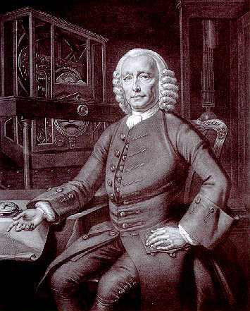
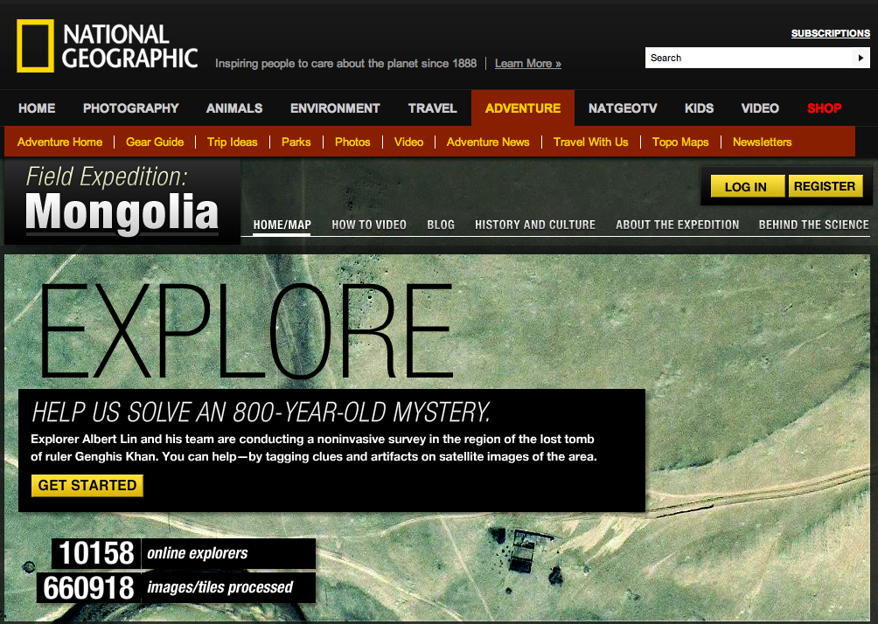
Crowd-sourcing: Then & Now

Slide 4
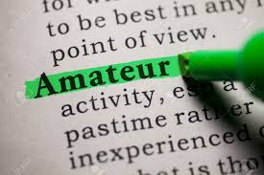
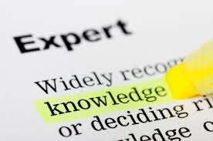
“Amateur” vs. “Expert”

Slide 5
Types of GLAM crowd-sourcing
Identification projects
Transcription projects
Mapping projects
User-generated content projects

Slide 6
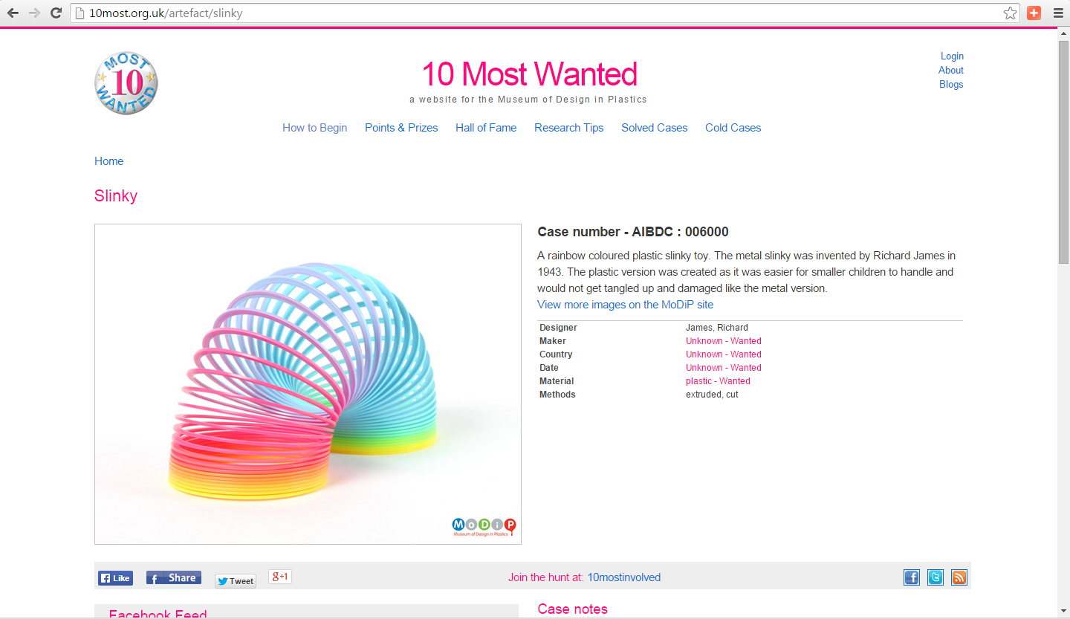
Identification: Museum of Design in Plastics (U.K.)

Slide 7
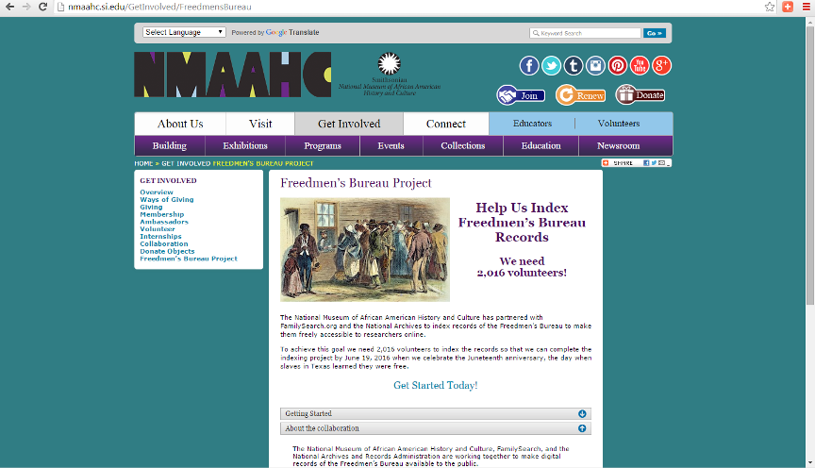
Identification: Smithsonian Freedmen’s Bureau Project

Slide 8
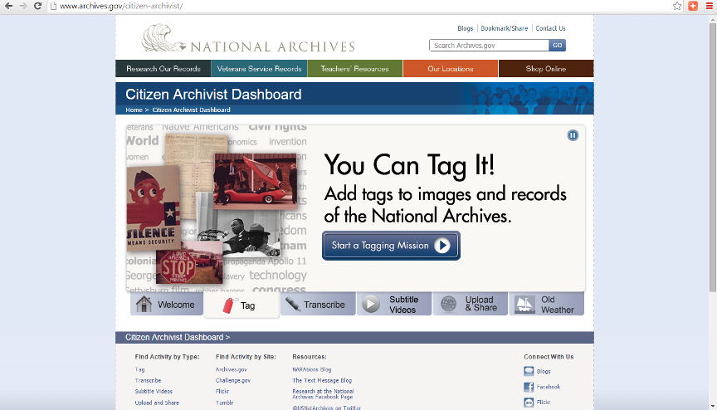
Transcription: U.S. National Archives

Slide 9
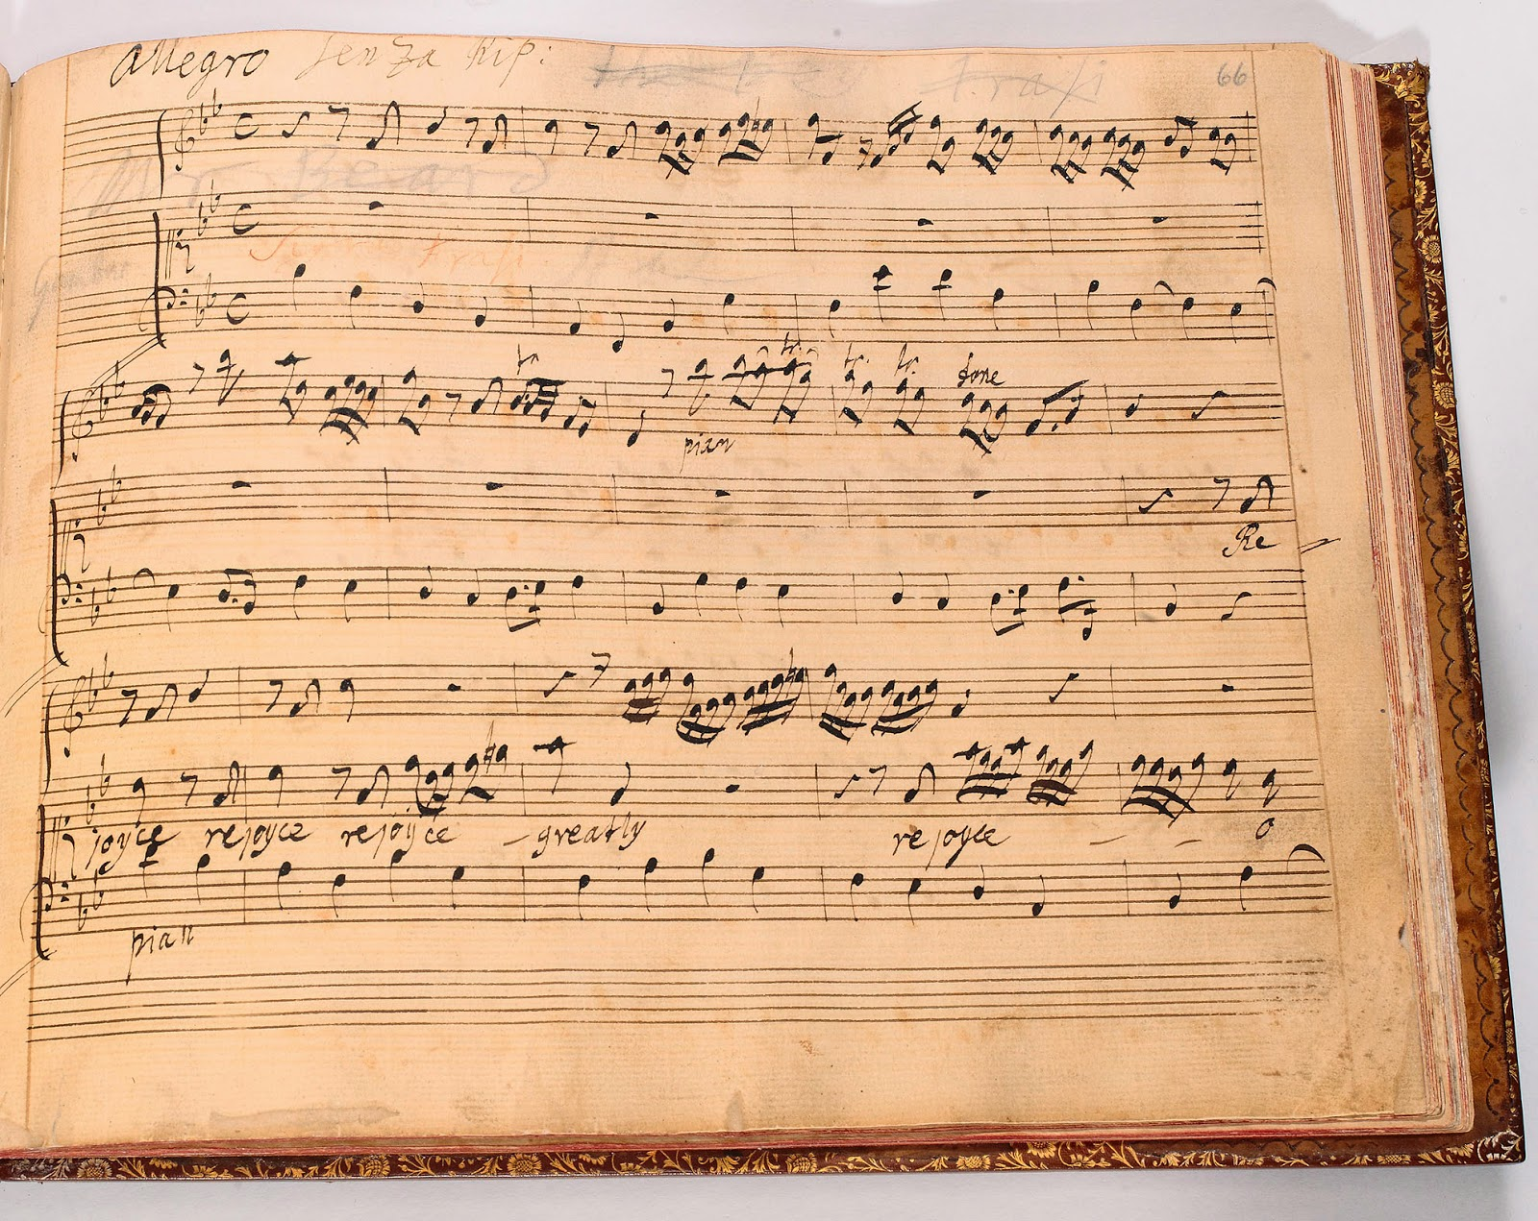
Identification: Bodleian scores (U.K.)

Slide 10
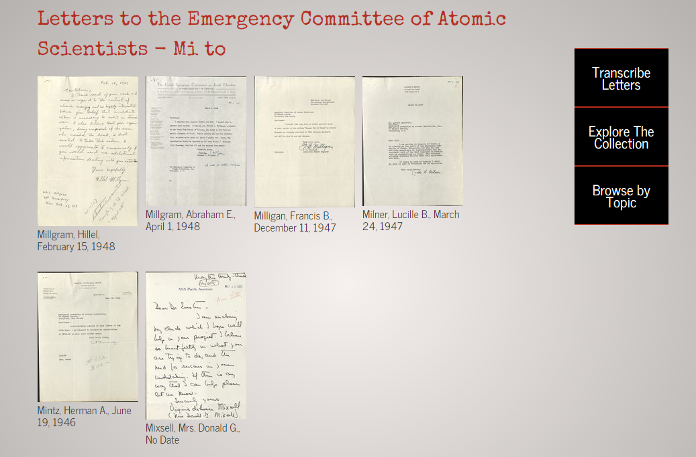
Transcription: Letters to Einstein

Slide 11
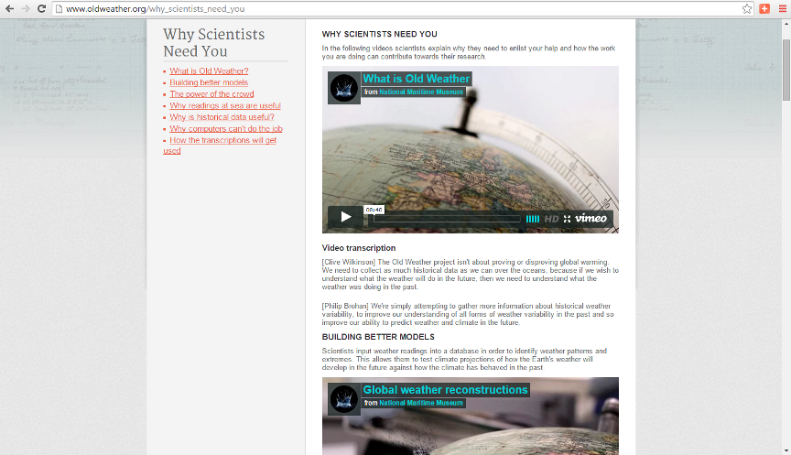
Transcription: Old Weather

Slide 12
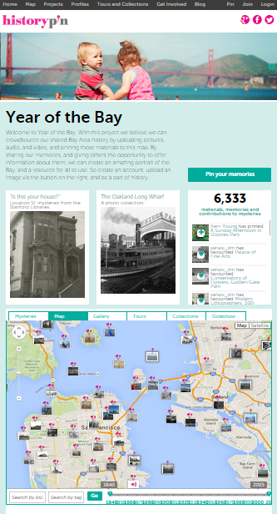
Mapping: Year of The Bay

Slide 13
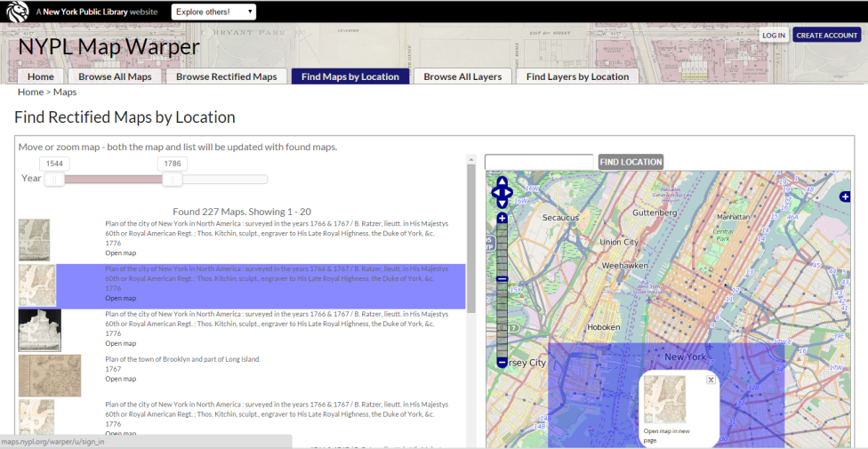
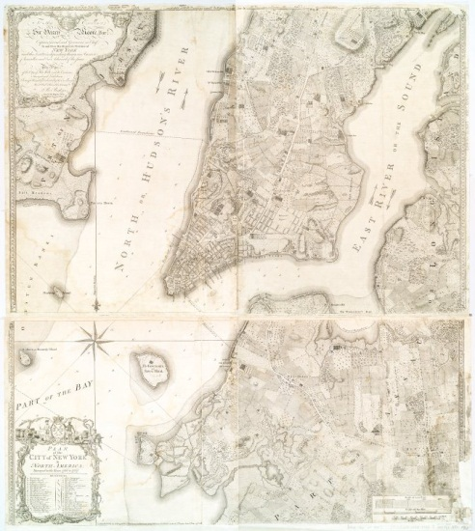
Mapping: New York Public Library MapWarper

Slide 14
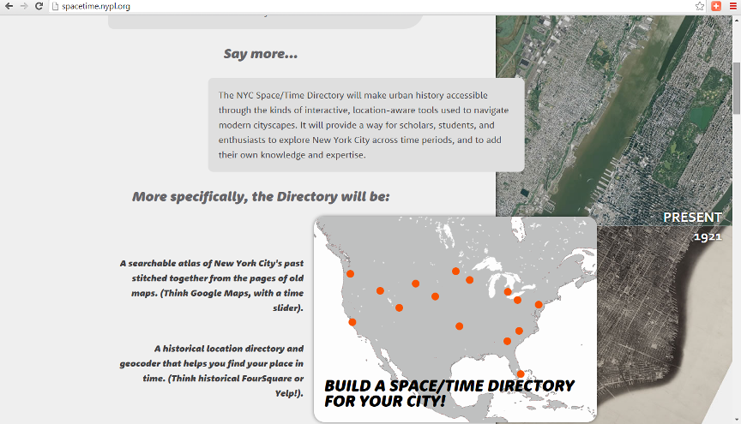
Mapping: New York Public Library Space/Time Directory

Slide 15
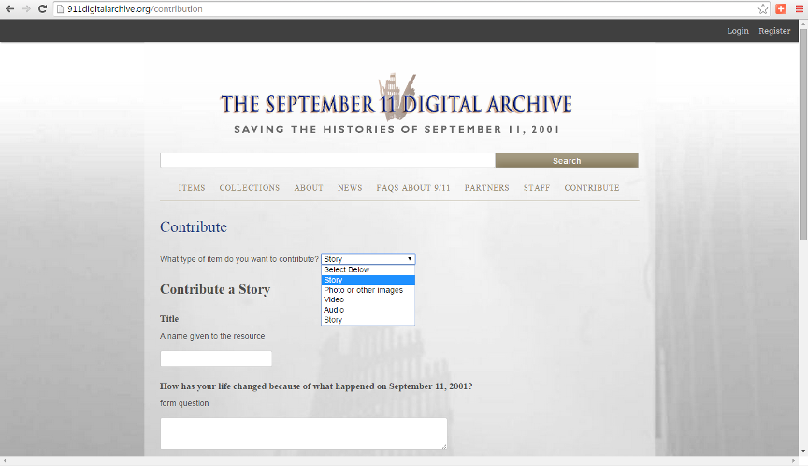
User-Generated Content: 9/11 Archive

Slide 16
Benefits & Opportunities
New goals without old limits (time / finances / resources)
New virtual communities & user groups
Involving & engaging community
Utilizing public knowledge, expertise & interests
Improving quality & value of data
Data discoverable in different ways for diverse audiences
New insight on user desires / interests
Demonstrating GLAM value by listening to community
Encouraging a sense of public ownership & responsibility

Slide 17
Challenges & Risks
Front-end effort for small or narrow projects with no environmental scan
Competition from digital content providers
Distraction of gaming / engagement opportunities
Social pressure against crowdsourcing expertise
Potential for “disintermediation” of GLAM professionals?

Slide 18

Organizing the Crowd of Crowds

Slide 19
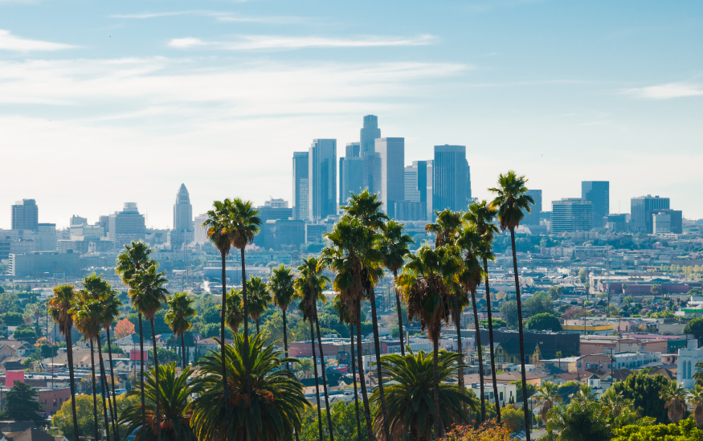
THANK YOU!
Kenn Bicknell
Digital Resources Librarian
Los Angeles County Metropolitan Transportation Authority (USA)
bicknellk@metro.net
Metro.net/library

