Slide 1
Research Library, Archive & Records Management
Matthew Barrett, Director
barrettm@metro.net x27444

Slide 2
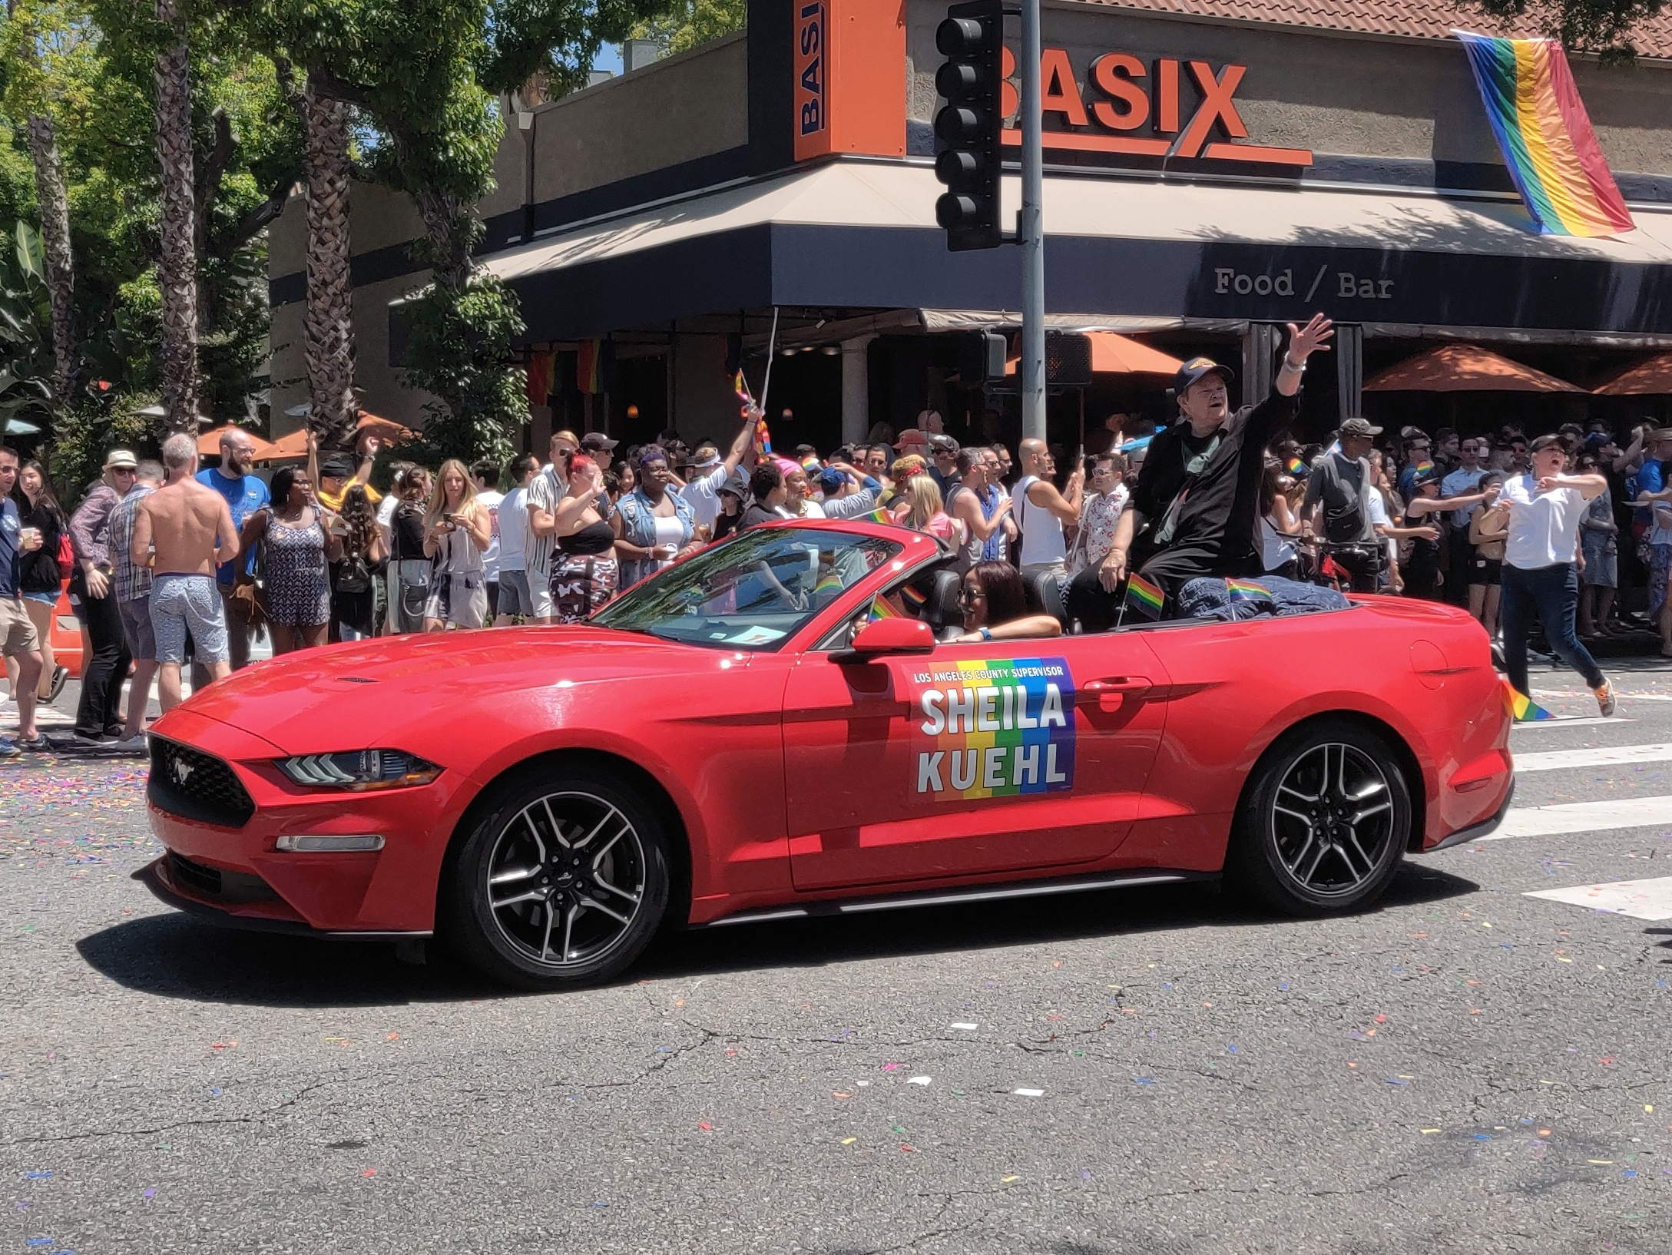
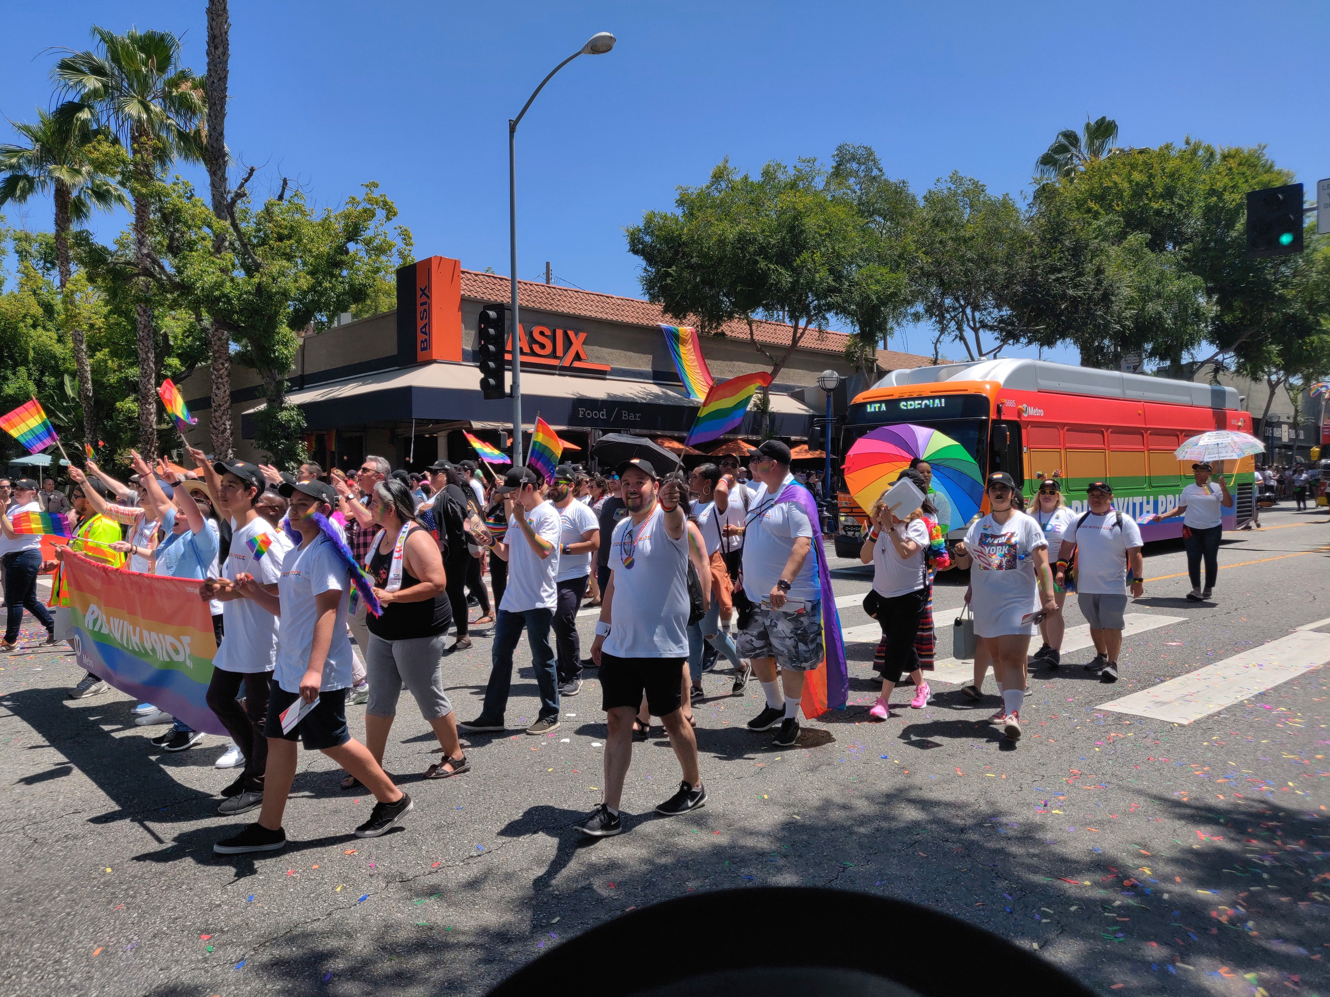
LGBTQ+ History at Metro & prior
2019 marks 20 years of Pride parade participation by Metro! Thank you to everyone who contributed along the way.

Slide 3
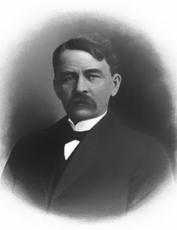
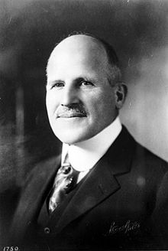
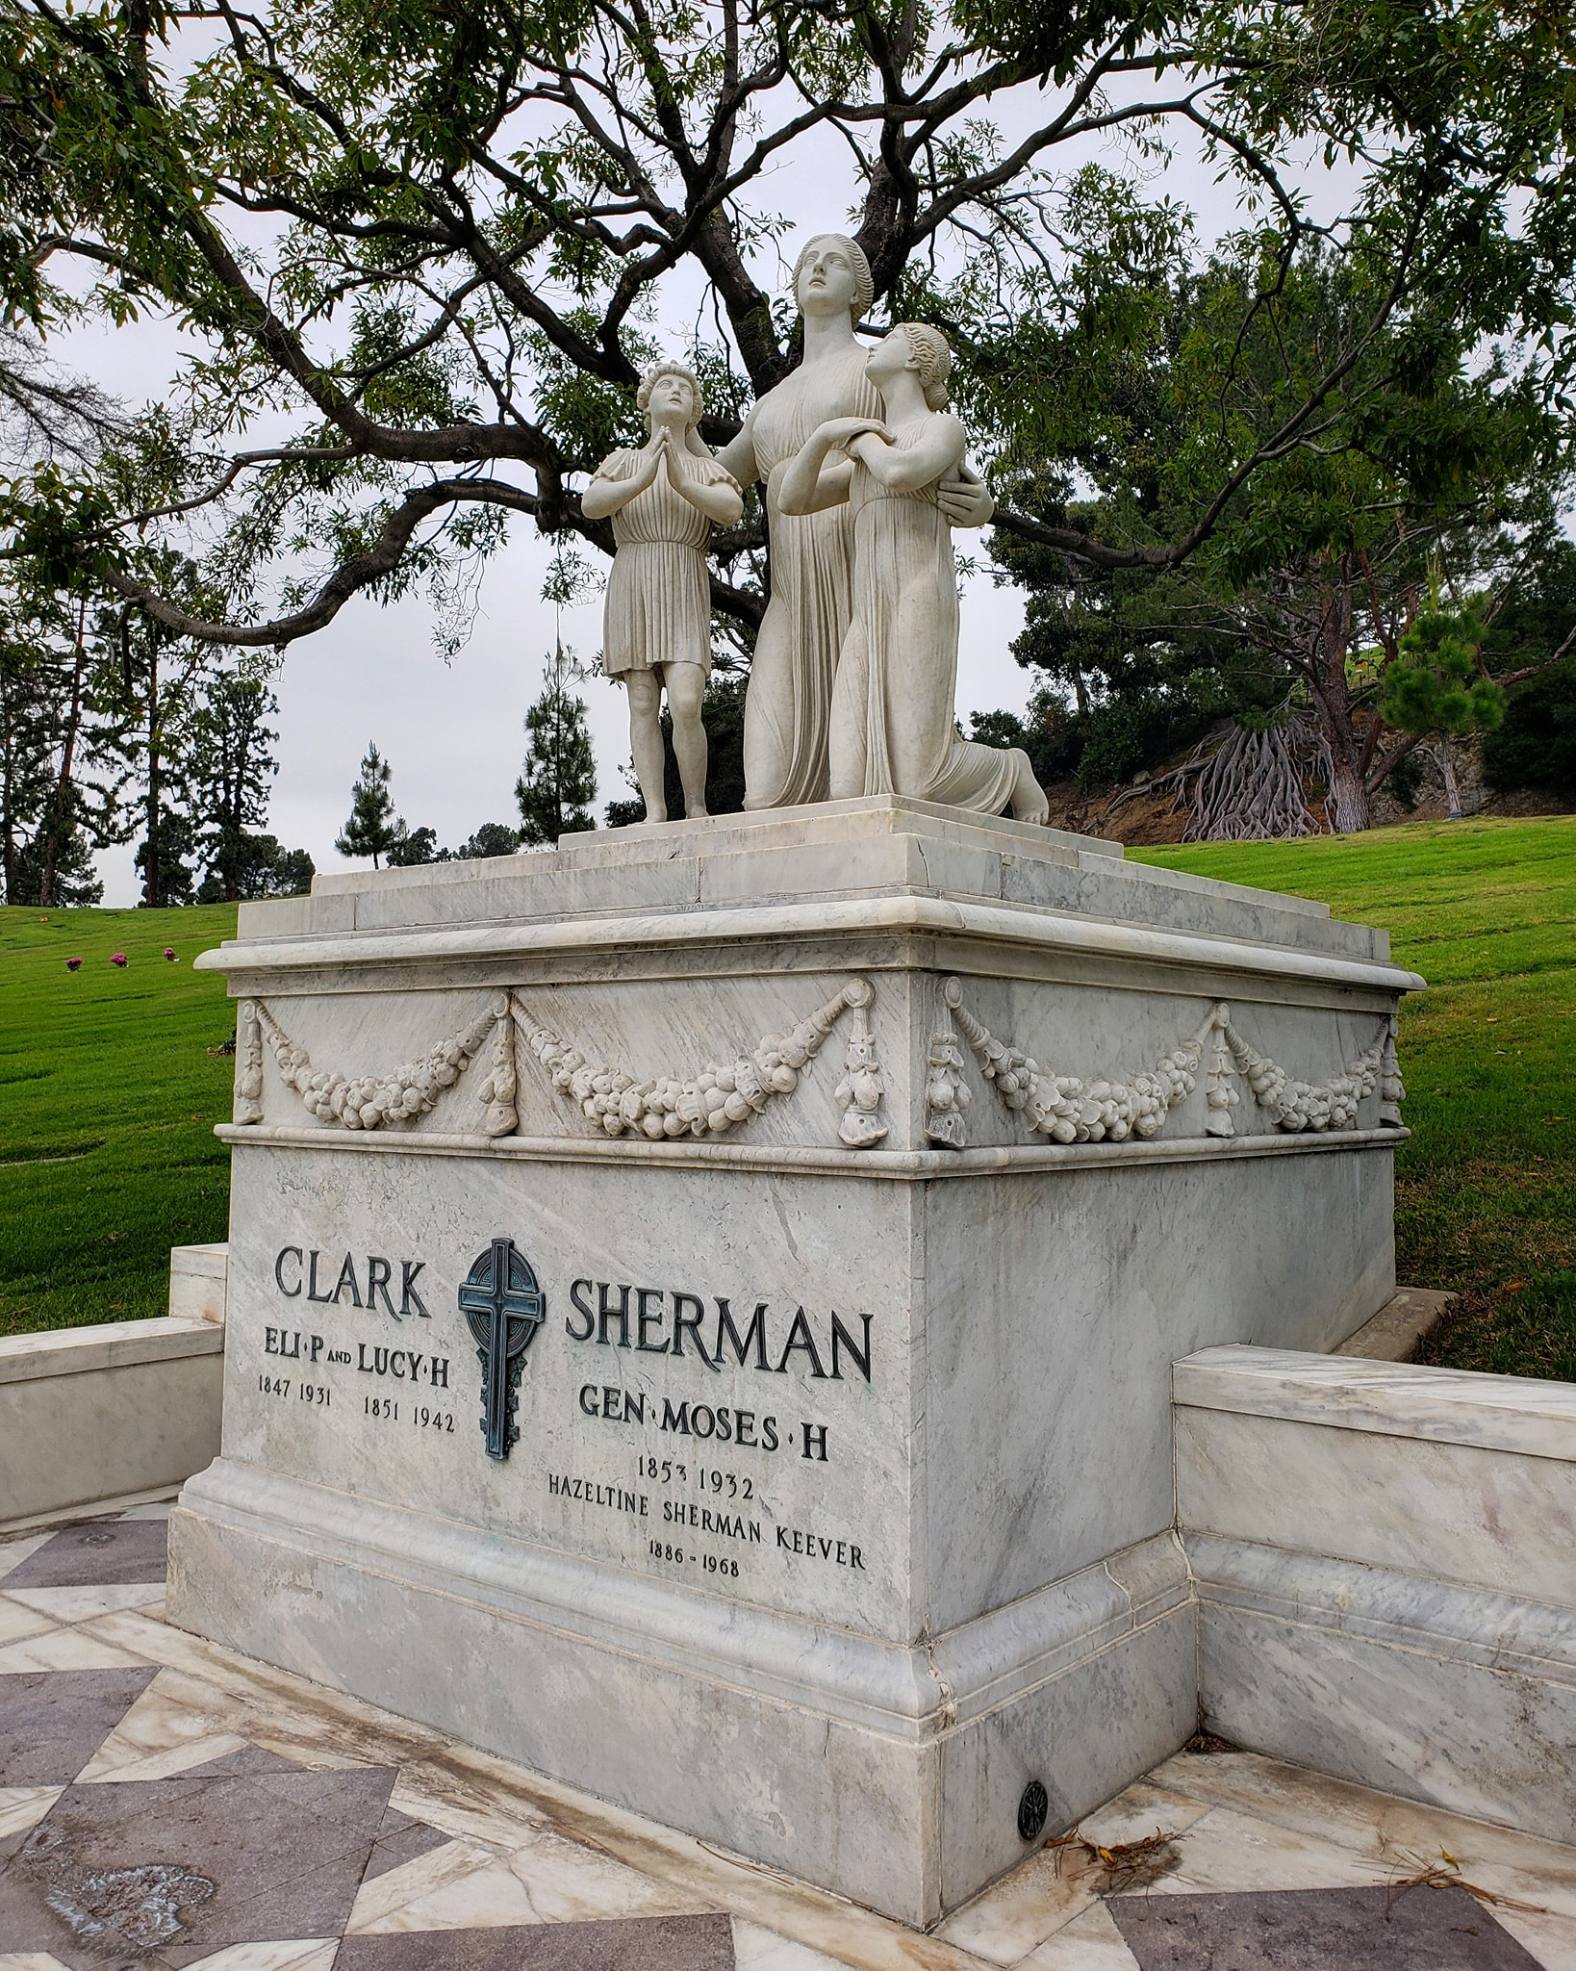
LGBTQ+ History at Metro & prior
How did Metro end up with a bus division in West Hollywood?
Division 7 in West Hollywood began as the Los Angeles Pacific Rail Company’s Sherman Yard in 1896. It was built by close friends Eli Clark and Moses H. Sherman, for whom Clark Drive, Sherman town, (now West Hollywood), and Sherman Avenue (now Santa Monica Boulevard), and Sherman Oaks were named. They were early pioneers of L.A.’s interurban electric railways that laid track from downtown to the sea.
They purchased the 5.56 acre West Hollywood site in January 1896, and an additional 13.81 acres of reclaimed land in 1906 after the adjacent swampy Sherman land was filled in with dirt from trackway excavations on Sunset Boulevard. Sherman and Clark also opened our Transportation Research Library in 1895 at their downtown rail yard, the Los Angeles Consolidated Railway Building.
The West Hollywood Division was passed down through Pacific Electric (1911-1953), Metropolitan Coach Lines (1953-1958), LAMTA (1958-1964), SCRTD (1964-1993), and LACMTA (1993-present).

Slide 4
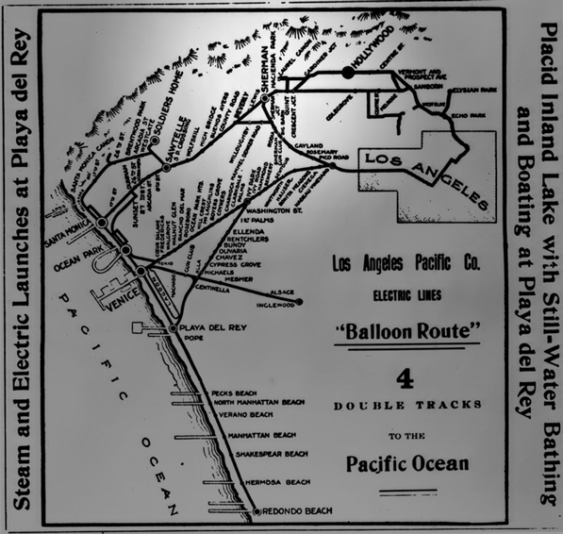
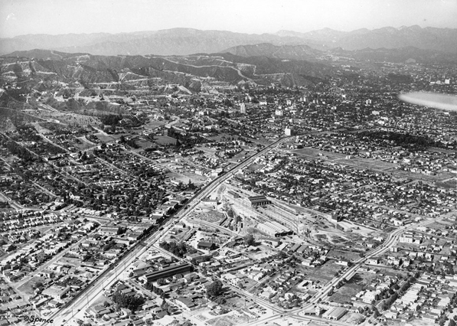
LGBTQ+ History at Metro & prior
West Hollywood, 1929. 19+ acre Pacific Electric Rail Yard spans SM Blvd to Melrose. Division 7 converts to bus service on 9/5/1954. Southern half later becomes the Pacific Design Center.
West Hollywood, once known as Sherman

Slide 5
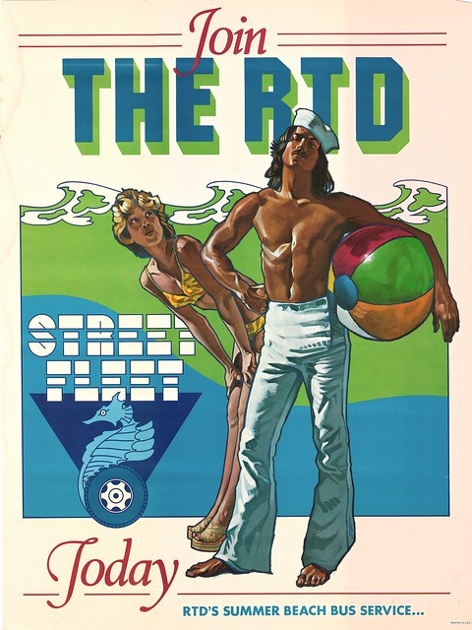
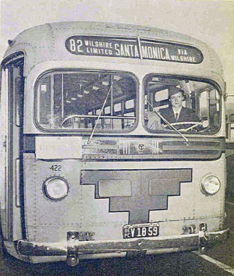
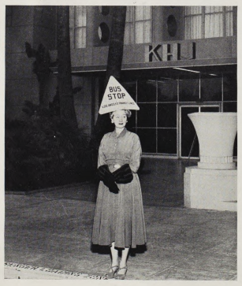
LGBTQ+ History at Metro & prior
Bertha Durborrow, AF Pilot, Golfer, WWII bus operator, 1942
Hedda Hopper, Hollywood gossip columnist, celeb outer, & hat enthusiast
Drew Struzan, poster artist contracted by SCRTD in 1974

Slide 6
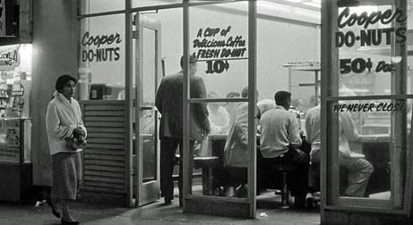
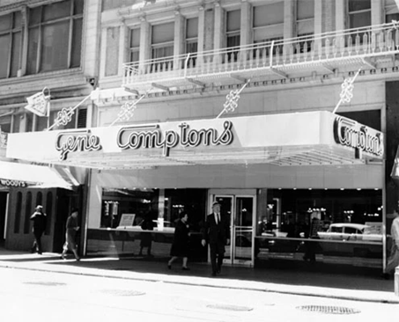
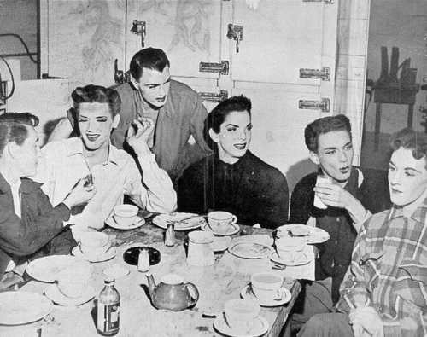
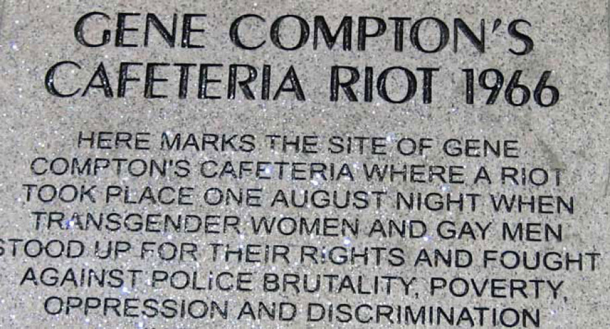
LGBTQ+ History at Metro & prior
San Francisco
Gene Compton’s Cafeteria Riot
August 1966
Los Angeles, 5th & Main
Cooper Do-Nuts Riot
May 1959

Slide 7
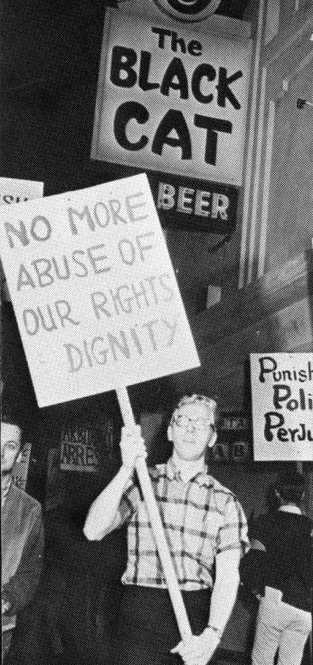
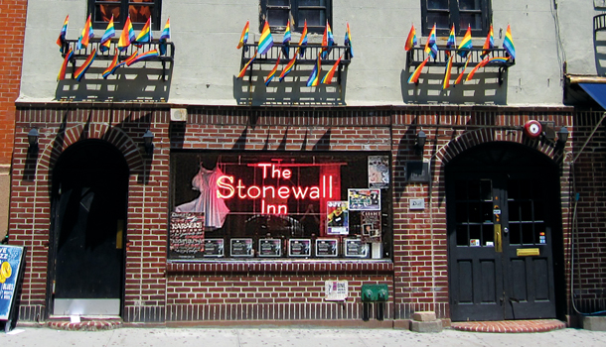
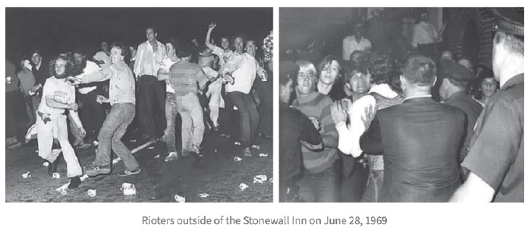
LGBTQ+ History at Metro & prior
New York, Christopher Street
Stonewall Inn Riot
June 28 & 29, 1969
Los Angeles, Silverlake
Black Cat Tavern
Protest, February 11, 1967
LA Historic Cultural Monument #939

Slide 8
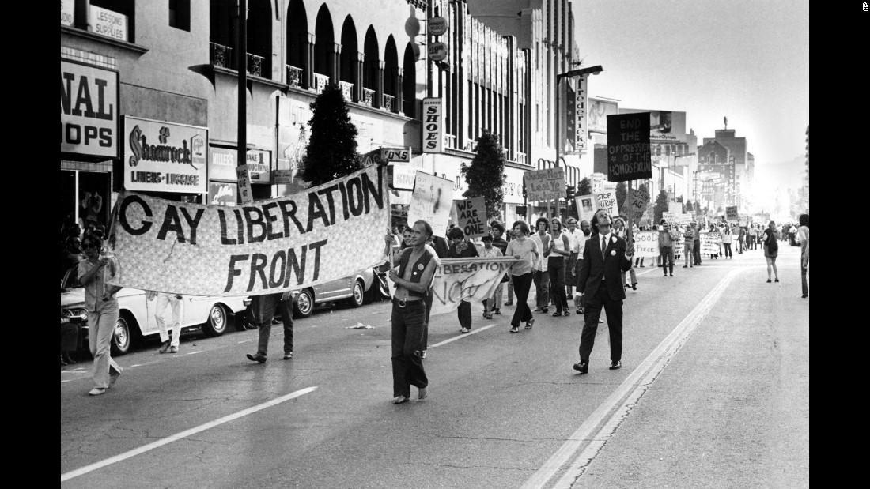
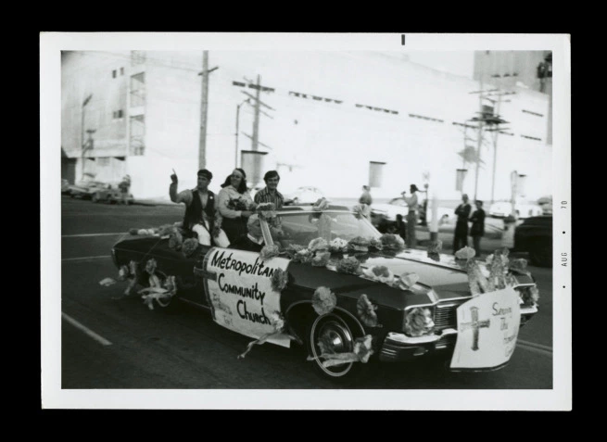
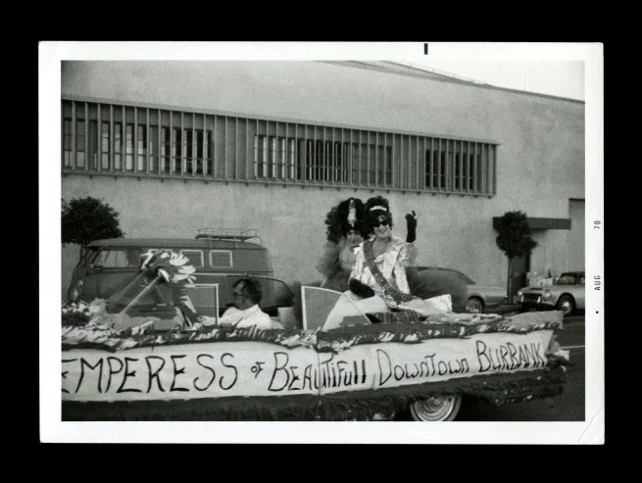
LGBTQ+ History at Metro & prior
First Pride Parades, Marches, & Demonstrations –
Chicago - Saturday June 27th, 1970
Los Angeles, San Francisco, New York City - Sunday June 28th 1970
Los Angeles held an actual police permitted parade, down Hollywood Blvd, with floats and organized groups.
More images of the first parade can be found here: https://artblart.com/tag/early-gay-activism/

Slide 9
LGBTQ+ History at Metro & prior
The Southern California Rapid Transit District (SCRTD) staff, primarily in its Scheduling and Marketing departments, began having LGBTQ social gatherings, after work happy hour events, and an annual holiday dinner starting in the mid-1980s.
The first HIV awareness article appears in employee news in 1983. The first profile of an HIV positive employee appears in 1988.
In late 1988, the governing boards of SCRTD and Los Angeles County Transportation Commission (LACTC) agreed to talk about a merger of the two agencies.
SCRTD LGBTQ staff invited LACTC LGBTQ staff to join them in socializing that same year. The group called itself QuIT, Queers/Queens in Transit.
Pre-email (1992), pre-intranet (1996) days, event invites were all word of mouth, and the occasional use of a pink/lavender highlighter in the printed employee directory.

Slide 10
LGBTQ+ History at Metro & prior
Merger Issues – Clash of cultures: the more closeted, conservative transit district and the more out, progressive transportation agency:
Sexual Orientation was initially left out of the first EEO/Non-Discrimination Statement published by the Merger Steering Committee pre-merger. It existed in LACTC’s policy statement and employees were surprised to see it removed from the merger’s version. Ally Richard Alatorre, Chair of the Merger Steering Committee, amended it and the inclusive statement was adopted at the first LACMTA Board Meeting February 4, 1993.
After a year of internal discussion, the Employee Benefits program for the merger included Domestic Partner Benefits starting with open enrollment in 1994. The City and County began offering domestic partner benefits to their employees just a couple of years earlier.
QuIT social group falls apart during massive layoffs, over 700 in the first 3 years of Metro.
Diversity Task Force created in 1997. Includes LGBTQ employees.
First Metro Pride Parade bus appears in 1999.

Slide 11
LGBTQ+ History at Metro & prior
Some of the early Metro LGBTQ Leadership, Influencers and allies:
Julian Burke SCRTD Board of Directors 1973, Metro CEO 1997-2001.
George Takei SCRTD Board of Directors 1973 to 1984.
*Ellen Levine, LGBTQ ally, headed up transit operations from 1994-1998, ensured employees and supervisors attended LGBTQ sensitivity training. She had a office at West Hollywood Division 7.
*Bill Gay 1994-1999 and *Helen Ortiz Gilstrap, Ops Public Affairs 1994-2000.
*John Escher, TOS Division 7 and VO. Coordinated between LA Pride and Division 7 operations on parade and festival weekend logistics.
Don Ott – OMB, Facilities Maintenance, later CAO.
Ryan Nakagawa – Chief Ethics Officer, 1992-1999.
Gary Clark – Government Relations and Board Research Svcs 1988-2005.
Bevan Dufty – Government Relations 1988-1993, now SF County Supervisor.
David Miller – Employee Pension & Benefits 1991-1994.
Mary Reyna – SCRTD and County Counsel Attorney.
*employees that had a direct role in the first Pride bus.

Slide 12
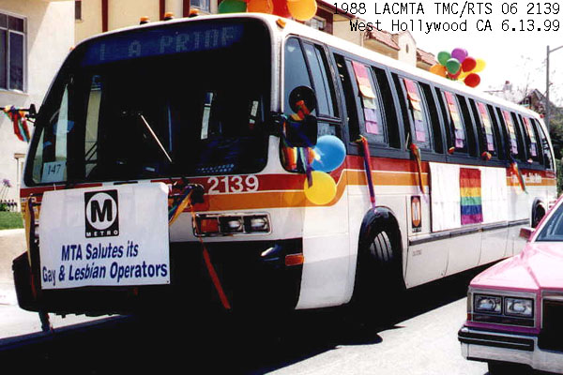
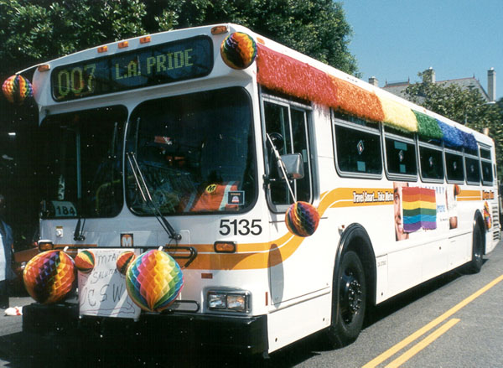
LGBTQ+ History at Metro & prior
20 years of Pride Buses
1999
2000

Slide 13
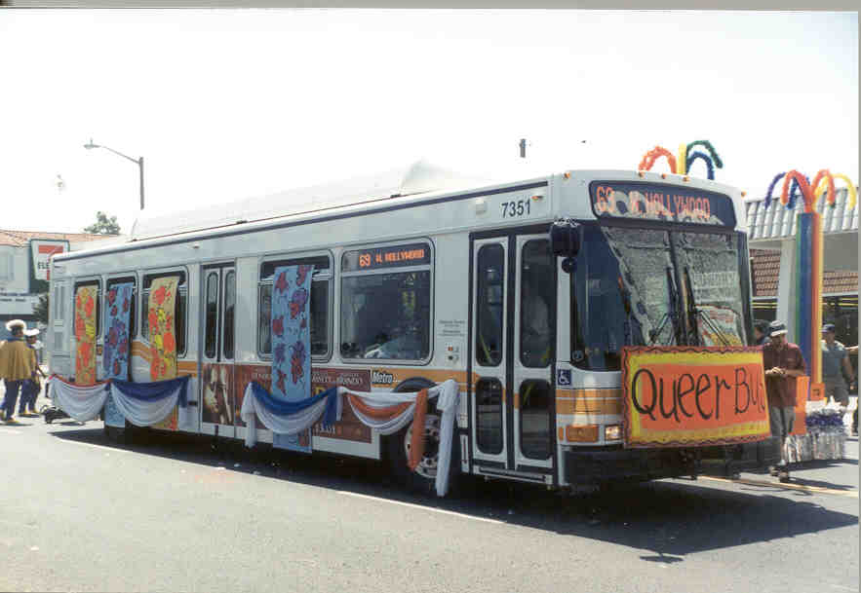
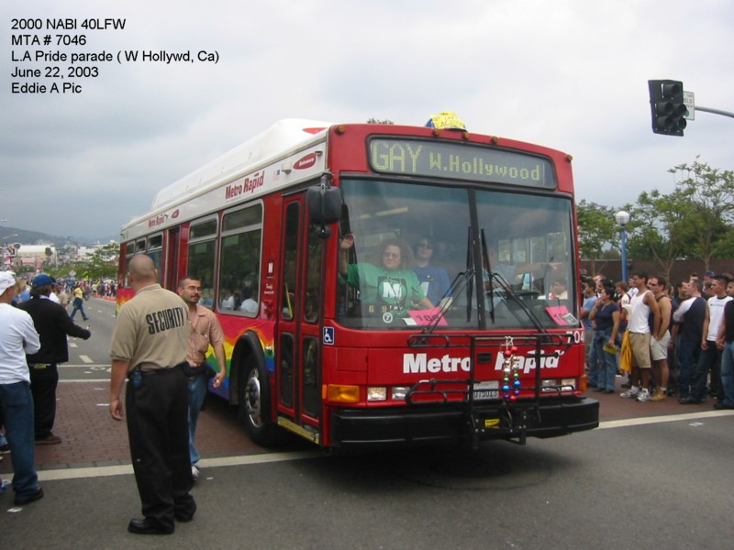
LGBTQ+ History at Metro & prior
2001
2003

Slide 14
LGBTQ+ History at Metro & prior
1994 and 1995 HR Analyst for Transit Police recruitment has a booth at the LA Pride festival
1996-1998 Metro public affairs continues participating in the festival to promote Metro transit programs with lots of giveaways and customer info.
1999-2004, LA Pride parade employee participation is mostly done on the downlow, on a need to know or special invite basis. Board members also participate but don’t coordinate with Metro.
2003 – New Metro Branding campaign kicks off
2005 – The Design Studio is enlisted to “brand” Metro participation in the annual Christopher Street West AKA L.A. Pride, Gay, Lesbian, Bisexual, Transgender, Questioning…. Parade.

Slide 15
LGBTQ+ History at Metro & prior
2005 – Ice breaker and ally Jody Litvak sends out the first all staff email invitation to participate and has flyers posted in the elevator lobbies. A mini-backlash occurs from some of Metro’s religious/conservative employees who were unaware of Metro previous years of participation in the event, or even what the full name of the event was. Difficult but important step toward equality in the workplace.
Mayor Antonio Villaraigosa, Supervisor Zev Yaroslavsky, and Santa Monica Councilmember Pam O’Connor are among the first board members to regularly participate in the LA Pride Parade.
2008 - Pam O’Connor is the first member of the Board of Directors to coordinate the ride/walk/march with the Metro bus and participants.
Can be seen on YouTube via local WeHo cable access coverage that year:
https://www.youtube.com/watch?v=qz6stI1zMGM

Slide 16
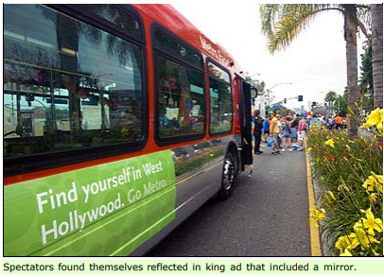
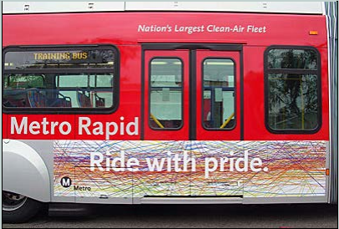
LGBTQ+ History at Metro & prior
2005
2006

Slide 17
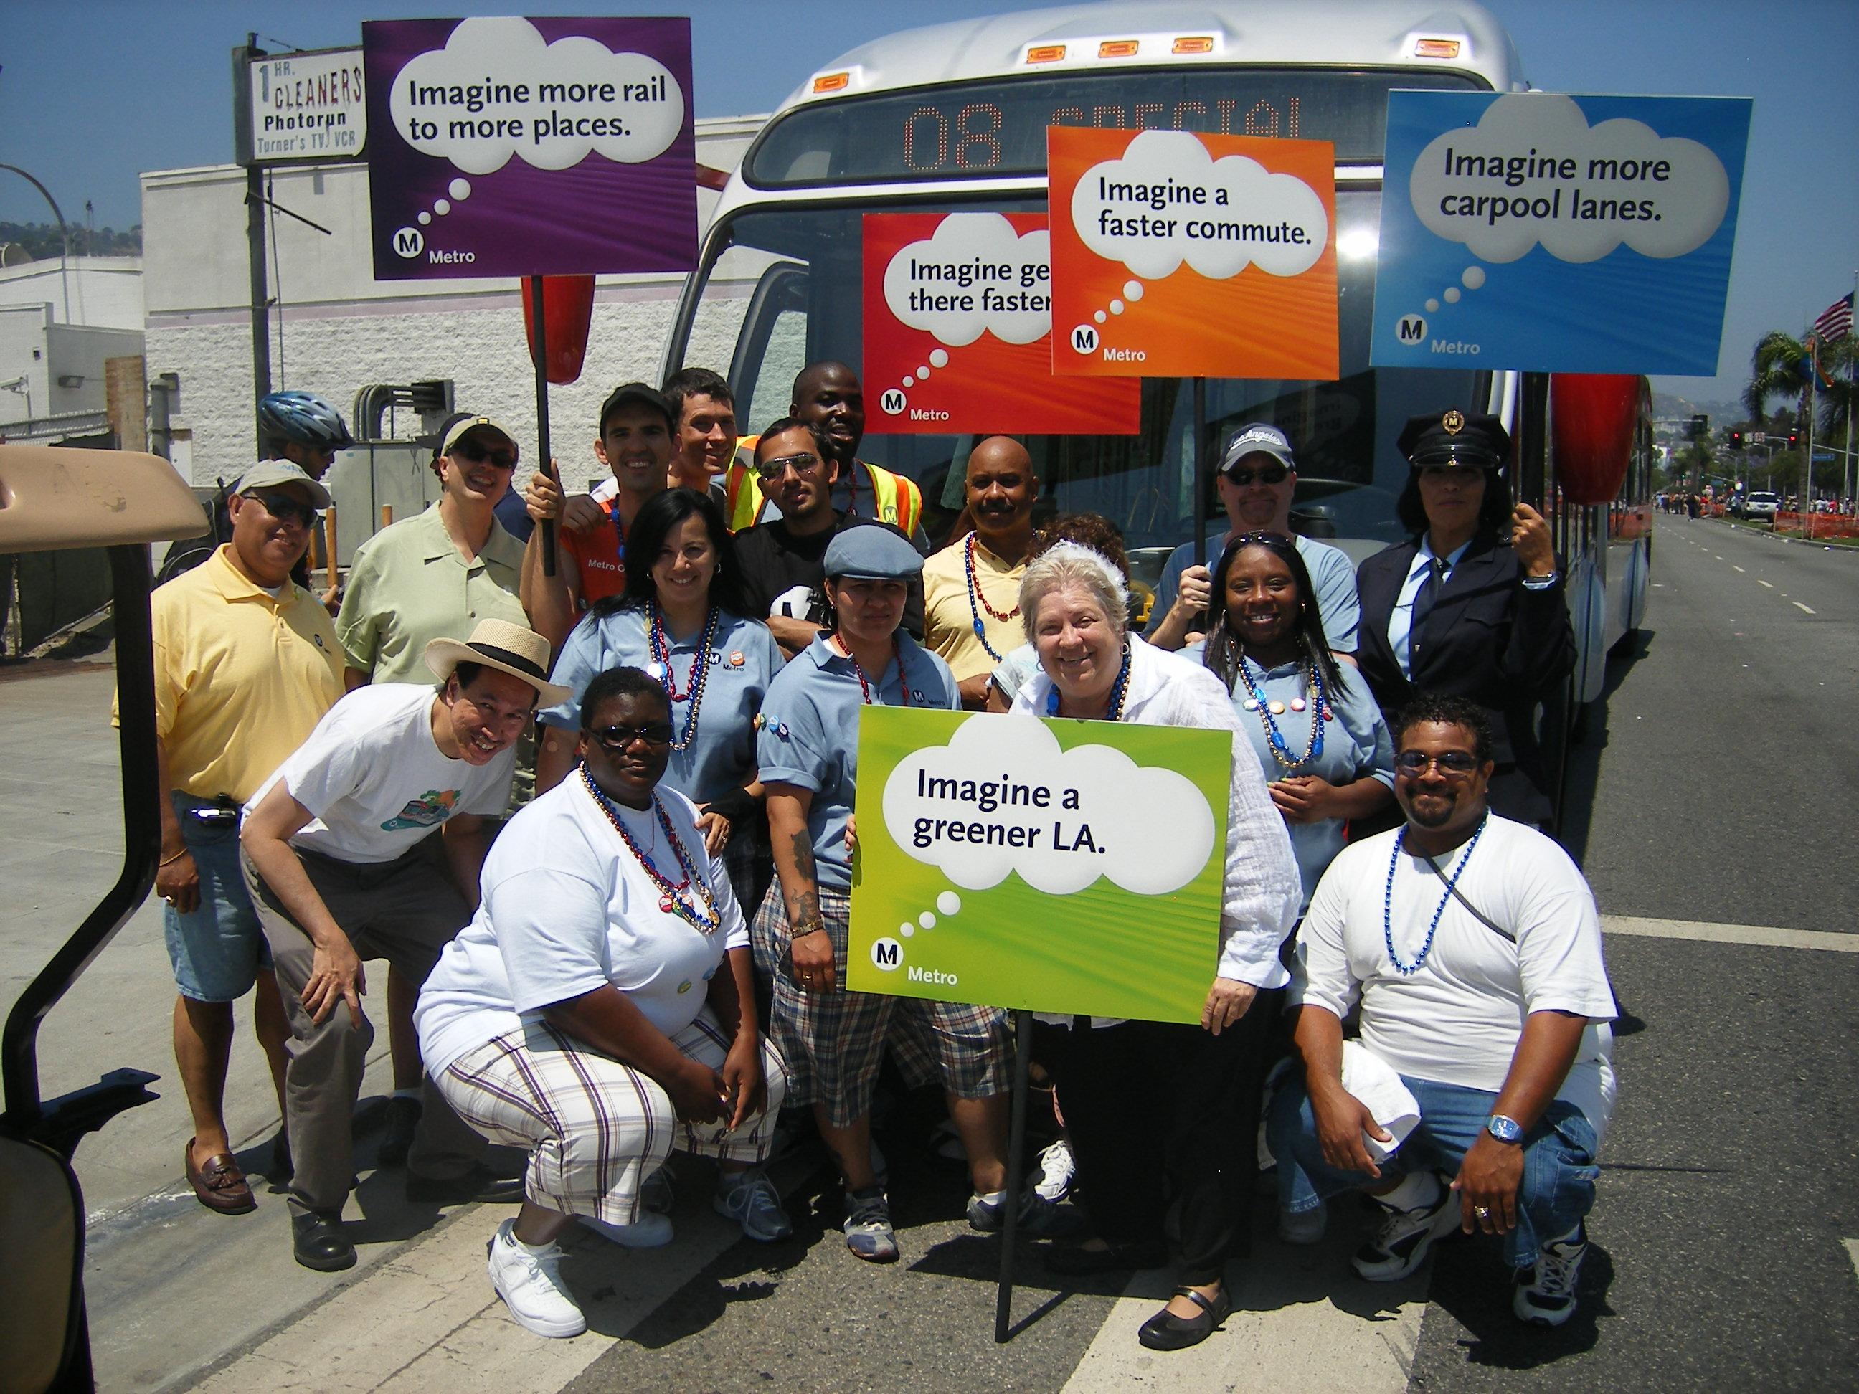
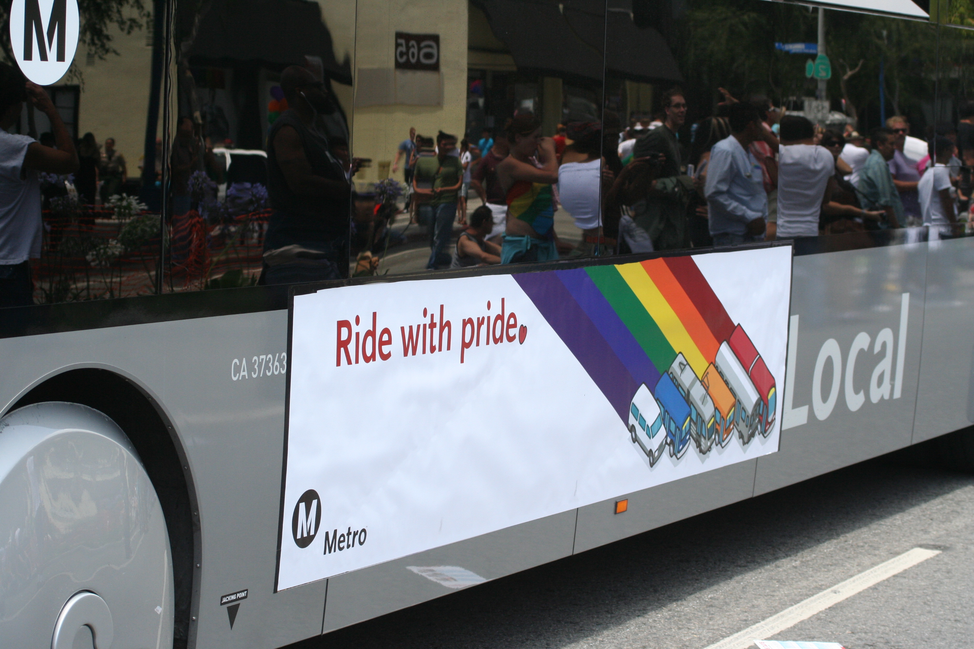
LGBTQ+ History at Metro & prior
2008
2009

Slide 18
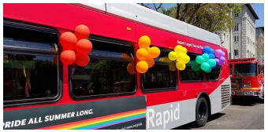
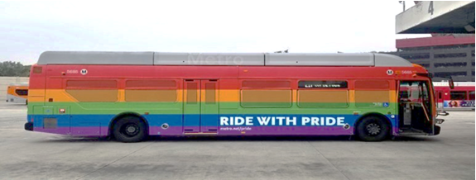
LGBTQ+ History at Metro & prior
2018
2019

Slide 19
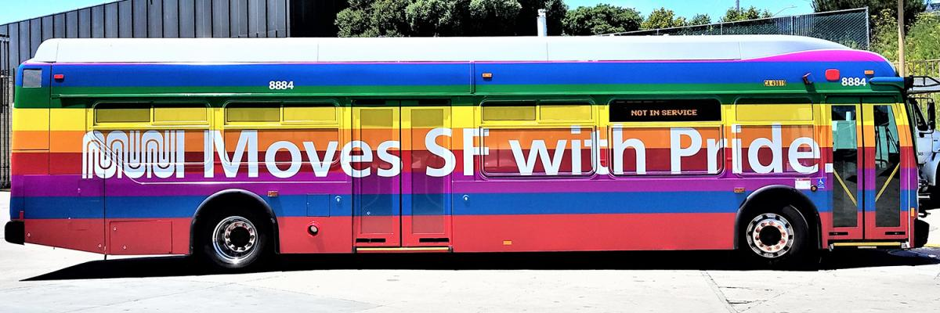
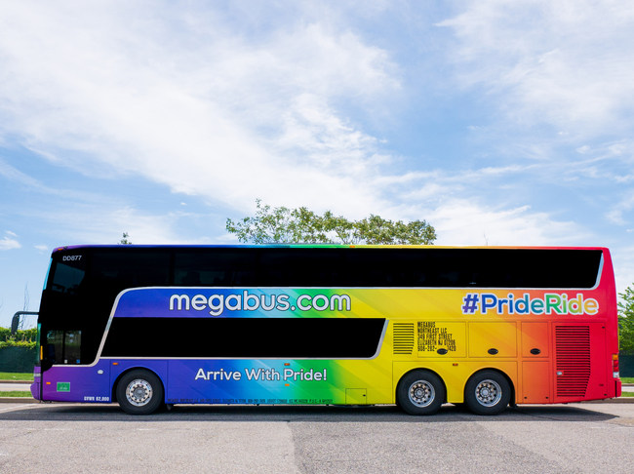
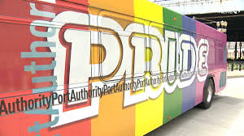
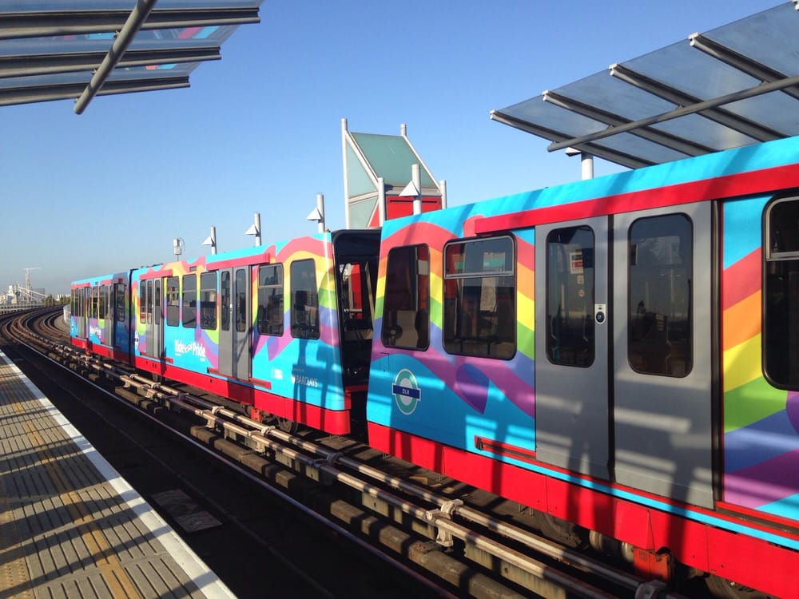
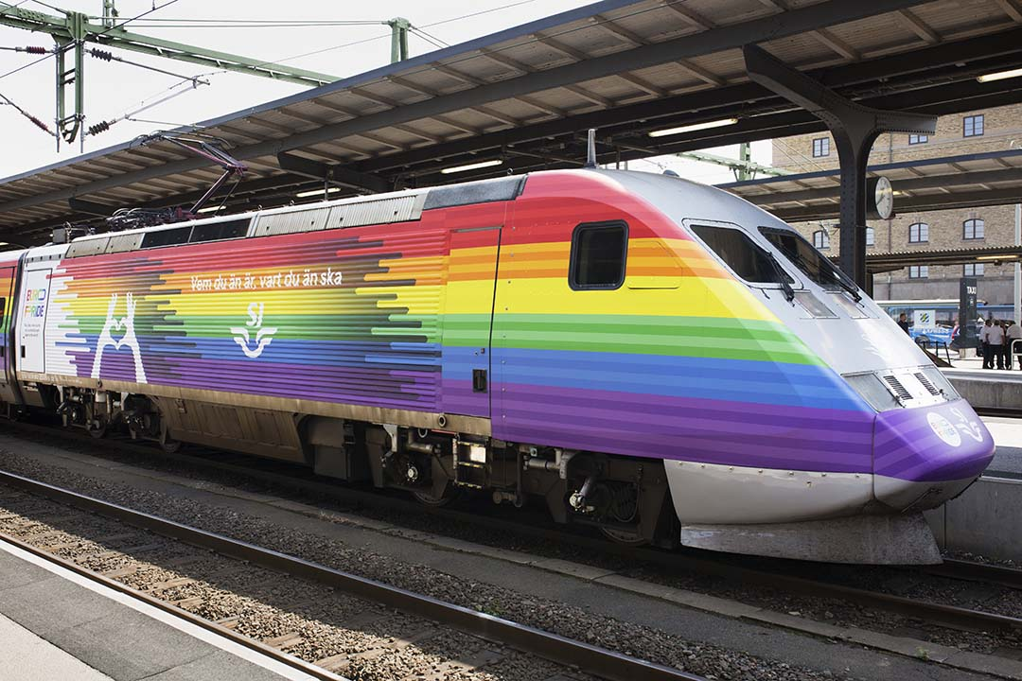
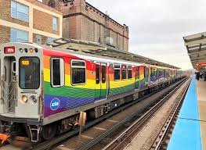
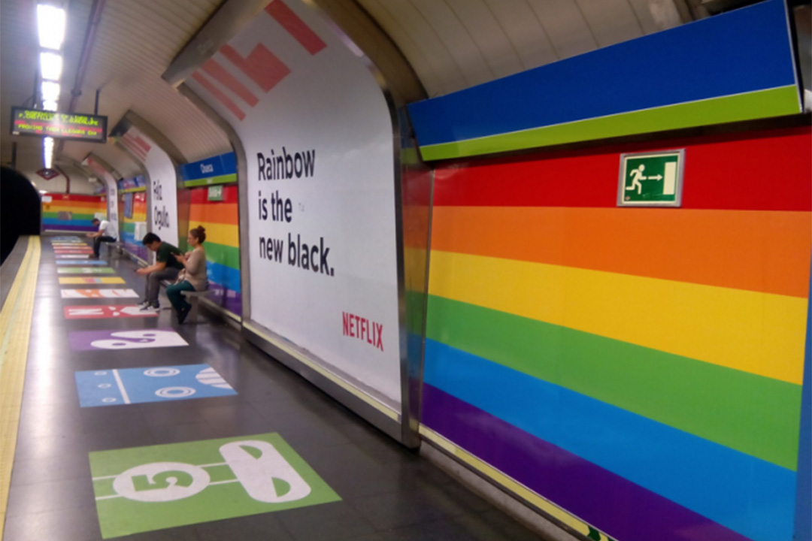
LGBTQ+ History at Metro & prior
Pride rainbow flag buses, trains, and transit stations are now regularly seen in the US, Canada, Australia, & Europe

Slide 20

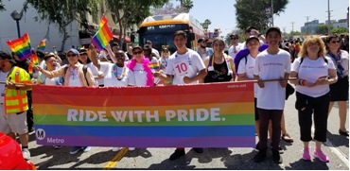
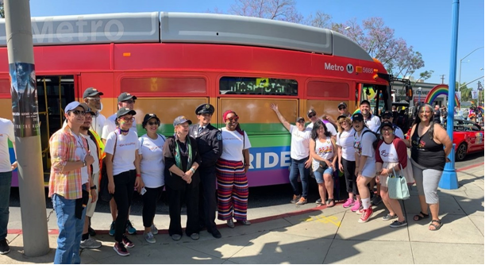
Today
out@metro became an official affinity group in 2015, thanks to Luke & Kevin
out@metro facebook page, thanks to Luke, Devon, and Ray
Civil Rights 11 – Gender Transition Policy approved in 2015, updated in 2019. Workplace transition plan guidelines and tips for working with transgender co-workers are available on MyMetro intranet. Thanks to Luke, Jonaura, and Mary.
Out Metro Board Directors include LA County Supervisor Sheila Kuehl, City of Long Beach Mayor Robert Garcia, and LA City Councilmember Mike Bonin. Ally Mayor Garcetti regularly participates in LA Pride.
LGBTQ+ events, networking and visibility has never been better.

