Slide 1
Los Angeles Transit History
Matt Barrett, Director
Transportation Research Library, Archive & Records

Slide 2
Research Library & Archive
Originally the library of the Los Angeles Consolidated Railway Company, later LARy (1895-1945), and intended to serve as both public outreach and an employee resource.
Archive of Los Angeles transit history from 1873-present.
Founding member of the Special Library Association’s Transportation Division.
Repository of federally funded transportation research starting in 1971.
Began computer cataloging into OCLC’s World Catalog using Library of Congress Subject Headings and honoring interlibrary loan requests from outside institutions in 1978.
Transportation research library for employees, consultants, students, academics, other government agencies and the general public.
Partner of the National Transportation Library, member of Transportation Knowledge Networks, and affiliate of the National Academies’ Transportation Research Board (TRB).
Largest transit operator-owned library, forth largest transportation library collection after U.C. Berkeley, Northwestern University and the U.S. DOT’s Volpe Center.
Member of Getty/USC’s L.A. as Subject Archives Forum.

Slide 3
Accessing Collections Online
Online:
Metro Transportation Research Library Catalog librarycat.metro.net
Public Records records.metro.net
Daily aggregated transportation news headlines blog: headlines.metroprimaryresources.info
LA Transit history highlights and 365 calendar using documents in our collection: metroprimaryresources.info
Photos: flickr.com/metrolibraryarchive
Film/Video: youtube/metrolibrarian
Social Media: facebook, instagram, bluesky, tumblr, historypin, Tiki-Toki (timeline), Peopleplotr (family tree)
Email: library@metro.net or RMC@metro.net
In Person:
Research Library/Archive: 15th floor, Metro headquarters
Records Management: Plaza Level, Metro headquarters

Slide 4
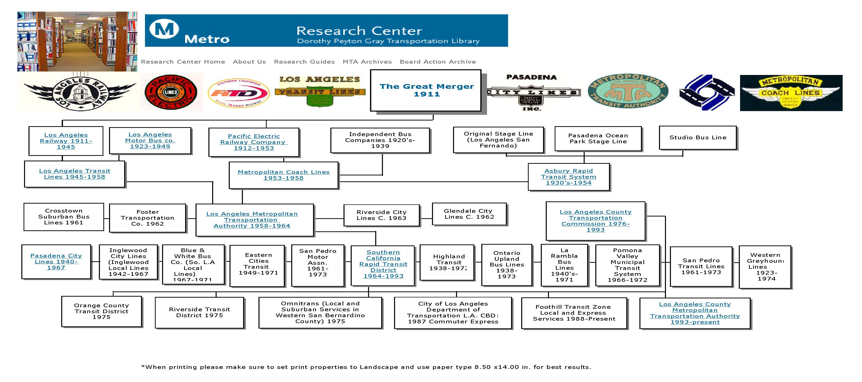
L.A. Transit’s Family Tree
Full Version Online:
Peopleplotr (family tree)

Slide 5
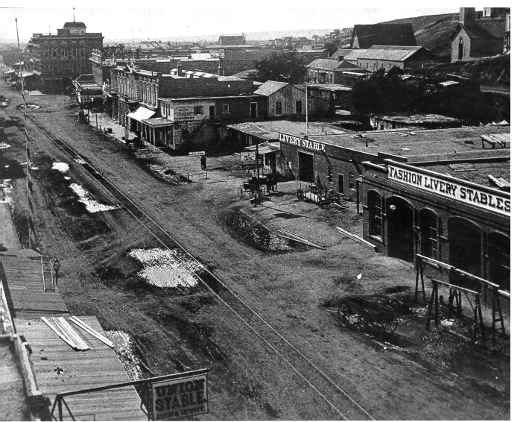
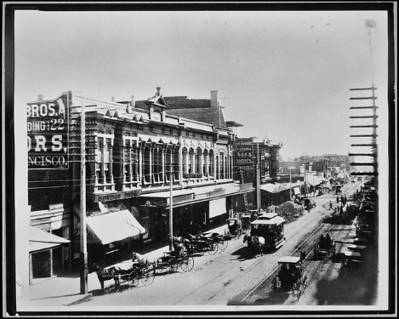
1870’s Horse Drawn Rail

Slide 6
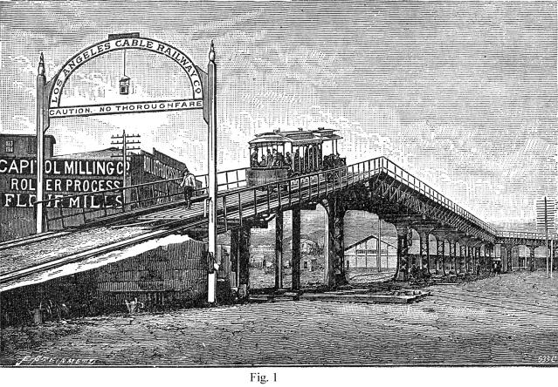
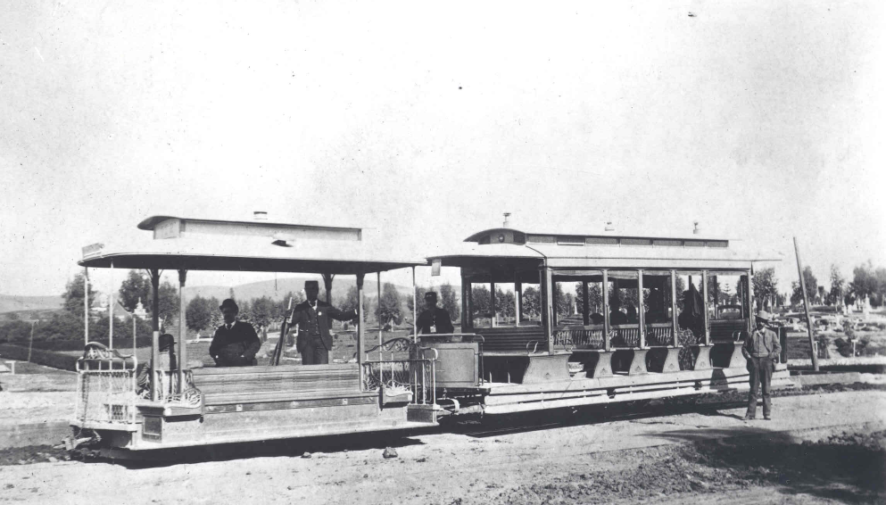
1880’s – Cable Cars
As population and transit use grew in Los Angeles, horse drawn rail cars were quickly replaced with newer technology cable cars.
Cable Cars proved highly unreliable operating under the unpaved dirt roads of early Los Angeles, they frequently froze, choked with dirt and gravel.

Slide 7
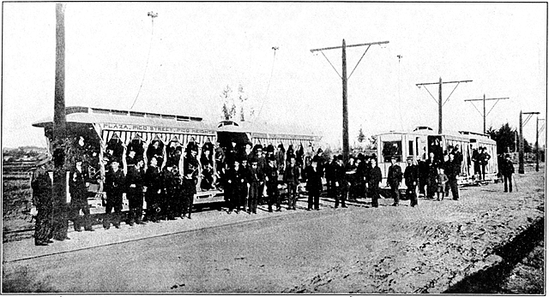
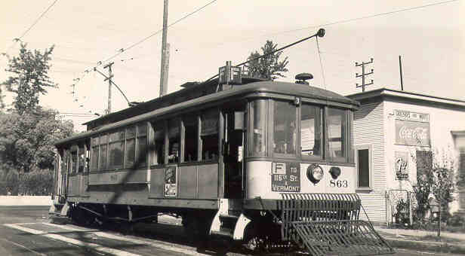
1890’s - Electrification
Better technology and overhead electrically-powered rail cars allowed the transit system to rapidly consolidate, expand, and create the sprawling Southern California we know today.

Slide 8
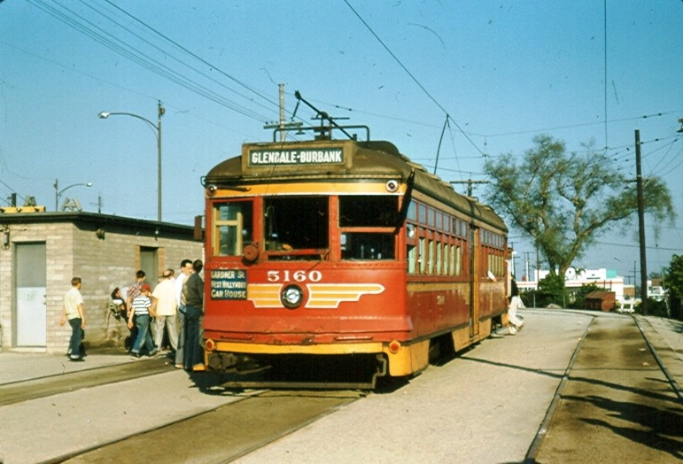
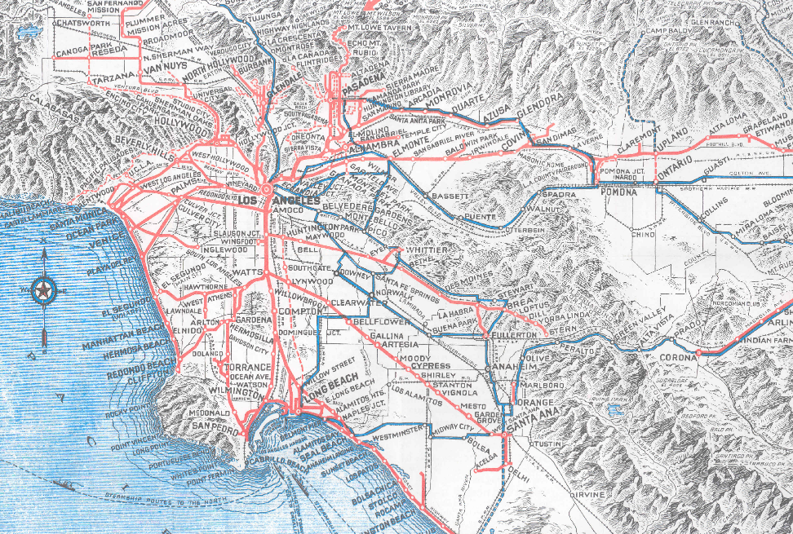
Pacific Electric (1895-1953)
Connected the suburbs and the city center, served Los Angeles, San Bernardino, Riverside and Orange Counties, also ran connecting buses.
Peak number of rail lines in 1925, peak ridership in 1923, and again during WWII due to rationing.
It was the electric “Metrolink” commuter rail of its day, only much more extensive with 1,100 track miles, up to 2,700 trains a day, and multiple hubs.
Created the footprint of today’s sprawl.

Slide 9
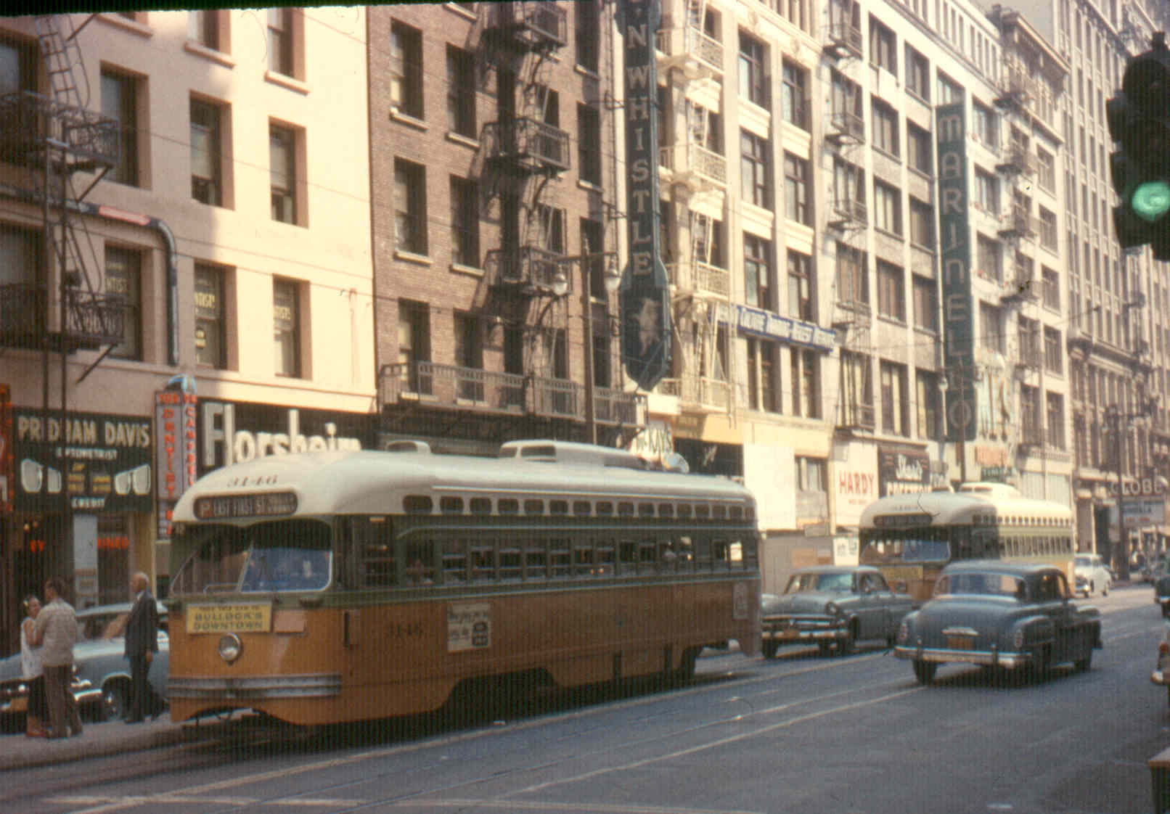
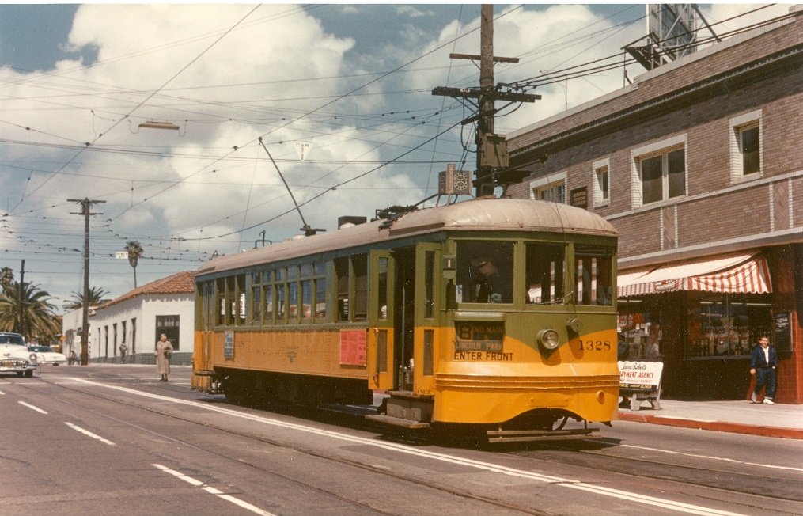
Los Angeles Railway (1895-1945)
Operated in the center of city streets, connecting points north, south, east and west with downtown Los Angeles, Pacific Electric and other transit service providers.
Peak number of lines around 1925, peak ridership during WWII, 742 streetcars and about 650 track miles, also operated motorbuses and electric trolley buses.
Grandfather of today’s urban bus system. Largely forgotten and frequently confused with Pacific Electric.

Slide 10
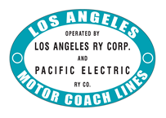
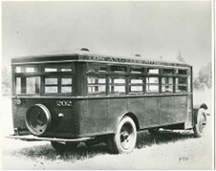
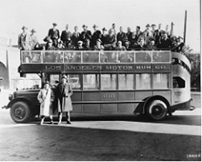
Los Angeles Motor Coach (1923-1949)
LA’s first bus company, formed by the two rail transit companies PE and LARy, to serve communities along Western Ave, Vermont Ave, Wilshire Blvd, Sunset Blvd and Beverly Blvd beginning in 1923. Tested first gas-electric hybrid buses on Wilshire, 1927.
Population of Los Angeles had exploded from 576,000 people in 1920 to 987,000 in 1923. Buses were deployed to serve underserved areas and function as a rail feeder system.

Slide 11
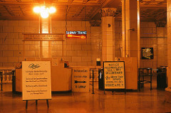
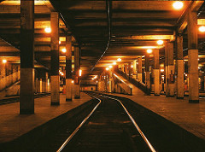
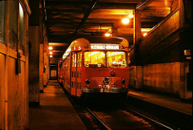
Pacific Electric Subway Tunnel (1925-1955)
Pacific Electric built a one-mile single bore tunnel between Sunset/Glendale Blvd and 4th/Hill to speed three rail lines under downtown surface street traffic.
Construction began in 1924 and the tunnel opened on New Year’s Eve 1925.
4th/Hill Subway Terminal Building is now the Metro 417 Loft Apartments. Station still exists 60 feet below. The north end of the tunnel was blocked by an apartment building, and the tunnel was severed by the construction of the Bonaventure Hotel.

Slide 12
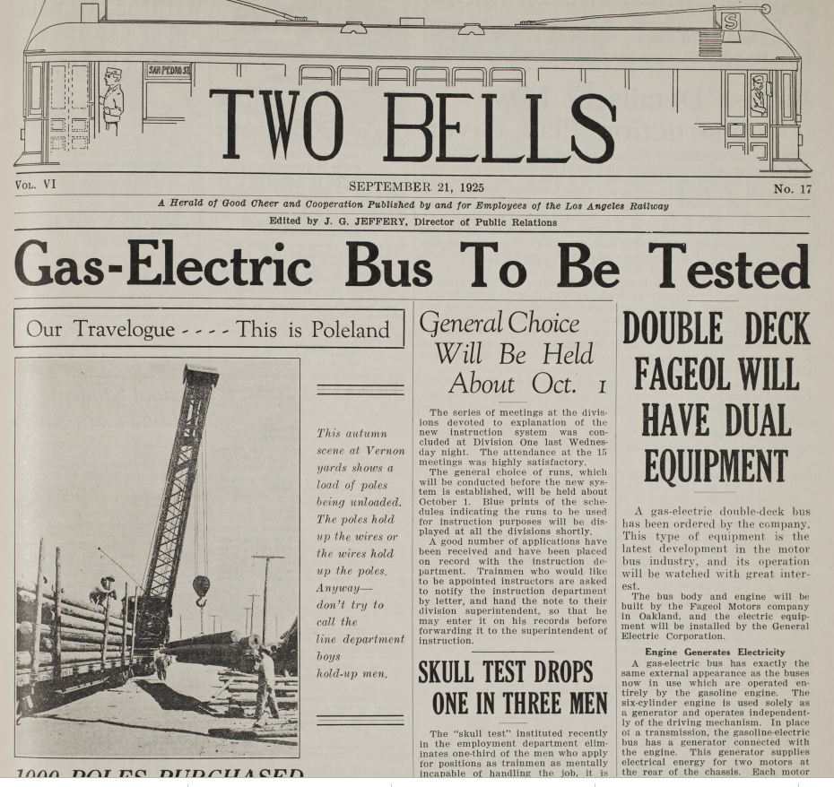
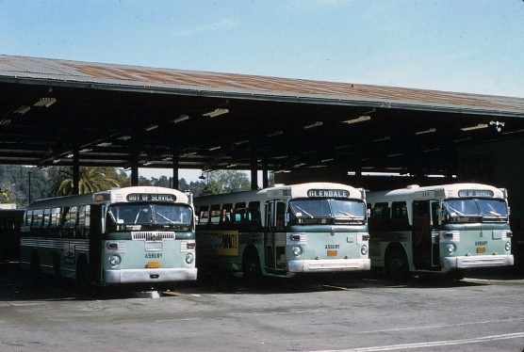
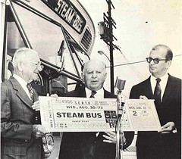
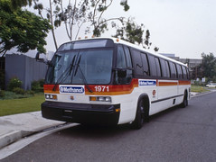
Early Alternative Fuel Efforts
1927 – first gas-electric hybrid buses purchased and tested by L.A. Railway
1946-1959 – Fleet of 60 Twin Coach propane powered buses operated by Asbury Rapid Transit, later Metro Coach Lines.
1973 – SCRTD propane powered MiniBus fleet
1974 – California Steam Bus Project – first FTA funded alternative fuel bus demonstration program with Sacramento, San Diego and SCRTD
1980’s SCRTD experiments with Clean Diesel particulate trap buses, Methanol, Ethanol, and CNG propulsion buses.
1994 – alternative propulsion buses only policy adopted by the Board of Directors.
Last diesel buses retires

Slide 13
Why did rail transit go away?
Capital costs to replace aging power substations, catenary wire and rail cars, buses become the economical alternative, rail-to-bus conversions begin in 1925, rapidly accelerate in 1950’s with highway construction.
Public Utilities Commission held back fare increases – 5 cents from 1877 to 1927, 7 cents from 1928 to 1945, 10 cents from 1946 to 1951, 15 cents from 1952 to 1956.
Freeway construction begins in 1938 and projects sever a number of rail lines in the 1950’s. No public subsidies for capital or operating costs available from local, state or federal governments until after 1968.
Cultural changes - automobile reliability improves, AC and automatic transmission, status symbol marketing, and women & minorities enter the industrial workforce.
Transit service operators believed that the new freeway system would accommodate transit buses as a high-speed backbone, thereby increasing their attractiveness to passengers.
GM perfects and markets the 45-seat transit bus; air conditioning and air suspension become options. See Let’s Go To Town film.
Diesel is not yet considered to be a component of a new phenomenon called “smog” See 1967 film “The Answer is Clear” by Detroit Diesel.

Slide 14
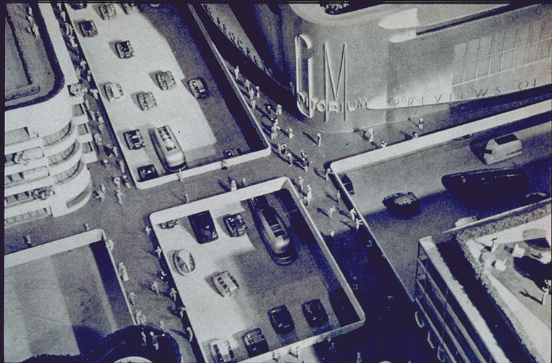
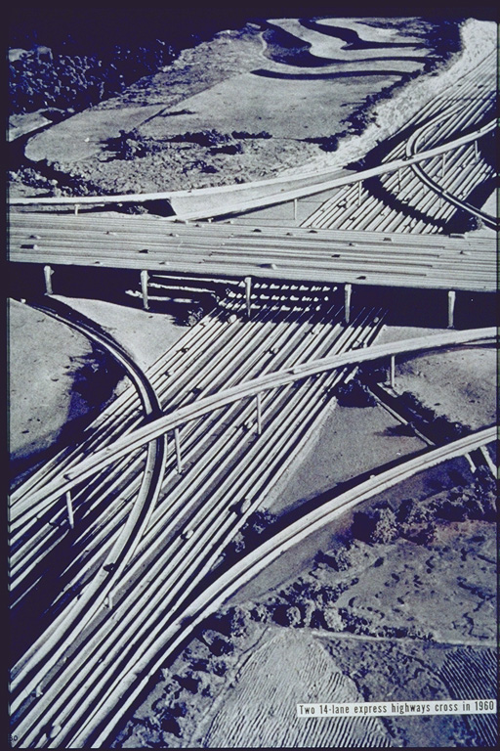
Influences:1939 New York Worlds Fair – GM’s Futurama Exhibit
Concept for car, bus and pedestrian only cities with elevated sidewalks for pedestrian safety.
Imagined 14 lane freeway interchanges.

Slide 15
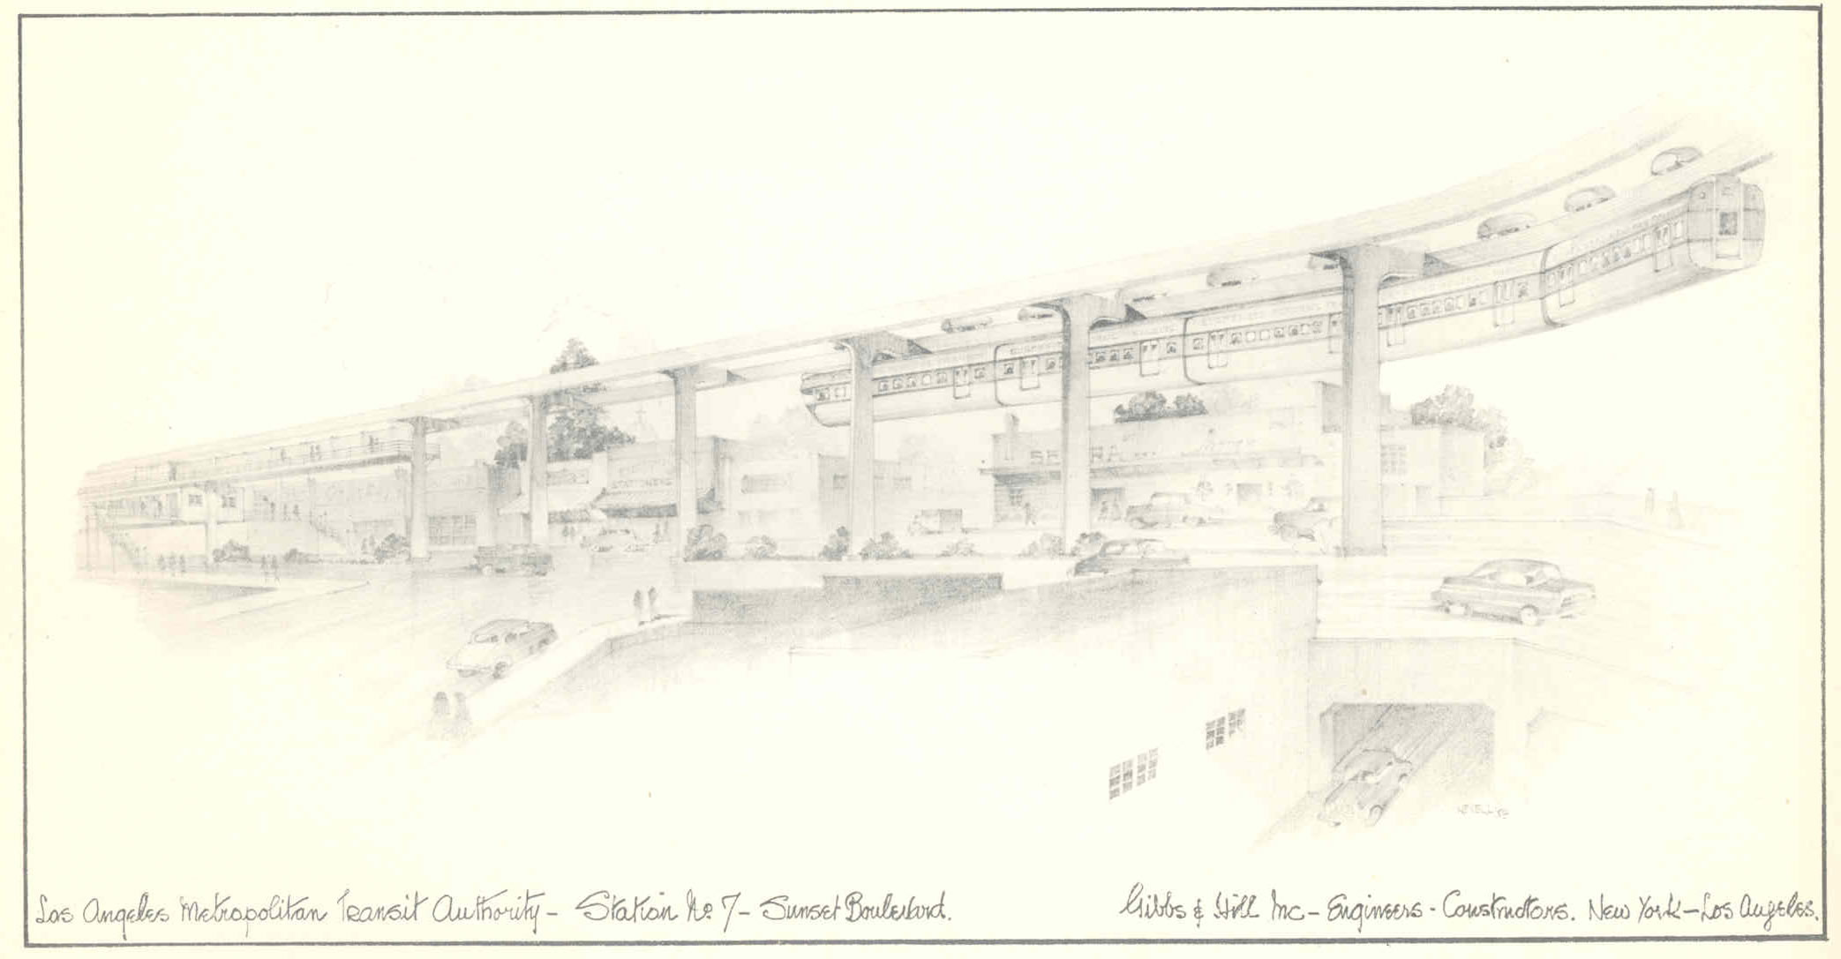
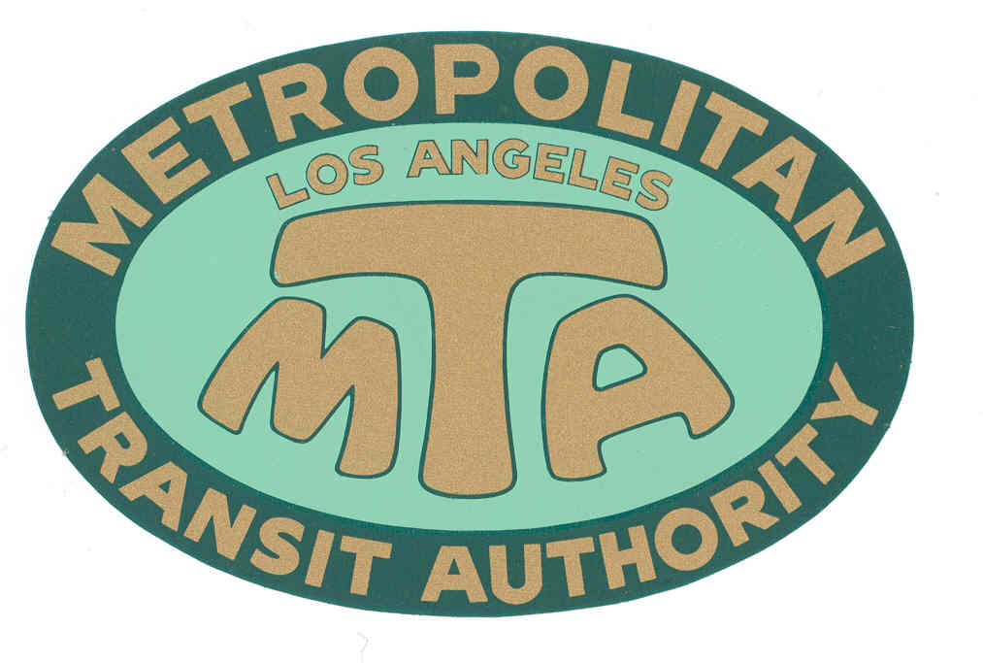
Los Angeles MTA (1951-1964)
Formed by the State in 1951 to study a monorail line from Long Beach to Panorama City along the L.A. River.
Seven Member governing board appointed by the Governor. Powers expanded in 1954 to propose a new mass transit system for the region.
Powers expanded again in 1957 allowing MTA to become a transit operator.
Purchased Metropolitan Coach Lines (formerly Pacific Electric) and Los Angeles Transit Lines (formerly Los Angeles Railway), effective March 3, 1958.
First transit agency in the U.S. to offer Senior Discount Fares, 7/1/1961.

Slide 16
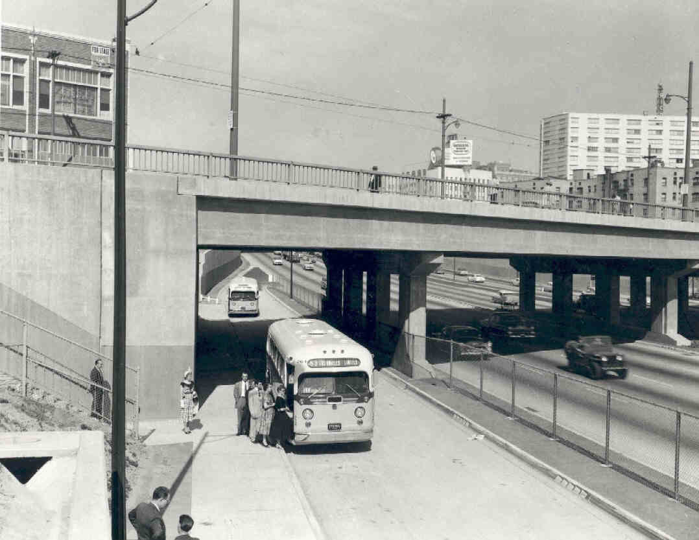
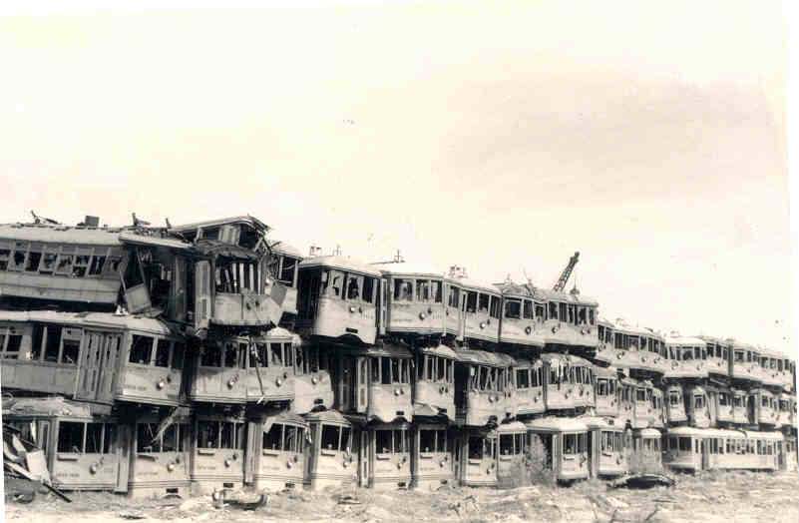
MTA Rail Transit still operating in 1958 – 12 lines
5 rail lines from Pacific Electric (1898-1953) via Metropolitan Coach Lines (1953-1958):
Long Beach, San Pedro, Bellflower, Watts Local, and Catalina Terminal.
The last “Red Car” runs to Long Beach on April 9, 1961.
5 streetcar lines and 2 electric trolley bus lines from Los Angeles Railway (1895-1945) via Los Angeles Transit Lines (1945-1958):
West Jefferson Blvd & Huntington Park (J), West Pico & East 1st St. (P), Whittier Blvd. & West 3rd St. (R), San Pedro St. & Western Ave. (S), Vernon & Vermont Ave (V), Line 2 and Line 3.
The last “Yellow Car” runs on March 31, 1963.

Slide 17
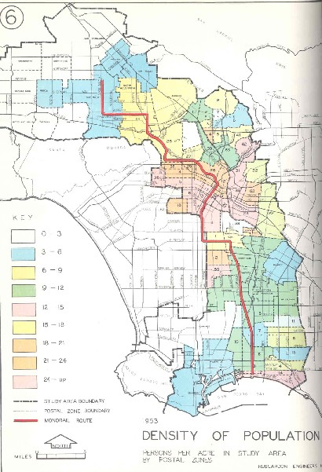
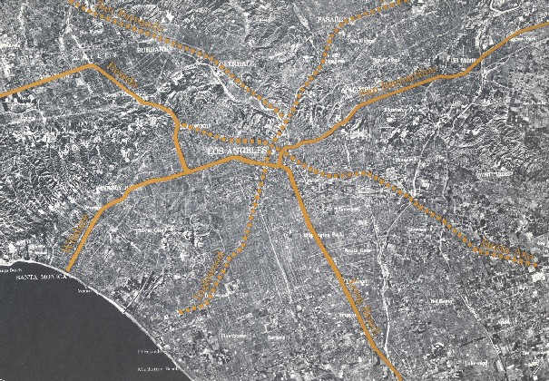
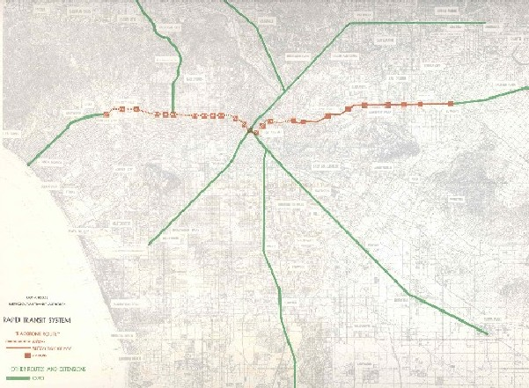
Los Angeles MTA (1951-1964)
1954 study of one monorail line, 45 miles/$165 million, grows in 1960 to a 75 mile/$529 million monorail plan with elevated rail along Wilshire.
Expanded monorail plan meets strong opposition from Valley Boulevard, Wilshire Corridor and especially Beverly Hills.
MTA’s plan is scaled down to a “Backbone Route” with subway under Wilshire Boulevard and at-grade rail to El Monte.
Alweg and Goodell Monorail Co.’s release their own monorail plans and offer to build systems for “free” in exchange for next 40 years of MTA’s farebox revenue.
MTA notifies private companies that any plan that does not include subway along the Wilshire route is unacceptable. MTA fails in its PR efforts with general public.

Slide 18
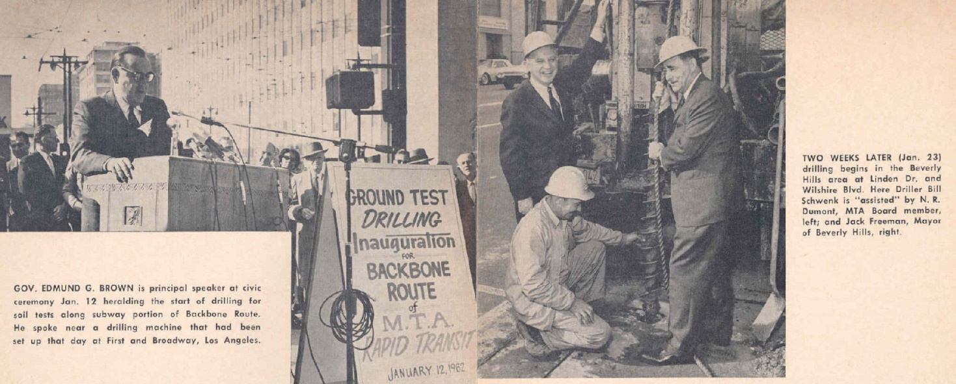
Los Angeles MTA (1951-1964)
Politicians vociferously battle over if and how transit would be subsidized and what the very definition of subsidy really is. Public becomes thoroughly confused.
The MTA, without the ability to tax, issue bonds, or take property via eminent domain, without the existence of any Federal or State capital assistance programs, holds two subway groundbreaking ceremonies: in downtown with Gov. Edmund G. Brown on 1/12/62, and in Beverly Hills with BH Mayor Jack Freeman, on 1/23/62.
State Sen. Rees (D-Beverly Hills) re-writes MTA legislation to give the transit agency the powers it was missing, re-launching it as the Southern California Rapid Transit District (SCRTD) in September 1964.

Slide 19
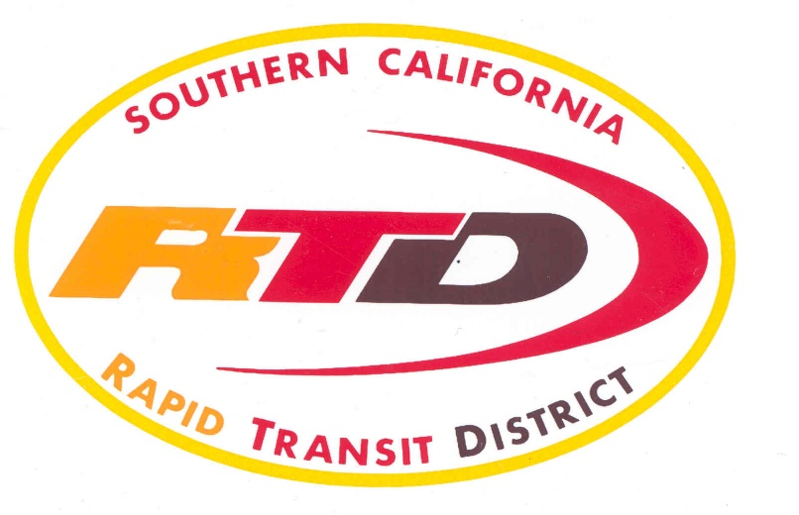
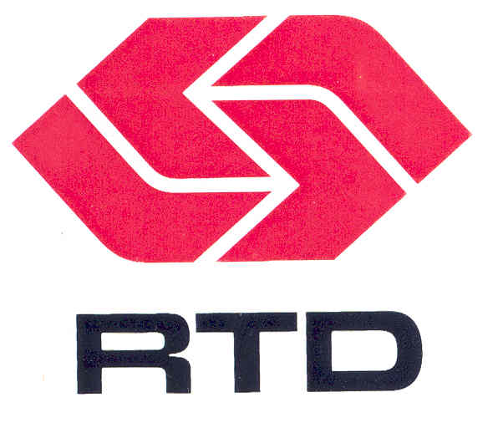
SCRTD (1964-1993)
New agency has an eleven-member board appointed by local elected officials, the powers of eminent domain, taxation through local referendum, bond issuance, and creation of Benefit Assessment Districts.
It is enthusiastically welcomed in an event at the Ambassador Hotel with 400 civic leaders.
Takes its legislative charge to create a new mass transit system for Los Angeles seriously and goes to work marketing public transportation as a needed and necessary community asset.
Federal government forms the Urban Mass Transit Administration in 1964 (now called the Federal Transportation Administration).
Operates transit service in L.A., Orange, Riverside and San Bernardino counties.
Takes over 11 other failing or failed transit companies, standardizing routes and fares.

Slide 20
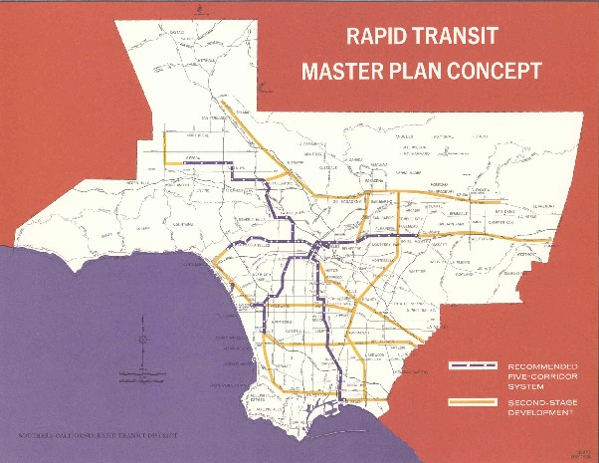
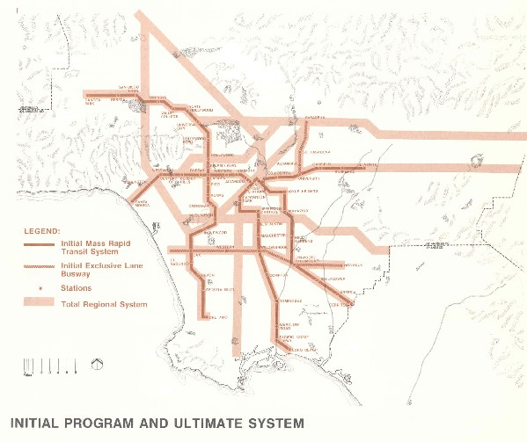
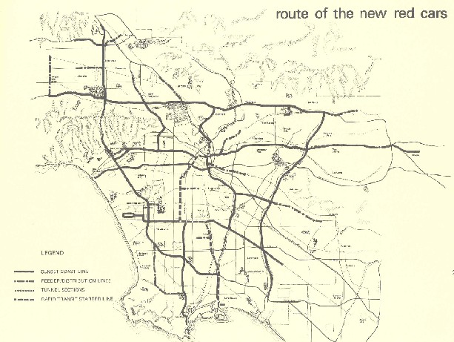
SCRTD (1964-1993)
1968 Plan -
Initial 62 mile system that could expand to 300 miles, projected cost of $2.5 billion, 8.5 year construction period.
Rejected by voters, 44.8% yes.
1974 Plan –
Initial 116 mile system that could eventually expand to a 250 miles, projected cost of $6.6 billion, 12 year construction period.
Rejected by voters, 46.3% yes.
1976 “Baxter Ward” Plan –
281 mile system, 230 miles of elevated heavy rail and 51 miles of light rail, projected cost of $7.5 billion.
Rejected by voters, 40.6% yes.

Slide 21
SCRTD (1964-1993)
Known for Innovations & Special Services:
El Monte Busway HOV Project
Mini-Bus circulator routes and Freeway Flyer services
Bus Technology
In-house Air Quality Testing lab
1974 FTA/California Steam Bus project
Particulate traps, methanol, ethanol and CNG buses
Double Deck and Articulated buses
First large scale wheel chair lift equipped bus order in history
Innovative Bus Scheduling and Grid System re-design
Technology – Robotic Parts Delivery, Pre-GPS Radio tracking system
FFGA for Metro Rail Subway Project & Construction
Electric Trolley Bus System project begun (later cancelled)
Rail Start up for the first new Light Rail Line & Subway Line
Earthquake service, Civil Unrest service, Papal Visit, 1984 International Olympic Games, and coordinating other large scale special events.
Union Station Gateway Headquarters Project

Slide 22
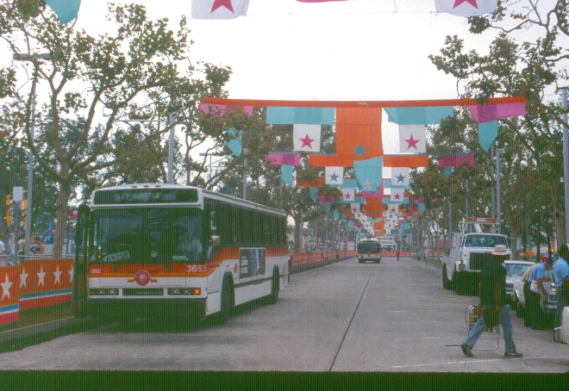
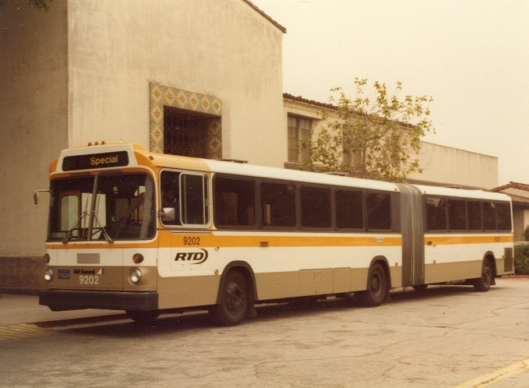
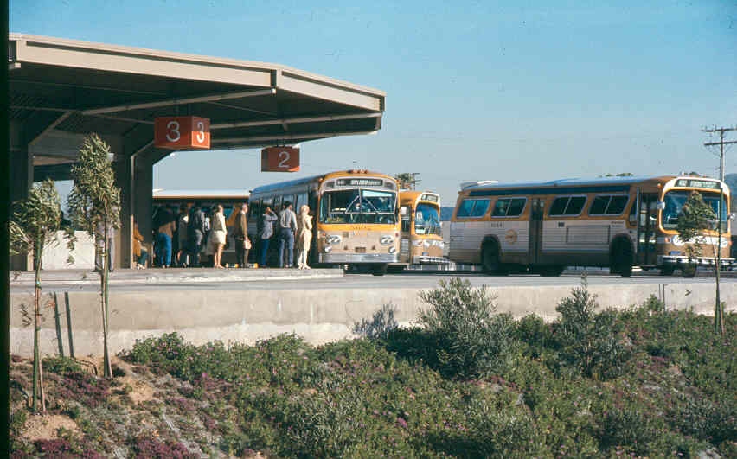
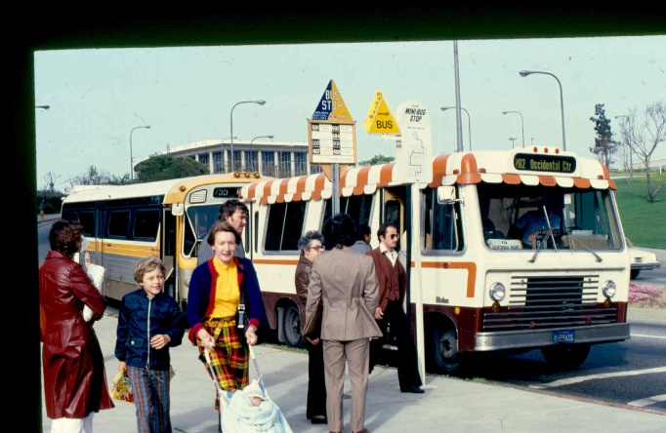
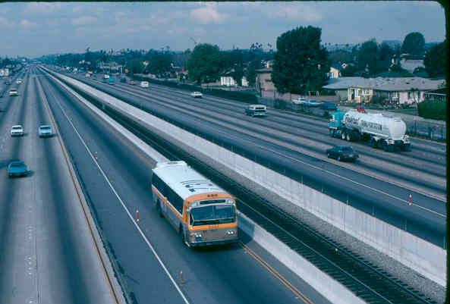
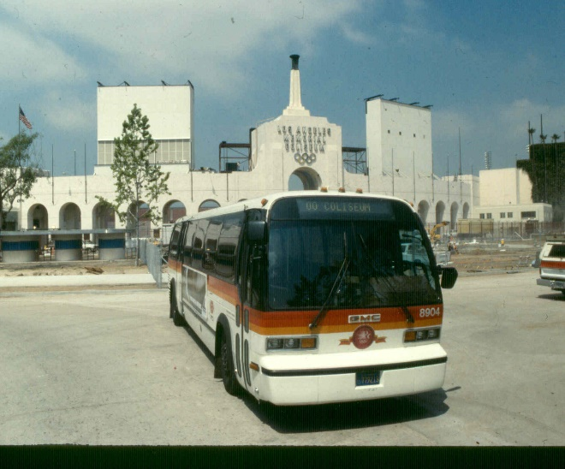
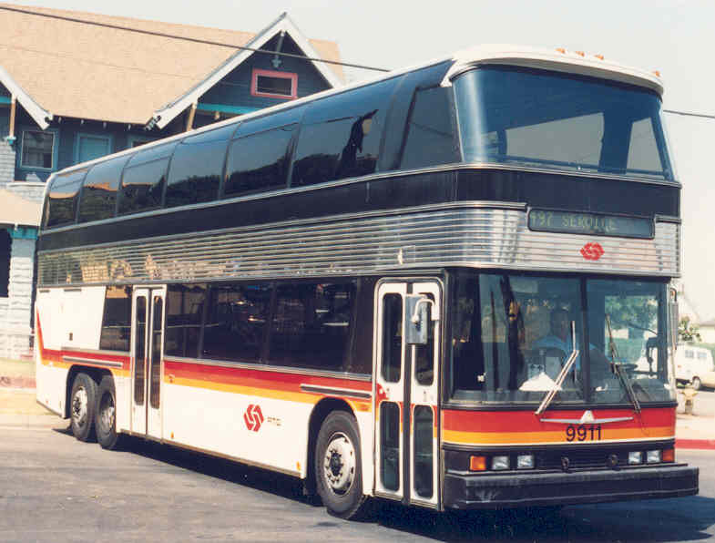
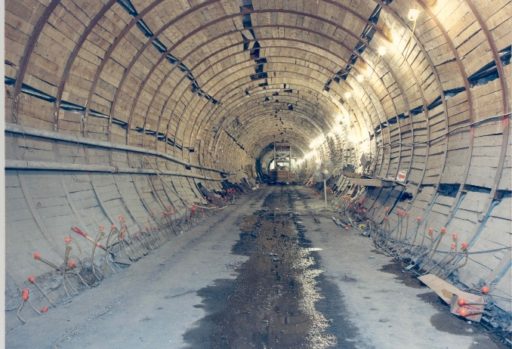
SCRTD (1964-1993)

Slide 23
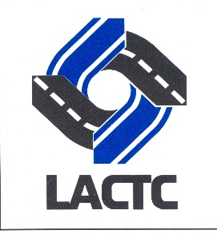
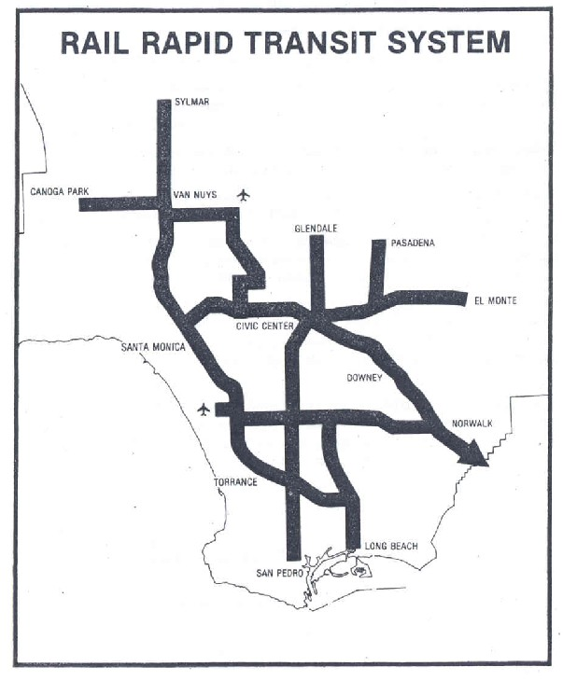
Los Angeles County Transportation Commission (1977-1993)
State creates the Los Angeles County Transportation Commission (LACTC) in 1976 to coordinate between municipal transit operators and SCRTD, plan countywide transportation improvements and ensure efficient use of local, state and federal transportation funding.
In 1980, a majority of Los Angeles County voters approve Proposition A (54.3%), a half cent sales tax for transportation improvements, 35% of revenue is dedicated for rail construction.
Plans and builds the Metro Blue Line, Green Line and Red Line extensions.
Map from 1980 Proposition A voter information materials

Slide 24
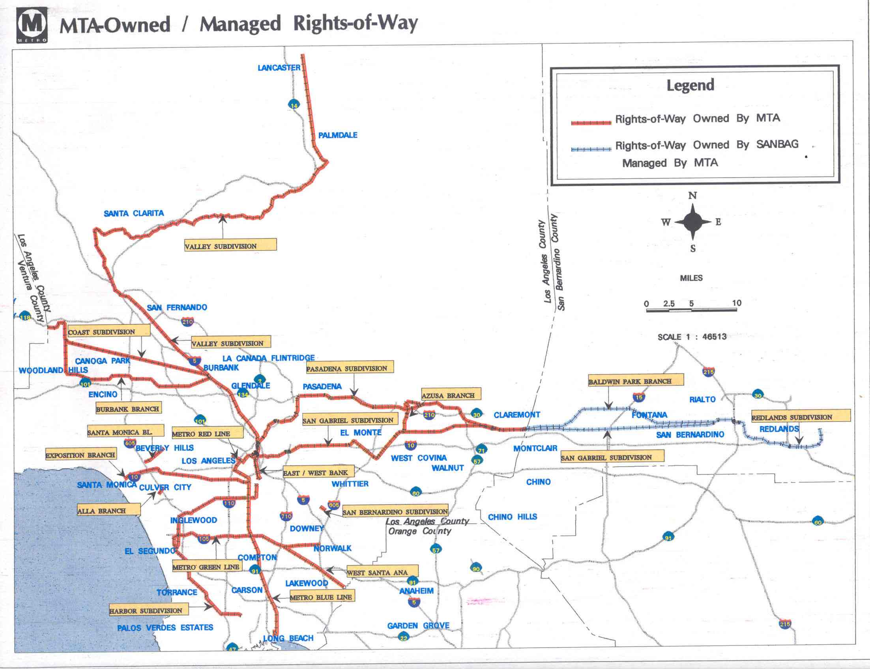
Los Angeles County Transportation Commission (1977-1993)
A second half-cent sales tax for transportation, Proposition C, was approved by a majority of Los Angeles County voters (50.4%) in 1990, along with propositions 108, 111 and 116.
The Transportation Commission begins negotiations with Southern Pacific, the parent company of the former Pacific Electric system, to acquire 450 miles of right-of-way in Southern California. The parties eventually agree on a purchase price of $980 million in 1992. The commuter rail system known as Metrolink is born and spun off as an independent five-county joint powers authority.

Slide 25
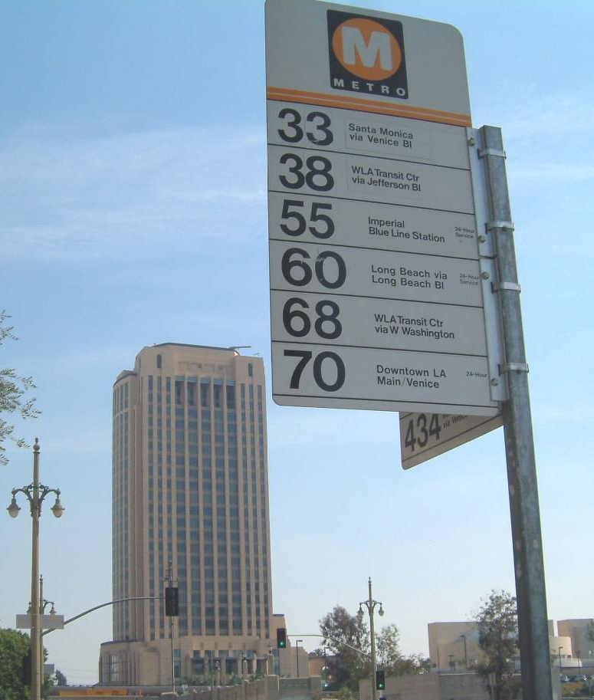
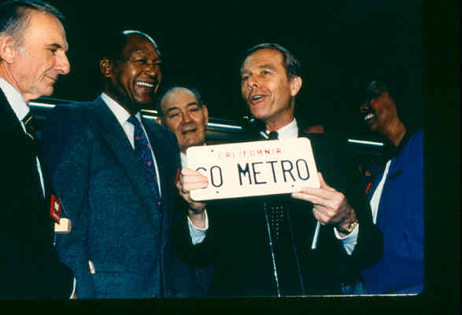
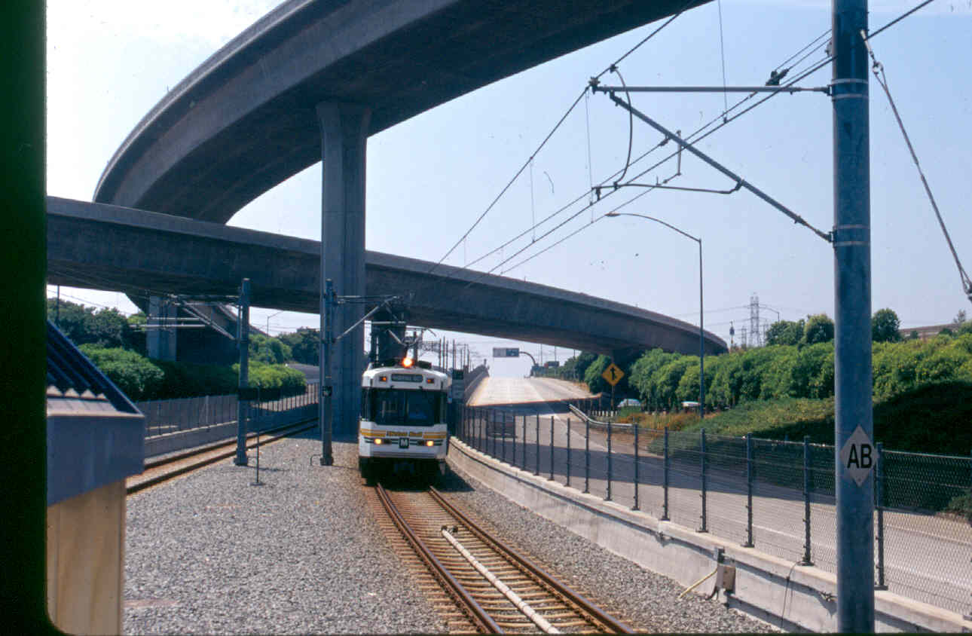
Merging Transit with Transportation
1988, the two agencies agree on an eight-point plan that includes consolidating all rail construction under a single third entity, naming the lines the Metro Red Line, Metro Blue Line and Metro Green Line, and open discussion of an eventual merger.
1992, the Governor signs AB152 (Katz) that creates the Los Angeles County Metropolitan Transportation Authority, also known as MTA or Metro, effective February 1, 1993. It becomes a planning, funding, construction, and operating multi-modal “super agency” for Los Angeles County.

Slide 26






Current Metro
Metro Rapid
Metro Local
Metro Express
Metro Light Rail
Metro Heavy Rail
Metro BRT Transitways

Slide 27

History of Ballot Measures for Rapid Transit
Note: Prop A (1980) & Prop C (1990) were sponsored by the Los Angeles County Transportation Commission, exempt from Prop 13
and passed by simple voter majorities. After the 1993 merger with SCRTD, a 2/3rds majority vote under Prop 13 became a requirement.

Slide 28
Timelines, Websites, Museums and historical societies
Los Angeles Transit: Los Angeles Transit History Timeline
25th Anniversary of the Metro Blue Line
Union Station 75th Anniversary Timeline
Los Angeles Rail Network 1900-2028 timeline https://www.youtube.com/watch?v=nH9toJw6-k8
Local:
Pacific Electric Historical Society http://www.pacificelectric.org
Electric Railway Historical Association http://www.erha.org/
Los Angeles Railroad Heritage Foundation http://larhf.org/
Southern California Railroad Museum (formerly known as the Orange Empire Railway Museum https://socalrailway.org/
Go big or go home transit museums:
New York City Transit Museum https://www.nytransitmuseum.org/
London Transport Museum https://www.ltmuseum.co.uk/

Slide 29
Selected YouTube films & videos
From the Metro Librarian Channel:
Shirley Temple Inaugurates Los Angeles’ New Streetcars (1937) https://www.youtube.com/watch?v=I2cwcnTyR2E&t=6s
Los Angeles Transit Lines: It’s a Big Job (1947) https://www.youtube.com/watch?v=tNRA5LAVVD0
Let’s Go to Town – Solutions to City Traffic Congestion (1950’s) https://www.youtube.com/watch?v=CElngLAjMaA&t=38s
Detroit Diesel: The Answer is Clear (1967) https://www.youtube.com/watch?v=-3z4ctf71Xg&t=261s
SCRTD Meeting the Challenges (1983) https://www.youtube.com/watch?v=hKtixeeJrJk
Metro Blue Line Grand Opening (1990) https://www.youtube.com/watch?v=scqwa--KhJU
Union Station Gateway Joint Development Project (1992) https://www.youtube.com/watch?v=BRWeThfv-Js
Metro Motion - Union Station 75th Anniversary https://www.youtube.com/watch?v=yZ7L87bu7oY
(current set to private, working on getting it re-posted)

Slide 30
Books/Films on LA Transit History
This Was Pacific Electric - DVD - A documentary film by Tom Eberhardt
Railtown: The fight for Los Angeles Metrorail and the future of the city by Ethan Elkind
Henry E. Huntington and the Creation of Southern California by William B. Friedricks
From Railway to Freeway - Pacific Electric and the Motor Coach by Eli Bail.
Los Angeles & the Automobile by Scott Bottles.
Street Railways and the Growth of Los Angeles by Robert C. Post.
Ride the Big Red Cars: How Trolleys Helped Build Southern California by Spencer Crump
The Great Car Craze: How Southern California Collided with the Automobile in the 1920’s by Ashleigh Brilliant

Slide 31
Some historical Figures in L.A. Transit History
Eli P. Clark – Very early LA rail transit
Moses Sherman – Very early LA rail transit
Collis P. Huntington – intercontinental railroad/Southern Pacific Railroad
Henry E. Huntington – Pacific Electric, LARy after 1911
John Parkinson – Architect of Union Station, City Hall, more
Thomas M. Rees – Wrote 1964 SCRTD Act
Walter M. Ingalls – Wrote 1977 Transportation Commissions Act
Jackie Bacharach – early modern era rail transit development policymaker
Nick Patsaouras – public transit development and policy
Mayor Tom Bradley – championed public transit during his five terms as Mayor
Supervisor Kenneth Hahn – Prop A and Blue Line
Richard Katz – Wrote 1993/1993 LA Metropolitan Transportation Authority merger Act

Slide 32
Professional Organizations
American Public Transportation Association https://www.apta.com/
National Academies Transportation Research Board http://www.trb.org/Main/Home.aspx
International Association for Public Transport https://www.uitp.org/
Metro Americas https://metroamericas.com/
American Association of State Highway Officials https://www.transportation.org/
MoveLA, InvestingInPlace, Urban Land Institute

Slide 33

End
Other related transit history presentations created by the Transportation Research Library:
Black History Month
LGBTQ+ Pride History Month
Transportation history presentation by Metro AAEA staff – Black History Month

