Slide 1
Pumping Up Social Media With New Strategies:
15 for 2015
Internet Librarian 2014
Pre-Conference Workshop
October 26, 2014
Kenn Bicknell
Digital Resources Librarian
Los Angeles County Metropolitan Transportation Authority

Slide 2
15 Strategic Directions
News Aggregation
Online Newspapers
Local History Advocacy
New Technology Tools
Augmented Reality
Localized Calendaring
Creative Storytelling
Exploiting Embedded Resources
Volumization
The Exo-Library
Knowledge Base
Open Data
Infographics / Data Visualization
New Collaborations
New Promotional Opportunities

Slide 3
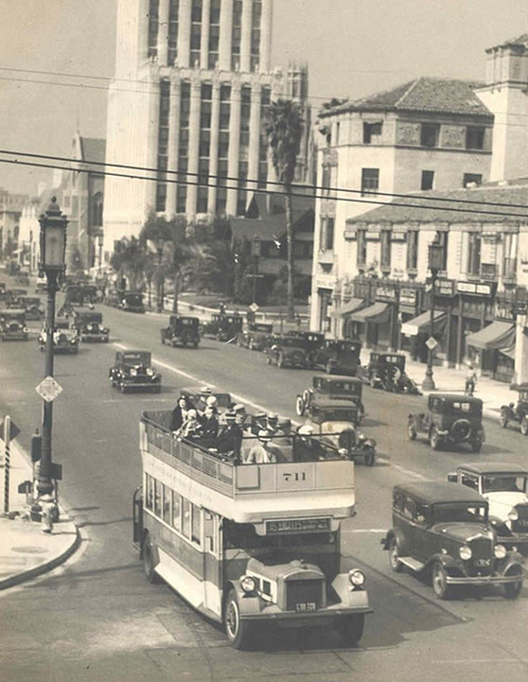
About The Metro Library
Notes:
The Metro Transportation Library is rather unique.
We are the most comprehensive transit-operator owned libraries in the United States, and the only multimodal transportation library in Southern California.
We serve over 8,000 employees, plus contractors, consultants, educators, students, the media, transit buffs, history nerds, and our colleagues in transit and transportation throughout the world.
(I will be using various historic images from our collection to spruce up some of these slides. This image is of a 1920s open-air double-decker bus on Wilshire Boulevard. Not only are the buses great to share, but so is the story of why streetcars were never built on Wilshire – it was full of mansions way back when and wealthy citizens had it written into the city code, and it remains to this day. You can read that story on our blog later)

Slide 4
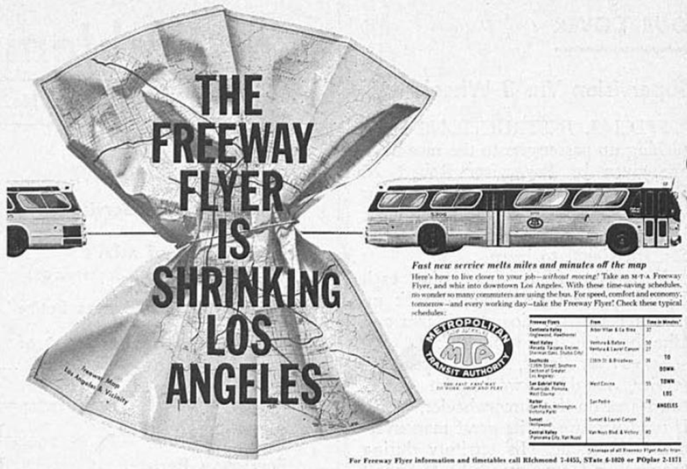
Breaking The Mold
Notes:
So that’s 9,000 employees, in a County of about 10 million people, and we’re on the 15th floor of a building in downtown Los Angeles – not the most accessible place for the public.
But as a publicly-funded government agency, we serve not only our staff, including planners, engineers and operators, but contractors, consultants, academics, instructors, students, journalists and other media types, historians, bloggers, transit advocates, the film industry, L.A. history nerds, and pretty much everyone else!
And oh yes, we do it all with just 1.5 Librarians. I’m ONE, and my Library Administrator is the .5 (He also oversees Records Management, which is rather ulcer-inducing.
Obviously, traditional service model does not work.

Slide 5
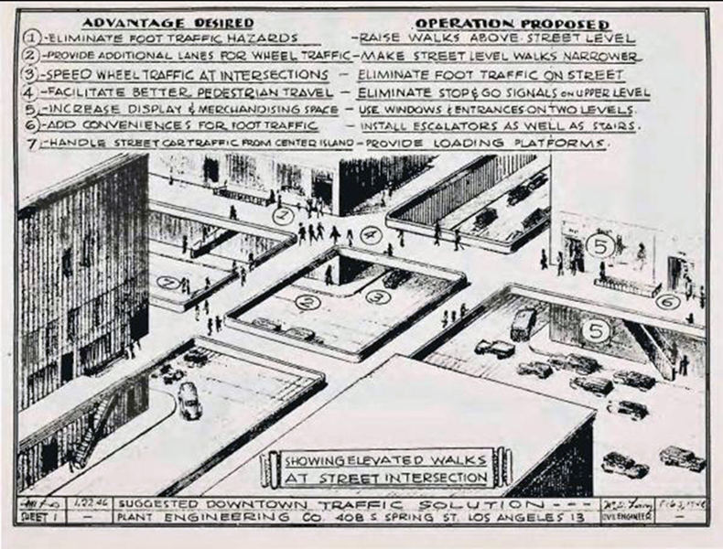
The Perfect Storm
Drives Innovation
Notes:
I could do an entire presentation about the collection and its history, but I will just give you the basic facts to provide the context for how we have met the challenge of outreach through innovation despite being resource-deprived.

Slide 6
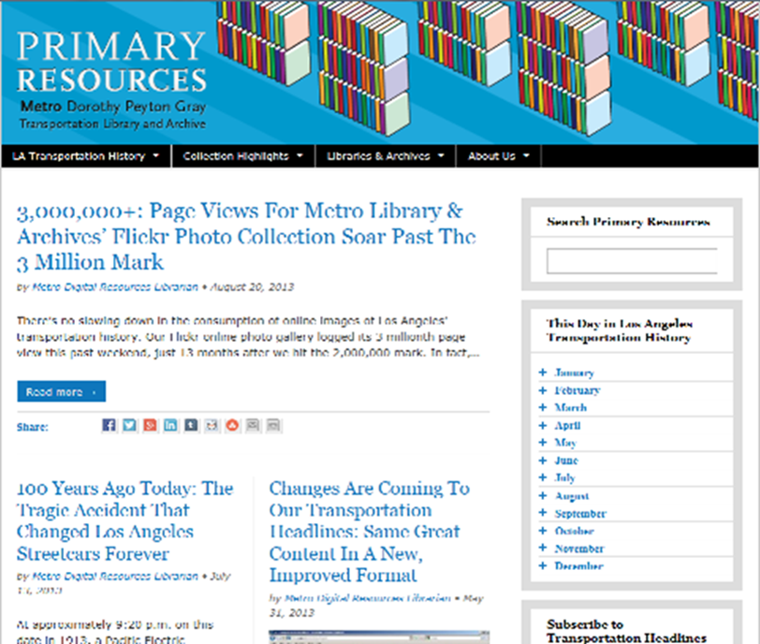
“Better Than Free”:
8 Generative Values Of Digitization

Slide 7
Our Changing
News Consumption
Growth in online news easy to disseminate
Growth in ways information can be repurposed & shared
Growth in hyper-local citizen journalism
24/7 access to news and round-the-clock news cycle
Users welcoming valuable knowledge amidst info-glut

Slide 8
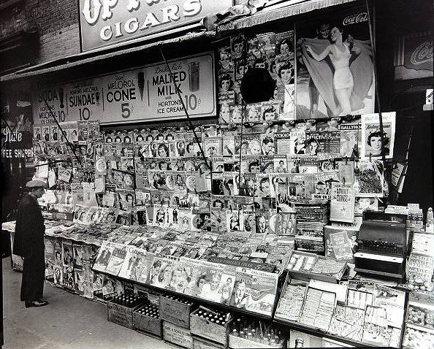
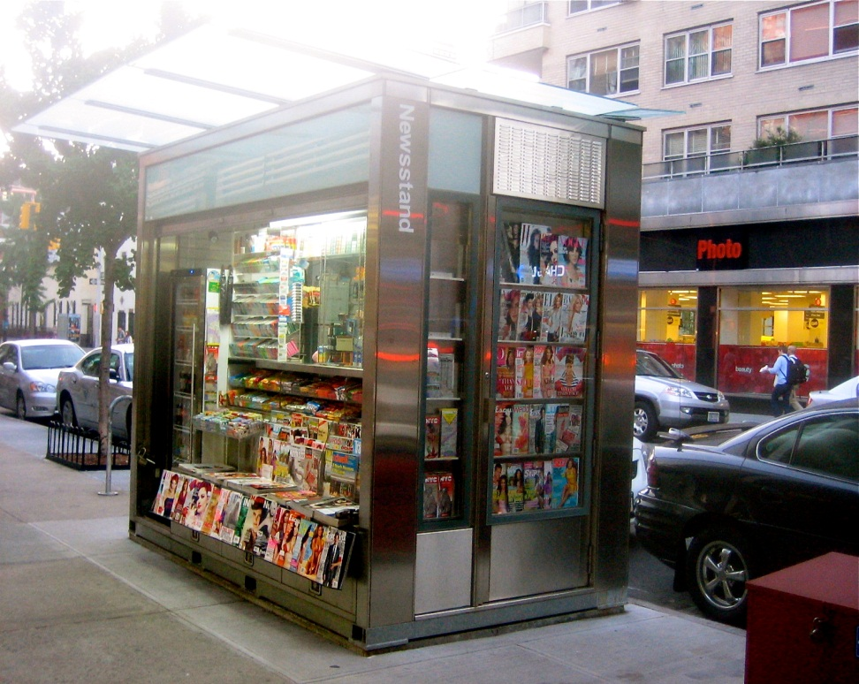
News Aggregation
Notes:
Let’s start with news aggegation and dissemination. Why would a library want to get involved in THIS?
As libraries strive to position themselves as not just RELEVANT, but VITAL, one strategic direction is to leverage the expertise of information professionals in GATHERING and PUSHING organizational or community news from a variety of sources into a must-read digest.
So what are we looking at here. On the left is a traditional newsstand, circa 1950s. On the RIGHT, a contemporary or “MODERN” newsstand. What’s MODERN is the HOUSING of the media, not the way TYPE of media, or the WAY in which the consumer accesses the information contained in it.
The consumer still has to make their choice based on past experience with a particular publication, or what they see on the cover (given that you aren’t supposed to stand there and read the entire publication).
The consumer has to TAKE THEIR CHANCES on what they find inside will be important or interesting to them.

Slide 9
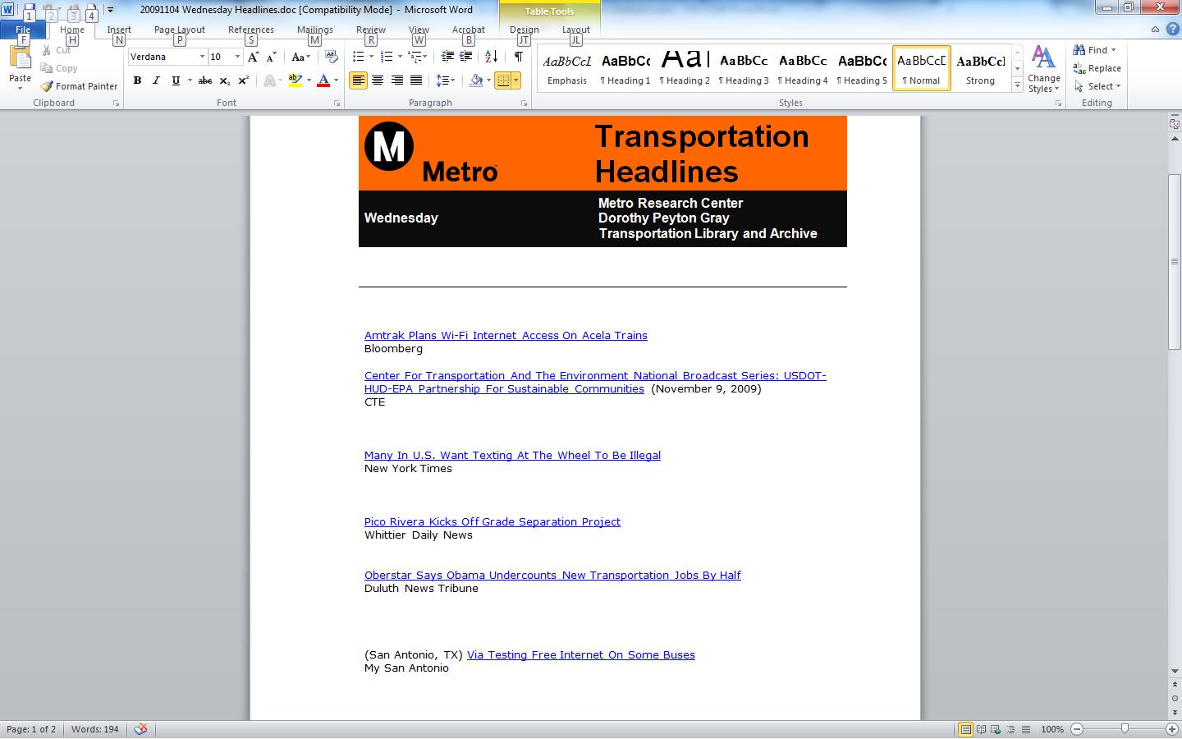
Blogger Headlines Product

Slide 10
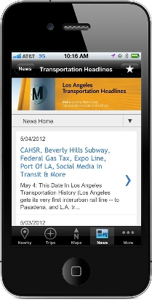
Aggregation
Notes:
We began aggregating transportation news way back in 2005. Our initial blogger platform is like the Stonehenge of transportation social media
This eventually evolved into a curated keyword list in Google Alerts. When Los Angeles County passed what is known as “Measure R” in 2008, a PERFECT STORM of converging factors slammed us in the face. More citizen advocacy, more attention being paid to multiple transit projects and proposals in a range of planning and construction, and more opportunity to inform people – OR GET IT WRONG
We had to evolve, and we had to go mobile as well. But alas, Google Alerts died off recently, so we had to go with another aggregator tool and began using Feedly
However, there are other models for getting what you need and what will work best for you and what you are trying to accomplish

Slide 11
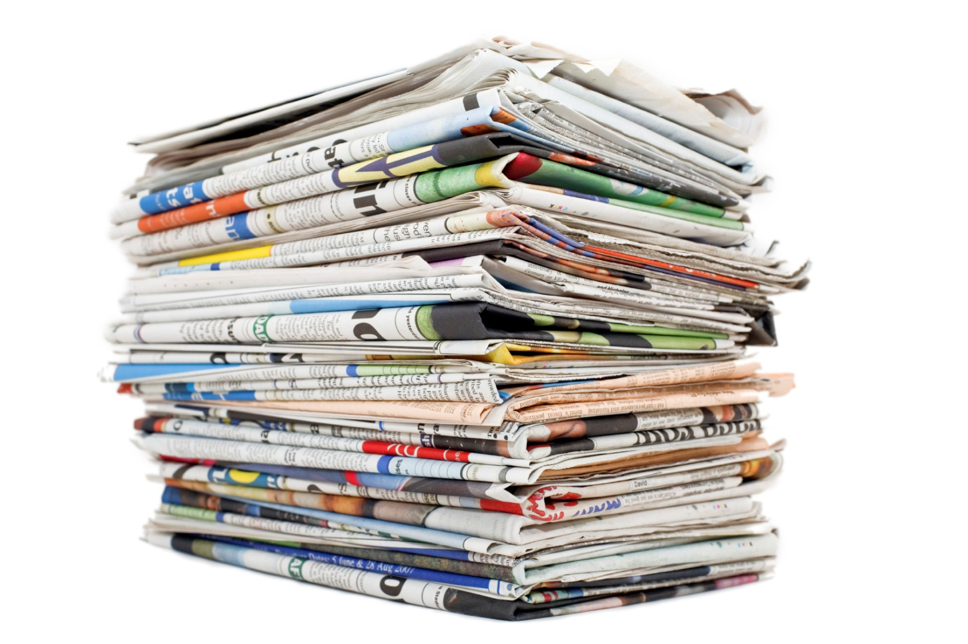
2: Online Newspaper
Notes:
Metro Library identity
Collecting and disseminating disparate information on an interdisciplinary topic in a timely way.
Transportation is complicated
Los Angeles County is a complicated landscape
Local, state, federal realms all have their own complexities

Slide 12
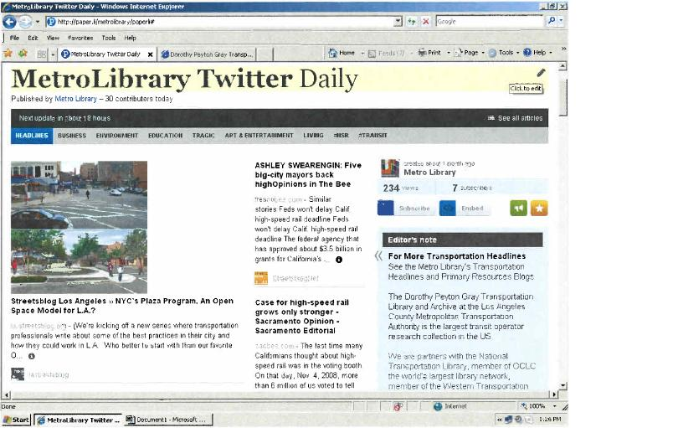
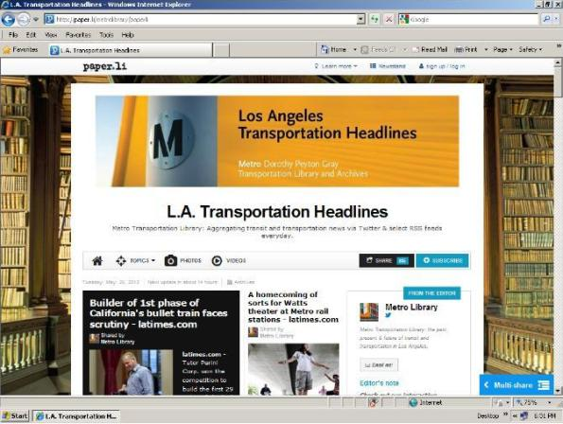
Creating Your Own Newspaper
Notes:
Over time, we realized that a growing list of 40-50 headines and links was neither sustainable in terms of labor involved 5 days a week, nor visually appealing for the reader.
We migrated our platform from a hands-on Blogger site to a the Paper.li online newspaper format. Paper.li takes Twitter feeds and publishes them daily or weekly as a “tweet digest.” It’s like the old informercial: “Just set it and forget it.” It publishes automatically with the frequency you choose.
But by gaming the system with curated twitter feeds and some crafty front-end customization, we got rid of clutter and began publishing our own customeized newspaper. On the left you see a screen shot of the “raw” rendering of the daily “Twitter” news, but on the right is the enhanced product, with a branded banner, more information about us in the box on the right, a nice background image, etc.

Slide 13
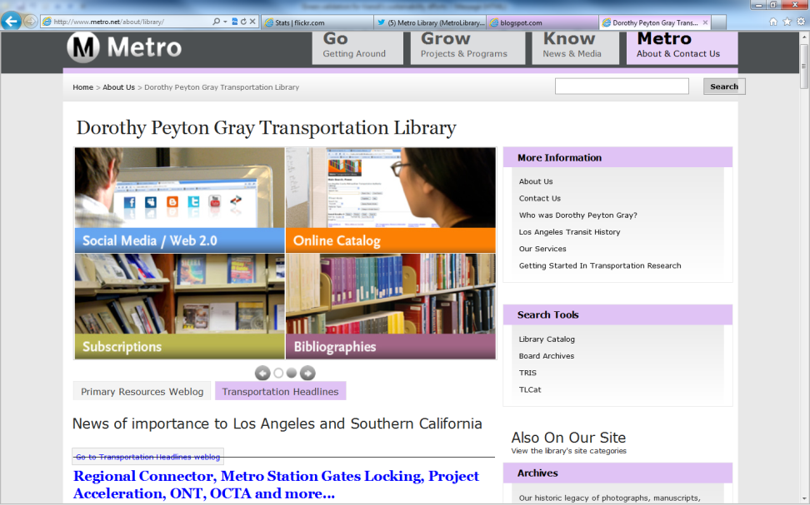
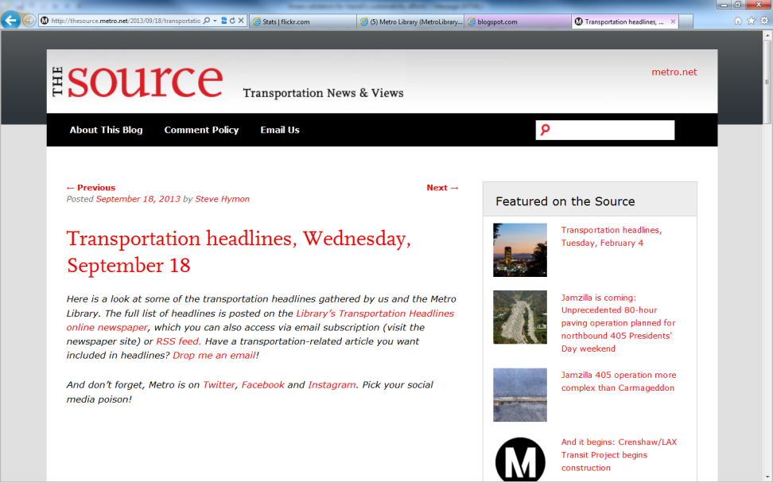
Featured Content Every Day
Notes:
Now, our Daily Transportation Headlines is a core Library service. On the left is a screenshot of our Library homepage. In the lower left you see how RSS feed brings the curated transportation news content into that prime real estate.
On the right is a screenshot for THE SOURCE, the primary online communication tool for the entire agency. Our transportation headlines are featured there also, with added commentary from other Departments, so we have internal and external customers, along with repurposing within our organization to supplement their messaging out to the community.
We have received national recognition for this effort, and when we have had to suspend publication of it for technical issues, BOY, do we hear about it from our subscribers. They PANIC and ask, “DID YOU STOP PUBLISHING THE HEADLINES?” It’s a great service to not only keep our users informed and save them time so they can focus on other things, but it also serves as a platform to promote some of our other products as well!
We are currently re-evaluting our platforms and the time and labor involved, but the product’s value CANNOT be denied.

Slide 14

Case study:
Community News Rooms
Fourth Estate (Detroit)
NEED: Watchdog journalism in “news deserts”
PROPOSAL: Pooling community talent and resources into a network of independent, sustainable and cooperatively networked organizations
OUTCOMES: Self-sustaining Town Square, Real local public interest news

Slide 15
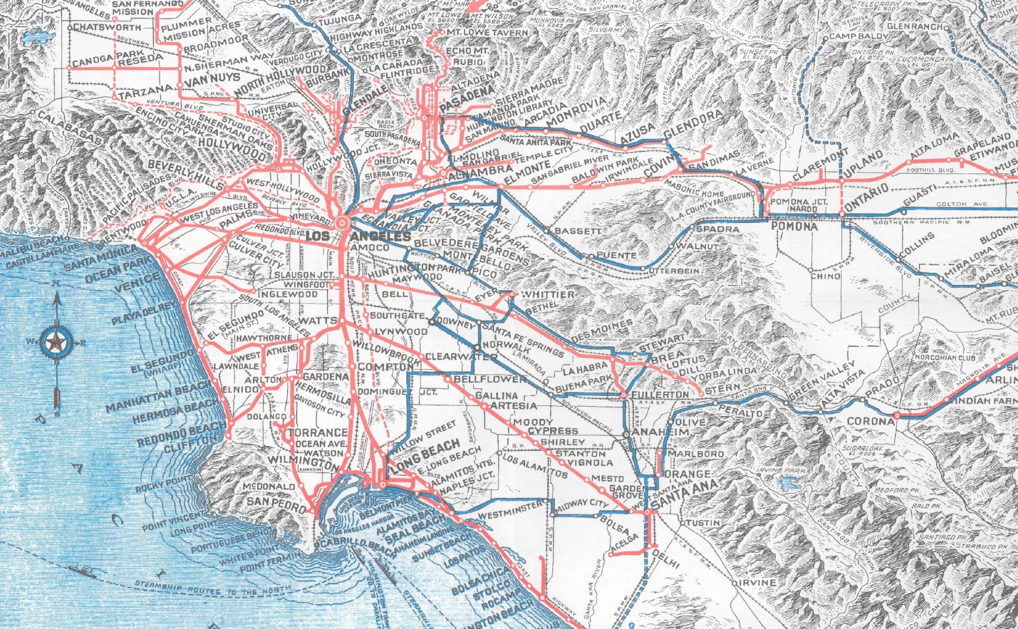
Local History Advocacy

Slide 16
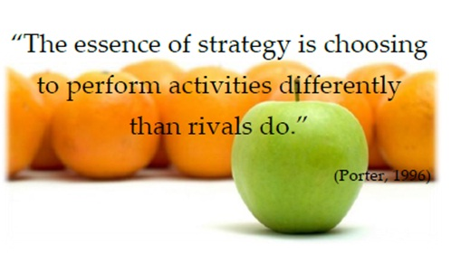
Differentiation

Slide 17
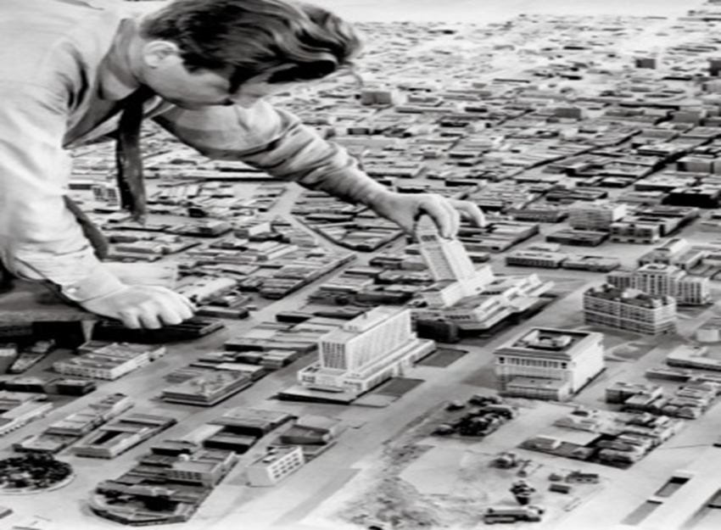
Community Curation
Notes:
Let’s move on to the second strategic direction, which is “COMMUNITY CO-CURATION”
This means joining forces to take responsibility for bringing together disparate groups that:
build community
Foster a sense of belonging
Preserve cultural and historical heritage
Champion facets of local uniqueness
So you might be saying, “Kenn, we’re a library. We already do that stuff.” But the KEY to this new strategic direction is leveraging the new technologies that enable NEW collaborations that weren’t possible before. Building community has always been there (or at least for a very long time) but HOW is rapidly changing

Slide 18
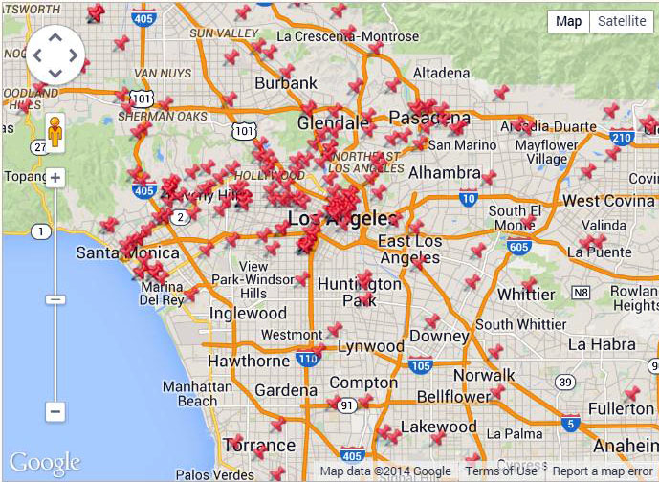
L.A. as Subject

Slide 19
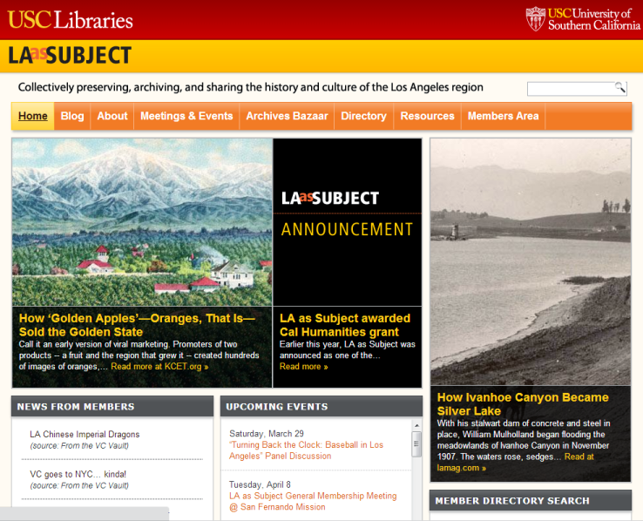
L.A. as Subject

Slide 20
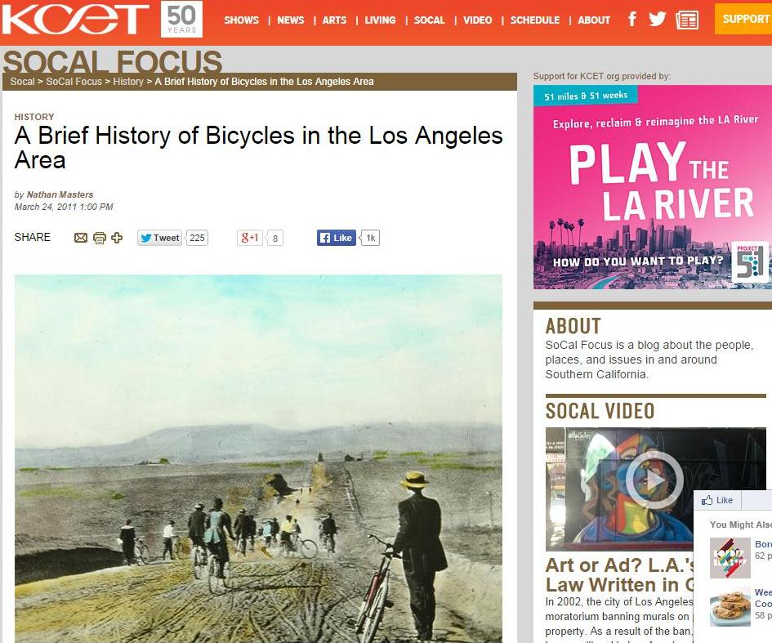
Media Partnerships

Slide 21
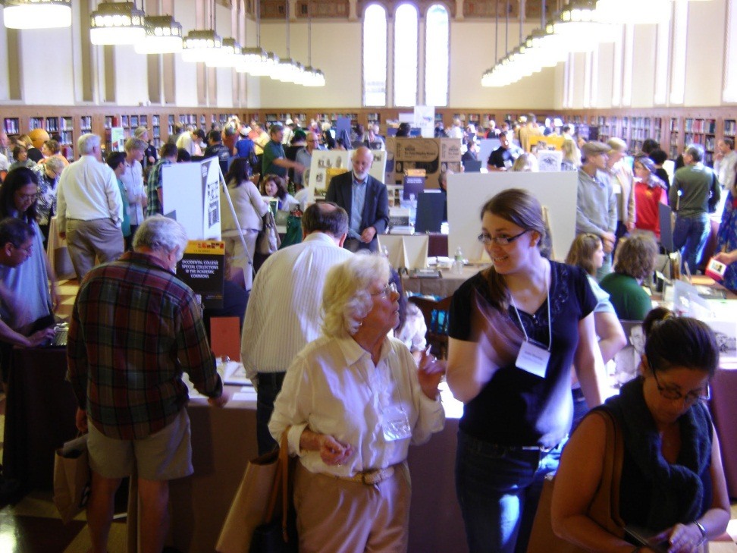
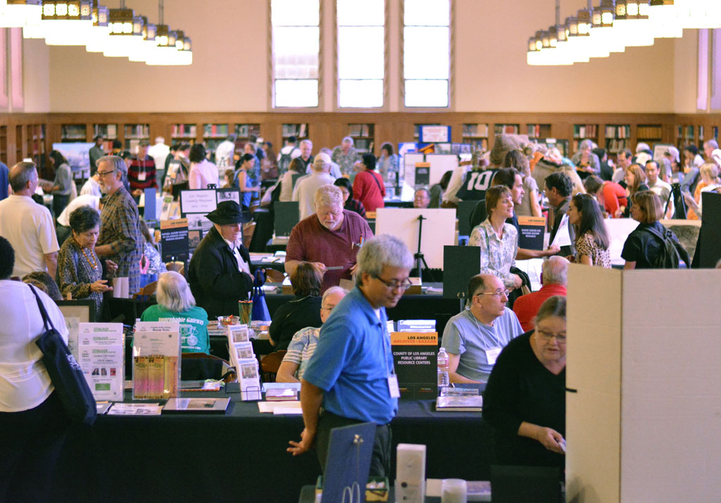
Archives Bazaar

Slide 22
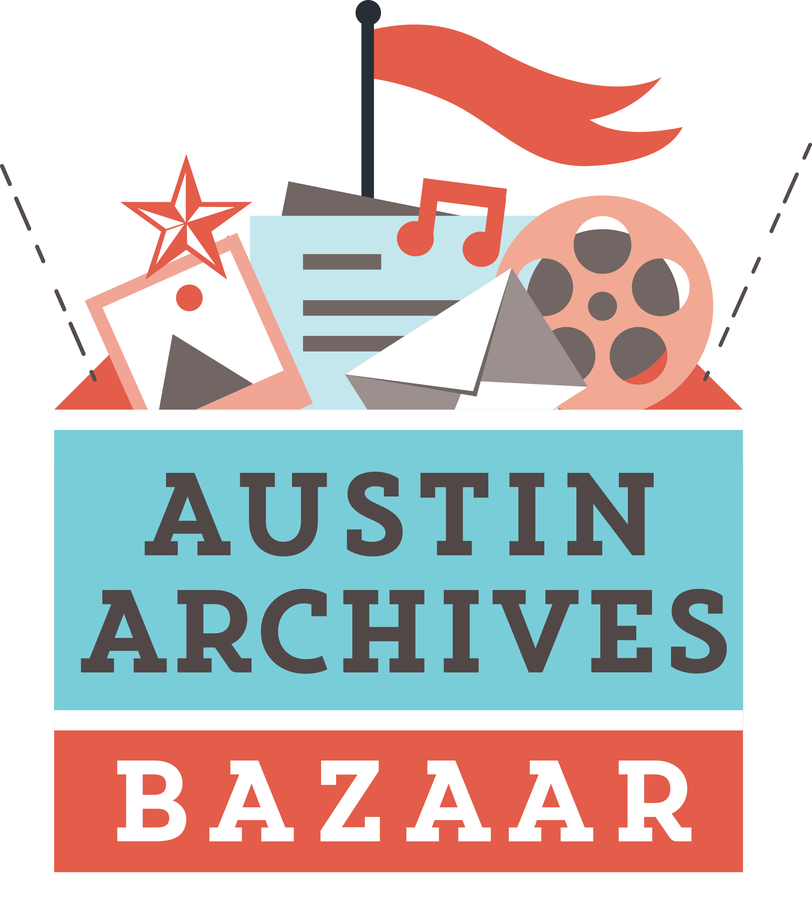
Archives Bazaar

Slide 23
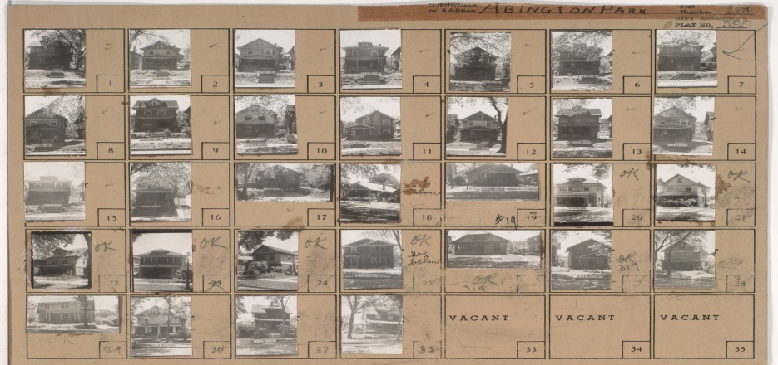
Case Study:
Kansas City (MO)
Then & Now
NEED: Engendering interest in city’s history via one comprehensive resource: 1940 Tax Assessment photos
PROPOSAL: Crowdsource item-level metadata, add contemporary images as platform for storytelling, neighborhood development
OUTCOMES: Citizen sense of place, increase knowledge about historic assets, link past to present and future, model for other cities

Slide 24
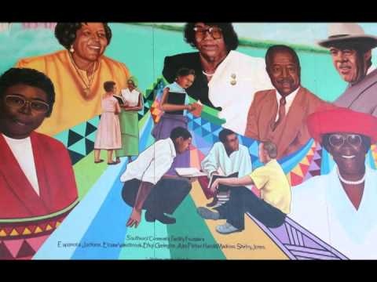
Case Study:
Citizenscapes: Stories of Our San Francisco
NEED: Preserve diverse neighborhood histories in a time of rapid gentrification and change
PROPOSAL: Program to train people how to be digital “citizen storytellers using smart phones, tablets, cameras
OUTCOME: Neighborhood history for SFPL audiovisual archives, public engagement, model for other cities, skill-building for participants

Slide 25
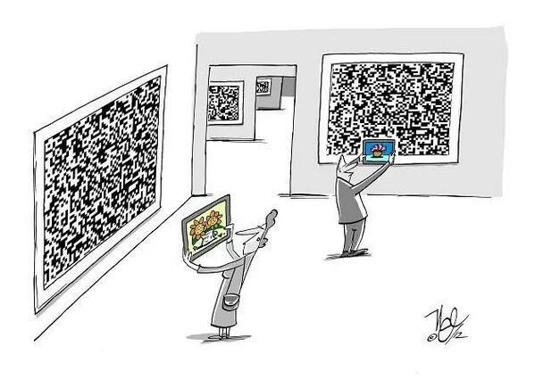
New Technology Tools

Slide 26
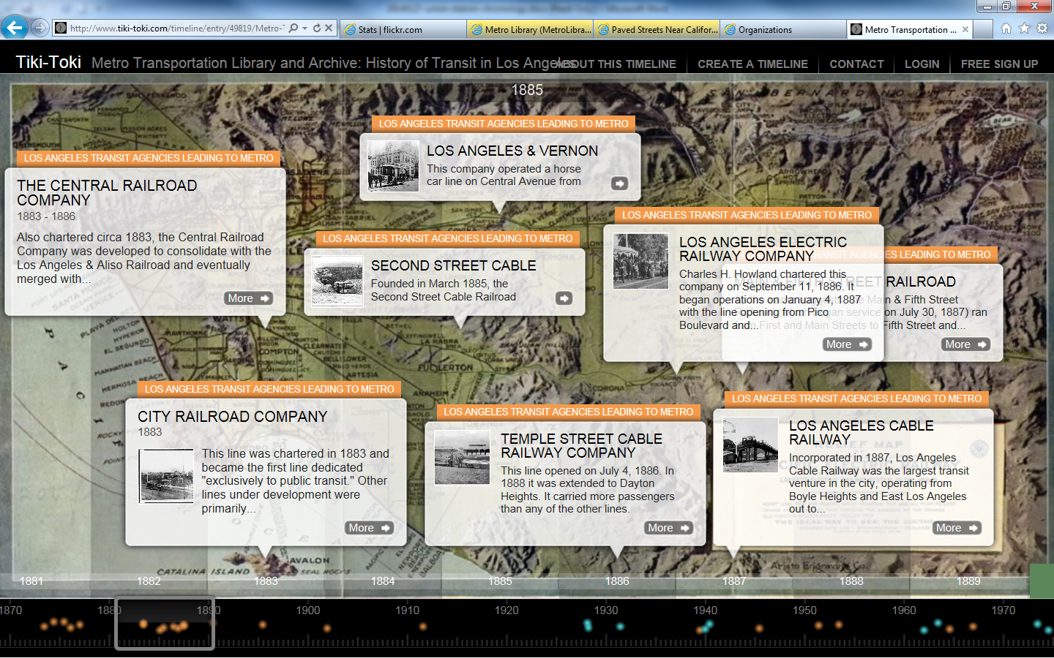
Interactive Timelines
Notes:
We have used other tools to explain local history as well.
One of them I discovered is Tiki Toki, a free interactive timeline tool that our superstar intern built and launched to tell the very complex story of Los Angeles transportation history going back to the 1870s.
Did you know that Los Angeles had cable cars, just like San Francisco? Check out the timeline later to learn why they lasted less than a decade.
I don’t know how well you can see this screenshot, but it features a traditional horizontal timeline where you can drag through the decades at the bottom, or click on any of the text bubbles that feature thumbnail photos to link to the corresponding Flickr photo set within our online collection, as well as video, digital documents, etc.
We had all the resources in-house to plug into a creative timeline, with hyperlinks out to our primary resources. Tiki Toki loved it so much, they chose OUR timeline from amongst 100,000 created on their website as their inaugural “Timeline Of The Month” featured on their own blog.

Slide 27
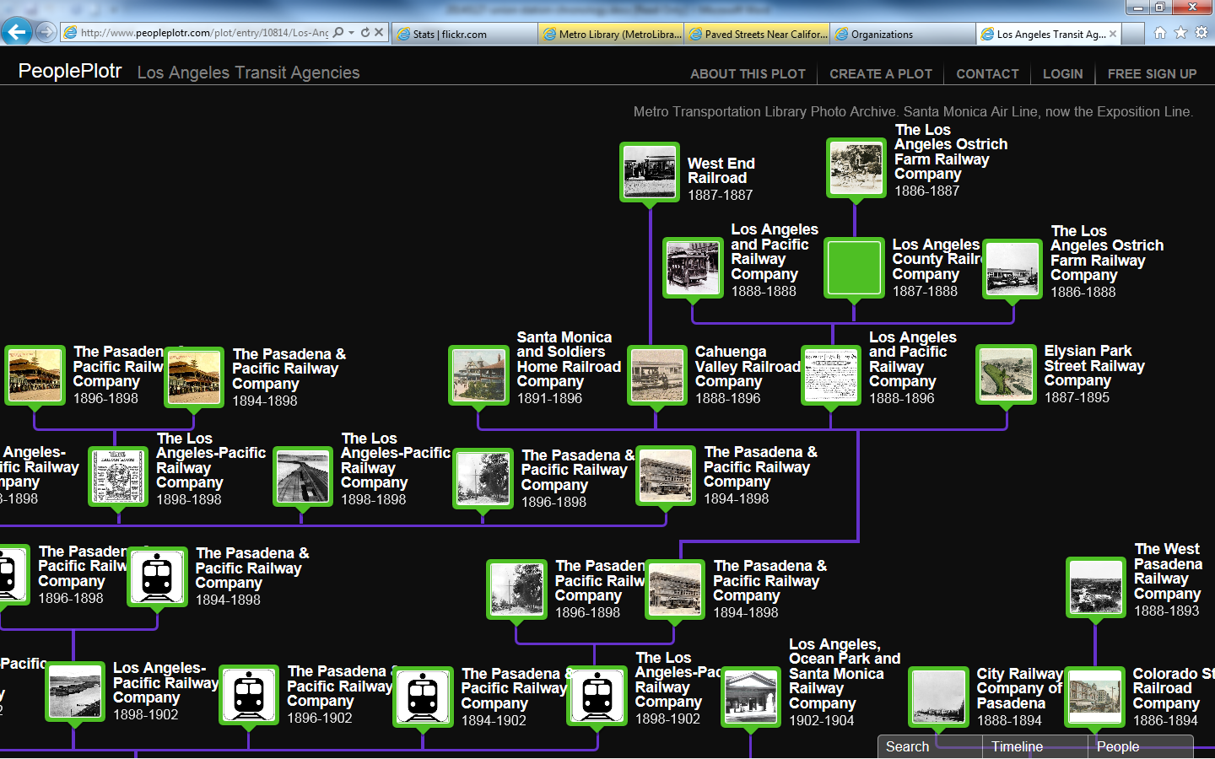
Interactive Family Trees
Notes:
We have used other tools to explain local history as well.
One of them I discovered is Tiki Toki, a free interactive timeline tool that our superstar intern built and launched to tell the very complex story of Los Angeles transportation history going back to the 1870s.
Did you know that Los Angeles had cable cars, just like San Francisco? Check out the timeline later to learn why they lasted less than a decade.
I don’t know how well you can see this screenshot, but it features a traditional horizontal timeline where you can drag through the decades at the bottom, or click on any of the text bubbles that feature thumbnail photos to link to the corresponding Flickr photo set within our online collection, as well as video, digital documents, etc.
We had all the resources in-house to plug into a creative timeline, with hyperlinks out to our primary resources. Tiki Toki loved it so much, they chose OUR timeline from amongst 100,000 created on their website as their inaugural “Timeline Of The Month” featured on their own blog.

Slide 28
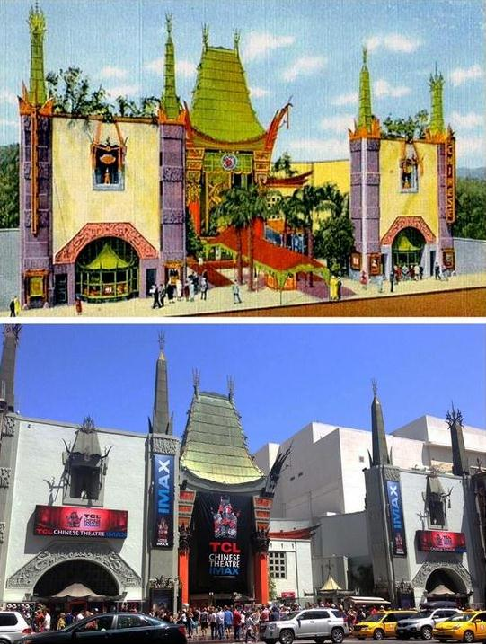
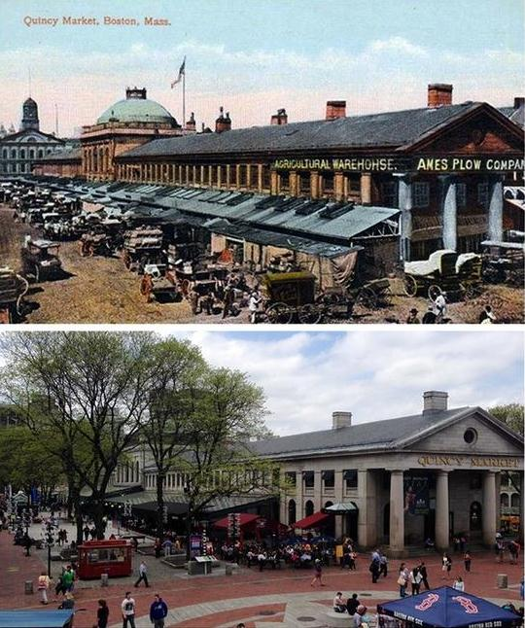
ScenePast App

Slide 29
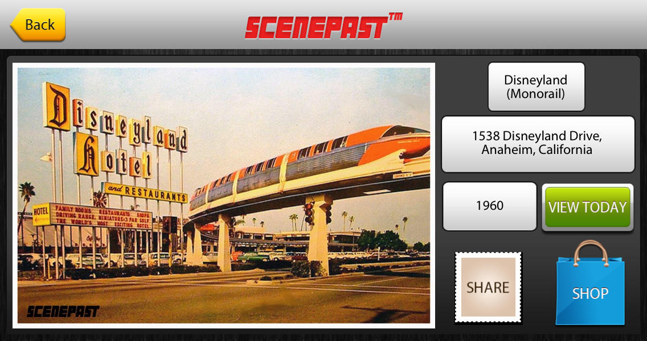
ScenePast App

Slide 30
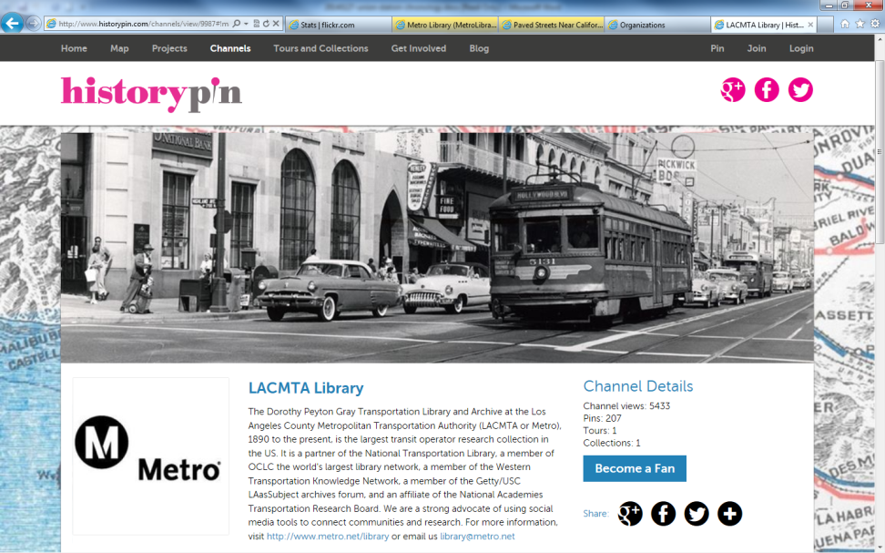
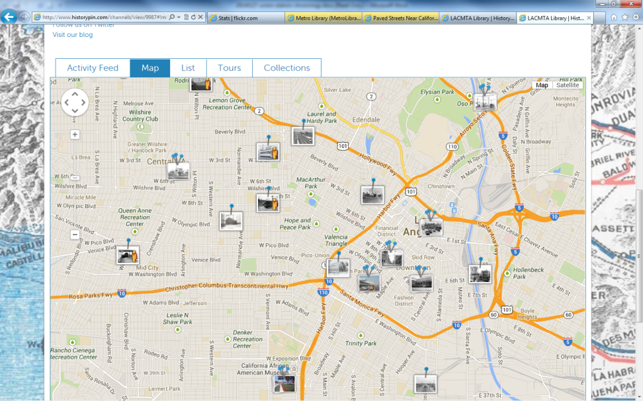
Beyond Flickr: HistoryPin
Notes:
Now things start getting really interesting. Up to this point, I’ve shared some of the tools I’ve used at the Metro Transportation Library for just our resources. But what happens when we start playing in a shared sandbox?
This is Historypin. In a nutshell, it was developed by a guy named Nick Stanhope in London. He was looking at old family photos with his grandmother, and asking her “Who is in this picture?” “Where was this taken?” “What are they doing?” and so forth.
She shared with him all the stories behind the images – the METADATA if you will, and he realized that he would never have known all that good stuff if he hadn’t asked. Obviously, once our seniors are gone, the metadata goes out the window with them. Some of us have varying degrees of experience with oral histories, but check this out.
Historypin acts like a photo sharing site, with geolocation features like you would find in Flickr mapping, but it ALSO features a chronological data layer – so you can search for images across place AND time. Once I heard about THAT, I was all about it.
We were a global launch partner for Historypin, uploading 200 images to get going. We wanted to be sure that they clustered together and weren’t just scattered all over the map, so you could move about easily without searching for other photos from our collection. So we focused on Broadway downtown, Hollywood, and a few other key areas for the initial upload.
On the left is an image of our Historypin site – you see a 1950s photo of Hollywood Boulevard at Highland Avenue – a multi-modal image with streetcars, automobiles, pedestrians and there’s a bus back there, too…
You can create an account and upload your photos here and view them through your own channel or “mashed up” with contributions from other individuals and libraries, archives, museums and other collections.
On the right, you see a zoomed-in map of central Los Angeles where our photos are clustered. The tabs above the map show that you can search our images as a feed, a list, or grouped by collection, or even as a tour – which is wonderful for telling a story through maps and photos in order, like we did with our images of the role that transportation played in the 1984 Summer Olympics in Los Angeles. We promoted that narrative while the 2012 London games were going on, leveraging a contemporary event as an opportunity to highlight our own historic resources.

Slide 31
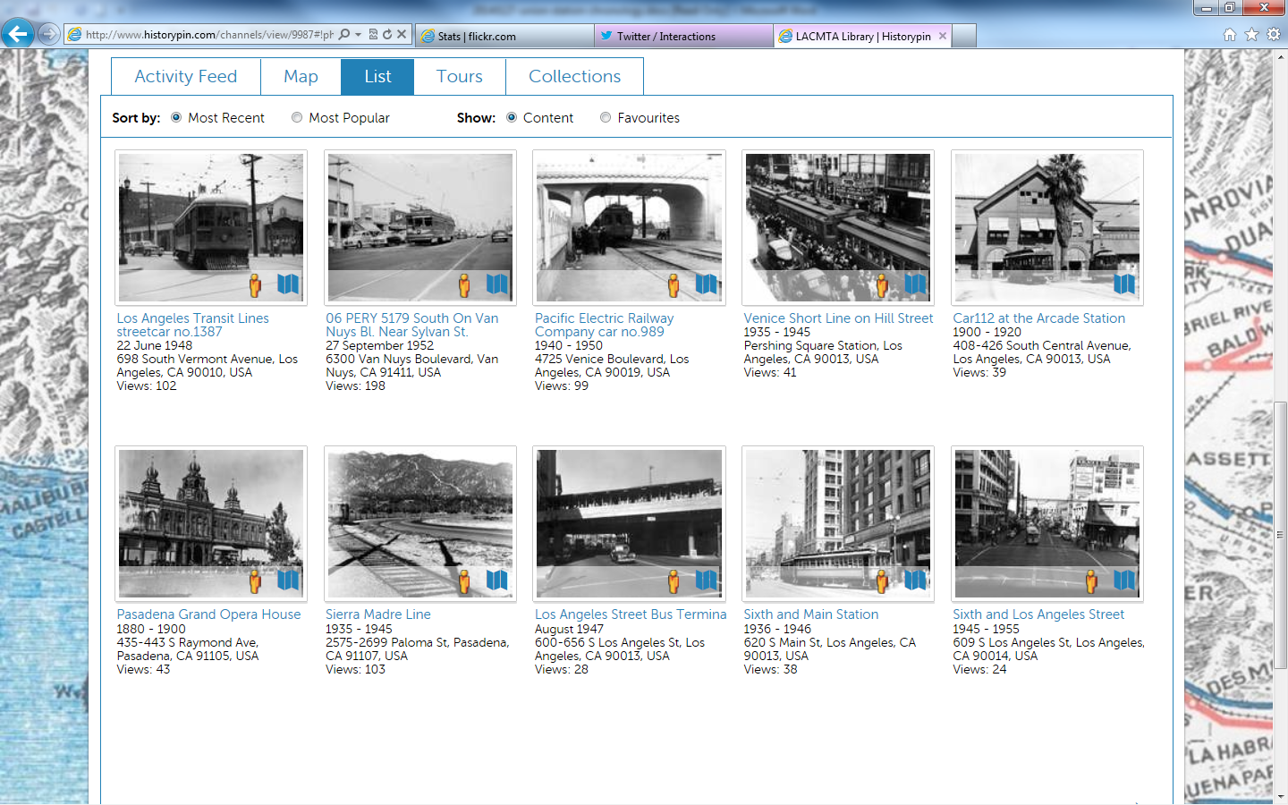
Augmented Reality

Slide 32
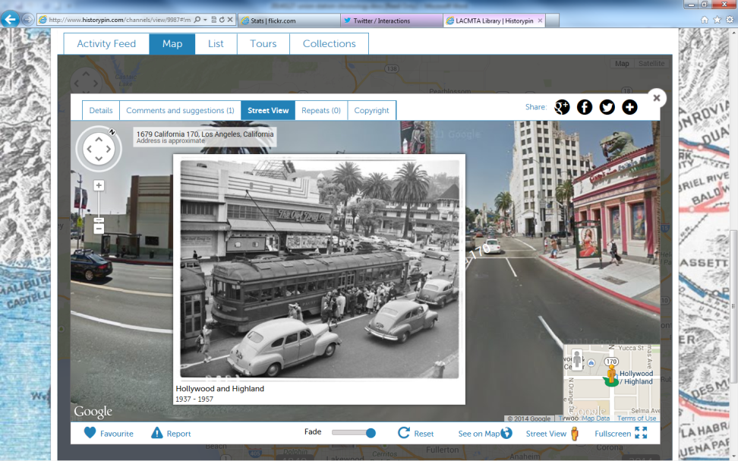
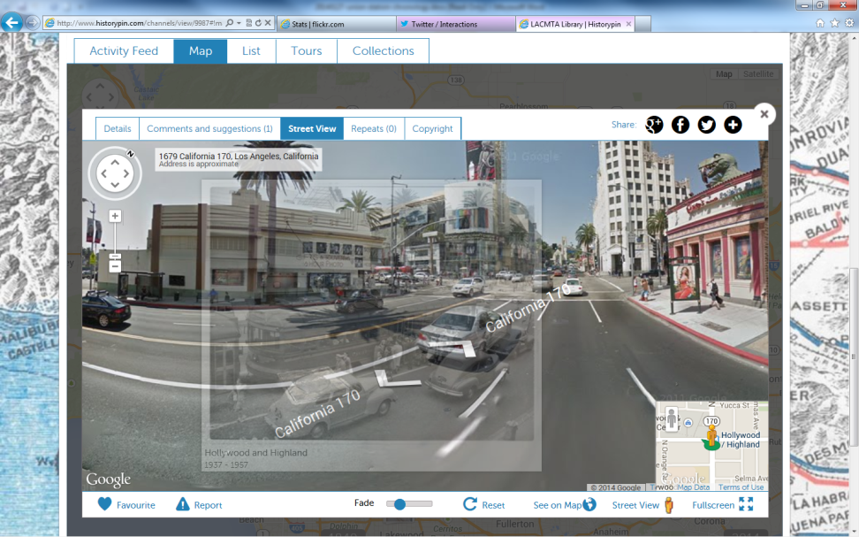
Augmented Reality
Google Street View
Fade Button Slider
Notes:
Here’s one of our Historypin images – a late 1940s photo of that same intersection of Hollywood Boulevard and Highland Avenue in the heart of Hollywood, looking northwest. We’ve clicked the “little yellow guy” to superimpose the geo-located image over contemporary street view, and position it accordingly so it matches up.

Slide 33
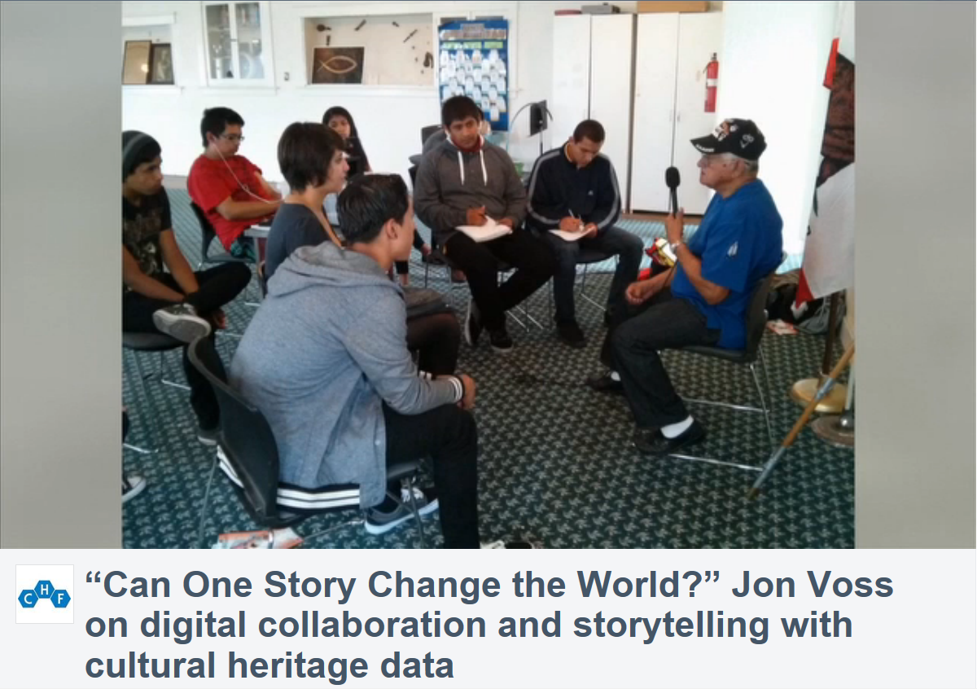
Case Study: Santa Ana PL
Notes:
And at Santa Ana Public Library, they are fortunate to have a superstar archivist named Manny Escamilla. Manny has organized “TEEN COMMUNITY HISTORIANS” who do a number of wonderful things out in the community like working in conjunction with Cal State Fullerton to train them in how to do oral histories and investigate information about photos uploaded to Historypin. The city’s demographics have changed quite a bit over the past few decades, and the Local History Room had found that its collection reflected about 5% of the current population.
Manny set out to change that – and he motivated and enlisted a small army of teenagers to help him. They have received grants to record the stories of Hispanic veterans, among other projects. They are a force to be reckoned with!
Part of that story – storytelling with cultural heritage data – along with MANY more Historypin applications, can be found in a great presentation by Jon Voss of Historypin from which this screenshot is taken, so contact me offline if you’d like the link!
It’s phenomenal. Very powerful stuff.

Slide 34
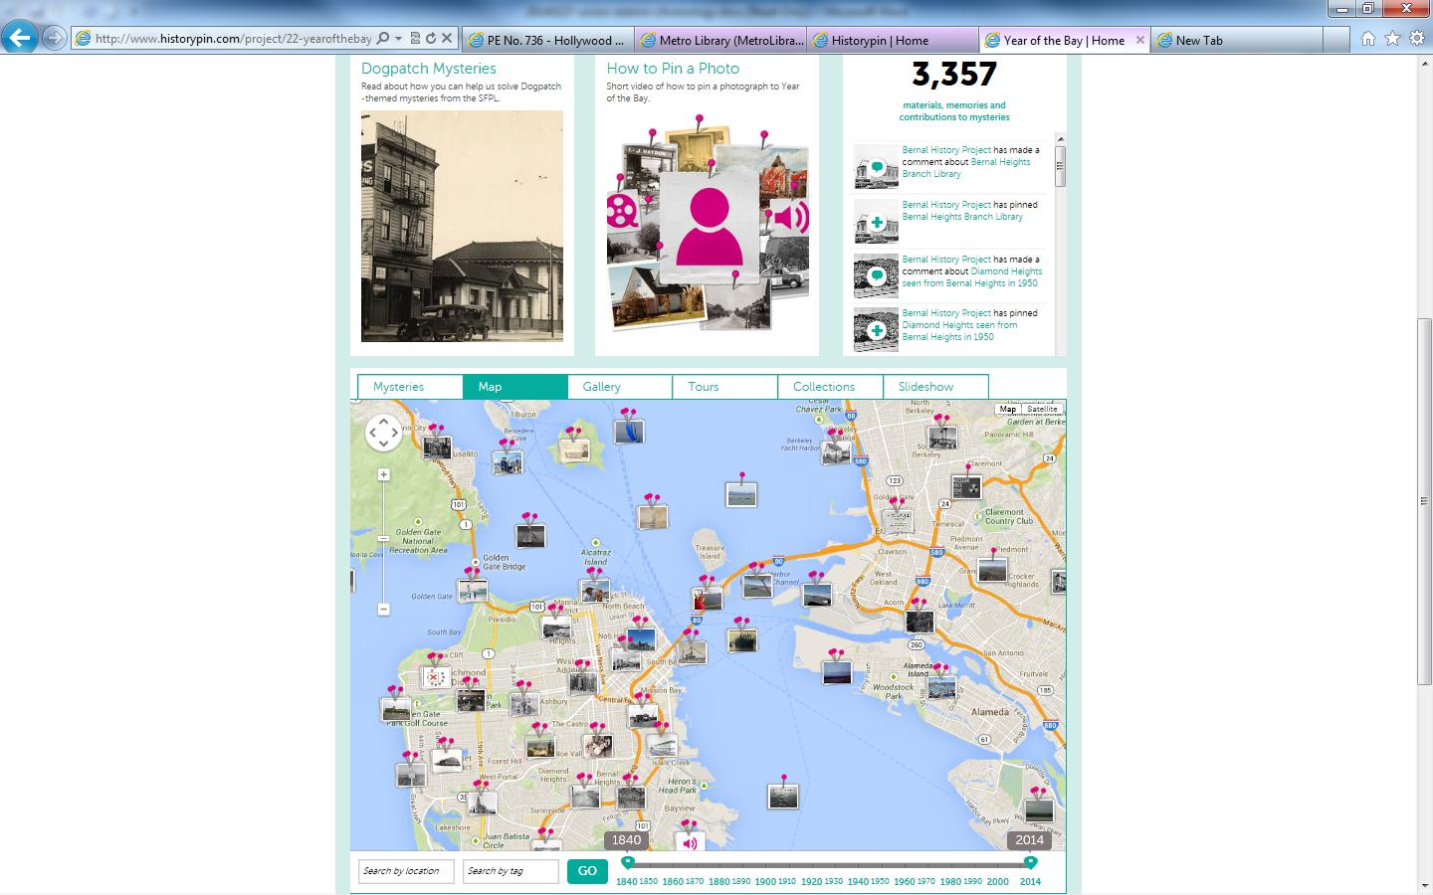
Collaboration Around New Tools
Notes:
While you can leverage an incredible tool like this for your own purposes, it truly begs for collaborative opportunities. And we are already beginning to see this type of activity as libraries, archives and museums begin working together to upload images together.
Here’s a screenshot for “Year Of The Bay,” a Historypin site marking the 150th anniversary of the Port of San Francisco. The images come from several institutions around the Bay Area. At the bottom you can see the “chronology slider” to choose which point in time you want to see photos from – the map reorients the thumbnails that match the decade you choose.
Not only is it content-rich, and not only does it foster collaboration amongst various institutions, and not only does it serve as a powerful educational tool, but to quote ANOTHER infomercial: “BUT WAIT, THERE’S MORE!”…and that wonderful MORE is that it solicits community participation to help identify photos, to map them, to position them properly for the Google Street View augmented reality overlay, and to enjoy some treasure hunts and contests associated with this anniversary. (You know, you gotta wonder about those images that are pinned to the map in the middle of the Bay, but besides Alcatraz, I hope those are for images taken from a boat and not just someone playing “Pin the Tail on the Donkey” with our historical resources!).
So to summarize: Getting information directly from the community, to CROWDSOURCE THIS METADATA, is very powerful indeed. And fun. And can only lead to the type of engagement that will carry over to other service areas for your library.

Slide 35
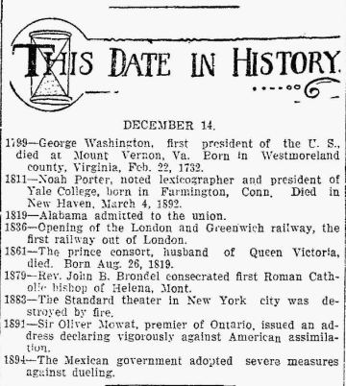
Calendaring

Slide 36
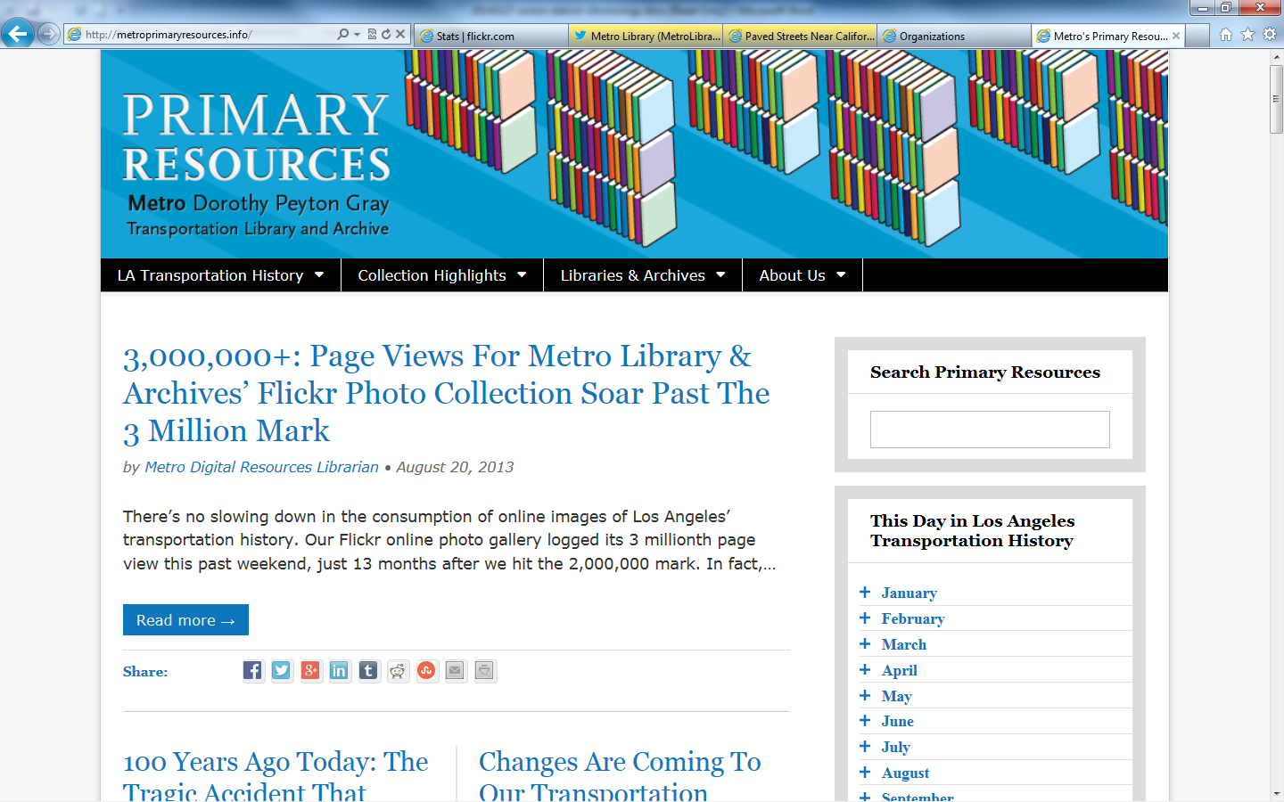
Online Calendar

Slide 37
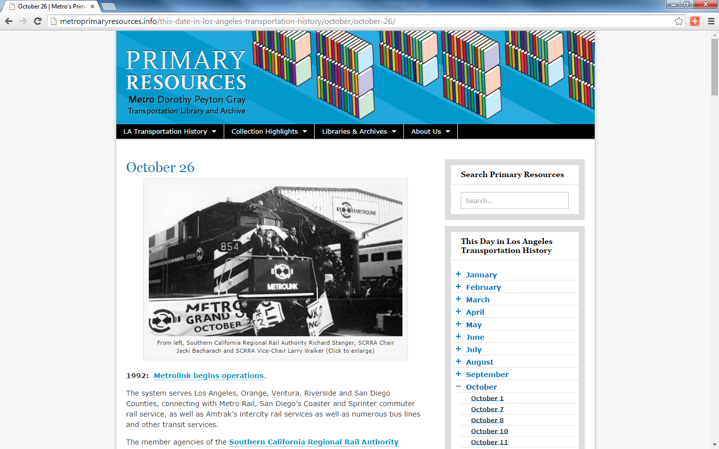
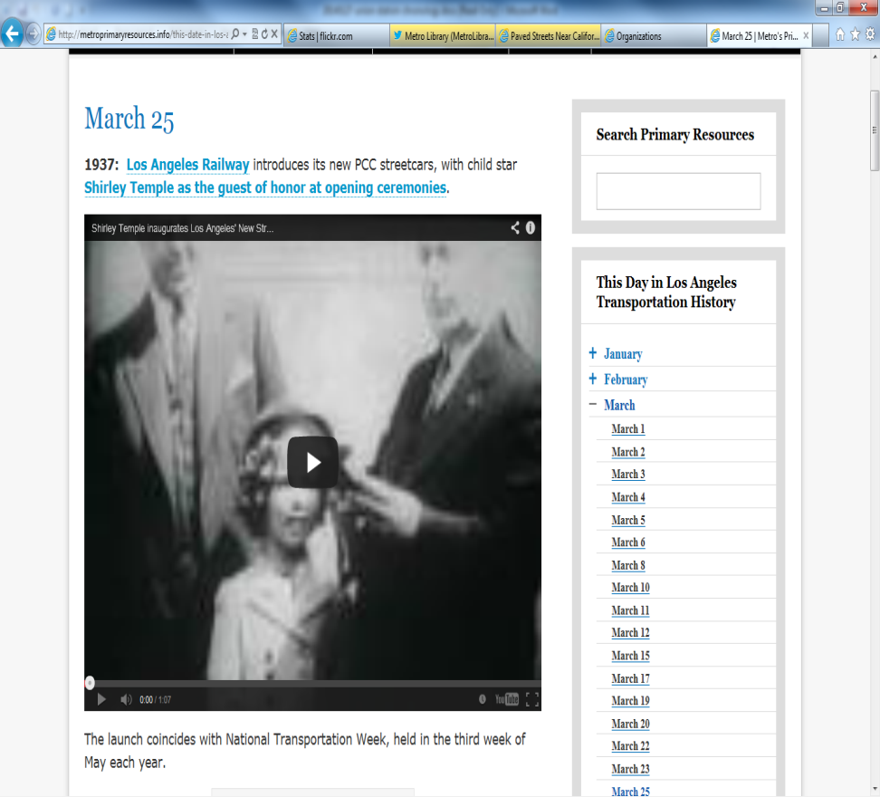
Sample Calendar Entries http://bit.ly/1yLjGKV

Slide 38
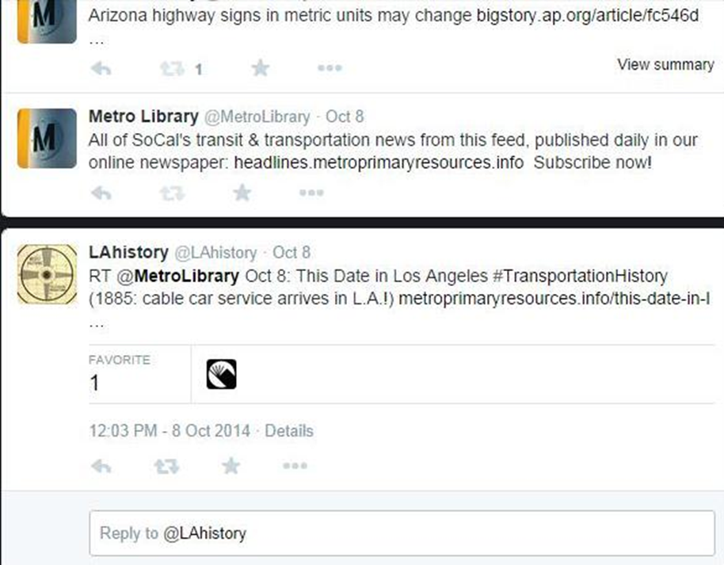
Local History Goes Viral

Slide 39

Storytelling Comes Alive

Slide 40
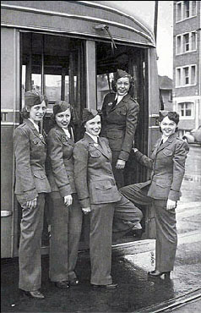
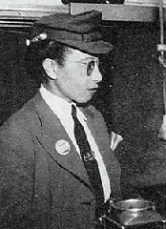
L.A.’s First “Motormanettes”

Slide 41
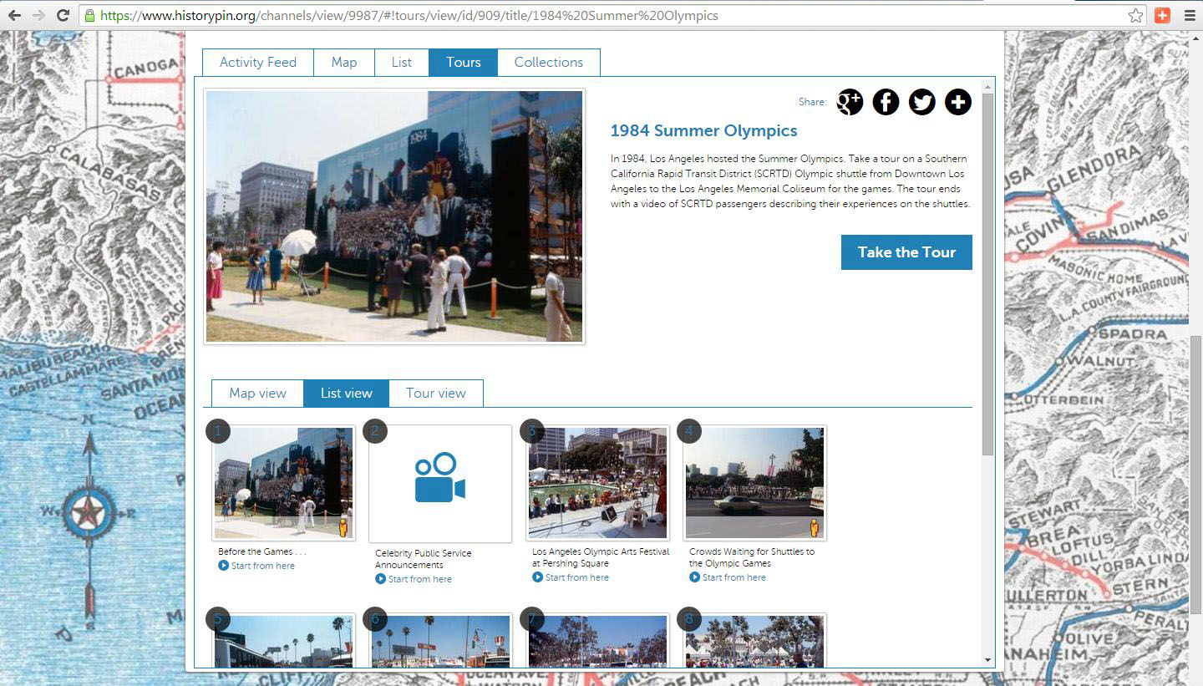
1980 Summer Olympics Tour

Slide 42
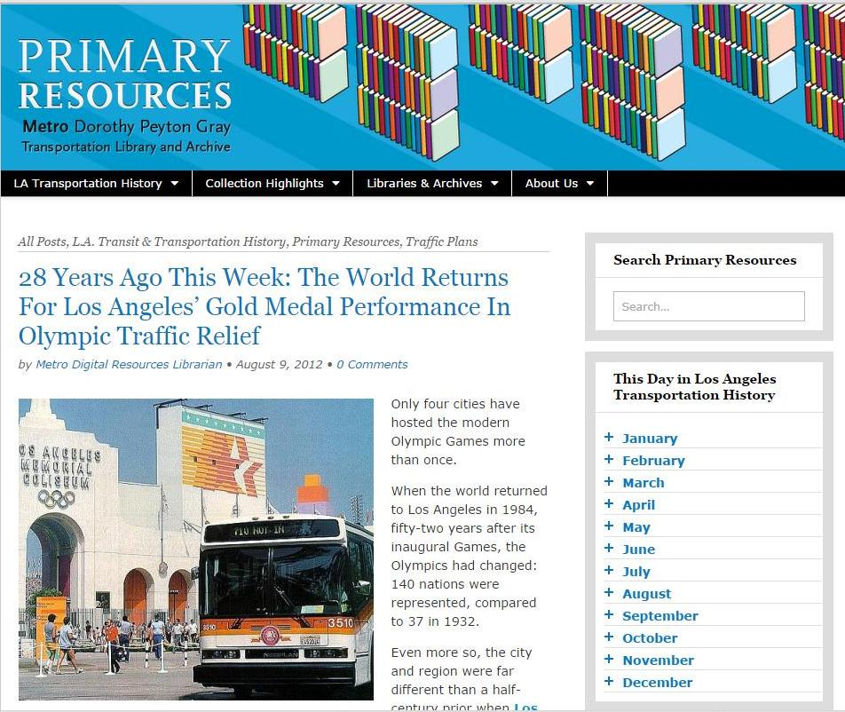
1980 Olympics: Storytelling

Slide 43
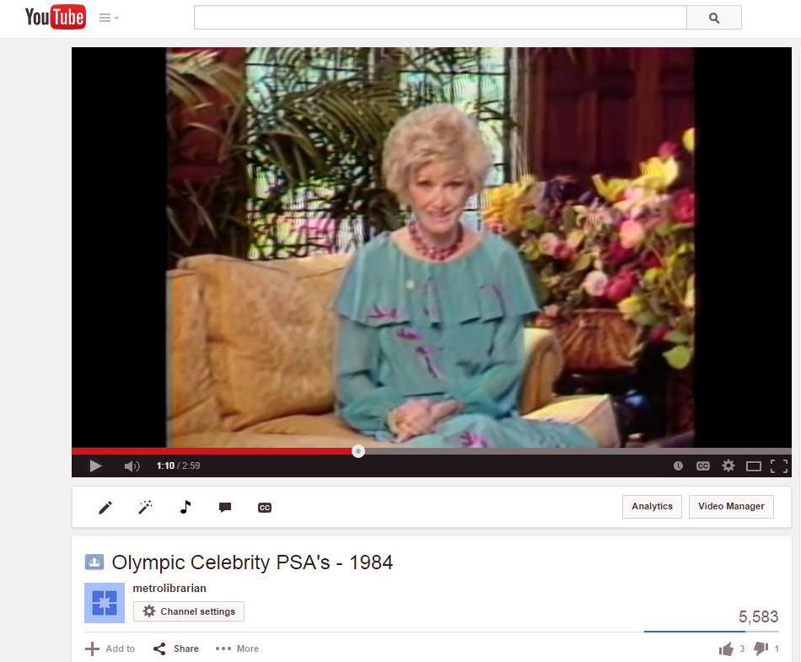
1980 Olympics: Storytelling

Slide 44
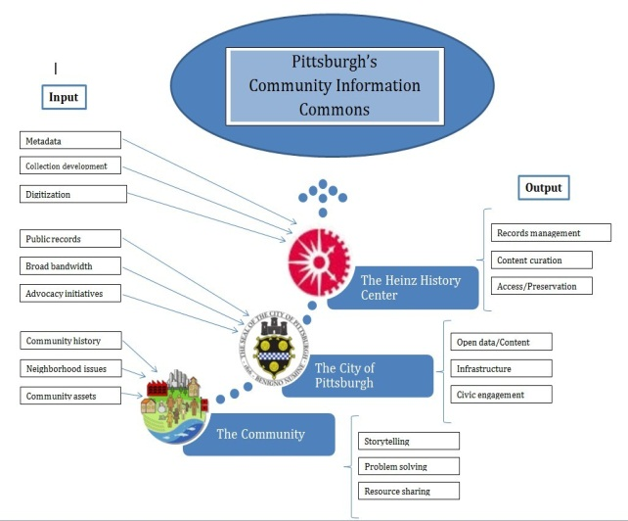
Case study: Pittsburgh
(PA) Community
Information Commons
NEED: Compliance with open data legislation does not address long-term access and preservation issues
PROPOSAL: Knowledge Base of community history, issues, resources for problem-solving, strategizing and engagement to curate and disseminate content
OUTCOMES: Building & empowering knowledgeable communities, replicable model, crowdsourced strategization

Slide 45
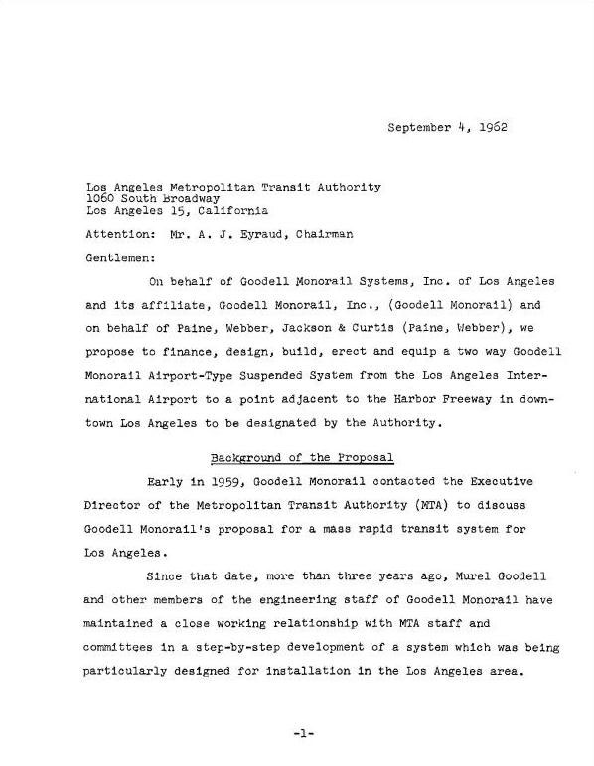
Exploiting Embedded Resources

Slide 46
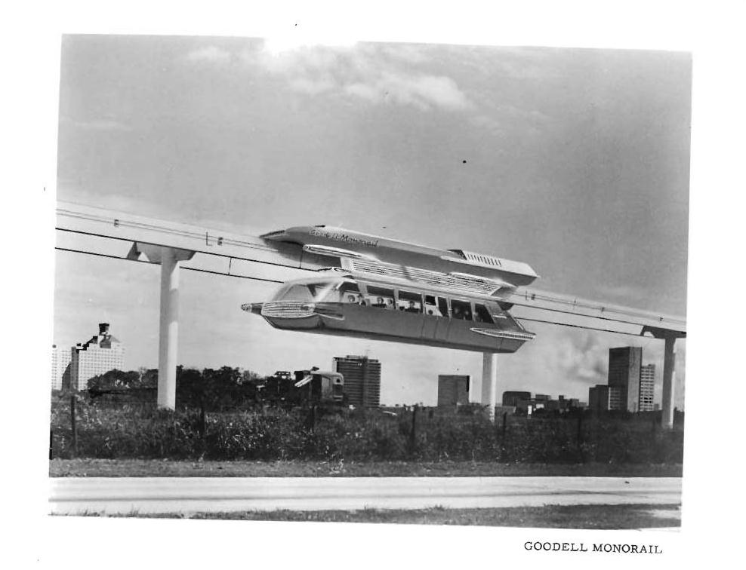
Goodell Monorail Rendering

Slide 47

A+D Museum: Never Built Exhibit

Slide 48

Goodell Monorail, 1962

Slide 49

Volumization

Slide 50

Volumization
Notes:
Tumblr to Flickr, Twitter to Facebook, Instagram to everything, Pinterest…

Slide 51

Volumization

Slide 52

Creative Collaboration
Notes:
As noted in my introduction, I serve as the Executive Chair of LA as Subject, a network of more than 200 archives, libraries, museums, historical societies and cultural institutions who collections pertain to the history and culture of Southern California. We are currently working with Historypin to get more members’ digitized images uploaded to create an incredible experience for both the user and the participants. It can only create closer working relationships and higher visibility for all.
I also hope we can partner with other organizations outside of the library/archive world who value this type of work as well. For example, the LA Conservancy.
While they don’t have collections, they do have extraordinary, trained docents who provide historical walking tours of Los Angeles. Imagine a high-interest guided walking tour supplemented by “augmented reality” on your phone or tablet. Pre-loaded tours could be accessed on loaned iPads – there’s lots of potential for cross-pollination with what people are doing in Museums as well.
The sky’s the limit, and I intend to explore how high we can fly with this one.

Slide 53


The Exo-Library

Slide 54

Interactive Transit Kiosks

Slide 55

Interactive Transit Kiosks

Slide 56

Interactive Transit Kiosks

Slide 57
Synesthesia:
Multisensory experiences for a multisensory world
Memories in the Museum (Alzheimers)
Costumes with embossed sound / Mexico City
Digital scent technology
Music: the Next Big Thing (http://bit.ly/10fdOLH)

Slide 58

Case Study: “City Key-osks”: Bringing Community
Information To The
Masses (Baton Rouge, LA)
NEED: Bridge gap for information-deprived
PROPOSAL: Essential services & information available 24/7, plus boost for visitors
OUTCOMES: Playing an essential role in community building and fostering civic pride

Slide 59

Case Study: Library as Cruise Ship
Destination (FIU)
NEED: 9 million passengers rarely exposed to rich, diverse cultural resources such as Wolfsonian, Jewish Museum of Florida
PROPOSAL: Build itineraries & presentations for visitors to explore what Miami Beach holds for them
OUTCOMES: Ongoing partnerships with cruise lines, social networking opportunities, enriched travel experiences leading to broader support

Slide 60

Knowledge Base

Slide 61

Open Data: “The New Oil”

Slide 62


Some statistics, please…
Notes:
From the beginning of time until the year 2003, we humans created 5 exabytes of data (5 billion gigabytes). In the year 2011, we created that much data EVERY TWO DAYS. In other words, 90% of all the data in the world was created 2009-2011.
Again, from 2011, 10% of all the photos ever taken in history, were taken that year.
Every hour, we create enough internet traffic to fill 7 billion DVDs. (Every hour!)
The amount of data generated between 2012 and 2015 was expected to double.
Data is not generated only at the national or even state level. Look at all of the information being generated at the county or city level. By Universities and private enterprise that is sharing it on the web. Think about all the micro-level data being generated by drone photography. So we can imagine what this is like at the local level.

Slide 63

Case Study: California
State Library Public
Information Portal
NEED: State needs infrastructure for data, State Library has “information & knowledge sharing burned into its DNA”
PROPOSAL: Improve govt information access, boost civic awareness, spur community action via connection to state’s 1,182 public libraries
OUTCOMES: Revamped data.ca.gov site as data set clearinghouse in 2015, CalCloud in 2016

Slide 64

Case Study:
Libraries as Labs for
Open Government
(Oakland, CA)
NEED: Increasing public data + less public penetration = underutilized & disengaged citizenry
PROPOSAL: Bring citizens of disparate neighborhoods together for technology applications for local govt
OUTCOMES: Future civic app design, local civic software incentives, informed/engaged population

Slide 65

Infographics / Data Visualization

Slide 66

Case Study:
National Library Coding
League Challenge
NEED: Addresses STEM-related learning opportunities, inequities in gender. 68% of young Americans view PLs as playing important role in everyone succeeding
PROPOSAL: Librarians & Tech mentors facilitate group challenges around the country
OUTCOMES: Coding skills for teens, a national model

Slide 67

The Path Forward

Slide 68

New Paradigm Considerations

Slide 69
“Better Than Free”:
8 Generative Values Of Digitization
Notes:
I started working at Metro Library three months before the passage of Measure R, when everything kind of hit the fan, so to speak. But we rose to the occasion. The Digital Resources position was new, and I took some time to think about a long-range strategy, but not too much time – because I’m a firm believer in diving right in as well. There were other challenges, such as the complex subject focus of our collection. Transportation is incredibly interdisciplinary. It involves urban planning, land use, architecture, finance, legal issues, geology, social justice…many different areas that demand a lot of an employee to develop subject expertise. And I had no transportation background, so while I was working on digitization and social media, I asked my Library Administrator to PLEASE cc me on every reference question answered via email, and fortunately nearly all of our reference questions are via email…and I will talk in a few minutes about what I have done with all that information.
Meanwhile, I started considering what needs to go into a digitization project and overall plan. I found Kevin Kelly’s “Better than Free” generative values a good place to start, and I will review them briefly here.

Slide 70

Immediacy
Notes:
EVERYONE understands the “expectation economy,” and if you’re like me, standing in front of your microwave telling it to hurry up, you can appreciate the time-sensitive value of getting what you want right away. This extends to information, and as we have begun systematically digitizing our collection, we know that our users appreciate us sending them links to EIRs and other reports that are hundreds, if not thousands, of pages long.

Slide 71

Personalization
Notes:
Another value we have accentuated is personalization – delivering information tailored to the needs and proficiencies of our users. Obviously, we would not answer a reference question asked by one of our staff engineers in the same way we would a high school student, so we need to make considerations in our digitization efforts to ensure we are not taking a “one size fits all” approach.

Slide 72

Interpretation
Notes:
Another value we have accentuated is personalization – delivering information tailored to the needs and proficiencies of our users. Obviously, we would not answer a reference question asked by one of our staff engineers in the same way we would a high school student, so we need to make considerations in our digitization efforts to ensure we are not taking a “one size fits all” approach.

Slide 73

Authenticity
Notes:
Authenticity is another important value – reinforcing the perception that in this day and age of mash-ups, Photoshop and other types of edits, digitization allows users to “handle” true copies while we guard the unaltered originals for safekeeping.

Slide 74

Accessibility
Notes:
We need to elbow our way into an increasingly agile and mobile, but crowded, world.
We are competing for eyeballs in telling our story and promoting our value.
Multiple platforms are key to being where our users are, and I will be addressing more of this a little later. In the image here, you can see a “modern” streetcar headed for Century City – as proposed back in the early 1960s when Century City was being built.

Slide 75

Findability
Notes:
But providing access means nothing if users cannot locate resources.
Findability is a different consideration than access – we need to address the ease with which users can locate material, not just access it.
(This image is the “before” and “after” images of one of the many bridge crossings over the Los Angeles River in March, 1938. Hard to imagine now during the drought, but L.A. got like 15 inches of rain in a few days. The heavy runoff washed out numerous Los Angeles Railway and Pacific Electric streetcar lines, leading to the “concretization” of the River to avoid future floods)

Slide 76

Embodiment
Notes:
Embodiment addresses our desire to further strengthen our reputation as a trusted source for information.
We protect not just individual resources, but collections and the overall heritage of the mobility agenda and transportation legacy of Southern California.
(What you’re looking at here is a recently discovered image of visitors atop Mt. Lowe, the railway east of Los Angeles that was one of the biggest tourist attractions in California in the early 1920s).

Slide 77

Patronage
Notes:
And finally, we want to build on all of these values.
I believe that the only thing better than free is more of it. Nothing beats word of mouth marketing, so engaging our users and making them into our own most valuable boosters and referrers is in our in addressing the other values

Slide 78

New Promotional Opportunities

Slide 79

Los Angeles Historic Traffic Plans

Slide 80

Getty Museum: Overdrive

Slide 81

National Building Museum, Washington D.C.

Slide 82

CONTENT MARKETING CYCLE

Slide 83

How Can We Best Support
Each Other?

Slide 84
Kenn Bicknell email: bicknellk@metro.net
www.metro.net/library
http://metroprimaryresources.info
Librarycat.metro.net
Kennbicknell.com
@StrategicLbries

