Slide 1
Vancouver Delegation Briefing
Los Angeles County
Transportation Revenue Initiatives
David Yale
Managing Executive Officer, Planning, Programming, and Grants
Heather Hills and Cosette Stark
Deputy Executive Officers, Countywide Planning and Development
Los Angeles County Metropolitan Transportation Authority
November 14, 2012

Slide 2




Measure R (2008) Imagine Campaign
Notes:
Imagine campaign was also instrumental in this environment in getting people to think about new options. Was done as a part of LRTP development but impact not lost on Measure R campaign.

Slide 3
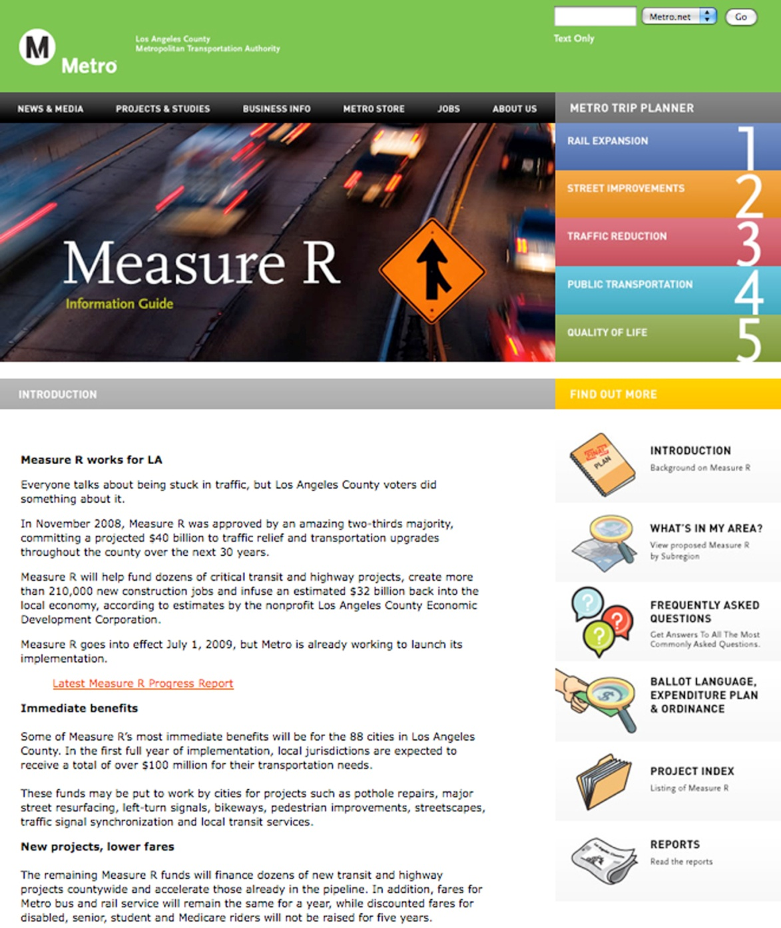
Measure R (2008) Fact Sheet

Slide 4
Measure R Value and Benefits
Economic Impacts
500,000 new jobs
$83.9 billion in economic output (measured by business revenues)
$30.6 billion in earnings for jobs created
Over $9.2 billion in tax revenues, at the Federal, State, County and local levels
Environmental Impacts
191 million vehicle miles travelled reduced annually
522,000 pounds of emissions reduced annually
9.4 million gallons of gasoline saved annually

Slide 5
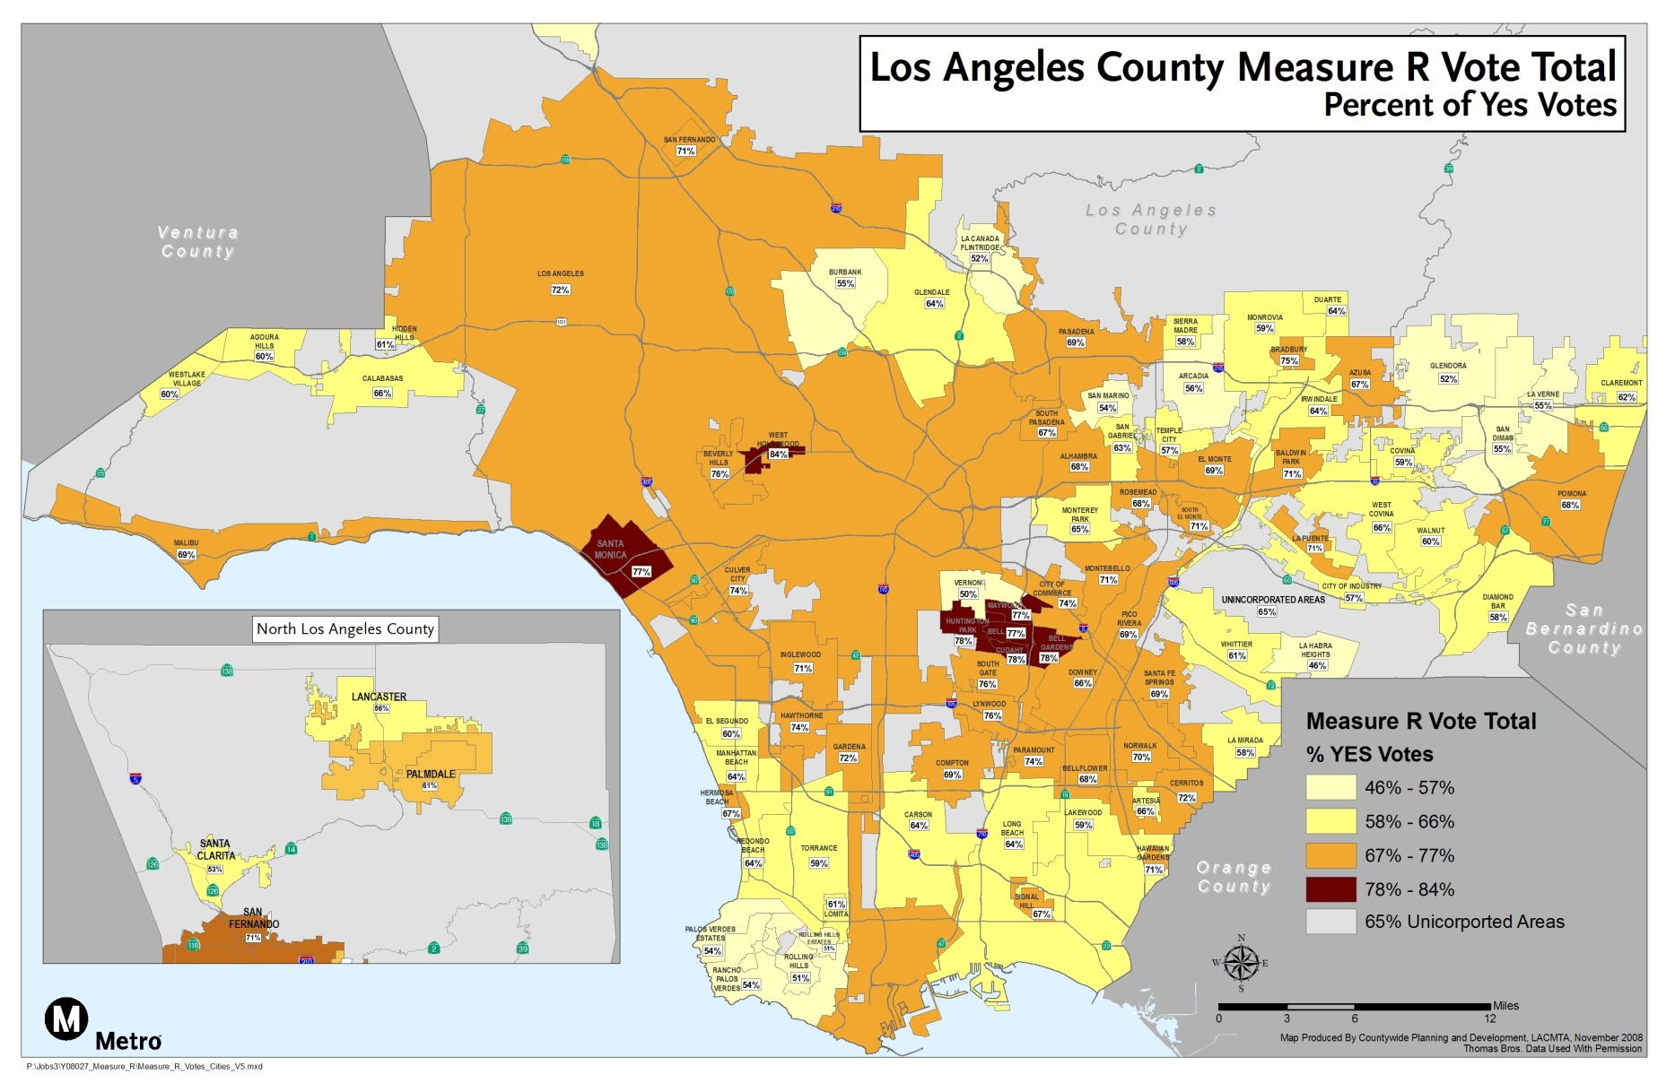
Measure R – Passed by 38,000 Votes in November 2008

Slide 6
The Goal for Los Angeles County :
Deliver 30 Year Measure R Program in 10 Years
Complete 12 transit projects in 10 years
    Create 160,000 jobs
    Eliminate 522,000 lbs of carbon emissions every day
    Reduce vehicle miles traveled by 191 million
    Increase transit boardings by 77 million
  Seek to accelerate 15 highway projects
    Create 256,000 jobs
    Relieve Congestion Countywide

Slide 7
Measure R Extension
Strategic Financial Plan Alternatives Considered

Slide 8
TIFIA Funding Increased under MAP-21

Slide 9
TIFIA Allows Full Subordination of Loan
Measure R Revenues
LACMTA Senior Debt Service
LACMTA Subordinate Debt Service
TIFIA MCA Parity with Prior TIFIA
New Projects (Crenshaw Project Corp.)
LACMTA
Requirements:
33% participation
  At Master Credit Agreement or Project level?
“A” Rated, maximum 10% credit subsidy
Non-project related revenue only
  No tolls
Springing Lien
Revenues remaining after payment of debt obligations are released to LACMTA.

Slide 10
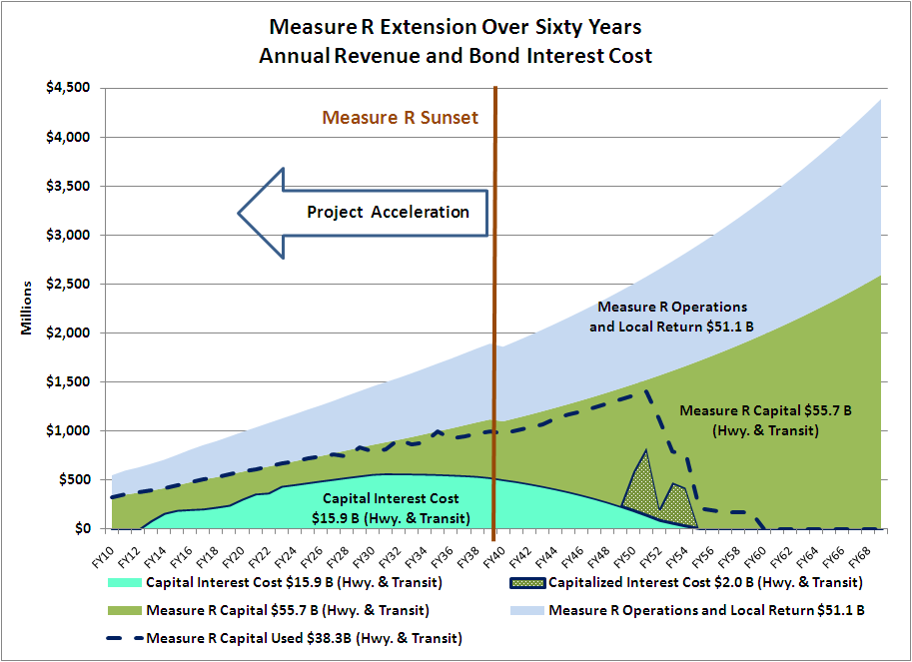
Measure R Highway & Transit
Revenue and Interest Cost

Slide 11
Preferred Strategic Financial Plan by Funding Source

Slide 12
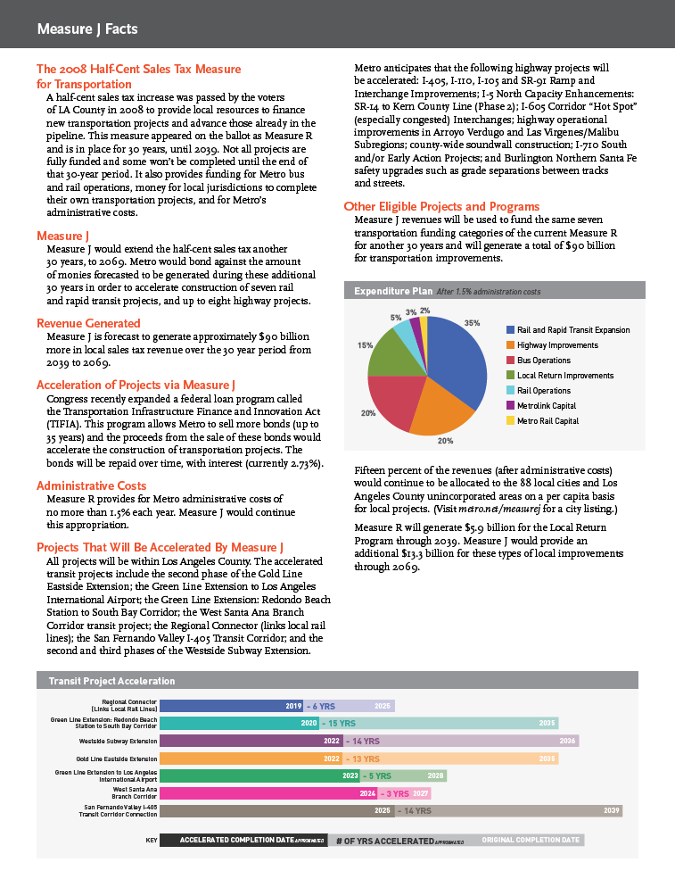
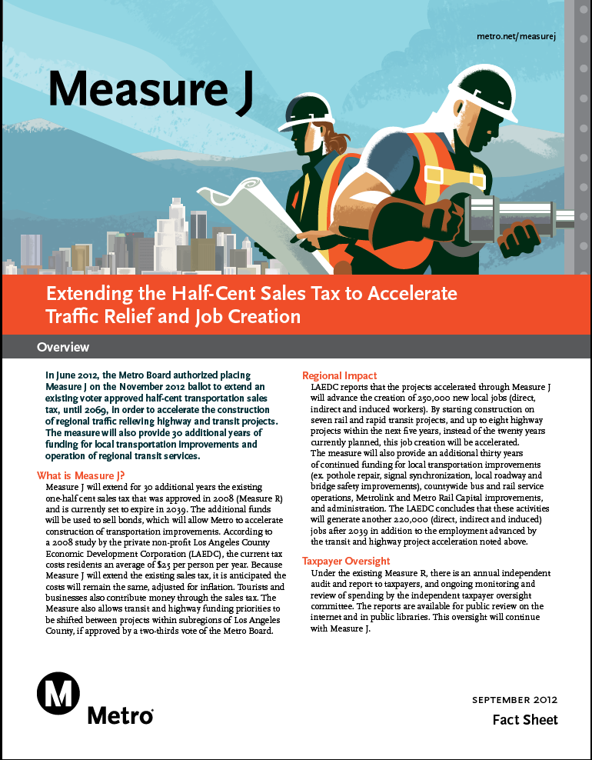
Measure J Fact Sheet

Slide 13
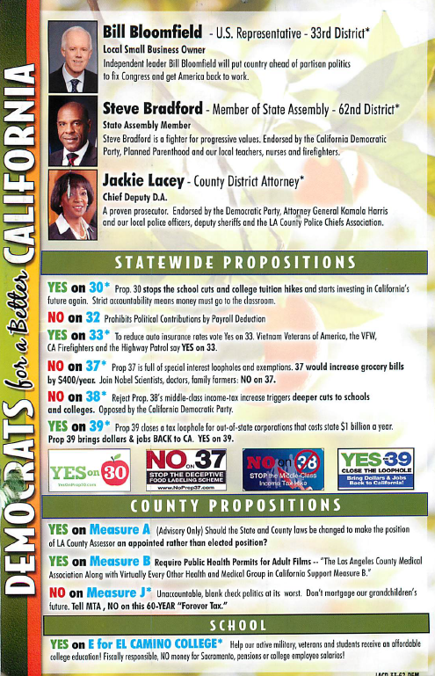
Opposition to Measure J

Slide 14
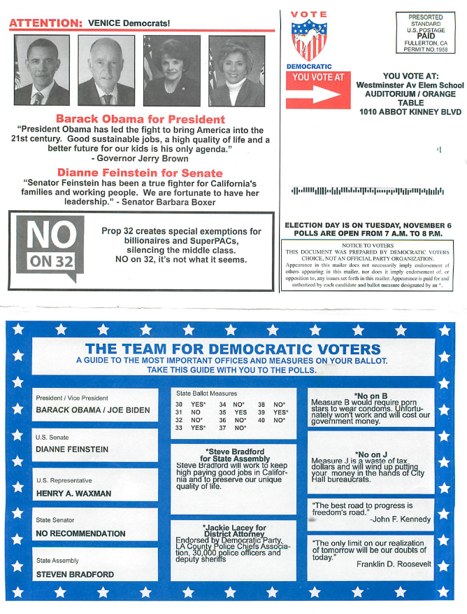
Opposition to Measure J

Slide 15
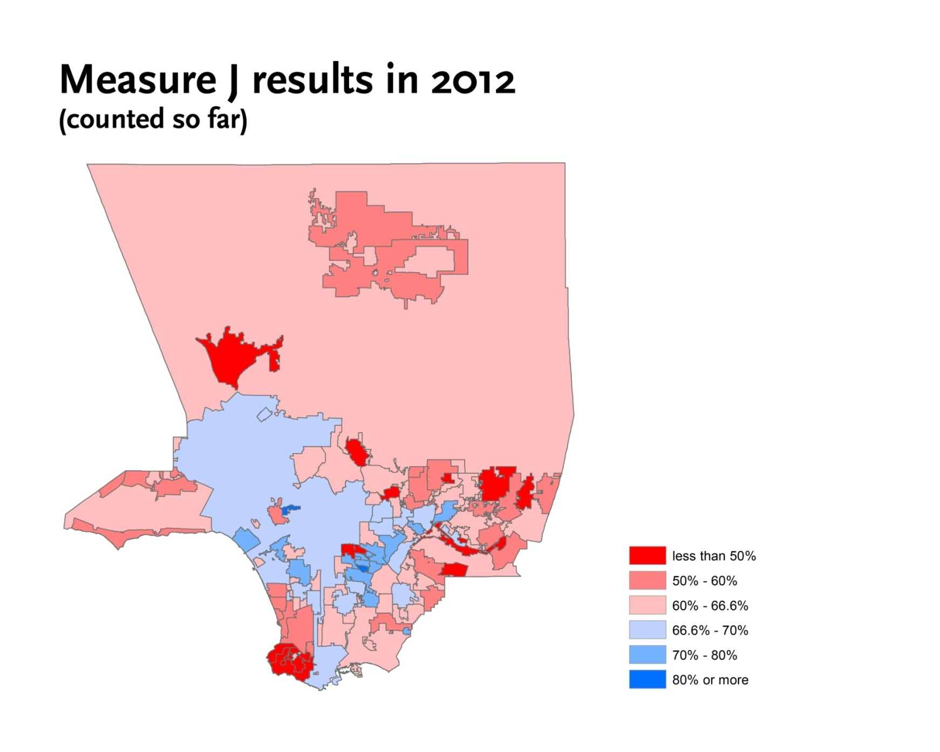
Measure J Results as of Nov. 7, 2012

Slide 16
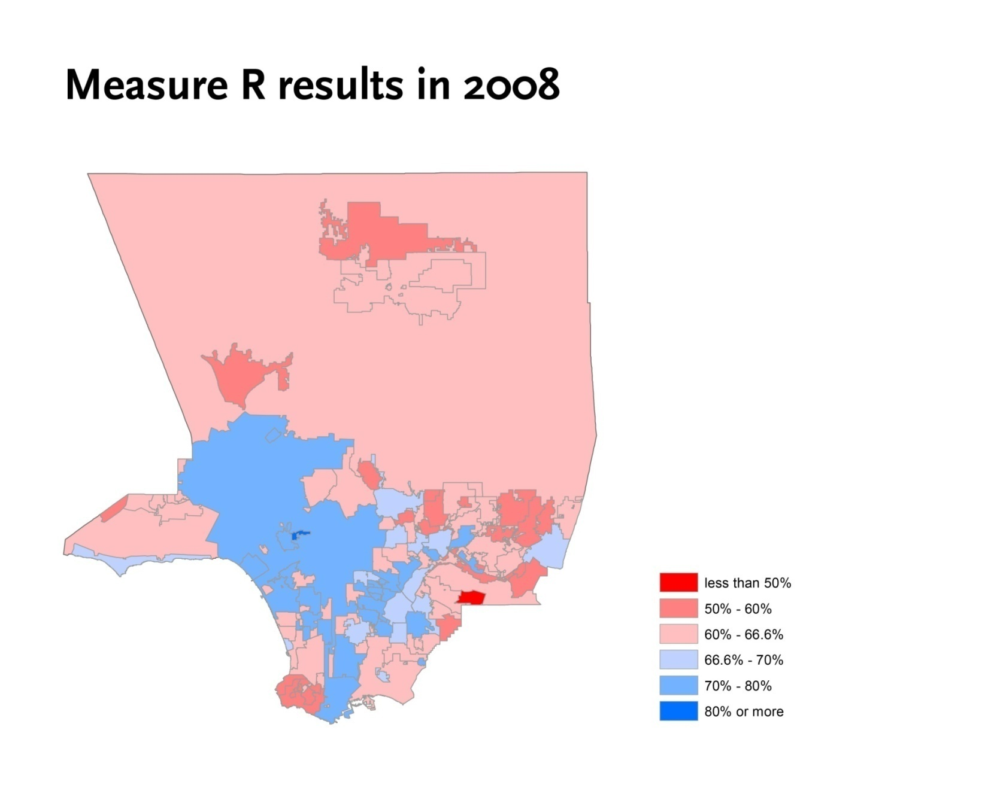
Measure R Results in 2008

Slide 17
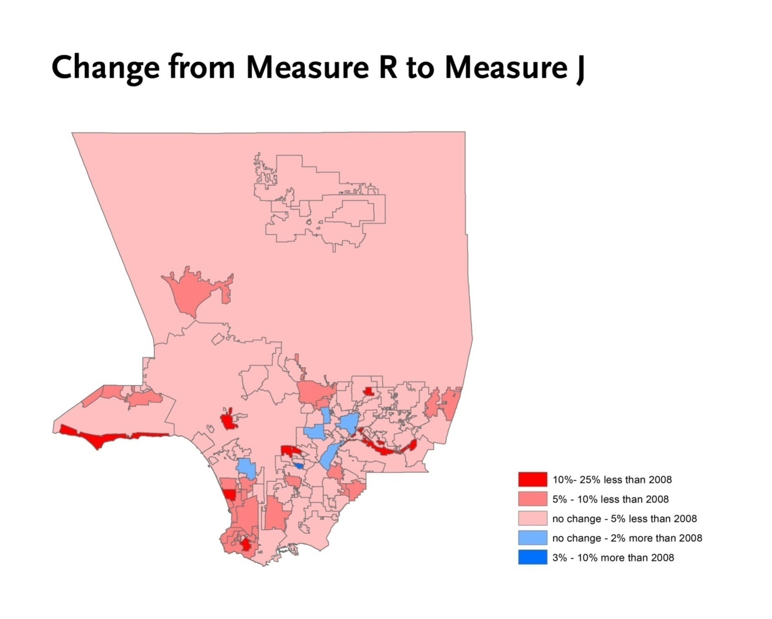
Change from Measure R to Measure J

Slide 18
Lessons Learned
Measure R’s success
  Metro “brand”
  Substantial support
  Optimal outreach
Measure J’s 65% “failure”
  Opposed by some Board members
  Lost by 2 percentage points
Consensus is possible
Coalition is necessary
Champion is needed
Support of full Board of Directors is needed

Slide 19
Project Development Input Process for Long Range Plan/Ballot Initiative
COG Input
Ballot Development
Mobility Matrix
Now – Feb 2015
Preliminary Needs
Preliminary Project List Development
Aug 2014 – Feb 2015
Initial Polling
Jan 2015
Project List & Financial Plan
Mar – Jun 2015
Update Projects if Needed
Jul 2015 – Feb 2016
Board Action on Ordinance
May 2016
Ballot Election
Nov 2016
Final Polling
Mar 2016
Update Project Costs & Schedules
Feb – Mar 2015
Other Stakeholders
Sub-Regional Needs
Sub-Regional Goals
Sub-Regional Projects* and Priorities
Develop COG Ballot Priorities
(Mar – Jun 2015)
Updated/Revised Lists
Other Stakeholders
Develop COG Ballot Priorities
Mar 2015 – May 2016
Update/Revise Projects Based on Initial Polling
Refine Sub-Regional Projects
Assist with Development of Financial Plan and Ordinance
Hold Metro Executive Team Quarterly Meetings
Updates to Final List
Other Stakeholders
LRTP Funded
LRTP Strategic
* “Projects” refers to projects & programs
Yes
No

