Slide 1
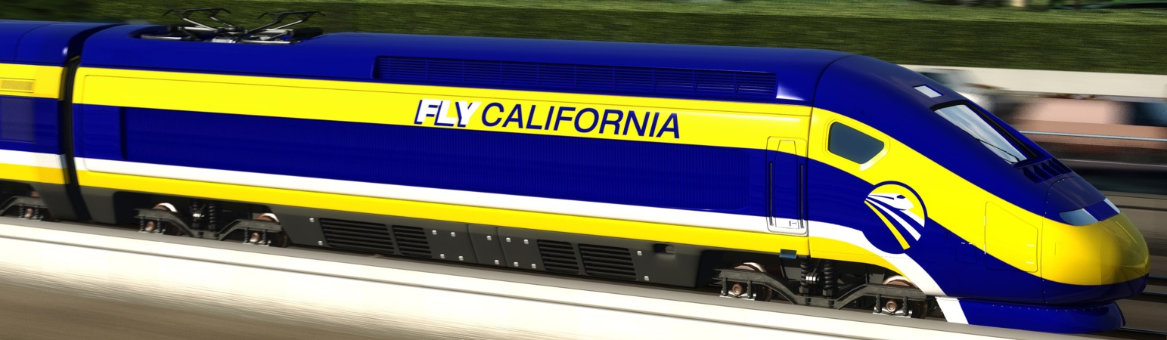
California High-Speed Rail
Metro Bus Operations Subcommittee
January 2010

Slide 2
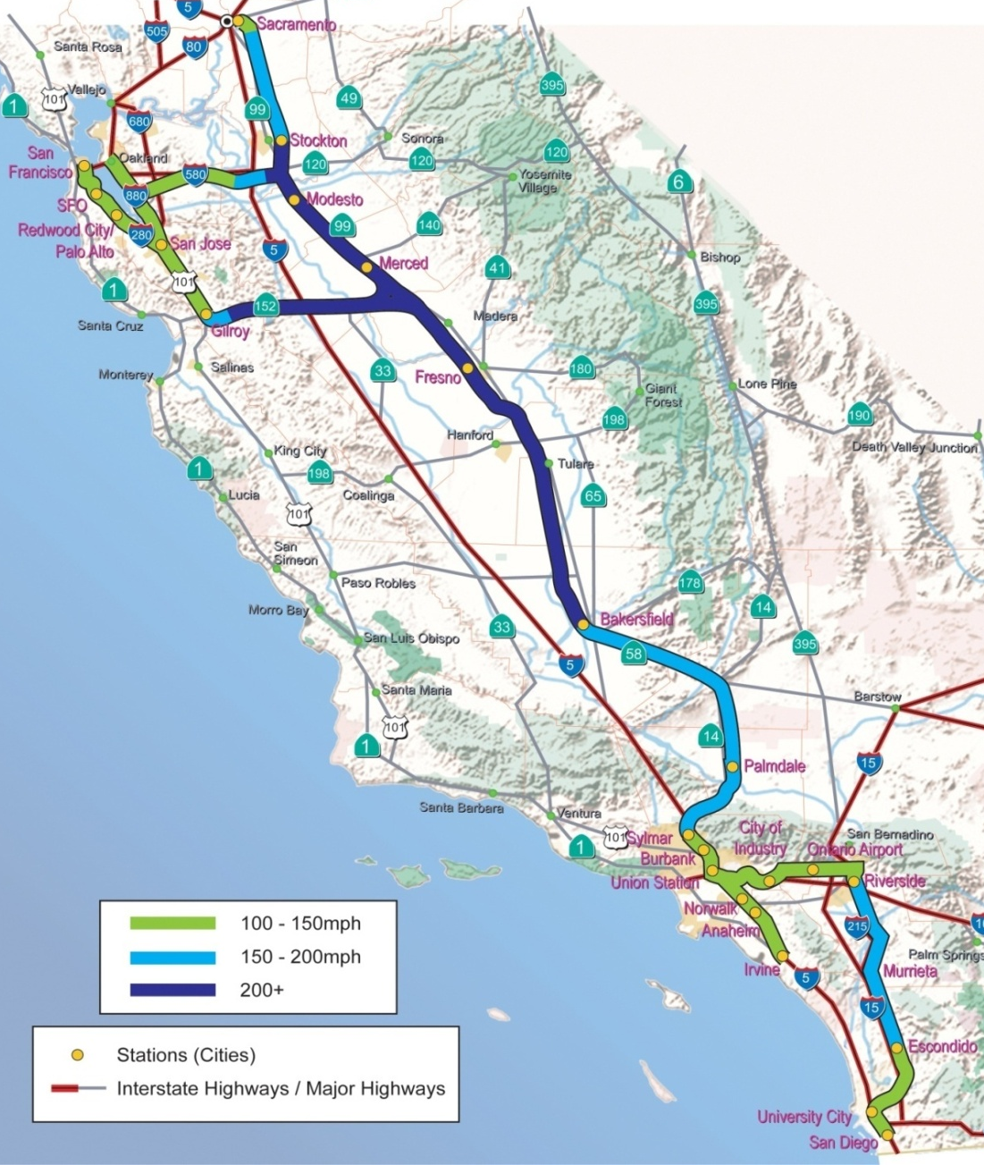
The High-Speed Future
800-mile system connecting major cities
Steel wheel-on-steel rail
100% clean electric power
Maximum operating speeds in excess of 200 mph
Grade separated
Safe and Reliable

Slide 3
Project History
2009 Pres. Obama designates $8B in ARRA funds
2008 Voters approve Prop. 1A - $9.95B bond
2007-present Project-level EIR/EIS process
2005 Program-level EIR/EIS certified by HSRA/FRA
1996 High-Speed Rail Authority created

Slide 4
Project Funding
Nov. 2008 Voters approve Prop. 1A - $9.95B bond
Feb. 2009 President Obama designates $8B in ARRA for high-speed train systems nationally
October 2009 California submits application to FRA requesting $4.73 Billion in matching funds from Track 2 ARRA stimulus funds.
Jan/Feb. 2010 Awaiting word on FRA Funding Decisions

Slide 5
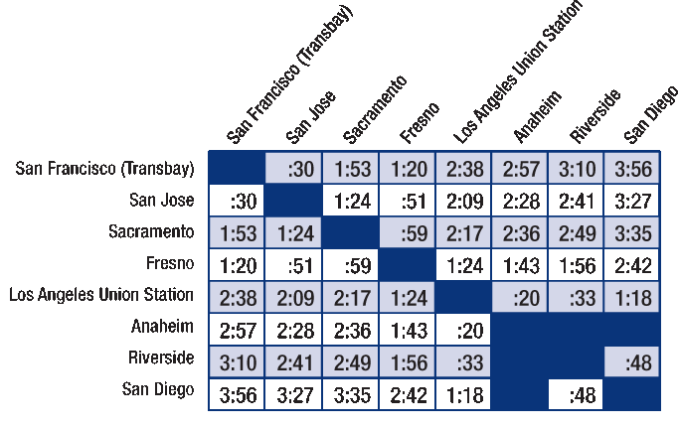
The High-Speed Future
Service up to 220 MPH linking Southern California, the Central Valley and the San Francisco Bay Area.

Slide 6
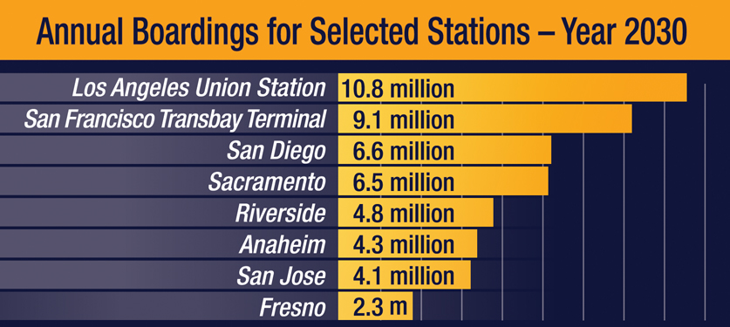
A New Travel Option for All Californians

Slide 7
Benefits
  Dependence on foreign oil reduced by 12.7 million barrels a year
  Greenhouse gases cut by 12 billion pounds a year
  Create 54,800 jobs by 2020; 96,300 jobs by 2035
  Increase local tax revenues
  Infuse an additional 2%-4% into the Los Angeles Region’s economic growth annually

Slide 8
Federal ARRA Deadlines
October 2009 ARRA applications due.
September 2011 Record of Decision/Notice of Determination by FRA & HSRA Board
September 2012 Begin construction.
September 2017 Construction complete

Slide 9

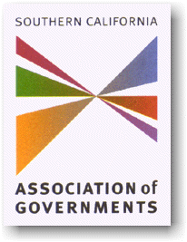
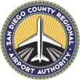


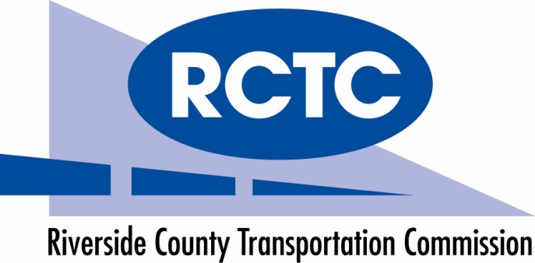


Southern California Partners

Slide 10
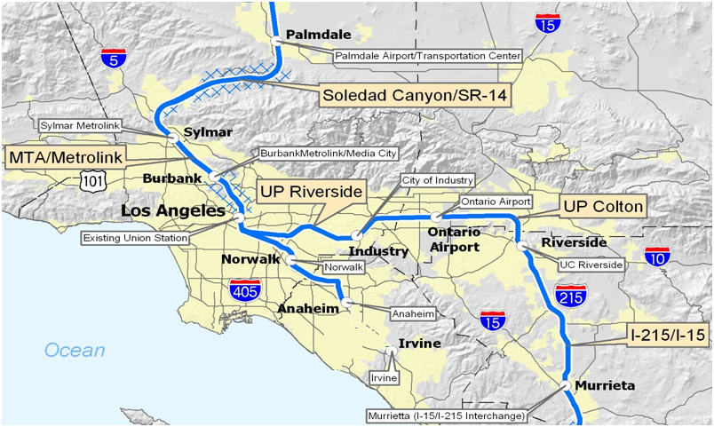
Southern California
Los Angeles to Bakersfield
via Palmdale
Los Angeles to San Diego
via Inland Empire
Anaheim to Los Angeles

Slide 11
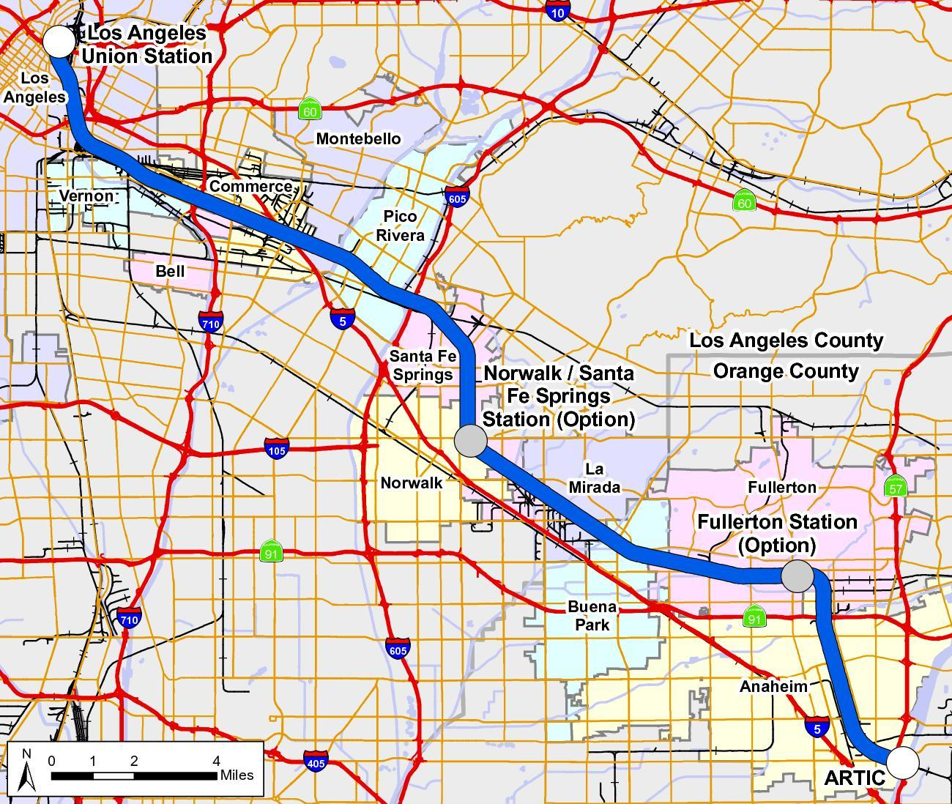
LA-Anaheim Section Overview
Hobart Yard to Los Angeles Union Station:
Junction with HST line to Inland Empire / San Diego
Exclusive HST tracks along Los Angeles River to LAUS
Anaheim to Fullerton:
Limited Freight Traffic
Fewer Tracks Needed (2-4)
Narrower ROW
Fullerton to Hobart Yard:
Extensive Freight Traffic
More Tracks Needed (5-6)
Approx. 100’ Wide ROW

Slide 12
Environmental Process
Initial Outreach
NOP/NOI
Scoping Meetings
Scoping Summary
Report
Agency Outreach
Plan
2. Project
Definition
Alternatives Analysis
Project
Definition / Description
Technical Reports
Impact / Mitigation
Analysis
3. Draft
EIR/EIS
Administrative Draft EIR/EIS
Draft EIR/EIS
Public Circulation of Draft EIR/EIS
Public
Hearings
4. Final
EIR/EIS
Selection of Preferred Alternatives
Response to Comments
Final EIR/EIS
ROD/NOD
Public Document
Technical Report
Outreach Activity

Slide 13
AA Evaluation Measures
Operations
Community Disruption / Impacts
Travel Time
Environmental Constraints / Impacts
Constructability
Intermodal Connections
Development Potential
Property Impacts
Right-of-Way Constraints
Capital and Operating Costs

Slide 14
LA-Anaheim Section - Next Steps
Summer 2009 Alternatives Analysis released
Winter/Spring 2010 On-going city & stakeholder coordination, Stakeholder Working Group, public open houses
Spring 2010 DRAFT Project-Level EIR/EIS
Spring/Summer 2010 Public Hearings
Winter 2010 HSRA to certify Final EIR/EIS
Spring 2011 Record of Decision/Notice of Determination by FRA & HSRA Board

Slide 15
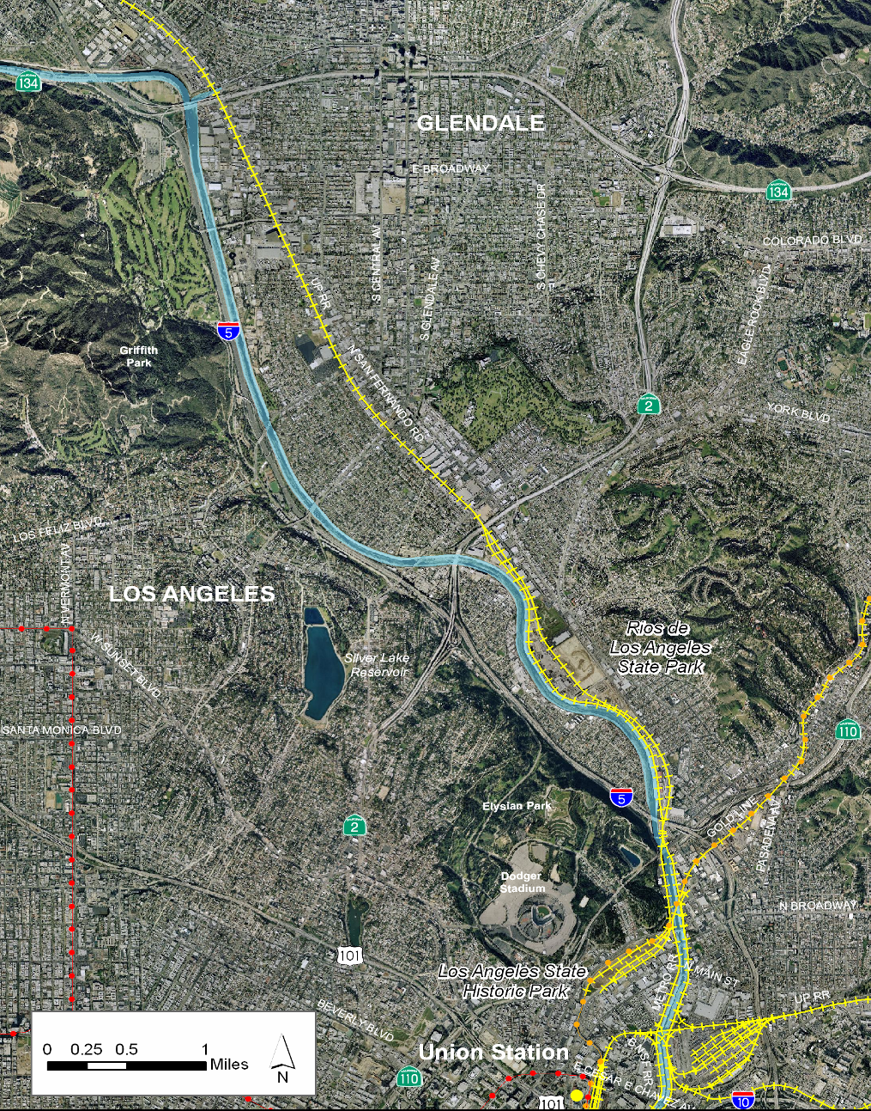
LA to Palmdale,
Union Station to SR-134
SR - 134
Verdugo Wash
Los Angeles Zoo
Griffith Park
Glendale Metrolink Station
SR - 2
Los Angeles River
Taylor Yard Park
Rio de Los Angeles State Park
Metrolink Maintenance Facility
Dodger Stadium/Elysian Park
I-5 and SR-110
Arroyo Seco
Los Angeles Union Station
Cornfield Park
LA State Historic Park

Slide 16
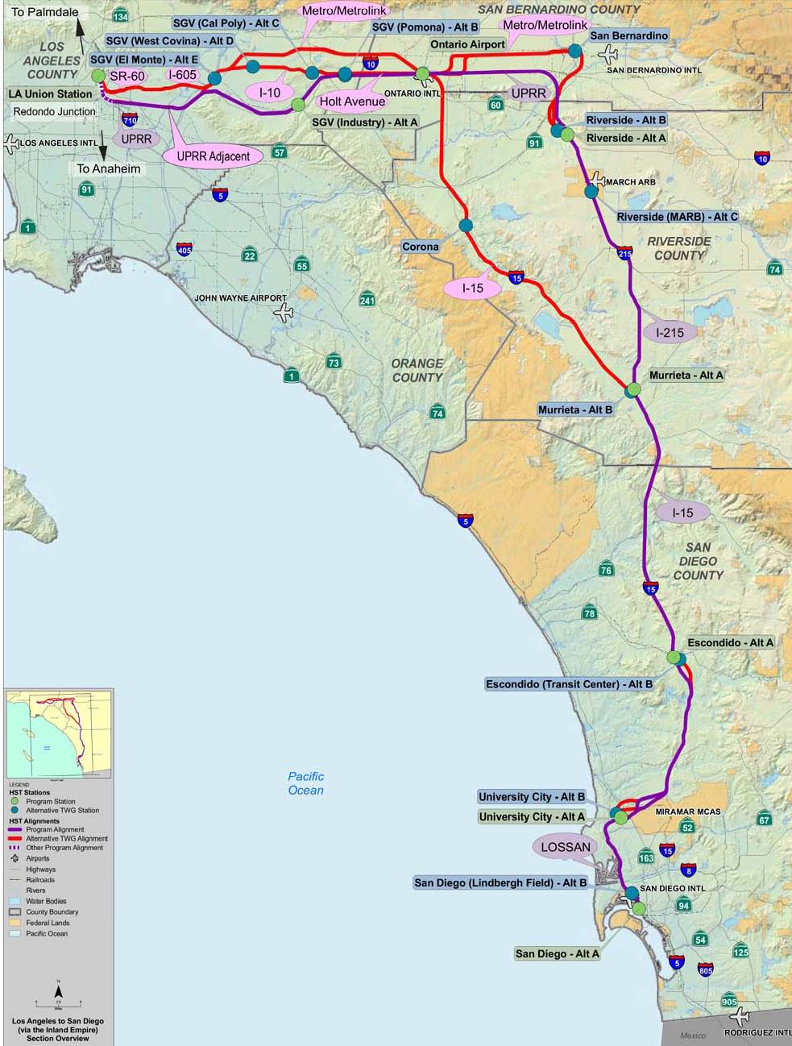
Los Angeles - San Diego Section Overview
  160+ miles
  Eight potential stations
  Strong intermodal connectivity
  Four counties
  Three Caltrans Districts
  Nearly 100 cities
  Air-Rail Potential

