Slide 1
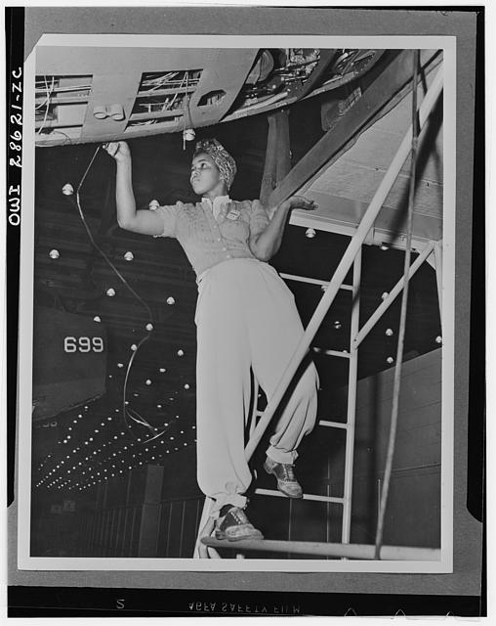
Black History &
Los Angeles
Transit: Local Firsts
Dorothy Peyton Gray Transportation Research Library, Archive & Records Management

Slide 2
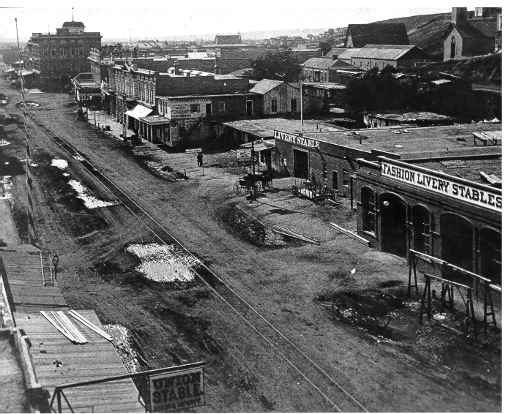
Early Years – Horse Drawn – 1870’s
Notes:
First franchise granted in 1873, first line opens in 1874. Horse drawn rail is the biohazard of its day, frequently complained about in newspaper letters to the editor.

Slide 3
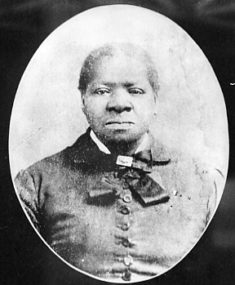
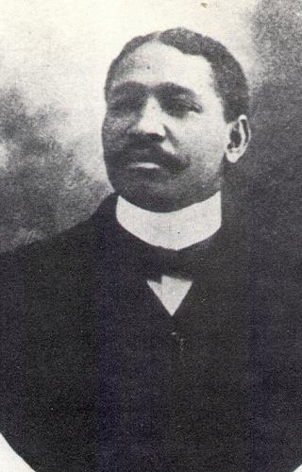
Bridget “Biddy” Mason & Robert Owens
1850s – Mason worked as a nurse and midwife, became first African American woman to own land in Los Angeles
Owens family built a livery business, supplying horses and cattle to new arriving settlers
1872 – the First African Methodist Episcopal Church was organized in Mason’s home on Spring Street

Slide 4
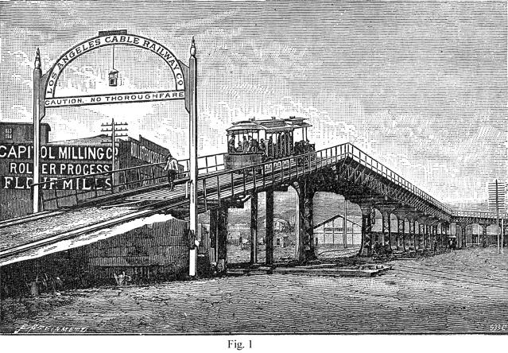
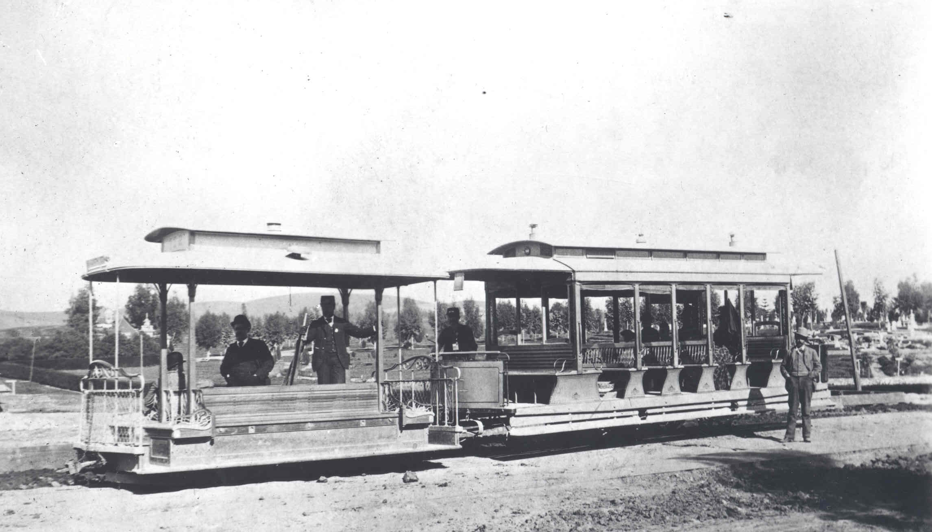
Early Years – Cable Cars – 1880’s
As population and transit use grew in Los Angeles, horse drawn rail cars were quickly replaced with newer technology cable cars.
Cable Cars proved highly unreliable operating under the unpaved dirt roads of early Los Angeles, they frequently froze, choked with dirt and gravel.
Notes:
Innovation with Cable drawn railways, all of these companies went bankrupt quickly. Accident prone, unpaved streets, and expanding city made service with this technology a challenge.

Slide 5
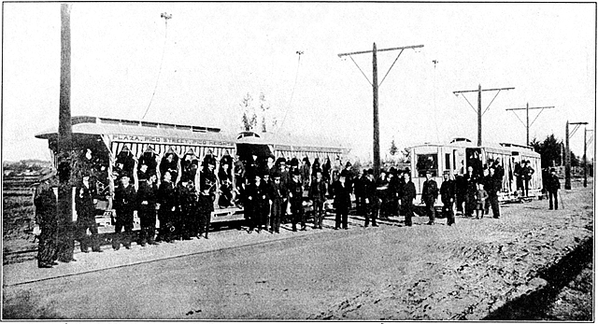
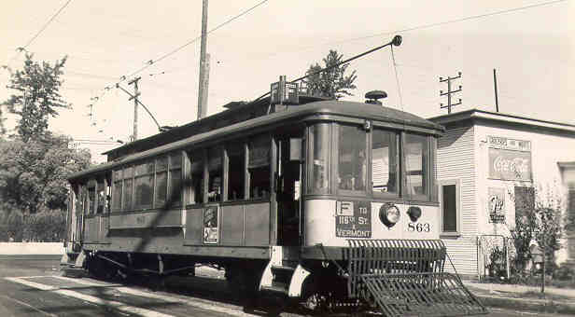
Early Years – Electrification – 1890’s
Better technology, overhead electrically-powered rail cars, allowed the transit system to rapidly consolidate, expand, and create the sprawling Southern California we know today.
Notes:
Quickly supplants horse drawn and cable railways. Leads to the first transit library open to the public in 1895. Had to convince the Victorian era minded public that electricity and speed were safe.
Massive expansion outward, first to Pasadena, then Long Beach, based on those successes, every suburban community lobbied for rail connections to downtown.

Slide 6
Black Population in Los Angeles
LA is founded in 1781 – among its first 44 settlers are 26 people of African and mixed Mexican African descent.
1880 102
1890 1,258
1900 2,231
1910 7,599
1920 15,579
1930 38,894
1940 63,744
1950 170,000+
Los Angeles rivals the East Coast in manufacturing jobs
Many of those jobs union with middle class pay & benefits

Slide 7
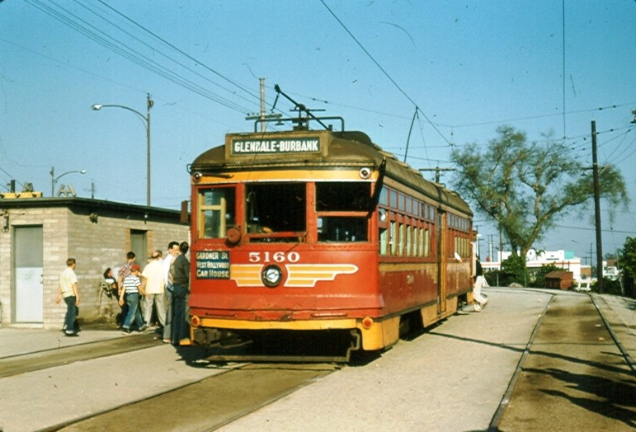
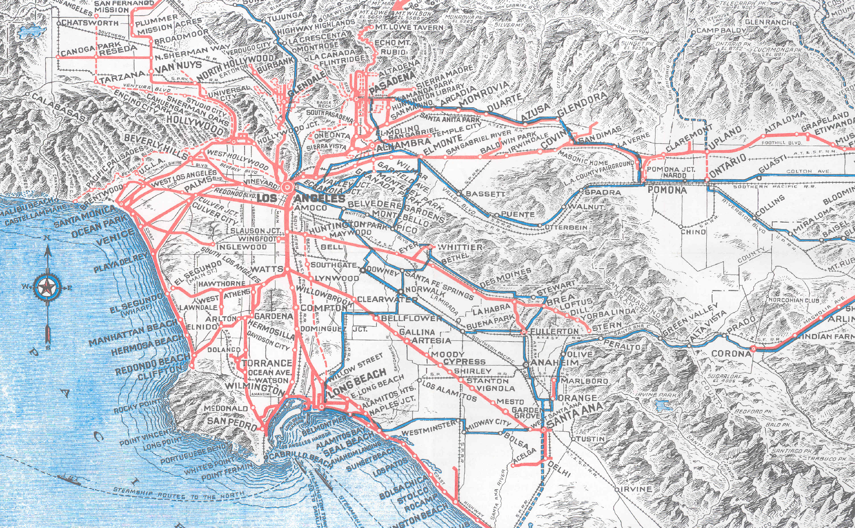
Pacific Electric (1898-1953)
Made concept of suburbia possible. Connected the suburbs and the city center, served Los Angeles, San Bernardino, Riverside and Orange Counties, also ran some connecting buses and open top double deck buses on Wilshire Boulevard.
Peak number of rail lines in 1925, peak ridership in 1923, and again during WWII due to rationing.
It was the electric “Metrolink” commuter rail of its day, only much more extensive with 1,100 track miles, up to 2,700 trains a day, and multiple hubs. Important connection from South LA to Downtown.
Notes:
The Red Cars – source of urban mythology promoted in Disney’s Who Framed Roger Rabbit. Story is repeated as fact – Standard Oil, Firestone Tire and General Motors conspired to dismantle the Red Cars.
Timelines don’t match up. The court case was about anti-competitive contracting with suppliers and took place in 1948. National City Lines was involved, which was the parent company of theYellow Cars, not the Red Cars, and most of LA’s rail was converted to bus in the 1950’s, after the court case, not before.
System connected four counties. 450 miles of its remaining right of way was purchased from Southern Pacific in 1992 for $980 million. Allowed Metrolink to begin service quickly and preserved corridors for future Light Rail and BRT.

Slide 8
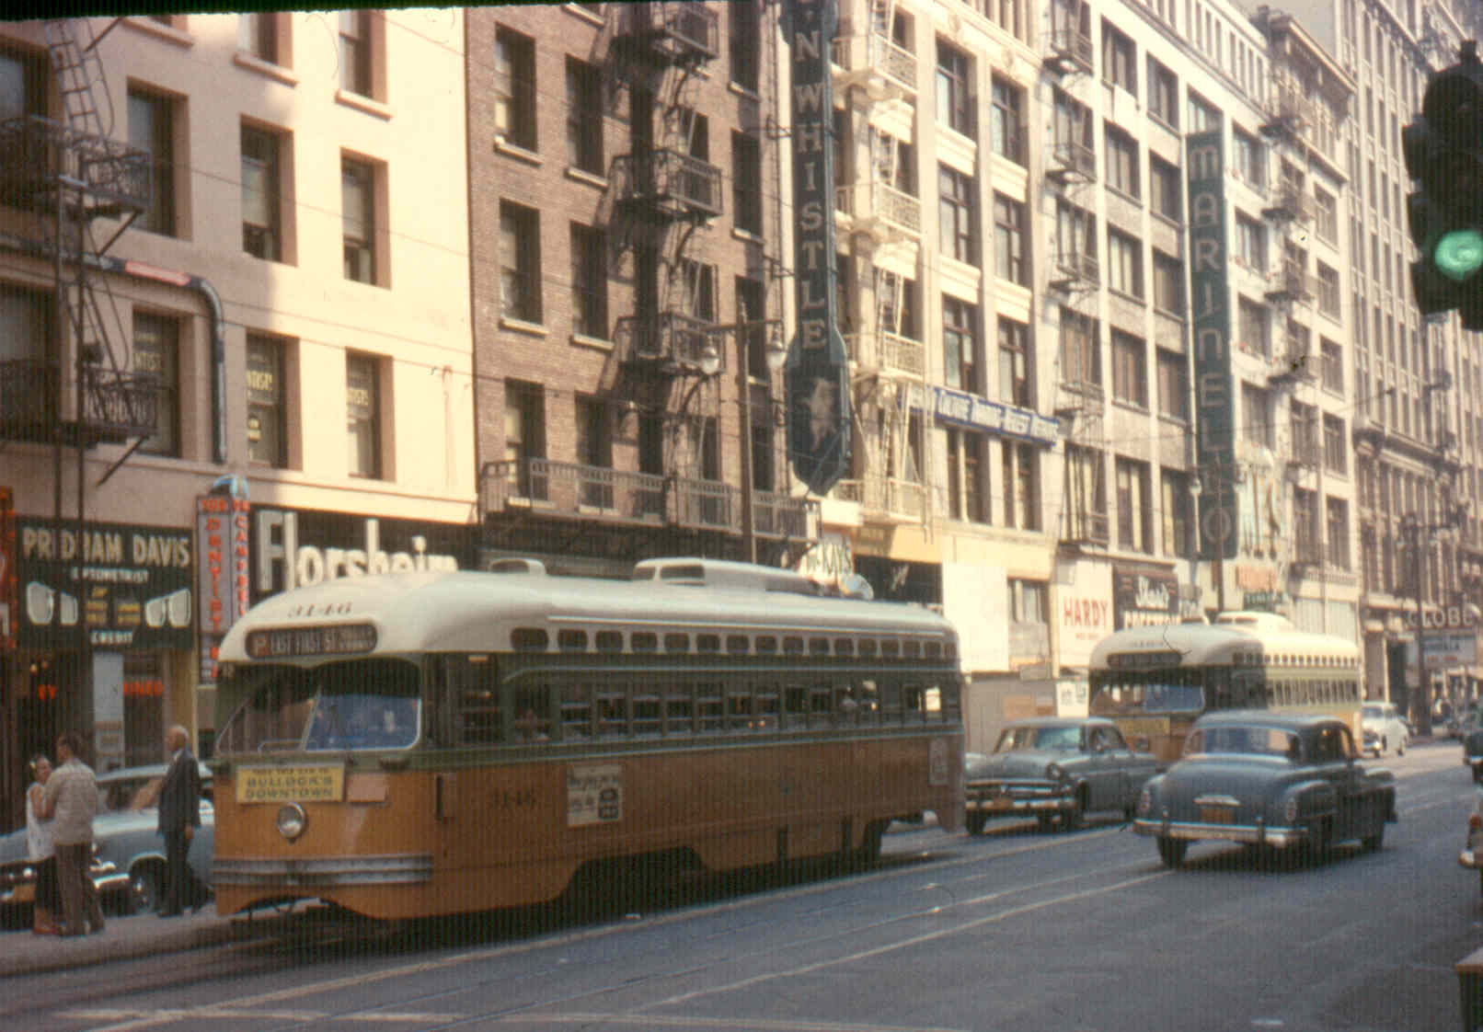
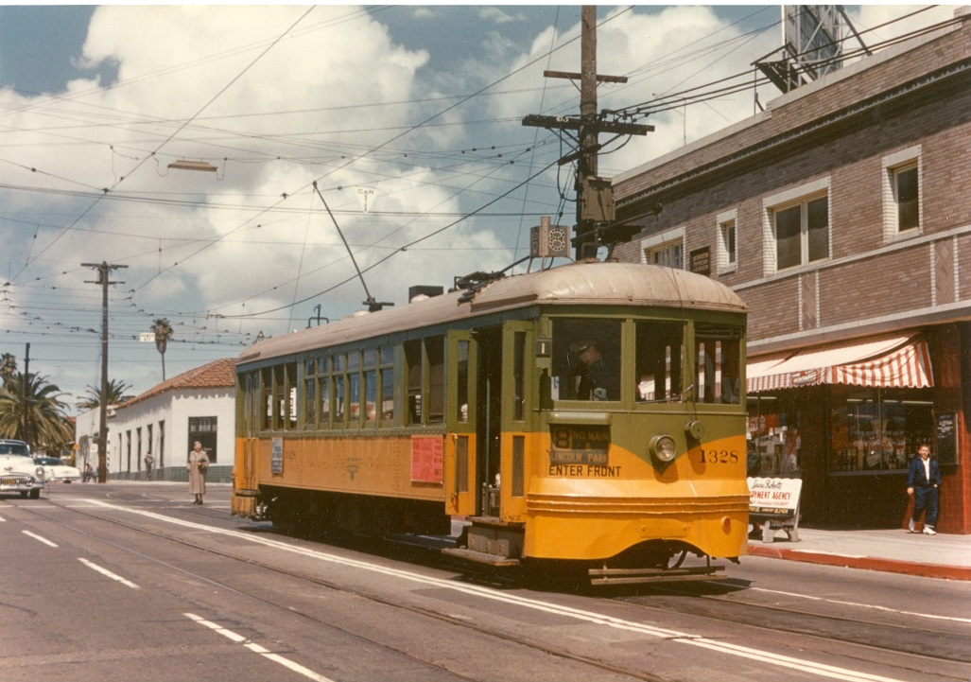
Los Angeles Railway (1895-1945)
Operated in the center of city streets, connecting points north, south, east and west with downtown Los Angeles, Pacific Electric and other transit service providers.
Peak number of lines around 1925, peak ridership during WWII, 742 streetcars and about 650 track miles, also operated motorbuses and electric trolley buses.
Known as the “Yellow Cars”. Grandfather of today’s urban bus system. Largely forgotten and frequently confused with Pacific Electric. Important connections from all over South LA to Downtown.
Notes:
Henry Huntington, ran this system until his death in 1927. His estate continued to run it until 1945 when it sold it to Los Angeles Transit Lines.
Work horse system, morphed into today’s bus system.

Slide 9
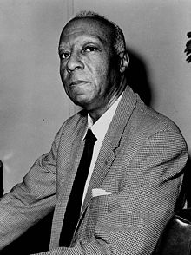
A. Phillip Randolf
Randolf organized and led the Brotherhood of Sleeping Car Porters, the first predominantly Black labor union.
In the early civil-rights movement, Randolph led the March on Washington Movement, which convinced President Franklin D. Roosevelt to issue Executive Order 8802 in 1941, banning discrimination in the defense industries during World War II. After the war Randolph pressured President Harry S. Truman to issue Executive Order 9981 in 1948, ending segregation in the armed services.
In 1963, Randolph was the head of the March on Washington, which was organized by Bayard Rustin, at which Reverend Martin Luther King, Jr. delivered his "I Have A Dream" speech. He inspired the Freedom budget, sometimes called the "Randolph Freedom budget", which aimed to deal with the economic problems facing the Black community, particularly workers and the unemployed.

Slide 10
WW II – President Roosevelt’s Order
Executive Order 8802
  On June 25, 1941, President Roosevelt created the Fair Employment Practices Committee (FEPC) by signing Executive Order 8802, which stated, "there shall be no discrimination in the employment of workers in defense industries or government because of race, creed, color, or national origin." This was due in large part to the urging of A. Philip Randolph, who was the founding president of the Brotherhood of Sleeping Car Porters.
  The Fair Employment Practices Commission (FEPC) implemented US Executive Order 8802, requiring that companies with government contracts not to discriminate on the basis of race or religion. It was intended to help African Americans and other minorities obtain jobs in homefront industries.

Slide 11
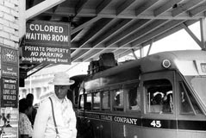
Los Angeles Railway & the Initial Reaction
Henry E. Huntington’s Estate ran Los Angeles Railway (LARy) after his death in 1927, up until 1945.
LARy wrote letters to the wartime Fair Employment Practices Commission in 1942 arguing they couldn’t comply with Order 8802 due to the costs associated with building new facilities required to keeps races/genders separate.
*LARy correspondence is kept in the National Archives & Records Administration offices in San Bruno, California.

Slide 12
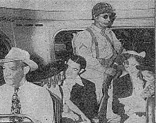
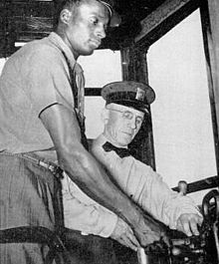
Meanwhile on East Coast….
White streetcar operators went on strike.
President Franklin D. Roosevelt authorized the Secretary of War Henry L. Stimson to take control of the Philadelphia Transportation Company (now SEPTA), and Major-General Philip Hayes was put in charge of its operations.
After several days of unsuccessful negotiations with the strike leaders, Hayes issued an order that the striking workers return to work on August 7, 1944, and that those refusing to comply be fired, stripped of their military draft deferment, and denied job availability certificates by the War Manpower Commission for the duration of the war.
This ultimatum proved effective and on August 7 the strike ended and the strikers returned to work. The black workers, whose pending promotions to non-menial jobs triggered the strike, were allowed to assume those jobs.

Slide 13
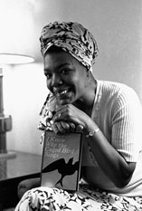
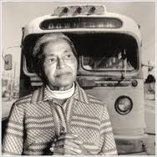
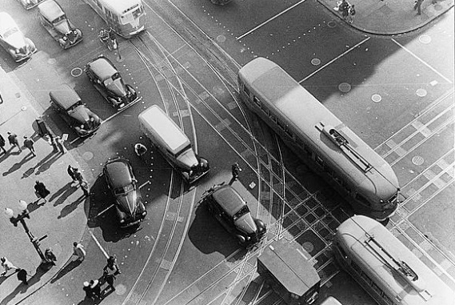
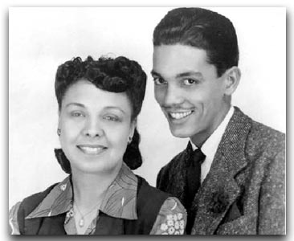
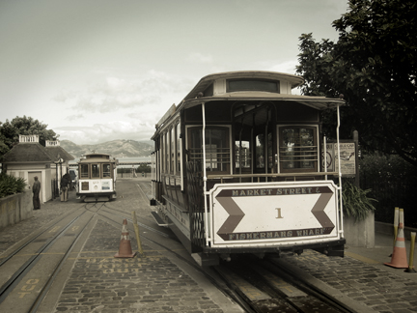
Firsts Around the Country
Philadelphia: William Barber had to be protected by troops in order to Operate
  See Philly.com “In Midst Of A World War, They Had To Mobilize Against Hate Wildcatters Of '44 Froze City Transit - Until Troops Came”.
New York: Rupert Bath, a newspaper columnist and an immigrant from Trinidad became New York City’s first black Subway motorman.
Washington DC: B.A Simmons and Sarah Owens
  See Washington City Paper “Today in D.C. History: Streetcar Operator Hires 1st African American Motorman” about B.A. Simmons
  See Video: Sarah Owens - First post WWII black woman bus operator in Washington DC
San Francisco Muni: Audley Cole
  See “Transit in San Francisco, a selected chronology 1850-1995” not mentioned, his wife becomes San Francisco’s first black public school teacher.
  Also San Franciso Cable Cars: Maya Angelou The famous author, poet, and social activist Maya Angelou dropped out of Mission High School at 15 to work the cable cars. “The thought of sailing up and down the hills of San Francisco in a dark-blue uniform, with a money changer at my belt, caught my fancy,” she later recalled in 1969's I Know Why the Caged Bird Sings. Angelou won the job as San Francisco’s first African American (and female) cable car conductor by heckling reluctant company managers until they caved and she was hired to ring the cars’ bells and swing “on the back of the rackety trolley, smiling sweetly and persuading [her] charges to ‘step forward in the car, please.’”

Slide 14
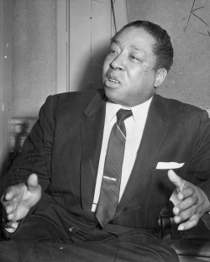
L.A. had a different advocate for equality-
Reverend Clayton D. Russell
During World War II Russell become one of the most prominent leaders in Los Angeles’s African American community.
In 1941 he organized the Negro Victory Committee, which sponsored mass meetings and demonstrations to protest discrimination against African American workers.
Russell and his church, whose membership peaked at 4,000, were also the driving force behind the Victory Markets, a chain of cooperative grocery stores that served the rapidly expanding African American community during the war.
In addition to leading the struggle against employment discrimination, Russell worked to elect African Americans to political offices.

Slide 15
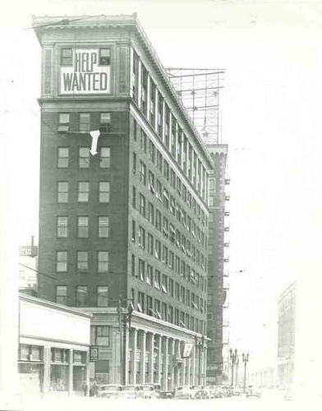
Rev. Clayton Russell’s Action Plan
Weekly radio addresses against LARy’s hiring practices to put pressure on the company.
Held war bond buying fund raisers with Hollywood celebrity concerts in Pershing Square Park to publicly shame LARy further. Generated public empathy with his cause.
He led marches to LARy headquarters at 1060 S. Broadway and sent in prospective black employees to fill out job applications.
LARy’s company physician passed only 5% of black job applicants.

Slide 16
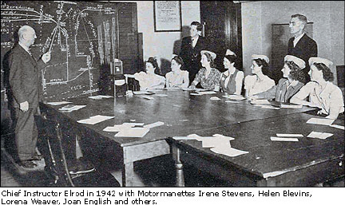
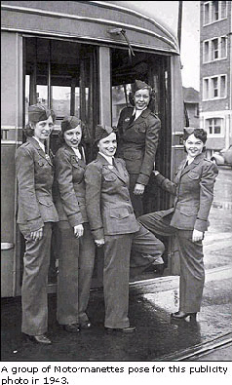
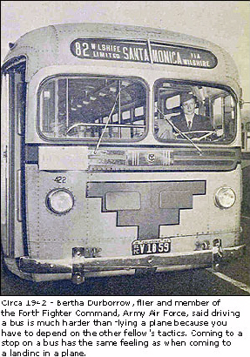
LARy Hires Women ahead of others
Much to male instructors surprise, women drove as well as men, and LARy hires over 200 women to replace drafted men.
Women had to sign an agreement to give up their job to any returning veterans they displaced.

Slide 17
LARy hires its first Black streetcar operators
Initial group of 10 men passed physicals and were supposed to start training, but felt too intimidated to show up.
Second group of 2 men passed physicals, completed training classes, and were sent to Division 5, but not given assignments.
LARy then hires Arcola Philpott, a black women from Chicago, makes it past the physical exam, training classes, and receives an assignment to operate Streetcar Line F – 116th/S. Vermont to Union Station loop, operating out of Division 5 (now Arthur Winston/Mid Cities/Division 5).

Slide 18
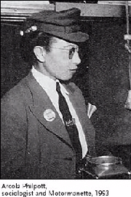
Arcola Philpott
Arcola Philpott was born Arcola Ruffins on July 21, 1913.
She married Robert Philpott and had two children, Robert Jr. and Ethel.
Arcola was an accomplished pianist and spoke several foreign languages.
Prior to coming out to Los Angeles from Chicago, she performed welfare work for seven years and also worked in research for the University of Chicago's History Department.
She attended Loyola University studying social science, and attended City College while in Los Angeles.
1945 payroll record indicates she she lived near the corner of Adams and Central, at 1119 E. Adams. She also worked at the Brown Derby Restaurant.
After she returned to Chicago, she worked as a licensed practical nurse as well as a journalist for the Chicago Defender and Pittsburgh Courier.
In her later years she worked as a docent for the Museum of Science and Industry and the Chicago Public Library. Arcola Philpott passed away on May 14, 1991. She is survived by her daughter Ethel, three grandchildren and one great-grandchild.

Slide 19
Glass Ceilings Broken Through for Motormen/Operators
Arcola Philpott’s employment at LARy earned her an important place in L.A. Transportation History. She opened two doors that had previously been closed.
Arcola’s daughter Ethel, who still lives in Chicago, believes it was the sight of other women going to work doing traditionally men’s jobs that inspired her Mother.
  “My Mother was just like that, born in the wrong era for all the things she wanted to do, she was a real go-getter. She was extremely intelligent, courageous, fearless, and a life-long learner”.
Within a few weeks of Arcola being on the job, and without any negative reaction, LARy went on to hire 20 black women and 50 black men as Operators.

Slide 20
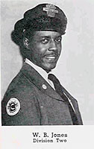
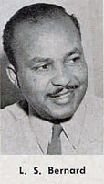
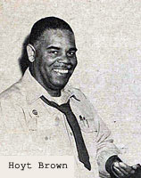
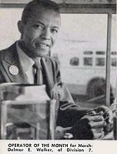
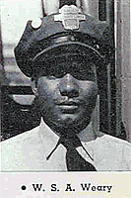
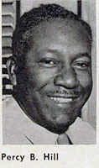
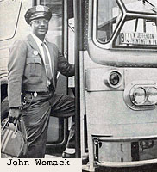
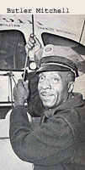
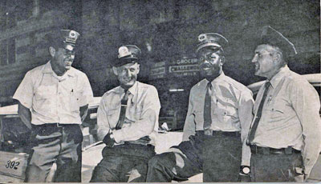
L.A.s first African American Operators and Supervisor
Supervisor Nathaniel Lewis
Source: Employee Newsmagazines

Slide 21
Some Issues Remained in Maintenance
Some white ATU members went on sit down strike at South Park Shops (today’s CMF) after WWII when they returned from the war and discovered their former (black) employees were now their Supervisors.
LARy overreacts and demotes them back down to Clerks.
LARy later reinstates them to Supervisors after pressure from Rev. Clayton Russell, the Mayor of Los Angeles and the City Attorney. (source: LA Times)
The 4 years of bad PR for the Los Angeles Railway prompts its sale to Los Angeles Transit Lines in 1945 – and may explain why there is no mention of the Huntington's role in LARy, only Henry E. Huntington and his efforts with early pre-1911 Pacific Electric Red Cars, at the Huntington Library and Gardens.

Slide 22
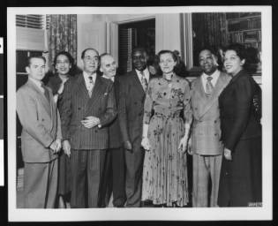
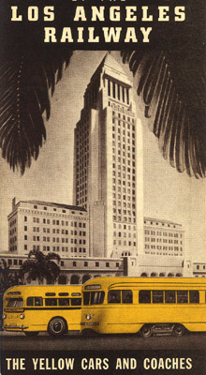
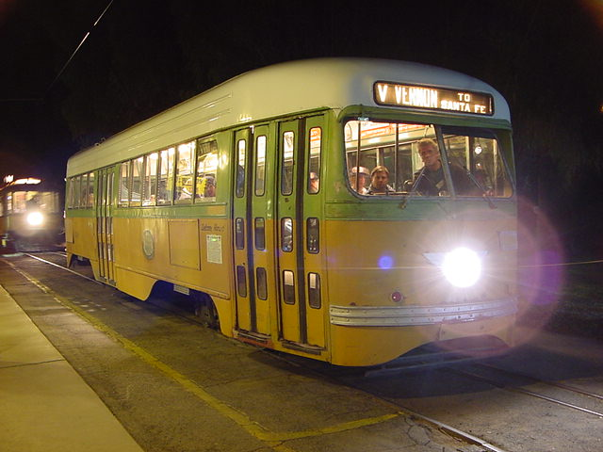
Black community leaders travel to Washington DC to report on progress in L.A.
U.S. Rep. Helen Gahagan Douglas, third from right, meeting some of her Los Angeles constituents who have traveled to Washington, D.C.
The visitors are, from left, Claude McKinnon, Juanita Terry, Dr. H. Claude Hudson, Amerigo Bozzani, H.A. Howard, Douglas, Clayton Russell, and Gwendolyn Diggs Russell. Douglas represented the 14th District of California in the House of Representatives from 1945 until 1950.
Clayton Russell was the head of the People's Independent Church of Christ; Gwendolyn Diggs Russell was his wife. H. Claude Hudson was president of the Los Angeles branch of the NAACP 1924 until 1934, and in 1947 founded Broadway Federal Savings, a financial institution serving Los Angeles' African-American community.

Slide 23
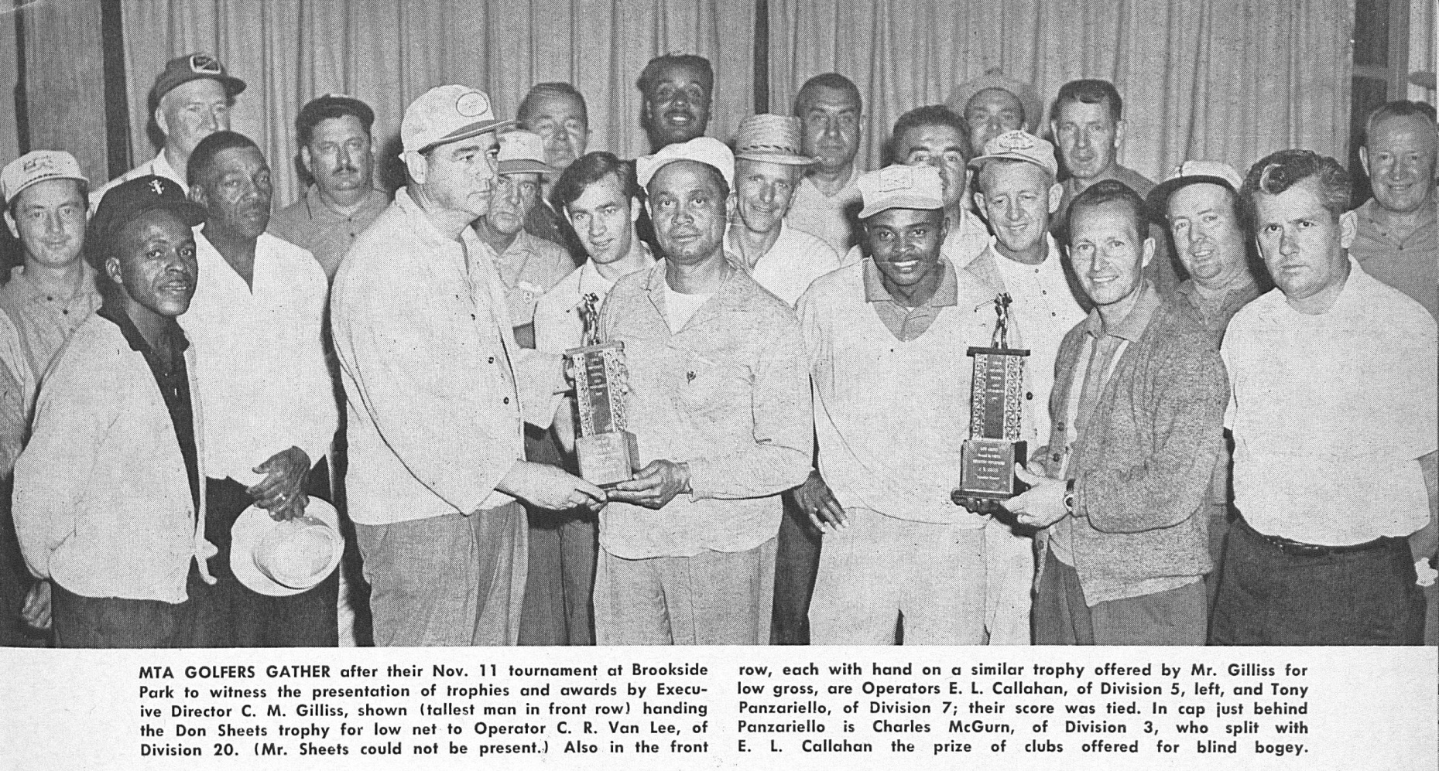
A chance for employees to get to know each other – socializing through sports clubs
Division 7 Golf Club – December 1962

Slide 24
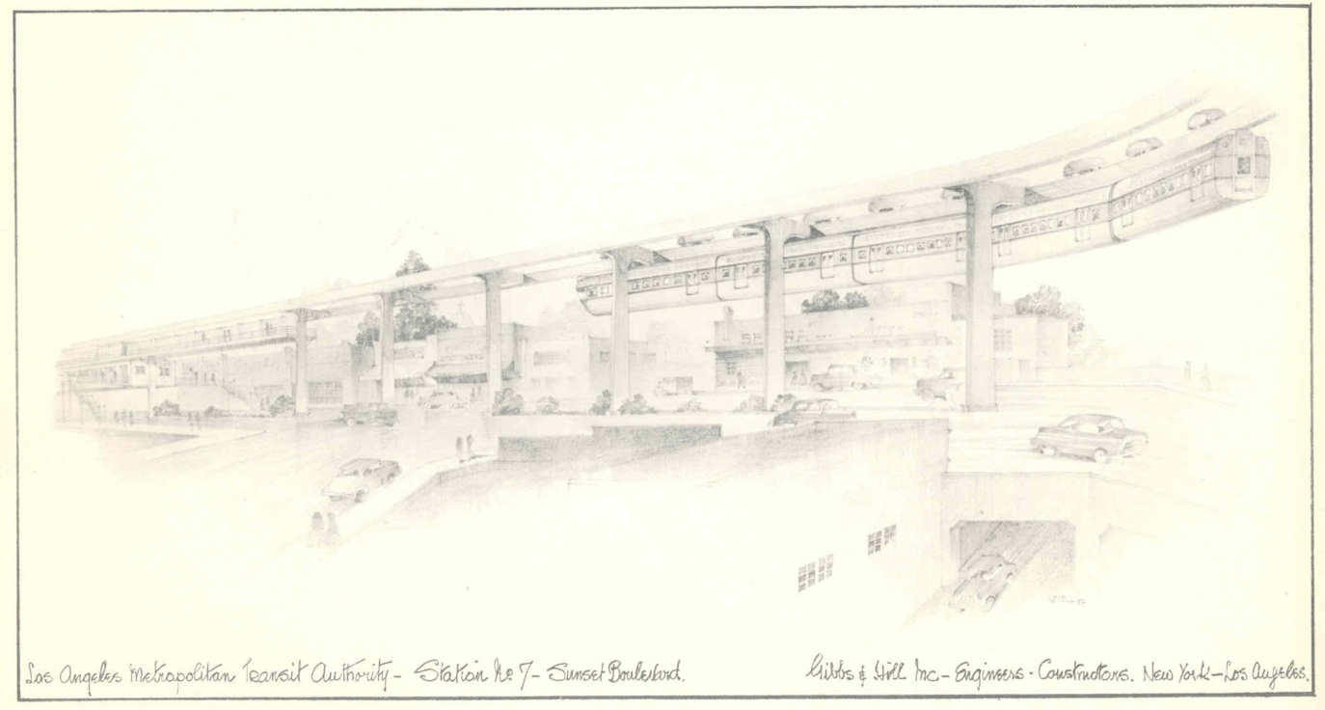
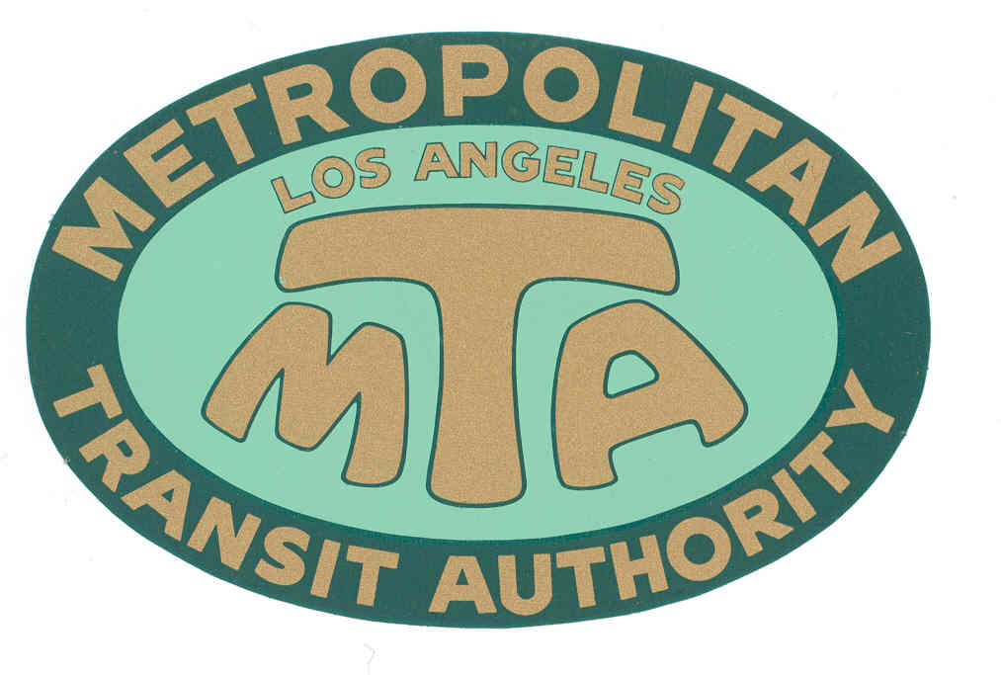
Los Angeles Metropolitan Transit Authority
(1951-1964)
Formed by the State in 1951 to study a monorail line from Long Beach to Panorama City within a one mile boundary of the L.A. River.
Seven Member governing board appointed by the Governor. Released its first report in 1954. Powers expanded in 1954 to propose a new mass transit system for the region.
Powers expanded again in 1957 allowing MTA to become a transit operator.
Purchased Metropolitan Coach Lines (formerly Pacific Electric) and Los Angeles Transit Lines (formerly Los Angeles Railway), effective March 3, 1958.
Notes:
Known for shutting down 10 remaining rail lines while imagining a new mass transit system for Los Angeles based on Monorail technology. Suspended car French technology. This is the system science fiction writer Ray Bradbury still talks about today.
During its brief history, they managed to confuse the public and anger the Wilshire corridor, most notably Beverly Hills.
Source of the Westside Subway as the only viable was to provide mass transit along Wilshire Blvd.
First Senior Fares in the US, implemented in 1962 – 50 years ago.

Slide 25
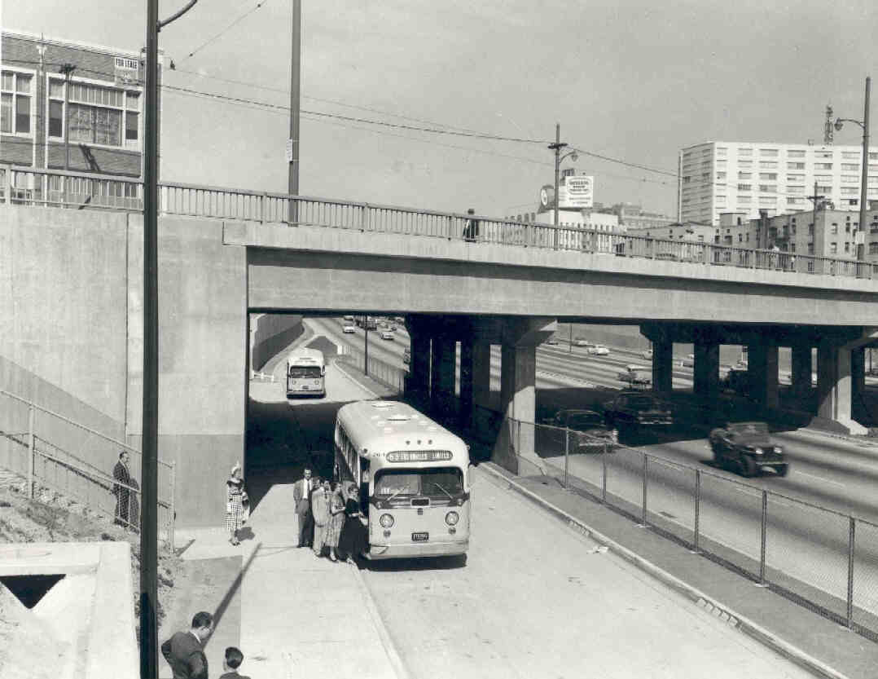
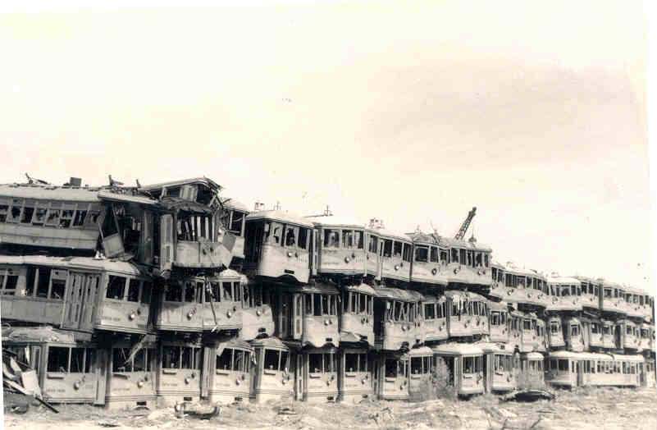
Rail lines still operating in 1958:
From Pacific Electric (1898-1953) via Metropolitan Coach Lines (1953-1958):
  Long Beach, San Pedro, Bellflower, Watts Local, and Catalina Terminal.
  Last “Red Car” runs to Long Beach on April 9, 1961.
From Los Angeles Railway (1895-1945) via Los Angeles Transit Lines (1945-1958):
  West Jefferson Blvd & Huntington Park (J), West Pico & East 1st St. (P), Whittier Blvd. & West 3rd St. (R), San Pedro St. & Western Ave. (S), Vernon & Vermont Ave (V).
  Last “Yellow Car” runs on March 31, 1963.
Notes:
Many believed that new highways would become the speedy backbone for bus routes and that there was no need to preserve rail service.
Some scrapped streetcars went to South Korea after WWII, others were sold to Veracruz Mexico and Buenas Aires Argentina. Some were dumped in the ocean off of Redondo Beach as artificial reefsto enhance fishing.
Many were burned in mysterious fires.
Some were saved and operate today at the Orange Empire Railway Museum in Riverside California.

Slide 26
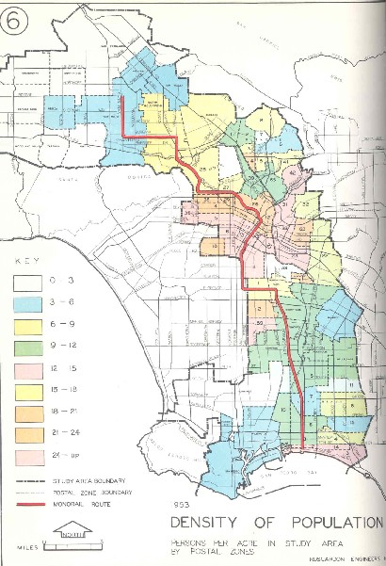
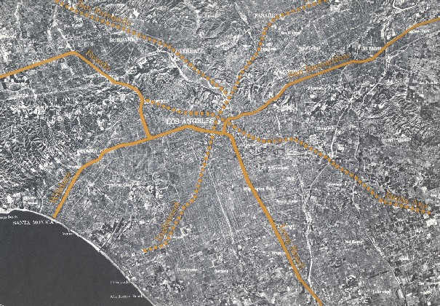
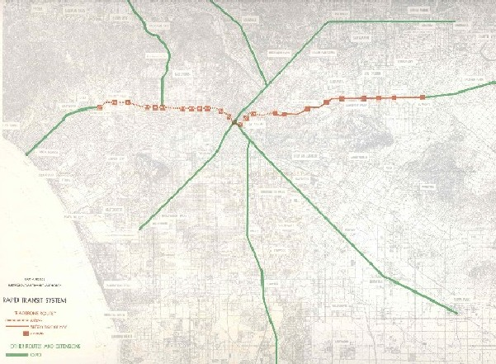
Los Angeles Metropolitan Transit Authority
(1951-1964)
The initial 1954 study of one monorail line, 45 miles/$165 million, grows in 1960 to a 75 mile/$529 million monorail plan with elevated rail along Wilshire.
Expanded monorail plan meets strong opposition from Valley Boulevard, Wilshire Corridor and Beverly Hills.
MTA’s plan is scaled down to a “Backbone Route” with subway under Wilshire Boulevard and at-grade rail to El Monte.
Alweg and Goodell Monorail Co.’s release their own monorail plans and offer to build systems for “free” in exchange for next 40 years of MTA’s farebox revenue.
MTA notifies private companies that any plan that does not include subway along the Wilshire route is unacceptable. MTA fails in its PR efforts with general public.

Slide 27
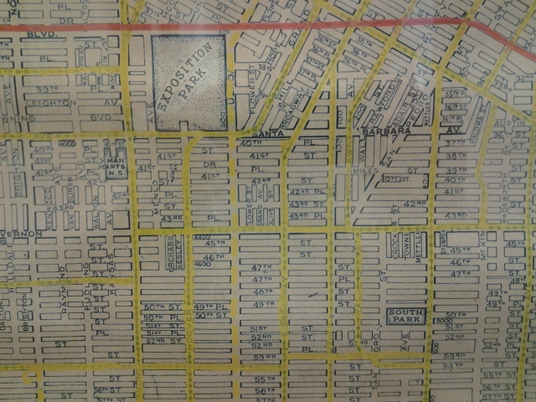
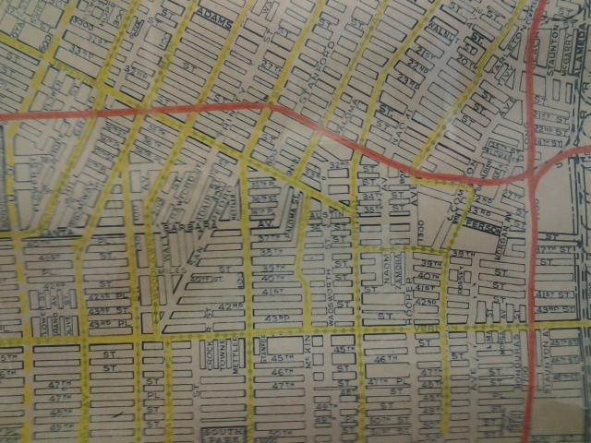
Compare new LAMTA plans with the prior clean air electric transit and freight rail system, pre-freeway.
South LA had the most dense coverage of Yellow Car and Red Car rail lines to reach jobs in Downtown, the Ports, and the Westside.
Massive freeway construction and conversion to diesel freight trains and diesel buses divide and pollute South and East LA neighborhoods.

Slide 28
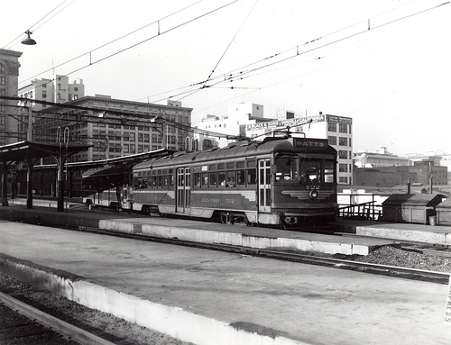


Only Protests Against Ending Rail Transit
The only areas of Los Angeles to organize against dismantling the last remaining Red Car trains were residents of South Los Angeles and Watts. Watts began as community of Pacific Electric track worker housing. Without the trains, their public transit journeys to job centers were twice as long and much more expensive with LA’s mix of private and public operators.
Sacramento listened and extended the Red Car’s life refusing to approve Pacific Electric’s first application to convert the Long Beach and Watts Lines to buses.
The new local MTA disastrously tried to convince South LA residents that buses and new Monorails would be better.
After 1965, the post-Watts riots McCone Commission report cited the lack of access to a well coordinated transit system as one of the root causes of the civil rebellion.
Slauson Tower

Slide 29

Los Angeles Metropolitan Transit Authority
(1951-1964)
Politicians vociferously battle over if and how transit would be subsidized and what the very definition of subsidy really is. Public becomes thoroughly confused.
The MTA, without the ability to tax, issue bonds, or take property via eminent domain, without the existence of any Federal or State capital assistance programs, and still subject to taxation itself, holds two subway groundbreaking ceremonies: in downtown with Gov. Edmund G. Brown on 1/12/62, and in Beverly Hills with Mayor Jack Freeman, on 1/23/62.
State Sen. Rees (D-Beverly Hills) re-writes MTA legislation to give the transit agency the powers it was missing, re-launching it as the Southern California Rapid Transit District (SCRTD) in September 1964.
Notes:
First MTA tried to obtain a federally funded loan to build the Wilshire Subway, selling the project as a series of underground civil defense shelters connected by rail.
Beverly Hills was adamant that any mass transit system passing through their city be underground. Myth that Beverly Hills has opposed subway, to the contrary, they proposed the idea when faced with an elevated monorail running through their city..

Slide 30


Southern California Rapid Transit District (1964-1993)
New agency has an eleven member board appointed by local elected officials, the powers of eminent domain, taxation through local referendum, bond issuance, and creation of Benefit Assessment Districts.
It is enthusiastically welcomed in an event at the Ambassador Hotel with 400 civic leaders.
Takes its legislative charge to create a new mass transit system for Los Angeles seriously and goes to work marketing public transportation as a needed and necessary community asset.
Federal government forms the Urban Mass Transit Administration in 1964 (now called the Federal Transportation Administration).
Operates transit service in L.A., Orange, Riverside and San Bernardino counties.
In response to the Watts Riots, it takes over 11 other failing or failed transit companies, standardizes routes and fares, begins work on creating bus system grid layouts, and their fast work prompts a letter of gratitude from Gov. Reagan to SCRTD.
Notes:
Did things no other transit agency could
In house emissions testing.
First alternative fuel transit bus – federally funded project to create a Steam powered bus.
Robotic inventory delivery for its massive rebuild center.
After 12 years of planning and lobbying, obtained a federal full funding grant agreement and began building the subway in 1986.

Slide 31



Leilia Bailey – Breaks The Glass Ceiling for Women a Second Time
The remaining few women operators from the WWII era retired from the LAMTA when the last streetcars ran in 1963. They did not make the transition to buses.
LAMTA, then SCRTD goes seven years without a woman operator.
Leilia Bailey applies to be an SCRTD Bus Operator in 1970 and is initially denied an Operator’s job and offered a office job instead.
She files a complaint with U.S. Equal Employment Opportunity Commission.

Slide 32

Leilia Bailey – Breaks The Glass Ceiling for Women a Second Time, a career of firsts

Slide 33








Southern California Rapid Transit District (1964-1993)

Slide 34


Los Angeles County Transportation Commission (1977-1993)
State creates the Los Angeles County Transportation Commission (LACTC) in 1976 to coordinate between municipal transit operators and SCRTD, plan countywide transportation improvements and ensure efficient use of local, state and federal transportation funding.
In 1980, a majority of Los Angeles County voters approve Proposition A (54.3%), a half cent sales tax for transportation improvements, 35% of revenue is dedicated for rail construction.
Map from 1980 Proposition A voter information materials

Slide 35

Los Angeles County Transportation Commission (1977-1993)
A second half-cent sales tax for transportation, Proposition C, was approved by a majority of Los Angeles County voters (50.4%) in 1990, along with propositions 108, 111 and 116.
The Transportation Commission begins negotiations with Southern Pacific, the parent company of the former Pacific Electric system, to acquire 450 miles of right-of-way in Southern California. The parties eventually agree on a purchase price of $980 million in 1992. The commuter rail system known as Metrolink is born and spun off as an independent five-county joint powers authority.

Slide 36



Merging Transit with Transportation
1988, the two agencies agree on an eight-point plan that includes consolidating all rail construction under a single third entity, naming the lines the Metro Red Line, Metro Blue Line and Metro Green Line, and open discussion of an eventual merger.
1992, the Governor signs AB152 (Katz) that creates the Los Angeles County Metropolitan Transportation Authority, also known as MTA or Metro, effective February 1, 1993. It becomes a planning, funding, construction, and operating multi-modal “super agency” for Los Angeles County.

Slide 37



African American Firsts to Remember
First SCRTD Board Member – Thomas G. Neusom, appointed 1969
First LACTC Board Member – Mayor Tom Bradley, 1977
First LACMTA Board Member – Mayor Tom Bradley & Supervisor Yvonne Burke, 1993

Slide 38

African American Firsts to Remember
First SCRTD Assistant General Manager, EEO Programs – Walter Norwood
First SCRTD Assistant General Manager, Customer Relations – Bob Williams
First LACTC Deputy Executive Director – Jerry Givens
First LACTC Assistant Executive Director Finance – Les Porter

Slide 39



African American Firsts to Remember
First LACMTA CEO – Franklin E. White
First LACMTA Deputy CEO – John Catoe
First LACMTA COO – Carolyn Flowers
First LACMTA CROO – Gerald Francis

Slide 40
African American Firsts to Remember
First LACMTA CCO – Rae James
First LACMTA CAO – Judith Pierce
First LACMTA Treasurer – Les Porter
First LACMTA EEO Programs Director – Gail Charles
First LACMTA Director of Human Resources – Ray Inge
First LACTMA Manager of Career Development – Naomi Nightingale
Expo Start up Operators & Rail Roadeo Winners – Sheila Celestain and Carolyn Kelly

Slide 41

Field Trip?
L.A. African Firefighters Museum
Address: S. 1401 Central Ave.
Phone: (213) 744-1730
http://www.aaffmuseum.org/

Slide 42

Field Trip?
Mayme A. Clayton Library & Museum - The Clayton Collection is the largest and most academically substantial independently held assemblage of its kind in the world. It is second in size and scholarly scope to the renowned Schomburg Collection in the New York City Public Library.
The collection was assembled over a 40-year period by Mayme Agnew Clayton, Ph.D., (1923 - 2006), a career university librarian and a collector of great brilliance. Dr. Clayton’s singular commitment to preserve African American culture and history was inspired by her desire to ensure that children would know the richness and diversity of African American contributions to American and the world.
4130 Overland Ave,
Culver City, CA
90230-3734
(310) 202-1647
http://www.claytonmuseum.org/

Slide 43

End
Photo by Fred Camino

