Slide 1
Discrete Choice Models and Behavioral Response to Congestion Pricing Strategies
Prepared for:
The TRB National Transportation
Planning Applications Conference
Mark Fowler & Stacey Falzarano,
Resource Systems Group, Inc.
Kazem Oryani and Cissy Kulakowski,
Wilbur Smith Associates

Slide 2
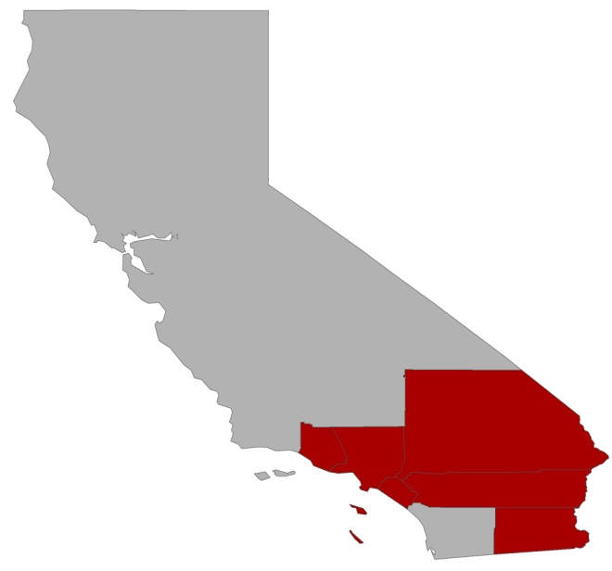

Southern California Association of Governments
Today
Nation’s largest MPO
6 Counties
38,000 square miles
19 million residents
550 million daily VMT
20 minutes of delay per driver per day
2030
San Bernardino
24 million residents
30 minutes of delay per driver per day
Ventura
LA
Riverside
Orange
Imperial

Slide 3

SCAG Express Travel Choices Study
Objectives
Understand how congestion pricing can be used in the SCAG region to:
Reduce congestion and improve transportation system performance
Improve air quality
Enhance transportation revenues
Approach
Outreach and public participation
Case studies for existing pricing projects
Update SCAG regional travel demand model to incorporate pricing
  Understand behavioral response to pricing
    Stated preference surveys
Performance and feasibility analysis, develop regional strategy, identify pilot projects, etc...

Slide 4
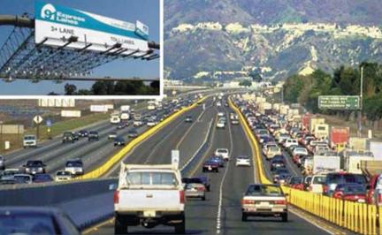

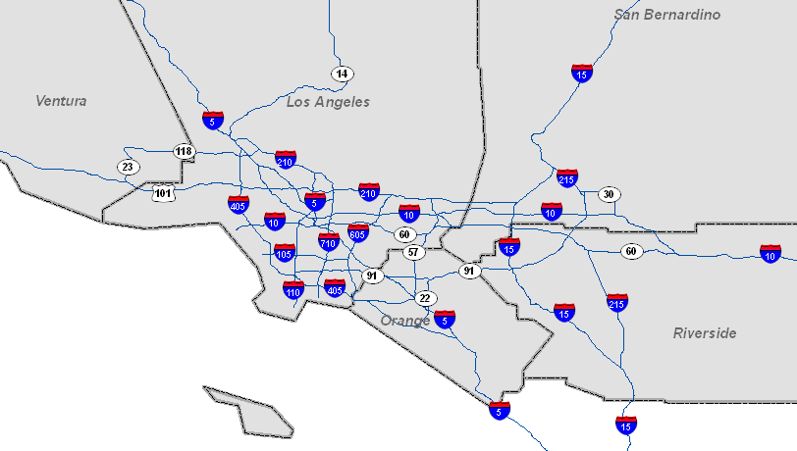




Pricing Strategies Under Consideration
Express Lanes
Single Facility Pricing
Corridor Pricing
Regional Facility Pricing
Cordon Pricing
Area Pricing
Express Parking
VMT Pricing

Slide 5
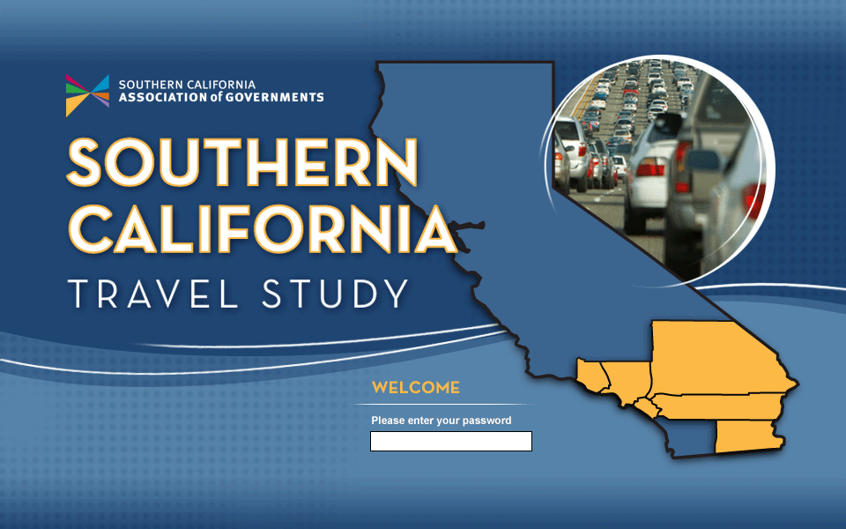
Stated Preference Survey
Evaluate the behavioral response of travelers in the region to the 8 different congestion pricing strategies
Estimate proportions of
  Route shift
  Mode shift (HOV, transit)
  Departure time shift
  Changes in destination
  Trip reduction
Estimate traveler values of time (VOT)
Provide inputs to the travel demand model

Slide 6
Stated Preference Questionnaire
Developed SP questionnaire with four main groups of questions:
Revealed Trip Characteristics
  Details of a recent trip in the region
  Trip purpose, time of day, origin, destination, occupancy, frequency, etc.
  Ability to shift destination/time of day
Stated Preference Exercises
  How would you travel under hypothetical future conditions that may include pricing?
  Mode, time of day, route, trip reduction
Debrief and Opinion
  Debrief of SP experiments
  Opinion of pricing strategy, tolling in general
Demographics
  Basic household demographics
  Income, gender, age, household size, household vehicles, etc.

Slide 7
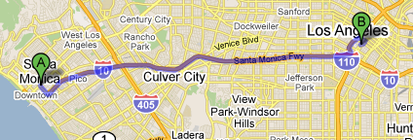

What are the behavioral responses for each strategy?
Behavioral response depends on:
  Type of pricing
  Specifics of pricing implementation
  Revealed trip details (origin, destination, time of day, etc.)
Example trip: Santa Monica to Staples Center
Depart at 6 PM, 14.7 miles, 20-60 minutes
Pricing Example 1: Express Lanes on I-10
Add tolled Express Lanes to I-10
Discount for off-peak travel
Discount for HOV
GP Lanes remain toll-free
Drive on I-10 Express Lanes and pay toll
Drive on I-10 Express Lanes earlier or later (reduced toll)
Drive on I-10 Express Lanes in a carpool (reduced toll)
Drive on I-10 regular lanes (toll free)
Take transit
Don’t make trip
Pricing Example 2: Cordon Pricing around Downtown LA
Price all travel into downtown LA
Discount for off-peak travel
Discount for HOV
Drive to Staples Center and pay toll
Drive to Staples Center earlier or later (reduced toll)
Drive to Staples Center in a carpool (reduced toll)
Change destination?
Take transit to Staples Center
Don’t make trip

Slide 8
Comparison of Behavioral Responses
Pricing Strategy | Don’t Make Trip | Change Destination | Take Transit | Form Carpool | Change Departure Time | Change Route
Single Facility Pricing
Express Lanes
Regional Facility Pricing
Corridor Pricing
Cordon Pricing
Area Pricing
Express Parking
VMT Pricing
X
X
X
X
X
(if applied equally)
Significant impact
Some impact
Minimal impact
X
No impact

Slide 9

Stated Preference Exercises
Behavioral response information used to develop SP exercises
Each SP exercise presented up to 5 alternatives for making their trip in the future, described by relevant attributes
Attributes varied across all 8 exercises
Each respondent saw two sets of 8 SP exercises for two different pricing strategies
Alternatives
Attributes
Toll route during the peak
Toll route outside the peak
Toll route in a carpool (HOV)
Alternate route
Alternate destination
Transit
Travel time
Travel cost (toll cost/fare)
Departure time
Occupancy
Mode

Slide 10
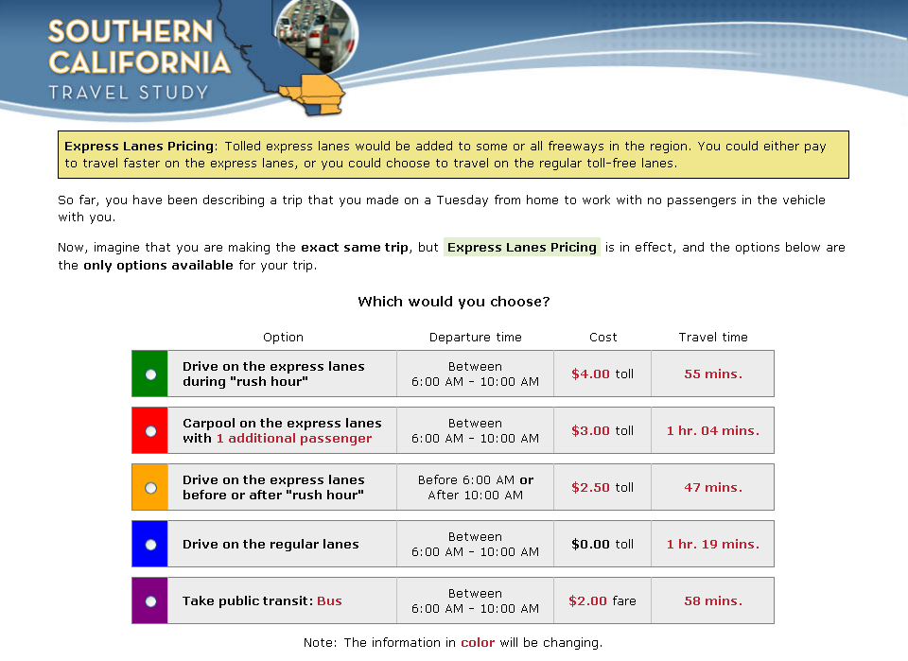
Example Stated Preference Exercise: Express Lanes

Slide 11
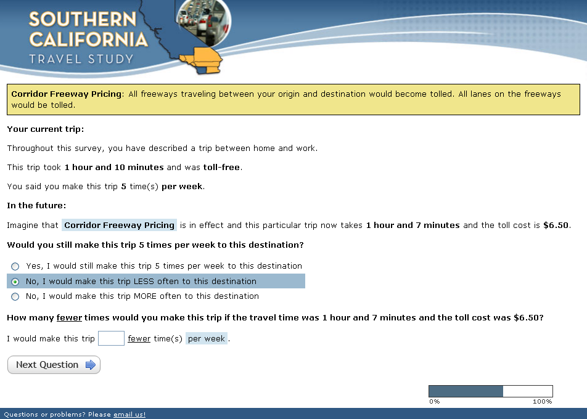
Trip Suppression Questions
Ask about trip reduction under a specific travel scenario
Follow-up to find out how trips would be reduced

Slide 12
Survey Administration and Sample Characteristics
Survey administered online to residents of all six counties
3,590 responses
Each respondent evaluated 2 different pricing strategies
County of Residence
Pricing Strategies Evaluated
*Census data from the 2009 American Community Survey

Slide 13
Sample Characteristics
Alternate destination availability
  Differs by trip purpose
Is an alternate destination available for this trip?
Ability to shift departure time earlier or later
Earlier
Later
Departure time shift
  54% can shift earlier
  62% can shift later
Opinion of pricing strategy
Opinion of pricing strategy
  Opinion decreases as the ability to avoid the toll/fee decreases

Slide 14
Choice Model Estimation
Multinomial Logit (MNL) models estimated using the SP data
Tested numerous utility specifications
  Variables from the SP experiments (travel time, cost, etc.)
  Revealed trip characteristic variables (trip purpose, time of day, etc.)
  Demographic variables
Models segmented by trip purpose and time of day
Final model specification chosen based on:
  Expected application
  Statistical significance of parameter estimates
  Model fit
  Intuitiveness and reasonableness of the results
Segment | Description
Work Commute | Work commute trips at any time of day
Business-related | Business-related trips at any time of day
Non-work Peak | All other trip purposes during peak hours (6:00 AM – 10:00 AM; 3:00PM – 7:00 PM)
Non-work Off-peak | All other trip purposes during off-peak hours (10:00 AM – 3:00 PM; 7:00 PM – 6:00 AM)

Slide 15
Choice Model Results
Model Coefficients for Commute Segment
Coefficients specified for:
  Travel time
  Toll cost
  Mode/route specific constants
  Departure shift
  Dummy variables for current HOV/transit users
  Bias removing variables
VOT varies from $6.00 to $20.00 depending on traveler segment and household income

Slide 16
Sample Model Sensitivities: Express Lanes
Attribute | Express Lanes | Express Lanes Shift Early | Express Lanes Shift Late | Express Lanes HOV | Regular Lanes | Transit
Travel Time | 35 minutes | 30 minutes | 30 minutes | 40 minutes | 50 minutes | 60 minutes
Toll Cost | $0.10-$1.00/mi | 50% discount | 50% discount | 50% discount | Toll free | $2.00 fare
Shift Amount |  | 60 minutes | 60 minutes
Occupancy |  |  |  | +1 passenger
Notes
Work Commute Segment
Illustrative only
Based on uncalibrated choice model
Results presented for only 1 example trip with the characteristics outlined above
Results do not include interactions with regional network model

Slide 17
Sample Model Sensitivities: Area Pricing
Attribute | Current Destination | Current Dest Shift Early | Current Dest Shift Late | Current Dest HOV | Alternate Destination | Transit
Travel Time | 35 minutes | 30 minutes | 30 minutes | 40 minutes | 50 minutes | 60 minutes
Area Pricing Fee | $1.00-$10.00 | 50% discount | 50% discount | 50% discount | Toll free | $2.00 fare
Shift Amount |  | 60 minutes | 60 minutes
Occupancy |  |  |  | +1 passenger
Notes
Work Commute Segment
Illustrative only
Based on uncalibrated choice model
Results presented for only 1 example trip with the characteristics outlined above
Results do not include interactions with regional network model

Slide 18
Trip Suppression Model Estimation
Linear regression model
  Dependent variable: percent of trips reduced
  Independent variable: difference in utility (before/after pricing)
  Model included trip distance and household income effects
Work Commute Suppression Results
Non-work Peak Suppression Results
Toll Difference | Travel Time Difference
 | 0 | -5 | -10 | -15 | -20
$0.00 | 0.0% | +0.7% | +1.4% | +2.2% | +2.9%
$2.00 | -1.3% | -0.6% | +0.2% | +0.9% | +1.6%
$4.00 | -2.5% | -1.8% | -1.1% | -0.4% | +0.3%
$6.00 | -3.8% | -3.1% | -2.4% | -1.7% | -0.9%
$8.00 | -5.1% | -4.4% | -3.7% | -2.9% | -2.2%
$10.00 | -6.4% | -5.6% | -4.9% | -4.2% | -3.5%
Toll Difference | Travel Time Difference
 | 0 | -5 | -10 | -15 | -20
$0.00 | 0.0% | +1.2% | +2.4% | +3.6% | +4.7%
$2.00 | -3.8% | -2.6% | -1.5% | -0.3% | +0.9%
$4.00 | -7.6% | -6.5% | -5.3% | -4.1% | -2.9%
$6.00 | -11.5% | -10.3% | -9.1% | -7.9% | -6.7%
$8.00 | -15.3% | -14.1% | -12.9% | -11.7% | -10.6%
$10.00 | -19.1% | -17.9% | -16.7% | -15.6% | -14.4%

Slide 19
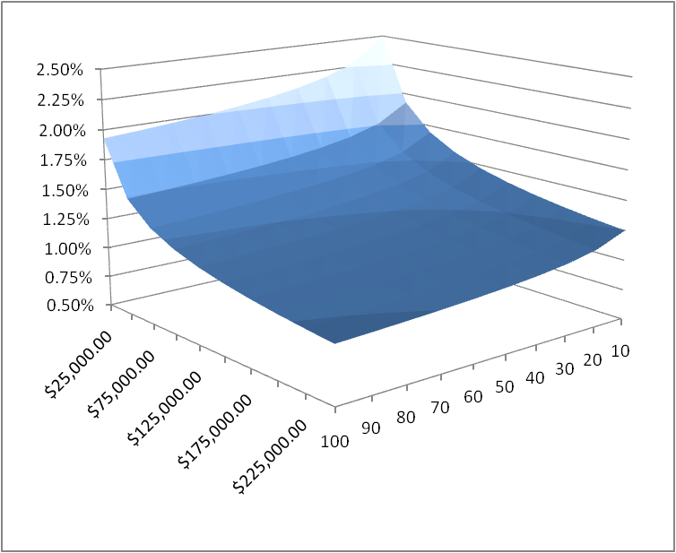
Trip Suppression Results
Trip Suppression by Income and Trip Distance
  Work Commute Segment
  No travel time difference
  $2.00 toll
Distance (miles)
Income

Slide 20
Conclusions
Tolling can have a significant impact on travel behavior
The models developed using the survey data indicate that facility pricing and regional facility pricing could substantially affect travel behavior in three ways:
  Time-of-day shifts
  Changes in mode
  Use of express lanes
Similarly the models show that area, cordon, or VMT pricing could, in addition:
  Affect trip destinations
  Cause suppression of trips
These effects can collectively become quite significant as prices increase
Incorporating the survey results into the travel demand model will allow the project team to evaluate a wide range of congestion pricing strategies.

Slide 21


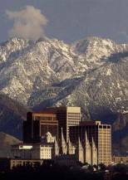

Contact
Chicago
●
Vermont
●
Utah
Mark Fowler
Tom Adler
Stacey Falzarano
Resource Systems Group, Inc.
mfowler@rsginc.com
(802) 295-4999
Kazem Oryani
Cissy Kulakowski
Wilbur Smith Associates
koryani@wilbursmith.com
(203) 865-2191
Thanks to: Annie Nam, Guoxiong Huang, Wesley Hong, and Warren Whiteaker of the Southern California Association of Governments
Notes:
21

