Slide 1
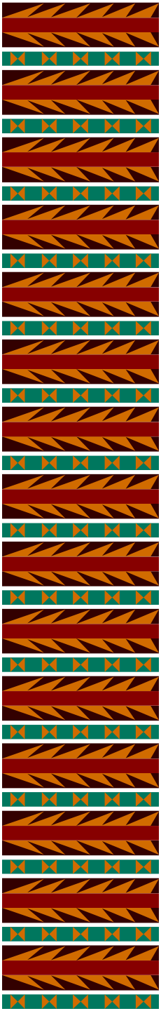
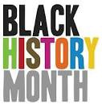

LACMTA
Celebrates Black History Month
African Americans in Transportation

Slide 2
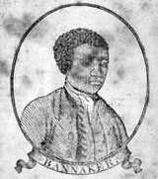
African Americans in Transportation
1791 Benjamin Banneker- Surveyor Washington DC
•A portrait of Benjamin Banneker
on the cover of his Farmers Almanac - circa 1795
Benjamin Banneker reached national acclaim for his scientific work in the 1791 survey of the Federal Territory (now Washington, D.C.). In 1753, he built one of the first watches made in America, a wooden pocket watch. Twenty years later, Thomas Jefferson commissioned Banneker to perform the surveying & mapping lay out of Washington D. C. after receiving a recommendation from George Elliot.

Slide 3
African Americans in Transportation
H I G H W A Y S
1935 (WPA)
Works Progress Administration
B R I D E G E S
In 1935 President Theodore Roosevelt formed the Works Progress Administration which was later renamed the Work Projects Administration (WPA). This program helped provide economic relief to the all citizens of the United States who were suffering through the Great Depression. The depression, while imposing hardships of people of all races and ethnic
backgrounds, struck blacks particularly hard. The WPA came at a time of critical need for African-Americans. Jobs formed by the WPA included a variety of construction of bridges, highways, dams, hospitals, along with providing training and work in the clerical, professional and arts endeavors. By the time the program ended in February 1943, it had allocated
$11 billion dollars and employed more than 8 million people.
D A M S
The WPA not only hired African-Americans, its projects contributed to their well- being. WPA construction crews built and renovated hospitals, housing projects, schools, parks, playgrounds, and swimming pools in Black communities

Slide 4
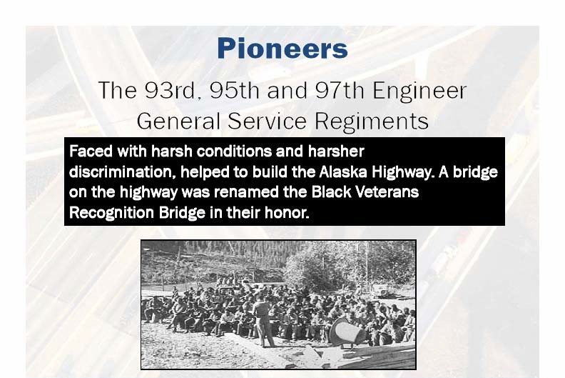
African Americans in Transportation
E N G I N E E E R S
1942 Alaska Highway
B U I L D E R S
President Franklin Roosevelt authorized the building of the Alaska Highway in February 1942 with black engineers and builders.

Slide 5
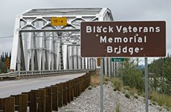
African Americans in Transportation
E N G I N E E E R S
B U I L D E R S
1942 Alaska Highway
Memorials for the veterans are scattered in spots throughout the highway, including the Black Veterans Memorial Bridge, dedicated in 1993.

Slide 6
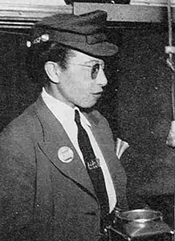
African Americans in Transportation
1944 Los Angeles' First African American Motor Women
In August of 1944, and without much fanfare, Los Angeles Railway hired its first African-American motorman, a motormanette,
Mrs. Arcola Philpott.

Slide 7
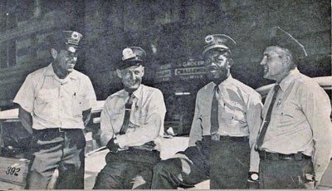
African Americans in Transportation
1945 Los Angeles' First African American Motormen
Los Angeles Railway initially hired 10 black motormen who did not show up due to weather conditions. LA Railway then hired two more black motormen who completed training but were never given assignments.
Nathaniel Lewis, third from left, with fellow operators in 1958.

Slide 8
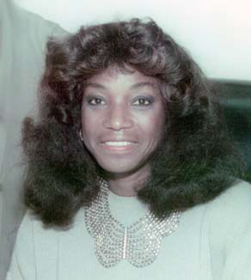
African Americans in Transportation
1987-1991 First African American Women Director Southern California Rapid Transit District (RTD)
Leilia Bailey-Leahy started her transportation career in July, 1971 when she was hired by the Southern California Rapid Transit District (RTD) as an Operator. She worked at Division 5 (now known as the Arthur Winston Division) for a number of years. Mrs. Bailey-Leahy worked her way up through the ranks to become the Assistant Director of Transportation (1986 to 1987) and then
Director of Transportation (1987 to 1991).
Leilia M. Bailey-Leahy

Slide 9
African Americans in Transportation
1933-1964 Los Angeles Bus and Rail Operators
In 1964, the Southern California Rapid Transit District merged with the Los Angeles County Transportation Commission to form the current Metropolitan Transportation Authority in 1993.
Today, bus and rail operator workforce of Metro employs of nearly 5,000 employees includes 32 percent women, 49 percent African-American men, and twenty-three percent African-American women.

Slide 10


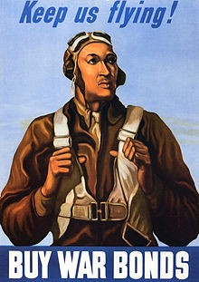
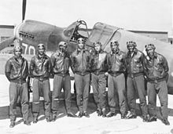
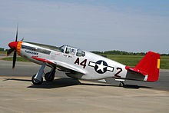
African Americans in Transportation
1892-1926 Tuskegee Airmen
The Tuskegee Airmen is the popular name of a group of African-American pilots who fought in World War II. Formally, they formed the 332nd Fighter Group and the 477th Bombardment Group of the United States Army Air Corps (United States Army Air Forces after 20 June 1941).
The Tuskegee Airmen were the first African-American military aviators in the United States armed forces. During World War II, African Americans in many U.S. states were still subject to the Jim Crow lawsThe American military was racially segregated, as was much of the federal government. The Tuskegee Airmen were subjected to racial discrimination, both within and outside the army. Despite these adversities, they trained and flew with distinction. All black military pilots who trained in the United States trained at Tuskegee, including five Haitians.

Slide 11

African Americans in Transportation
1864-1922 Patent and Electrical Lighting Engineer
Drafting and his creative genius led him to invent a method of making carbon filaments for the Maxim electric incandescent lamp.
1881, supervised the installation of the electric lights in New York, Philadelphia, Montreal, and London.
Worked for Thomas Edison
Lewis Latimer was the original draftsman for Thomas Edison (who he started working for in 1884) and as such was the star witness in Edison's infringement suits. Lewis Latimer was the only African American member of the twenty-four "Edison Principles",
Thomas Edison's engineering division of the Edison Company. Latimer also co-authored a book on electricity published in 1890 called, "Incandescent Electric Lighting: A Practical Description of the Edison System."

Slide 12
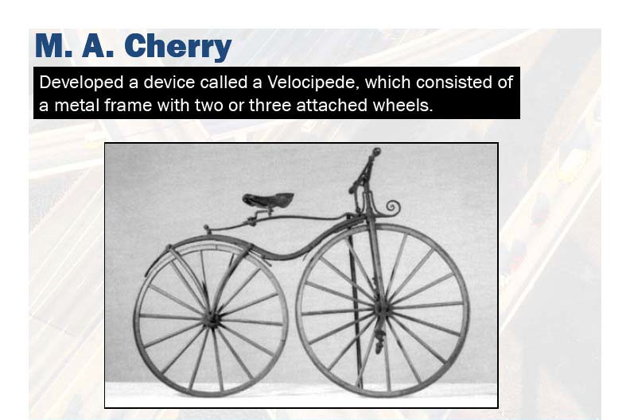
African Americans in Transportation
1888 Black Inventor Tri Cycle & Street Car Fender

Slide 13
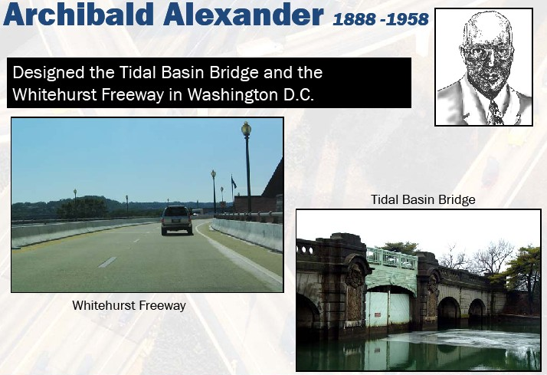
African Americans in Transportation
1888 Washington DC Designer- Planner

Slide 14
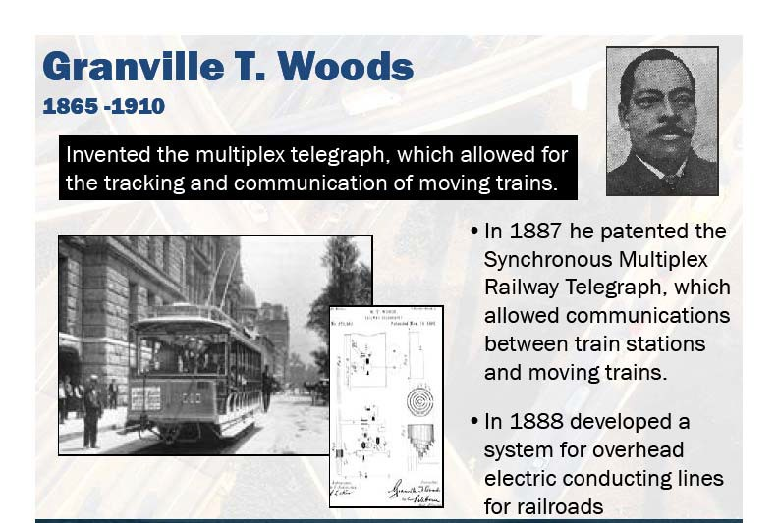
African Americans in Transportation
1865-1910 Inventor –Train Communications Systems

Slide 15
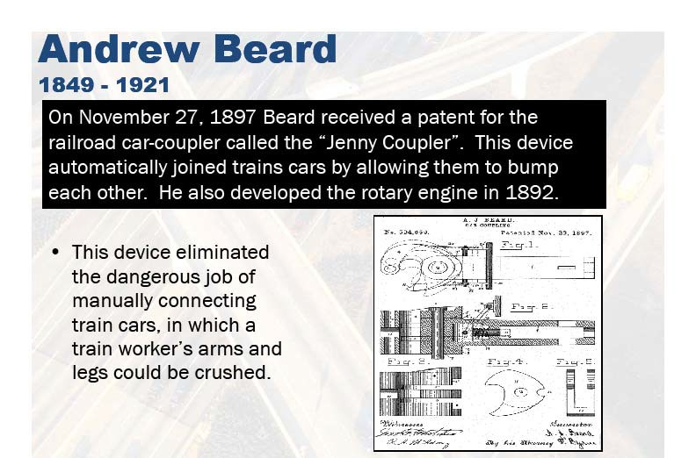
African Americans in Transportation
1849 Inventor Rail Coupler

Slide 16
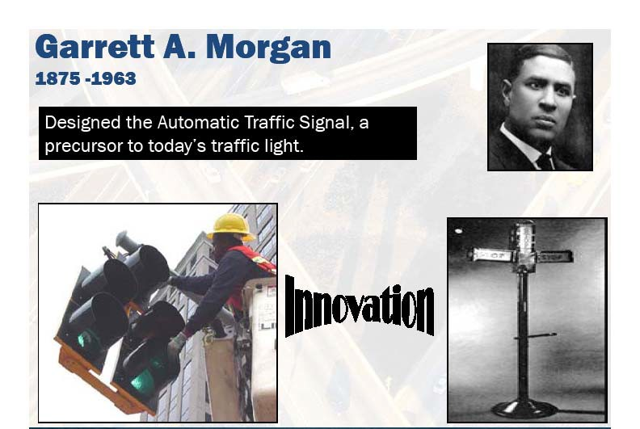
African Americans in Transportation
1875-1963 Designer of the Automatic Traffic Signals

Slide 17
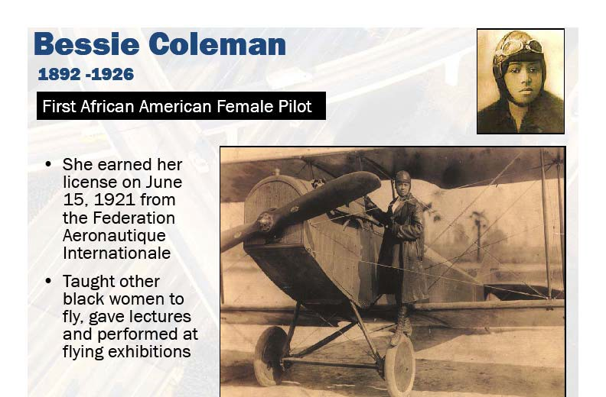
African Americans in Transportation
1892-1926 Aerospace Pilot

Slide 18
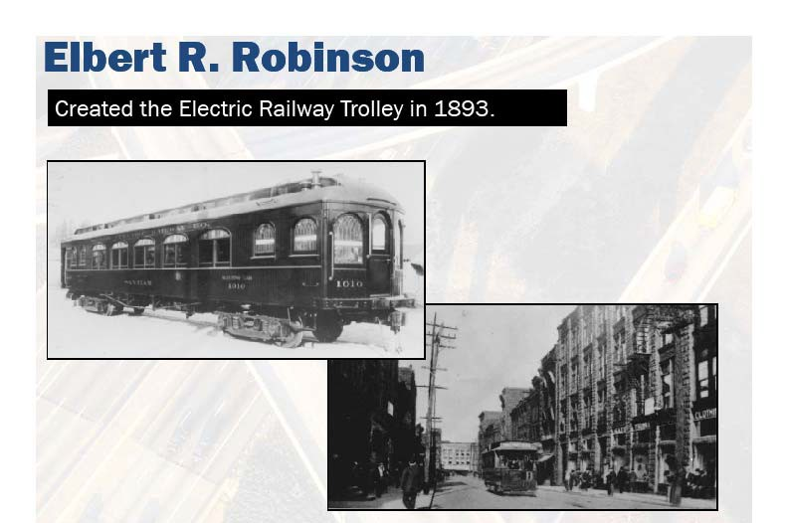
African Americans in Transportation
1893 Black creator of the Electric Railway Trolley

Slide 19
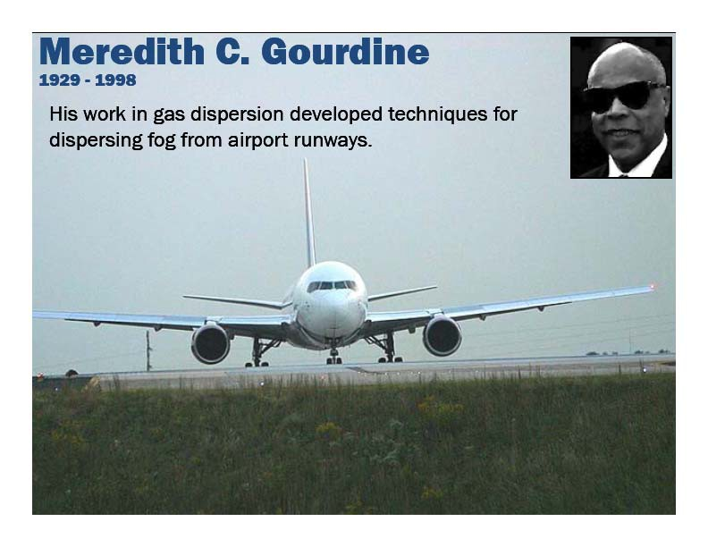
African Americans in Transportation
1929-1998 Engineer Designer–Airport Runway Defogging Methodology

Slide 20
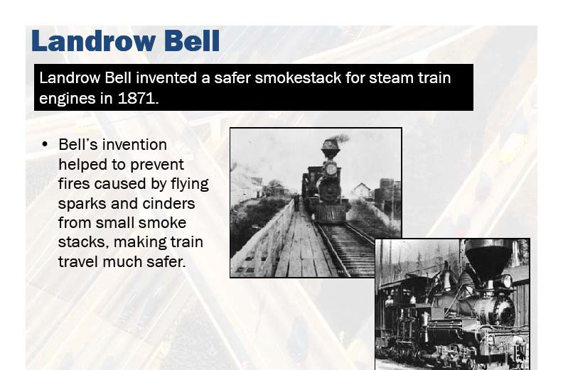
African Americans in Transportation
1871 Inventor- Rail Safety Devices

Slide 21
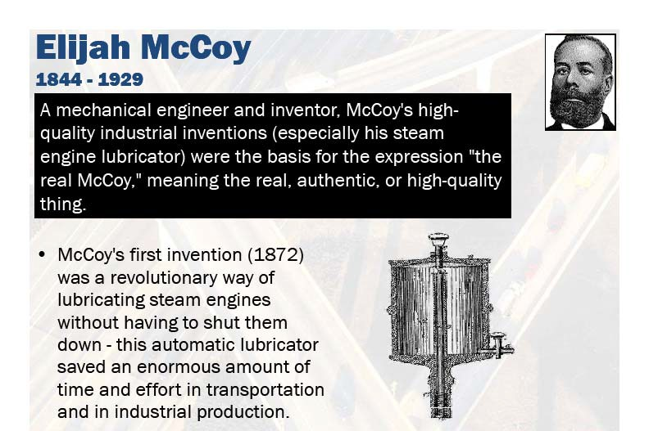
African Americans in Transportation
1872 Engineer & Inventor Rail Engine Lubricator

Slide 22

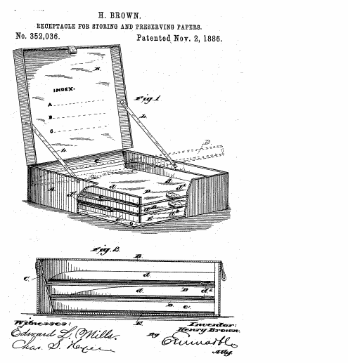
African Americans in Transportation
1886 Henry Brown Black Inventor – Fire Proof Box
Henry Brown patented a "receptacle for storing and preserving papers on November 2, 1886" This was a fire and accident safe container made of forged metal, which could be sealed with a lock and key. It was special in that it kept the papers separated. Perhaps an early forerunner to the filofax?

Slide 23

African Americans in Transportation
1849-1921 Andrew Jackson Beard Inventor –Rail Couplers
Andrew Beard (1849-1921) In 1892, he patented a rotary engine. In 1897, Andrew Beard patented an improvement to railroad car couplers commonly called the Jenny Coupler (not to be mistaken for the Janney coupler). It did the dangerous job of hooking railroad cars together,. Andrew Beard received $50,000 for the patent rights to his Jenny coupler.

Slide 24

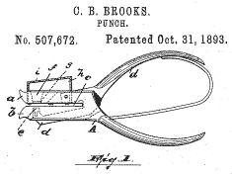
African Americans in Transportation
1896 Charles Brooks Black Inventor - Paper Punch
Charles Brooks - Street Sweeper Truck Charles Brooks of Newark, New Jersey invented improvements to street sweeper trucks that he patented on March 17, 1896. Charles Brooks also patented an early paper punch, also called a ticket punch. It was a ticket punch that had a built-in receptacle on one of the jars to collect the round pieces of waste paper and prevent littering.

Slide 25
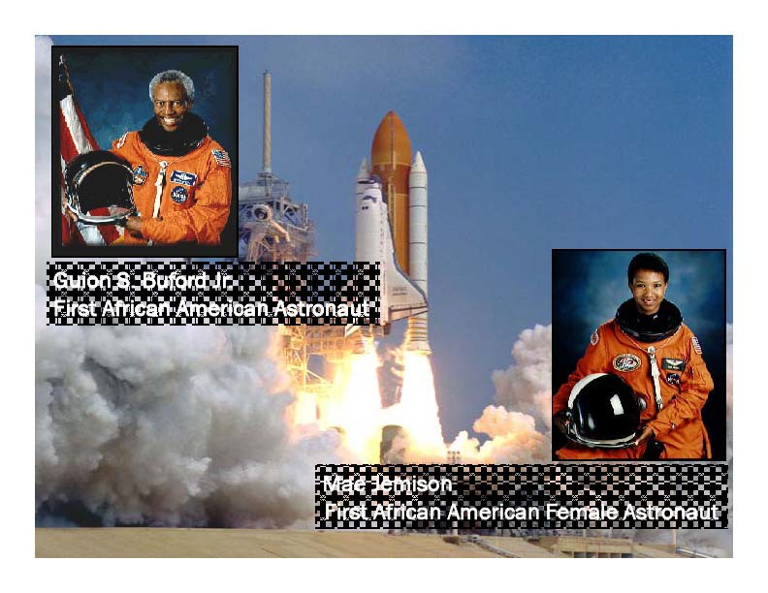
African Americans in Transportation
Black Astronauts

Slide 26
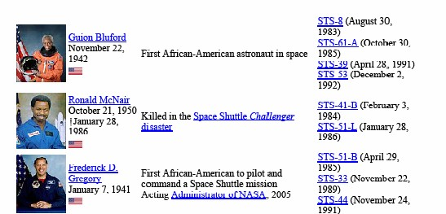
African Americans in Transportation
Black Astronauts

Slide 27
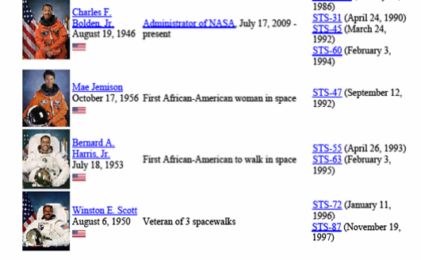
African Americans in Transportation
Black Astronauts

Slide 28
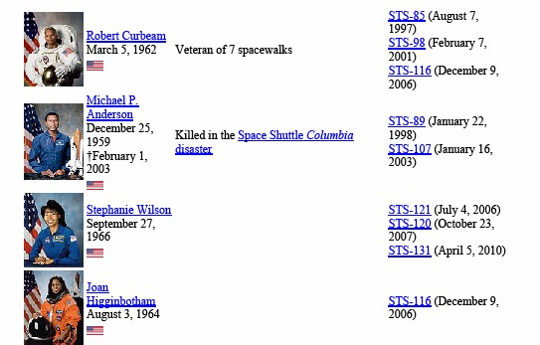
African Americans in Transportation
Black Astronauts

Slide 29
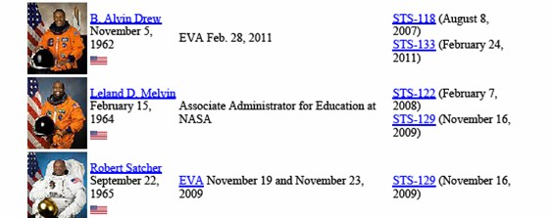
African Americans in Transportation
Black Astronauts

Slide 30
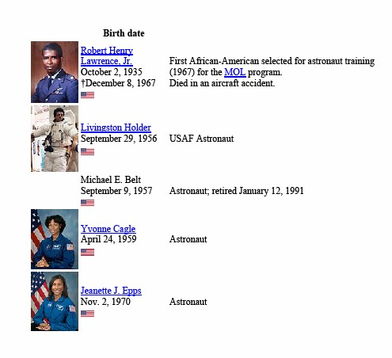
African Americans in Transportation
Black Astronauts

Slide 31


African Americans in Transportation
1958 Aerospace Engineer Designer Emmett W. Chappelle
In 1958 Chappelle joined the Research Institute in Baltimore, a division of the Martin Marietta Corporation which was famous for designing airplanes and spacecraft.
While designing instruments for the Mars Viking spacecraft,. He also showed how satellites can monitor luminescence levels to monitor crops (growth rates, water conditions and harvest timing).

Slide 32
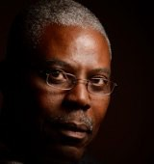
African Americans in Transportation
Inventor & Technology
Molaire, holder of 58 American patents and 120 foreign patents. Originally from Haiti, Michel Molaire was a research associate at the Office Imaging Research and Development Group of Eastman Kodak now a Principal for MOLAIRE CONSULTING LLC. Michel Molaire received his B.S. degree in chemistry, M.S. degree in chemical engineering, and M.B.A. degree from the University of Rochester. He has been with Kodak since 1974. After receiving more than 20 patents, Molaire was inducted into Eastman Kodak’s Distinguished Inventor’s Gallery in 1994. Senior Research Associate Chemist Senior materials, formulation and coating scientist. You can thank him for some of your most treasured Kodak Moments.
Dr. Michel Molaire
•INVENTED AND DEVELOPED AN ELECTROGRAPHIC IMAGING PROCESS AND MATERIALS USEFUL FOR COLOR FILTER ARRAY FABRICATION AND XEROGRAPHIC MASTER APPLICATIONS.
•DEVELOPED AND STUDIED HIGH-TEMPERATURE RESISTANT PHOTOPOLYMERIZABLE COMPOSITIONS USEFUL FOR MACRORESIST, ABRASION RESISTANT COATINGS, PRINTED CIRCUIT BOARD AND AUTOMATED TAPE BONDING APPLICATIONS

Slide 33
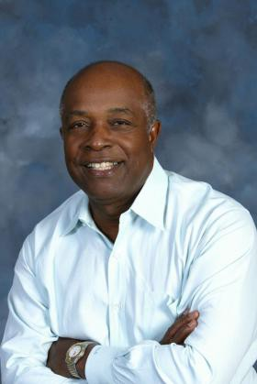
African Americans in Transportation
Sensor for High Speed Rail
Ken Coleman, Chairman, Accelyris, MIPS Technologies
SAN JOSE -- Biometric sensors for high speed rail, bringing the sense of smell to gaming devices, new medicines, new advances in online couponing, mobile communications, environmentally-friendly building materials, clean energy and batteries which can power electric cars for a thousand miles are some of the discoveries in the pipeline among African- American cutting edge firms which will be showcased at The Tech Museum of Innovation Saturday, June 18.
Ken Coleman, Chairman, Accelyris, MIPS Technologies
Ken Coleman, chairman of two publicly-traded companies, Accelrys and MIPS Technologies, is among the dynamic technology leaders of the future African- American technological discoveries.

Slide 34


African Americans in Transportation
1920 Invented the Electrical Resistor
Otis Boykin is best known for inventing an improved electrical resistor used in computers, radios, television sets and a variety of electronic devices. His resistor helped reduce the cost of those products. Otis Boykin also invented a variable resistor used in guided missile parts, a control unit for heart stimulators, a burglar-proof cash register and a chemical air filter. In total, Otis Boykin patented twenty- eight electronic devices Otis Boykin was born on August 29, 1920 in Dallas, Texas. In 1941, after graduating from Fisk University, Otis Boykin was employed as a laboratory assistant for the Majestic Radio and TV Corporation of Chicago, testing automatic controls for airplanes. Boykin-Fruth, Incorp.

Slide 35
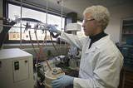
African Americans in Transportation
1994 Engineering Aerospace Robert Bryant NASA's Langley Institute.
Chemical engineer, Doctor Robert G Bryant works for NASA's Langley Research Center and has patented numerous inventions. Highlighted below are just two of the award winning products that Robert G Bryant has helped invent at Langley. LaRC-SILaRC-SI. Robert Bryant headed the team that invented Soluble Imide (LaRC-SI) the self-bonding thermoplastic that received an R&D 100 award for being one of the most significant new technical products of 1994. While researching resins and adhesives for advanced composites for high-speed aircraft,. According to a NasaTech report LaRC-SI proved to be a moldable, soluble, strong, crack-resistant polymer that could withstand high temperatures and pressures, unlikely to burn, and was resistant to hydrocarbons, lubricants, antifreeze, hydraulic fluid, and detergents. Applications for LaRC-SI have included use with mechanical parts, magnetic components, ceramics, adhesives, composites, flexible circuits, multilayer printed circuits, and coatings on fiber optics, wires, and metals.

Slide 36
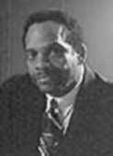
African Americans in Transportation
1962 Aerospace Engineering
George Edward Alcorn, Jr. received a four- year academic scholarship to Occidental College in Los Angeles, where he graduated with a Bachelor of Science in Physics. George Edward Alcorn received his degree with honors while earning eight letters in basketball and football. George Edward Alcorn earned a Master of Science in Nuclear Physics in 1963 from Howard University, after nine months of study. During the summers of 1962 and 1963, George Alcorn worked as a research engineer for the Space Division of North America Rockwell. He was involved with the computer analysis of launch trajectories and orbital mechanics for Rockwell missiles, including the Titan I and II, Saturn IV, and the Nova.

Slide 37





African Americans in Transportation
2012 Smart Cars –Black Inventor Revolutionizes Transportation CityCar
William Lark, Jr., an African American PhD. Candidate at MIT, is the chief designer for the CityCar, a stackable small car that folds .
The cars, which are smaller than Smart Cars, are battery-electric, so they don’t cause tailpipe emissions. They also weigh less than a 1,000 pounds and are intended to “meet the demand for enclosed personal mobility.”
The two-passenger vehicle will be available for use around different cities and allow
drivers to pick up and drop off the vehicles
at different locations. According to MIT, the car will be available in a city somewhere in Asia as a pilot program within the next five years

Slide 38
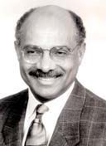
African Americans in Transportation
LEADERS
March 1, 1993-1995
Franklin E. White Chief Executive Officer Los Angeles County Metropolitan
Transit Authority,
•Franklin E. White is named MTA’s first CEO on February 4 after the merger of Southern California Rapid Transit District (RTD) &Los Angeles County Transportation (LACTC). MTA officially takes over policy-making, bus and rail operations and construction on April 1. 1993. MTA adopts $3.4 billion budget, the agency’s first spending plan. A total of 246 positions and 21 vacancies are eliminated during the merger.
•First and only Black METRO CEO
Mr. White had served in 1985 as commissioner of the New York State Department of Transportation.
Franklin White

Slide 39

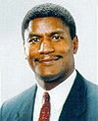
African Americans in Transportation
LEADERS
1975
William Thaddeus Coleman Secretary of Transportation
1997
Rodney Slater Secretary of Transportation

Slide 40
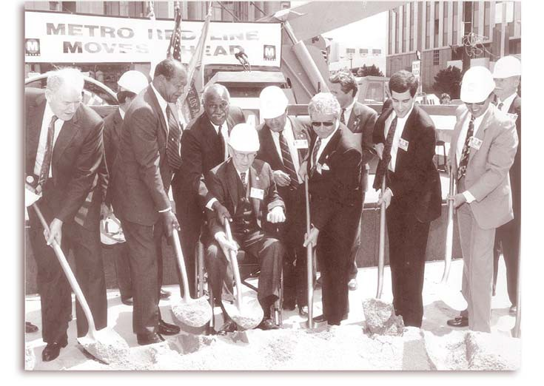
African Americans in Transportation
LEADERS
1996 - LA Mayor Tom Bradley & RTD Board Member Nate Holden
At 1st and Hill streets, participants at groundbreaking ceremony for Metro Red Line subway on Sept. 29, 1986 included LA Mayor Tom Bradley, LA City Councilmembers John Ferraro and Richard Alatorre, LA County Supervisor Kenneth Hahn, Southern California Rapid Transit District (RTD) Director Nick Patsaouras, RTD Board Member Nate Holden, RTD director of systems design and analysis Joel Sandberg, Los Angeles County Transportation (LACTC) Executive Director Neil Peterson and LACTC Commissioner Ray Grabinski.

Slide 41

African Americans in Transportation
LEADERS
1974-1983 Nate Holden
•California State Senator 1974-1978 where he authored and co-authored more than 70 bills that became law.
•Los Angeles City Council (1987 to 2003).
•Chairman of the Air Quality and Waste Management Committee
•Chairman of the Transportation Committee.
•Chairman of the Inter-Government Relations Committee
•Vice-Chairman of the Public Safety Committee.
•Vice-Chairman of the Rapid Transit District (RTD)
•Public Utilities Transit and Energy Committee.
•Member of the LA County Transportation Committee (LACTC)
•Member of the LA Metropolitan Transit Authority (LAMTA).

Slide 42

African Americans in Transportation
LEADERS
1973-1993 Thomas “Tom” Bradley Mayor of Los Angeles, California – Five Terms
On January 29, 1993, former Los Angeles Mayor Tom Bradley stood among a swarm of public officials and transit agency staffers on the cramped Pershing Square subway platform. Standing shoulders above everyone else, including then-California Gov. Pete Wilson, Bradley proudly inaugurated the opening of the first modern subway in Los Angeles.
“Twenty years is a long time. That’s how long we have been pushing on this dream, this vision of what we should do in Los Angeles County,” Bradley
said, referring to the subway’s quixotic path to reality in ‘93. “I made a promise when I ran for mayor in 1973 that in 18 months, we’d deliver by
breaking ground for rapid transit. Well, I missed by only a few months…”

Slide 43

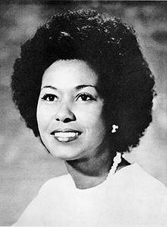
African Americans in Transportation
LEADERS
1972-Present Former MTA Board Chair Yvonne Brathwaite Burke
March 29, 2012, nominated by President Barack Obama to serve as Director of the Amtrak Board of Directors.
•1967-1972 California State Assemblymember, 63rd District
•1972-1978 California's First Black Congresswoman
•1979-1980 Los Angeles County Board of Supervisors 4th District
•1972-2008 Los Angeles County Board of Supervisors 2nd District

Slide 44
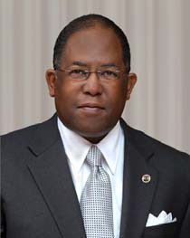
African Americans in Transportation
LEADERS
2013- MARK RIDLEY-THOMAS,
Los Angeles County Board of Supervisors Supervisor District 2nd
MRT vision to connect the Crenshaw public transit rail line to the airport. “This would link airport terminals to Metro’s Crenshaw and Green lines with an “automated people mover” similar to those used in airports such as San Francisco and Newark, New Jersey. “The Crenshaw rail line is scheduled to open in 2019”
•2008 –Present Los Angeles County Board of Supervisors
•2006-2008 California State Assemblymember, 26th District
•2002-2006 California State Assemblymember, 48th District
•1991-2002 Los Angeles City Council
•1972-1978 California State Assembleman

Slide 45
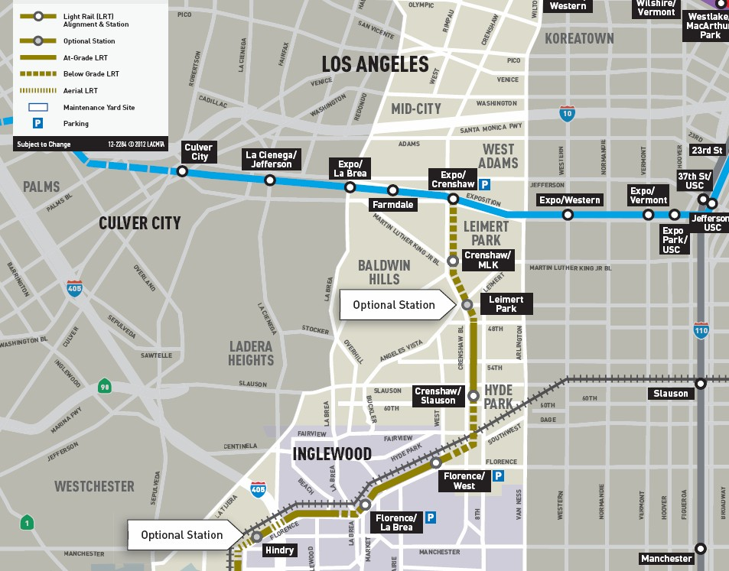
African Americans in Transportation
LEADERS
Crenshaw & Exposition Metro Line Construction

Slide 46

African Americans in Transportation
LEADERS
2007 & 2011 City of Los Angeles Council member Herb J. Wesson, Jr.
President of Los Angeles City Council Member of the Exposition Metro Line Construction
District boundaries include the Crenshaw District & the Lemert historically black neighborhood.
•2007 – Present of City of Los Angeles
•Council District of the 10th
•Chair of the Arts, Parks and Neighborhoods Committee
•Chairs the Rules and Elections Committee.
•Member of the Housing, Community and Economic Development (HCED)
•1998-2004 State Assembly District 47th
Chief of Staff to 2nd District Supervisor Yvonne Burke
Chief of Staff to former 10th District Councilmember Nate Holden

Slide 47
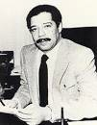
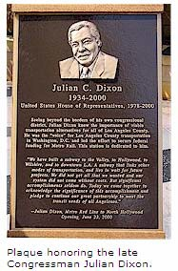
African Americans in Transportation
1979 -2000 U. S. Representative & Congressman Julian C. Dixon
This special bronze plaque signifies the tremendous gratitude MTA and the region owe to Congressman Julian Dixon for the accomplishments he made in improving transportation for Los Angeles County," said MTA Board Chairman John Fasana. "Not only a champion of rail, Congressman Dixon also helped secure funding to revamp MTA's bus service and provide funding for more than a dozen municipal bus operators in Los Angeles County."
The Metro Red Line Seventh Street Metro Center station was selected to honor the late Congressman Dixon because the station brings together two important rail lines, both of
which Dixon was key in assisting with funding.
The 7th Street Metro Center Station, the junction of the Metro Red Line subway system and the Metro Blue Line light rail system, has been renamed the 7th Street/Metro Center/Julian Dixon Metro Rail Station. The plaque unveiled today will be placed in a prominent location within the station. He was 'The Voice' of Los Angeles County transportation in Washington, leading the effort to secure federal funding for Metro Rail and, together with the late Tom Bradley and Kenny Hahn, put together the combination of federal, state and local funding that established this critical component of Los Angeles' mass transit system," said Burke.
He was elected to the California State Assembly as a Democrat in 1972, and served in that body for three terms. Dixon was elected to the House of Representatives in 1978. He chaired the rules committee at the 1984 Democratic National Convention and the ethics probe into Speaker Jim Wright. Dixon won re-election to the 107th United States Congress, but died of a heart attack in December 2000.

Slide 48



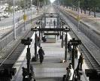
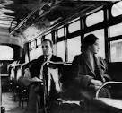





African Americans in Transportation
April 23, 1998 METRO Rosa Parks Station
BOARD RENAMES METRO RAIL STATION IN HONOR OF ROSA PARKS, MOTHER OF THE MODERN DAY CIVIL RIGHTS.
Parks' refusal to give up her seat on a Montgomery, Alabama bus in1955 was a milestone in the modern day civil rights movement. "Rosa Parks is clearly a symbol of civil rights in the 20th Century, said Los Angeles Mayor and MTA Board Chairman Richard J. Riordan. "We are honored to recognize her contributions to American history in this public way. I hope MTA's passengers will recall her actions when passing through the Rosa Parks Station. Parks was arrested as the result of her quiet protest. Her defiance touched off a wave of other non- violent civil rights demonstrations throughout the South and the rest of country, and led to a boycott of Montgomery's city bus system which lasted 381 days. The renaming follows a celebration on March 20, 1998 when officials unveiled an artist's rendering of a bronze plaque to be installed at the station in Parks' honor.

Slide 49
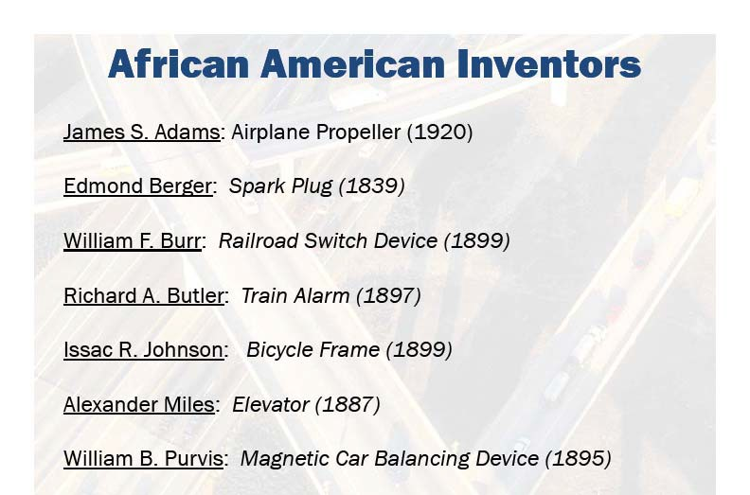
Other Black Transportation Inventors

Slide 50
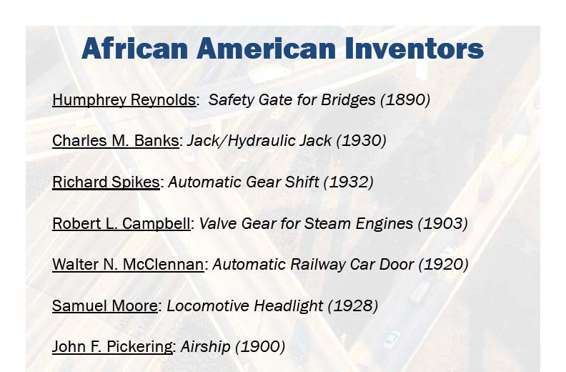
Other Black Transportation Inventors

Slide 51
African Americans in Transportation
 | February 12, 2013 Black History Month Celebration METRO (A.A.E.A )African American Employees Association

