Slide 1

Metro Workforce
Who We Are
(September 2014)

Slide 2

Metro is Comprised of Five Unions and One Non-Contract Group
AFSCME: Supervisors
ATU: Mechanics/Maintenance
Non-Contract: Management, Professionals and Administrative Staff
SMART: Bus and Rail Operators
TCU: Clerks, Custodians and Customer Information Agents
Teamsters: Security

Slide 3

Headcount by Labor Group

Slide 4
Years of Service (All Reg. Full-Time Employees)
One out of five regular FT employees have 20 or more years of service

Slide 5
Age Box Plots by Labor Group (Reg. Employees)
Median age lowest for SMART (45.34) and highest for Non-Contract (52.47)
Youngest employee 20.28 years old (Service Attendant) and oldest employee 83.17 years old (Sr. Service Attendant)

Slide 6
Non-Contract Employees Are Majority Baby Boomers

Slide 7
Metro Employees Born All Over the Globe
Countries Represented Shaded in Light Blue

Slide 8
Top Countries Represented by Foreign-Born Employees
Over One-Third Born Outside of the US

Slide 9

Organization Chart

Slide 10

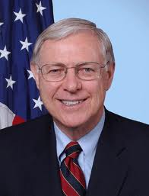
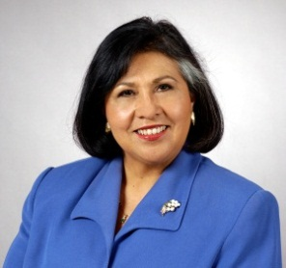
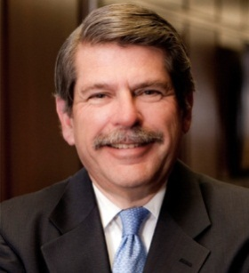
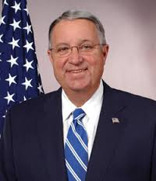
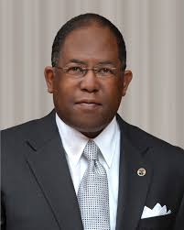
Metro Board Members
County Supervisors (5)
Michael Antonovich
Gloria Molina
Zev Yaroslavsky
Don Knabe
Mark Ridley-Thomas

Slide 11
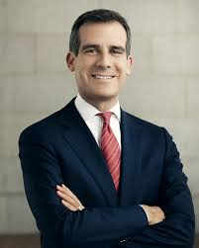
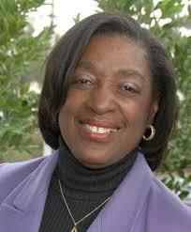
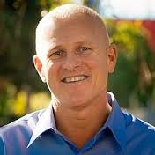
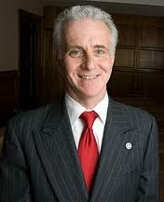
Mayor and Mayoral Appointees (3)
Jacquelyn Dupont-Walker
Ward Economic Development Executive Director
Eric Garcetti
Metro Board Chair
Mayor
City of Los Angeles
Mike Bonin
City Council Member District 11
Los Angeles
Paul Krekorian
City Council Member District 2
Los Angeles

Slide 12
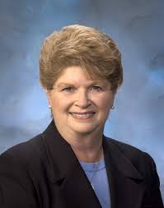
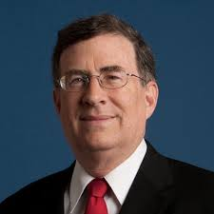
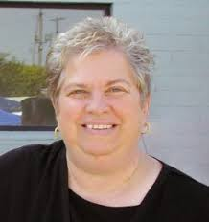
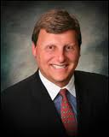
Appointees of the Los Angeles County City Selection Committee (4)
Diane DuBois
Mayor, City of Lakewood
(Southeast Long Beach Sector)
2nd Vice Chair, John Fasana
Duarte City Council
(San Gabriel Valley Sector)
Pam O’Connor
Mayor, City of Santa Monica
(Southwest Corridor Sector)
Ara Najarian
Mayor, City of Glendale
(The North County/San Fernando Valley Sector)
Notes:
Four representatives from outlying cities. The structure of the board membership aims to ensure representation from all corners of the region on the Metro Board.

Slide 13
Thank You

