Slide 1
SLA Transportation Division
Innovation Award:
Interactive Timelines to Support Transportation Information & Education
Kenn Bicknell
Los Angeles County
Metropolitan Transportation Library & Archive
June 13, 2015

Slide 2
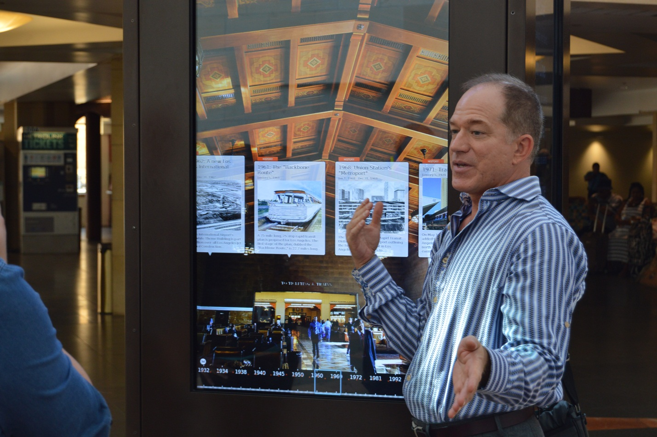

Slide 3
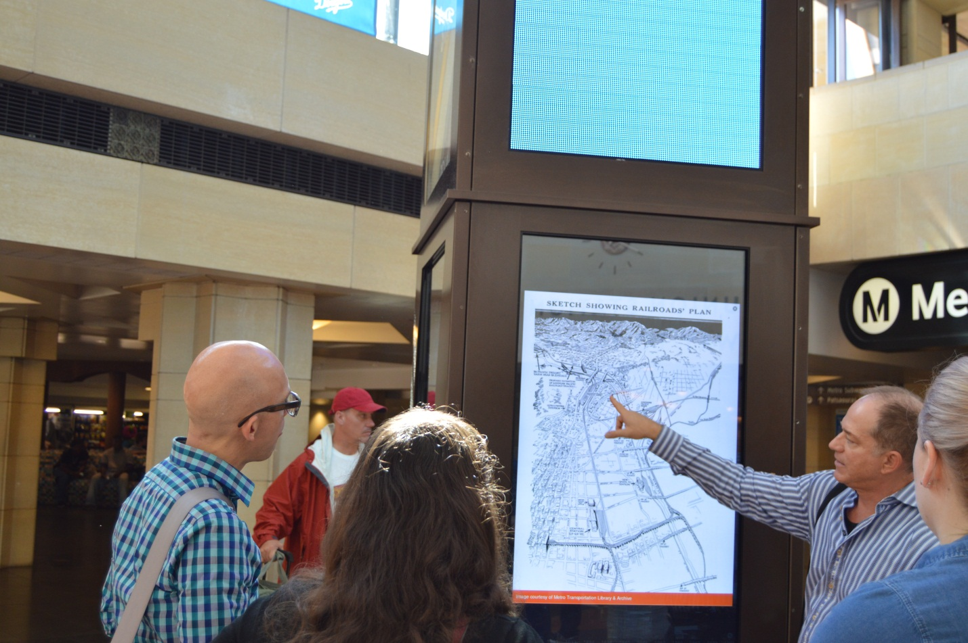

Slide 4
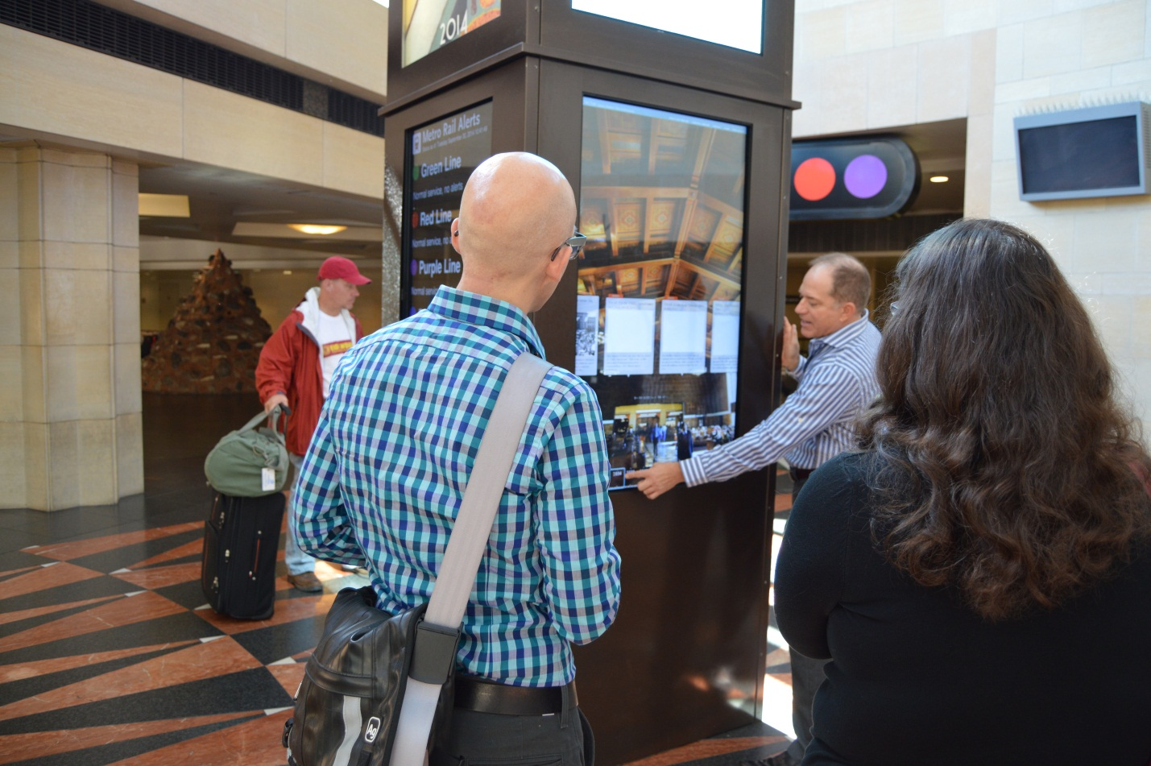

Slide 5
