Slide 1
Touch Me Here:
Bringing Digital Resources to Public Interactive Kiosks
Internet Librarian: B303
“Grabbin’ ‘Em With Tech!”
Kenn Bicknell
Los Angeles County
Metropolitan Transportation Authority
Library & Archive
October 28th, 2015

Slide 2
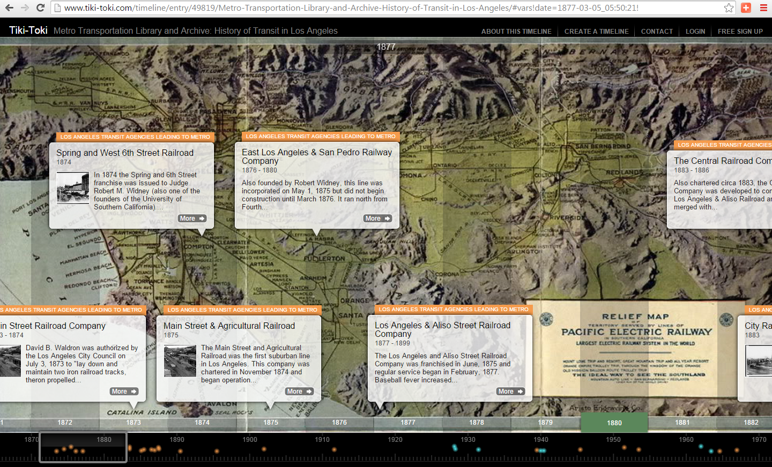
Tiki-Toki Interative Timelines

Slide 3
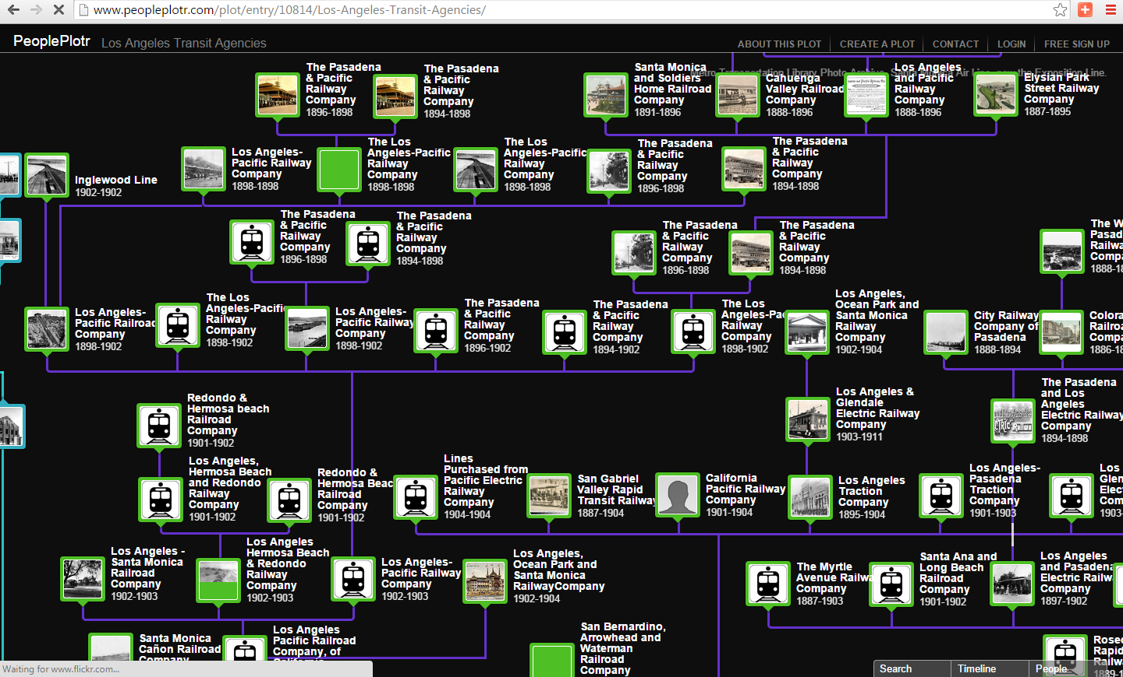
PeoplePlotr Family Tree Org Charts

Slide 4
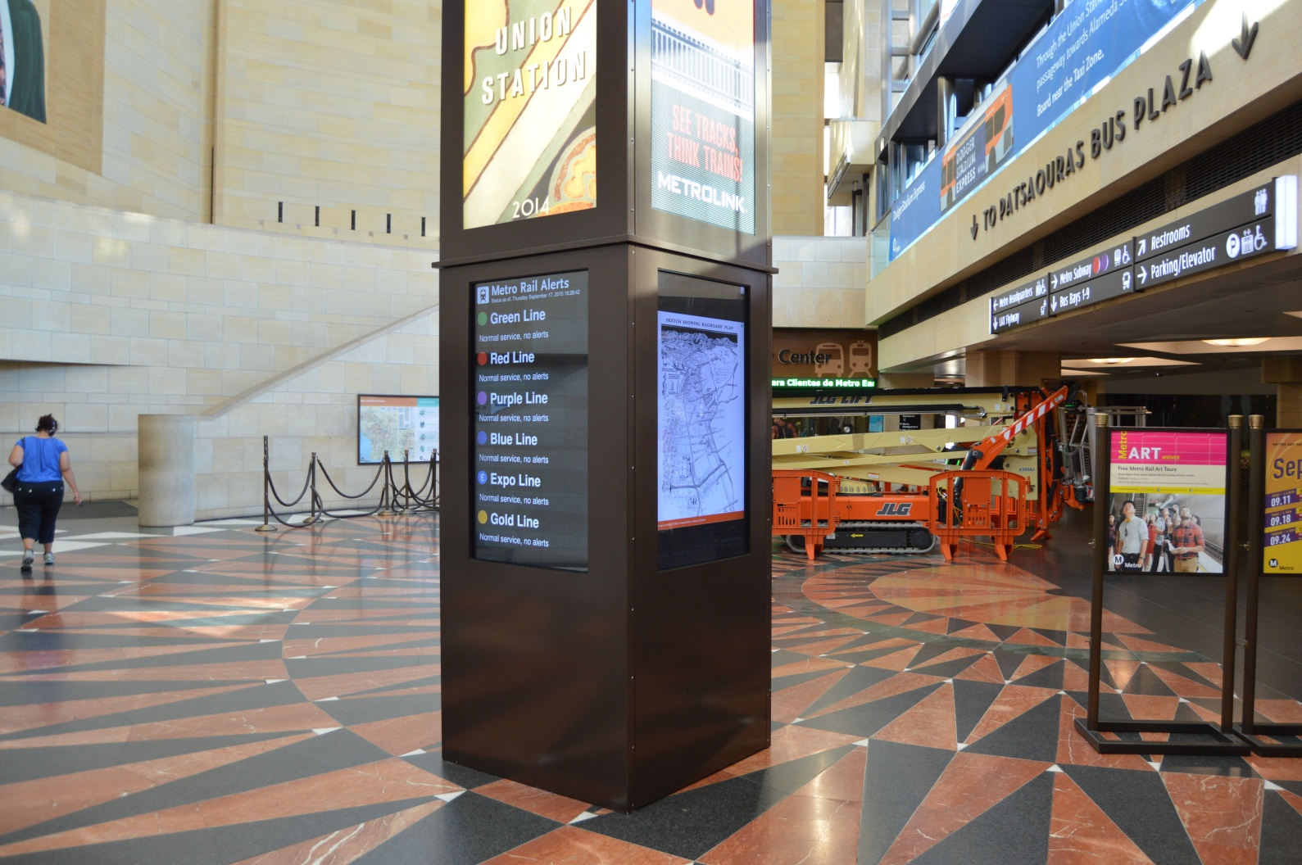
The “Ambient Exo-Library”

Slide 5
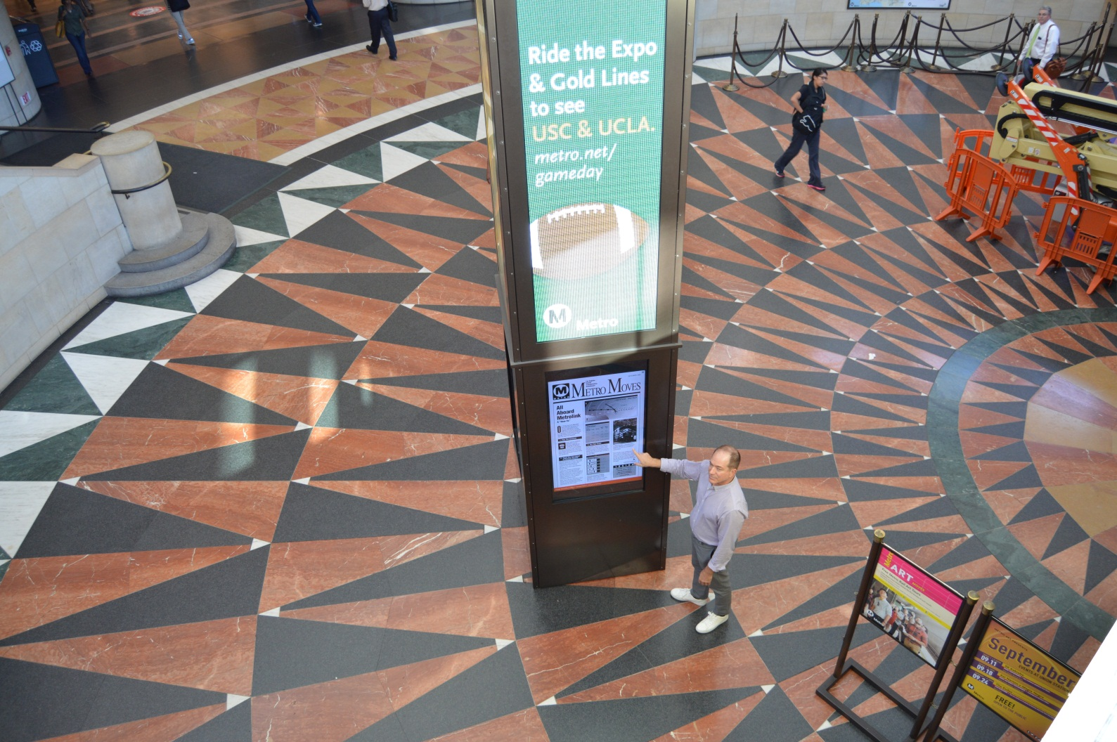
High-traffic visual encounter

Slide 6
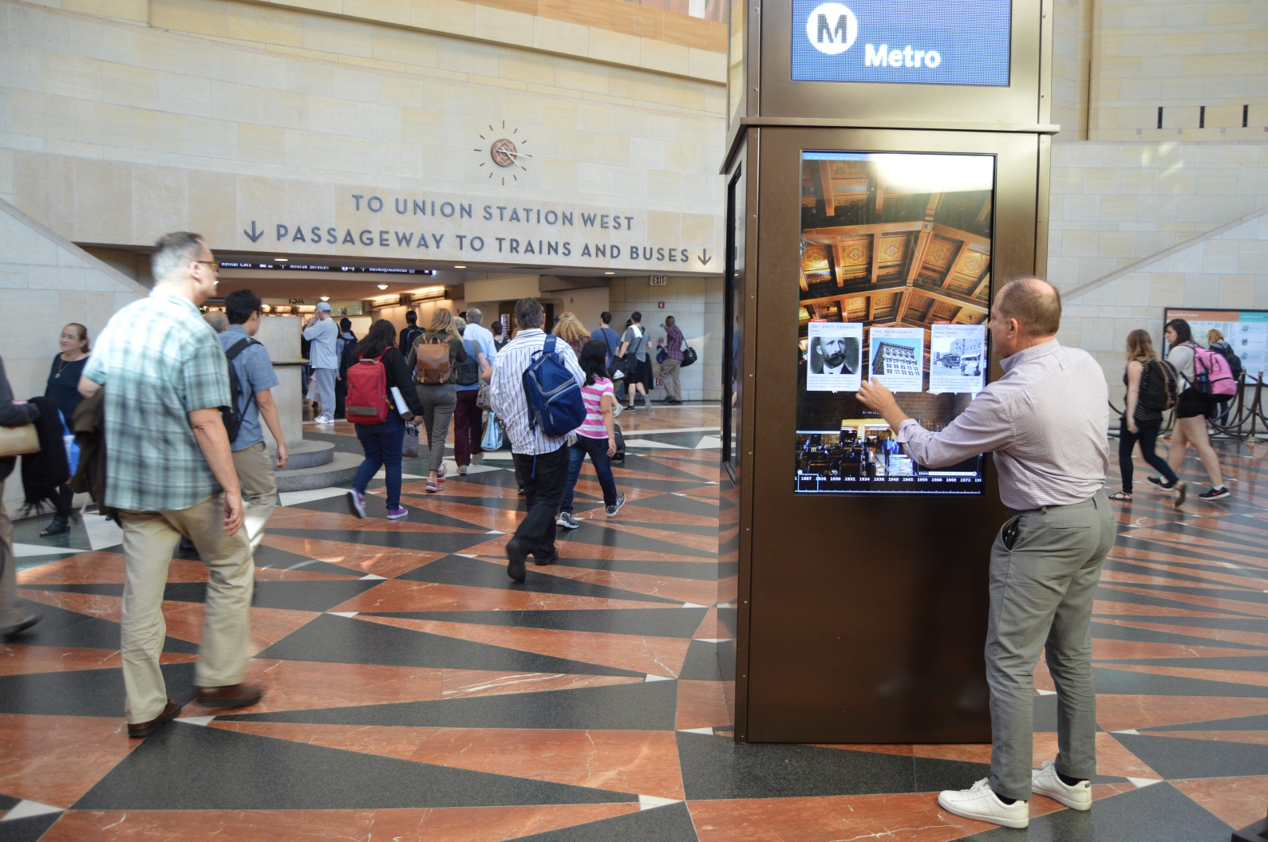
Vertically reoriented timeline

Slide 7
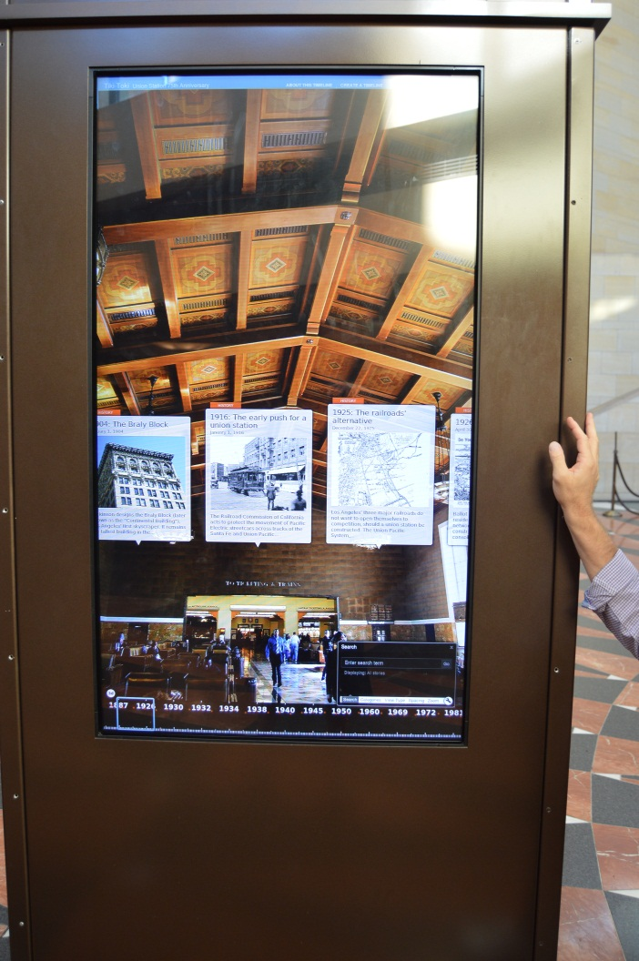
Mixed-format data points

Slide 8
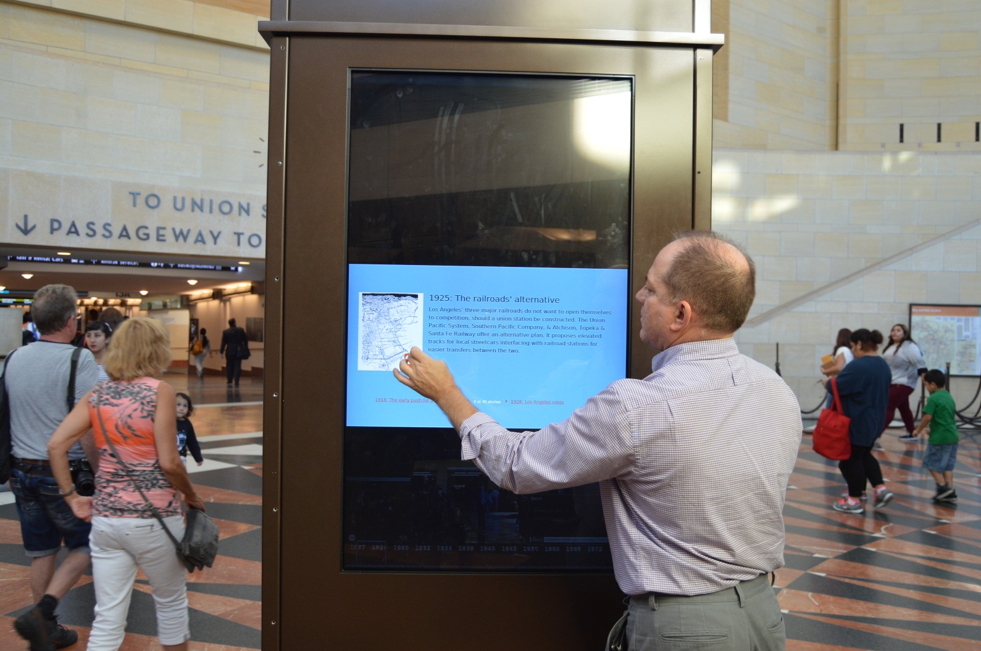
Text and context

Slide 9
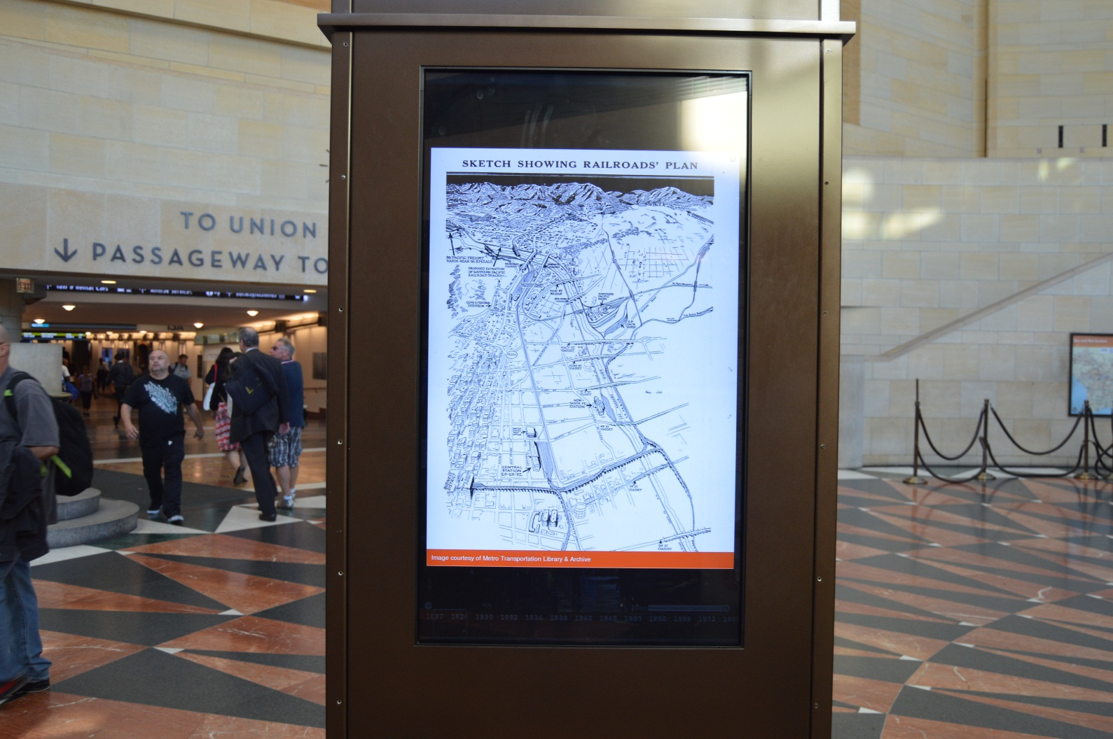
High-resolution images

Slide 10
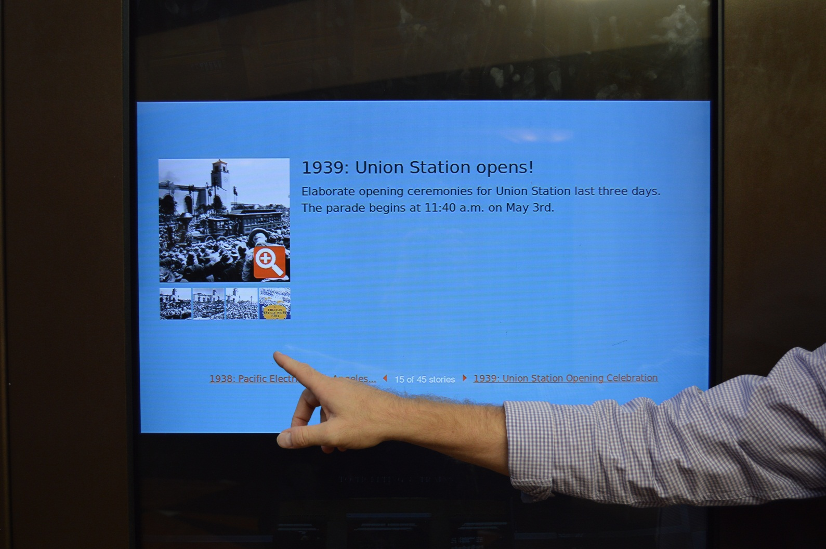
Galleries

Slide 11
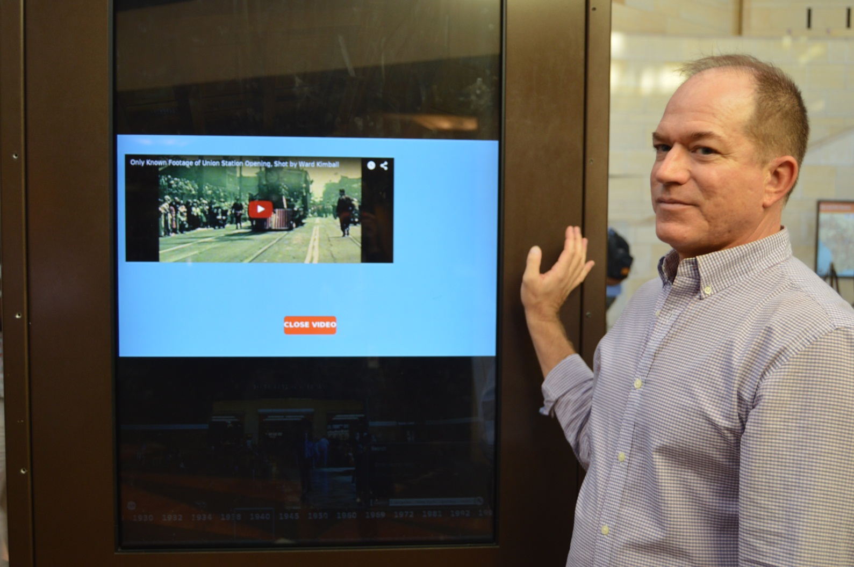
Video

Slide 12
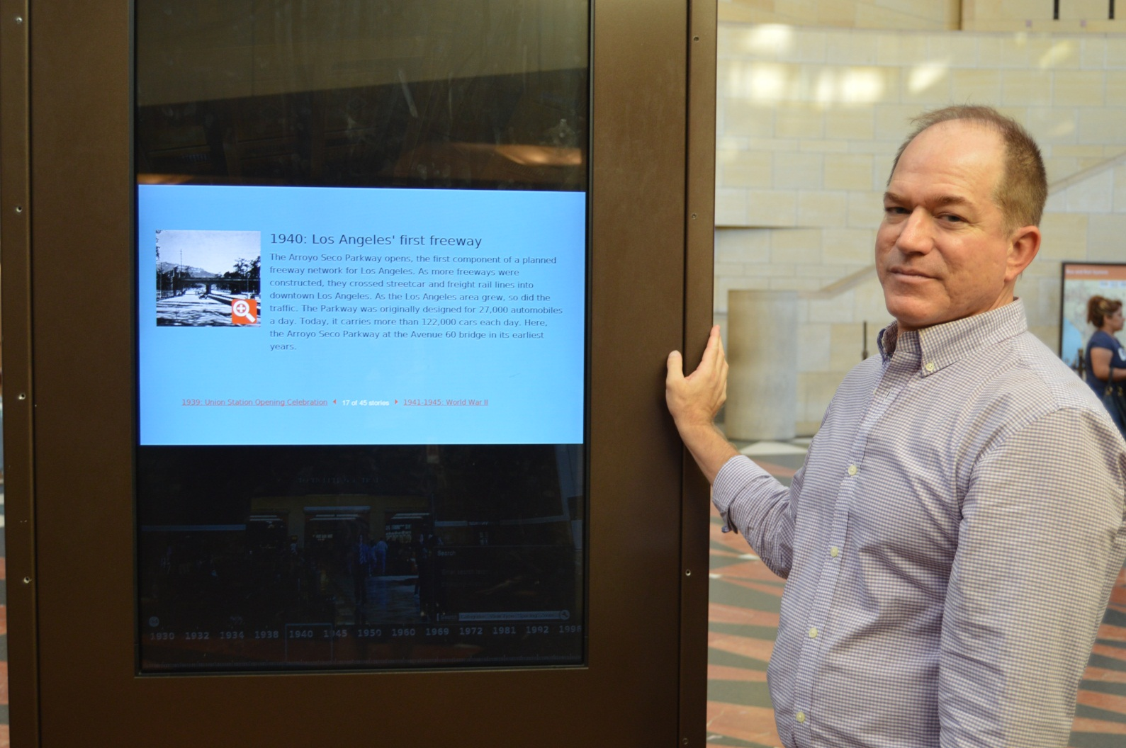
Food for thought

Slide 13
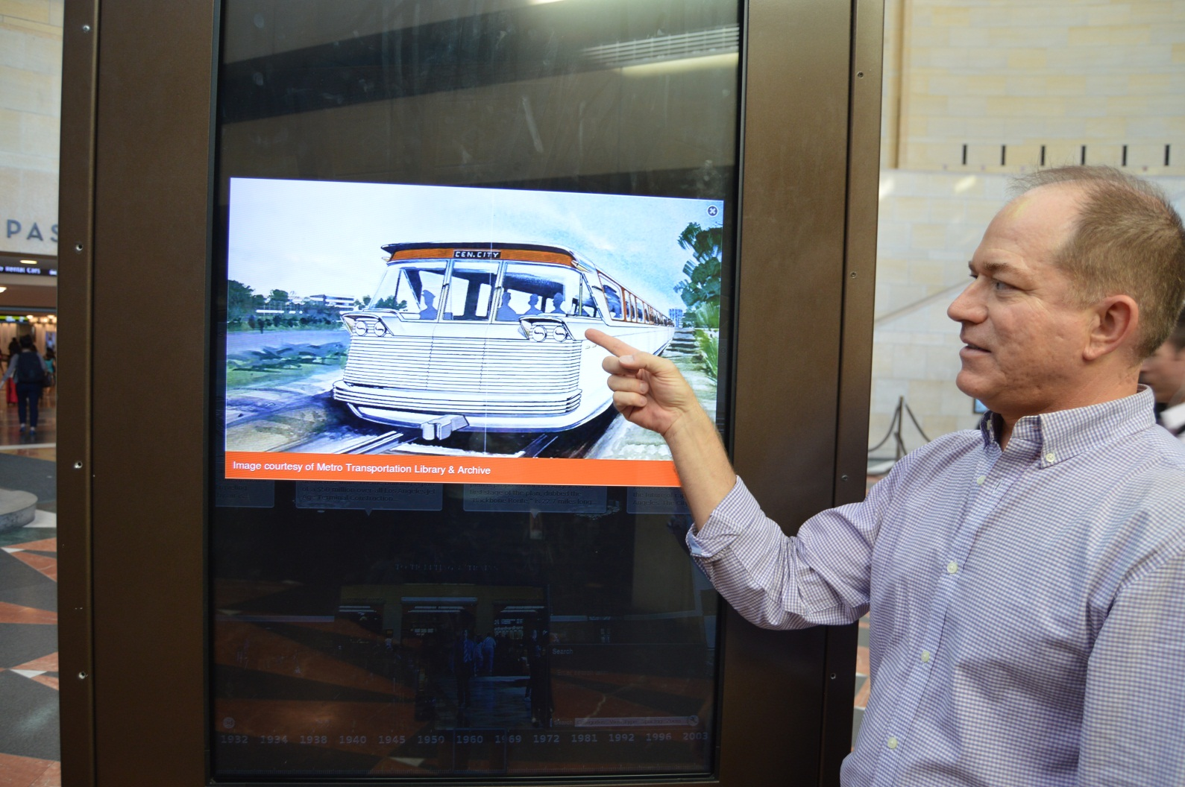
…and dessert

Slide 14
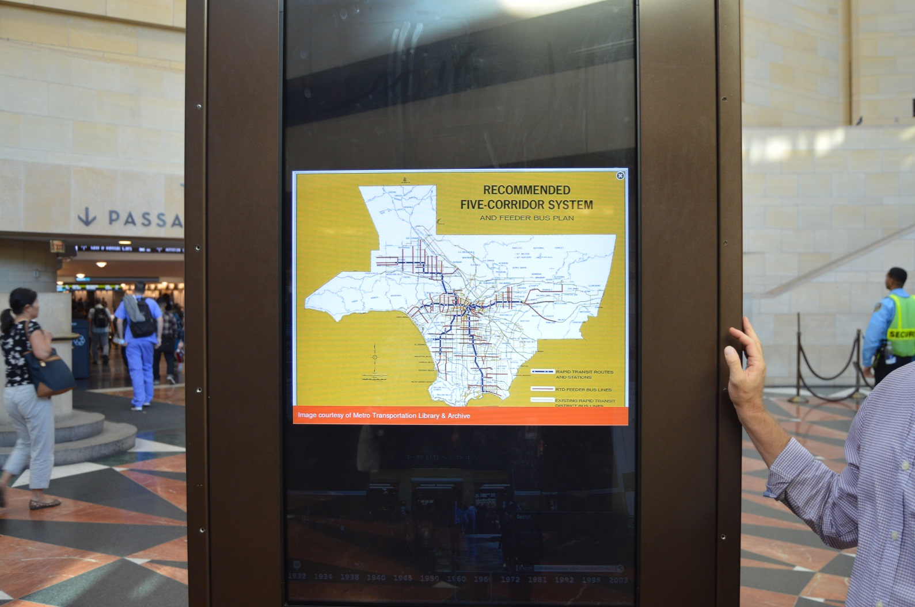
Making resources shine

Slide 15
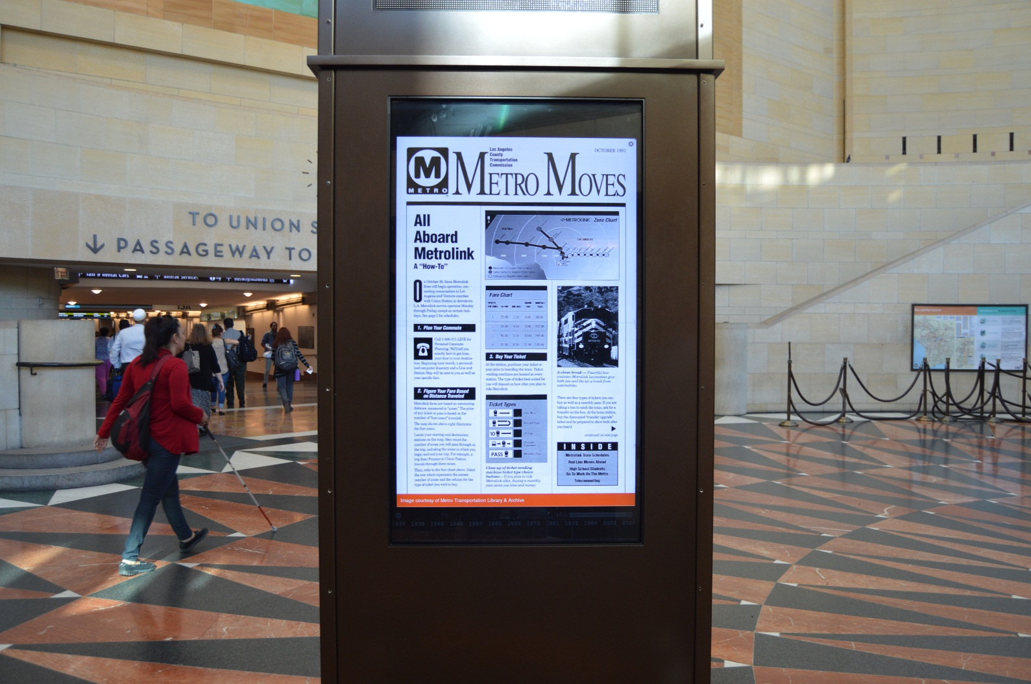
Giving them new life

Slide 16
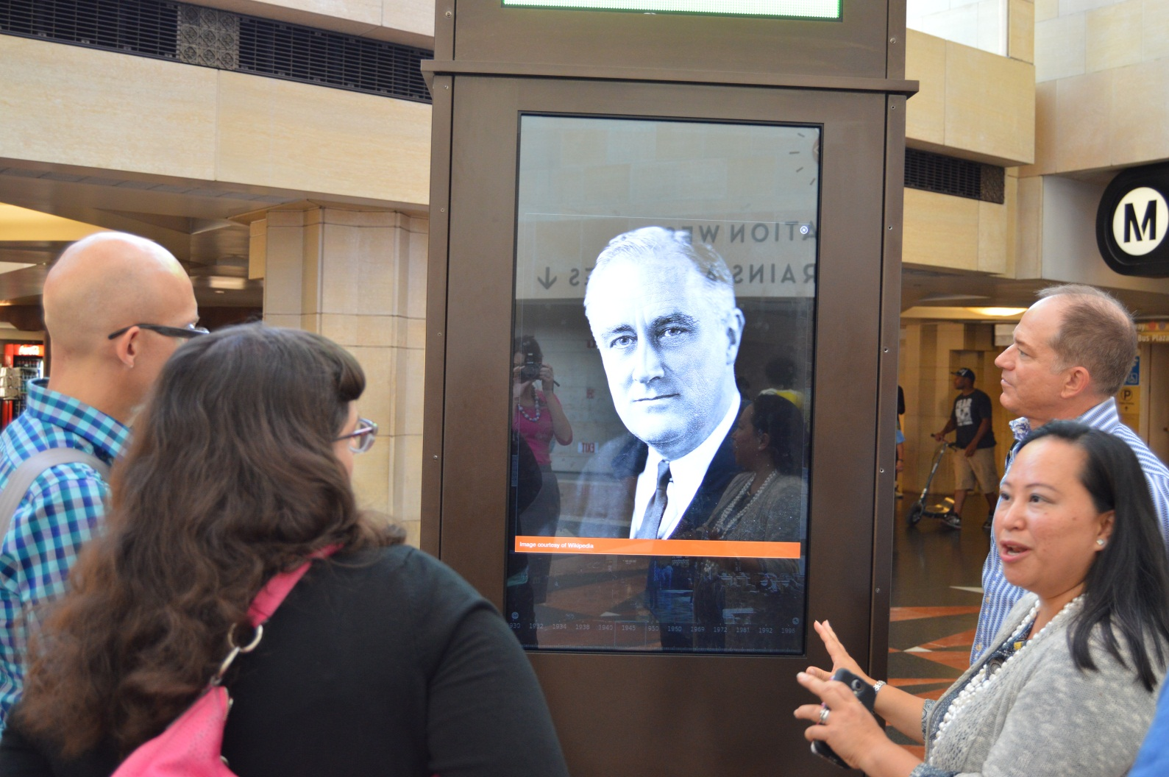

Slide 17
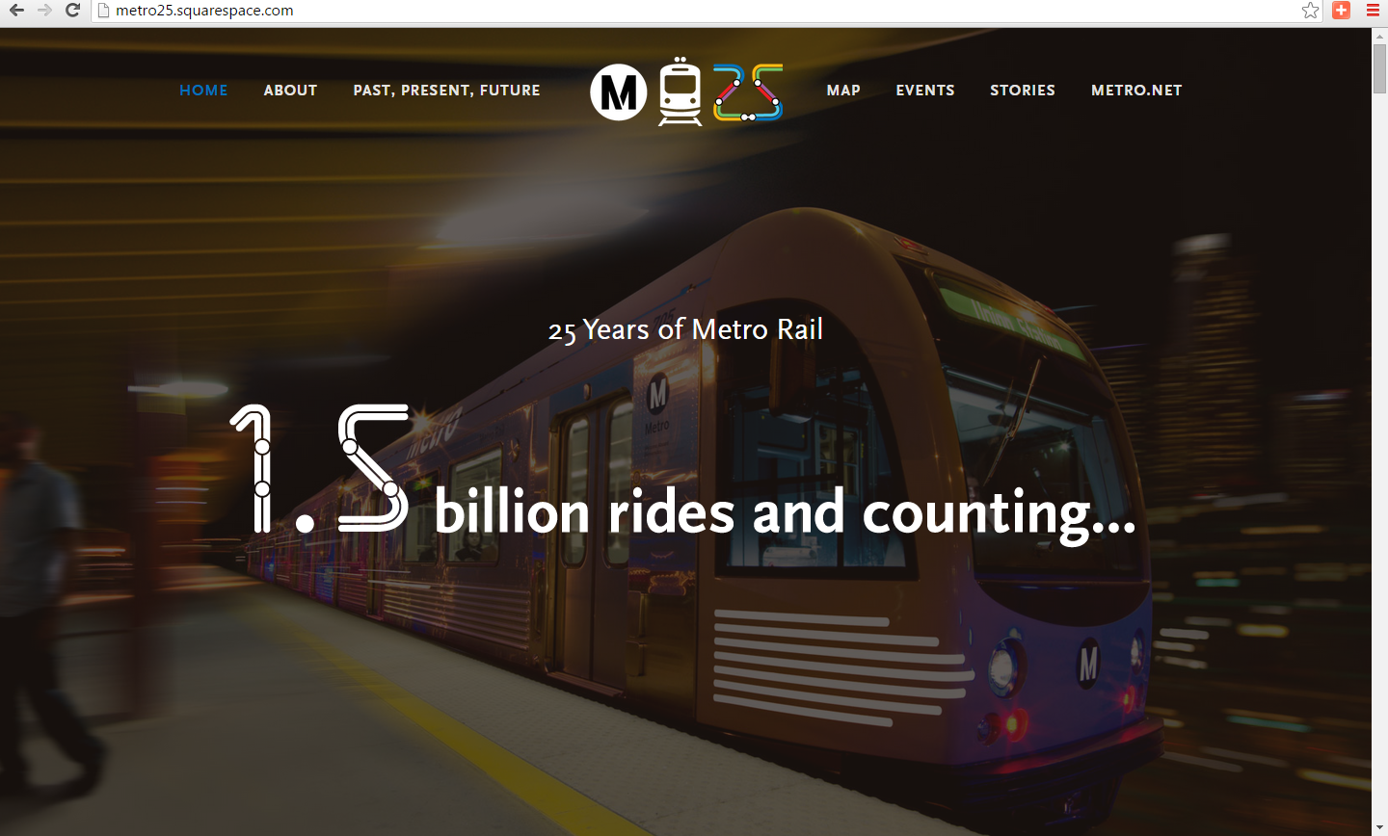
Metro Rail at 25

Slide 18
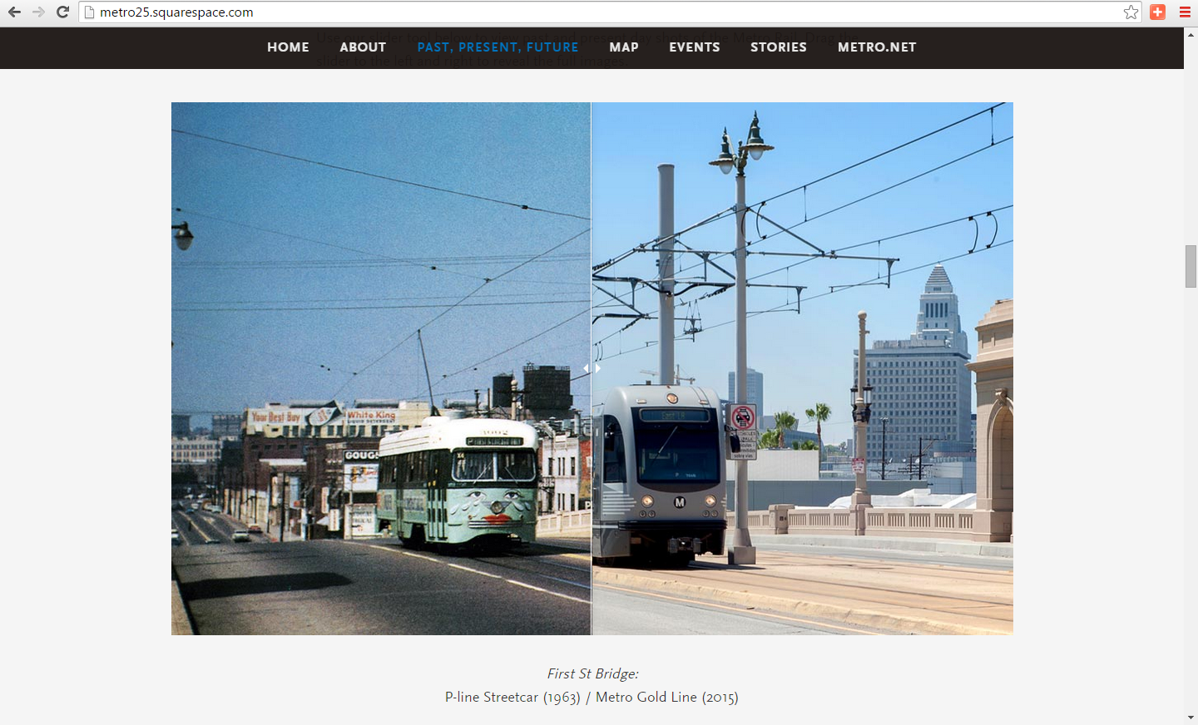
SquareSpace: Then & Now sliders

Slide 19
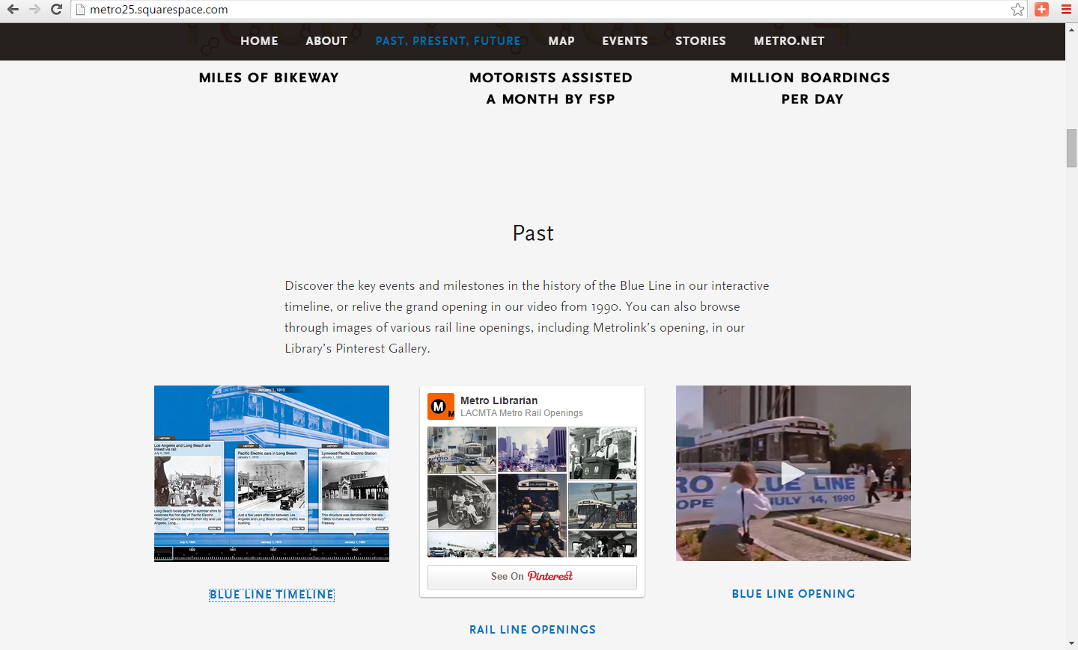
Historical Context

Slide 20
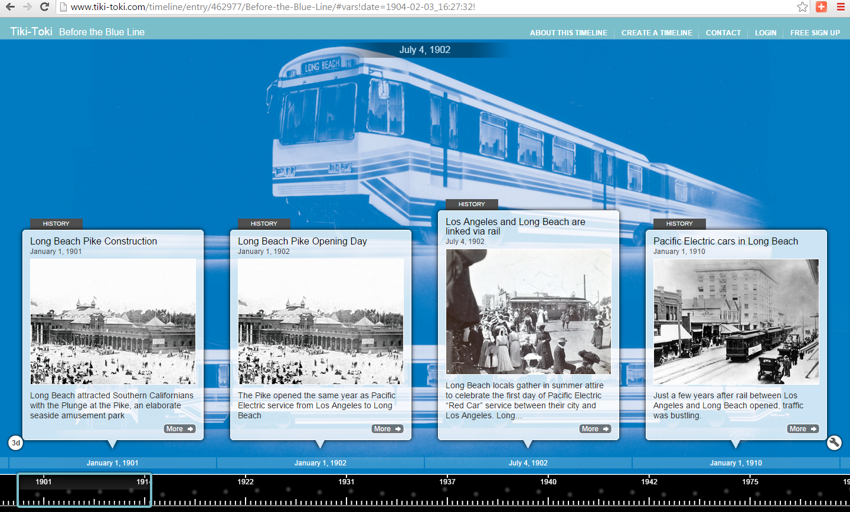
Collaboration &
Context Opportunity

Slide 21
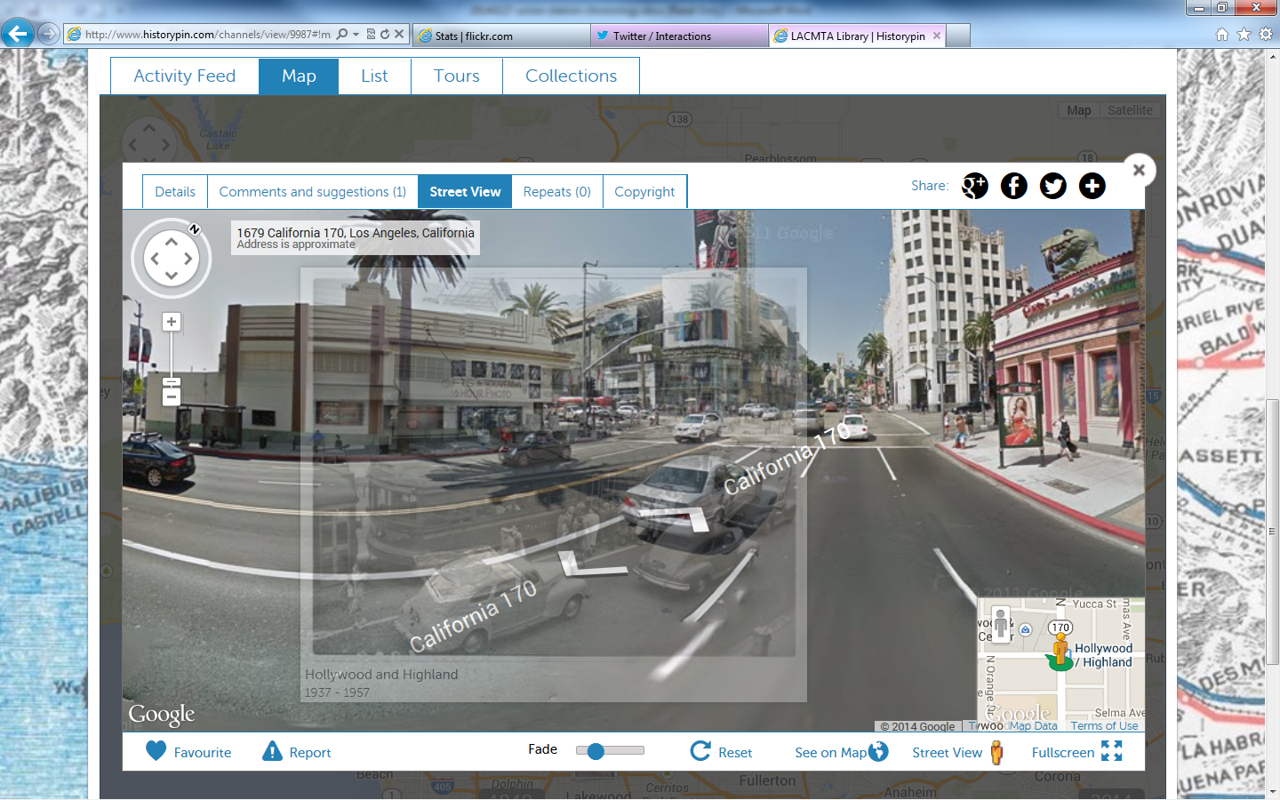
Ambient exo-library meets Augmented Reality

Slide 22
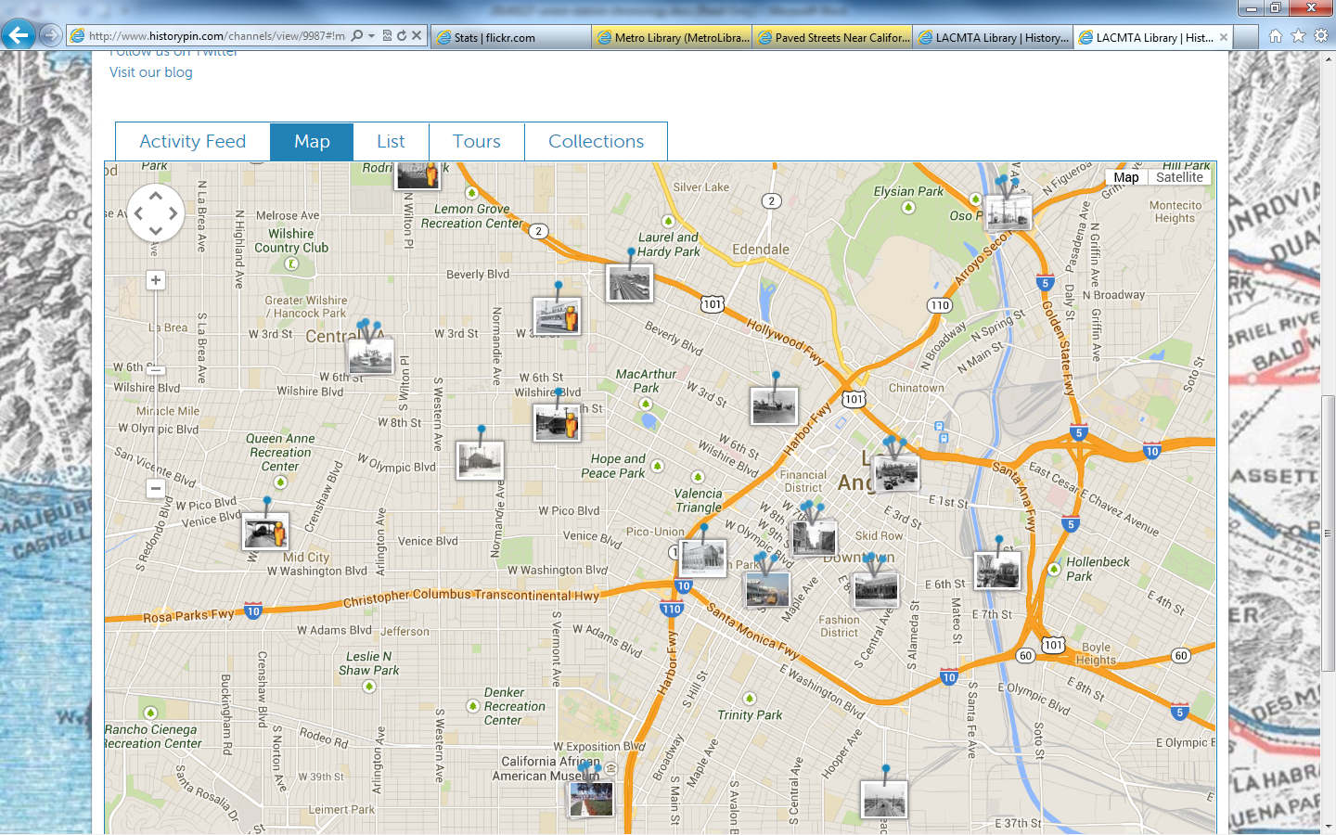
Robust collaboration opportunites

Slide 23
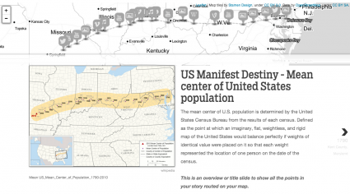
Collaborations & new tools

Slide 24
Thank you!
Kenn Bicknell
Digital Resources Librarian
Los Angeles County Metropolitan Transportation Authority
Metro.net/library
bicknellk@metro.net

