Slide 1
Touch Me Here:
Bringing Digital Resources to Public Interactive Kiosks
Kenn Bicknell
Los Angeles County
Metropolitan Transportation Authority
Library & Archive
August 28th, 2015

Slide 2
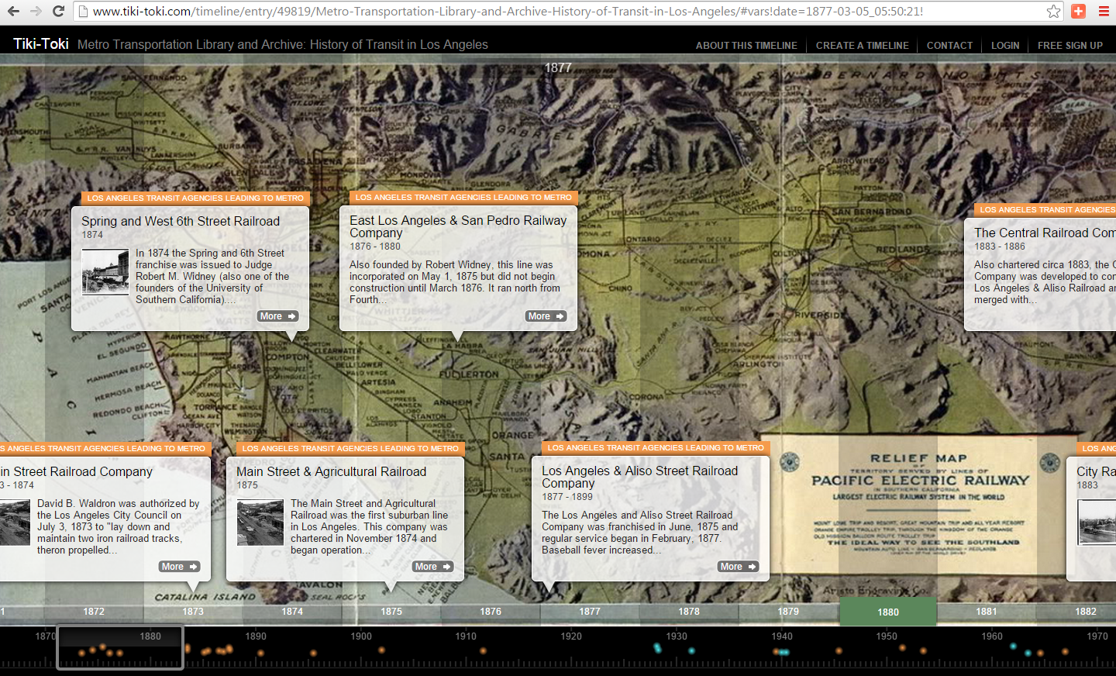

Slide 3
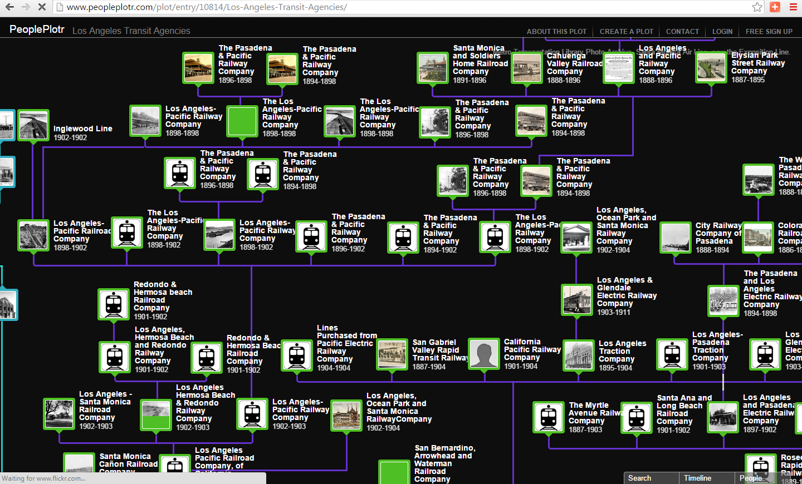

Slide 4
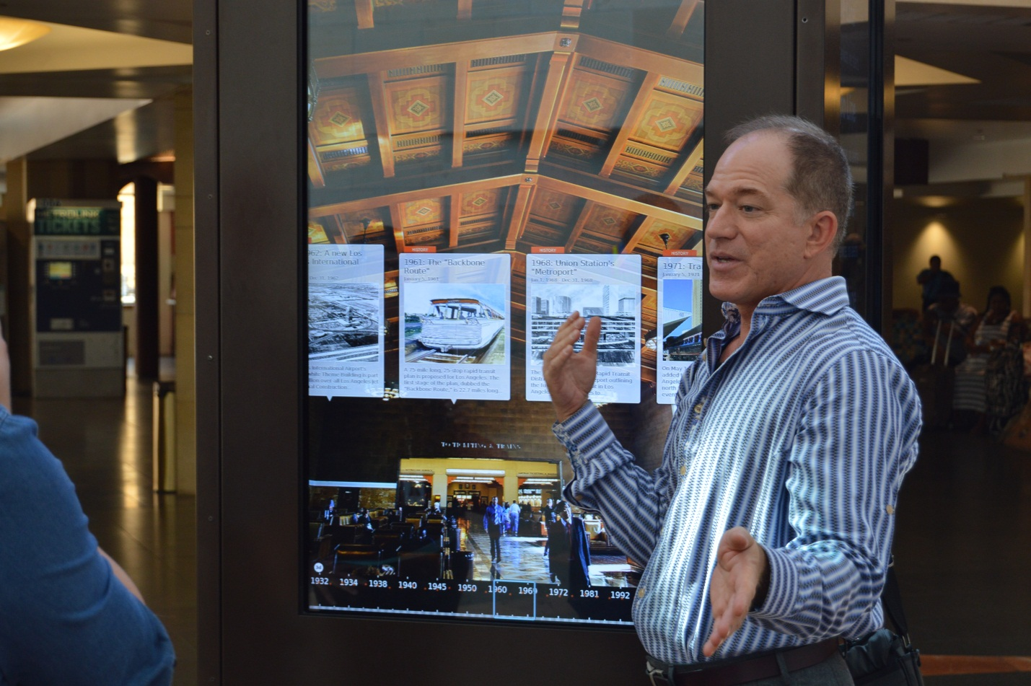

Slide 5
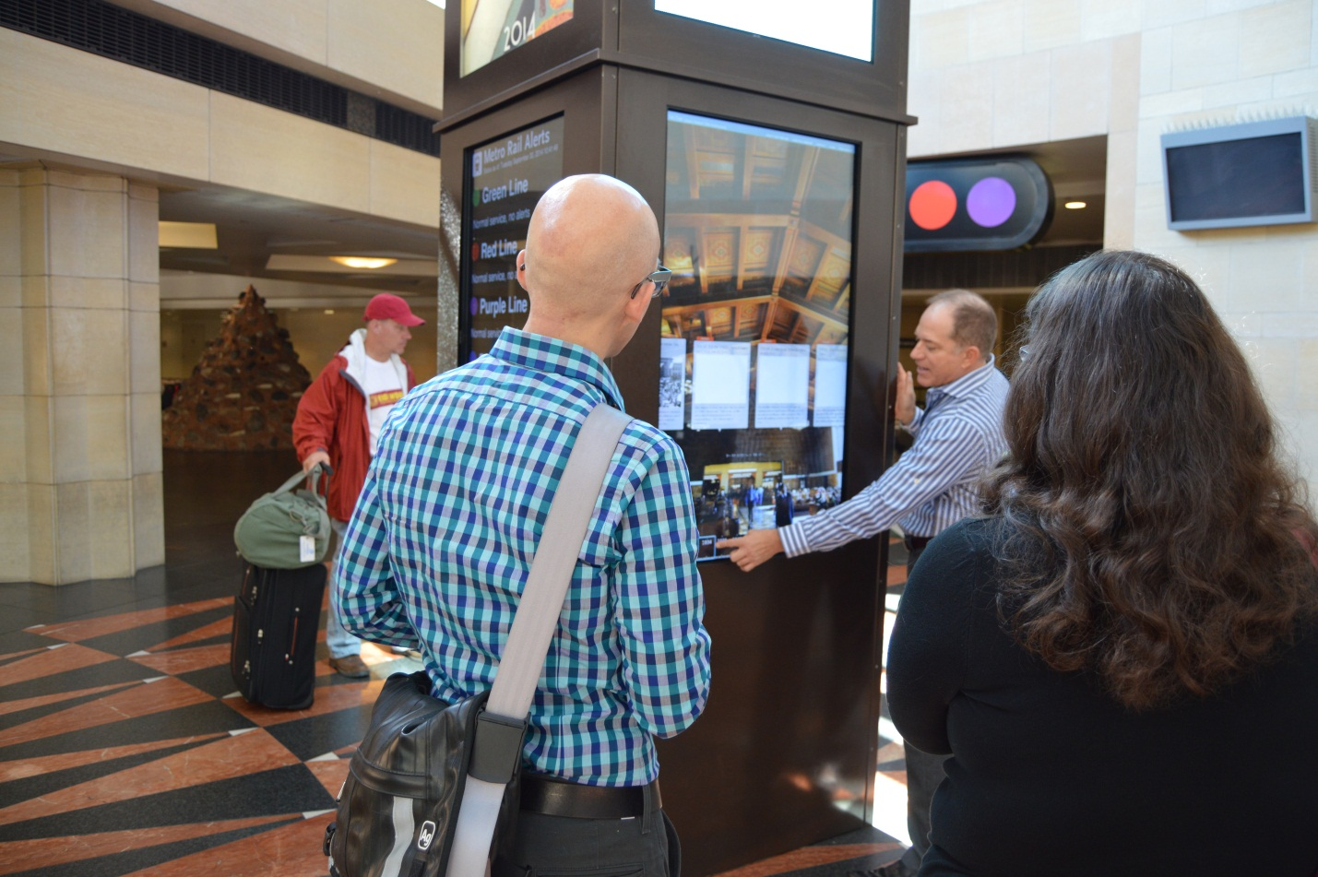

Slide 6
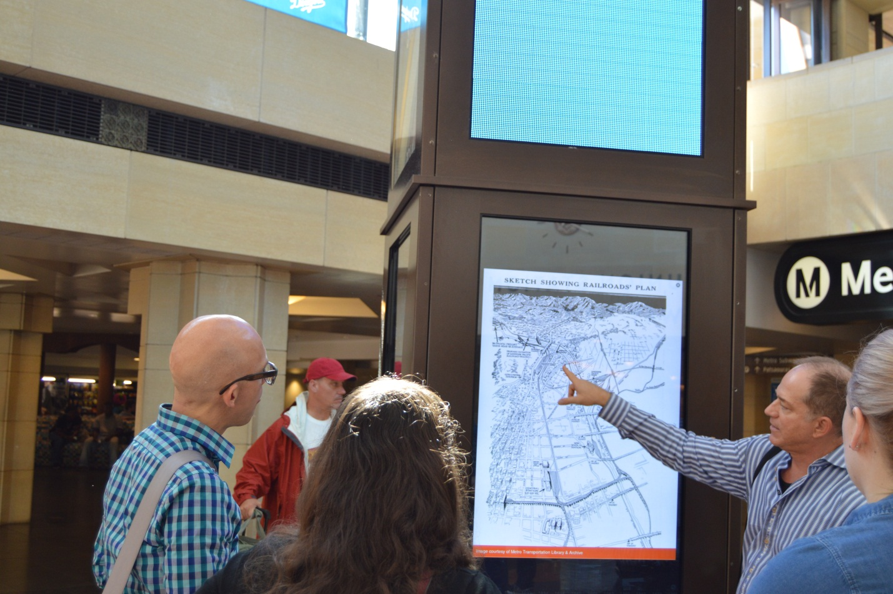

Slide 7
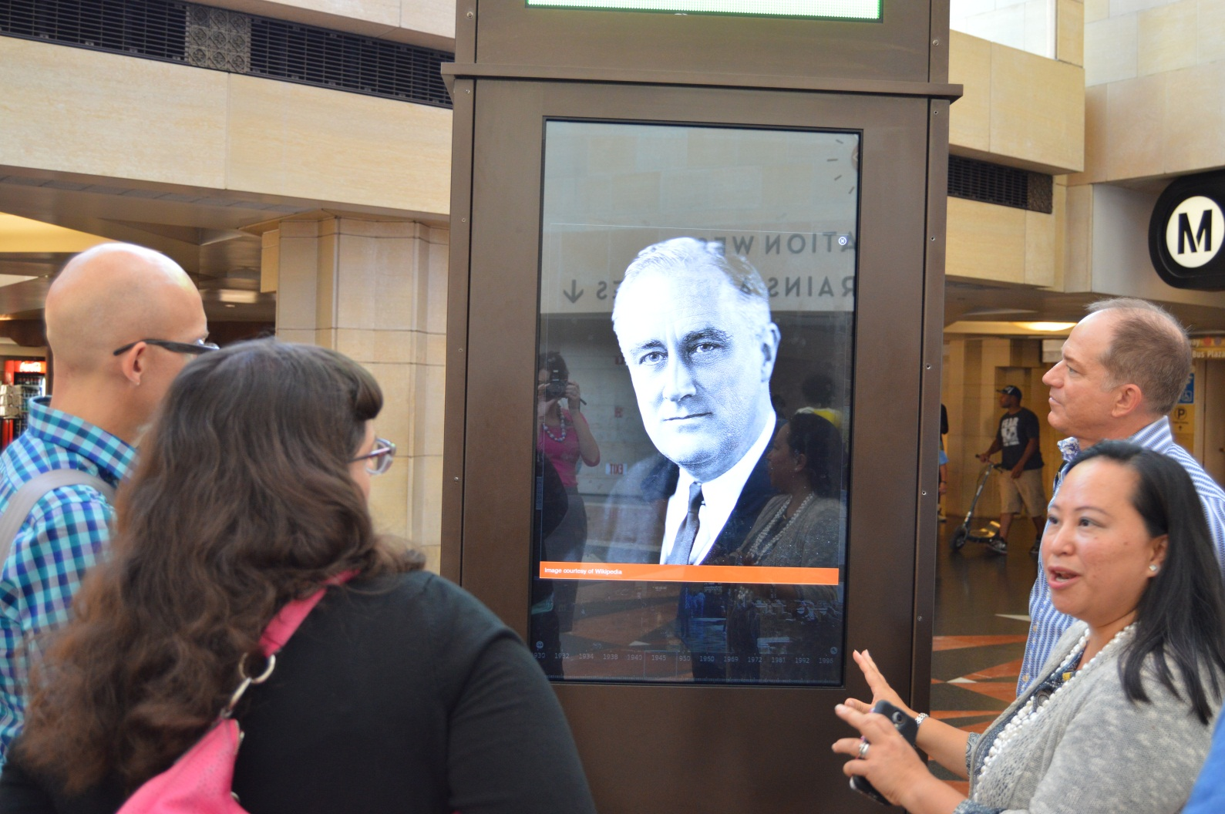

Slide 8
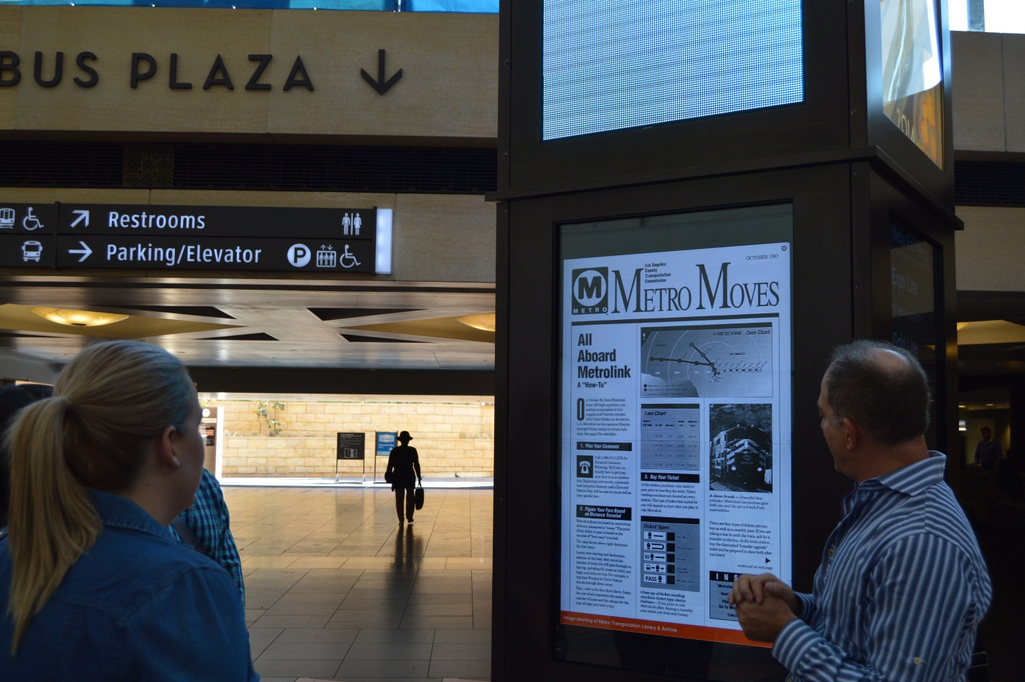

Slide 9
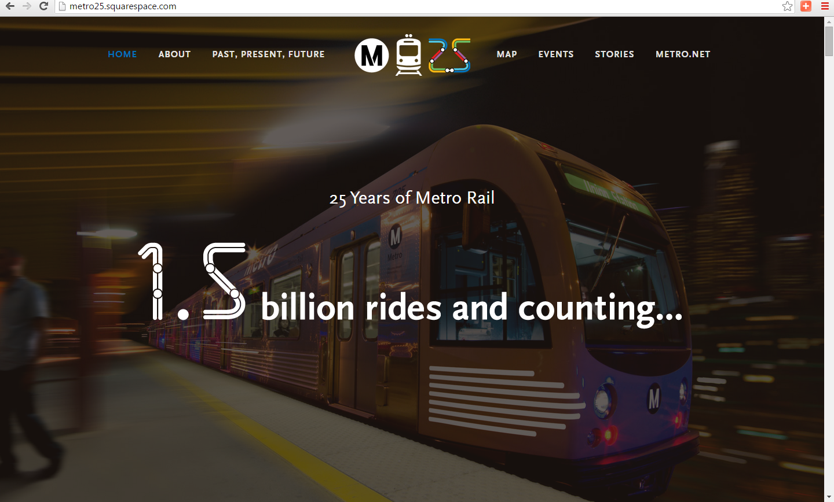

Slide 10
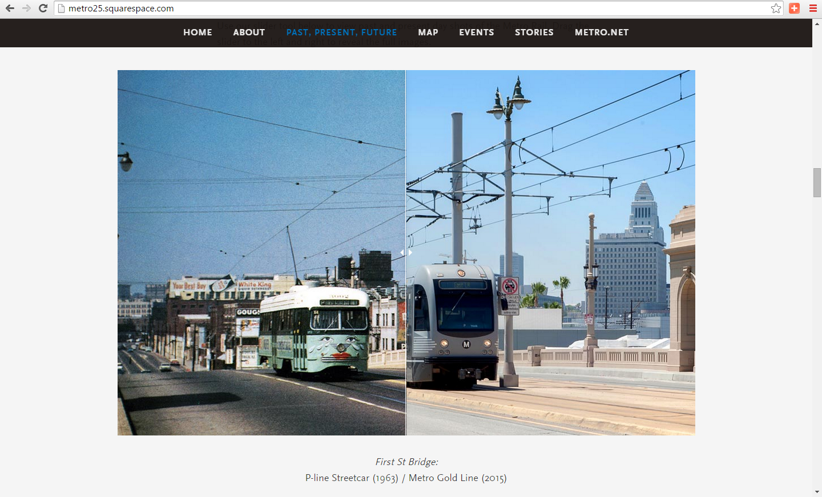

Slide 11
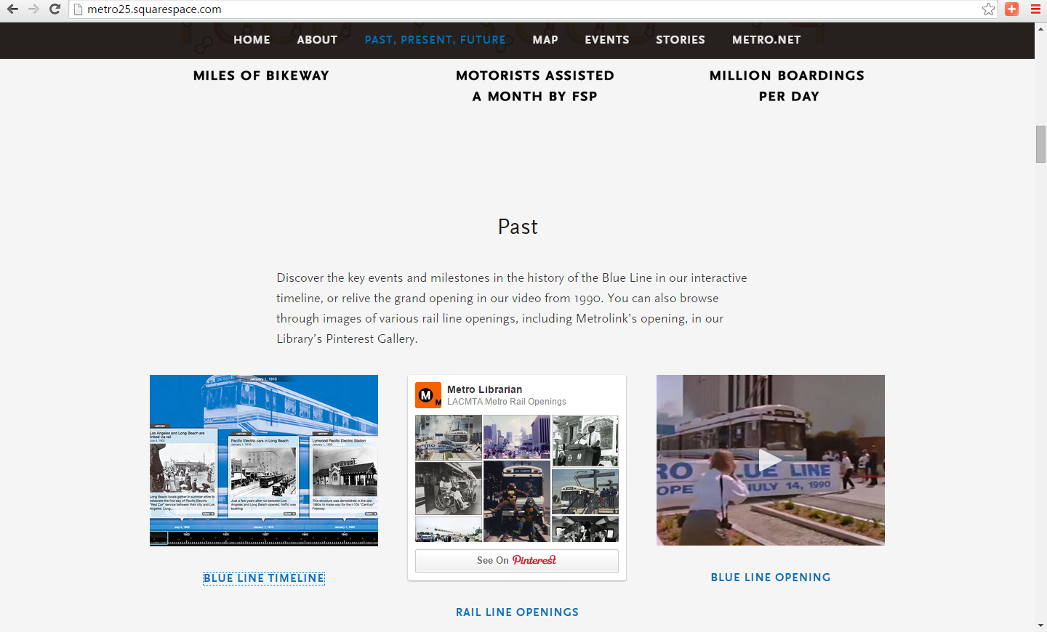

Slide 12
