Slide 1
C203: Digital Library Services & Preservation
Internet Librarian 2015
Kenn Bicknell
Digital Resources Librarian
Los Angeles County Metropolitan Transportation Authority

Slide 2
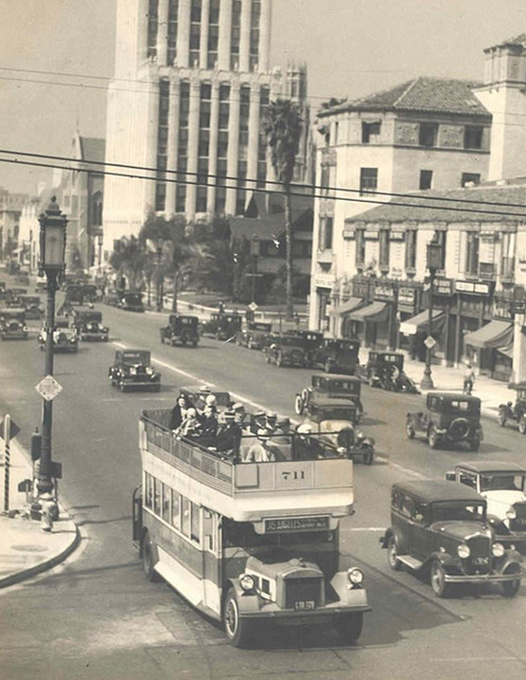
Challenge-Based Opportunties at The Metro Library

Slide 3
Engagement Strategies
NEWS AGGREGATION & DISSEMINATION
COMMUNITY CURATION
DIGITAL DATA ALCHEMY

Slide 4
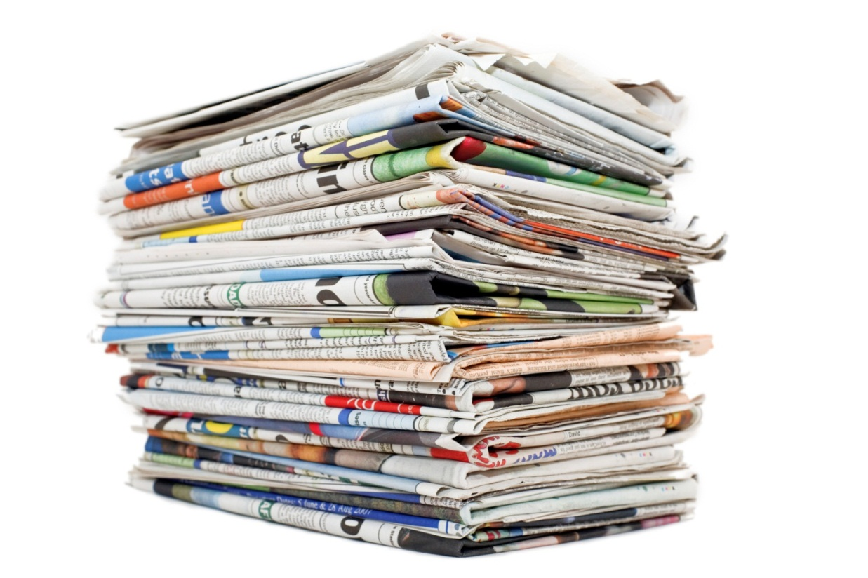
Online Newspaper: Library as Aggregated Information Channel

Slide 5
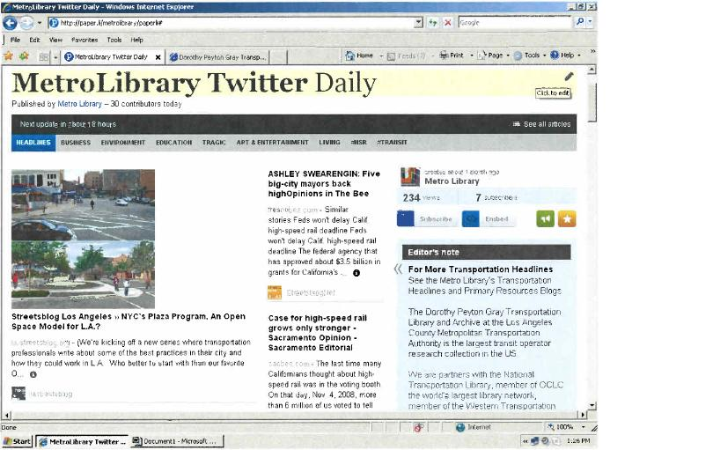
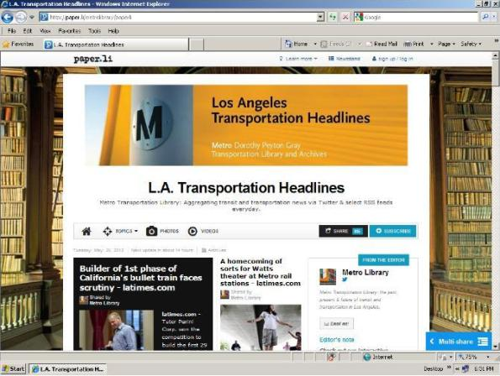
Creating a Newspaper including your own digital content

Slide 6
Community Curation: Themes
Local history advocacy
New(ish) technology tools
Beyond “traditional” social media
Calendaring
Storytelling comes alive
Exploiting embedded resources
Creative collaboration

Slide 7
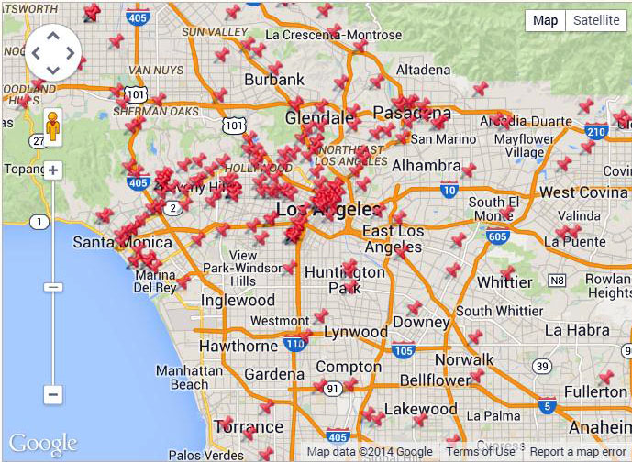
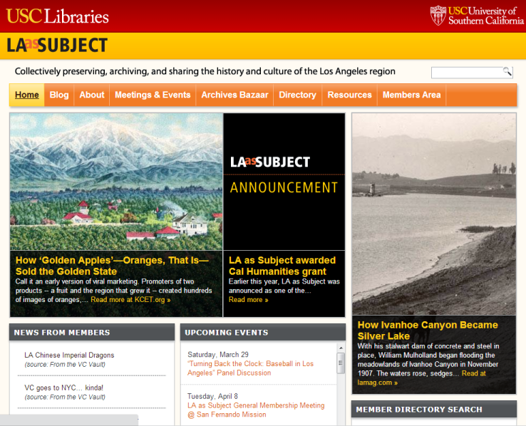
Local History Advocacy

Slide 8
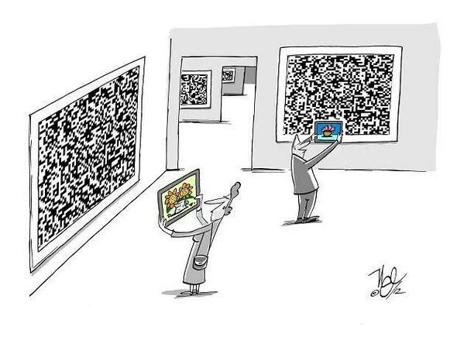
New(ish) Technology Tools

Slide 9
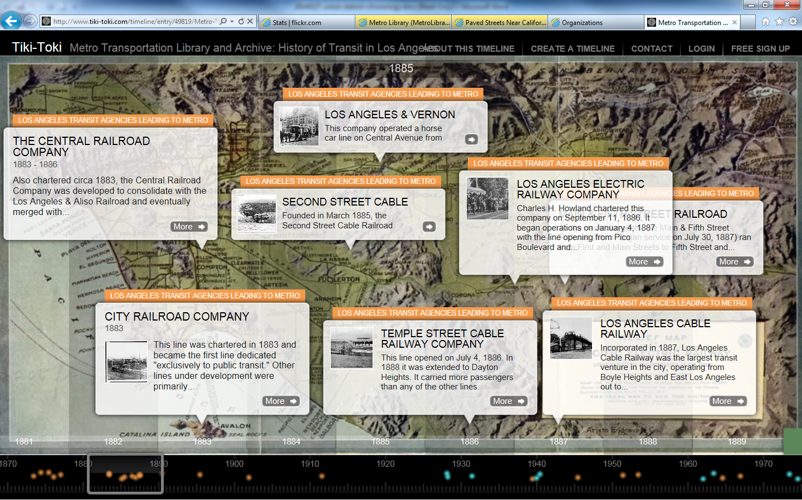
Interactive Timelines

Slide 10
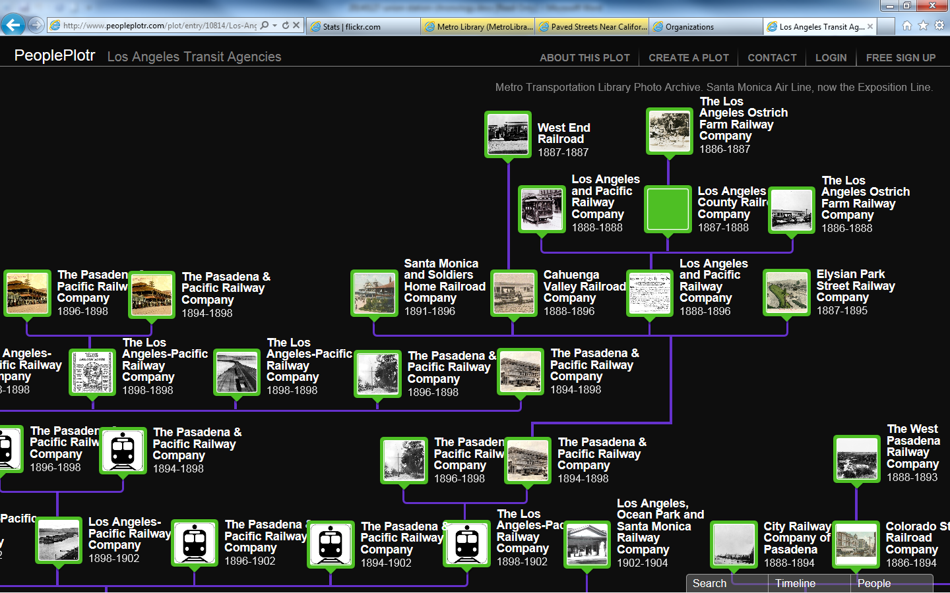
Interactive Timelines

Slide 11
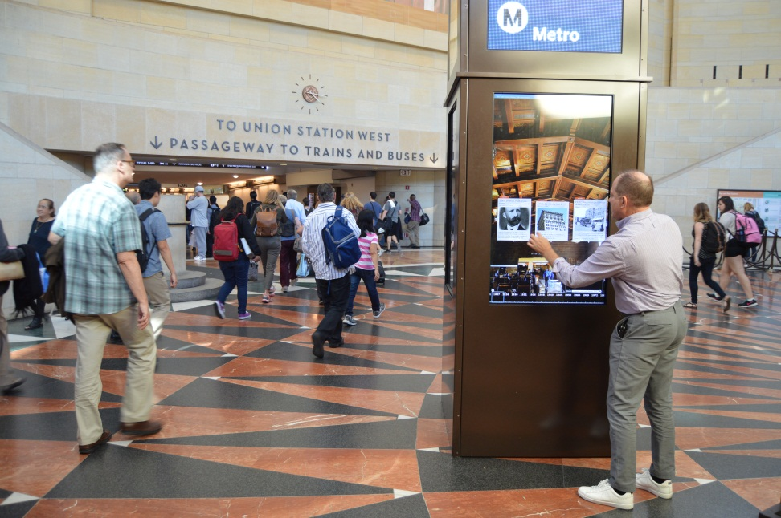
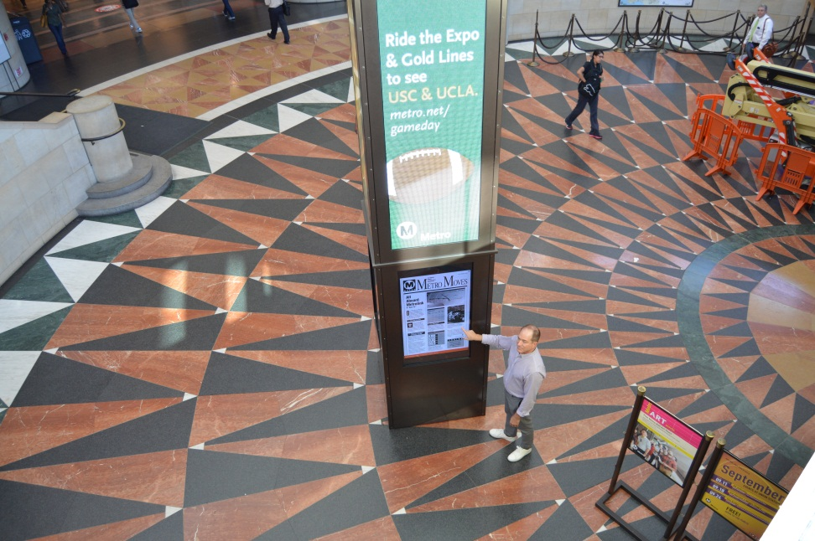
Interactive Timelines

Slide 12
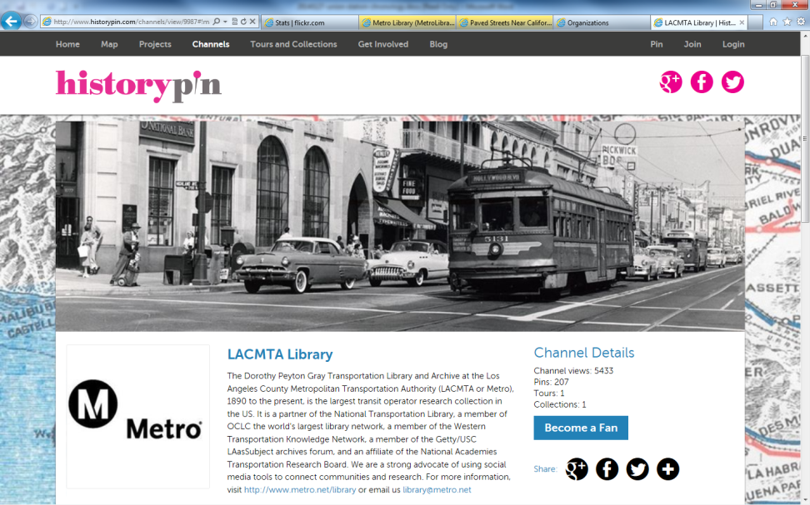
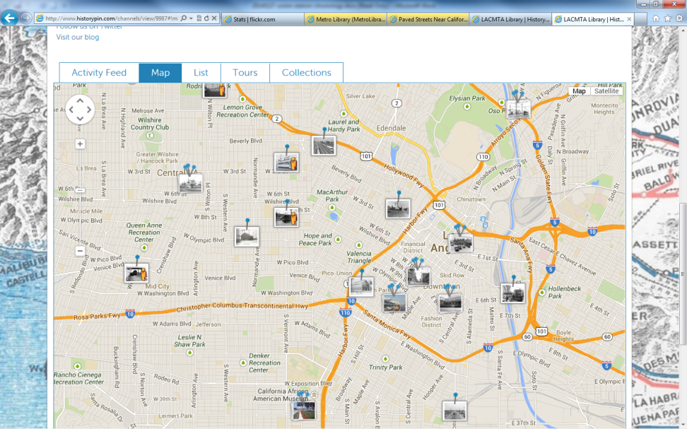
Beyond “traditional” social media

Slide 13
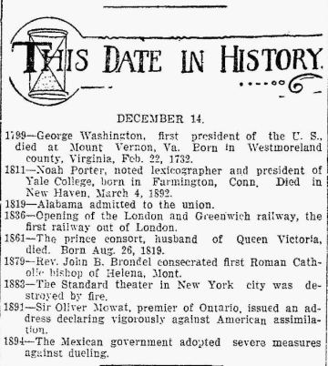
Calendaring

Slide 14
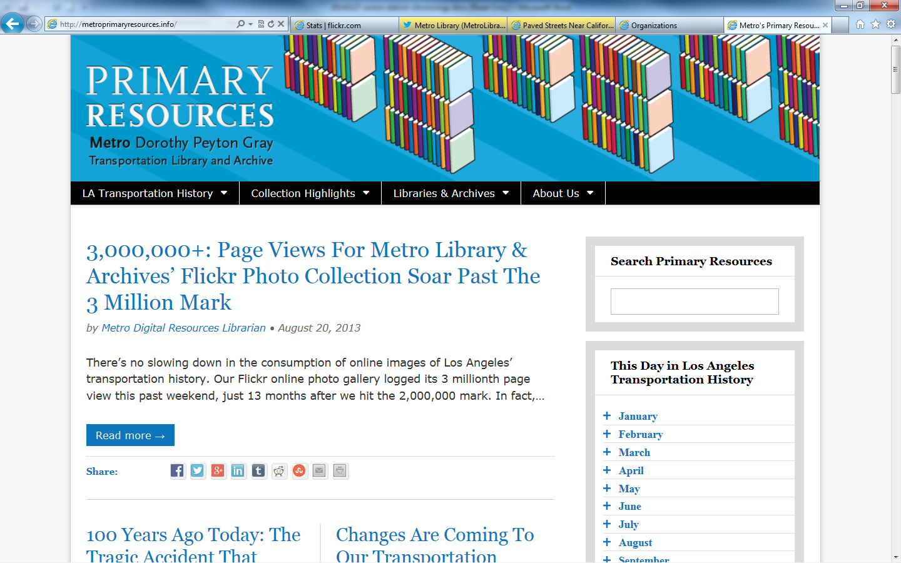
Online calendar

Slide 15
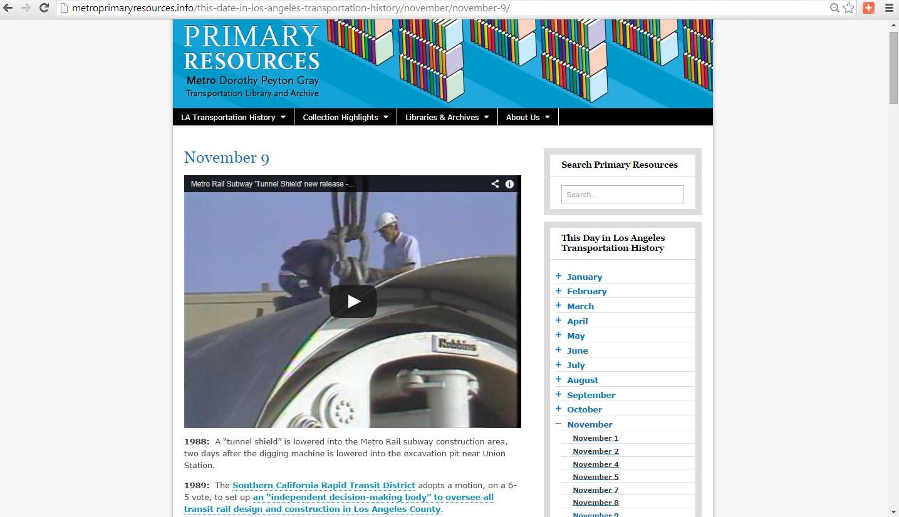
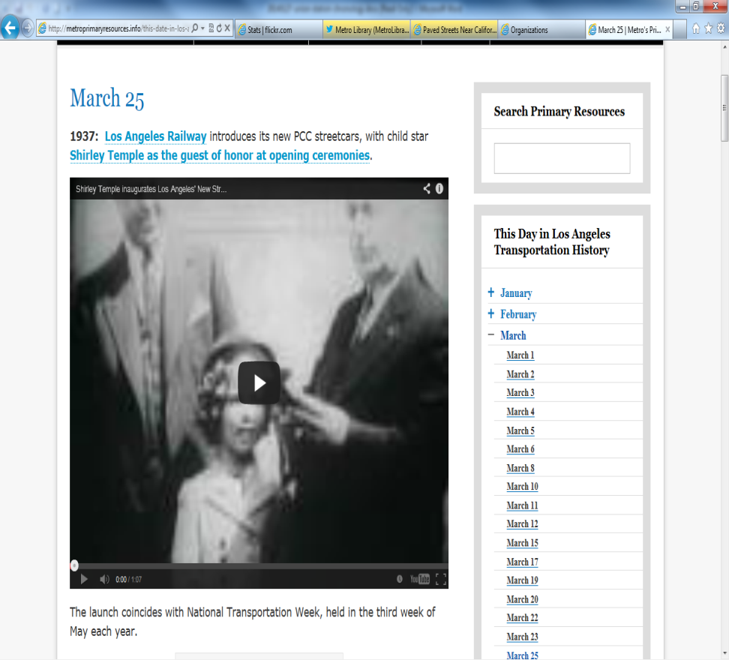
Sample Calendar Entries

Slide 16
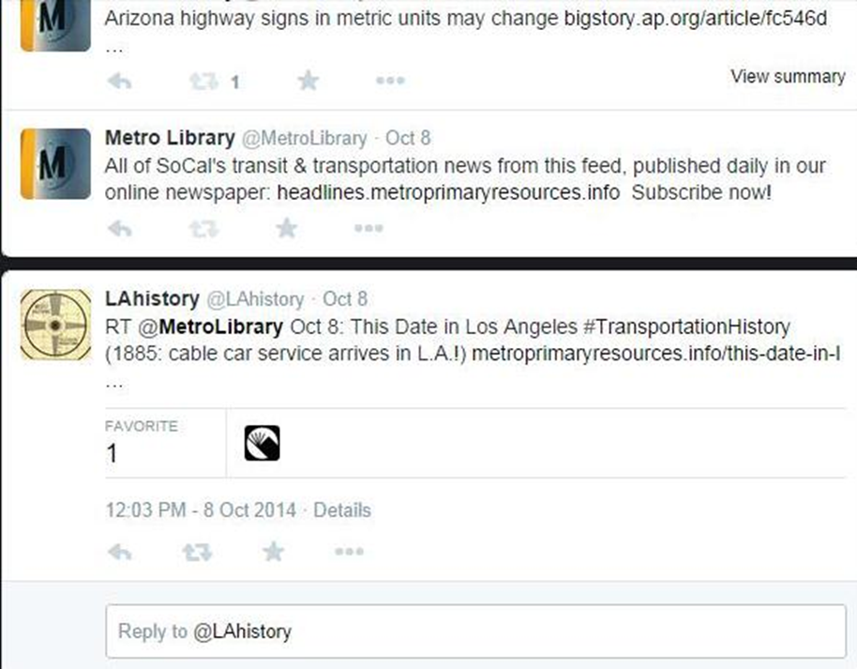
Local History Goes Viral

Slide 17
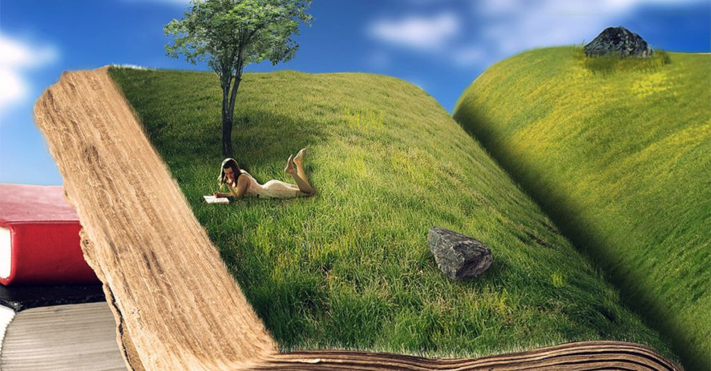
Storytelling Comes Alive

Slide 18
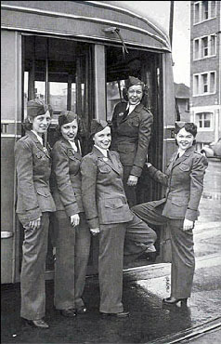
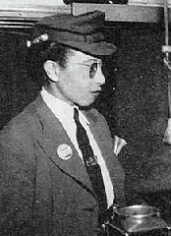
L.A.’s First “Motormanettes”

Slide 19
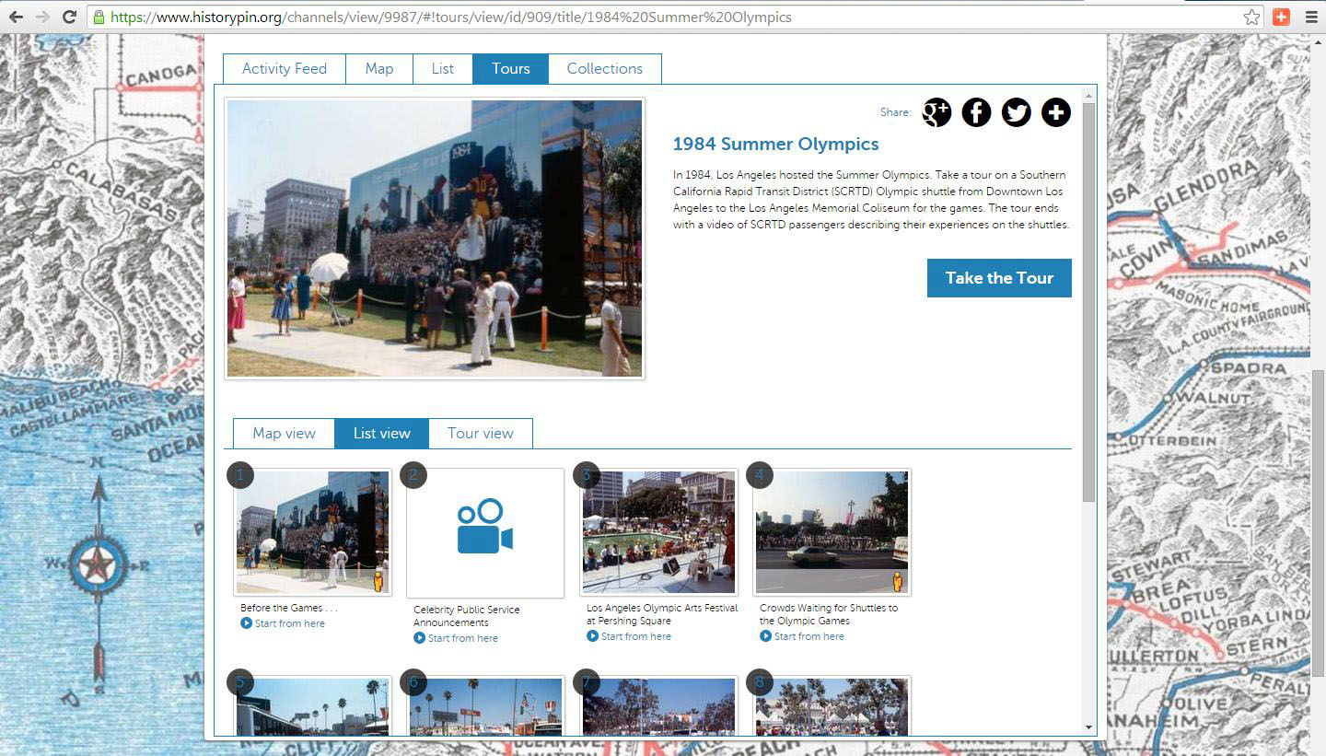
1984 Summer Olympics “Tour”

Slide 20
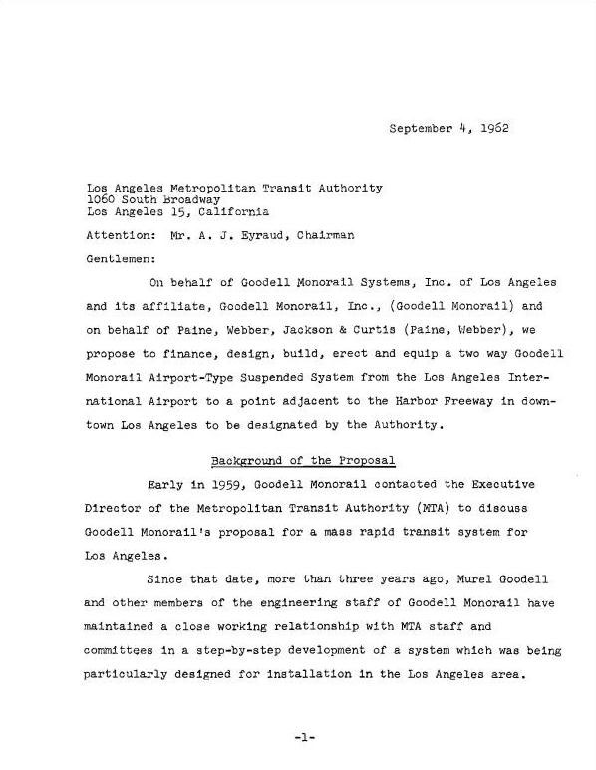
Exploiting Embedded Resources

Slide 21
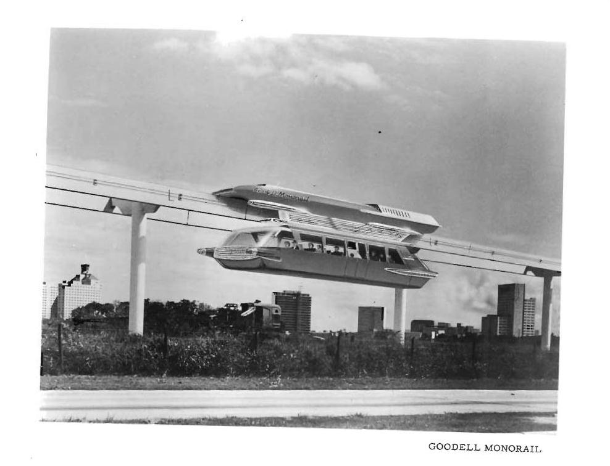
Goodell Monorail Rendering

Slide 22
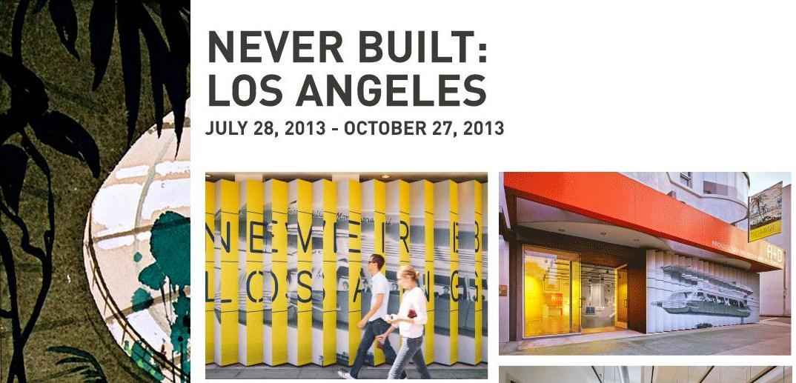
Taking Your Users Places &
Taking Your Library Places

Slide 23
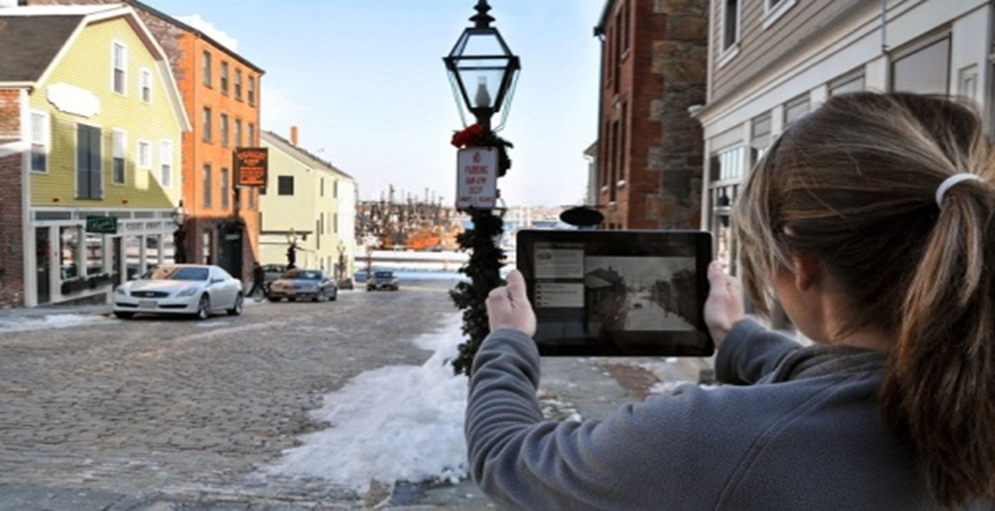
Creative Collaboration

Slide 24
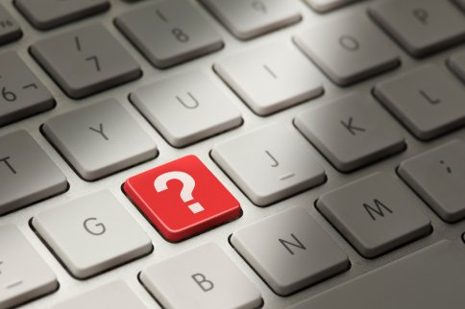
A Cautionary Tale…

Slide 25
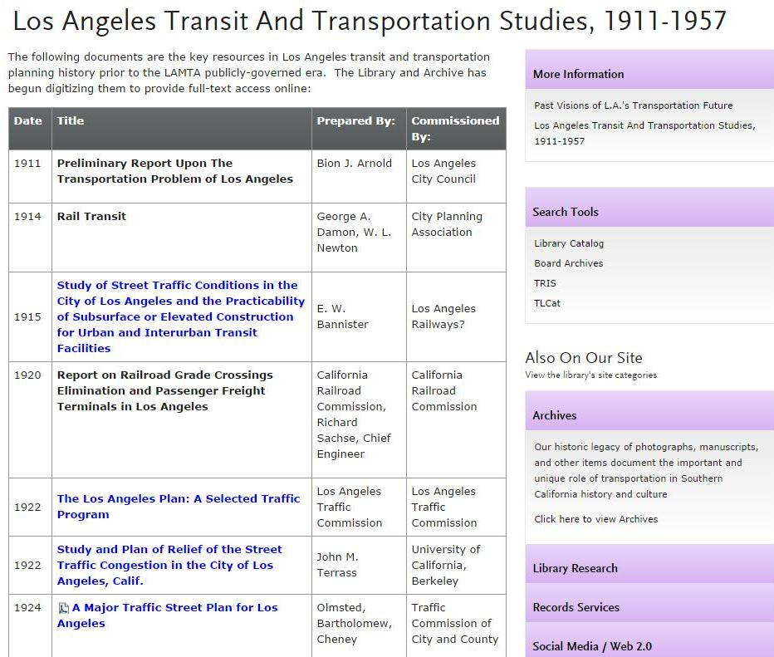
Los Angeles Historic Traffic Plans

Slide 26
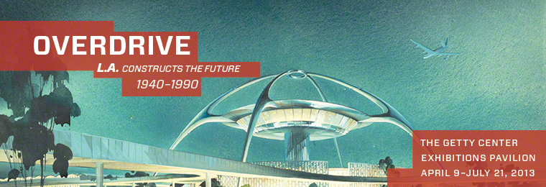
Getty Museum: Overdrive

Slide 27
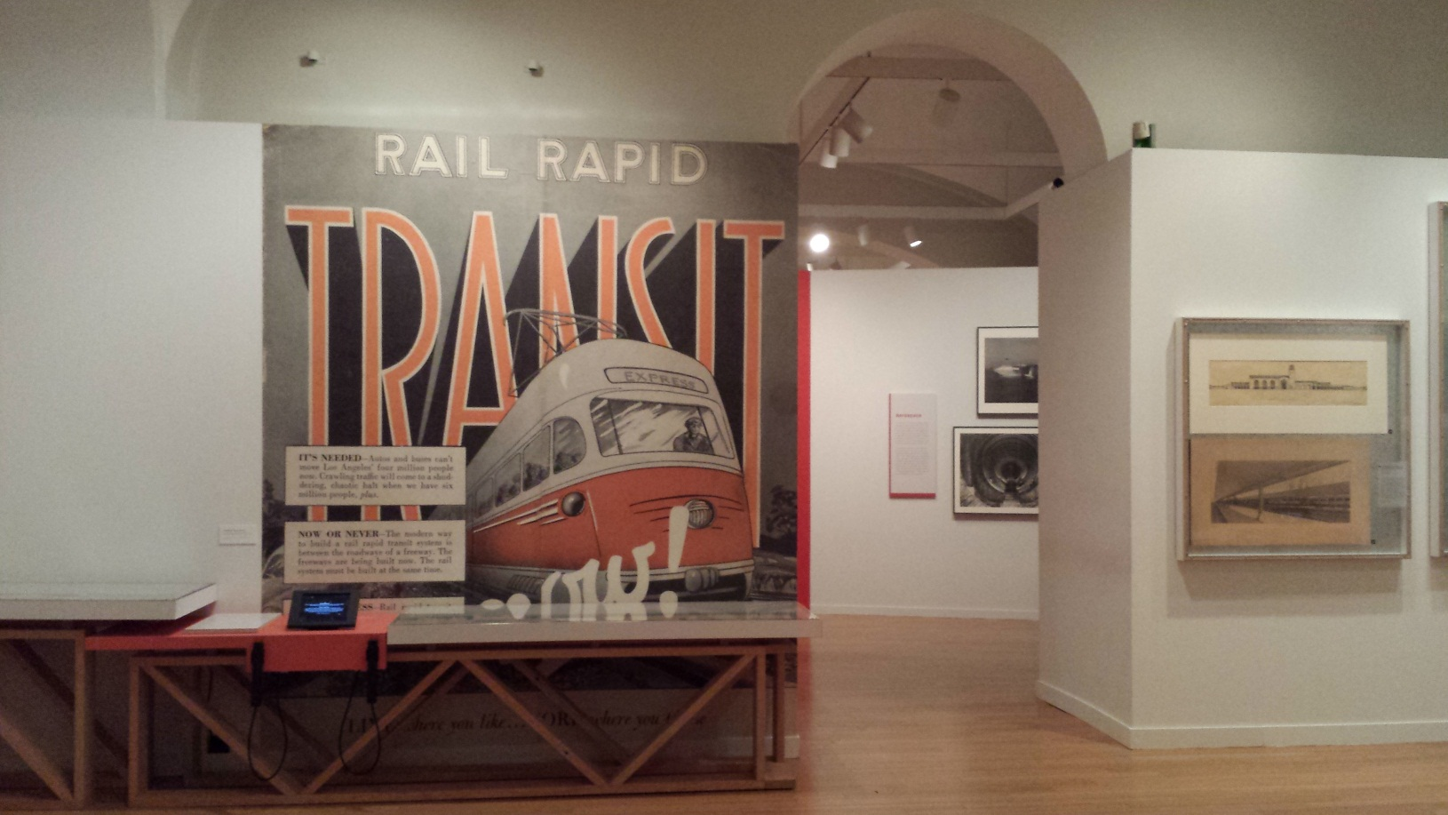
National Building Museum
Washington, D.C.

Slide 28
Resources
Our Website: metro.net/library
Our Primary Resources Blog (with “This Date in Los Angeles Transportation History”): metroprimaryresources.info
Daily Transportation Headlines: headlines.metroprimaryresources.info
L.A. as Subject: laassubject.org
Tiki-Toki timeline of Los Angeles transportation history: http://bit.ly/1bph9gz
PeoplePlotr family tree of Los Angeles transportation: http://bit.ly/1G9hFec
Our Flickr photo collection: https://www.flickr.com/photos/metrolibraryarchive/sets
Our YouTube channel: youtube.com/user/metrolibrarian
Our Tumblr page: lacmtalibrary.tumblr.com/
Our Historypin site: https://www.historypin.org/channels/view/9987/#!photos/list/
Our Twitter: @MetroLibrary
Anything else, just ask me! bicknellk@metro.net

