Slide 1
Video Surveillance
Matthew Barrett, Transportation Research Library, Archive & Records

Slide 2
Los Angeles County Metropolitan Transportation Authority
Transportation Library began in 1895 via Henry Huntington’s Los Angeles Railway
Nation’s Largest Transit Operator Research library
National Academy of Sciences’ Transportation Research Board Affiliate
National Transportation Library Partner
Member Western Transportation Knowledge Network
Member National Transportation Knowledge Network
Staff memberships in SLA, ARMA, ALA, and SAA
Research Library, Archive and Records Management Center
50,000 items catalogued in EOS ILS,
75,000 Inactive Records boxes indexed, stored at Iron Mountain
Millions of pages digitized, Oracle URM and SharePoint
5 employees with MLIS
3 employees with NARA certification
3 employees dedicated to scanning
1 employee dedicated to box management with Iron Mountain
New Electronic Records Management function for E-Discovery, Federated search and more

Slide 3
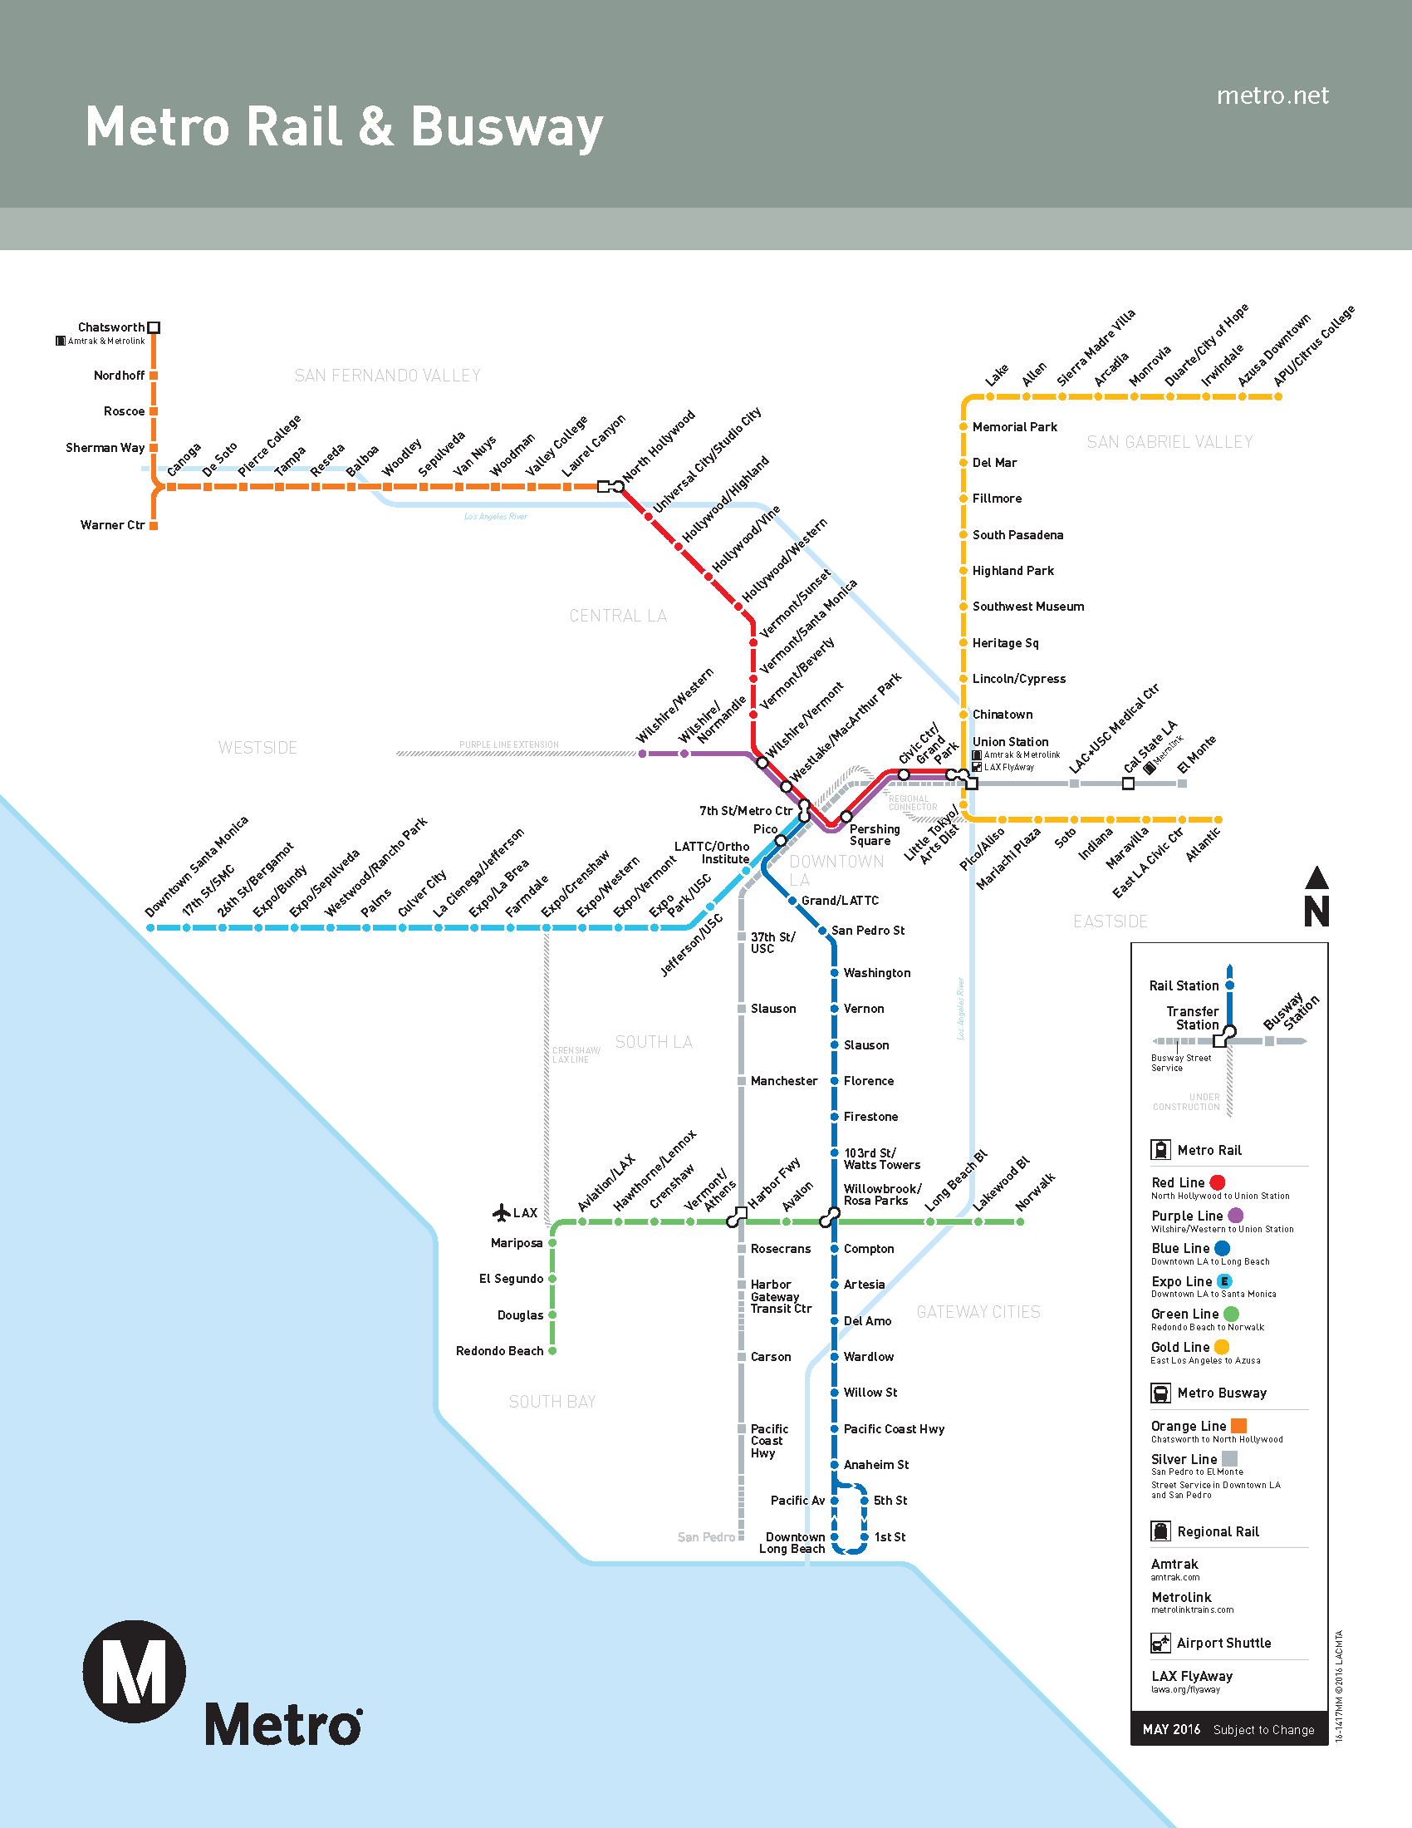
Los Angeles County Metropolitan Transportation Authority
Annual Budget = $5.6 Billion
9,892 Full Time Employees
Transit Service Area = 1,433 square miles
11 Bus Operations Divisions
170 Bus Routes
15,967 Bus Stops
2,228 Buses
6 Rail Operations Divisions
100 Rail Stations
105 Rail Service Miles
250+ rail cars
4 Light Rail Lines
2 Subway Lines
1 Central Cash Processing Facility
539 Carpool lane miles
123 tow trucks patrolling 475 freeway miles
64 miles of Bike Routes

Slide 4
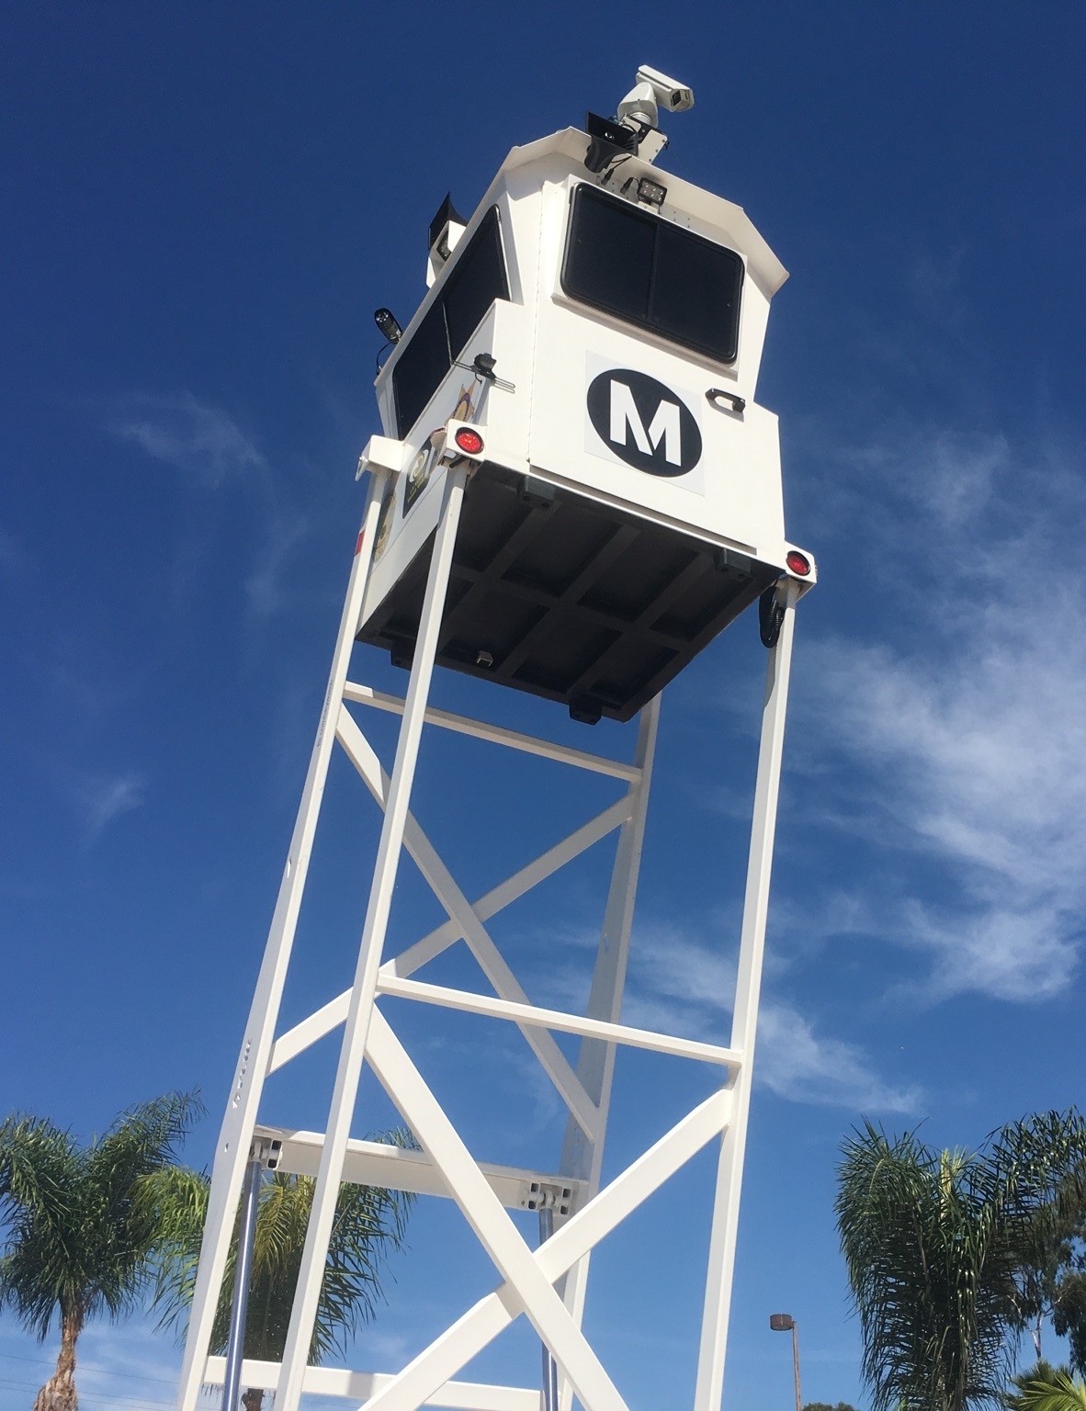
Rail Station Video
Red/Purple Lines: 320 cameras (20 cameras per station/mezzanine area, total of 16 stations/mezzanine areas)
Blue Line: 220 cameras (10 cameras per station, total of 22 stations)
Green Line: 168 cameras (12 cameras per station, total of 14 stations)
Gold Line: 190 cameras (10 cameras per station, total of 19 stations)
E. Los Angeles Gold Line: 80 cameras
Expo Line: 170 cameras
Orange Line: 147 cameras
Rail Station Cameras = 1,295

Slide 5
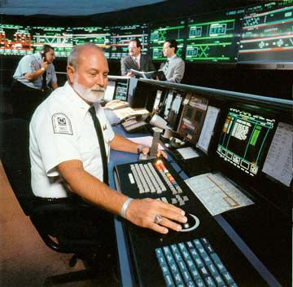
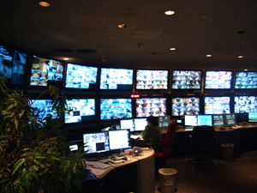
Rail Video Monitoring
Central Rail Operations Control Center
Live monitoring and DVR Recording of Incidents stations/on-board

Slide 6
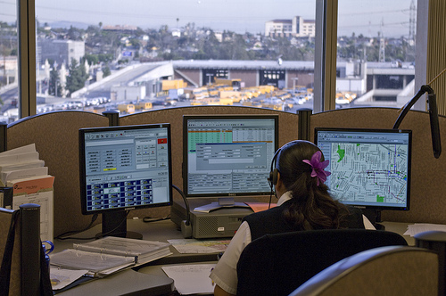
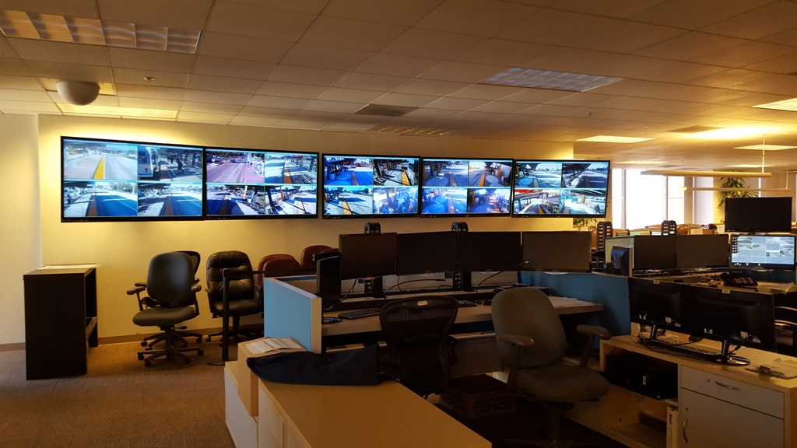
Bus Operations Control Center
Live CCTV monitoring of the Orange Line
DVRs on all 2,228 buses for reported incidents
6-10 cameras per bus depending on bus size
Downloaded incidents held for 24 months

Slide 7
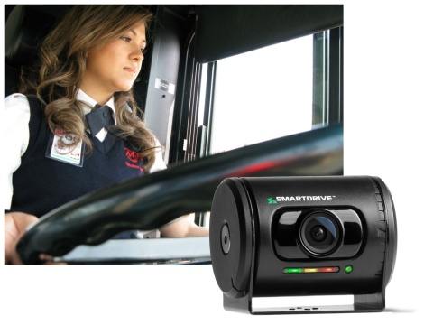
Smart Drive – 2 additional video cameras
G-Force and manually activated video camera system
Records Operator Cab area and in-front of bus
Auto Classification of incidents Tracks all 4,500 Operators of 2,228 buses
Video incidents forwarded daily to management for review and evaluation
Reduction in Worker’s Compensation Claims, Reduction in Liability in vehicle accidents
Increase in disciplinary actions including terminations
Being installed on trains now

Slide 8
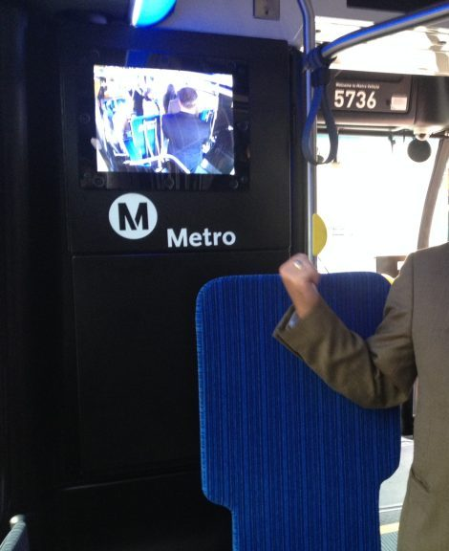
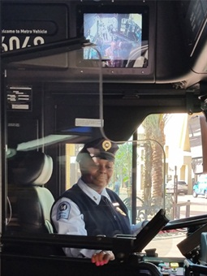
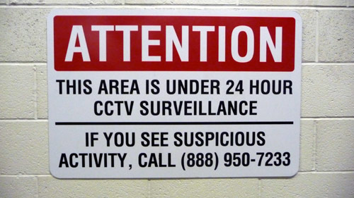
Bus Video – new approaches
Color
Audio
Wifi

Slide 9
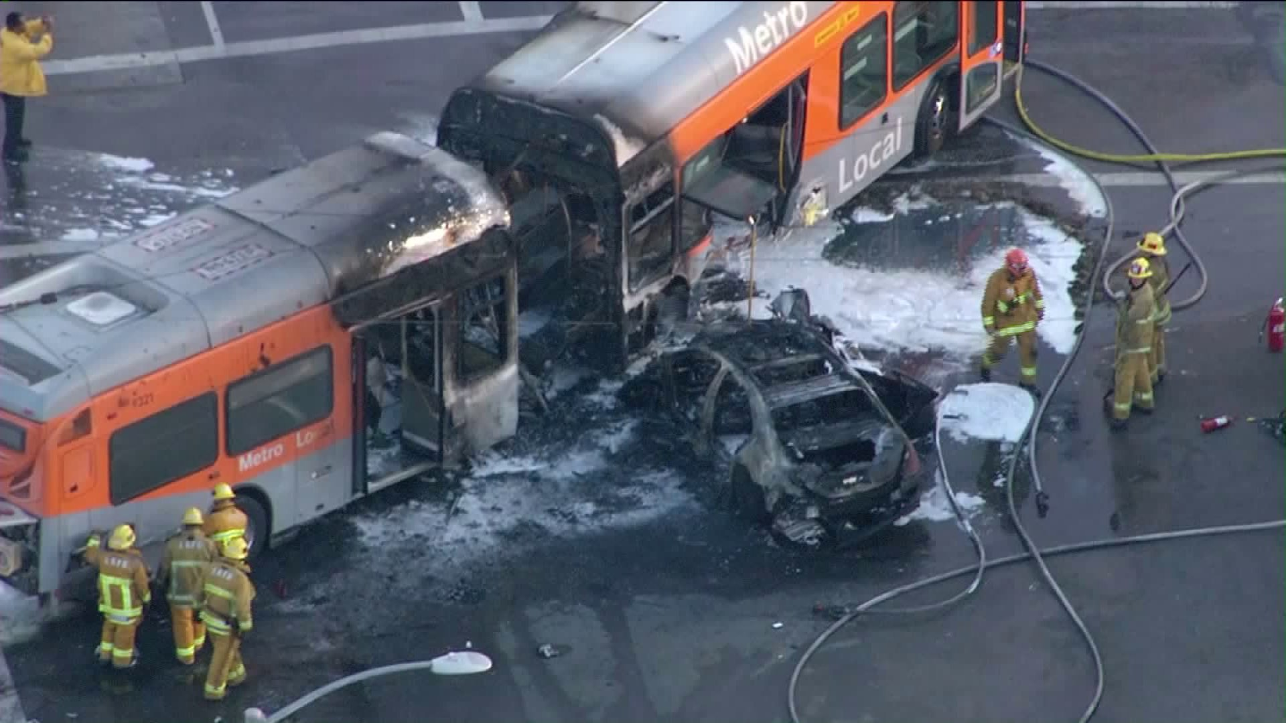
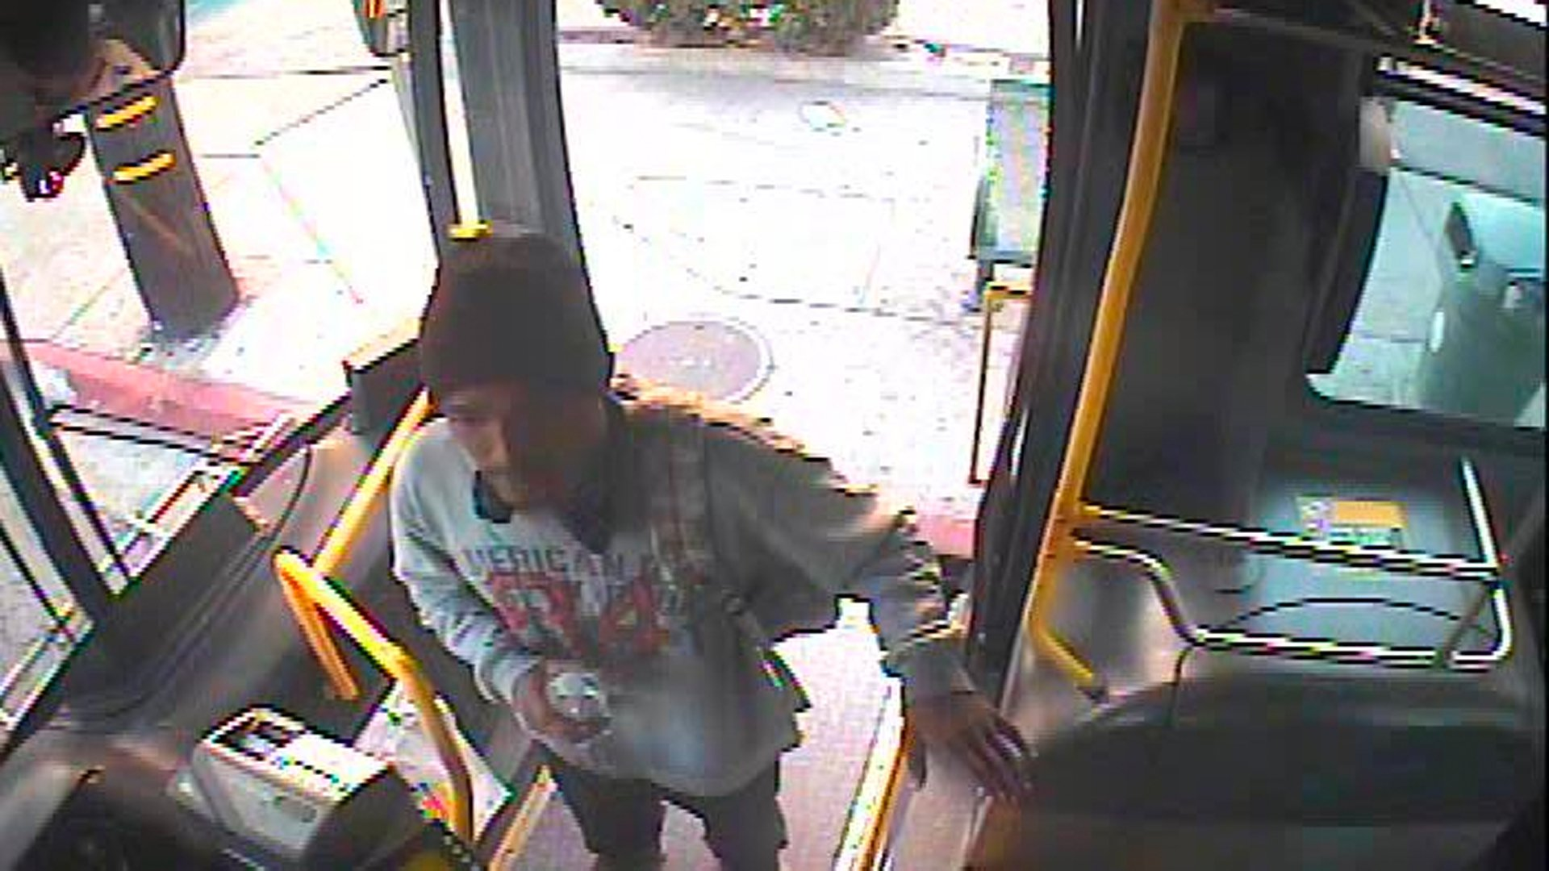
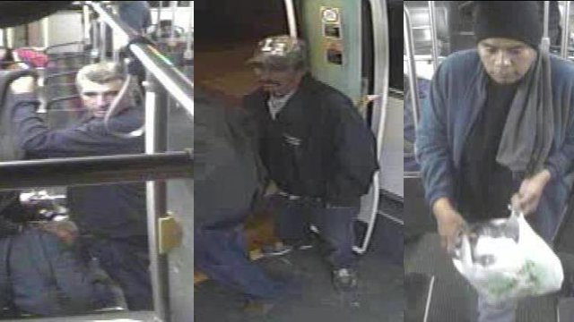
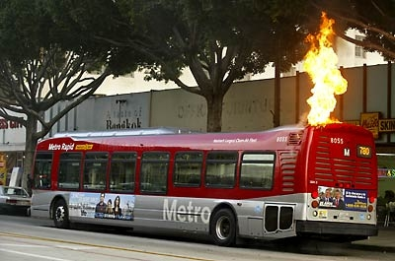
Intense efforts on video surveillance
Risk Management, liability, safety, security, accident investigation, liability, training, graffiti, and vandalism

Slide 10
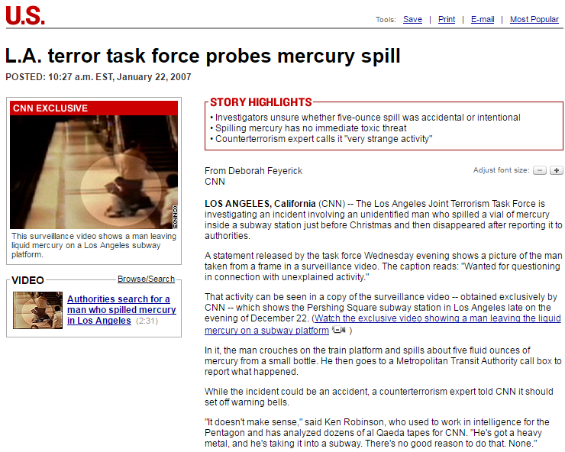
Video – Unauthorized Release?

Slide 11
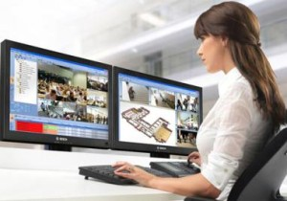
Video Management
Currently manual old school “chain of custody”
Moving to automated Digital Incident Management System, Wi-Fi downloading at end of day vehicle pull-in
24,000 DVR Incidents annually on average, bus only
Frequent upgrades to technology for efficiencies
Homeland Security Funding Grants

Slide 12
http://metro.net/library
http://headlines.metroprimaryresources.info
http://metro.net/records
http://lametro.nextrequest.com
barrettm@metro.net
library@metro.net

