Slide 1
Los Angeles County Metro
How can SB 272 inventories be useful
October 7, 2016
Matthew Barrett
Administrator,
Research & Records
Notes:
It is an honor to be with you today. I am Matthew Barrett and I run Metro’s Transportation Research Library, its historical archives and its Records Management function. I have been with the organization since 1991. While working for Metro, I earned by MLIS from UCLA’s graduate school of library and information studies in 1999. I have run the Metro Transportation Research Library and Archive since 2001, and added responsibility for Records Management in 2009.

Slide 2
L.A. Metro Background
FY17 Annual Budget = $5.6 billion
9,776 total FTEs
Planning, funding, construction and operation of transportation programs throughout LA County, + regional coordination
Centralized Records Management Center housed with Southern California’s largest (and only) transportation research library and archive, under ITS, as a direct report to the CIO
http://records.metro.net
http://metro.net/library
Notes:
Metro is a very large organization spread across 40+ facilities throughout LA County in addition to its headquarters at Union Station.
It runs a massive public works program funding by three separate countywide ½ cent sales taxes adopted by voters in 1980, 1990, and 2008.
The Transportation Research Library has cataloged about 50,000 items, the archive contains about 60,000 items, and Records Management currently has about 70,000 boxes in in-active storage.
Metro mastered its paper records management program a long time ago and has been adjusting its work with the rise of born digital information and data.
We have been digitizing documents since 1996 and now have millions of document images. More and more unstructured data is living a digital life along with structured data contained in our systems and applications. In 2015 we started a separate Electronic Records Management section of records management to tackle the challenges of e-discovery, legal holds, born digital information, auto classification, and the inevitable need to use artificial intelligence to accomplish more of our work.

Slide 3
From http://metro.net/records
Outreach: Posted key elements of the legislation on our website along with the inventory.
Screenshot:
Link: SB272 System Inventory Online
Notes:
We closely watched the data and electronic records initiatives of the past few legislative sessions. It was clear from the introduction of the SB272 that it was much more likely to garner support that prior efforts.
As is moved through committees with almost no opposition, we began holding internal meetings with Counsel, our government relations staff, ITS, and Metro’s web team to be prepared in advance.
Once the bill was signed into law, we worked with ITS and their asset inventory to identify systems that met the criteria of the SB272.and listed over 120 data sources.
We posted Metro’s SB272 inventory to the records website along with the definitions contained in the legislation.
At the time, Metro was undergoing an IT security evaluation by an outside firm headquartered in another state. The consultants found this legislative requirement surprising and interesting.

Slide 4
Brief Timeline: Digital & Data Records Online
2003 – Board Archive (1952-present)
2004 – Employee Newsmagazines (1920-present)
2005 – Social Media/Blog sites for distribution
2006 – Photographs (1874 – present), Films, Video
2008 – Data Sets on http://developer.metro.net
2009 – Records webpage, online request form
2010 – Digitized board audio files
2014 – Live webcasting/archiving board meetings
2015 – Granicus/Legistar legislative management
2016 – NextRequest & Councilmatics, Google Fusion Tables, SB272 Inventory
Notes:
Metro’s Research Library and Records Management staff have been working toward greater transparency and online accessibility to agency records and information for a long time now, starting with the wholesale digitization of the Board of Directors archive spanning more than 50 years.
Our records policy defines 10 special categories of records that may require legal review and possible redaction, but for the most part, we provide records as requested, and proactively catalog and make available records and data we believe to be most valuable to our constituents and customers.
The availability of Metro Librarians and an Archivist is especially helpful to students, researchers and community groups in gaining an understanding of the volumes of data contained in various Metro reports and data systems. We assist with curation and context to ensure users can understand the information and how it is used.

Slide 5
How can SB 272 inventories be useful?
Allows public to inform us of desired data sets online
Encourages inter-governmental cooperation
Drives both government & private innovation
Supports academic endeavors & scholarly research
Supports all levels of the business community
Encourages solicited & unsolicited proposals/solutions
Renews original 1968 commitment to transparency
Can level the playing field between physical records and electronically stored information by giving the public similar access to data that state and federal courts currently have via E-Discovery laws
Notes:
We sincerely hope that making the systems we use and the kinds of data we collection available to the public via the enterprise systems inventory will lead to discovery, cooperation, innovation, and better relationships between governments and constituencies.
The library staff have worked with local universities and colleges to provide GIS data sets, ridership data and passenger survey data for many years. The wider exposure of our enterprise data systems should assist in more academic study of Metro and what it delivers in LA County for the tax dollars it takes in.
Metro is swimming in vast streams of data that could easily be leveraged by others. An example would be the real time automatic passenger counting system data. An enterprising app builder may want to tap into this data stream and help inform transit users as to how full or empty an approaching bus or train might be.
Metro’s office of extraordinary innovation oversees our unsolicited proposals policy. Having our enterprise inventory and by extension the data sets from those enterprise systems available to records requestors can inform and strengthen such proposals.

Slide 6
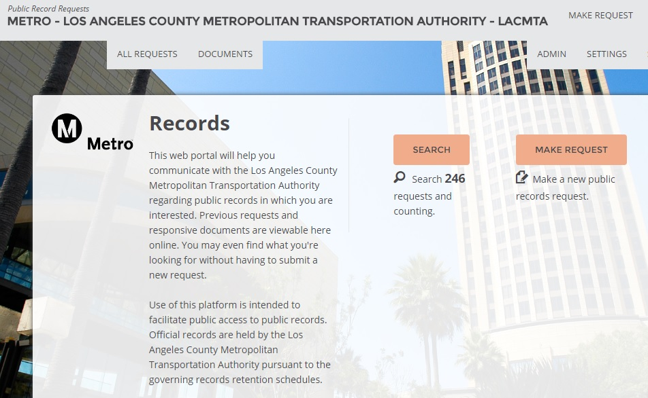
How can SB 272 inventories be useful?
Host requested records/data sets online in an open access system like NextRequest.com.
Show all requests, link to docs & data provided.
Screenshot:
Notes:
We just moved to a truly open California Public Records Request system. Created by NextRequest.com, this system allows us to open up our inventory of records requests in a searchable database with links to the documents and data we provided to requestors. Now anyone can access the requests we’ve received and honored with this self-service tool. As data sets become more commonly requested, they will be hosted here for others to discover.

Slide 7
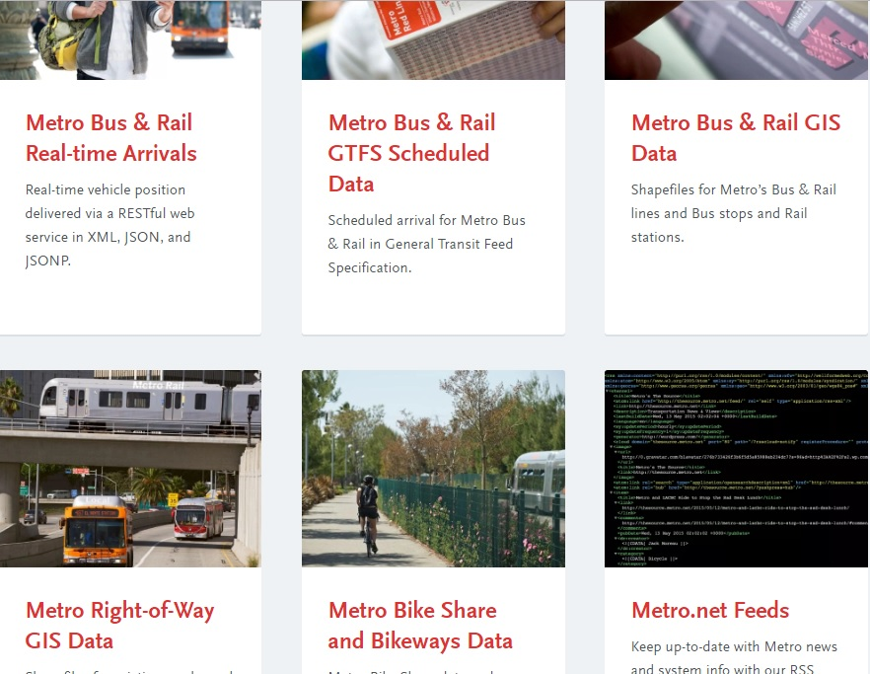
How can SB 272 inventories be useful?
Define, host and showcase data sets
Example: developer.metro.net
Screenshot:
Notes:
Metro actively posts data sets online now. SB272 Enterprise Inventory related requests will help inform us as to what data sets the public has a keen interest in. Our vendor database, our real estate holdings, our inventory list of parts and supplies, our awarded contracts are all subjects I anticipate seeing a greater level of interest.
Metro created developer.metro.net to house open source transit data available for the public including GTFS, GIS, realtime vehicle arrivals, Bikeways and realtime Bike Share, and Metro Right of Way.
There are over 50 transit/travel mobile applications using Metro's open source transit data
There are currently 14,000 members signed up to use Metro’s transit data
Api.metro.net is a web service designed to serve bus and rail location data, it receives 112,000 requests per weekday, 3.5 million requests for month
Partner with WAZE placing transit/travel data on WAZE app (1 million users in Los Angeles area)
Partner with Apple placing transit data on Apple Maps, and on 1 billion iPhones
1. Download GIS data 21.76% 2. Homepage 18.87% 3. Realtime API Overview 9.55% 4. Download Metros GTFS data 5.11% * 5. Introduction to GIS data 4.66% 6. Introduction to Bikeways data 3.66% 7. Realtime API examples 3.31%

Slide 8
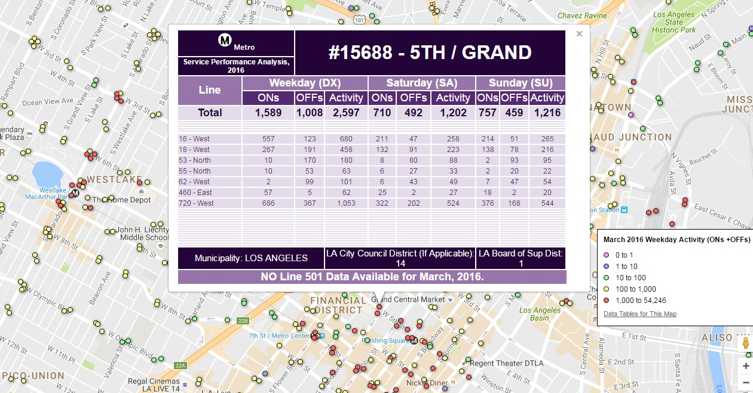
How can SB 272 inventories be useful?
Define and showcase data sets with visual tools
Example: Metro Ridership Data by stop/station
Screenshot:
Notes:
This particular data set, Metro Ridership in various geographic areas, has maintained a high level of interest among both academic as well as commercial real estate marketers and attorneys. It was the very first reference question I answered as a Librarian at Metro, and has continued to come up frequently ever since. I worked with Metro’s transit service performance group and now the data is online via Google Fusion Tables both as data and an interactive tool.
By leveraging both library reference questions, public records requests, and the affirmative addition of enterprise system data to the California Public Records Act, we hope to expand on efforts like the one above to support our communities.

Slide 9
Thank you
Notes:
Matt Barrett LA Metro Transportation Research Library, Archives & Records Mgmt. Information and Technology Services 213.922.7444 W
barrettm@metro.net metro.net | facebook.com/losangelesmetro | @metrolosangeles
twitter.com/metrolibrary | metro.net/library | headlines.metroprimaryresources.info Metro provides excellence in service and support.

