Slide 1
Los Angeles Transit History

Slide 2
Los Angeles Transit History
Matt Barrett, Director, Research Library & Records

Slide 3
Research Library & Archive
Originally the library of the Los Angeles Railway (1895-1945), and intended to serve as both public outreach and an employee resource.
Repository of federally funded transportation research starting in 1971.
Began computer cataloging into OCLC’s World Catalog using Library of Congress Subject Headings and honoring interlibrary loan requests from outside institutions in 1978.
Archive of Los Angeles transit history from 1873-present.
Transportation research library for employees, consultants, students, academics, other government agencies and the general public.
Partner of the National Transportation Library, member of Transportation Knowledge Networks, and affiliate of the National Academies’ Transportation Research Board (TRB).
Largest transit operator-owned library, forth largest transportation library collection after U.C. Berkeley, Northwestern University and the U.S. DOT’s Volpe Center.
Member of Getty/USC’s L.A. as Subject Archives Forum.

Slide 4
Accessing Collections Online
Online: metro.net/library & metro.net/records
Library Catalog librarycat.metro.net
Public Records lametro.nextrequest.com
TLCat –catalog of 38 transportation libraries tlcat.worldcat.org/
Daily aggregated transportation news headlines blog: headlines.metroprimaryresources.info
Highlights of current and historical documents in our collection: metroprimaryresources.info
Photos: flickr.com/metrolibraryarchive
Film/Video: youtube/metrolibrarian
Social Media: facebook, Google+, tumblr, google+, historypin, Tiki-Toki (timeline), Peopleplotr (family tree), Paper.li (news)
Records Management Center: lametro.nextrequest.com/
Email: library@metro.net or RMC@metro.net
In Person:
Research Library/Archive: 15th floor, Metro headquarters
Records Management: Plaza Level, Metro headquarters

Slide 5
L.A. Transit’s Family Tree
Full Version Online:
Peopleplotr (family tree)

Slide 6
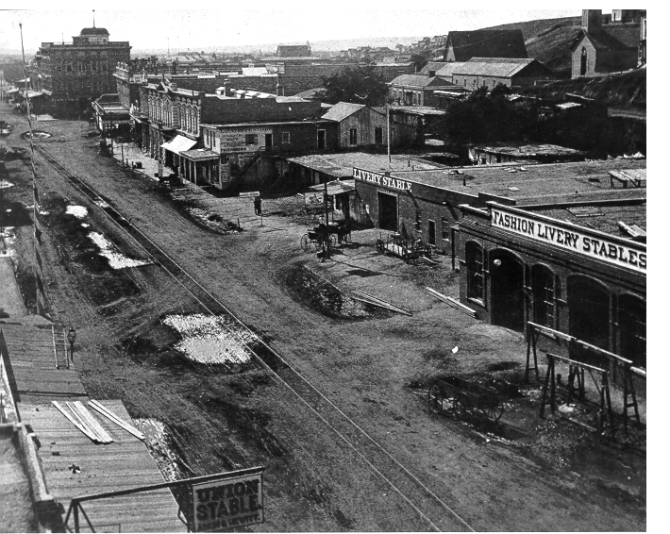
1870’s Horse Drawn Rail

Slide 7
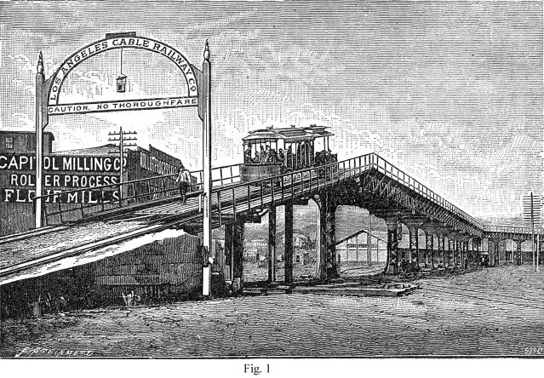
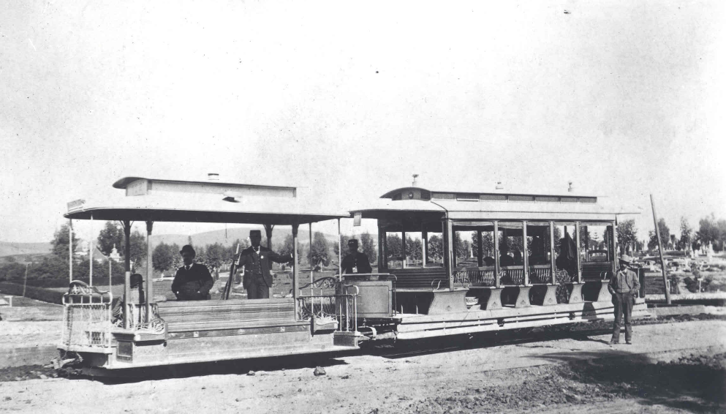
1880’s – Cable Cars
As population and transit use grew in Los Angeles, horse drawn rail cars were quickly replaced with newer technology cable cars.
Cable Cars proved highly unreliable operating under the unpaved dirt roads of early Los Angeles, they frequently froze, choked with dirt and gravel.

Slide 8
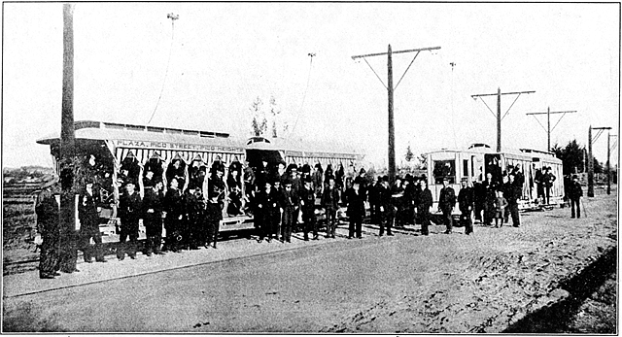
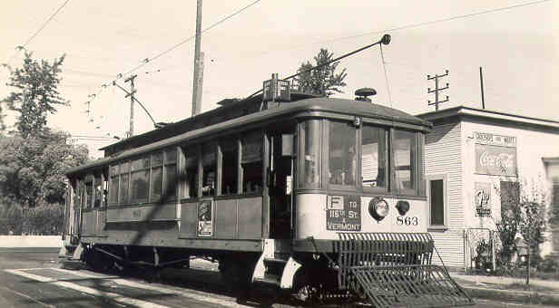
1890’s - Electrification
Better technology, overhead electrically-powered rail cars, allowed the transit system to rapidly consolidate, expand, and create the sprawling Southern California we know today.

Slide 9
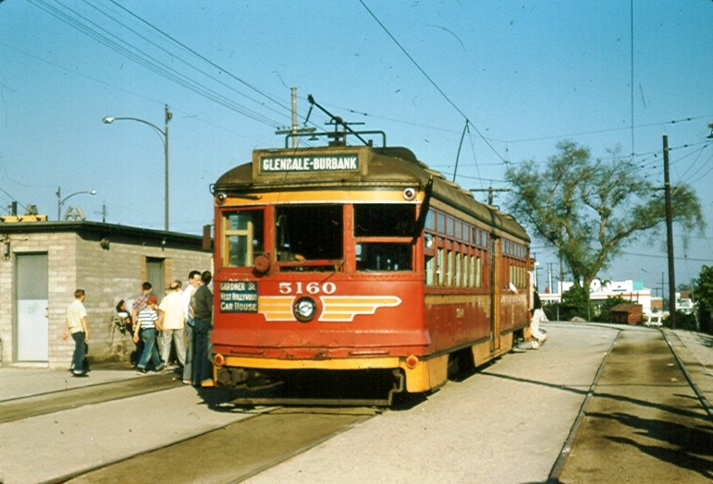
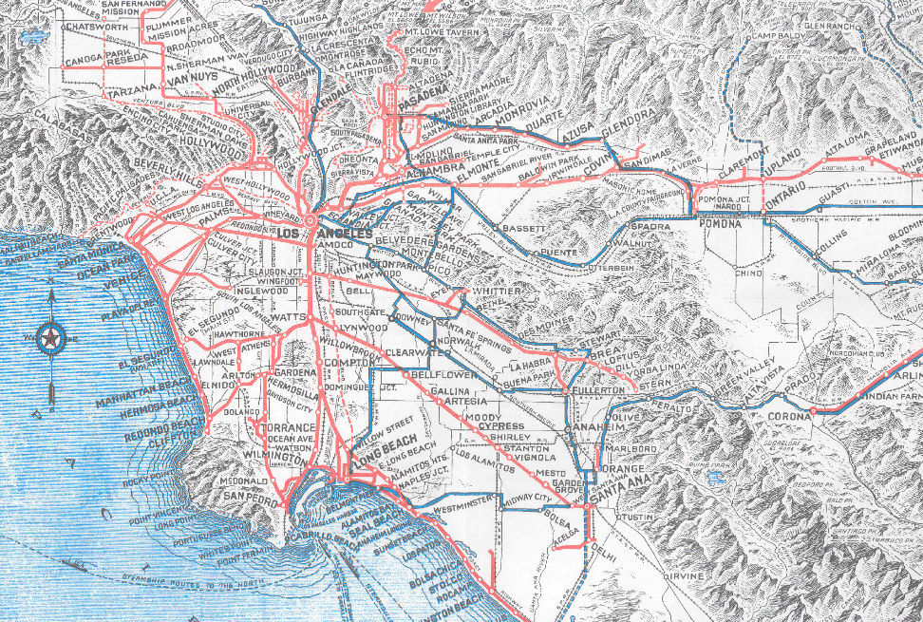
Pacific Electric (1895-1953)
Connected the suburbs and the city center, served Los Angeles, San Bernardino, Riverside and Orange Counties, also ran connecting buses.
Peak number of rail lines in 1925, peak ridership in 1923, and again during WWII due to rationing.
It was the electric “Metrolink” commuter rail of its day, only much more extensive with 1,100 track miles, up to 2,700 trains a day, and multiple hubs.
Created the footprint of today’s sprawl.

Slide 10
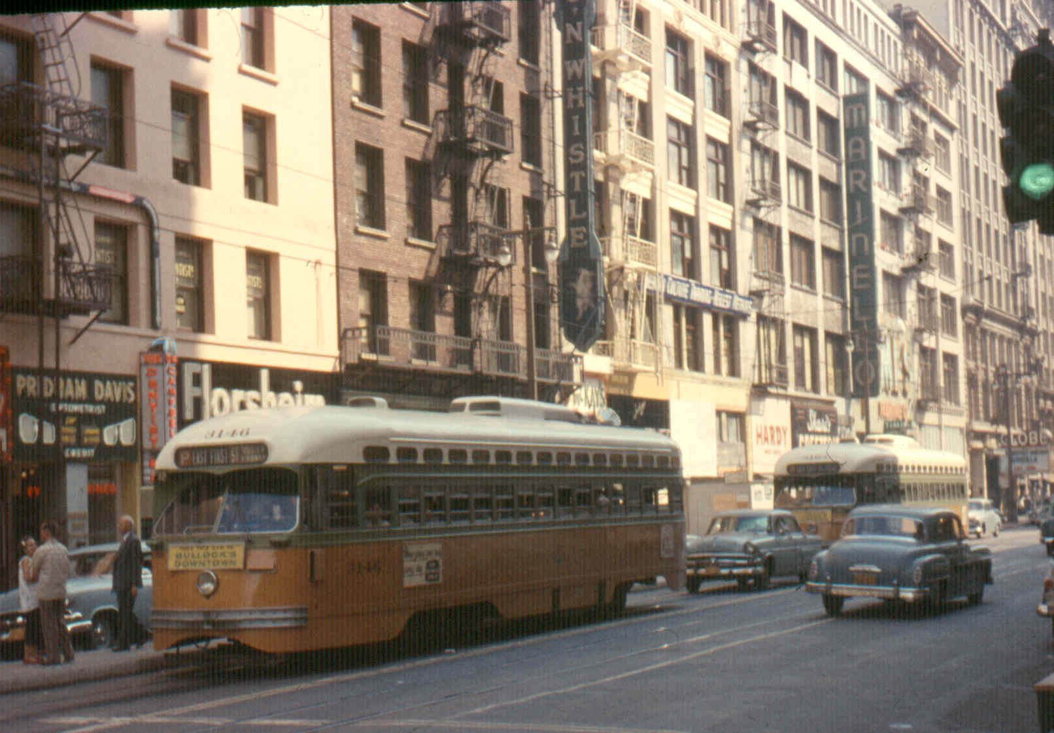
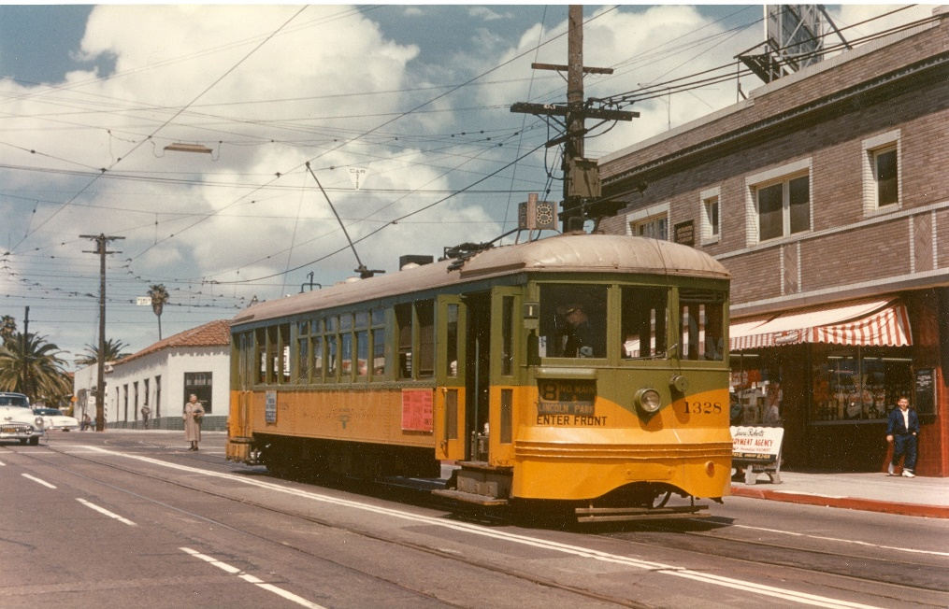
Los Angeles Railway (1895-1945)
Operated in the center of city streets, connecting points north, south, east and west with downtown Los Angeles, Pacific Electric and other transit service providers.
Peak number of lines around 1925, peak ridership during WWII, 742 streetcars and about 650 track miles, also operated motorbuses and electric trolley buses.
Grandfather of today’s urban bus system. Largely forgotten and frequently confused with Pacific Electric.

Slide 11
Why did rail transit go away?
Same business issues both pre and post WWII - huge capital costs to replace aging power substations, catenary wire and rail cars, buses become the economical alternative, rail-to-bus conversions begin in 1925, rapidly accelerate in 1950’s with highway construction.
Public Utilities Commission held back fare increases – 5 cents from 1877 to 1927, 7 cents from 1928 to 1945, 10 cents from 1946 to 1951, 15 cents from 1952 to 1956.
No public subsidies for capital or operating costs available from local, state or federal governments.
Cultural changes - automobile reliability improves, status symbol marketing, and women & minorities enter the industrial workforce.
Modal improvements - brand new un-crowded highways and freeways.
Transit service operators believed that the freeway system would accommodate and speed transit buses as a high speed backbone, thereby increasing their attractiveness to passengers.
GM perfects and markets the 45 seat transit bus; air conditioning and air suspension become options.
Diesel is not yet considered to be a component of a new phenomenon called “smog” See 1967 film “The Answer is Clear” by Detroit Diesel.

Slide 12
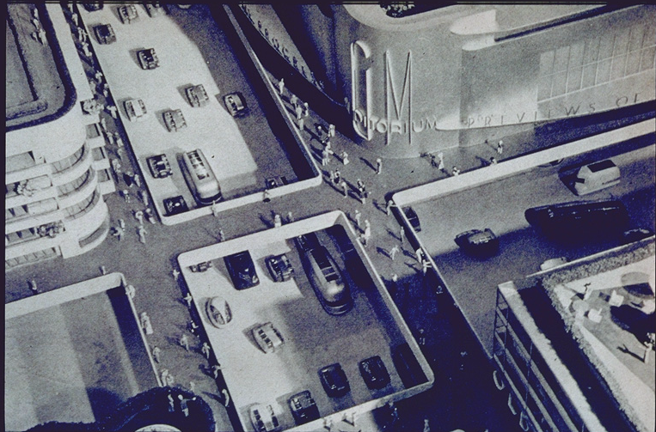
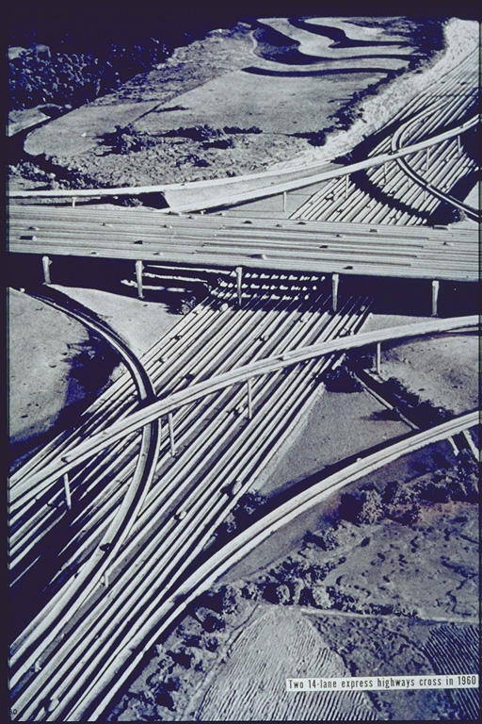
Influences:1939 New York Worlds Fair – GM’s 1939 Futurama Exhibit
Concept for car, bus and pedestrian only cities.
Imagined 14 lane freeway interchanges.

Slide 13
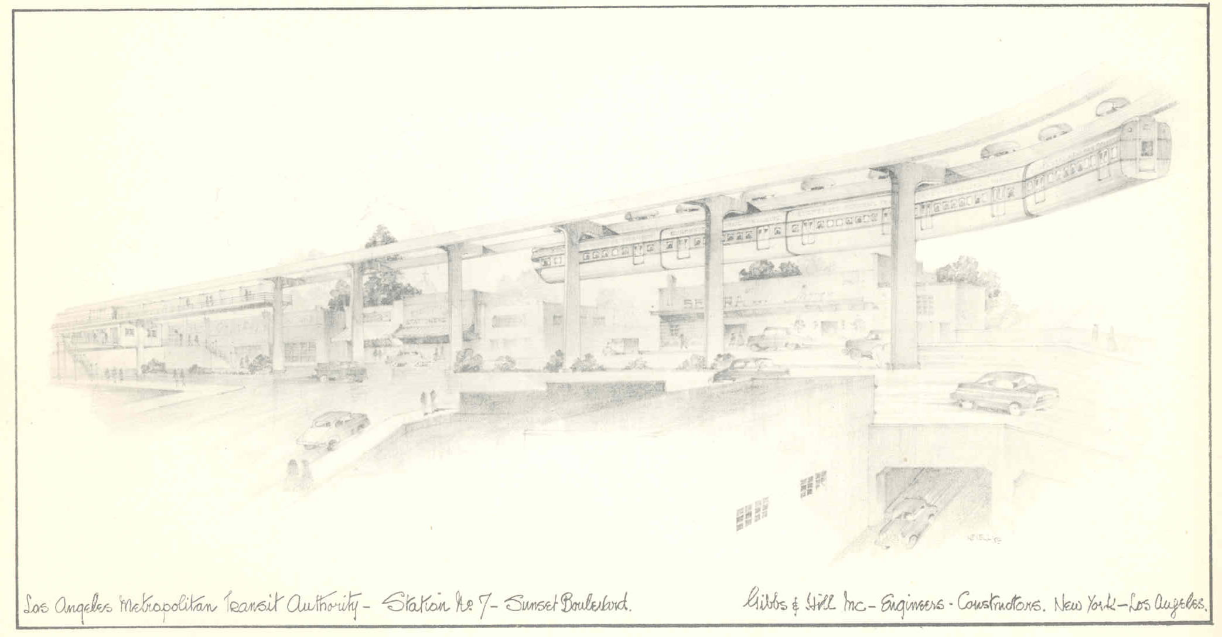
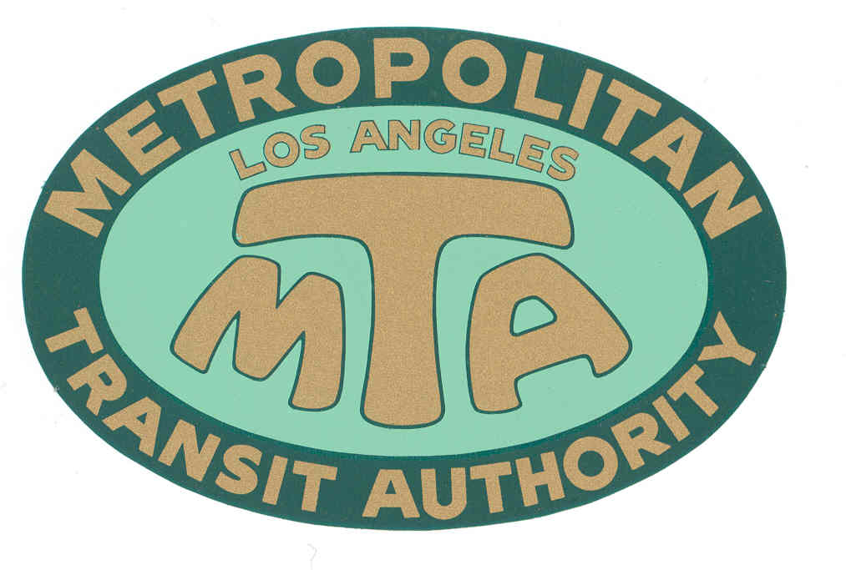
Los Angeles MTA (1951-1964)
Formed by the State in 1951 to study a monorail line from Long Beach to Panorama City along the L.A. River.
Seven Member governing board appointed by the Governor. Powers expanded in 1954 to propose a new mass transit system for the region.
Powers expanded again in 1957 allowing MTA to become a transit operator.
Purchased Metropolitan Coach Lines (formerly Pacific Electric) and Los Angeles Transit Lines (formerly Los Angeles Railway), effective March 3, 1958.

Slide 14
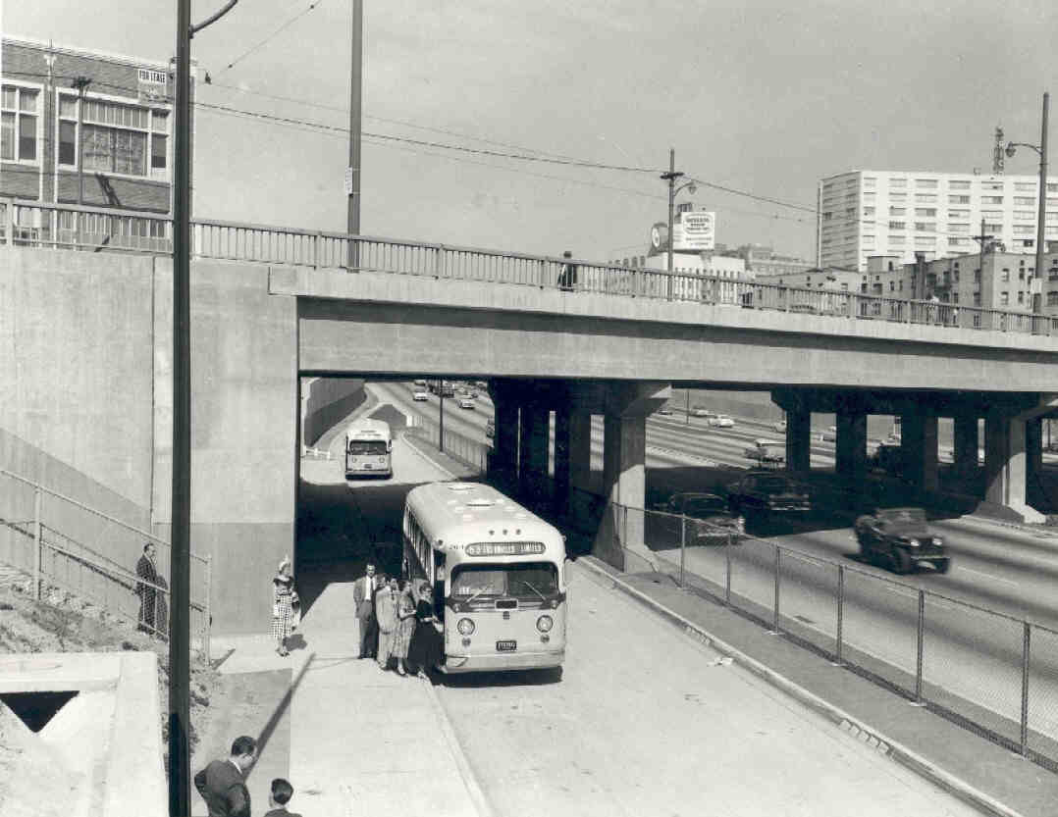
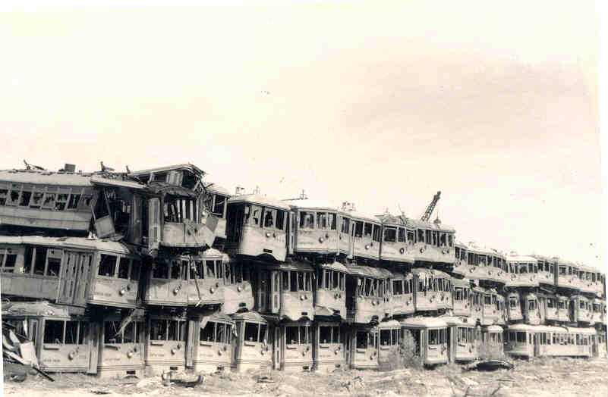
MTA Rail Transit still operating in 1958
From Pacific Electric (1898-1953) via Metropolitan Coach Lines (1953-1958):
Long Beach, San Pedro, Bellflower, Watts Local, and Catalina Terminal.
The last “Red Car” runs to Long Beach on April 9, 1961.
From Los Angeles Railway (1895-1945) via Los Angeles Transit Lines (1945-1958):
West Jefferson Blvd & Huntington Park (J), West Pico & East 1st St. (P), Whittier Blvd. & West 3rd St. (R), San Pedro St. & Western Ave. (S), Vernon & Vermont Ave (V).
The last “Yellow Car” runs on March 31, 1963.

Slide 15
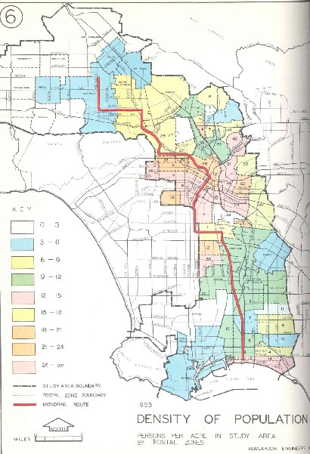
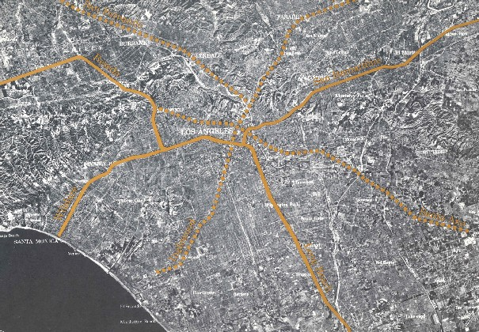
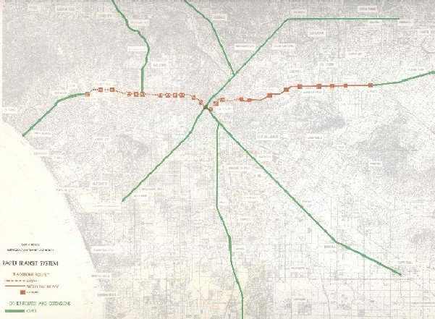
Los Angeles MTA (1951-1964)
1954 study of one monorail line, 45 miles/$165 million, grows in 1960 to a 75 mile/$529 million monorail plan with elevated rail along Wilshire.
Expanded monorail plan meets strong opposition from Valley Boulevard, Wilshire Corridor and especially Beverly Hills.
MTA’s plan is scaled down to a “Backbone Route” with subway under Wilshire Boulevard and at-grade rail to El Monte.
Alweg and Goodell Monorail Co.’s release their own monorail plans and offer to build systems for “free” in exchange for next 40 years of MTA’s farebox revenue.
MTA notifies private companies that any plan that does not include subway along the Wilshire route is unacceptable. MTA fails in its PR efforts with general public.

Slide 16
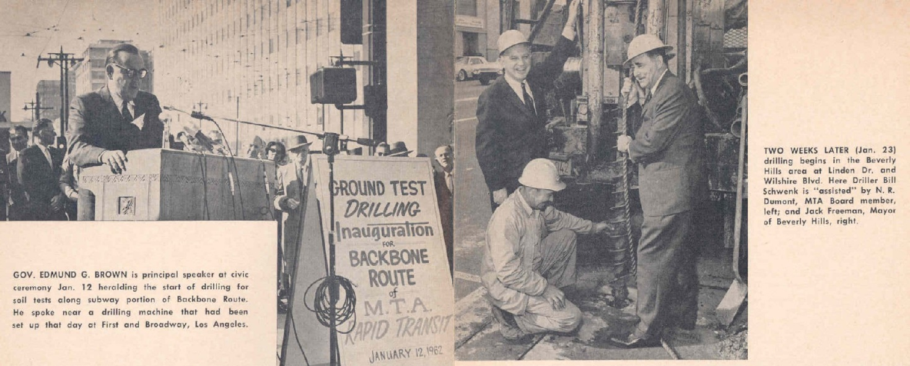
Los Angeles MTA (1951-1964)
Politicians vociferously battle over if and how transit would be subsidized and what the very definition of subsidy really is. Public becomes thoroughly confused.
The MTA, without the ability to tax, issue bonds, or take property via eminent domain, without the existence of any Federal or State capital assistance programs, holds two subway groundbreaking ceremonies: in downtown with Gov. Edmund G. Brown on 1/12/62, and in Beverly Hills with BH Mayor Jack Freeman, on 1/23/62.
State Sen. Rees (D-Beverly Hills) re-writes MTA legislation to give the transit agency the powers it was missing, re-launching it as the Southern California Rapid Transit District (SCRTD) in September 1964.

Slide 17
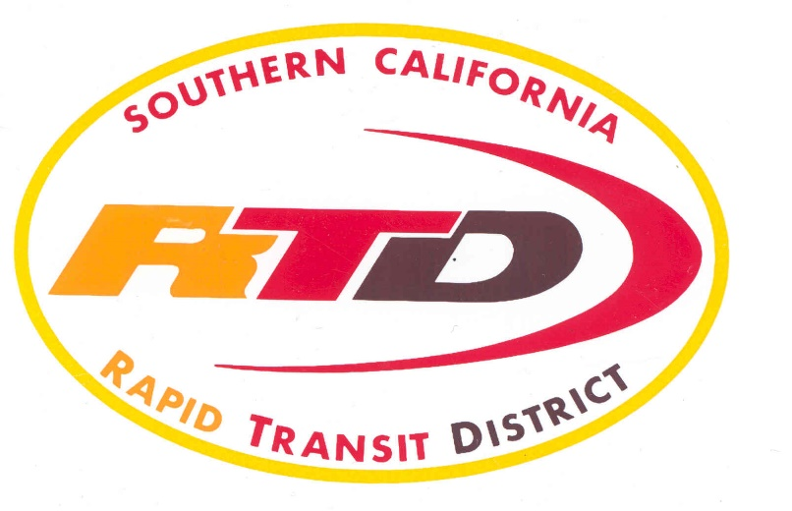
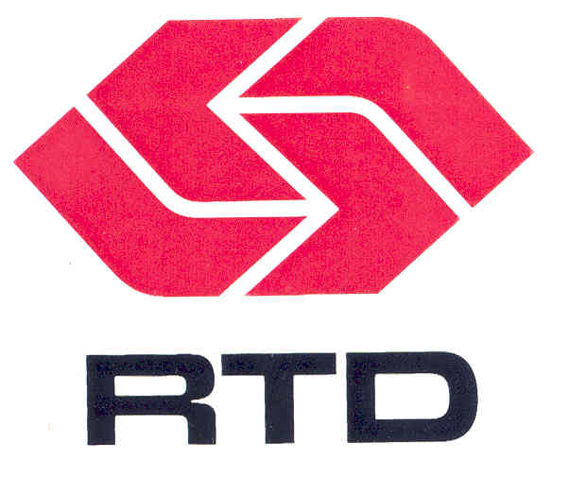
SCRTD (1964-1993)
New agency has an eleven member board appointed by local elected officials, the powers of eminent domain, taxation through local referendum, bond issuance, and creation of Benefit Assessment Districts.
It is enthusiastically welcomed in an event at the Ambassador Hotel with 400 civic leaders.
Takes its legislative charge to create a new mass transit system for Los Angeles seriously and goes to work marketing public transportation as a needed and necessary community asset.
Federal government forms the Urban Mass Transit Administration in 1964 (now called the Federal Transportation Administration).
Operates transit service in L.A., Orange, Riverside and San Bernardino counties.
Takes over 11 other failing or failed transit companies, standardizing routes and fares.

Slide 18
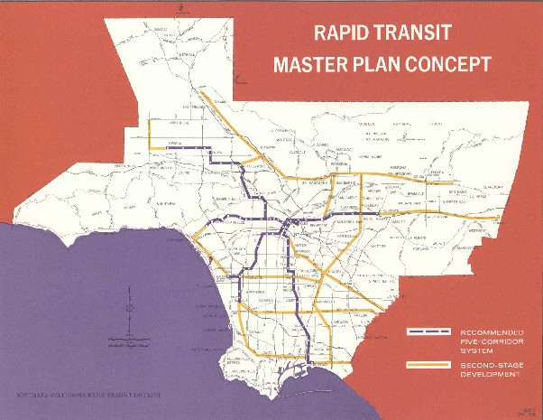
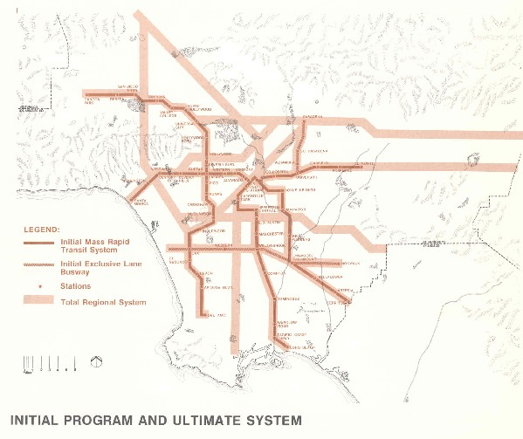
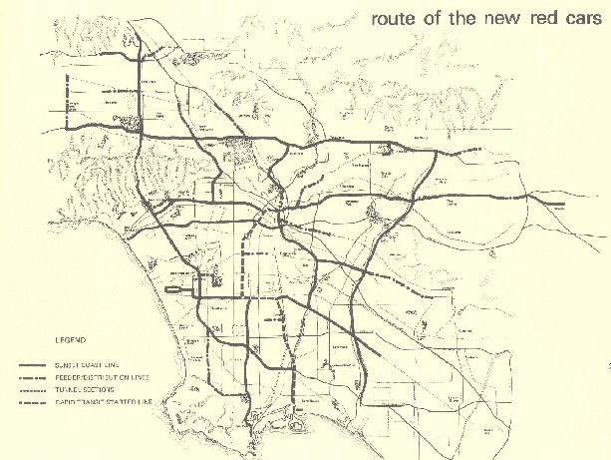
SCRTD (1964-1993)
1968 Plan -
Initial 62 mile system that could expand to 300 miles, projected cost of $2.5 billion, 8.5 year construction period.
Rejected by voters, 44.8% yes.
1974 Plan –
Initial 116 mile system that could eventually expand to a 250 miles, projected cost of $6.6 billion, 12 year construction period.
Rejected by voters, 46.3% yes.
1976 “Baxter Ward” Plan –
281 mile system, 230 miles of elevated heavy rail and 51 miles of light rail, projected cost of $7.5 billion.
Rejected by voters, 40.6% yes.

Slide 19
SCRTD (1964-1993)
Known for Innovations & Special Services:
El Monte Busway HOV Project
Mini-Bus circulator routes and Freeway Flyer services
Bus Technology
In-house Air Quality Testing lab
1974 FTA/California Steam Bus project
Particulate traps, alternative fuels
Double Deck and Articulated buses
First large scale wheel chair lift equipped bus order in history
Bus Scheduling and System Grid design
Technology – Robotic Parts Delivery, Pre-GPS Radio tracking system
FFGA for Metro Rail Subway Project & Construction
Rail Start up for the first new Light Rail Line & Subway Line
Earthquake service, Civil Unrest service, Papal Visit, 1984 International Olympic Games, and coordinating other large scale special events.

Slide 20
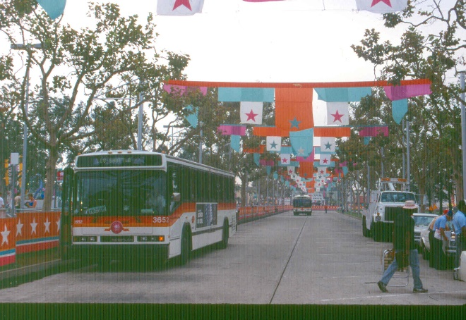
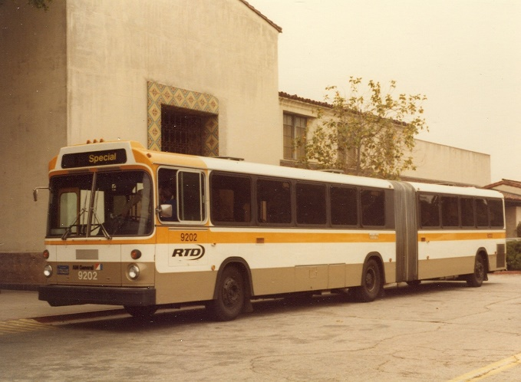
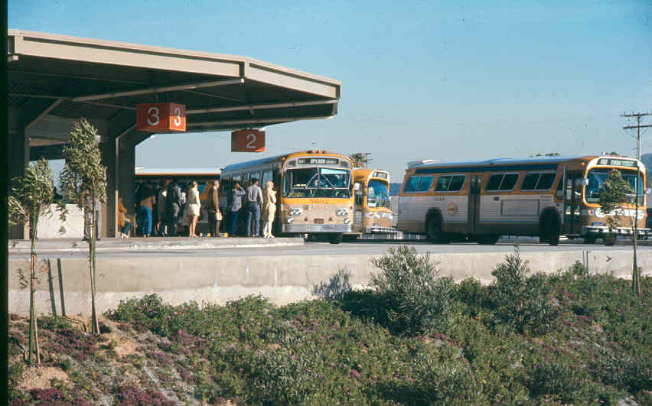
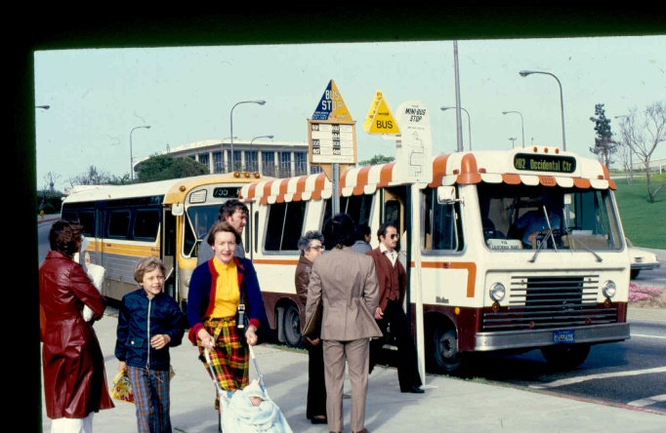
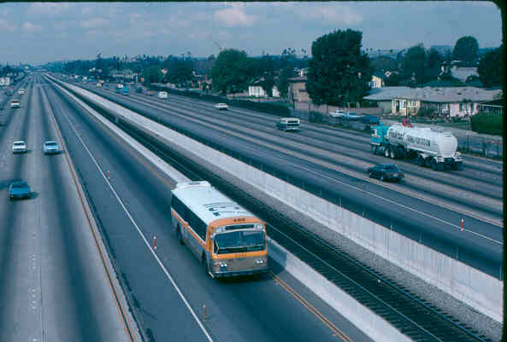
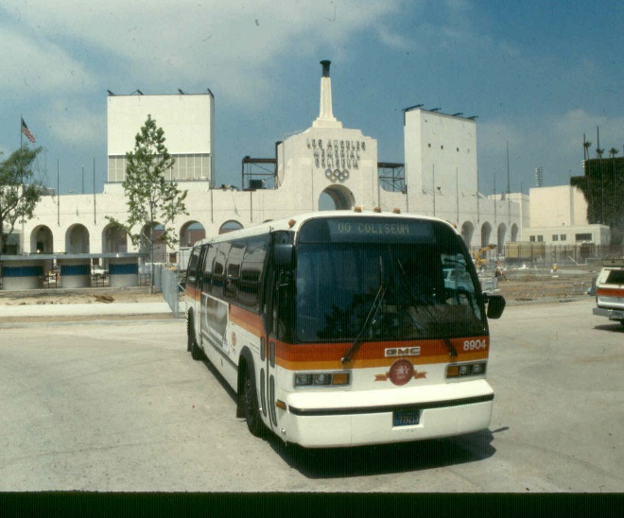
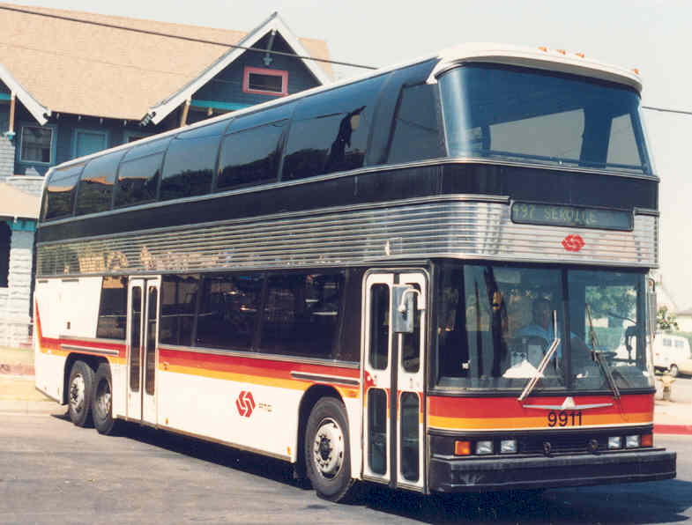
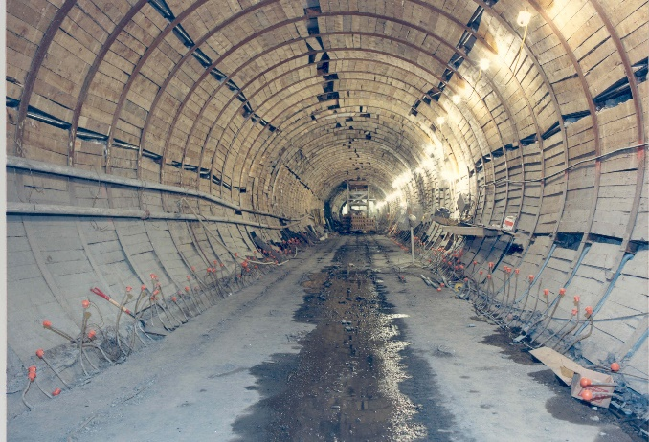
SCRTD (1964-1993)

Slide 21
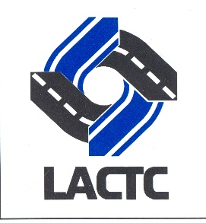
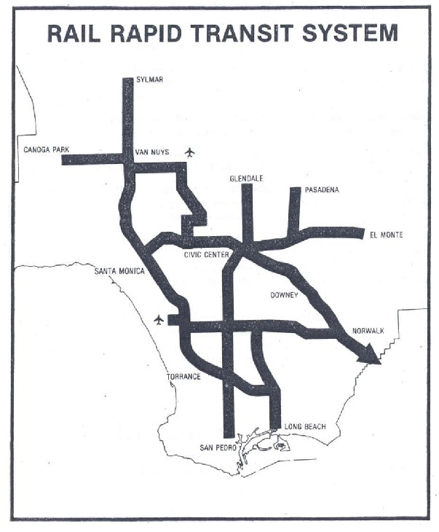
Los Angeles County Transportation Commission (1977-1993)
State creates the Los Angeles County Transportation Commission (LACTC) in 1976 to coordinate between municipal transit operators and SCRTD, plan countywide transportation improvements and ensure efficient use of local, state and federal transportation funding.
In 1980, a majority of Los Angeles County voters approve Proposition A (54.3%), a half cent sales tax for transportation improvements, 35% of revenue is dedicated for rail construction.
Map from 1980 Proposition A voter information materials

Slide 22
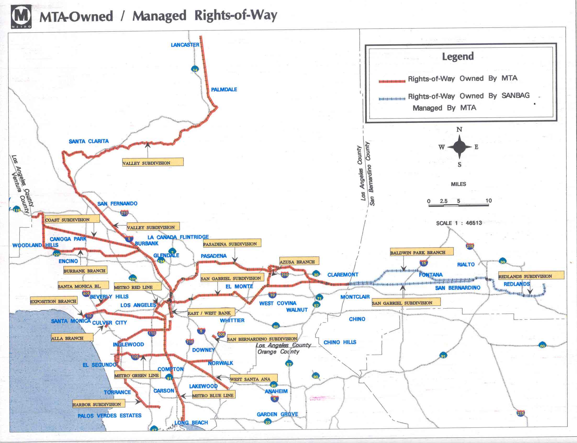
Los Angeles County Transportation Commission (1977-1993)
A second half-cent sales tax for transportation, Proposition C, was approved by a majority of Los Angeles County voters (50.4%) in 1990, along with propositions 108, 111 and 116.
The Transportation Commission begins negotiations with Southern Pacific, the parent company of the former Pacific Electric system, to acquire 450 miles of right-of-way in Southern California. The parties eventually agree on a purchase price of $980 million in 1992. The commuter rail system known as Metrolink is born and spun off as an independent five-county joint powers authority.

Slide 23
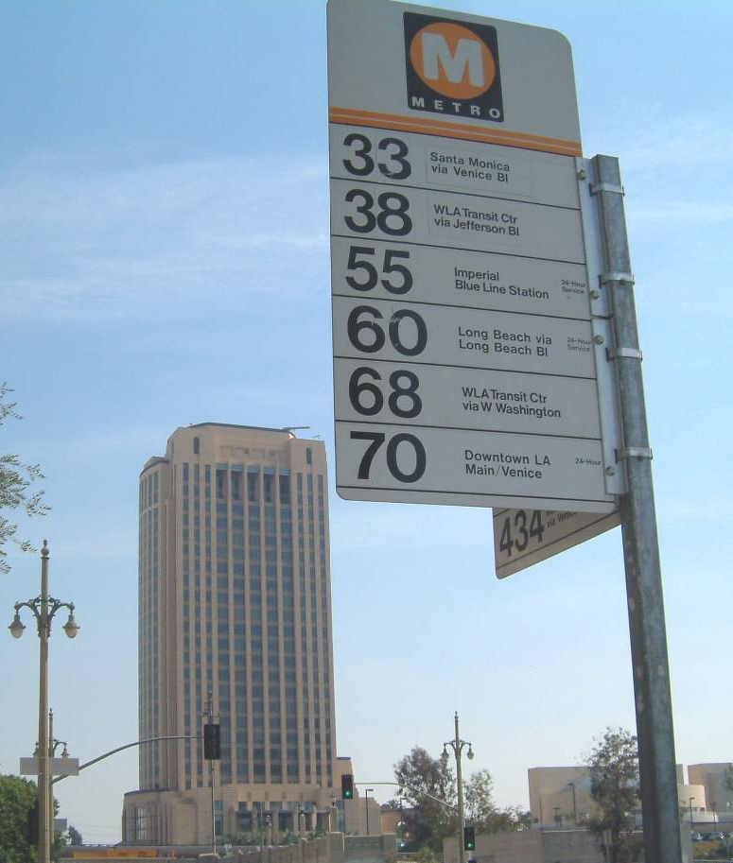
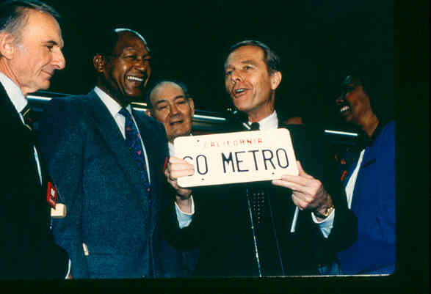
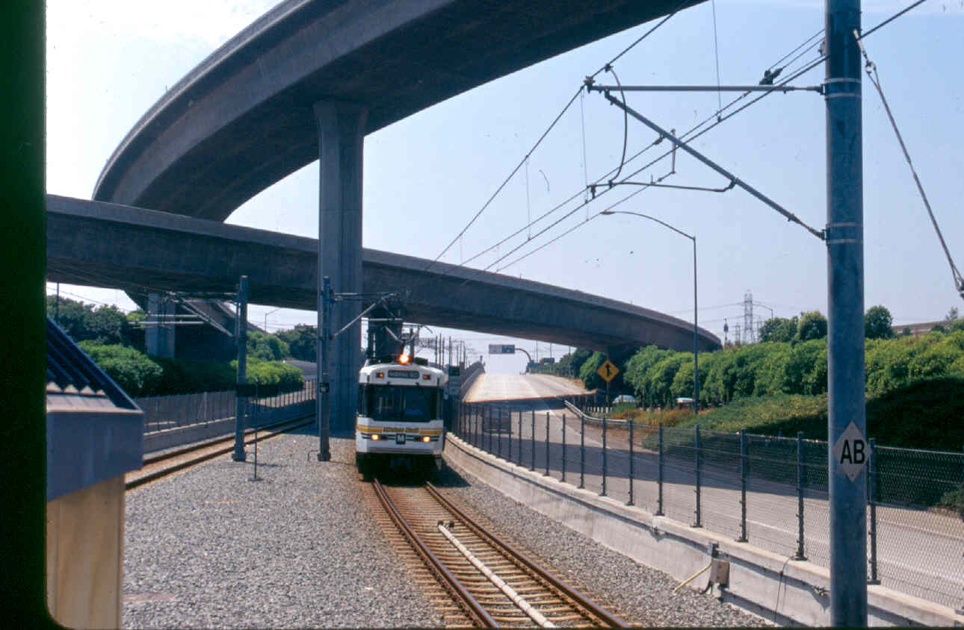
Merging Transit with Transportation
1988, the two agencies agree on an eight-point plan that includes consolidating all rail construction under a single third entity, naming the lines the Metro Red Line, Metro Blue Line and Metro Green Line, and open discussion of an eventual merger.
1992, the Governor signs AB152 (Katz) that creates the Los Angeles County Metropolitan Transportation Authority, also known as MTA or Metro, effective February 1, 1993. It becomes a planning, funding, construction, and operating multi-modal “super agency” for Los Angeles County.

Slide 24
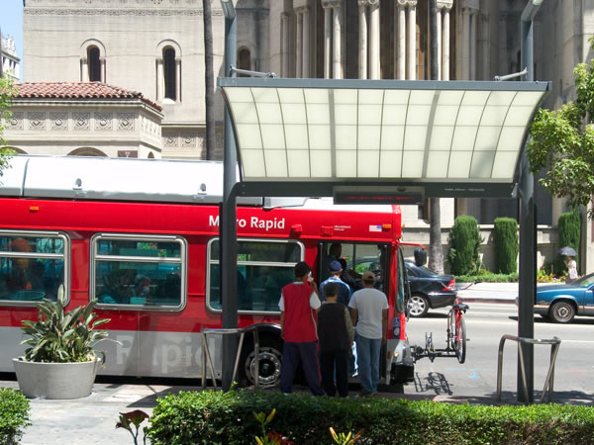
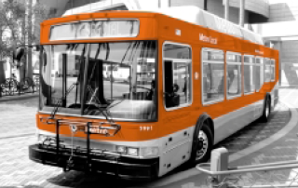
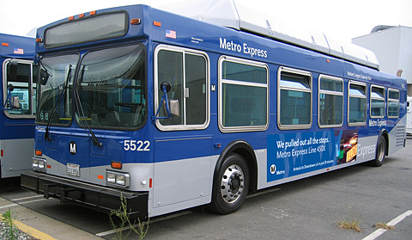
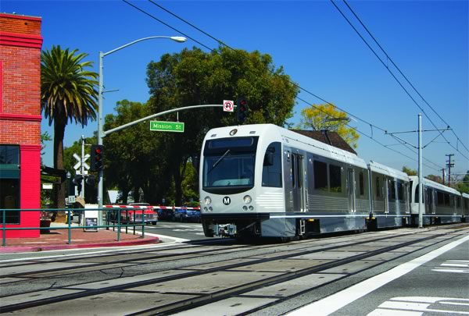
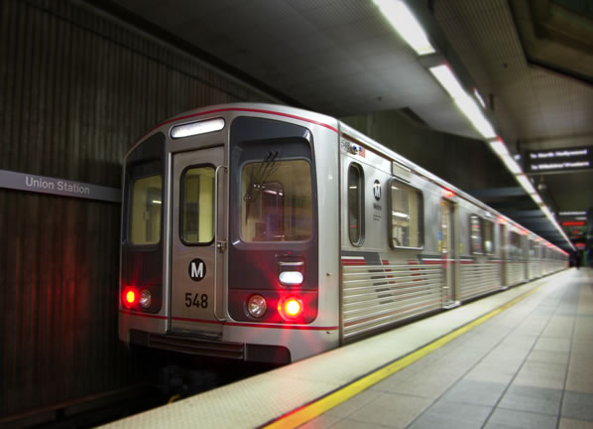
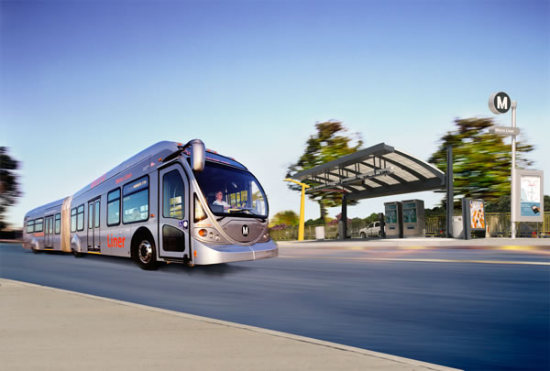
Current Metro
Metro Rapid
Metro Local
Metro Express
Metro Light Rail
Metro Heavy Rail
Metro Busway

Slide 25
Timelines
For general comparison purposes, MAX participant transit system development timelines found online:
Los Angeles Metro: Los Angeles Transit History Timeline
Atlanta MARTA: Tracing a History of Atlanta’s Public Transit
Dallas DART: DART History
Denver RTD: Fastracks Project History

Slide 26
Selected YouTube films & videos
From the Metro Librarian Channel:
Shirley Temple Inaugurates Los Angeles’ New Streetcars (1937) https://www.youtube.com/watch?v=I2cwcnTyR2E&t=6s
Los Angeles Transit Lines: It’s a Big Job (1947) https://www.youtube.com/watch?v=tNRA5LAVVD0
Let’s Go to Town – Solutions to City Traffic Congestion (1950’s) https://www.youtube.com/watch?v=CElngLAjMaA&t=38s
Detroit Diesel: The Answer is Clear (1967) https://www.youtube.com/watch?v=-3z4ctf71Xg&t=261s
SCRTD Meeting the Challenges (1983) https://www.youtube.com/watch?v=hKtixeeJrJk
Metro Blue Line Grand Opening (1990) https://www.youtube.com/watch?v=scqwa--KhJU
Union Station Gateway Joint Development Project (1992) https://www.youtube.com/watch?v=BRWeThfv-Js
Metro Motion - Union Station 75th Anniversary https://www.youtube.com/watch?v=yZ7L87bu7oY

Slide 27
Reading on LA Transit History
Electric Railway Historical Association – http://www.erha.org
Pacific Electric Historical Society http://www.pacificelectric.org
Railtown: The fight for Los Angeles Metrorail and the future of the city by Ethan Elkind
This Was Pacific Electric - DVD - A documentary film by Tom Eberhardt
Henry E. Huntington and the Creation of Southern California by William B. Friedricks
From Railway to Freeway - Pacific Electric and the Motor Coach by Eli Bail.
Los Angeles & the Automobile by Scott Bottles.
Street Railways and the Growth of Los Angeles by Robert C. Post.
Ride the Big Red Cars: How Trolleys Helped Build Southern California by Spencer Crump

Slide 28
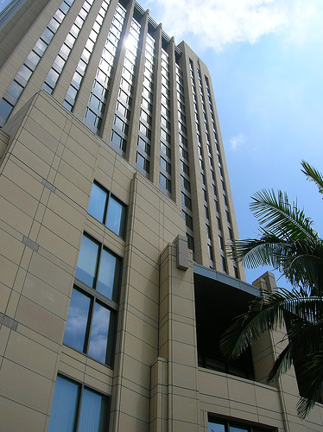
End

