Slide 1
Los Angeles Transit & Transportation History - Glendora Edition
Matthew Barrett
Metro Transportation Research Library, Archive & Public Records - metro.net/library

Slide 2
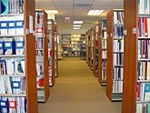
Transportation Research Library & Archive
Originally the library of the Los Angeles Railway (1895-1945), and intended to serve as both public outreach and an employee resource.
Repository of federally funded transportation research starting in 1971.
Began computer cataloging into OCLC’s World Catalog using Library of Congress Subject Headings and honoring interlibrary loan requests from outside institutions in 1978.
Archive of Los Angeles transit history from 1873-present.
Transportation research library for employees, consultants, students, academics, other government agencies and the general public.
Partner of the National Transportation Library, member of Transportation Knowledge Networks, and affiliate of the National Academies’ Transportation Research Board (TRB).
Largest transit operator-owned library, forth largest transportation library collection after U.C. Berkeley, Northwestern University and the U.S. DOT’s Volpe Center.
Member of USC’s L.A. as Subject Archives forum.
Notes:
Largest Transit Operator Library – Larger than APTA.
New York’s library was on the 55th floor of the World Trade Center
Other transit libraries in Seattle, Portland, Cleveland, Phoenix, etc
Far fewer than State DOT libraries who enjoy full support of AASHTO, its Research Advisory Committee and Transportation Research Board.
Public outreach role – now working closely with Records management on digitizing materials and functioning as a public reading room, both in-person and online. Materials provided by the library cost $1.63.
Who uses the library internally?
25% Operations
25% Planning
25% Finance & Admin
13% Consultants
12% Communications
Externally – library websites combined access was 4.2 million page views

Slide 3
Accessing the Transportation Research Library, Archive & Records
Online: metro.net/library
Library Catalog librarycat.metro.net
Daily aggregated transportation news headlines: headlines.metroprimaryresources.info
Highlights of current and historical documents in our collection: metroprimaryresources.info
Photos: flickr.com/metrolibraryarchive
Film/Video: youtube/metrolibrarian
Social Media: facebook, twitter, tumblr, google+, historypin, Tiki-Toki (timeline), Peopleplotr (family tree), Paper.li (news)
Records: records.metro.net
Email: library@metro.net
In Person:
15th floor of the Metro Headquarters building at the terminus of the Red/Purple Line, Gold Line & Metrolink, on the east side of Union Station, downtown Los Angeles.

Slide 4
Transit’s Family Tree
Full Version Online:
Peopleplotr (family tree)
Notes:
Many private operators prior to 1911 Merger that created two large systems, Pacific Electric for longer distance travel and Los Angeles Railway for shorter distance travel connecting with downtown.
First bus company created in 1923 by PE and LARy to serve Wilshire Blvd.
First large diesel bus order in 1940 (and first smog alert issued in 1943)
Fares regulated by Sacramento and held low for many years.
Public governance and local control begins in 1958 with first MTA.
SCRTD created to give the underpowered MTA the tools it needed.
Watts Riots – report on causes cited lack of access to a well coordinated transit system, SCRTD takes over 11 failing transit operators
Transportation Commissions created in 1976.
Merger of transit district and transportation commission in 1993.

Slide 5
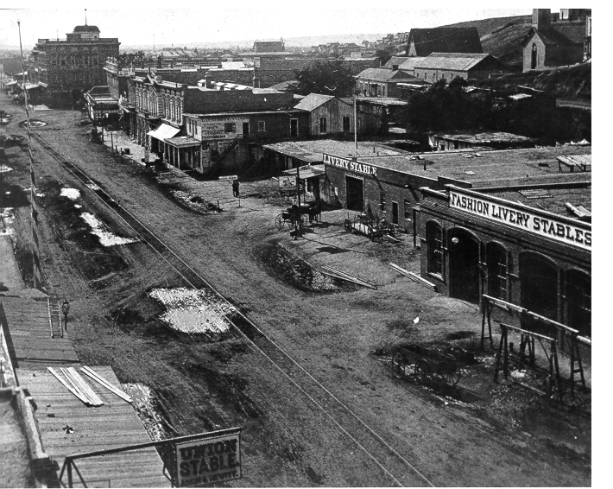
Early Years – Horse Drawn – 1870’s
Notes:
First franchise granted in 1873, first line opens in 1874. Horse drawn rail is the biohazard of its day, frequently complained about in newspaper letters to the editor. Public Transit began as a small business enterprise by Robert Widney. Biddy Mason, LA’s first successful black business woman owned stables nearby.

Slide 6
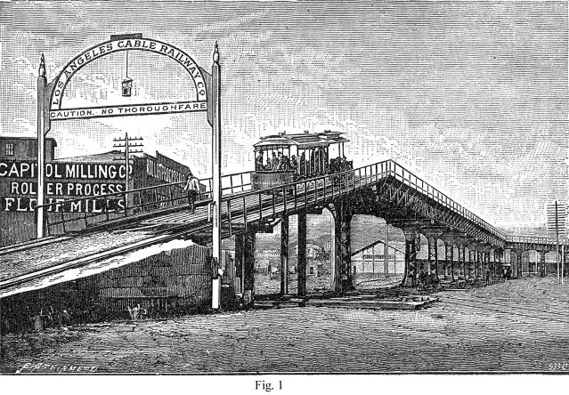
Early Years – Cable Cars – 1880’s
As population and transit use grew in Los Angeles, horse drawn rail cars were quickly replaced with newer technology cable cars.
Cable Cars proved highly unreliable operating under the unpaved dirt roads of early Los Angeles, they froze, choked with dirt and gravel when it rained.
Notes:
Innovation with Cable drawn railways, all of these companies went bankrupt quickly. Accident prone, unpaved streets, and expanding city made service with this technology a challenge.

Slide 7
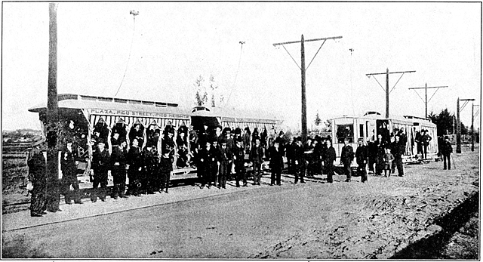
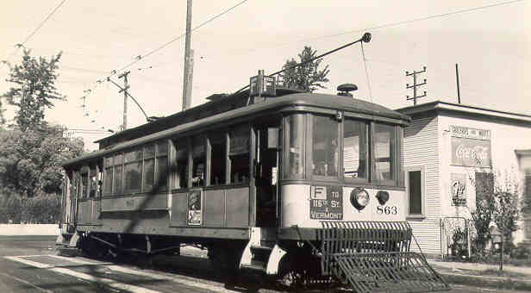
Early Years – Electrification – 1890’s
Better technology, overhead electrically-powered rail cars, allowed the transit system to rapidly consolidate, expand, and create the sprawling Southern California we know today.
Notes:
Quickly supplants horse drawn and cable railways. Leads to the first transit library open to the public in 1895. Had to convince the Victorian era minded public that electricity and speed were safe.
Massive expansion outward, first to Pasadena, then Long Beach, based on those successes, every suburban community lobbied for rail connections to downtown.

Slide 8
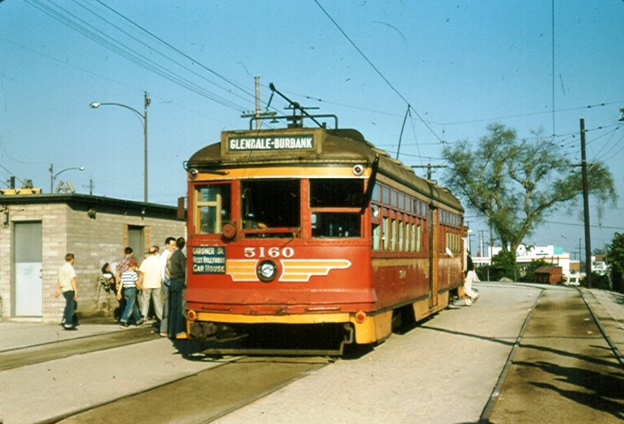
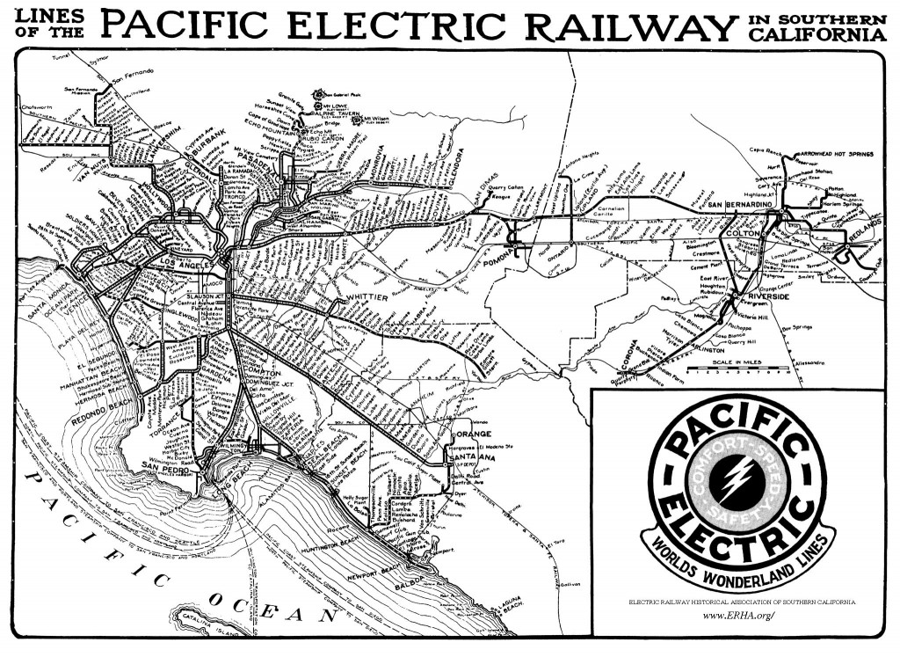
Pacific Electric (1898-1953)
Made concept of suburbia possible. Connected the suburbs and the city center, served Los Angeles, San Bernardino, Riverside and Orange Counties, also ran some connecting buses and open top double decker buses on Wilshire Boulevard.
Peak number of rail lines in 1925, peak ridership in 1923, and again during WWII due to rationing.
It was the electric “Metrolink” commuter rail of its day, only much more extensive with 1,100 track miles, up to 2,700 trains a day, and multiple hubs.
Notes:
The Red Cars – source of urban mythology promoted in Disney’s Who Framed Roger Rabbit. Story is repeated as fact – Standard Oil, Firestone Tire and General Motors conspired to dismantle the Red Cars.
Timelines don’t match up. The court case was about anti-competitive contracting with suppliers and took place in 1948. National City Lines was involved, which was the parent company of theYellow Cars, not the Red Cars, and most of LA’s rail was converted to bus in the 1950’s, after the court case, not before.
System connected four counties. 450 miles of its remaining right of way was purchased from Southern Pacific in 1992 for $980 million. Allowed Metrolink to begin service quickly and preserved corridors for future Light Rail and BRT.

Slide 9
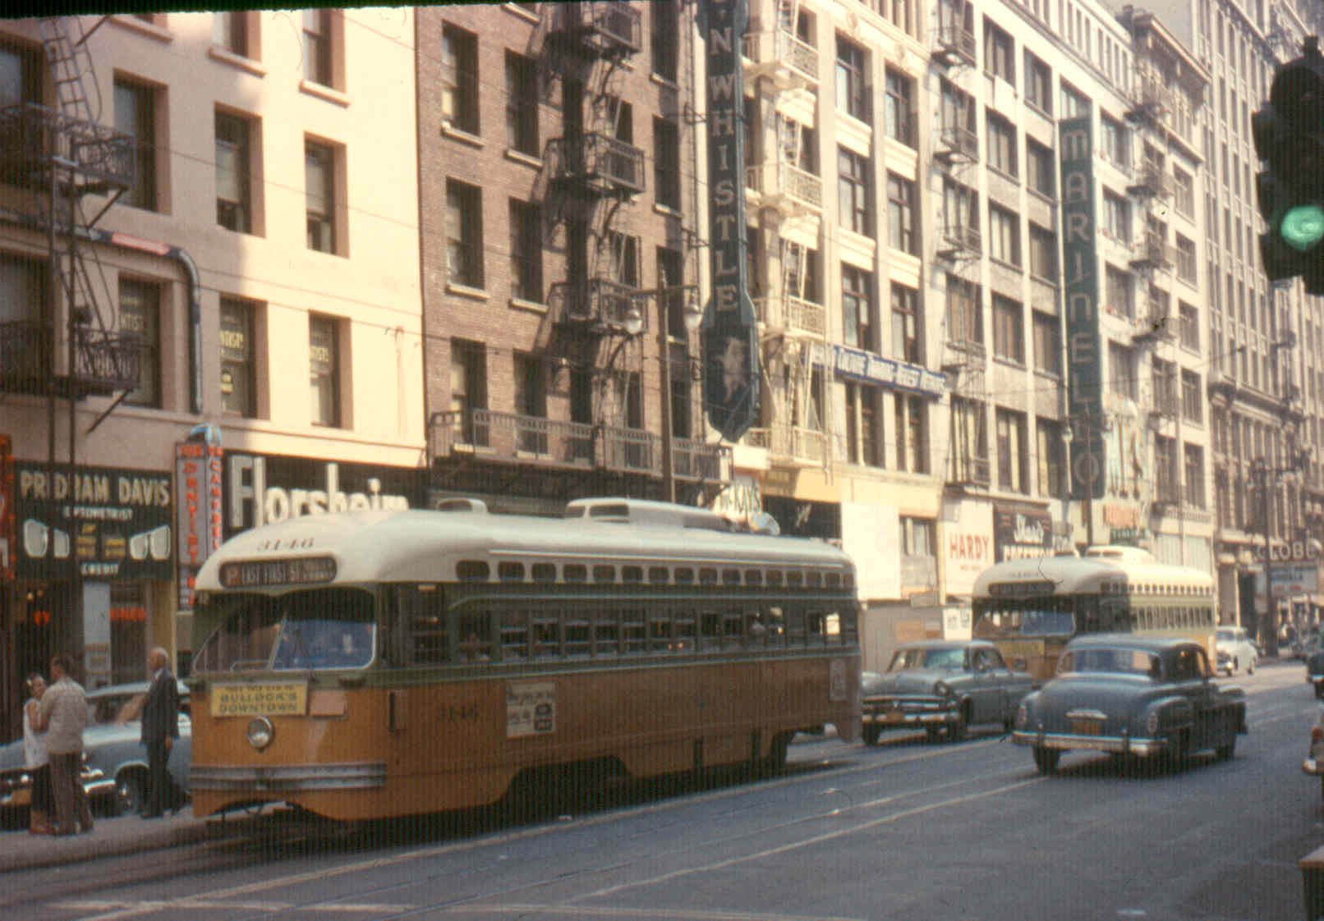
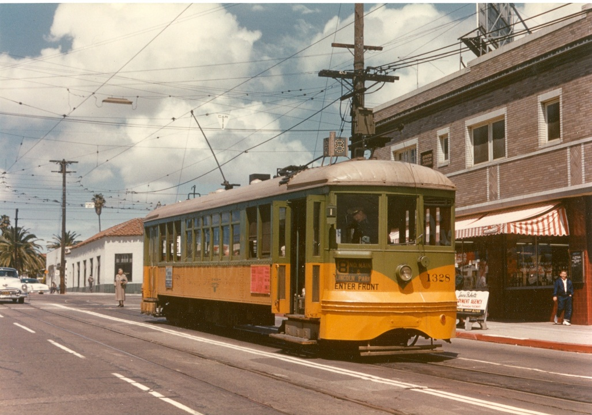
Los Angeles Railway (1895-1945)
Operated in the center of city streets, connecting points north, south, east and west with downtown Los Angeles, Pacific Electric and other transit service providers.
Peak number of lines around 1925, peak ridership during WWII, 742 streetcars and about 650 track miles, also operated motorbuses and electric trolley buses.
Known as the “Yellow Cars”. Grandfather of today’s urban bus system. Largely forgotten and frequently confused with Pacific Electric. Owned by Henry Huntington & Estate 1911 until 1945.
Notes:
Henry Huntington, ran this system until his death in 1927. His estate continued to run it until 1945 when it sold it to Los Angeles Transit Lines.
Work horse system, morphed into today’s bus system.

Slide 10
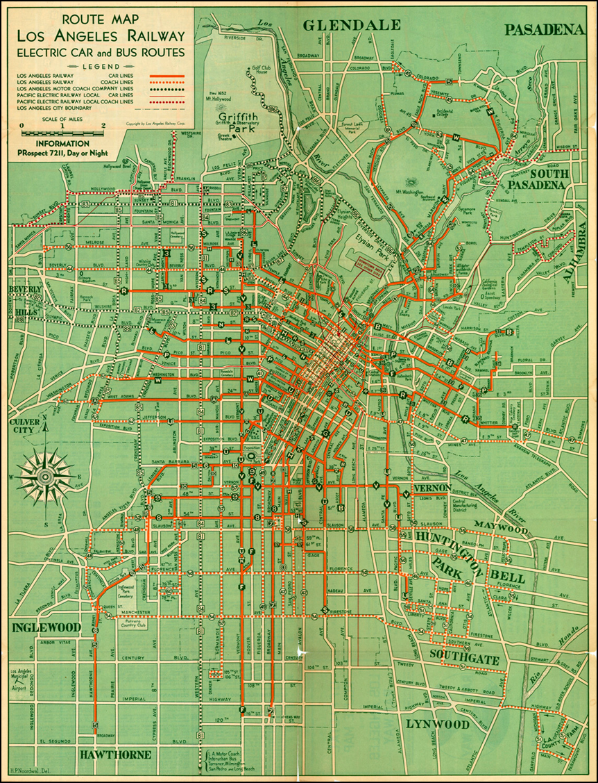
Map of the Los Angeles Railway Streetcar System in the 1930’s. Laid out a footprint that morphed into today’s bus transit system. Oldest continuously operating bus line, Western Avenue (north-south). Opened in August 1923, followed by Wilshire Blvd (east-west).
Urban Transit

Slide 11
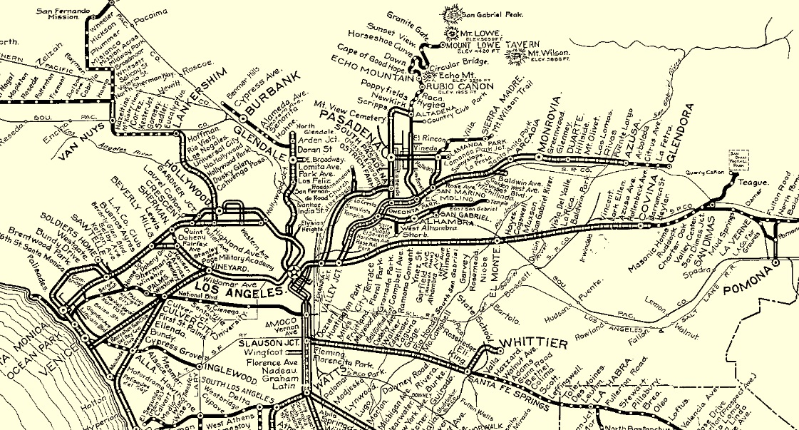
Pacific Electric in Glendora

Slide 12
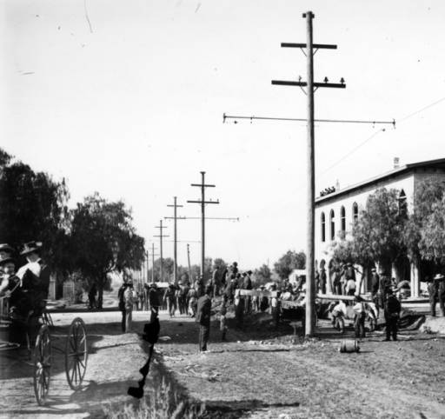
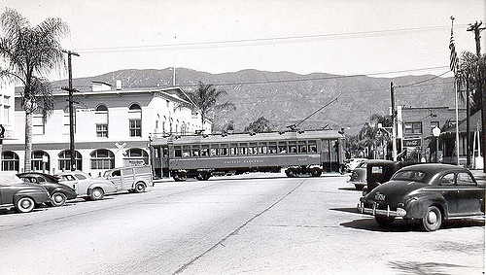
Pacific Electric in Glendora
Excerpt from Ride the Big Red Cars by Spencer Crump:
“It seems mighty nice to look out through the window from our desk and see the holes
being dug, the poles set, the trolley wire strung, and ties and rails being laid for the
Pacific Electric line,” the editor of the Glendora Gleaner wrote in his edition of
December 12, 1907. He added happily that the “line will make Glendora the terminus
and connect us with the City of Los Angeles, by twenty-seven miles distant and forty
minutes by time.” A week later the line officially opened. A brass band played and crowds
cheered when the first electric car arrived. Aboard the train here a group of Los Angeles civic
leaders headed by Henry Huntington. Speeches praised the trolley tycoon for the well-built line.

Slide 13
Pacific Electric in Glendora
First full line run from LA to Monrovia on March 1, 1903
17.5 miles in 53 minutes
$0.50 fare, roundtrip
Eastward construction continued, first train reached Azusa mid-November, 1907.
40 trains daily
Passenger rail service lasted until September 30, 1951.
Best year – 1945 with 2,730,816 passengers carried.
Important freight line
Local rail history resources:
Pacific Electric Historical Society – https://www.pacificelectric.org/
Los Angeles Railroad Heritage Foundation – http://larhf.org
Electric Railway Historical Association - http://www.erha.org/
Orange Empire Railway Museum - https://www.oerm.org/

Slide 14
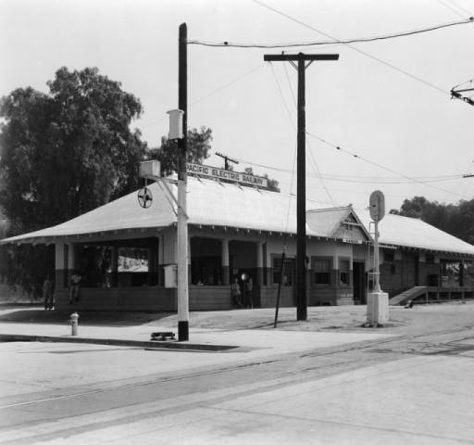
Pacific Electric in Glendora
PE Station on Michigan Avenue (later Glendora Avenue) – just south of Meda. Passenger ticket office and waiting room, agent’s office and freight room. Construction cost: about $5,000. Operated from 1907 until 1951; the structure has since been demolished.
With heavy use during WWII by passengers and freight – this line carried huge loads of rock to build the Los Angeles Harbor breakwater - the Monrovia-Glendora line tracks were in poor shape and in need of restoration, cost estimate in 1949 was $1,046,846.
Overhead power was de-energized on Nov. 30, 1951.

Slide 15
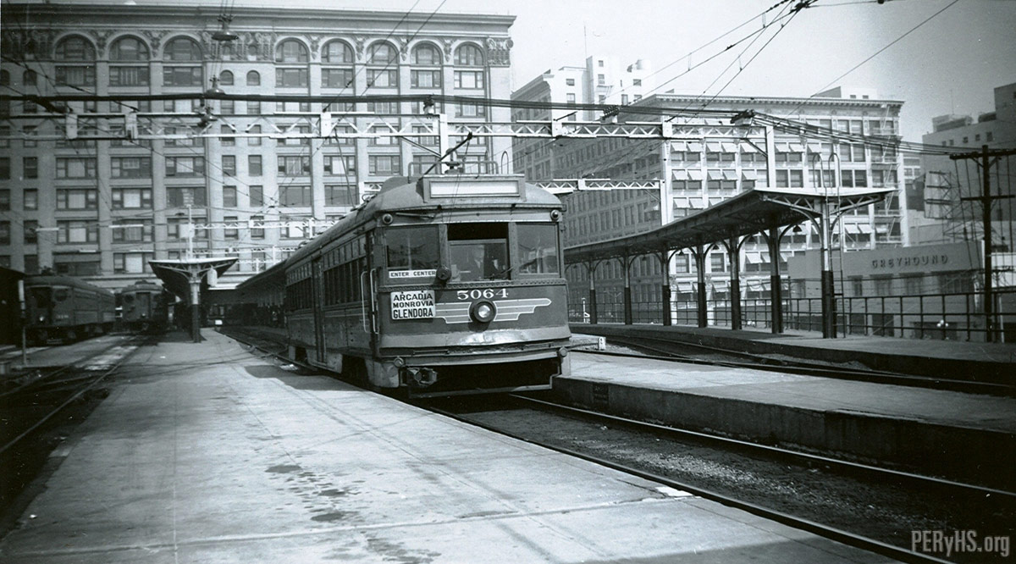
Pacific Electric in Glendora
Glendora bound train leaving 6th & Main Pacific Election Depot
From peryhs.org, Photographer Alan Weeks

Slide 16
Why did rail service go away?
Same basic business issues both pre and post WWII - huge capital costs to replace aging power substations, catenary wire and rail cars, buses become the economical alternative, rail-to-bus conversions begin in 1925, rapidly accelerates in 1950’s.
Public Utilities Commission held back fare increases – 5 cents from 1877 to 1927, 7 cents from 1928 to 1945, 10 cents from 1946 to 1951, 15 cents from 1952 to 1956.
No public subsidies for capital or operating costs available from local, state or federal governments.
Cultural changes - automobile reliability improves, status symbol marketing, and women & minorities enter the industrial workforce.
Modal improvements - brand new un-crowded highways and freeways.
Transit service operators believed that the freeway system would accommodate and speed transit buses as a high speed backbone, thereby increasing their attractiveness to passengers.
GM perfects and markets the 45 seat transit bus; air conditioning and air suspension become options.
Diesel is not yet considered to be a component of a new phenomenon called “smog”.

Slide 17
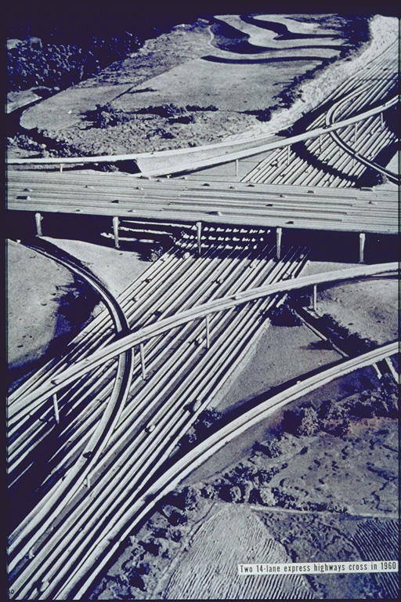
Influences:1939 New York Worlds Fair – GM’s 1939 Futurama Exhibit
Concept for car, bus and pedestrian only cities.
Imagined 14 lane freeway interchanges.
Notes:
Impact on public’s imagination about transportation. Federal Interstate Highway program begins 15 years later.

Slide 18
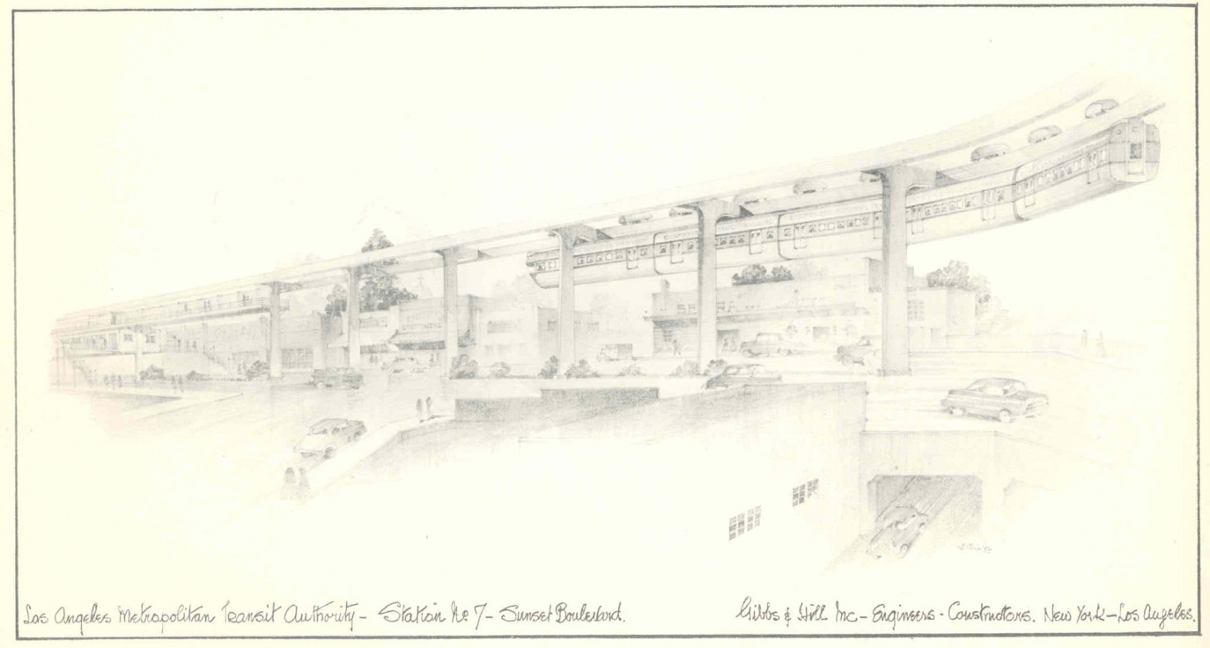
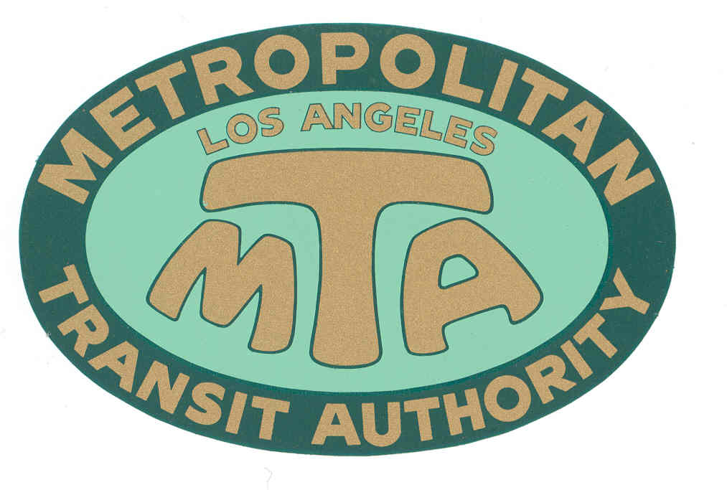
Los Angeles Metropolitan Transit Authority (1951-1964)
Formed by the State in 1951 to study a monorail line from Long Beach to Panorama City within a one mile boundary of the L.A. River.
Seven Member governing board appointed by the Governor. Released its first report in 1954. Powers expanded in 1954 to propose a new mass transit system for the region.
Powers expanded again in 1957 allowing MTA to become a transit operator.
Purchased Metropolitan Coach Lines (formerly Pacific Electric) and Los Angeles Transit Lines (formerly Los Angeles Railway), effective March 3, 1958.
Notes:
Known for shutting down 10 remaining rail lines while imagining a new mass transit system for Los Angeles based on Monorail technology. Suspended car French technology. This is the system science fiction writer Ray Bradbury still talks about today.
During its brief history, they managed to confuse the public and anger the Wilshire corridor, most notably Beverly Hills.
Source of the Westside Subway as the only viable was to provide mass transit along Wilshire Blvd.
First Senior Fares in the US, implemented in 1962 – 50 years ago.

Slide 19
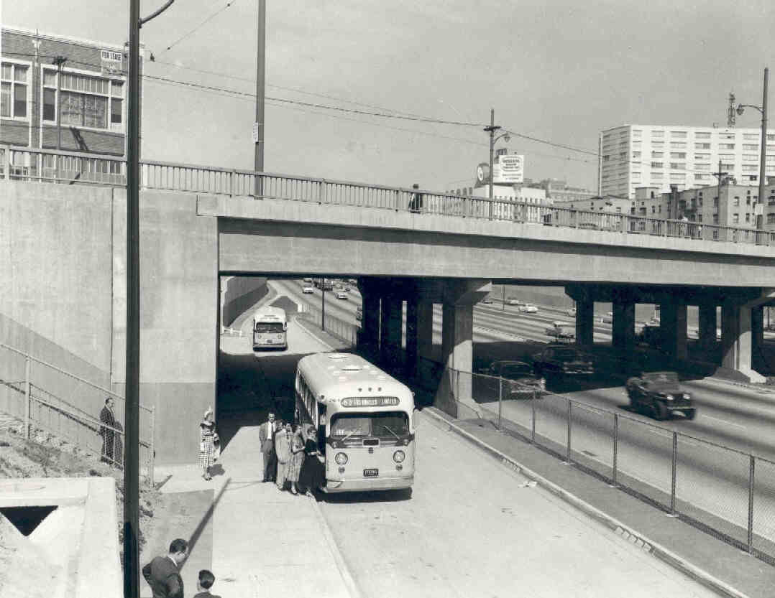
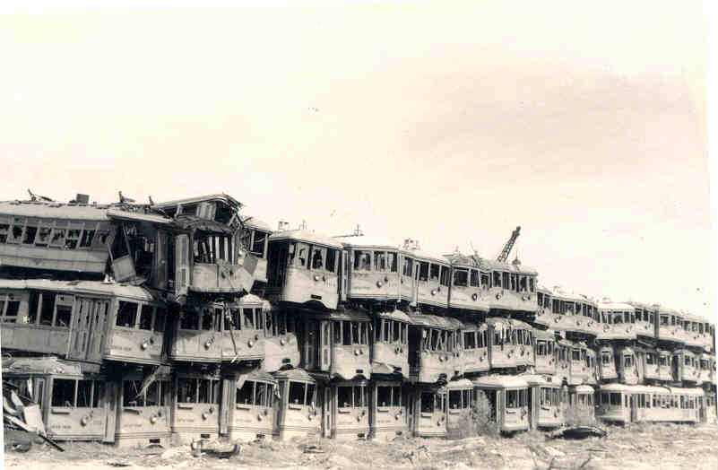
Rail lines still operating in 1958:
From Pacific Electric (1898-1953) via Metropolitan Coach Lines (1953-1958):
Long Beach, San Pedro, Bellflower, Watts Local, and Catalina Terminal.
Last “Red Car” runs to Long Beach on April 9, 1961.
From Los Angeles Railway (1895-1945) via Los Angeles Transit Lines (1945-1958):
West Jefferson Blvd & Huntington Park (J), West Pico & East 1st St. (P), Whittier Blvd. & West 3rd St. (R), San Pedro St. & Western Ave. (S), Vernon & Vermont Ave (V).
Last “Yellow Car” runs on March 31, 1963.
Notes:
Many believed that new highways would become the speedy backbone for bus routes and that there was no need to preserve rail service.
Some scrapped streetcars went to South Korea after WWII, others were sold to Veracruz Mexico and Buenas Aires Argentina. Some were dumped in the ocean off of Redondo Beach as artificial reefsto enhance fishing.
Many were burned in mysterious fires.
Some were saved and operate today at the Orange Empire Railway Museum in Riverside California.

Slide 20
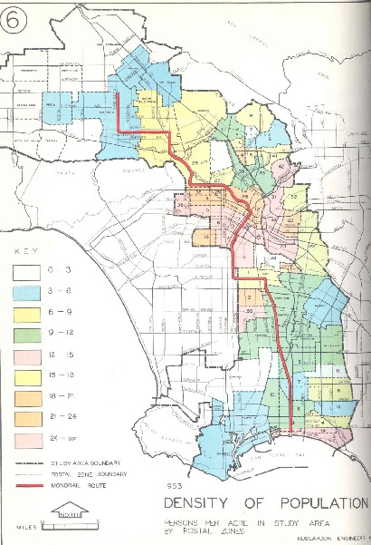
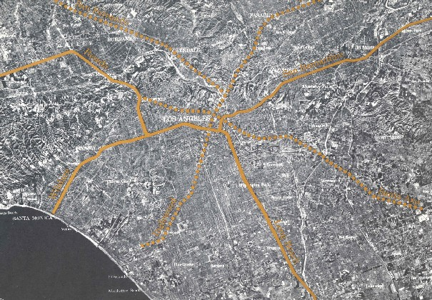
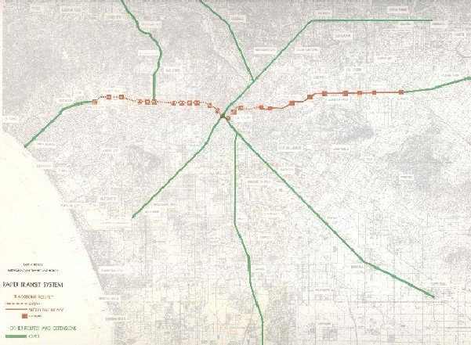
Los Angeles Metropolitan Transit Authority (1951-1964)
The initial 1954 study of one monorail line, 45 miles/$165 million, grows in 1960 to a 75 mile/$529 million monorail plan with elevated rail along Wilshire.
Expanded monorail plan meets strong opposition from Valley Boulevard, Wilshire Corridor and Beverly Hills.
MTA’s plan is scaled down to a “Backbone Route” with subway under Wilshire Boulevard and at-grade rail to El Monte.
Alweg and Goodell Monorail Co.’s release their own monorail plans and offer to build systems for “free” in exchange for next 40 years of MTA’s farebox revenue.
MTA notifies private companies that any plan that does not include subway along the Wilshire route is unacceptable. MTA fails in its PR efforts with general public.

Slide 21
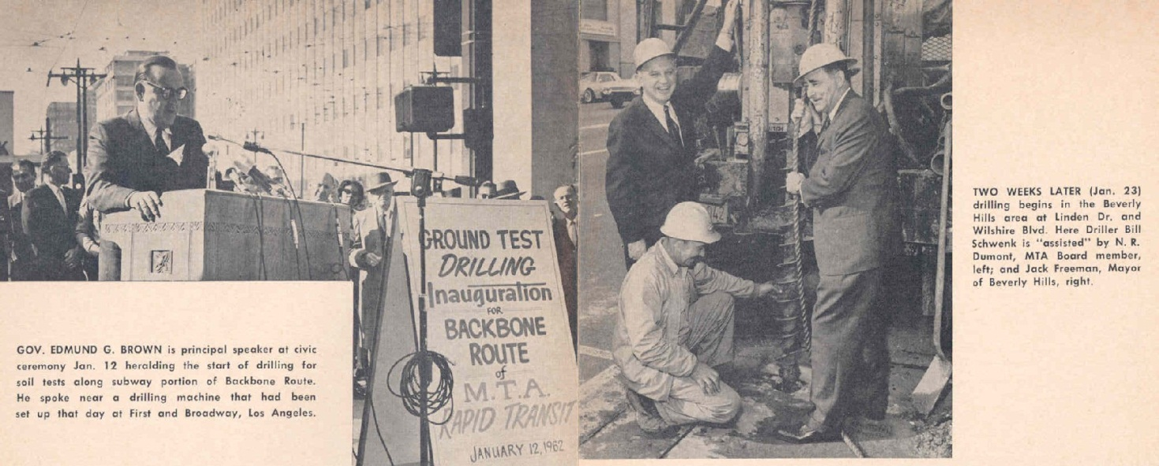
Los Angeles Metropolitan Transit Authority (1951-1964)
Politicians vociferously battle over if and how transit would be subsidized and what the very definition of subsidy really is. Public becomes thoroughly confused.
The MTA, without the ability to tax, issue bonds, or take property via eminent domain, without the existence of any Federal or State capital assistance programs, and still subject to taxation itself, holds two subway groundbreaking ceremonies: in downtown with Gov. Edmund G. Brown on 1/12/62, and in Beverly Hills with Mayor Jack Freeman, on 1/23/62.
State Sen. Rees (D-Beverly Hills) re-writes MTA legislation to give the transit agency the powers it was missing, re-launching it as the Southern California Rapid Transit District (SCRTD) in September 1964.
Notes:
First MTA tried to obtain a federally funded loan to build the Wilshire Subway, selling the project as a series of underground civil defense shelters connected by rail.
Beverly Hills was adamant that any mass transit system passing through their city be underground. Myth that Beverly Hills has opposed subway, to the contrary, they proposed the idea when faced with an elevated monorail running through their city..

Slide 22
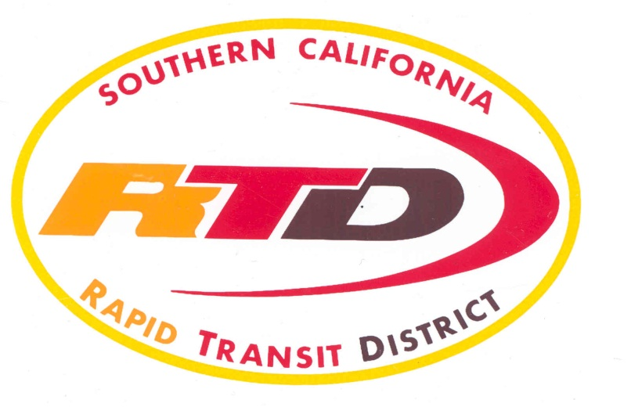
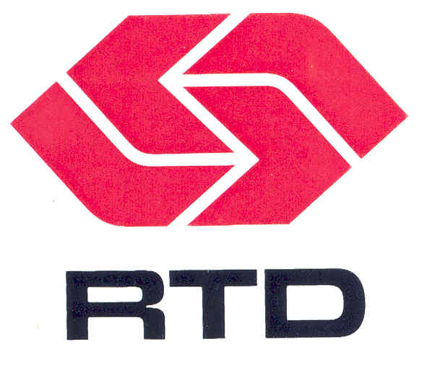
Southern California Rapid Transit District (1964-1993)
New agency has an eleven member board appointed by local elected officials, the powers of eminent domain, taxation through local referendum, bond issuance, and creation of Benefit Assessment Districts.
It is enthusiastically welcomed in an event at the Ambassador Hotel with 400 civic leaders.
Takes its legislative charge to create a new mass transit system for Los Angeles seriously and goes to work marketing public transportation as a needed and necessary community asset.
Federal government forms the Urban Mass Transit Administration in 1964 (now called the Federal Transportation Administration).
Operates transit service in L.A., Orange, Riverside and San Bernardino counties.
Takes over 11 other failing or failed transit companies, standardizing routes and fares.
Notes:
Did things no other transit agency could
In house emissions testing.
First alternative fuel transit bus – federally funded project to create a Steam powered bus.
Robotic inventory delivery for its massive rebuild center.
After 12 years of planning and lobbying, obtained a federal full funding grant agreement and began building the subway in 1986.

Slide 23
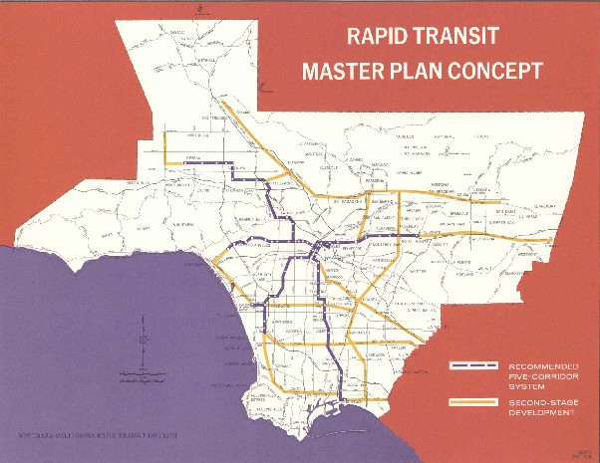
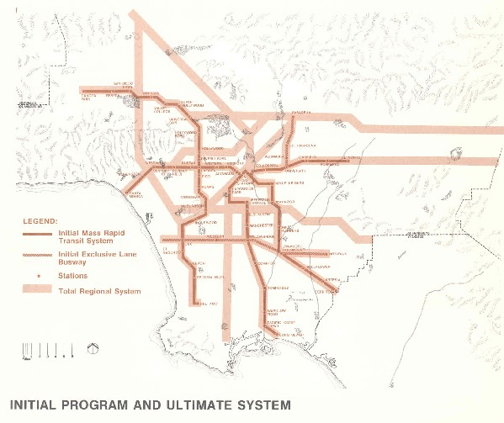
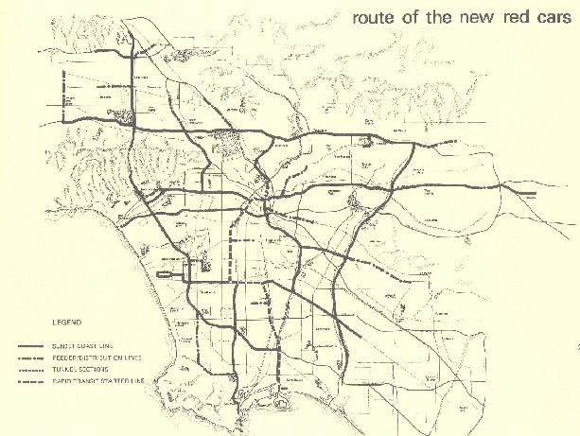
Southern California Rapid Transit District (1964-1993)
1968 Plan -
Initial 62 mile system that could expand to 300 miles, projected cost of $2.5 billion, 8.5 year construction period.
Rejected by voters, 44% yes.
1974 Plan –
Initial 116 mile system that could eventually expand to a 250 miles, projected cost of $6.6 billion, 12 year construction period.
Rejected by voters, 46% yes.
1976 “Baxter Ward” Plan –
281 mile system, 230 miles of elevated heavy rail and 51 miles of light rail, projected cost of $7.5 billion.
Rejected by voters, 40% yes.

Slide 24
Southern California Rapid Transit District (1964-1993)
Known for Innovations & Special Services:
El Monte Busway HOV Project
Mini-Bus circulator routes and Freeway Flyer services
Bus Technology
In-house Air Quality Testing lab
1974 FTA/California Steam Bus project
Particulate traps, alternative fuels
Double Deck and Articulated buses
First large scale wheel chair lift equipped bus order in history
Bus Scheduling and System Grid design
Technology – Robotic Parts Delivery, Pre-GPS Radio tracking system
FFGA for Metro Rail Subway Project & Construction
Rail Start up for the first new Light Rail Line & Subway Line
Earthquake service, Civil Unrest service, Papal Visit, National Democratic Convention, 1984 International Olympic Games, and coordinating other large scale special events throughout the County.

Slide 25
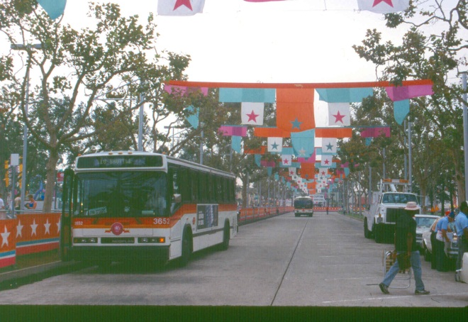
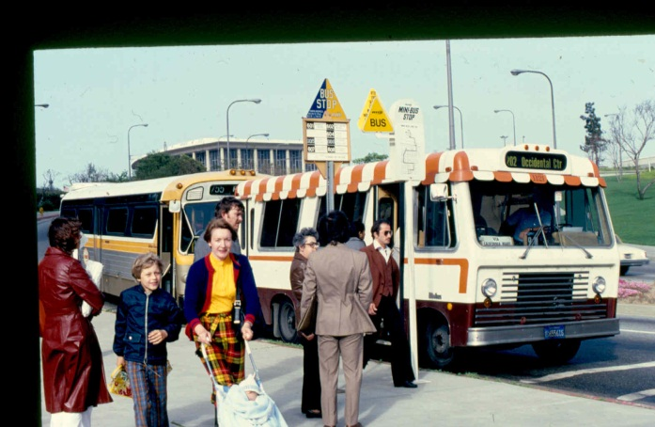
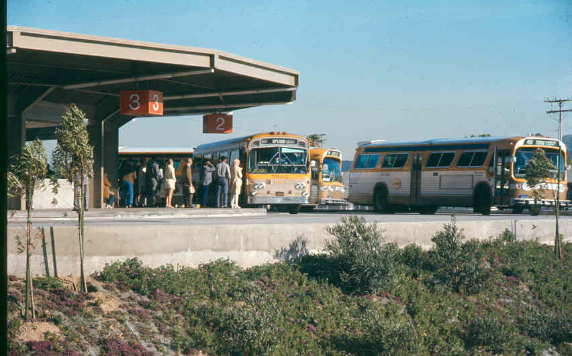
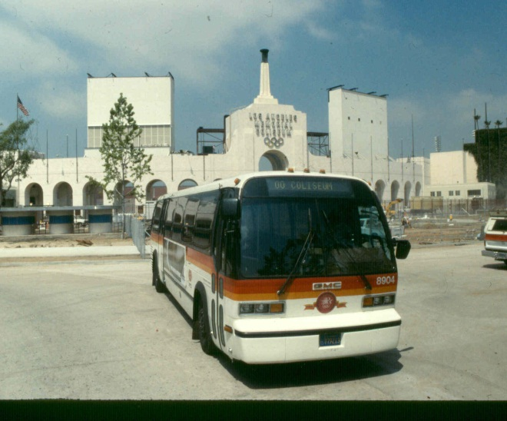
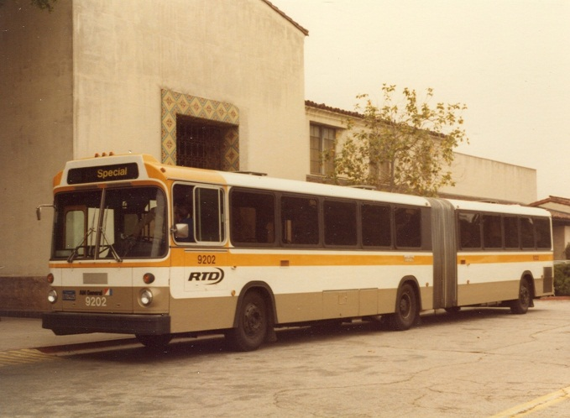
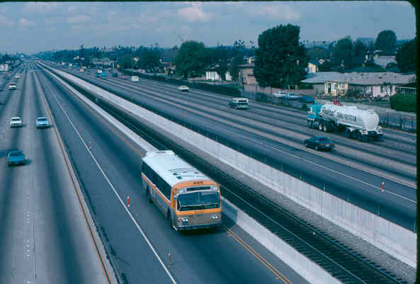
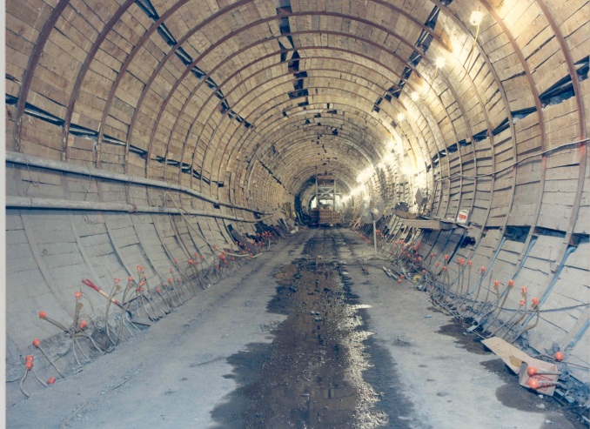
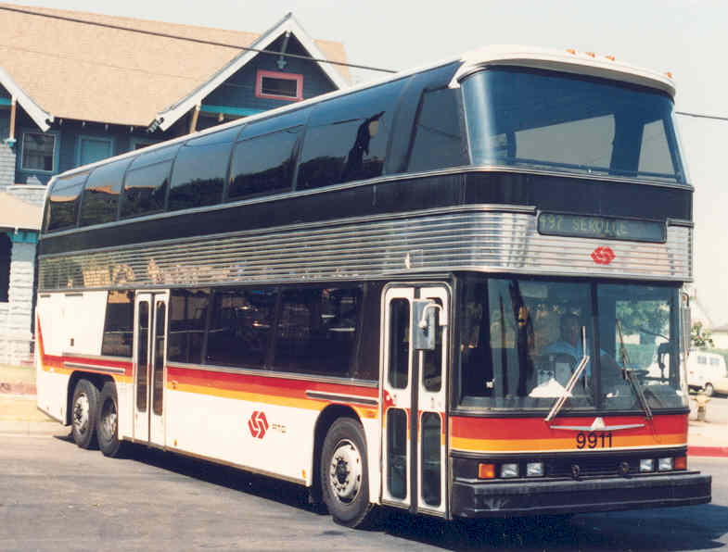
Southern California Rapid Transit District (1964-1993)

Slide 26
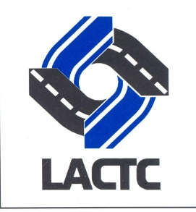
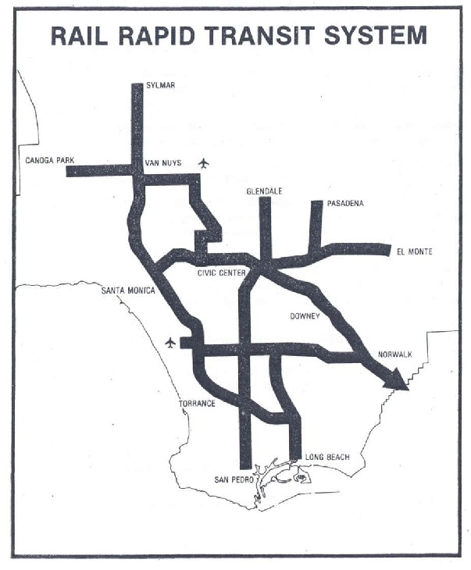
Los Angeles County Transportation Commission (1977-1993)
State creates the Los Angeles County Transportation Commission (LACTC) in 1976 to coordinate between municipal transit operators and SCRTD, plan countywide transportation improvements and ensure efficient use of local, state and federal transportation funding.
In 1980, a majority of Los Angeles County voters approve Proposition A (54.3%), a half cent sales tax for transportation improvements, 35% of revenue is dedicated for rail construction.
Map from 1980 Proposition A voter information materials

Slide 27
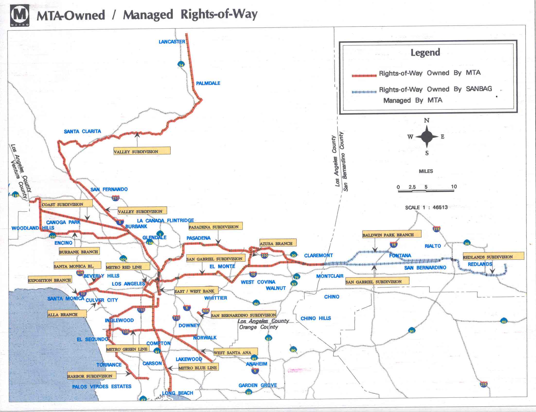
Los Angeles County Transportation Commission (1977-1993)
A second half-cent sales tax for transportation, Proposition C, was approved by a majority of Los Angeles County voters (50.4%) in 1990, along with propositions 108, 111 and 116.
The Transportation Commission begins negotiations with Southern Pacific, the parent company of the former Pacific Electric system, to acquire 450 miles of right-of-way in Southern California. The parties eventually agree on a purchase price of $980 million in 1992. The commuter rail system known as Metrolink is born and spun off as an independent five-county joint powers authority.
Created the Foothill Transit Zone, carved out of SCRTD’s service in 1988, setting up a contentious merger between the two agencies. In February 1993, the Commission issued a draft EIR/study of the North San Gabriel-San Bernardino Valley Rail Transit Corridor which became the current Foothill Gold Line project.

Slide 28
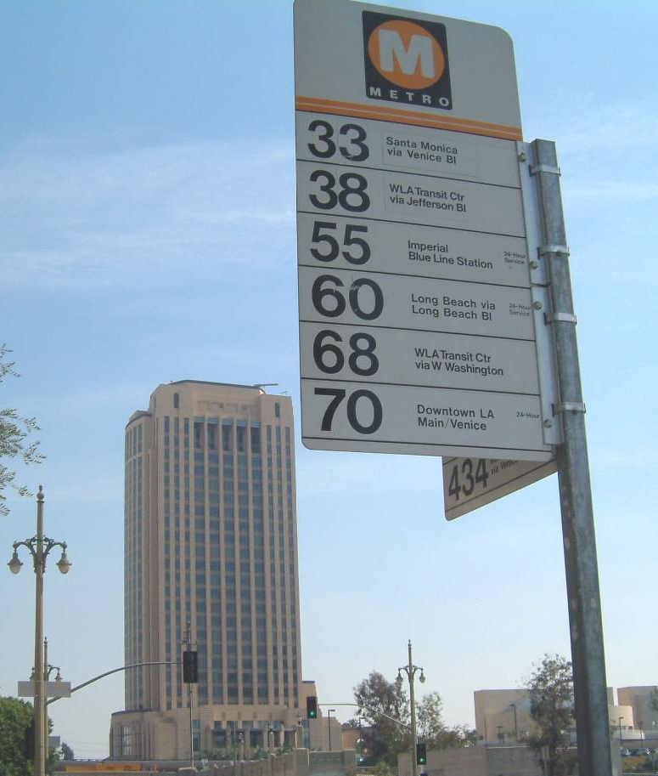
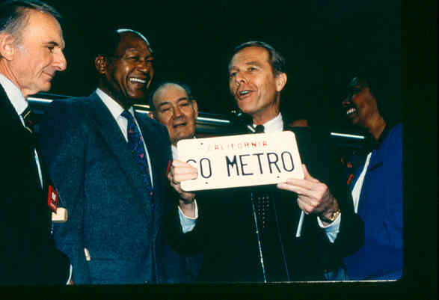
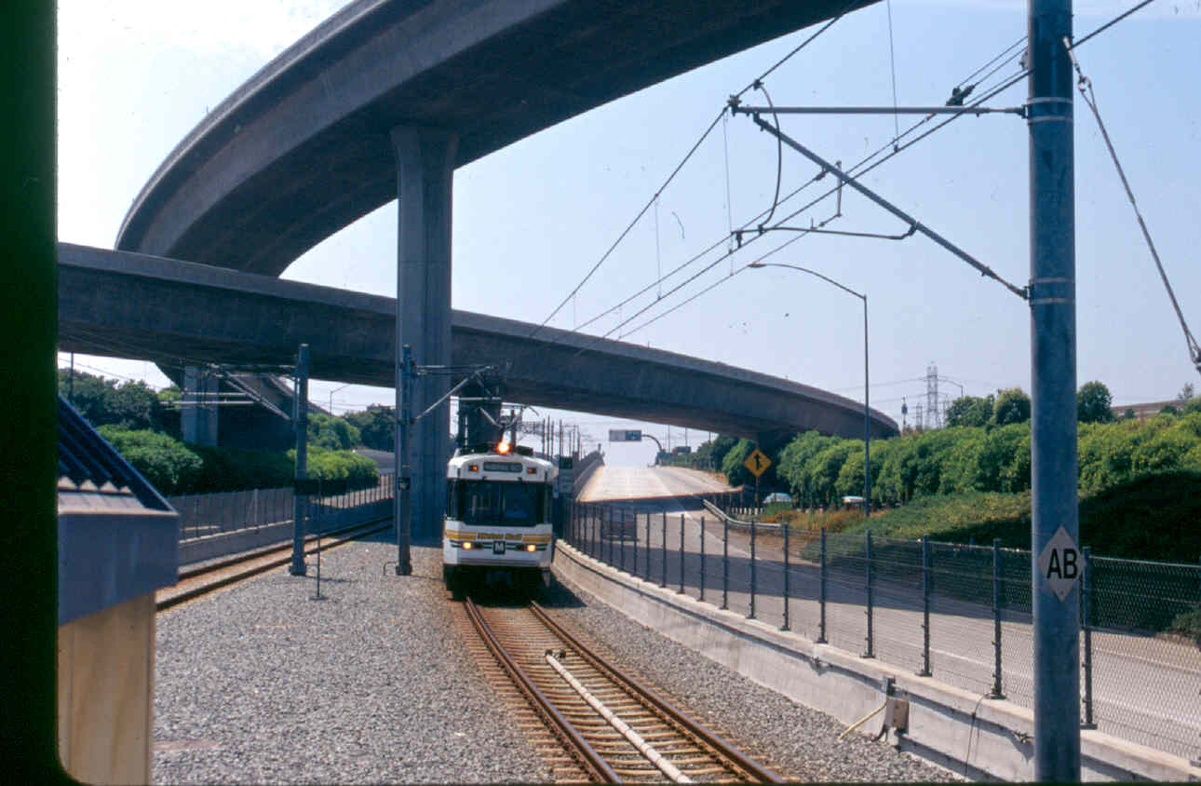
Merging Transit with Transportation
1988, the two agencies agree on an eight-point plan that includes consolidating all rail construction under a single third entity, naming the lines the Metro Red Line, Metro Blue Line and Metro Green Line, and open discussion of an eventual merger.
1992, the Governor signs AB152 (Katz) that creates the Los Angeles County Metropolitan Transportation Authority, also known as MTA or Metro, effective February 1, 1993. It becomes a planning, funding, construction, and operating multi-modal “super agency” for Los Angeles County.

Slide 29
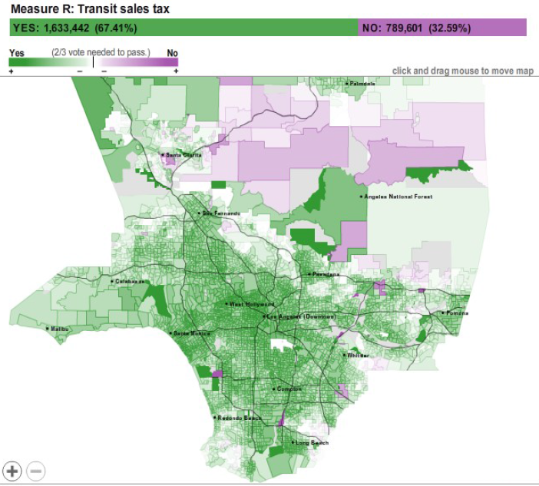
November 2008 – Measure R
A 3rd half cent sales tax for a specific 30-year transportation improvement plan is adopted by LA County voters at 67.4%, reaching the 2/3rds majority required for new taxes by local “districts” in California.
The prior Commission was exempt. Simple majority votes passed the two prior ½ cent sales taxes, without sunset clauses.

Slide 30
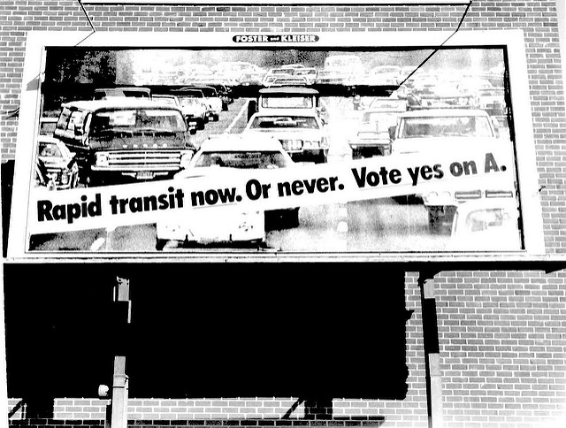
History of L.A. County Ballot Initiatives
Note: Prop A (1980) & Prop C (1990) were sponsored by the Los Angeles County Transportation Commission, exempt from Prop 13
and passed by simple voter majorities. After the 1993 merger with SCRTD, a 2/3rds majority vote under Prop 13 became a requirement.

Slide 31
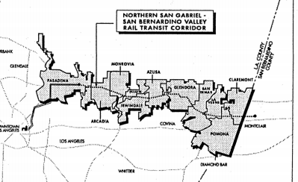
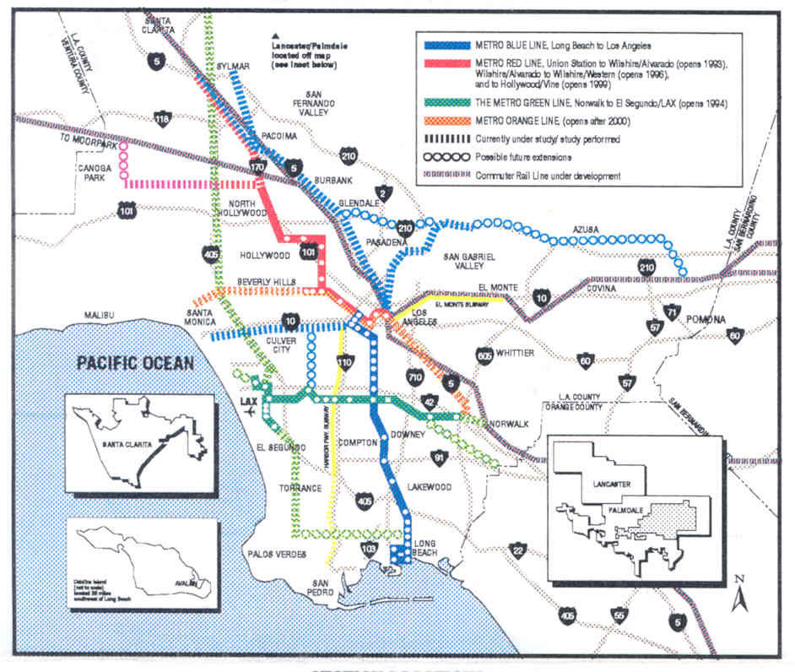
Path to the Foothill Gold Line Project
1980 – Voter approved Prop A ½ cent sales tax that includes dedicated funding for rail projects and emphasizes the use of existing rights of way
1990 – Pasadena-Los Angeles Metro Blue Line project approved
1991 – Korve Engineering is contracted to conduct the Northern
San Gabriel-San Bernardino Valley Transportation Corridor that would connect to the LA-Pasadena project as its continuation to the San Bernardino County line
1993 – Draft NSGSBV Environmental Impact Report is circulated for comment
1994 – Metro breaks ground on its Pasadena Blue Line project
1994 – Final NSGSBV Environmental Impact Report is adopted/certified, but not funded.
1995 – Metro begins reconstruction of bridges along Pasadena ROW
1998 – Metro suspends work on the Pasadena Blue Line project

Slide 32
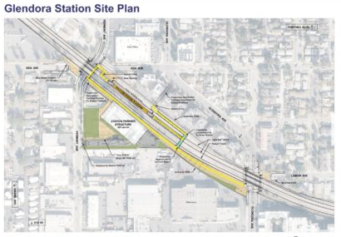
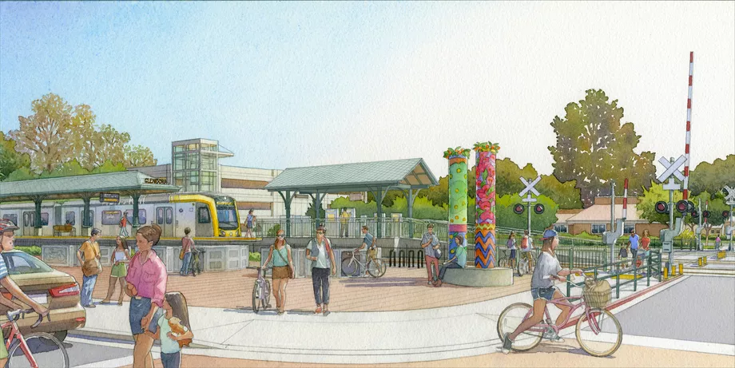
Path to the Foothill Gold Line Project
1999 – Pasadena Blue Line Construction Authority formed to resume the project
2001 – Metro Board renames the Pasadena-Los Angeles Metro Blue Line as the Metro Gold Line
2003 – Metro Gold Line opens. Pasadena Blue Line Construction Authority becomes the Foothill Gold Line Construction Authority
2004 – New Draft Foothill Gold Line Extension EIR circulated for comment
2007 – Final Foothill Gold Line Extension EIR adopted/certified
2010 – Draft Supplemental EIR for Phase 2b Azusa to Montclair circulated for comment. Gold Line extension from Pasadena to Azusa construction begins
2013 – Final Supplemental EIR for Phase 2b Azusa to Montclair adopted/certified
2016 – Gold Line extension from Pasadena to Azusa opens
2018 – Azusa to Montclair segment breaks ground, projected opening 2025/2026.

Slide 33
Multi-modal Transportation System
1,433 square-mile service area, 165 bus routes.
Nation’s largest clean-air transit fleet - 2,308 CNG buses + adding electric buses
13,978 bus stops & 280,794,035 annual bus boardings.
98 miles of Metro Rail – 93 stations. 2 heavy rail, 4 light rail lines & 110,139,493 annual rail boardings.
539 Carpool/HOV Lane Miles.
149 Tow Trucks on Metro Freeway Service Patrol with 300,000 motorist assisted annually.
Metro Rapid BRT system.
609 miles of bike routes, bike lanes, and bike paths, every bus is bike rack equipped.
Largest funding partner of 550-mile Metrolink commuter rail system.
FAQs: http://www.metro.net/news/facts-glance/
Ridership: http://www.metro.net/news/ridership-statistics/

Slide 34
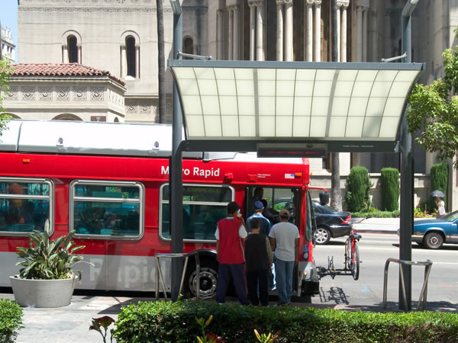
Metro’s Transit System
Metro Rapid
Metro Local
Metro Express
Metro Light Rail
Metro Heavy Rail
Metro BRT Rapid Busways
Notes:
Branding effort in 2003.

Slide 35
Growing rail network, improved highway network, and funds for many more transportation system improvements over 30 years.

Slide 36
Community Optimism for the future
From LA Curbed Blog:
The Most Optimistic Possible LA Metro Rail Map of 2040
https://la.curbed.com/2016/2/22/11095232/los-angeles-all-metro-projects-rail-map-2040
Fantasy map by Jake Berman

Slide 37
Metro’s Draft 28 by 2028
Read more here: https://thesource.metro.net/2018/01/25/agenda-and-preview-of-metro-boards-january-meeting/

Slide 38
Further Reading & Resources on Transit History
Railtown: the fight for Los Angeles Metro Rail & the future of the City by Ethan N. Elkind
Los Angeles Railroad Heritage Foundation – http://www/larhf.org
Pacific Electric Historical Society http://www.pacificelectric.org
Electric Railway Historical Association – http://www.erha.org
This Was Pacific Electric - DVD - A documentary film by Tom Eberhardt
Henry E. Huntington and the Creation of Southern California by William B. Friedricks
From Railway to Freeway - Pacific Electric and the Motor Coach by Eli Bail.
Los Angeles & the Automobile by Scott Bottles.
Street Railways and the Growth of Los Angeles by Robert C. Post.
Ride the Big Red Cars: How Trolleys Helped Build Southern California by Spencer Crump

Slide 39
End
Photo by Fred Camino

