Slide 1
Research Library, Archive & Records Management
Matthew Barrett, Director
barrettm@metro.net x27444

Slide 2
Records Management Repositories
Metro.net is a repository of public convenience, not a records management system, shortest lifespan for Metro’s publications – records schedule has no influence on it.
Transportation Research Library – https://librarycat.metro.net also not a records management system, but information lifespan is as long or longer than Records Management, also has supporting standards, reports, manuals, policies, etc.
Records Management Center – The official repository of Metro’s records, based on the Board adopted Records Retention Schedules and Gen 8 Records Policy. Oracle database for digital, Iron Mountain for paper, https://records.metro.net for California Public Records Act (CA’s version of FOIA) requests.

Slide 3
Records Management – Metro publications
Gen 8 Records Management Policy & Retention Schedule – adopted by the Board of Directors. Example for Planning:

Slide 4
Records Management
Electronic Documents – Quality Control Issues
Distribution on CDs and posted on Metro.net –
Missing files that are listed in the table of contents
Hyperlinks to blank documents
Hyperlinks to personal cell phones and email addresses of public meeting participants
Plagiarized content
Bad metadata

Slide 5
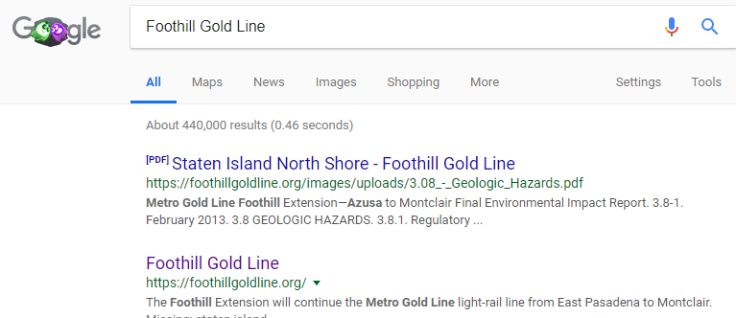
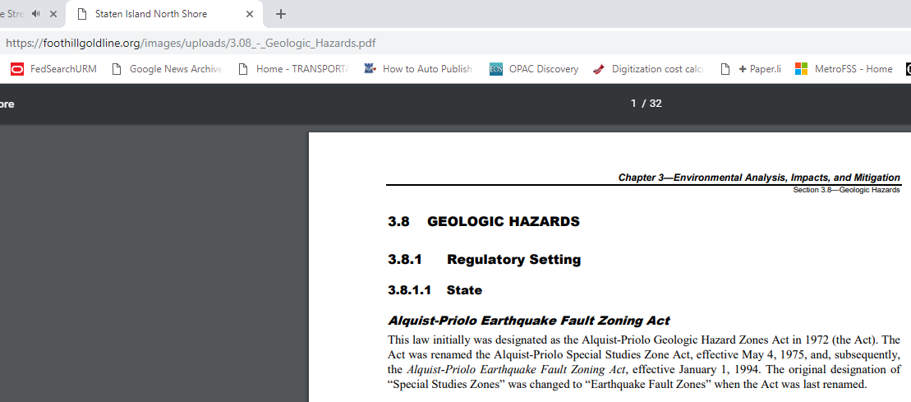
Records Management – bad metadata Example
File document properties need to match the content. Problem is most common when someone opens an old document and overwrites the content. Metadata is normally autogenerated when the file is first created and it doesn’t change unless someone manually changes it. This confuses users about the authenticity of the document.

Slide 6
Records Management - Email
Email has a 30 day default retention – looking at extending to 90 days
Public Comment email accounts (e.g. PurpleLineExt@metro.net) can have automated retention period suspended by ITS, but don’t rely on it. Per the retention schedule, public comments on transportation policies and programs are to be kept indefinitely – be sure they are kept someplace safe.
Significant emails that contain content that rises to the level of a record (such as a final directive or decision) should be kept according to the retention schedule for their relevant category.
Record Emails can be stored electronically in project management systems, shared drives, sharepoint, or Metro Enterprise licensed MS Onedrive or Dropbox accounts. Outlook is not a reliable storage system.
Do not use personal email accounts or personal file storage sites (Google Drive, personal OneDrive or Dropbox, etc) to conduct Metro business.

Slide 7
Records Management – Policy Resources
Records Management Policy – Gen 8 (includes retention schedules)
https://lacmta.sharepoint.com/sites/MyMetro/AdminPolicies/Policies/Records%20Management%20GEN%208.pdf
Legal Holds Policy – Gen 56
https://lacmta.sharepoint.com/sites/MyMetro/AdminPolicies/Policies/Legal%20Holds%20GEN%2056.pdf
Public Document Disclosure Requests – Gen 12
https://lacmta.sharepoint.com/sites/MyMetro/AdminPolicies/Policies/Public%20Document%20Disclosure%20Requests%20GEN%2012.pdf
We direct most requestors to our online NextRequest system: https://records.metro.net
Online Records Management Training
https://training.metroconnect.net (click on Training Catalog, then Records Management Online Tutorials)
Text of the California Public Records Act, CA Gov Code section 6250 et al:
https://leginfo.legislature.ca.gov/faces/codes_displayText.xhtml?lawCode=GOV&division=7.&title=1.&part=&chapter=3.5.&article=1
Questions or need records management consulting? RMC@metro.net or Joe Parise, Manager – Records and Information Management, x22333, parisej@metro.net

Slide 8
Records Management – Board of Directors
Current (2015-present) Board of Directors agendas, reports, minutes, and indexed webcast/video
Go to https://boardagendas.metro.net Migrating the previous board archive into this system is a long term project we’re working on.
Search predecessor agencies meeting minutes (1952-1993), and Metro Board of Directors, all documents, including Board Box items (1993-2015)
Go to https://metro.net/boardarchive
If you just want to search for “Board Box” items, (aka miscellaneous correspondence from staff to the Board of Directors).
Go to: http://metroprimaryresources.info/metro-board-box-misc-correspondence-search/
I try to up date it at the end of every month. You can also direct browse the directory at http://boardarchives.metro.net/BoardBox/ 2007 forward is organized by date in folders and file names.

Slide 9
Records Management – Other Resources
Staff are members of the American Records Management Association (ARMA), National Association of Government Archives and Records Administrators (NAGARA), Special Library Association Transportation Division (SLA) and the Society of American Archivists (SAA).
Subscribe to/Read the daily Transportation Headlines
https://headlines.metroprimaryresources.info
Check out the Transportation Research Library’s Blog, Primary Resources
https://www.metroprimaryresources.info
Search the Library Catalog
https://librarycat.metro.net
Search the TRB Transportation Research Information Database https://trid.trb.org
Contact a librarian – Matthew Barrett barrettm@metro.net, Kenn Bicknell bicknellk@metro.net or Nicholas Auricchio auricchion@metro.net or Maggie Sacco saccom@metro.net for research assistance.

