Slide 1
Metro
Department 101 Training Program
Subject Matter Course: Transportation Research Library, Archive & Records Management.
Metro Provides Excellence in Service and Support.

Slide 2
Research Library & Records - What We Do
DEPARTMENT 101 TRAINING PROGRAM
Library, Archive & Records Management
Provide Research Content and Records Management Services to employees, contractors & the public:
Provides public access and reference services for transportation collections.
Manages compliance with the California Public Records Act, State Library Act, State Data Access Act, and State/Federal E-Discovery Acts.
Supports eDiscovery Requests from Counsel & manages Legal Holds.
Audits against adopted policies and retention schedules for agency records.
Digitizes, indexes & manages records storage/retrieval services for Metro.​
Sets agency-wide Records Management Policy & Retention Schedules, Records Management Training, and coordinated with all departments.
Maintains Search, Metadata, Taxonomy, and Controlled Vocabularies.
Catalogs, archives and curates frequently accessed & high value collections.
Works with cultural institutions to highlight the contribution of transportation to the development of Los Angeles.
Reports to Board Administration, under the Board Clerk.

Slide 3
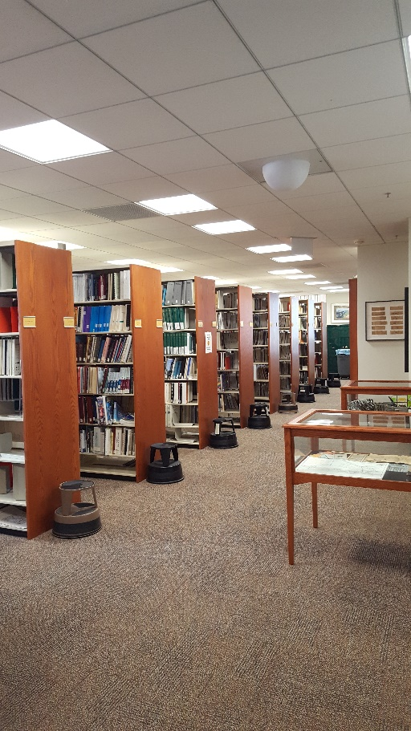
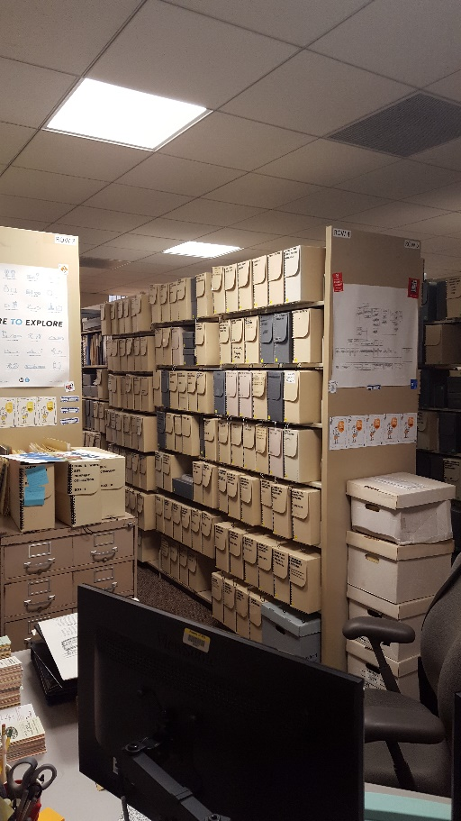
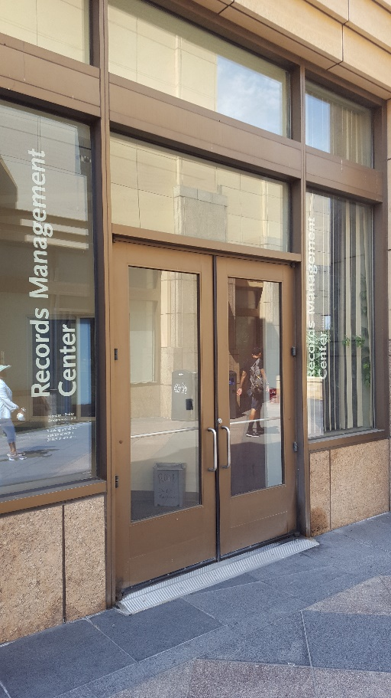
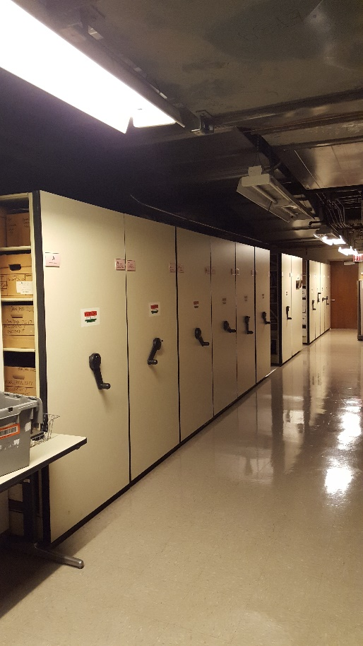
Research Library, Archive & Records
15th Floor Library
15th Floor Archive
Plaza RMC
P-1 RMC

Slide 4
Research Library, Archive & Records
Functional areas and staffing
Transportation Research Library
1 Library Svcs Manager, Library & Archives
1 Digital Resources Librarian
2 Librarians – 1 Cataloging, 1 Data Curation
1-2 part time student interns for circulation desk duties
Archives
1 Librarian
Records Management Center (RMC)
1 Info Governance Manager, 4 RIM Analysts, 3 TCU Records clerks
Electronic Records Mgmt – 1 Sr. Project mgr, 1 Principal Transportation Planner, 1 Sr. Dept Sys Analyst

Slide 5
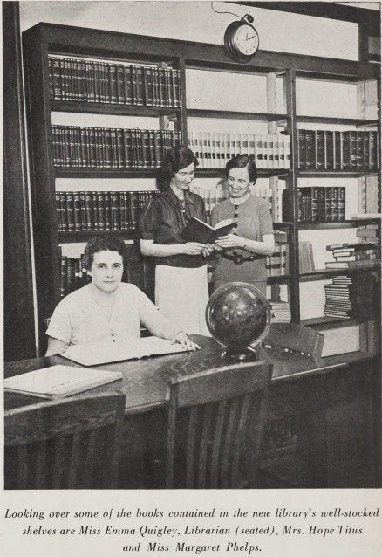
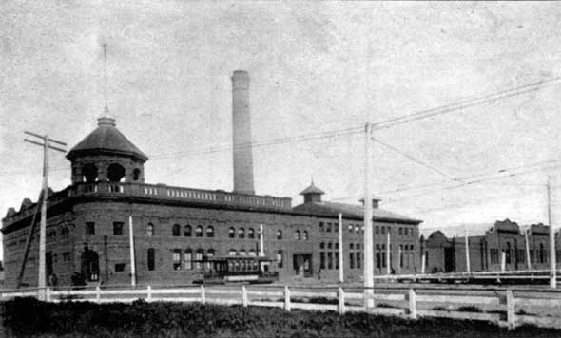
Transportation Research Library
Transportation Research Library
Dates back to 1895 through all of Metro's direct predecessors.
Temporarily closed during The Great Depression, reopened with the assistance of the Huntington Library.
Founding member of SLA's Transportation Division in 1943.

Slide 6
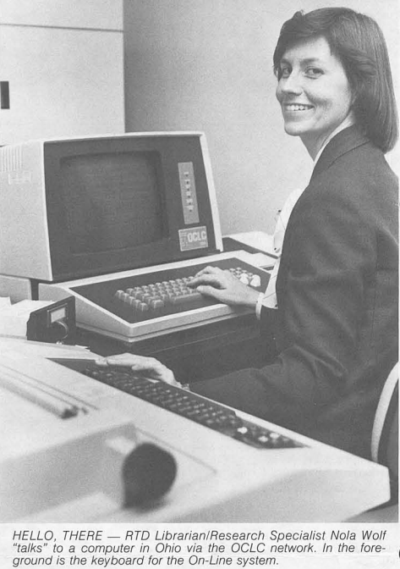
Transportation Research Library
Our Research Library collection became "computerized" in 1978 by joining OCLC/World Library Catalog network, sharing MARC format records of holdings with other libraries and honoring interlibrary loan requests.
Access to over 3 million records then, over 1 billion today.

Slide 7
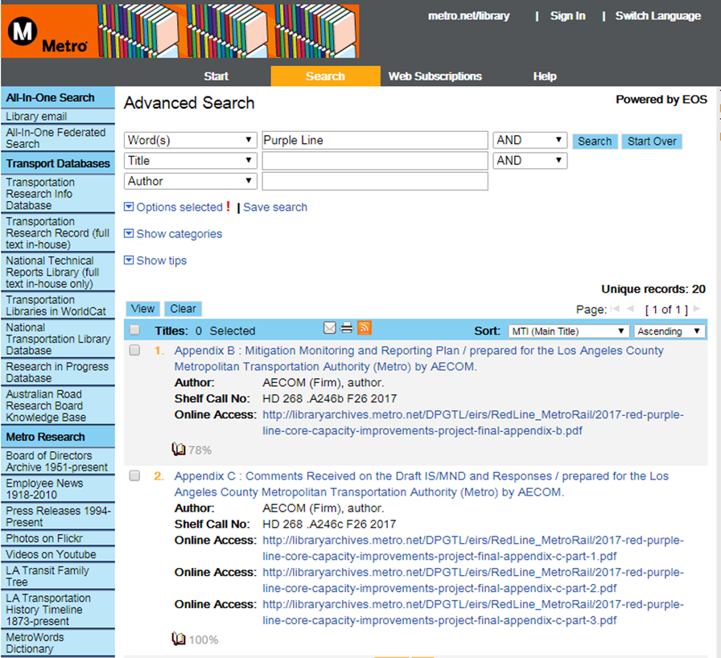
Transportation Research Library
Current Integrated Library System (ILS) is provided by Sirsi-Dynex/EOS and contains over 40,000 items, about 20% of which have links to full text resources.
http://librarycat.metro.net

Slide 8
Transportation Research Library
Library cataloging in MARC requires knowledge of 40,000 field combinations to accurately describe items under the internationally accepted standards, the traditional Anglo-American Cataloging Rules (AACR-2) or more recent standard RDA, the Resource Description & Access standard.
Data is shared among all OCLC members in WorldCat. One library creates the original record for a credit, all others download for a fee.

Slide 9
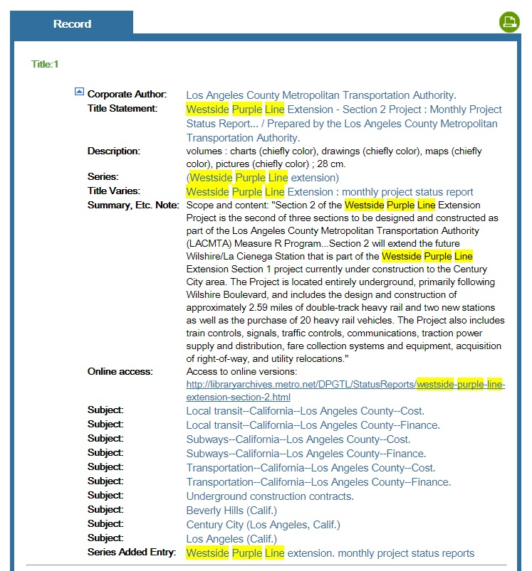
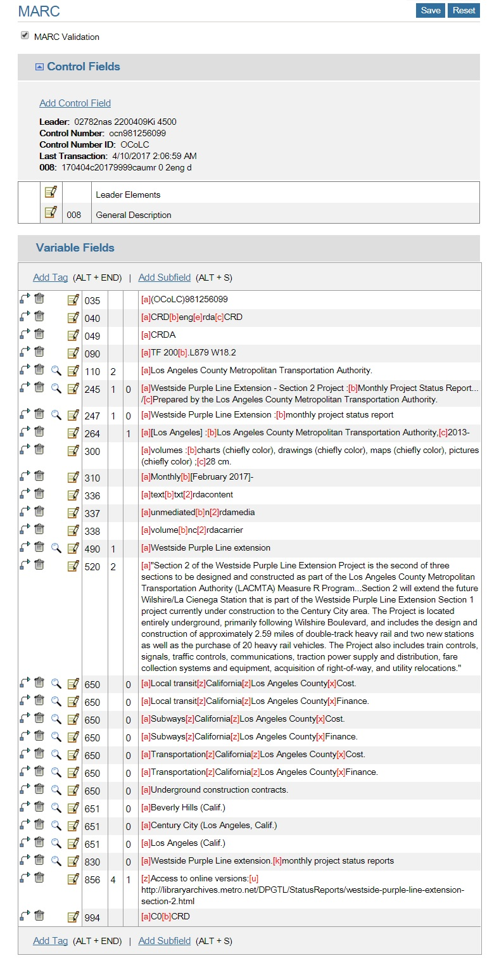
Transportation Research Library
Typical catalog view for public users
MARC Format Data

Slide 10
Transportation Research Library
Research Library is comprised of Metro's own transportation project plans, documents, studies, reports and publications and their related multidisciplinary reference materials. 40% of the collection is unique and not found anywhere else.
Also a repository of federally funded transportation research reports since 1971.
Guided by a Collection Development Policy

Slide 11
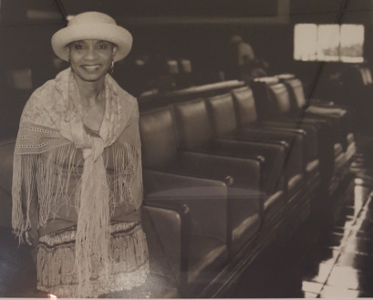
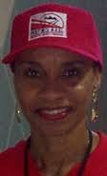
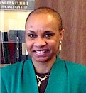
Transportation Research Library
Only Transportation Research Library in SoCal.
Named the Dorothy Peyton Gray Transportation Library & Archive by the Board of Directors in October 2001 in recognition of her career’s accomplishments. One of only two Metro facilities named after former employees.

Slide 12
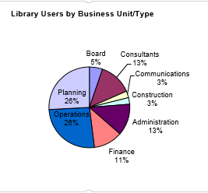
Transportation Research Library
Largest transit operator research library the United States. Similar size to Caltrans and the Bay Areas’ Metropolitan Transportation Commission research libraries.

Slide 13
Research Library- Paid Collections
Research Library provides network-wide access to paid online research databases/services:
National Technical Reports Library – access to over 3 million research report records/abstracts and over 800K full-text reports covering Aeronautics, Chemistry, Energy, Environment, Healthcare, Info science, Mathematics, Medicine & Biology, Physics, and Transportation.
Transportation Research Record Library – access to TRB's peer reviewed transportation research reports.
Elsevier Engineering Village & Compendex Databases
EBSCO Leadership & Management Digital Library
Overdrive/Libby E-Books

Slide 14
Research Library – Other Collections
Board Archive collection started in 2004 from holdings in the Records Management Center, 1951-2015. Current Board Info: boardagendas.metro.net
Employee Newsmagazine collection created in 2010 from holdings in the Archive 1916-2010.
California Highways collection created in 2015 from a donated collection and partnership with Occidental College. Uses Google Custom Search for Indexing.
Press Releases 1994-Present
News Clippings 1986-2015. Adding 1940-1985, recently found on microfilm in our archive.

Slide 15
Research Library - Services
Created Transportation Headlines blog and daily email news aggregation service in 2005: headlines.metroprimaryresources.info
Metro Primary Resources Blog to highlight significant Metro information using full text links to digitized photos, videos/films, and documents from the Library, Archive and Records Management based on reference questions, anniversaries and other prompts.
Includes “This Day in L.A. Transportation History” calendar (left side of the home page).

Slide 16
headlines.metroprimaryresources.info

Slide 17
Research Library - Services
Historical Family Tree
Timeline of LA Transportation History
Social Media sites starting in 2005 to circulate Metro Transportation Research Library information. Tumblr, Twitter, Facebook, HistoryPin using source materials stored in Flickr, Youtube, and digitized reports on libraryarchives.metro.net/dpgtl
Reference Question Research & Analysis

Slide 18
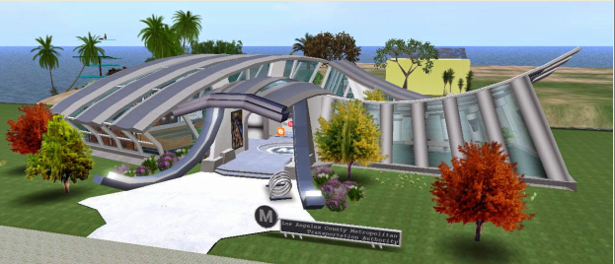
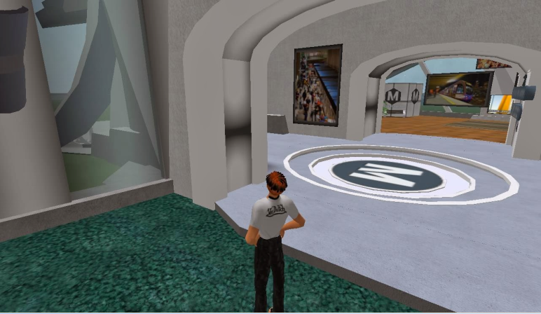
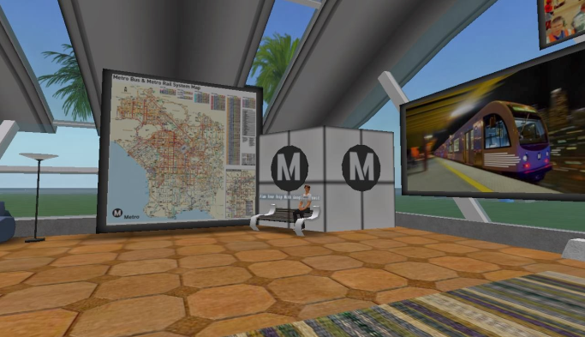
Transportation Research Library
Willing to experiment with new tech, and decommission failures, like virtual reality platform Second Life:

Slide 19
Transportation Research Library
Staff contributes to innovations in transportation research:
INTERNET LIBRARIAN INTERNATIONAL (2016 : London)
The Librarian as Journalist
Tools for the Library Innovator
OCLC WEBJUNCTION WEBINAR 2017 (online webinar : 250 attendees)
NATIONAL LIBRARY OF NORWAY (2017 : Oslo)
Tools for the Library Innovator: Living Our Better Than Free Values
Our Search for Relevance: The Path from Important to Essential
UNIVERSITY OF OSLO, NORWAY (2017 : Oslo)
Tools for the Library Innovator: The Bleeding Edge of Opportunity
DIRECTORATE GENERAL FOR EDUCATION & CULTURE, EUROPEAN COMMISSION (2017 : Brussels)
The Search for Relevance: Strategic Thinking for Library Innovation
AWARDS -
HISTORY/IT SCHOLARSHIP FOR DIGITAL THINKING (2016) Inaugural recipient of award to support innovative digital thinking in history organizations, in conjunction with the American Association for State and Local History
TRANSPORTATION RESEARCH BOARD, Panel member, NCHRP Project 20-97 Study: Improving the Findability and Relevance of Transportation Information. Budget $900,000.

Slide 20
Archive
A bridge between the transportation research library and records management that catalogs and curates historically and culturally significant materials documenting the contributions of transportation to the development of Los Angeles from 1873 to the present.
Contains records from our predecessors, private companies and public agencies, as well as donations from employees, estates and elected officials.

Slide 21
Archive
Digitized over 2,000 VHS tapes, 8mm and 16mm films. Opened a YouTube channel to host some of them online for public access. Now has over 4,000 subscribers and millions of views.
Digitized over 14,000 photographs. Created a Flickr site to host online for public access. Now has thousands of followers and photos have been accessed over 25 million times.
Archivist reviews and approves legal agreements for publishers and mass media.

Slide 22
Archive
Creates finding aids for individual collections
Submits finding aids to the Online Archive of California
Uses California Audiovisual Preservation Project Partners grant program to professionally preserve film and video at no cost to Metro. Preserved archival materials hosted online by Online Archive of California.

Slide 23
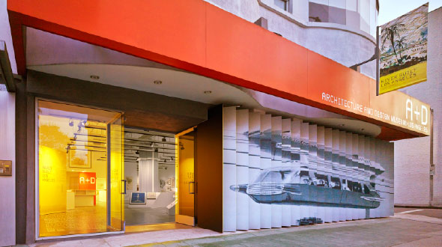
Archive
Works with other cultural institutions to exhibit items from Metro's collections, recently:
Getty Museum, Pacific Standard Time exhibit
National Building Museum, Washington DC
A + D Architecture and Design Museum of LA
USC's Doheny Library galleries
Los Angeles Central Library galleries
Los Angeles As Subject
Pasadena History Museum
California Historical Society

Slide 24
Records Management Center (RMC)
Administers the State of California Public Records Act (CPRA), adopted in 1968 as Government Code Sections 6250-6270.
Gen 8 Records Management Policy and Records Retention Schedules, Gen 12 Records Requests, and Gen 56 Legal Holds
Oversight of digitization/scanning production
Oversight of inactive records stored off-site AKA box management, currently Iron Mountain

Slide 25
Records Management Center
Currently researching and honoring an average of 2,000+ requests annually, a 300% increase since Measure R passed in 2008.
Now using NextRequest to manage the CPRA process at https://records.metro.net/
Audits every cost center every two years for compliance with Gen 8 Records Management Policy
Using Relativity software to manage legal holds

Slide 26
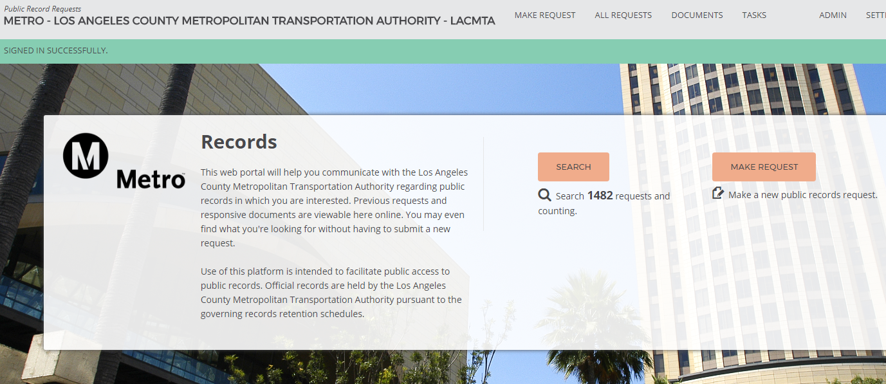
Next Request – https://records.metro.net

Slide 27
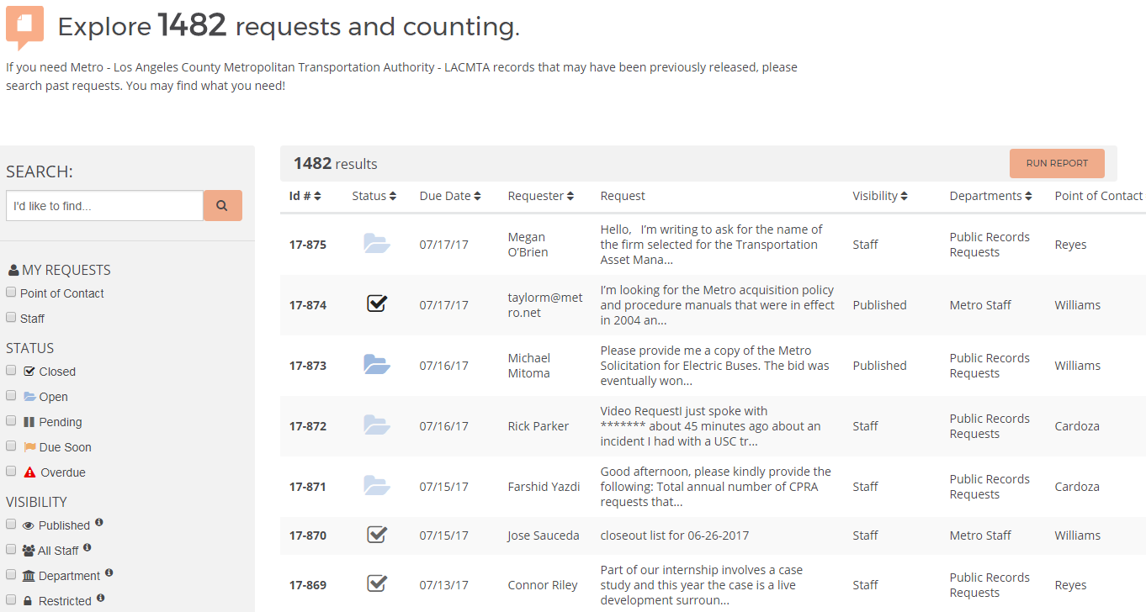
Next Request – https://records.metro.net

Slide 28
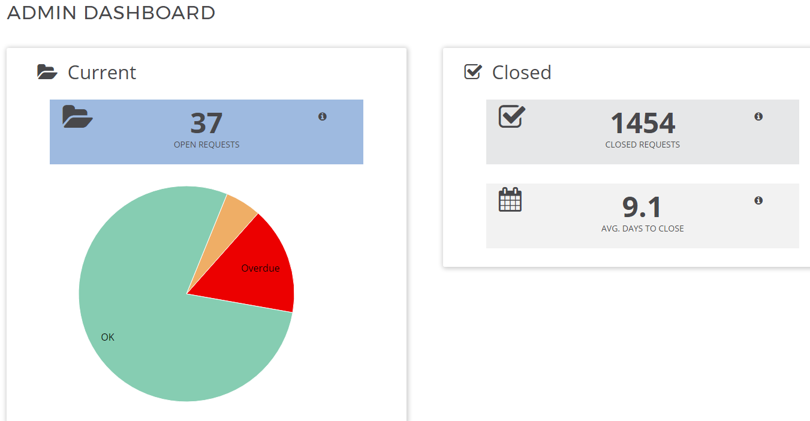
Next Request – https://records.metro.net
Simple Analytics

Slide 29
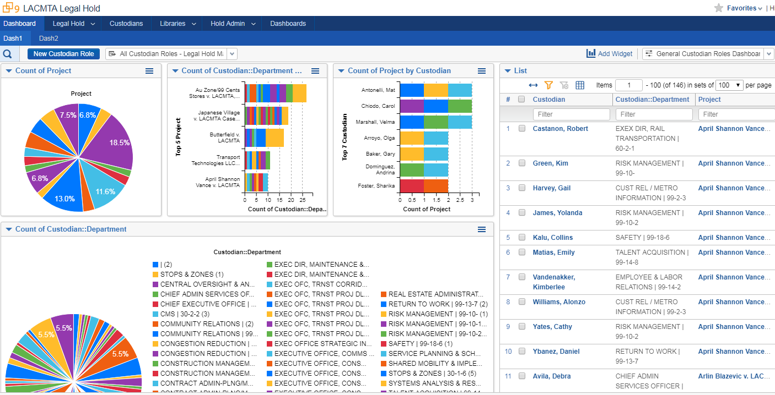
Relativity – Legal Holds Management
Simple Analytics

Slide 30
Digitizing paper records
Metro continues to create voluminous paper “final” records, largely due to a lack of an electronic approval/signature standard and process. Quickly improving post pandemic.
Scanning & Indexing 200k-300k pages annually
Storing in Oracle Universal Records Manager
New Federated Search by Fishbowl Solutions leverages our Mindbreeze Search Appliance and additional records repositories to make searching easier.

Slide 31
Records Management – Scan versus Store
ROI - Storing paper costs $0.15 cents per box of 2,500 pages per month at Iron Mountain or $1.80 annually per box.
Iron Mountain Paper Storage: Example - Ethics Form 700 Statement of Economic Interests - about 2,500 pages created annually, or 1 box. 7 year retention = $12.60.
But - Round Trip for a box from/to Iron Mountain is about $20 each time and requires manual searching of box contents.
Scanning costs: Labor + overhead for prep, scan, & quality control; software licenses for scanning and database; + hardware. ROI is low for short lifespan docs, EXCEPT for retrieval and access costs.
Electronic/Scanned Records with either a high research/retrieval value, or a very long retention period (over 20-30 years) improves ROI.

Slide 32
Electronic Records Management
Beginning to manage born digital records
Information Governance is the set of multi-disciplinary structures, policies, procedures, processes and controls implemented to manage information at an enterprise level, supporting an organization's immediate and future regulatory, legal, risk, environmental and operational requirements. Information governance should determine the balance point between two potentially divergent organizational goals: extracting value from information and reducing the potential risk of information.
Regulations and Policies
Ralph M. Brown Act (California Government Code 54950)
California Public Records Act (Government Code Section 6250-6270)
California E-Discovery Act (AB5)
Senate Bill 272, Chapter 795 (Government Code Section 6270.5)
Metro Legal Hold Policy (GEN 56)
Metro Records Management Policy (GEN 8)

Slide 33
Electronic Records Management
Digital records (continued)
Board Meeting records: Granicus, Legistar, Councilmatic.
High number of stakeholders in varying areas: Board of Directors (&Staff), Office of the CEO, Office of the Board Secretary, and the Public.
Goals:
Consistency
Paperless Workflow
Progress Insight
Centralized Repository
Customer-Friendly User Experience
Searchability
Findability

Slide 34
Electronic Records Management
Digital records (continued)
Federated Search: Mindbreeze Search, Oracle URM, Inactives (off-site records), and Metro.net.
Simultaneous search of multiple repositories from a single query. (“One-stop shop”)
SmartLogic/Semaphore Ontology System
Official taxonomy of Metro, over 15,000 managed terms
Compliance with State/Federal E-Discovery laws
Tagging of stored electronic information
See search enhancements in BoardAgendas.metro.net

Slide 35
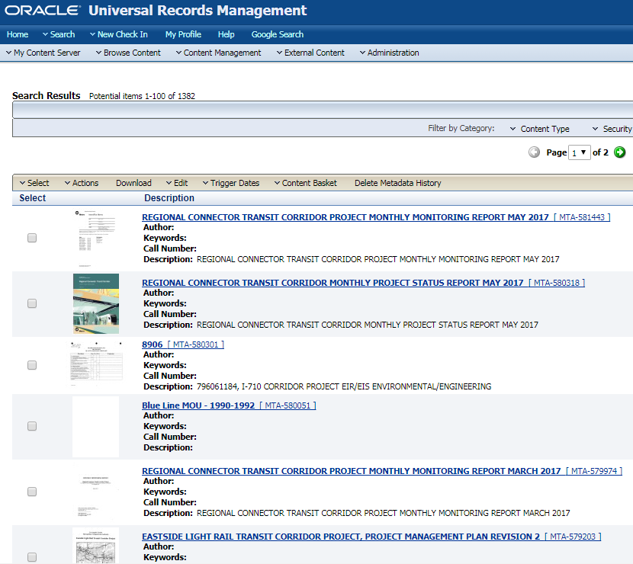
Oracle URM Scanned Records Search

Slide 36
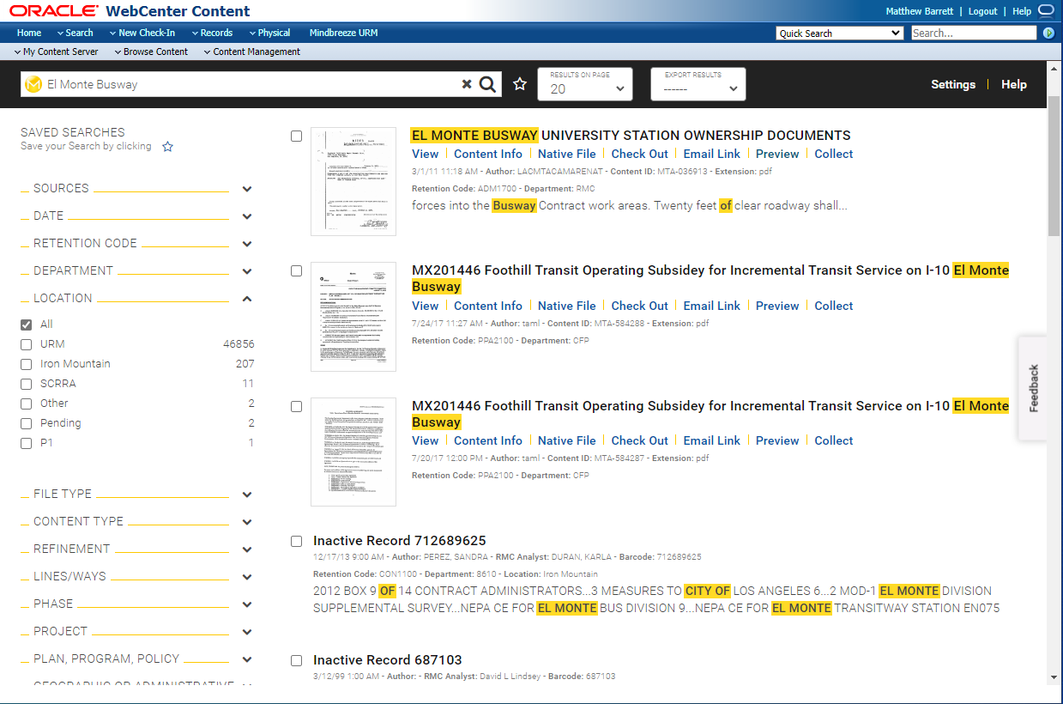
Oracle URM Records – Mindbreeze Search
New Mindbreeze based federated search returns more relevant results with document previews and filtering through dynamic navigation

Slide 37
Electronic Records Management
Digital records (continued)
eDiscovery:
Legal Hold Management
Automated management of Legal Holds notifications and reminders.
Auto-Classification
Automated classification and retention based on metadata, pattern/forms recognition, key and system field matching, Semantic Content Analytics ( i.e. concepts, topics, sentiment, similar, summary, vocabulary.)
Proof of Concept: Email & attachments
Next step: On Hold.

Slide 38
Electronic Records Management
Digital records (continued)
Infographics
Information Governance (Mitigation of Cost & Risk)
Reduced Governance (Higher Costs & Risk)

Slide 39
Contact Info & Links
DEPARTMENT 101 TRAINING PROGRAM
Transportation Research Library, Archive & Records Management
Contact us via:
library@metro.net, rmc@metro.net, & boardreport@metro.net
In Person:
Library & Archive, 15th Floor, or the Records Center, Plaza Level
Intranet Online (Quick Links Menu, Research Library):
Pages - Transportation Research Library & Archive (sharepoint.com)
Web:
https://lametro.nextrequest.com/
http://librarycat.metro.net & https://mtalibrary.on.worldcat.org/discovery
http://headlines.metroprimaryresources.info
https://www.youtube.com/user/metrolibrarian & more

Slide 40
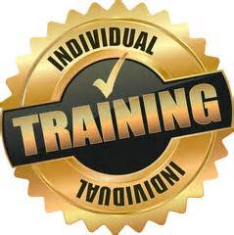
Certifications and Education
DEPARTMENT 101 TRAINING PROGRAM
What prepares you to work in Research Library and Records Management?
Certifications
Basic: NARA or NAGARA certificate in Records Management
Advanced: ARMA/ICRM Certified Records Manager
Advanced: ARMA/Certified Information Governance Professional
Degrees
Basic: Bachelors Degree (BA/BS) in history, English, computer science, etc.
Advanced: Masters Degree in Library and Information Science (MLIS) or Computer Science
Experience
Analysis, web/social media work, methods of organization, policy writing and performance measurement, database management, library, archives, museums, records repositories both physical and digital, information retrieval work, research settings, supervisory skills, and experience in instruction, public presentations, client relationship management/customer service.

Slide 41
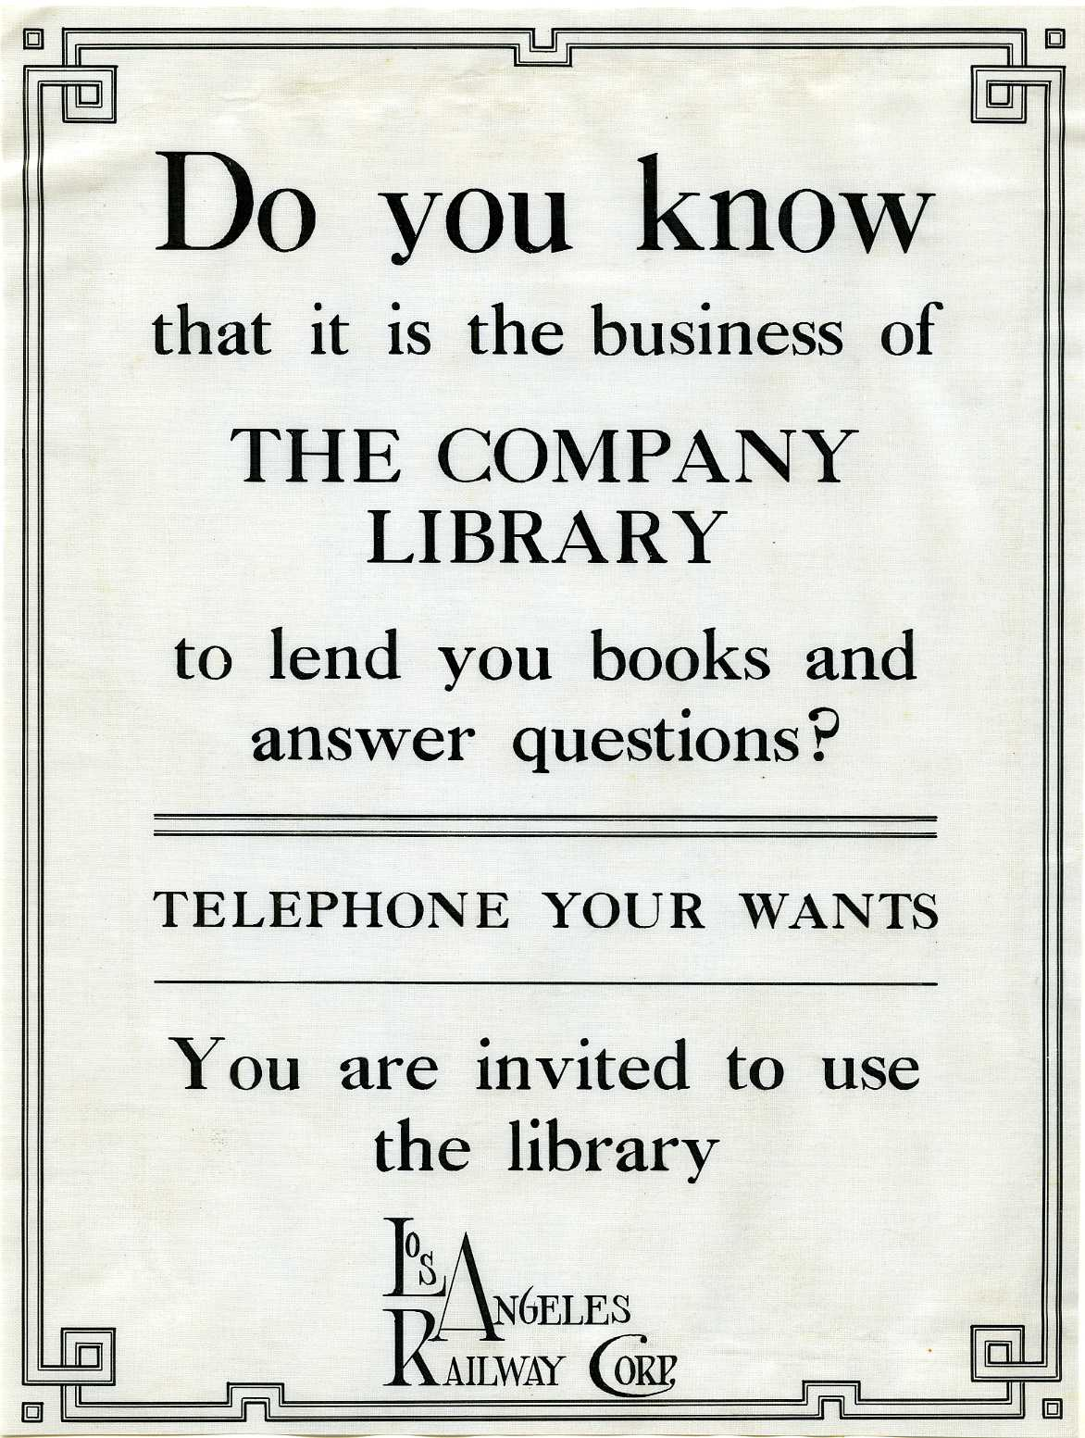
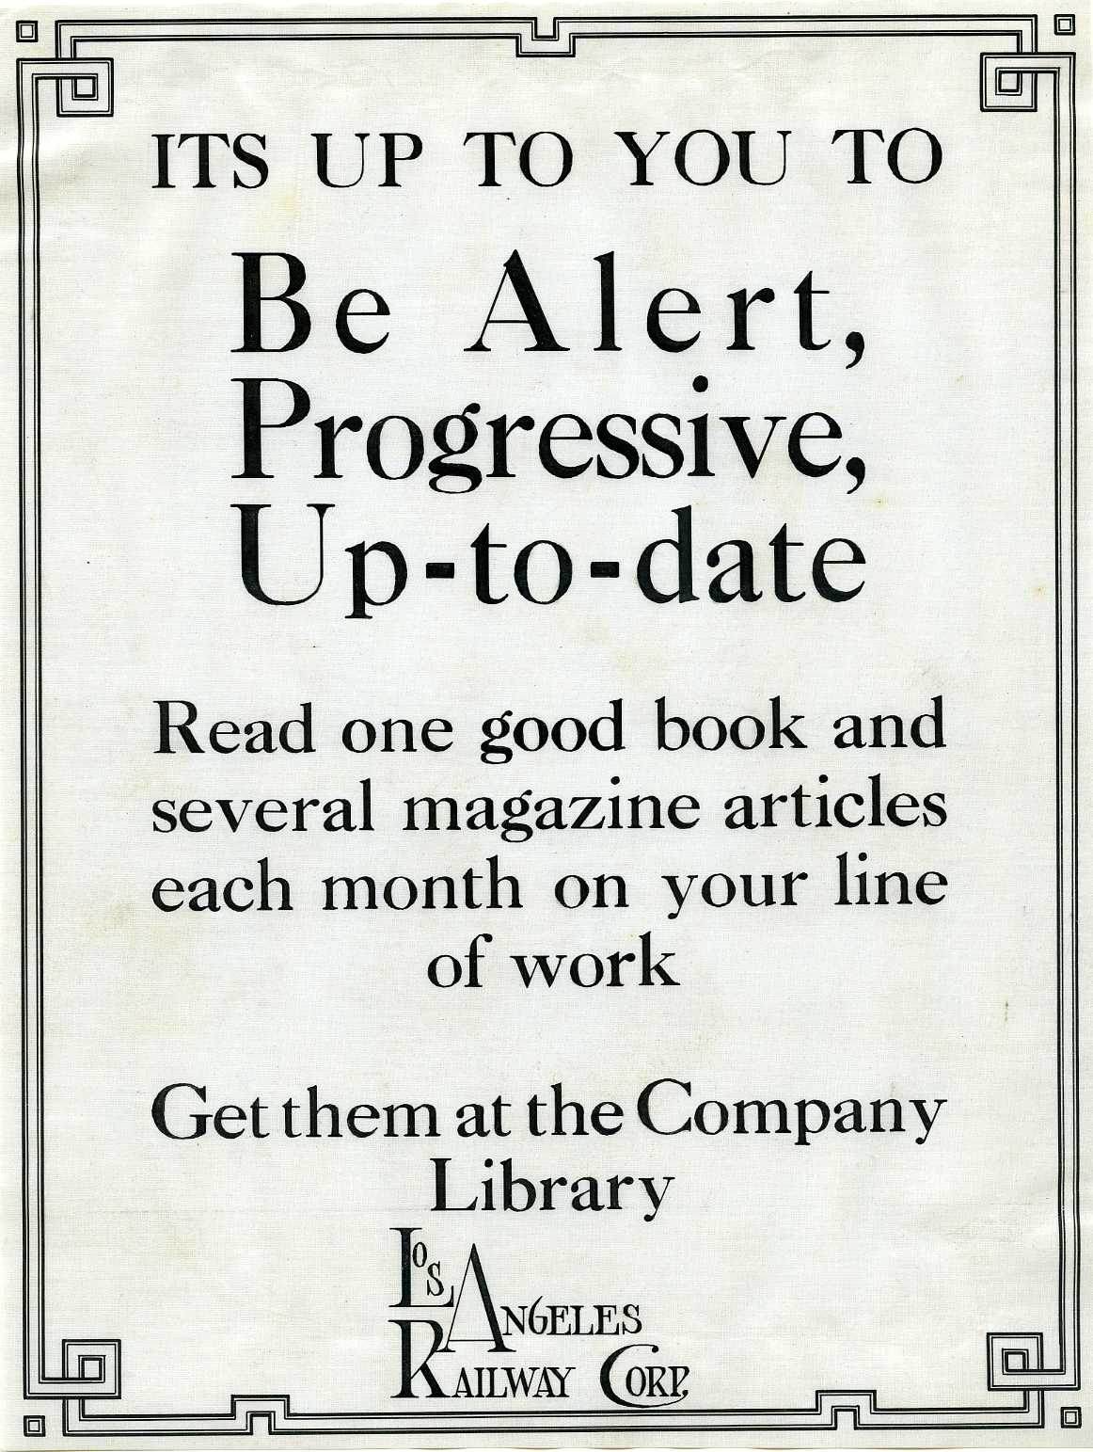
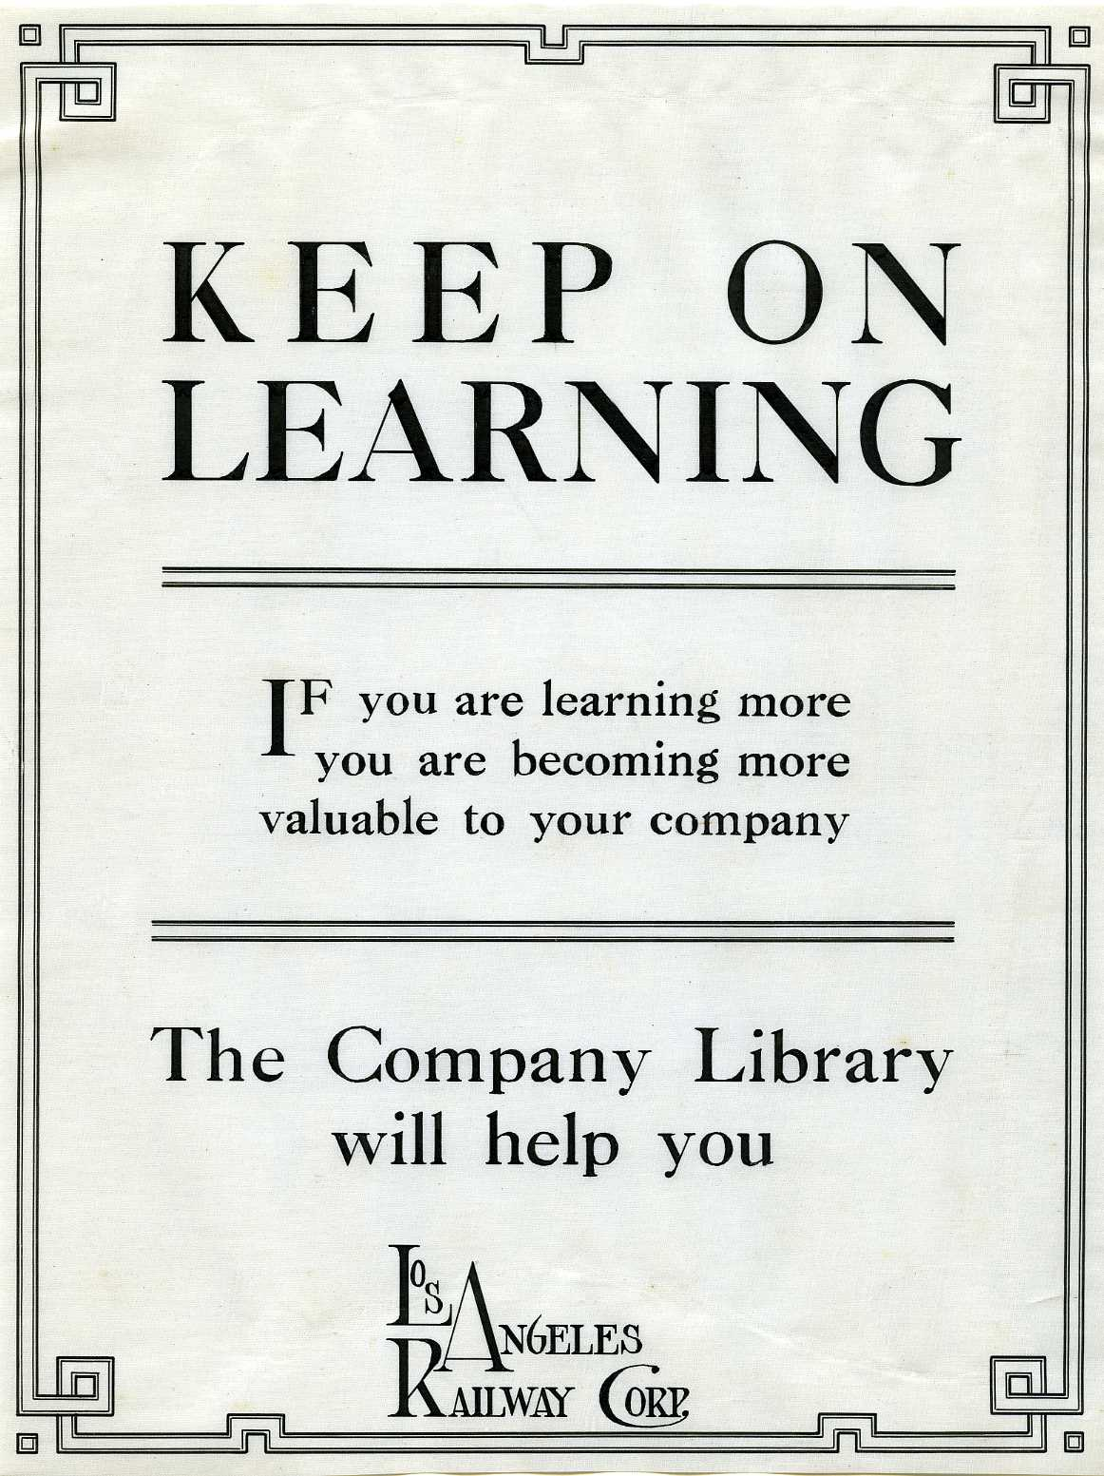
Discussion
DEPARTMENT 101 TRAINING PROGRAM
QUESTIONS?

Slide 42
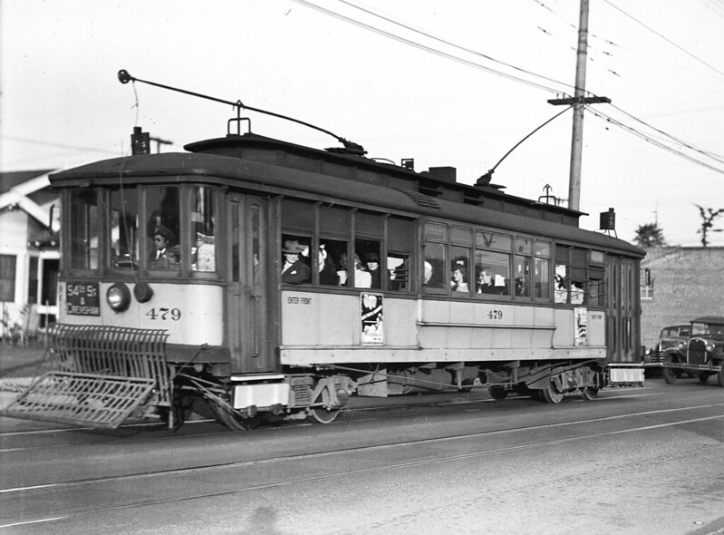
DEPARTMENT 101 TRAINING PROGRAM
Motormanette Arcola Philpott, 1944
End

Slide 43
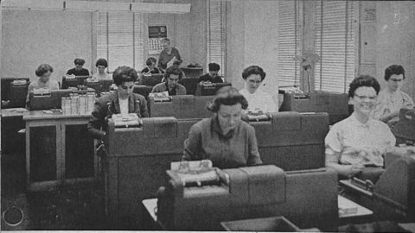
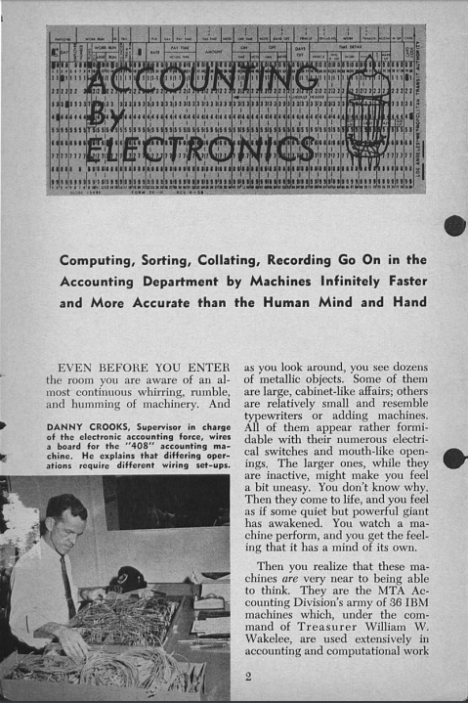
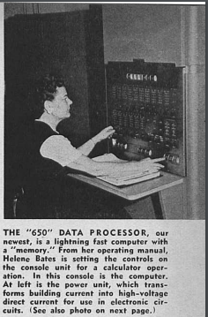
Bonus Material – Start of Electronic Info
First computers in 1951.
Used for farebox revenues, payroll and transit scheduling.
Fleet of 36 IBM 408’s and 650’s.

Slide 44
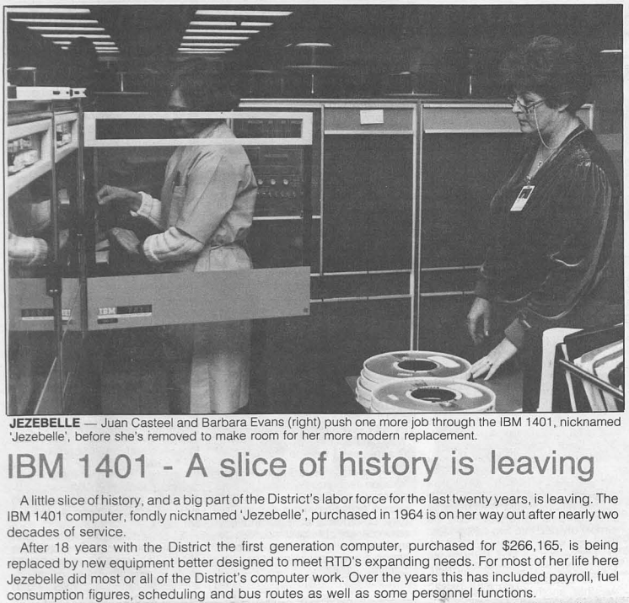
Bonus Material:1964-1982, Jezebelle retires

Slide 45
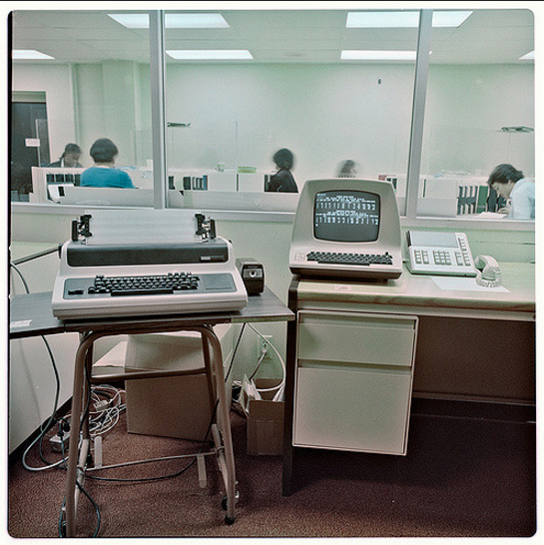
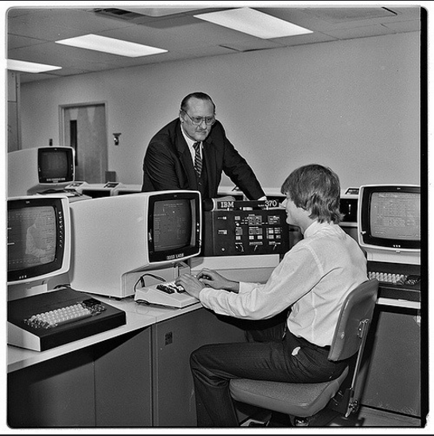
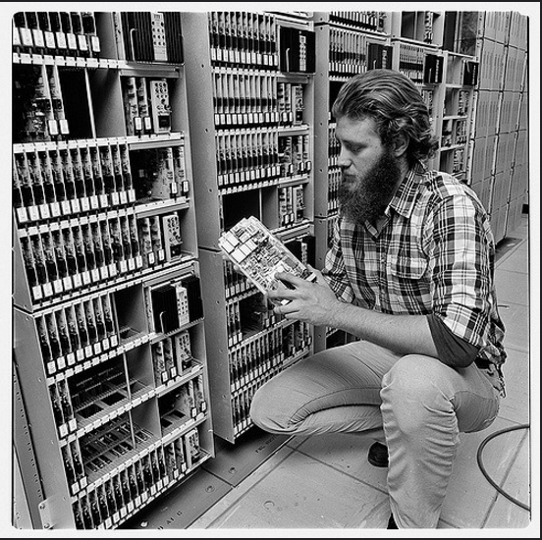
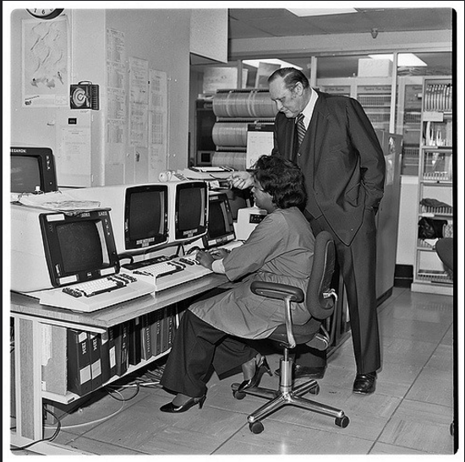
Bonus Material:1980’s - TransMIS I & II Innovation
The centerpiece of this new technology is the Transit Management Information System (TRANSMIS). Today, it encompasses maintenance, inventory, purchasing, accounts payable, general ledger, project control and contract administration functions. By next summer it will integrate planning, scheduling, transportation, human resources and payroll functions into the computer system.
IBM, which builds the computers behind RTD's computer network, showcased TRANSMIS at the recent American Public Transit Association annual convention in Washington, D.C. where it received rave reviews from transit agencies across the nation – via SCRTD Headway, November 1984.

Slide 46
Bonus Material: First PCs?
From the November 1986 edition of the SCRTD Headway newsmagazine:
“The District recently installed a new PC-based system to help recruit technical professionals looking for employment. PC users can reach the system at (213) 972-6448 during nonbusiness hours (5 p.m.-8 a.m.), with modem settings at 300 baud, data 7, stops 2, no parity, and full duplex….”
Not only is to the PC-based system a good way for technical people to find out about career opportunities at RTD, HR Director Pitchford sees it as a way to get an important message to the public. "The transit industry is becoming 'high-tech,' and has a place for technical professionals. The RTD wants to utilize, stretch, and reward professionals ready to harness the power of today's technology," she said.”

Slide 47
Bonus Material: First Email
From the July 1992 edition of the Information Systems Computer Express newsletter:
“E-Mail is here! Finally! You may have noticed that many of the computers now boast a new options on their colorful menus called Electronic Mail. So far a hundred of you have been trained… The momentum is on! E-Mail is here!
As an E-Mail user, you may send messages to your team members, members of other teams, or just about anybody who has an electronic mailbox. You also may attach a word processing or spreadsheet document with your message. A feature called Bulletin Board provides the capability to dispatch mail electronically to all users at once.”
The product was Microsoft Mail for PC Networks. Best guess is that the first email sent said “test”.

Slide 48
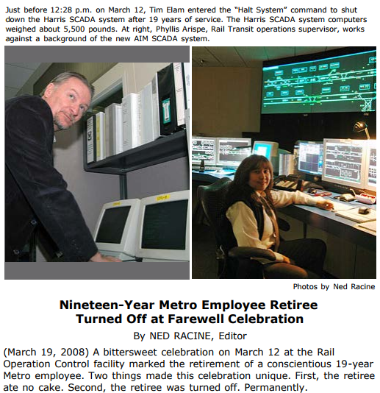
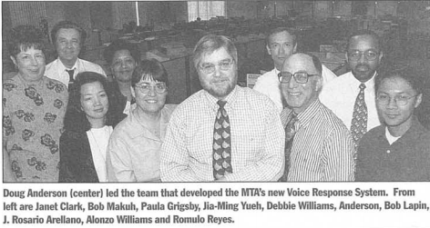
Bonus Material: The Last Mainframe?
Still some new apps created using mainframe, May 1998’s “Voice Response System” for Customer Relations
March 12, 2008, SCADA mainframe is halted -

